Slide 1
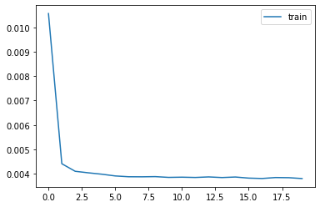
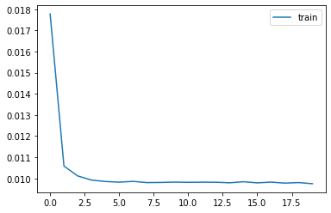
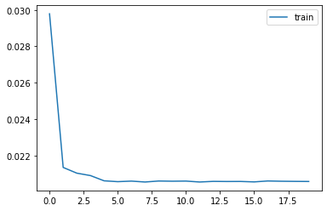
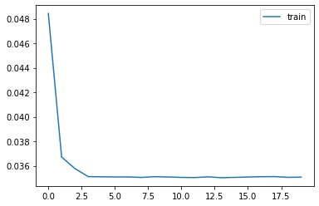
768 -> 512
768 -> 256
768 -> 128
768 -> 64

Slide 2
 | Response time | Note.
Basis(768 dim) | 0.77 | Geforce RTX 2060 Super
512 dim | 0.75
256 dim | 0.81 | Sensitive to computing power
128 dim | 0.67
64 dim | 0.63

