Slide 1
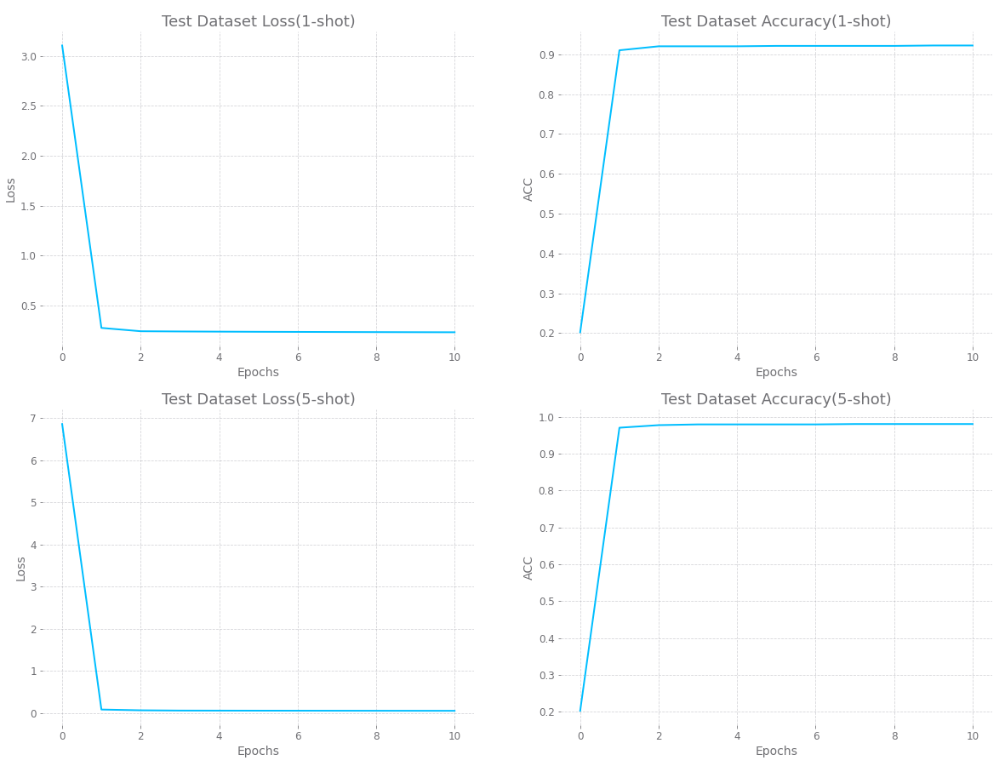

Slide 2
Model | 5 – Way Accuracy
Omniglot | 1 – shot | 5 - shot
Siamese nets | 97.3% | 98.4%
MAML(paper) no conv | 89.7% | 97.5%
MAML(paper) | 98.7% | 99.9%
My MAML | 92.2% | 98.1%

Slide 3
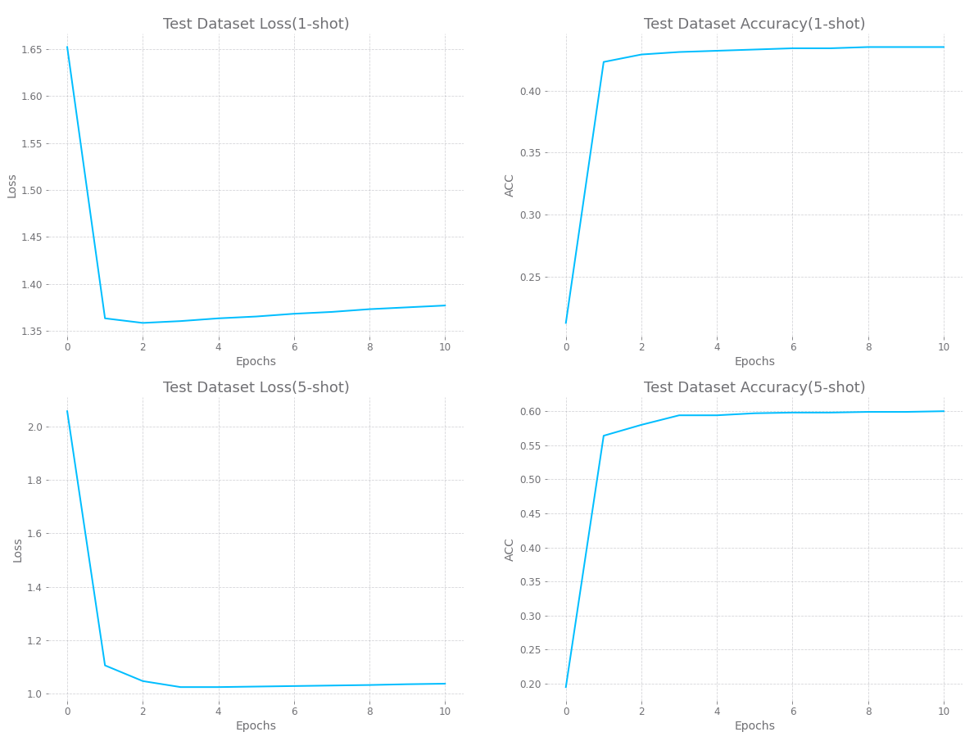

Slide 4
Model | 5 – Way Accuracy
MiniImagenet | 1 – shot | 5 - shot
Fine-tuning baseline | 28.86% | 49.79%
Nearest neighbor baseline | 43.56% | 55.31%
Matching nets | 43.56% | 55.31%
Meta-learner LSTM | 43.44% | 60.60%
MAML(paper) | 48.07% | 63.15%
MAML(paper) first order approx. | 48.70% | 63.11%
My MAML | 43.50% | 60.00%

Slide 5
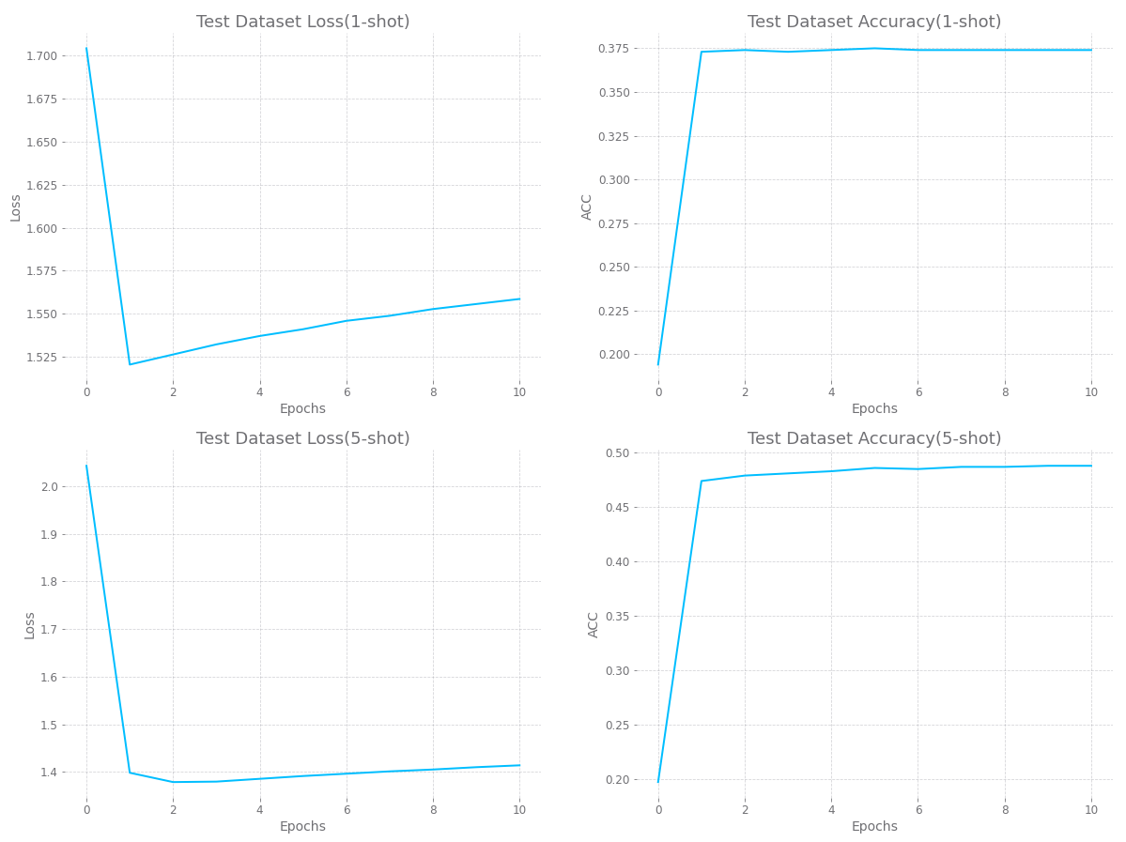

Slide 6
Model | 5 – Way Accuracy
Stanford Dogs | 1 – shot | 5 - shot
baseline(paper : k-NN) | 26.14% | 43.14%
Matching Nets FCE(paper) | 35.80% | 47.50%
Prototypical Nets(paper) | 37.59% | 48.19%
GNN(paper) | 46.98% | 62.27%
CovaMNet(paper) | 49.10% | 63.27%
My MAML | 37.40% | 48.88%

Slide 7
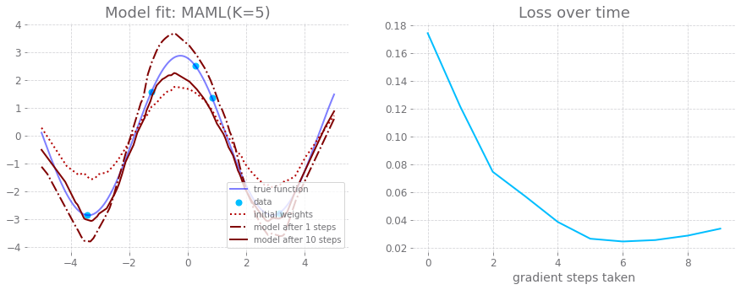
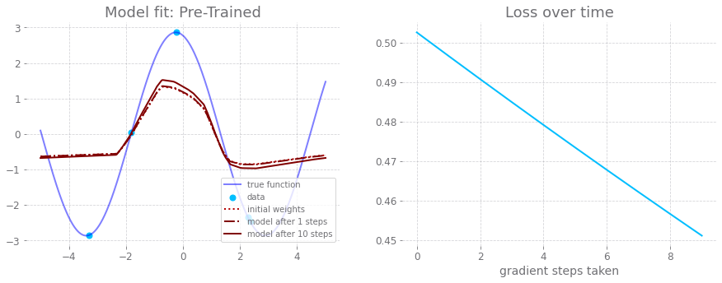

Slide 8
