Slide 1
Controller
RestController
Controller
PostMapping
PutMapping
DeleteMapping
GetMapping
Client
Request
Controller
DTO
Service
Entity
DAO
(Repository)
Entity
Database
(MySQL)
DTO
Entity
Entity
DTO
Response
View
(React)
Notes:
수정가능한 원본

Slide 2
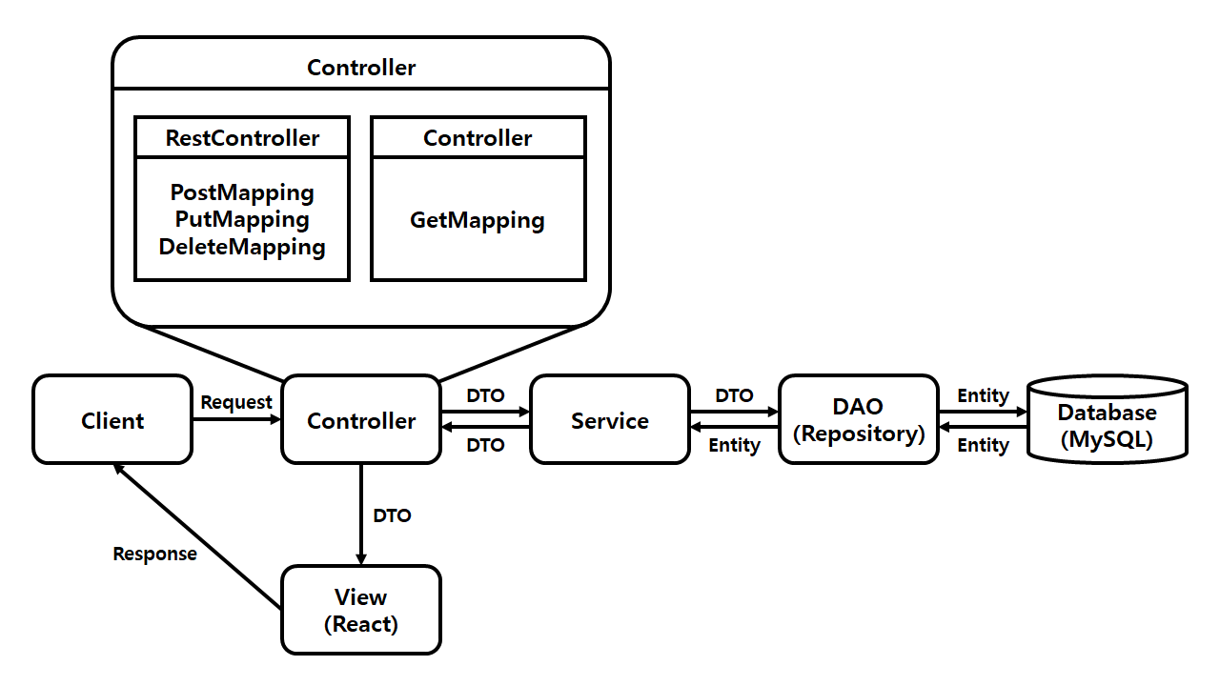
Notes:
단일 이미지화

