Slide 1
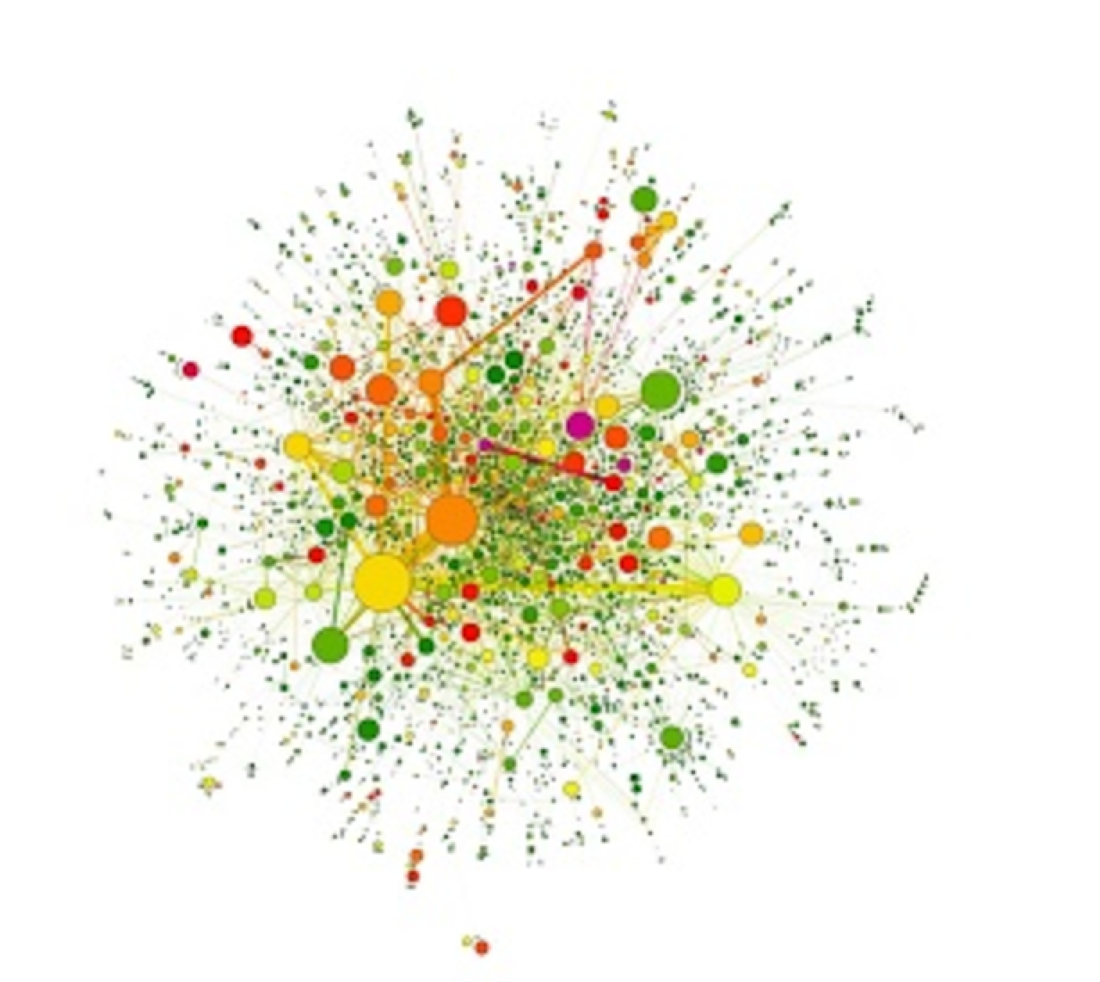
P(egs) bioinformatics
Postgraduate Evolution and Genomic Science Lecture series.
Notes:
For anyone who has not attended one of these before – this is a seminar series established in response to us becoming aware of a need for more bioinformatics training for postgraduates across the university. The series is organized and facilitated by PhD students in the division of Evolution and genomic science, with support from RA’s and postdocs in the divisions of EGS and Data Science. It is not designed to teach you everything you need to know, rather it is a very basic introduction to what you could do to help with your research, and some tips for where to go to find out more. We would like to thank Simon Hubbard (head of EGS) for once again backing the series, and being incredibly supportive towards us running them.

Slide 2
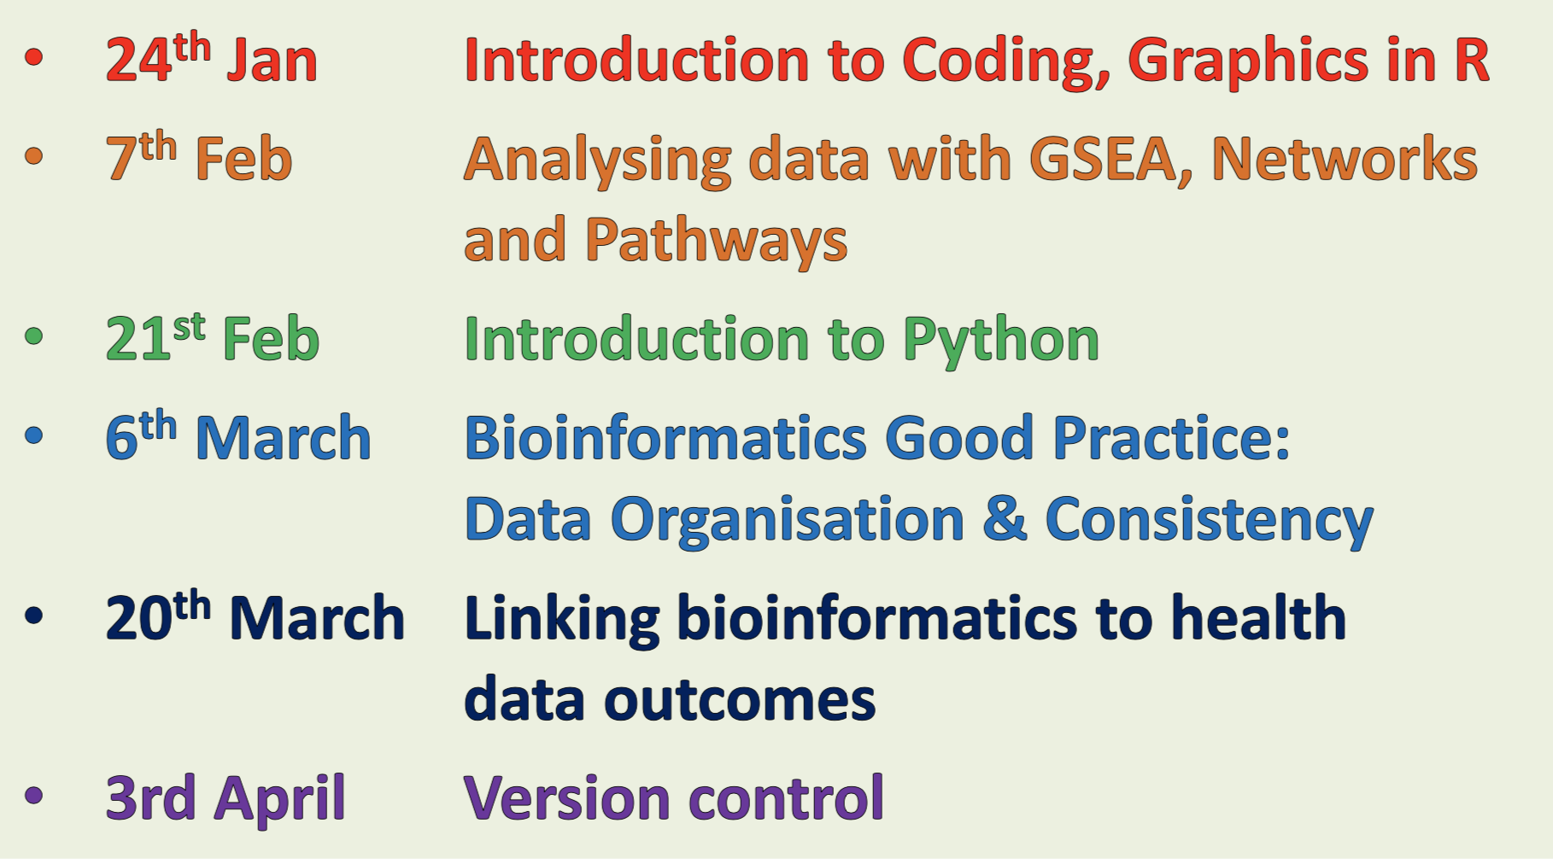
P(egs) lectures
Six Lectures - Every other Friday, 3pm
P
https://github.com/JoWatson2011/P-egs_Seminars

Slide 3
Hello!
I’m Jo Watson
3rd Yr PhD Student with Jean-Marc Schwartz & Chiara Francavilla
“Part-time bioinformatician”, proteomics data

Slide 4
Analysing data with GSEA, Networks and Pathways
or:
Why is this list of genes interesting and what do they do?

Slide 5
What are the ‘Interesting genes’…?
Differentially regulated (based on threshold)?
Follow similar expression or regulation patterns?
Found in a screen?
Co-expressed in a particular condition?

Slide 6
Example data for today…
ALDH4
FGF18
BBC3
KIAA1442
CEGP1
WISP1
GSTM3
PECI
TGFB3
HSA250839
CFFM4
AP2B1
FLJ11354
PEX12
GCN1L1
QDPR
KIAA1181
BTG2
MMSDH
CIRBP
MATN3
PIB5PA
RAI2
ERP70
KRT18
MIR
RAB27B
KIAA0882
DKFZP586A011
SEC14L2
DKFZP761L0424
…
167 in total
van 't Veer, L., Dai, H., van de Vijver, M. et al. Gene expression profiling predicts clinical outcome of breast cancer. Nature 415, 530–536 (2002).
Find full list on the github page:
examplegenes.txt

Slide 7

Gene & Protein Identifiers
Identifiers are used in and between databases to link records
ENST00000275493
ENSP00000275493
ENSG0000146648
…
Ensembl
EGFR
HGNC
P00533
UniProt
1956
NCBI GeneID
BioMart maps between database identifiers
Notes:
Some tools require your list of genes to be in a se

Slide 8
I: (Gene Set) Enrichment Analysis

Slide 9
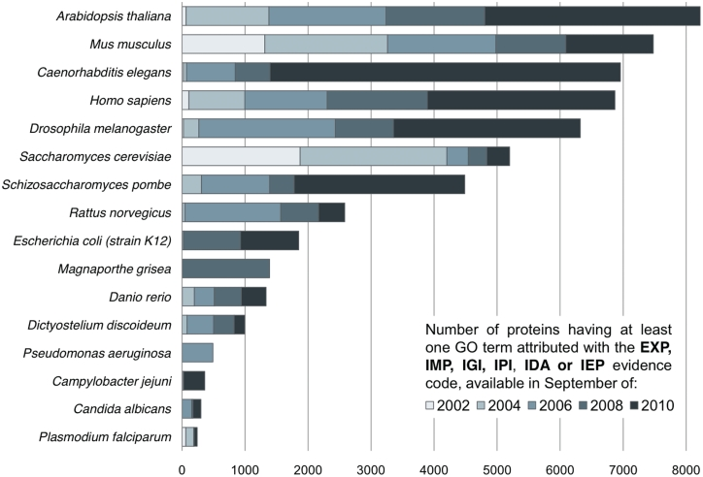
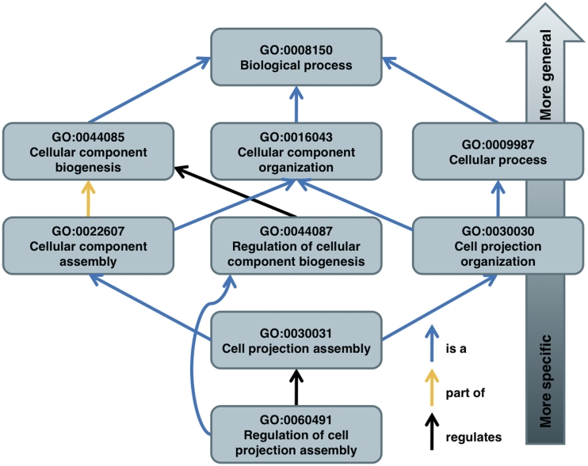
Gene Ontology (GO)
Terms annotated to proteins/genes based on Biological Processes (BP), Molecular Function (MF), Cellular Compartment (CC)
du Plessis L, Skunca N, Dessimoz C. The what, where, how and why of gene ontology--a primer for bioinformaticians. Brief Bioinform. 2011;12(6):723–735. doi:10.1093/bib/bbr002

Slide 10
Enrichment Algorithms
Over Representation
Analysis (ORA)
Gene Set Enrichment
Analysis (GSEA)
Experimental
value
Gene A
Gene B
Gene C
...
Gene A
Gene B
Gene C
...
3.2
4.5
0.1
...
Takes into account experimental values (e.g. differential expression)
Don’t have to filter for interesting genes
… not filtering can lead to ‘noise’
Simplest algorithms
Often leads to redundancy

Slide 11
ORA : The Hypergeometric Distribution
No. of items in “Background” Population = 14
No. of successes in the “Background” Population = 5
Take 3 coins
No. of items in the sample = 3
No. of successes sample = 1
What is the probability of getting a “success” in the sample due to random chance?

Slide 12

ORA : The Hypergeometric Distribution
No. of genes in “Background” Population = ~20,000
No. of genes with GO term x in the
“Background” Population = ?
167 interesting genes
No. of genes in the sample = 167
No. of genes with GO term x in the
sample = ?
What is the probability of getting genes annotated to GO term x in the sample due to random chance?
Notes:
20000 predicted protein coding genes in humans. 20000 records for human proteins in UniProt, not including slicing variants

Slide 13




Common web-based tools for ORA
Use generic
species background *
Input background
as separate list
Calculate programmatically
(R, Python, etc.)
A generic background may give misleading results, but may be the best option for understudied cells/tissues/species.

Slide 14

GSEA
Unlike ORA, takes into account experimental values
Kolmogorov–Smirnov-
like t-Test
+
Experimental
value
Gene A
Gene B
Gene C
...
3.2
4.5
0.1
...
2
1
3
...
Output:
Enrichment scores (ES)
Input: Ranked list of genes
Notes:
Well regarded method and useful for comparing to baseline conditions

Slide 15
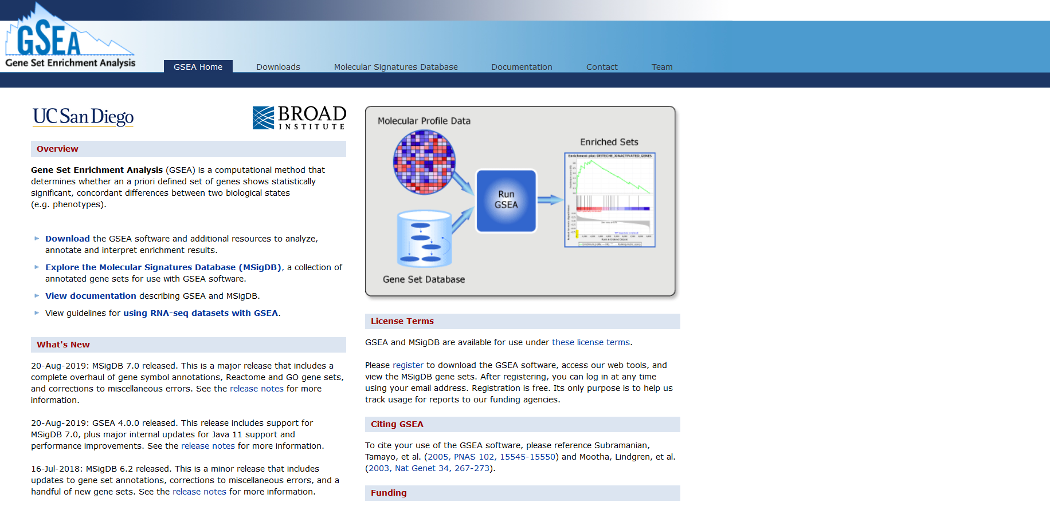
GSEA

Slide 16
Correcting for multiple hypotheses
“The more inferences are made, the more likely erroneous inferences are to occur.”
Benjamini-Hochberg test
Adjusted p-value
p-value
Notes:
www.biostathandbook.com/multiplecomparisons.html

Slide 17
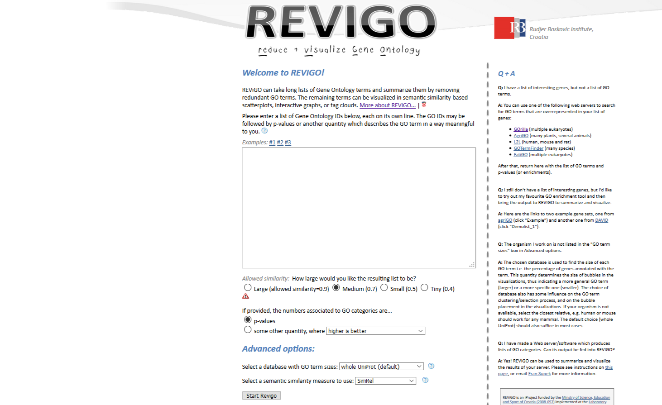
Filter ‘redundant’ terms using REVIGO

Slide 18
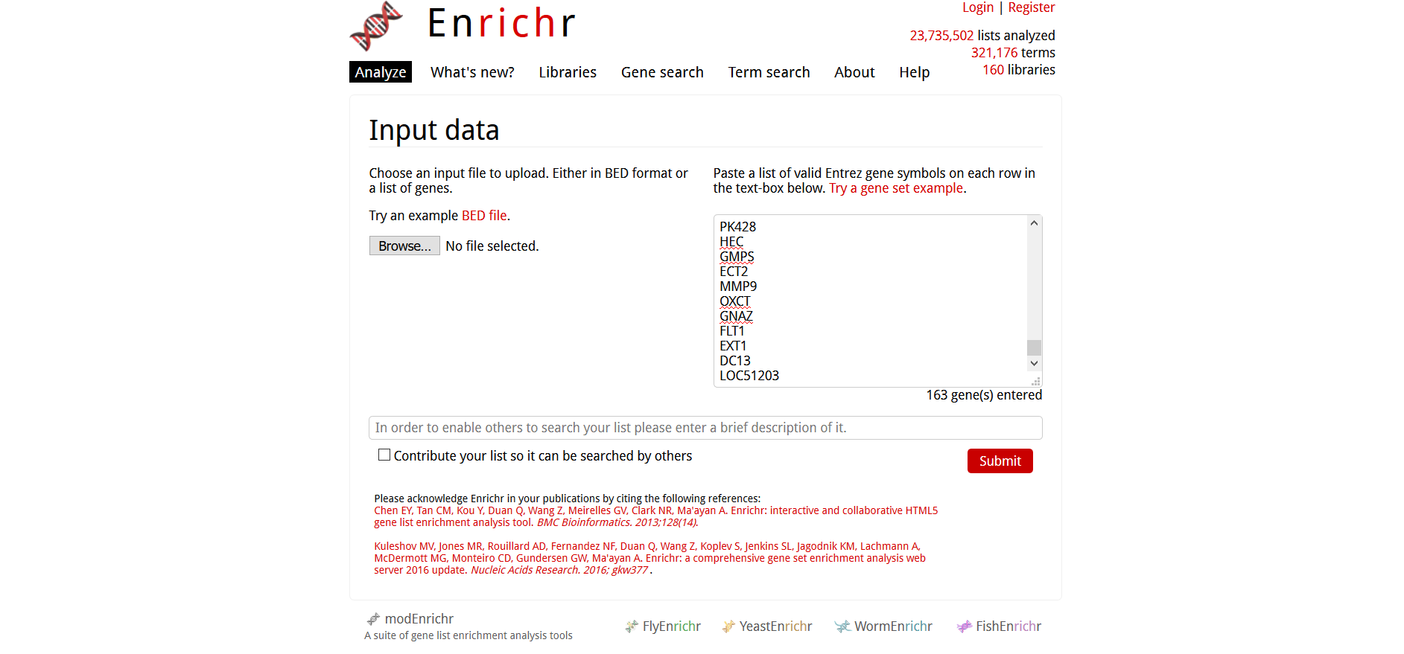
Applied to our example data…

Slide 19
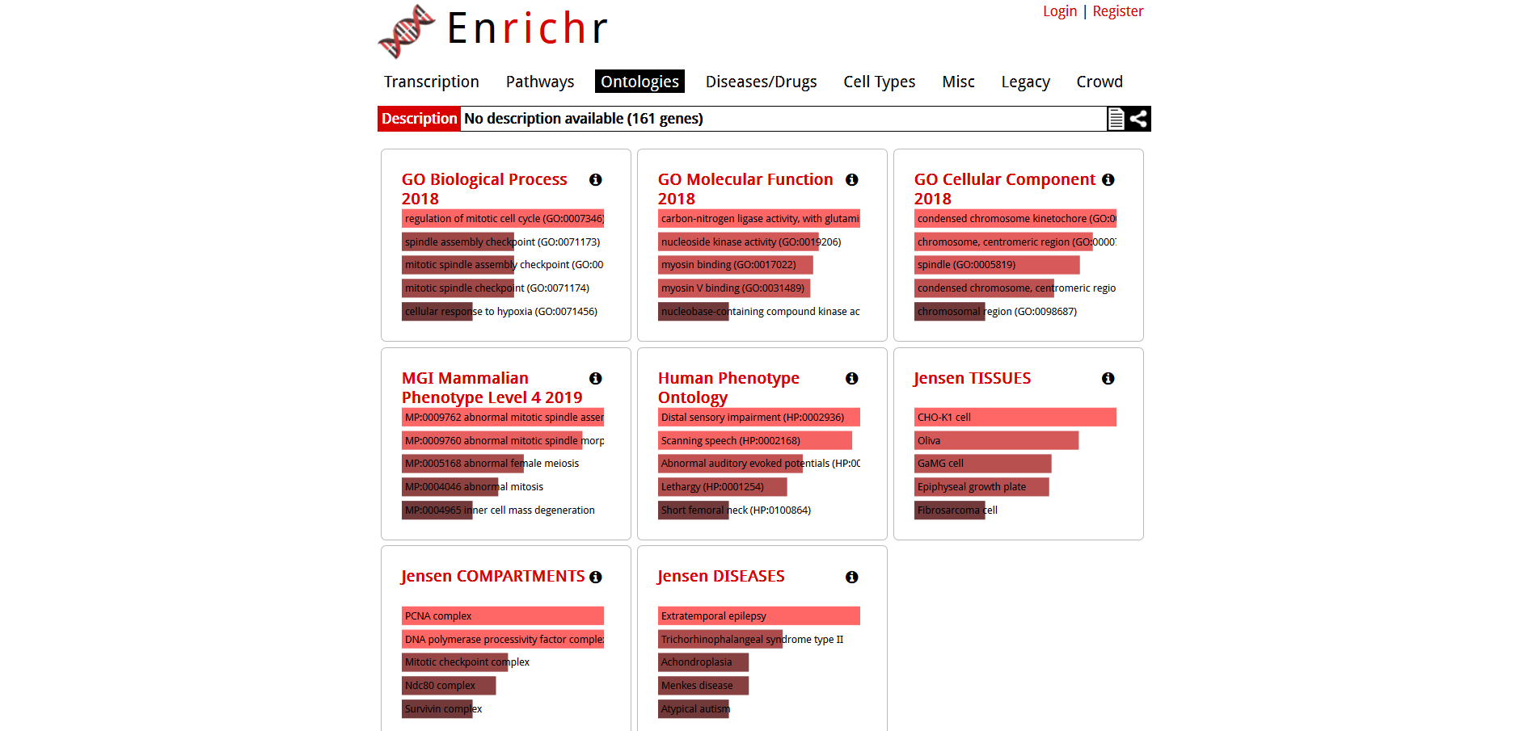
Applied to our example data…

Slide 20
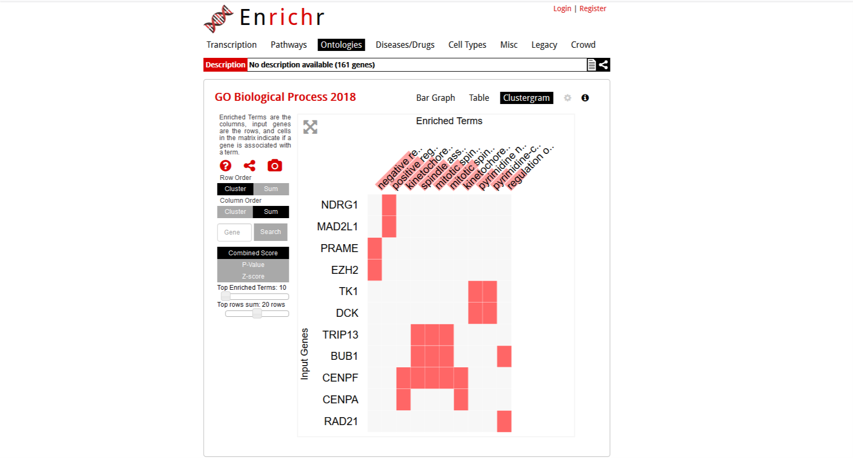
Applied to our example data…

Slide 21
II: Pathway Analysis

Slide 22



Pathways Data
Curated resources about which genes/proteins are involved in cellular processes

Slide 23
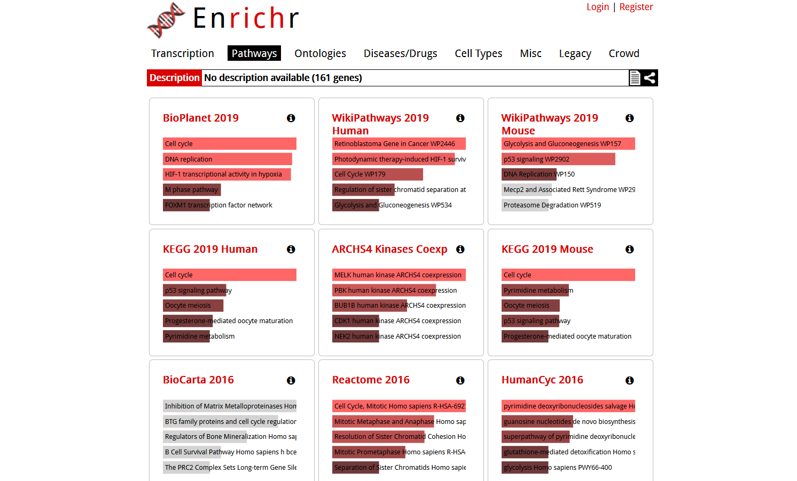
ORA of Pathways

Slide 24
Topology-based methods

Slide 25

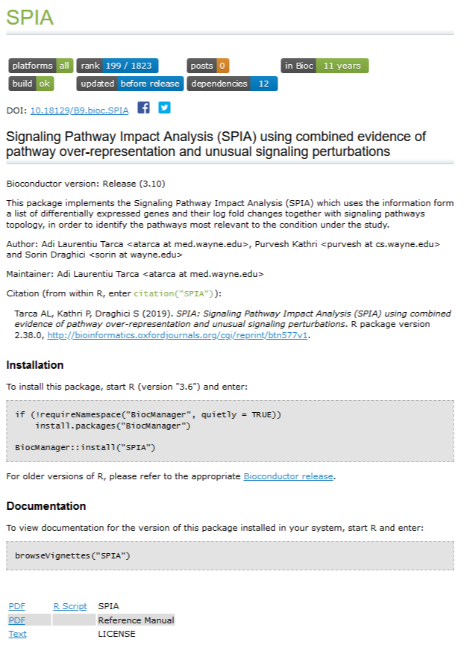
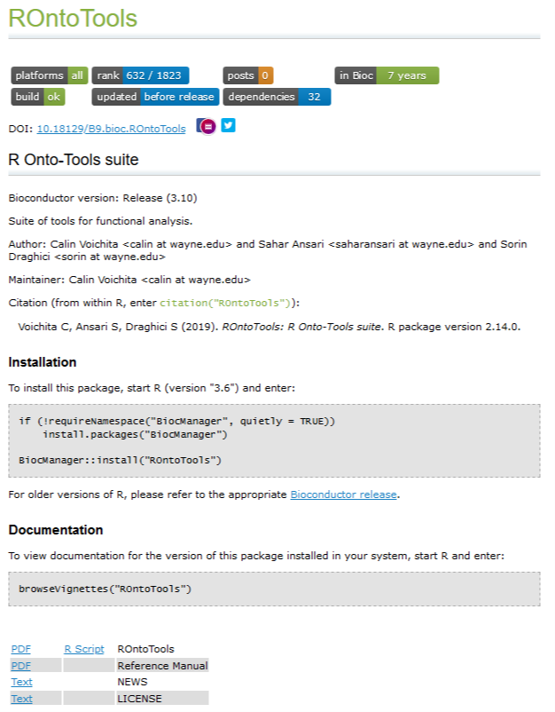
Topology-based methods

Slide 26
III: Network Analysis
https://github.com/JoWatson2011/P-egs_Seminars/tree/master/2019/2_Networks

Slide 27
What do we mean by a network?
F
B
A
E
H
C
G
D
Node (or vertex)
Edge (or link)

Slide 28


Networks can be used for…
Uncovering the role a component or interaction has
Finding functional units

Slide 29
STRING describes Protein-Protein Interactions

Slide 30
Visualisation with Cytoscape

Slide 31
Final Tips…
Show your working! What steps did you take in your analysis?
What version of the tools / databases did you use? Journals want to know! Cite the tool!
Think about how you will validate your findings.

Slide 32
Any Questions?
Notes:
For anyone who has not attended one of these before – this is a seminar series established in response to us becoming aware of a need for more bioinformatics training for postgraduates across the university. The series is organized and facilitated by PhD students in the division of Evolution and genomic science, with support from RA’s and postdocs in the divisions of EGS and Data Science. It is not designed to teach you everything you need to know, rather it is a very basic introduction to what you could do to help with your research, and some tips for where to go to find out more. We would like to thank Simon Hubbard (head of EGS) for once again backing the series, and being incredibly supportive towards us running them.

