Slide 1
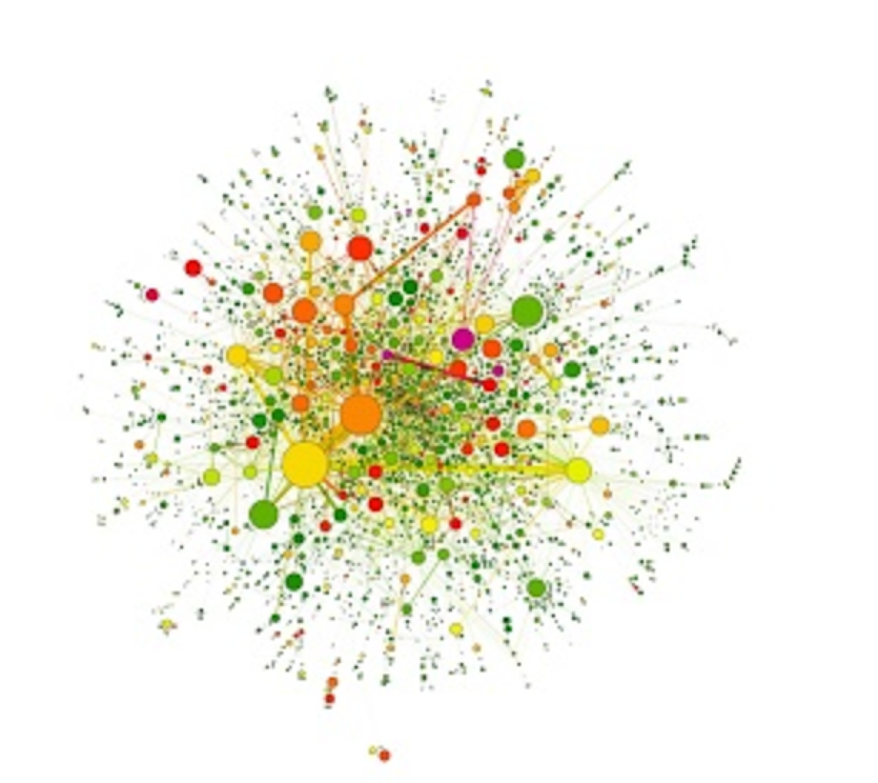
P(egs) bioinformatics for Postgrads
Version Control
Postgraduate Evolution and Genomic Science Lecture series.

Slide 2
Introduction
This is the bit where I tell you what I’m about to tell you

Slide 3
Introduction - why me?
BSc Computer Science (Leeds, 1996)
20 years as a software engineer
MSc Bioinformatics (Manchester, 2016)
Third year PhD - Computational molecular biology
Used version control throughout

Slide 4
Introduction – what is version control?
Tracks the history of project files
Contents, times, comments
Simple change reviews and reporting
Current changes and historical
Easy to revert changes
Recover from mistakes and data loss
Collaborate and publish

Slide 5
Introduction - scenarios
My code was working…
Move fast and break stuff
Now, what was I working on last week?
Time for the monthly, yearly or PhD summary report

Slide 6
Introduction – more scenarios
All my work is gone ☹
I wish I’d written down the exact methods
New data is available, what effect does it have?
It’s time to publish
Let’s work together

Slide 7
Introduction – this talk
We’re going to learn version control with Git to address these scenarios
There are others (Subversion, Mercurial, etc.)
Concepts
How to setup Git and GitHub
Basic operations
Scenarios in detail

Slide 8
Concepts
Let’s start with some important version control concepts

Slide 9
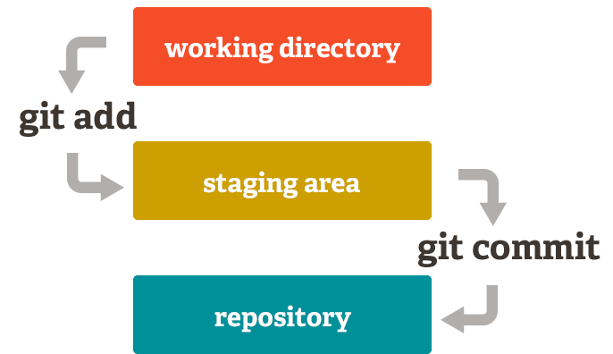
Concepts – working directory
Your working directory is the folder that contains all your project files – you already have one of these
Git tracks the files that you tell it about in the staging area
Committing changes adds them to what’s called a repository
History in the making
https://git-scm.com

Slide 10
Concepts - repositories
A repository is the complete history and contents of all your project files
Local
The repository on your machine is the local one
You can have many remote repositories
A ‘central’ one, called origin by default in Git
Your collaborators
Etc
Collaborator
origin
They are all equal

Slide 11
Concepts – commits and branches
A commit is a set of file changes with a descriptive comment
C
A branch is a series of commits that form a timeline
The main timeline in Git is called ‘master’ by default
master
Other branches are diverging alternate timelines that can be later merged, you can switch at any time
C
C
C
branch
merge
feature
C
C
You can easily abandon failed experiments
branch
experiment
We’re just going to use the master branch in this talk
C

Slide 12
Setup
Next we’ll see how to setup GitHub for remote repositories and Git for local ones

Slide 13
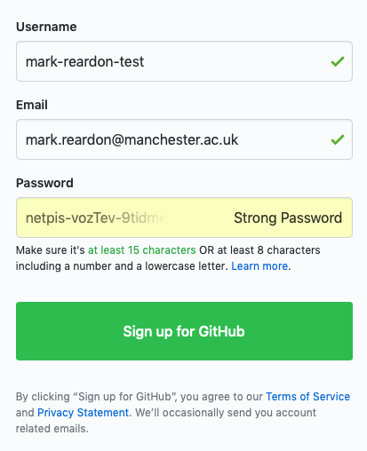
Setup - GitHub
We’ll use GitHub for our remote repositories
https://github.com/join
Pick a username and password
Click the ‘verify email’ link in the email sent to you
https://github.com/join

Slide 14
Setup – Installing Git
To control local repositories, we’ll install Git
For Mac and Windows, run the file that downloads:
https://git-scm.com/download/mac
https://git-scm.com/download/win
It’s ok to just click ‘Next’ if you’re unsure about an option
For Linux, follow the instructions:
https://git-scm.com/download/linux

Slide 15
Setup – Configuring Git
We need to tell our local Git installation who we are
git config --global user.name "mark-reardon-test”
git config --global user.email "mark.reardon@manchester.ac.uk"
Commands that start with git are typed into the command line on your local machine
You can also have different credentials for different repositories, use --local instead
Git will use these credentials when you update the remote repository, it will ask for your password when it needs it
Use the same email and username that you used on GitHub!

Slide 16
Setup – GitHub Desktop
The command line is powerful and good for doing things
GitHub Desktop is pretty and good for looking at things
https://desktop.github.com
Just install it for now
We’ll connect it to a local repository later

Slide 17
Operations
Let’s look at how to do useful things with Git

Slide 18
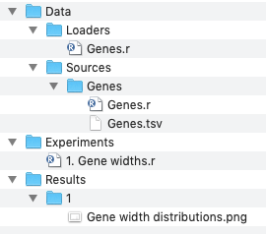
Operations – example project
We’re going to build a simple, scalable project in R
The data source retrieves data from an external source and saves it to disk
Run this once
The data loader loads the data in a consistent manner
Run this every time
The experiment analyses the data and outputs the results
First though, let’s create our repositories

Slide 19
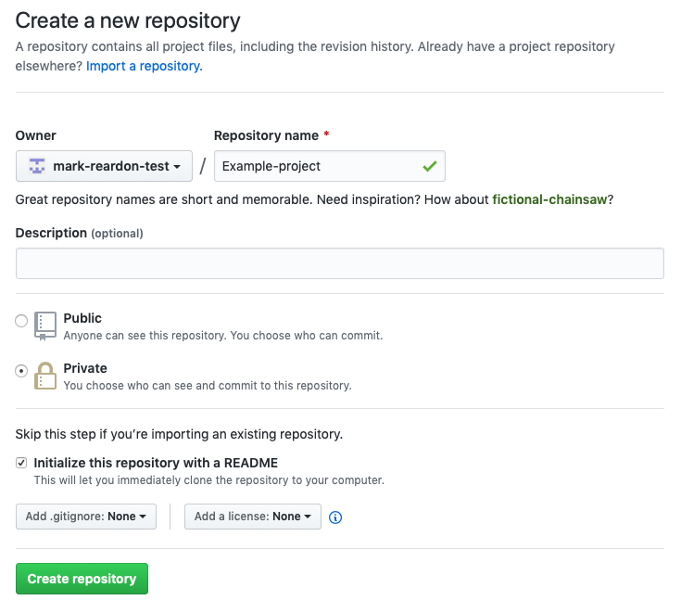
Operations – create remote repository
After you created your GitHub account you’ll be on the new repository page
https://github.com/new
Create a private repository with a Readme file

Slide 20
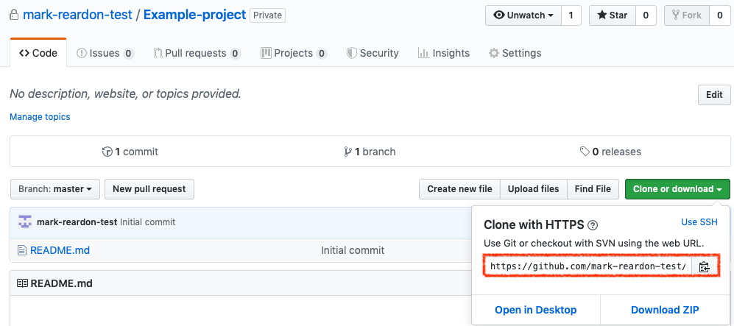
Operations – browse repository
You can already browse your remote repository
Click the green button and copy the repository address

Slide 21
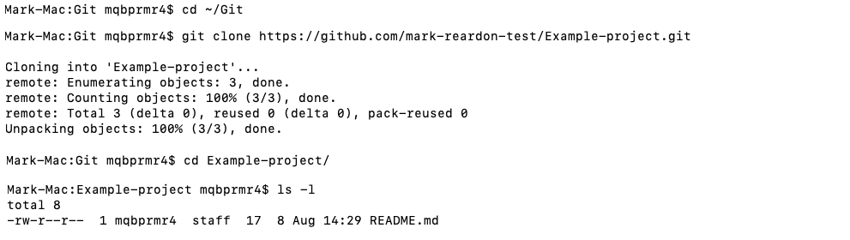
Operations – clone repository
Decide where to keep your local repository
Type git clone <repository address>
The repository is now on your local machine and linked to the remote

Slide 22
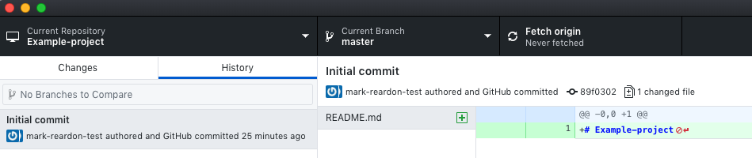
Operations – view local repository
In GitHub Desktop, choose ‘File, Add local repository’ and choose the folder that you cloned to
On the History tab, you can see that the Readme file was committed by GitHub when you created the repository
The green highlight means that something was added

Slide 23
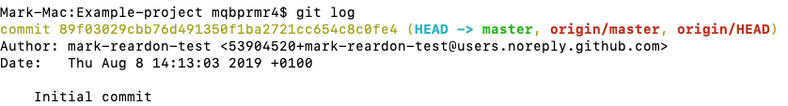
Operations – view local repository
In the command line, type git log to see the log
Each commit takes up a lot of space in the default view so we’ll use an alias (just copy/paste this!)
git config --add alias.l "log --graph --all --pretty=format:'%C(yellow)%h%C(cyan)%d%Creset %s %C(white)- %an, %ar%Creset'"

Slide 24
Operations – view local repository
Now just type git l
It’s a lot easier to read (once you know what the various bits mean)
For now, just notice the comment, name and time
Initial commit
mark-reardon-test
31 minutes ago

Slide 25
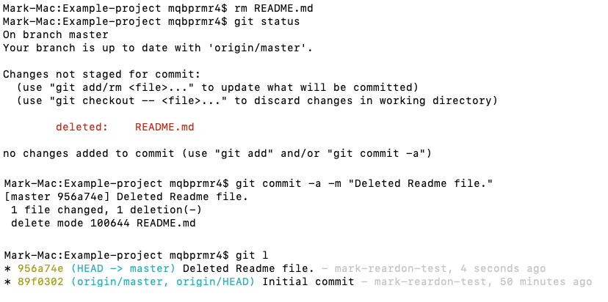
Operations – deleting a file
Let’s delete the Readme file and see what’s happened (with git status)

Slide 26
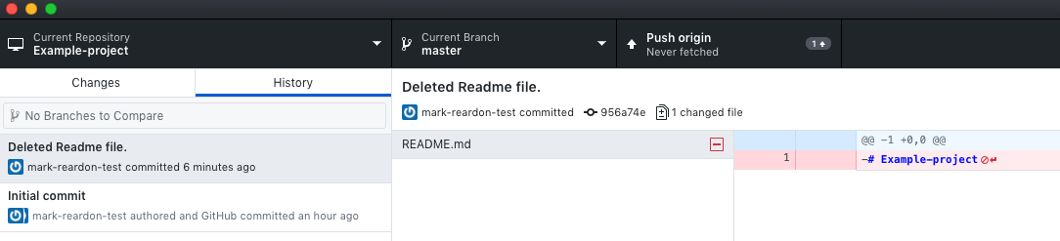
Operations – deleting a file
Let’s see that change in GitHub Desktop as well
The red highlight means we deleted something.

Slide 27
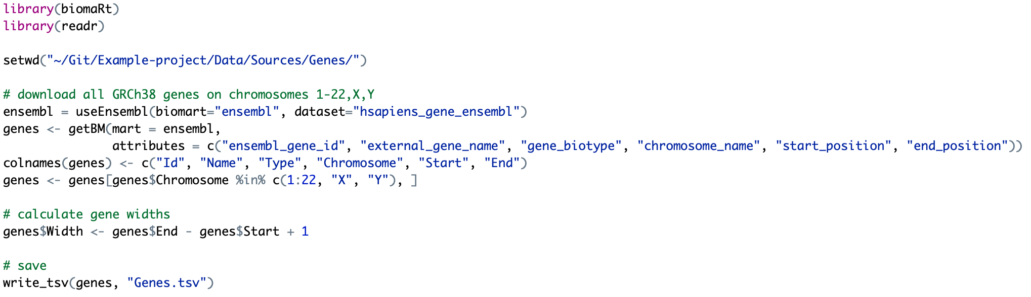
Operations – adding files
Let’s add a file that downloads human gene data
We’ll save it as Genes.r and run it to create Genes.tsv

Slide 28
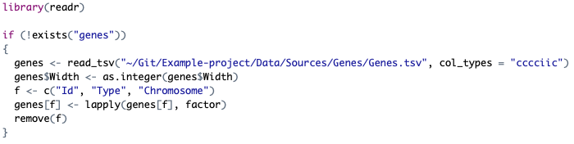
Operations – adding files
Let’s add a file that loads the data in a consistent way
This just means that we can get exactly the same data each time we run it

Slide 29
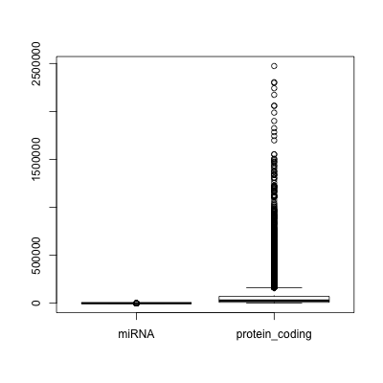
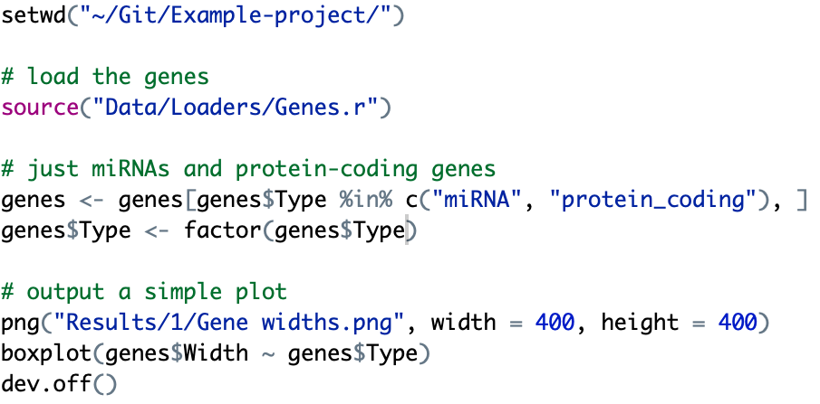
Operations – adding files
Finally, let’s use the data and analyse gene widths
We now have an example project to play with
As your project grows, add more data sources, loaders, experiments and results and it all stays nice and tidy

Slide 30
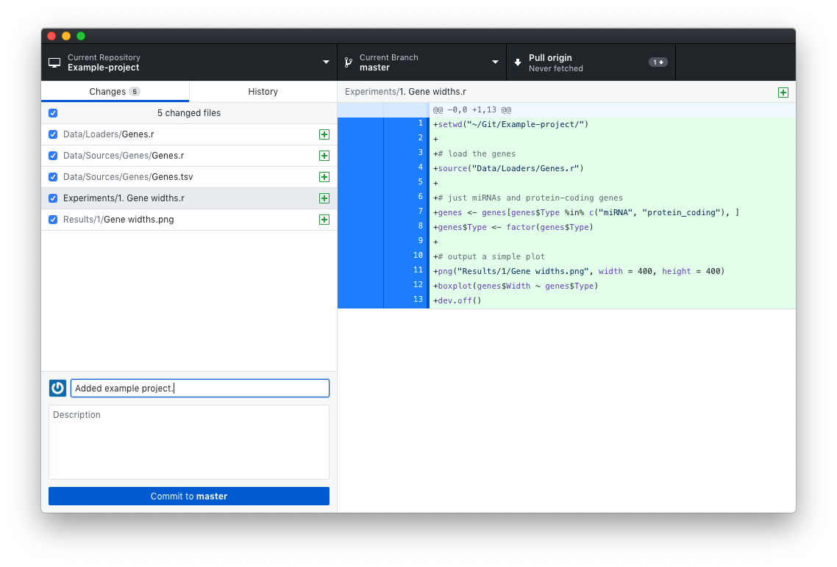
Operations – adding files
Look on the Changes tab in GitHub Desktop
Type a summary and click ‘Commit to master’

Slide 31
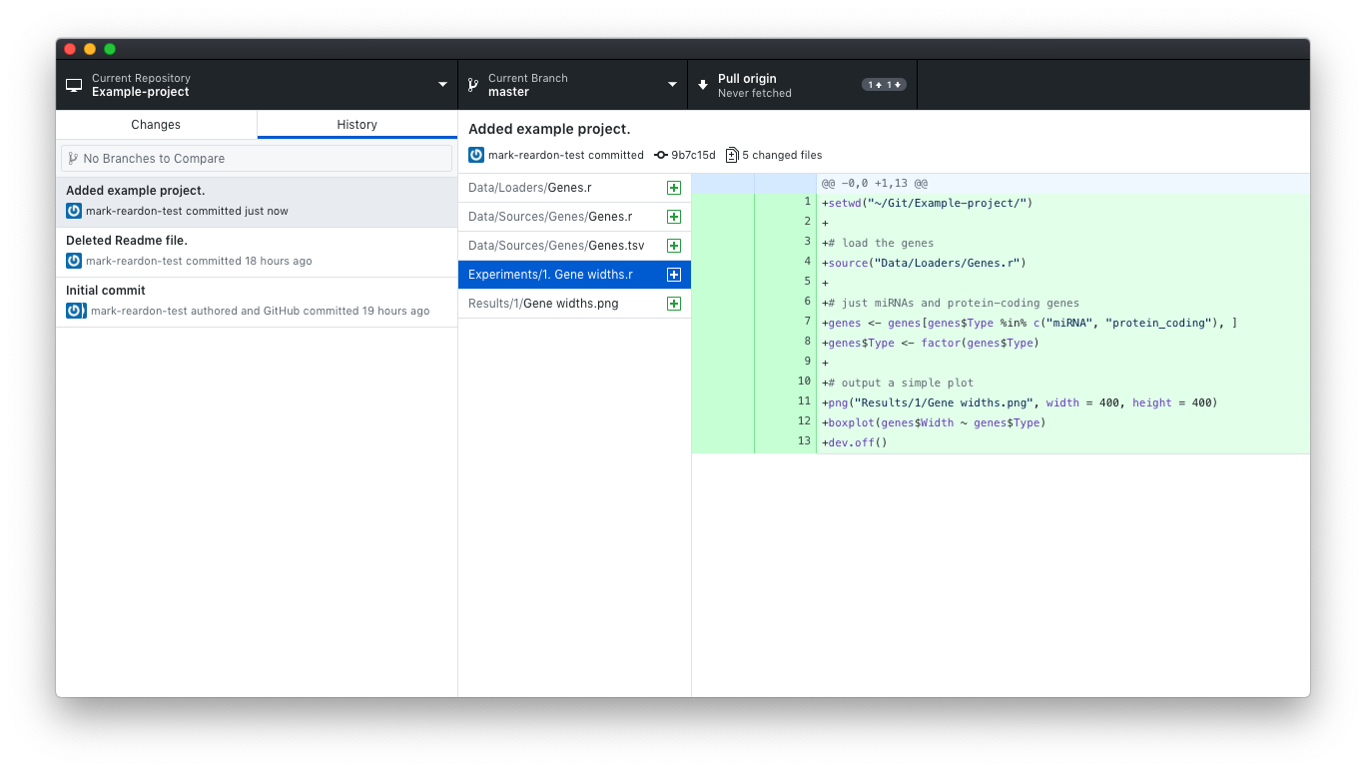
Operations – reviewing changes
Review the changes in the History tab

Slide 32
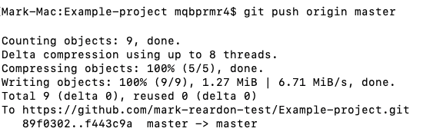
Operations – push to remote
So far the changes are just to the local repository, let’s back them up to the remote
git push origin master means push the changes on the master branch to the remote called ‘origin’

Slide 33
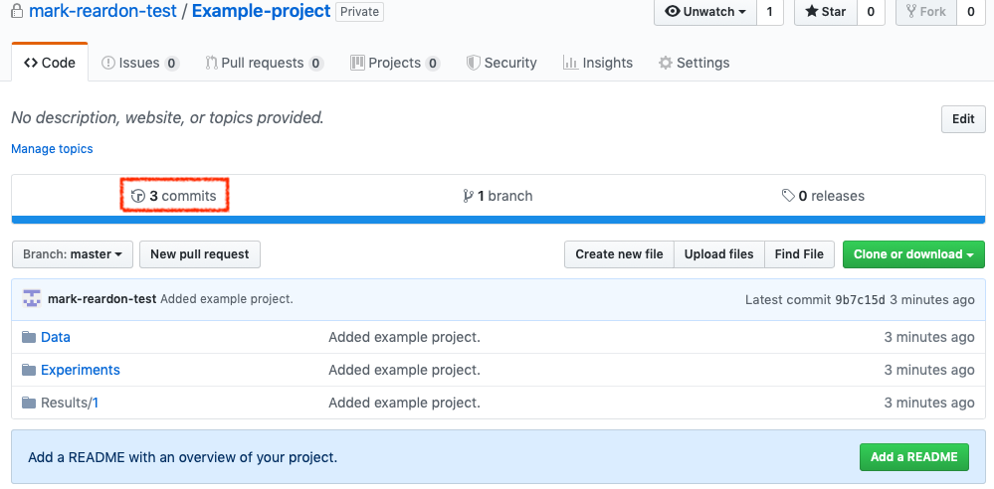
Operations – push to remote
Let’s have a look at GitHub

Slide 34
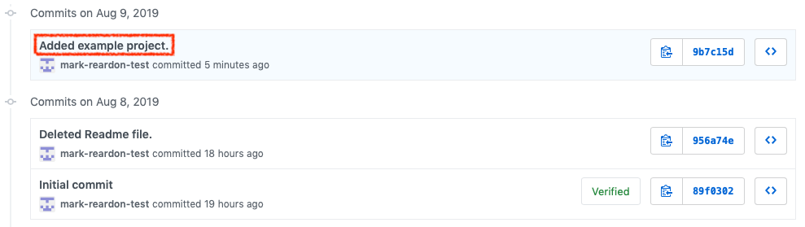
Operations – push to remote
Let’s have a look at the commits to be sure

Slide 35
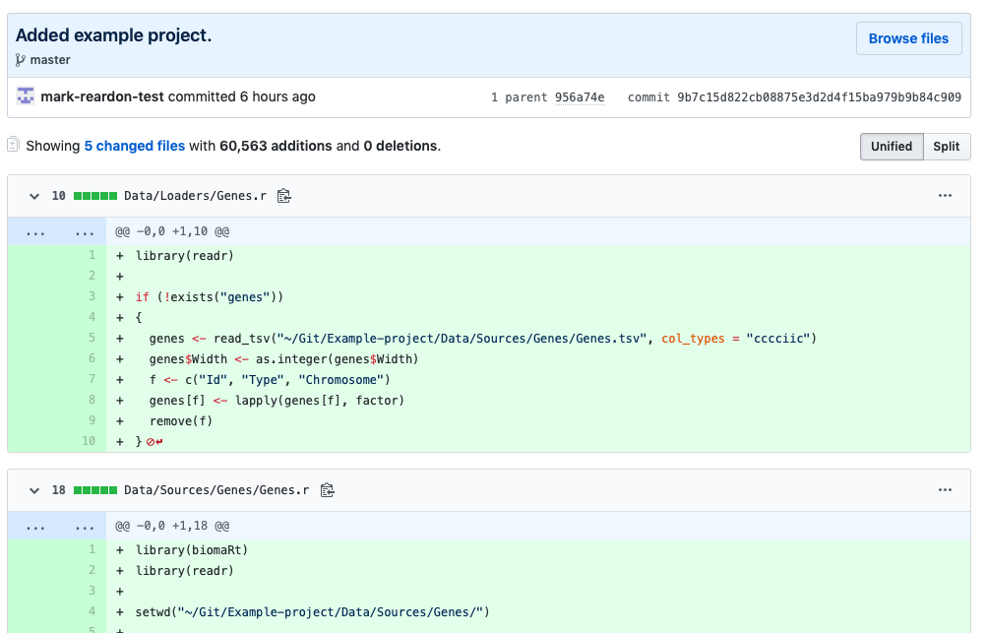
Operations – push to remote
Our files are there. We have offsite backups!

Slide 36
Operations – turn into repository
What if we already have a whole folder structure of files that we want to turn into a repository?
git init turns a folder into a repository (it actually creates a hidden folder called .git)
git commit -a -m “Added existing files.” adds your files and creates a commit
That’s only half the story however…

Slide 37
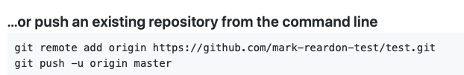
Operations – turn into repository
Create a repository on GitHub, let’s call it ‘test’
Don’t set the option to create a Readme file this time
After the empty ‘test’ repository is created there is a page of example commands
The first command links your local repository to the new remote
The second command sends your local history to the new remote
Your existing files are now backed up offsite as well

Slide 38
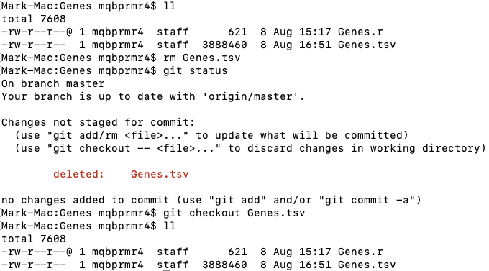
Operations – undoing changes
What if we deleted a file but wanted to get it back?
git status gives you a clue

Slide 39
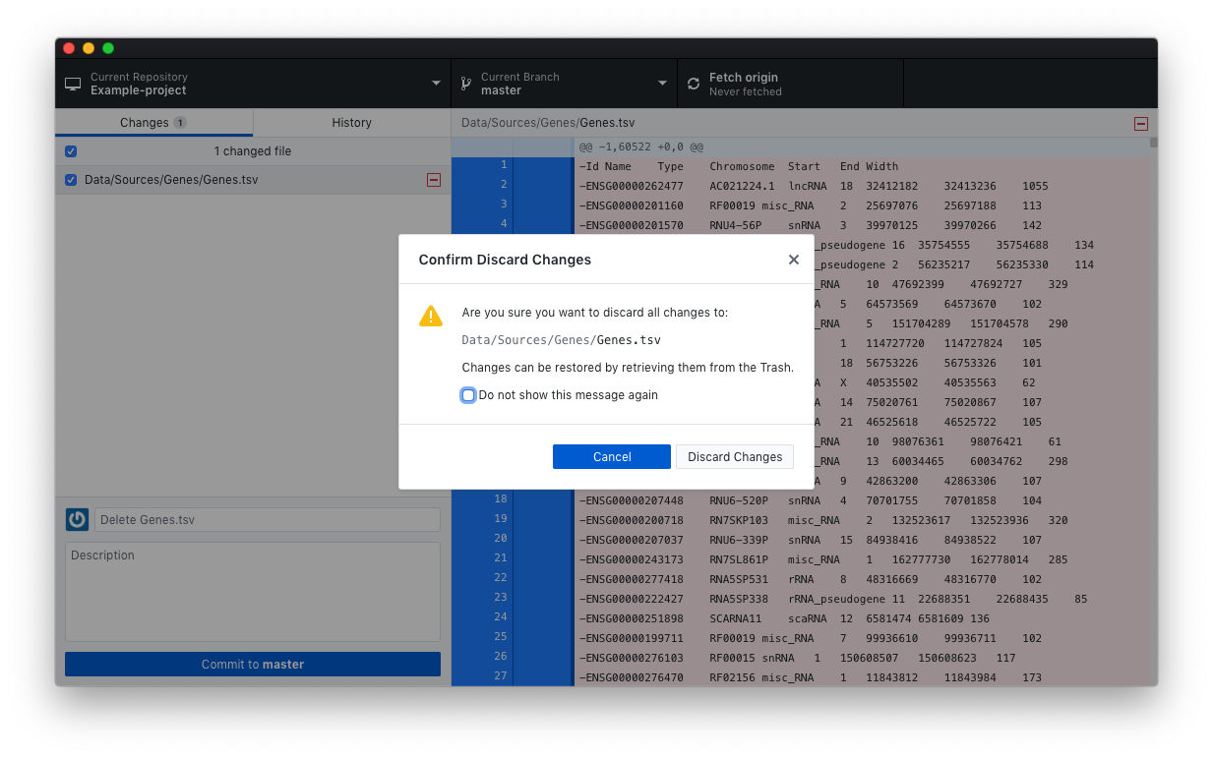
Operations – undoing changes
What if we deleted a file but wanted to get it back with GitHub Desktop?
Right-click on the deleted file and choose ‘Discard changes”

Slide 40
Operations – undoing entire commits
What if we committed some work and then realised it was incomplete?
git reset --soft HEAD~1
This removes the commit but leaves its changes in the working directory (--hard deletes the changes as well)
You can then edit and commit or undo the changes

Slide 41
Scenarios in detail
Let’s use what we’ve learnt to deal with some common scenarios

Slide 42
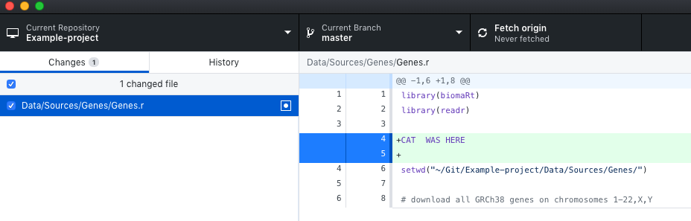
My code was working… Ah, that’s what I did
Looks like the cat walked on the keyboard
‘Discard changes’ to the rescue

Slide 43
Move fast and break stuff A line in the sand, a trail of breadcrumbs and a mixed metaphor
Your code currently works but you want to make some radical changes before you forget them
Commit any outstanding changes first!
This is the line in the sand, you can always get back to here
Make, test and commit your changes in chunks
These are your breadcrumbs
You can follow the breadcrumbs out of the maze:
git reset --soft HEAD~1

Slide 44
Now, what was I working on last week? No really, what was I doing?
When
git l --since=2.weeks
git l --since=“2019-08-01”
git l --since=“1 month ago”
Who
git l --author=“mark-reardon-test”
Search commit messages
git l --grep “added slide”
Search file changes
git l -S “boxplot(”
git l ~/Git/Example-project/Data/Sources/Genes

Slide 45
Time for the monthly, yearly or PhD summary report I’ve been really busy, honest
A month of history
git l --since=“1 month ago”
A year of history
git l --since=“1 year ago”
The month before last
git l --since "2 months ago" --until="1 month ago"

Slide 46


All my work is gone I will never lose work again
rm -rf *
git clone https://github.com/<user-name>/<repo>.git

Slide 47
I wish I’d written down the exact methods Methods are easy when you know how
You have written down the exact methods
Your commit history has it all
The exact code and data
The exact download dates (the commit times)
The order in which steps were carried out
What changed between online database versions
Because you download and commit the data each time
Etc.

Slide 48
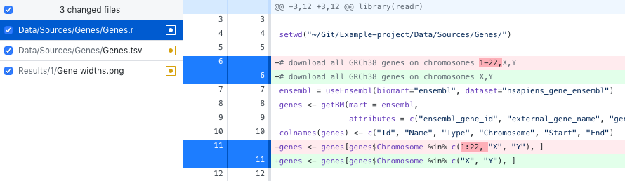
New data is available, what effect does it have? I’m frequently and genuinely surprised by this
Let’s just look at chromosomes X and Y
Note how a changed line is shown as a deleted line and an added line

Slide 49
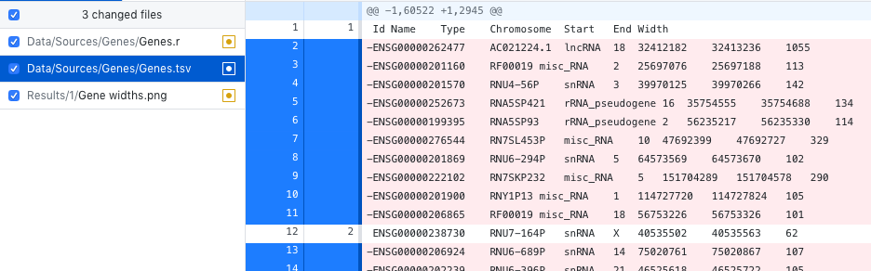
New data is available, what effect does it have? I’m frequently and genuinely surprised by this
Re-run the data source and we can see the precise effects on the data file
It is important to review changes, don’t assume it worked

Slide 50
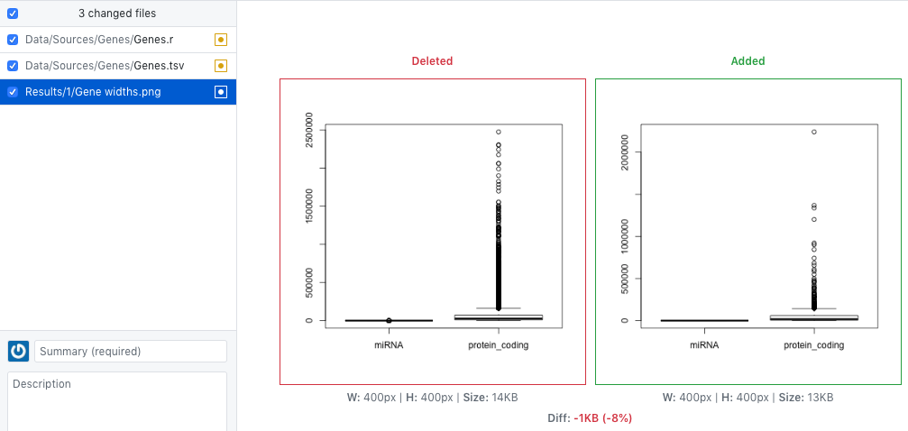
New data is available, what effect does it have? I’m frequently and genuinely surprised by this
We can see the effects on the results as well
Gain real insight into the effects of every change

Slide 51
It’s time to publish Open code and data are the way forward
Create another repository on GitHub, public this time
Clone it to your local machine
Copy the files you want to publish into the working directory
Code, data, figure generation scripts, etc.
Add and commit the files locally
Push to the remote - that’s it!
Publicise the remote repository address
Update the local repository and push to re-publish

Slide 52
Let’s work together We’ll get more done
Share your remote repository with your colleagues
Add them as collaborators on GitHub
Tell them to clone the repository
You and your collaborators can both push changes
Find out what your collaborators have done by pulling changes instead of pushing
git pull origin master
Git will guide you through merging their changes if they clash with yours

Slide 53
Summary
Let’s quickly review what we’ve covered and then go drink coffee

Slide 54
Summary
Version control tracks the full history of your files
Easy offsite backups and disaster recovery
Detailed progress reports
Detailed current and historical change reviews
Make controlled modifications to your work
Undo mistakes at any time
See what’s really happening to your work when you change it
Easily collaborate with others

Slide 55
More information
Lots of help available
git <command> -h
https://git-scm.com/doc
Cheat sheet to print and stick next to your monitor
https://github.github.com/training-kit/downloads/github-git-cheat-sheet.pdf
https://git-scm.com/book
Google it

Slide 56
Thank You!
Hopefully you’ll try using version control
Any questions?
We would like to say a big thank you to the Division of Evolution and Genomic Science for supporting this series, and all of you for attending!
Please join us for drinks and chat in the café!

