Slide 1
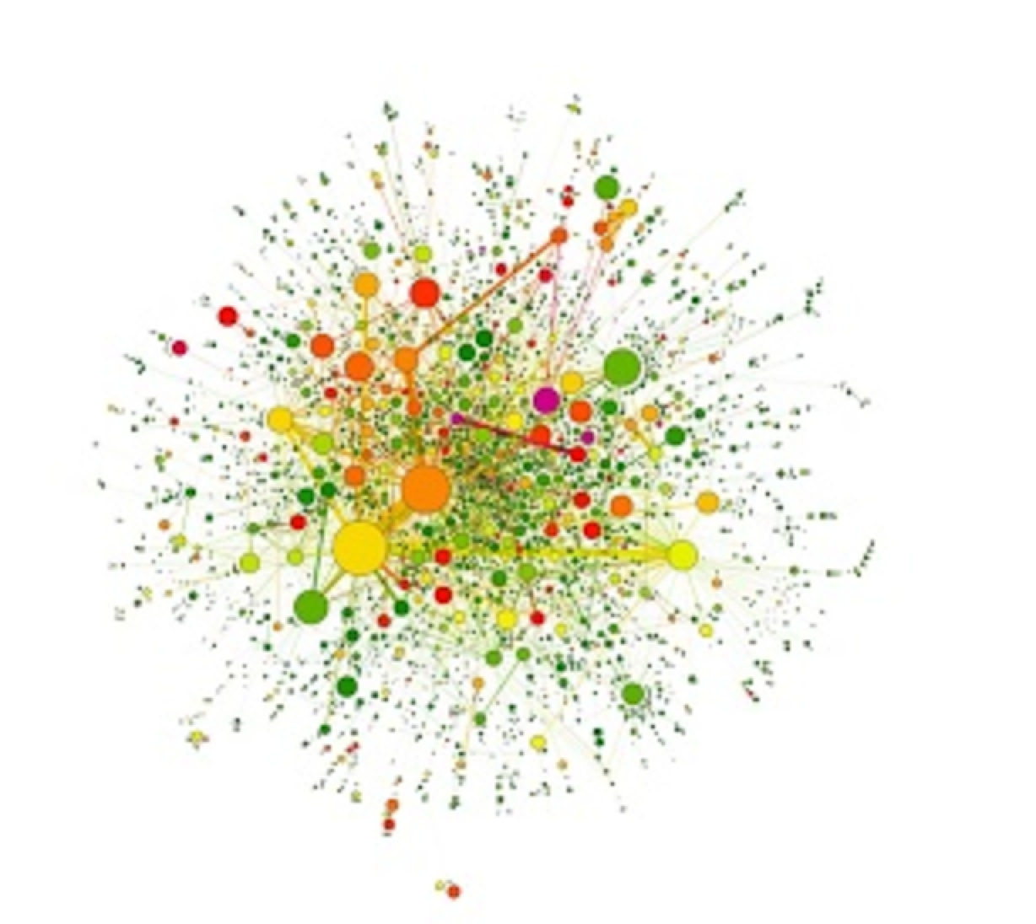
P(egs) bioinformatics
Postgraduate Evolution and Genomic Science Lecture series.

Slide 2

Introduction to Python
a very brief
EXTRA

Slide 3
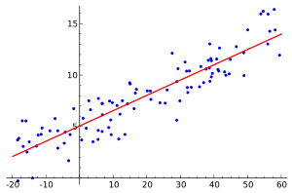



Why Python?
General purpose

Slide 4
Why Python?
Procedural
A
B
C

Slide 5

Why Python?

Slide 6
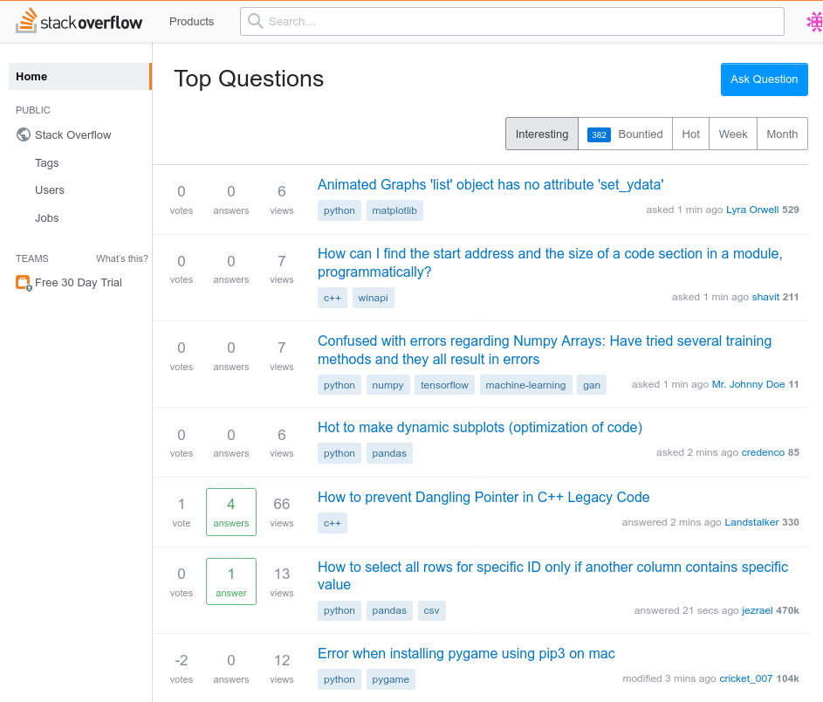

Slide 7
Jupyter Notebook
. . . in-browser editing for code . . .

Slide 8
Installing Jupyter (1 of 3)
Option 1: Do it yourself
Option 2: Don’t do it yourself [1]
[1] https://notebooks.azure.com
[2] https://cocalc.com
PYTHON 3.8

Slide 9
Installing Jupyter (2 of 3)
EXTRA
Python
apt-get install python3.7
(Ubuntu)
port install python3.7
(MacPorts)
Pip
curl https://bootstrap.pypa.io/get-pip.py -o get-pip.py
python3.7 get-pip.py
Virtualenv
pip install virtualenv
https://www.python.org/downloads/
https://pip.pypa.io/en/stable/installing/
https://virtualenv.pypa.io/en/latest/

Slide 10
Installing Jupyter (3 of 3)
EXTRA
Create a virtual environment
python3.7 -m virtualenv tutorial
Install stuff into your environment
tutorial/bin/pip install jupyter
Run Jupyter
tutorial/bin/jupyter notebook

Slide 11
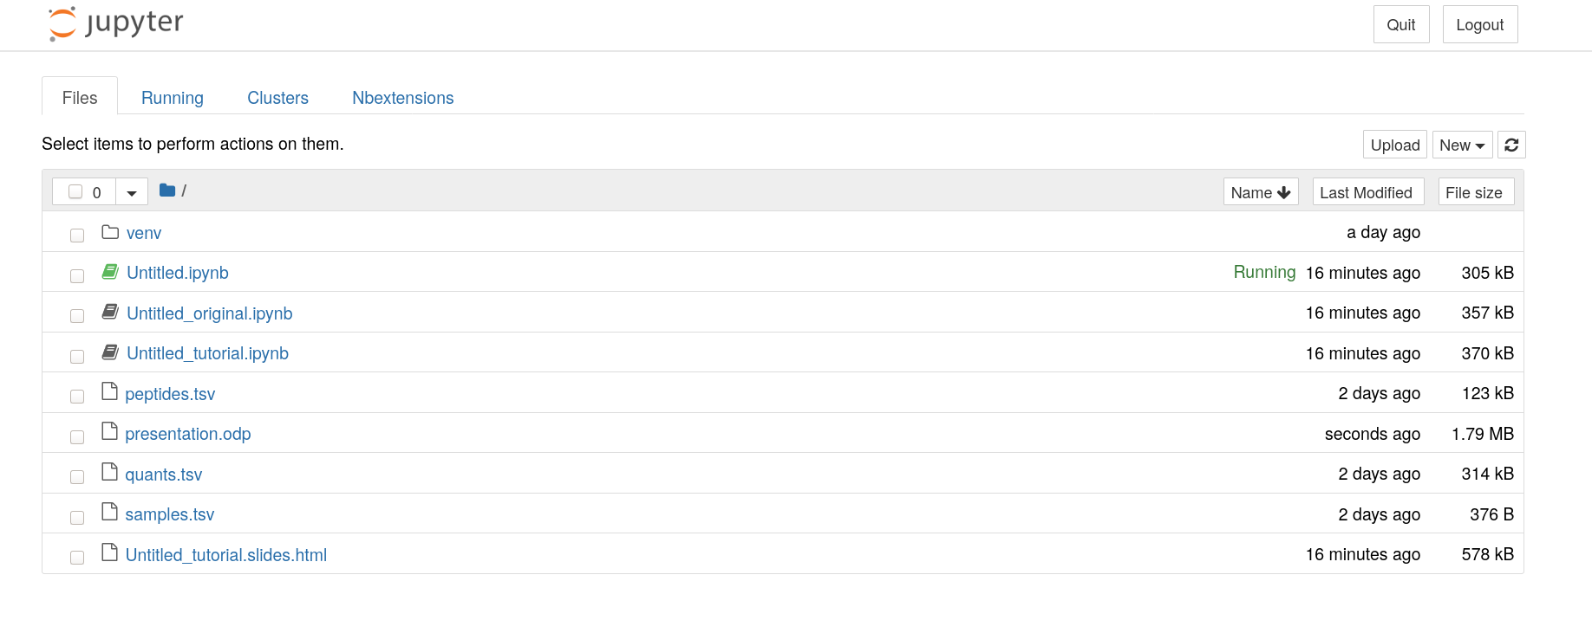

Slide 12
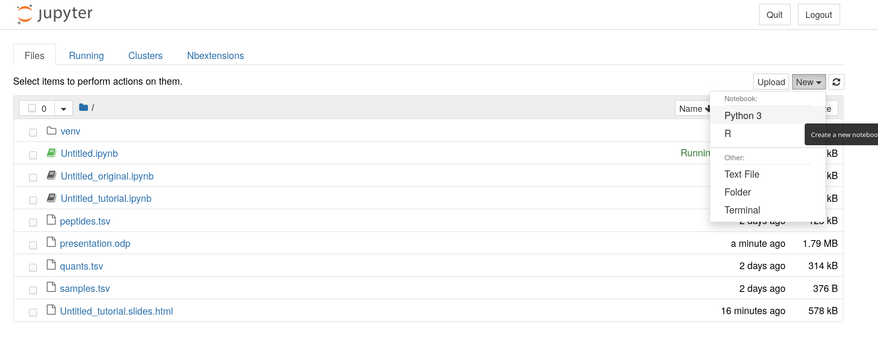

Slide 13
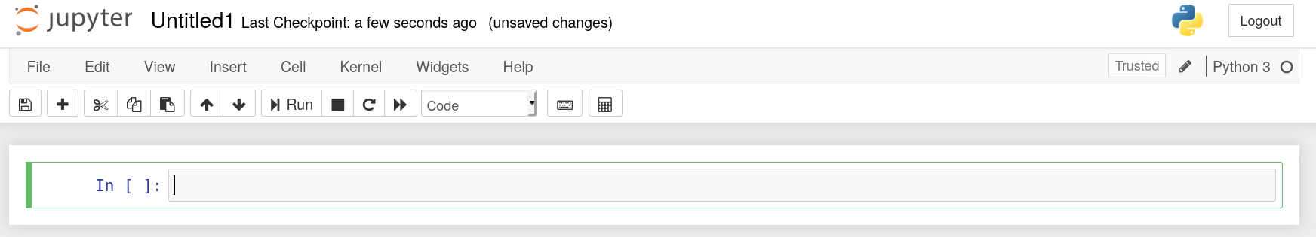
1
0

Slide 14
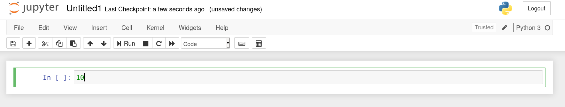
⇧
↲

Slide 15
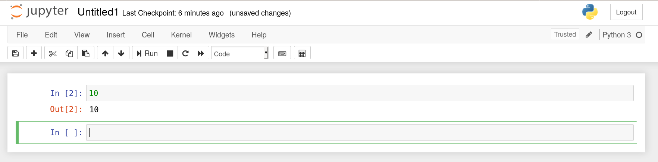

Slide 16
→

Slide 17

Case Study: Peptide Variability
Treatment
Treatment
...
Patient
Patient
Patient
...
Patient
Sample
Sample
...
Protein
Protein
Peptide
Peptide
a
b
...
Protein
Peptide
c
d
...
...
...
...
...
...

Slide 18
CSV
TSV
Sample,Patient,Age,Group ↲
S01 ,Alice ,31 ,Control ↲
S02 ,Bob ,28 ,Treatment↲
S03 ,Charlie,37 ,Treatment↲
Sample⟶Patient⟶Age⟶Group ↲
S01 ⟶Alice ⟶31 ⟶Control ↲
S02 ⟶Bob ⟶28 ⟶Treatment↲
S03 ⟶Charlie⟶37 ⟶Treatment↲

Slide 19
Peptide Variability
Protein
Protein
Peptide
Peptide
peptides.tsv
Protein
Peptide
...
...
Treatment
Patient
Sample
samples.tsv
Treatment
Patient
Sample
...
...
...
a
a
...
quants.tsv
a
a
...
...
...
...

Slide 20

Wide and long
EXTRA
Wide
Long
Patient
X
S2
Y
S2
Z
Peptide
Protein
Sample
Quant.
Peptide
A
1
2
2
2
3
Peptide
A
X
1
B
4
4
5
4
6
A
Y
2
C
7
4
8
4
9
A
Z
3
Peptide
B
X
4
B
Y
5
B
Z
6
C
X
7
C
Y
8
C
Z
9

Slide 21

Join
EXTRA
A
Peptide
Protein
Sample
Quant.
Peptide
Joining A to B on the Sample column
A
X
1
A
Y
2
C
A
Z
3
Peptide
Protein
Sample
Quant.
Condition
Peptide
B
X
4
Peptide
A
X
1
Control
B
Y
5
A
Y
2
Control
B
Z
6
A
Z
3
Treatment
Peptide
B
B
X
4
Control
Sample
Condition
B
Y
5
Control
X
Control
B
Z
6
Treatment
Y
Control
Z
Treatment

Slide 22

Transposing data
EXTRA
Q
Patient
X
S2
Y
S2
Z
Peptide
A
1
2
2
2
3
B
4
4
5
4
6
C
7
4
8
4
9
Q^{T}
A
B
C
X
1
2
4
2
7
Y
2
4
5
4
8
Z
3
4
6
4
9

Slide 23


