Slide 1
Toolchain Setup
Joachim Falk
Friedrich-Alexander-Universität Erlangen-Nürnberg
Hardware/Software Co-Design
9.1.2017

Slide 2
Outline
Access to our Submin repository manager
GIT Setup
Checkout
Compiling SysteMoC and Maestro

Slide 3
Submin Account Information for Repository Access
Your accounts should be as follows:
You should already have setup your passwords. To validate your access, you can login into the repository manager with the URL https://codesignrev.informatik.uni-erlangen.de/submin and your above provided account name and the password you already provided. Otherwise, follow the steps provided on the next slides.
Name | E-Mail | Username
Joachim Falk | joachim.falk@fau.de | falk
Michael Glass | michael.glass@fau.de | glass
Tobias Schwarzer | tobias.schwarzer@fau.de | schwarzer
Rafael Rosales | rafael.rosales@fau.de | rosales

Slide 4
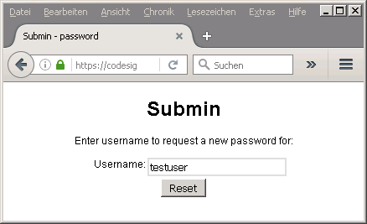
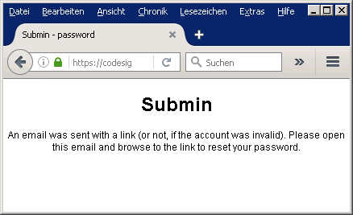
Password Setup for Your Account
Visit the following URL: https://codesignrev.informatik.uni-erlangen.de/submin/password/
Enter your username, i.e., replace testuser with the username provided in the previous slide.
Trigger the reset by clicking the button.

Slide 5
Password Setup for Your Account
To email send to the address provided in the table presented previously will contain an URL that starts the password reset procedure.
================================================================================================
You are receiving this email because someone requested a password reset for your account.
If you don't know what this is about, you can safely ignore it, the reset request will expire
automatically.
If you requested this password reset, you can reset your password by going to the following URL:
http://codesignrev.informatik.uni-erlangen.de/submin/password/<username>/JZ8vp...
Kind regards,
Submin
PS. The request was sent from 131.188.51.30
================================================================================================

Slide 6
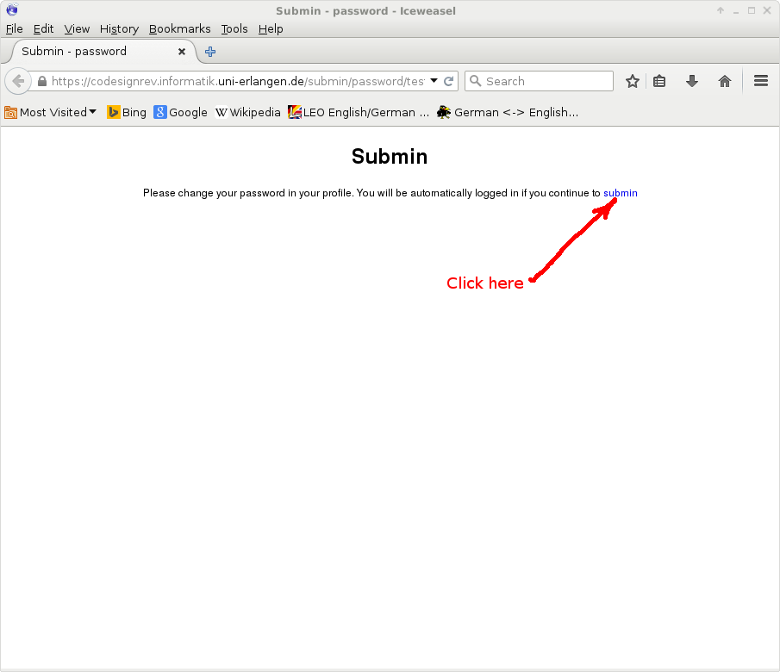
Password Setup for Your Account

Slide 7
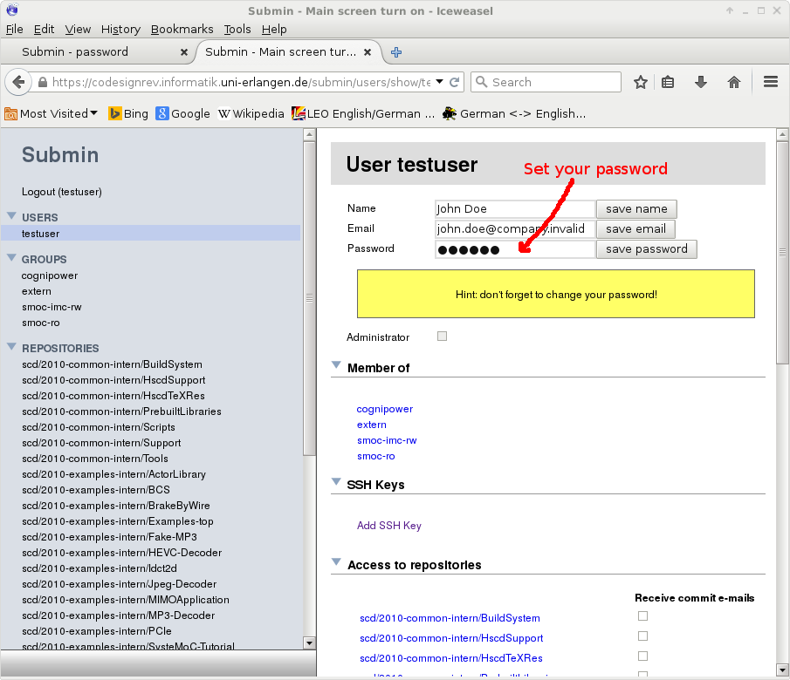
Password Setup for Your Account

Slide 8
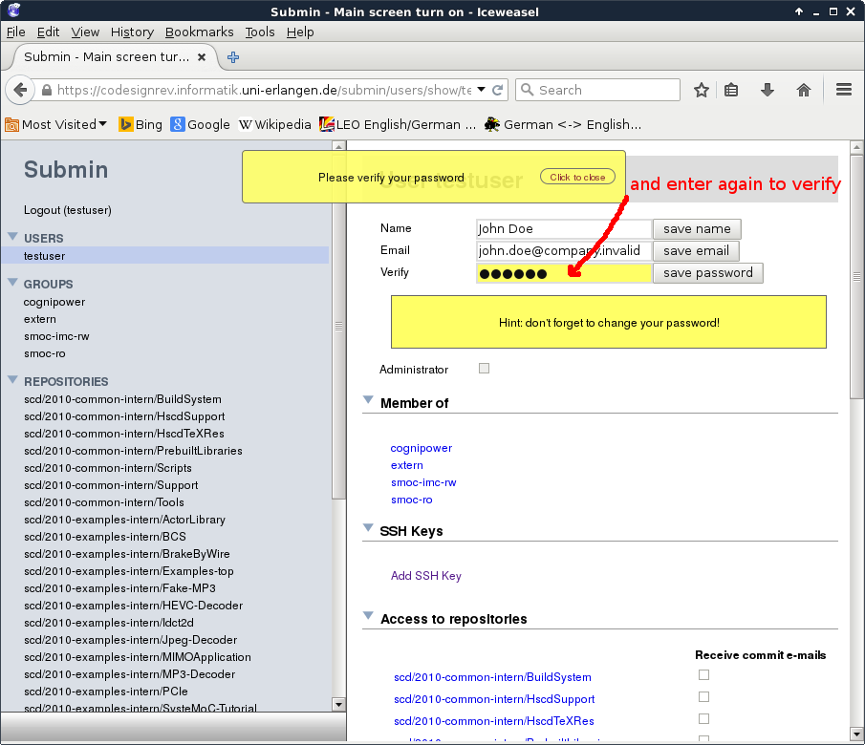
Password Setup for Your Account

Slide 9
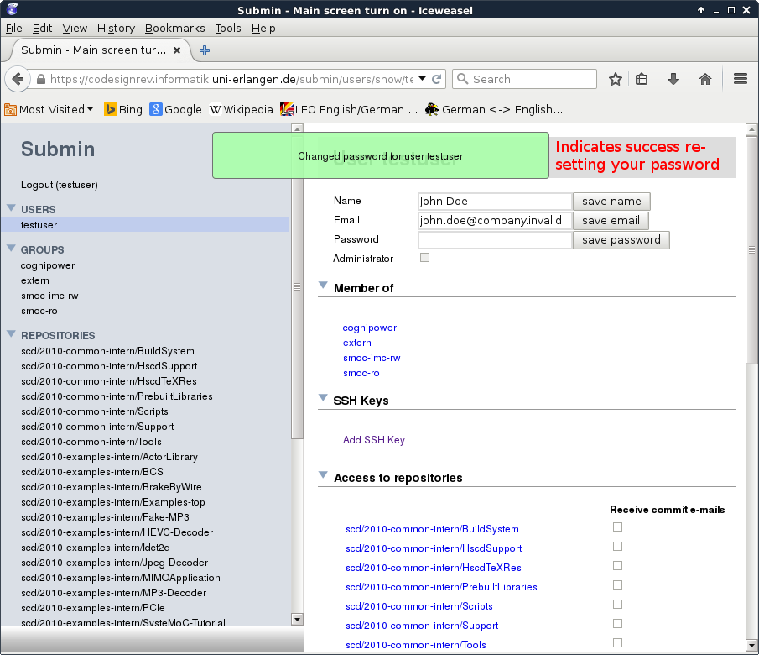
Password Setup for Your Account

Slide 10
Outline
Access to our Submin repository manager
GIT Setup
Checkout
Compiling SysteMoC and Maestro

Slide 11
GIT Setup
First ensure that git is present on your linux machine.
If it is missing, install it as follows on your debian based distribution:
[bash falk@codesign30:~]$ git --version
git version 1.9.1
[bash falk@codesign30:~]$ git --version
git: command not found
[bash falk@codesign30:~]$ sudo apt-get install git
Reading package lists... Done
Building dependency tree
Reading state information... Done
The following additional packages will be installed:
…
Need to get 6,019 kB of archives.
After this operation, 31.4 MB of additional disk space will be used.
Do you want to continue? [Y/n] Y
…

Slide 12
GIT Setup
Next, you have to create two files $HOME/.gitconfig and $HOME/.gitconfig.d/info/exclude
$HOME/.gitconfig as follows:
Update the provided URL with your username
[user]
name = Jon Doe
email = jon.doe@invalid
[push]
default = matching
[core]
excludesfile = ~/.gitconfig.d/info/exclude
[url "https://testuser@codesignrev.informatik.uni-erlangen.de/git/"]
insteadOf = codesign:

Slide 13
GIT Setup
You have to create two files $HOME/.gitconfig and $HOME/.gitconfig.d/info/exclude
$HOME/.gitconfig.d/info/exclude as follows:
One exclude pattern for auto generated files per line. These above are most common ones. Project specific exclude are commonly found in .gitignore files in the source directory of the project.
*~
*.[oa]
*.so
*.bak
*.tex-dep
*.tex-dep-enable
*.tex-stamp
*.aux
*.aux-dep
*.aux-dep-enable
*-fig.tex
*-tex.pdf
*.bbl
*.blg
*.log
,,*
++log.*
.*.sw*
*.kate-swp
.#*
.DS_Store
._*
obj
obj-*
tags
aclocal.m4
autom4te.cache
.gdb_history

Slide 14
GIT Setup via SSH
Modify $HOME/.gitconfig as follows:
Then, generate an SSH key by executing the following command:
Finally, register the public part (id_rsa.pub) of the generated key with Submin by following the steps given in the next slides.
[user]
name = Jon Doe
email = jon.doe@invalid
[push]
default = matching
[core]
excludesfile = ~/.gitconfig.d/info/exclude
[url "ssh://git@codesignrev.informatik.uni-erlangen.de/"]
insteadOf = codesign:
[bash testuser@codesign30:~]$ ssh-keygen -t rsa -b 4096
Generating public/private rsa key pair.
Enter file in which to save the key (/home/testuser/.ssh/id_rsa):
Enter passphrase (empty for no passphrase):
Enter same passphrase again:
…
[bash testuser@codesign30:~]$

Slide 15
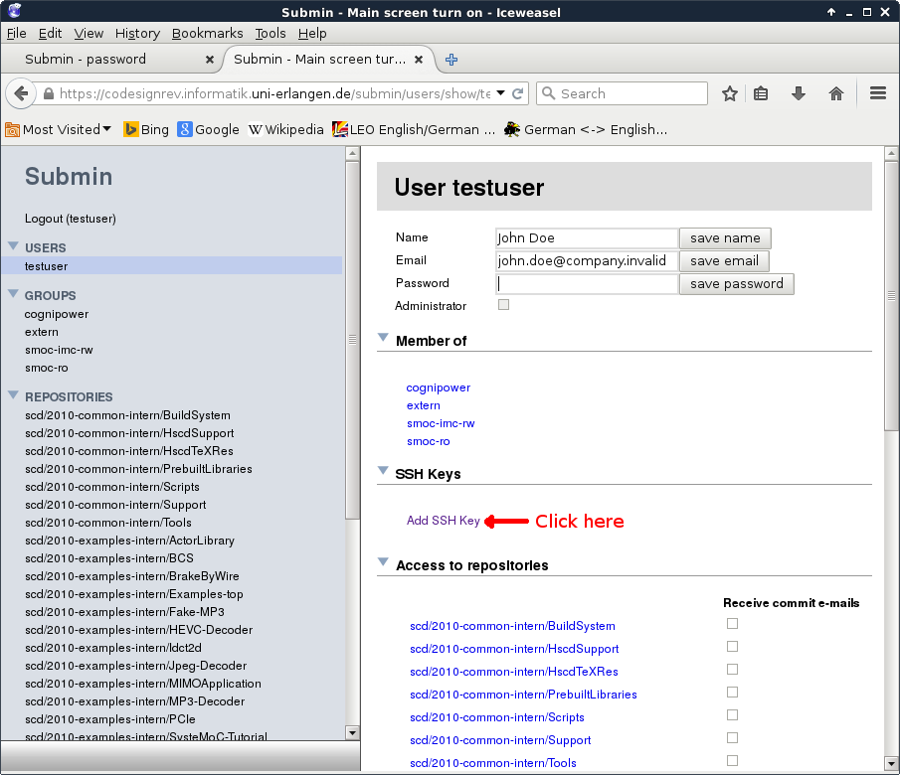
Submin Account Setup (Only for Access via SSH)

Slide 16
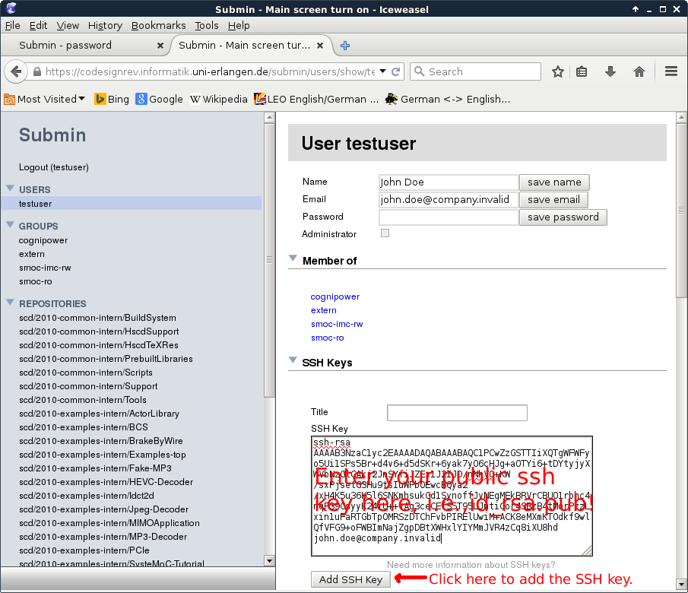
Submin Account Setup (Only for Access via SSH)

Slide 17
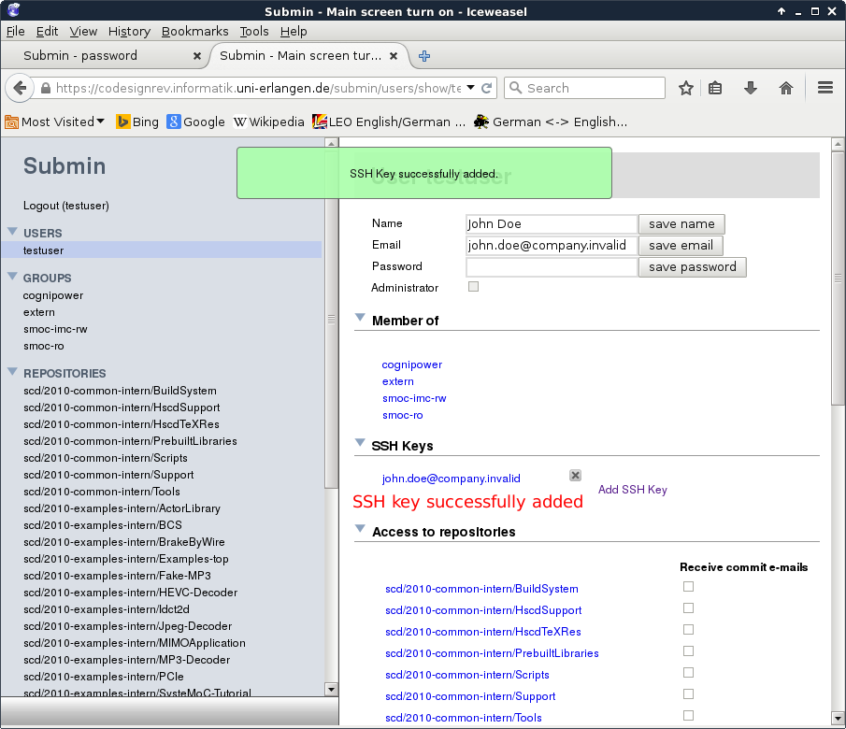
Submin Account Setup (Only for Access via SSH)

Slide 18
Outline
Access to our Submin repository manager
GIT Setup
Checkout
Compiling SysteMoC and Maestro

Slide 19
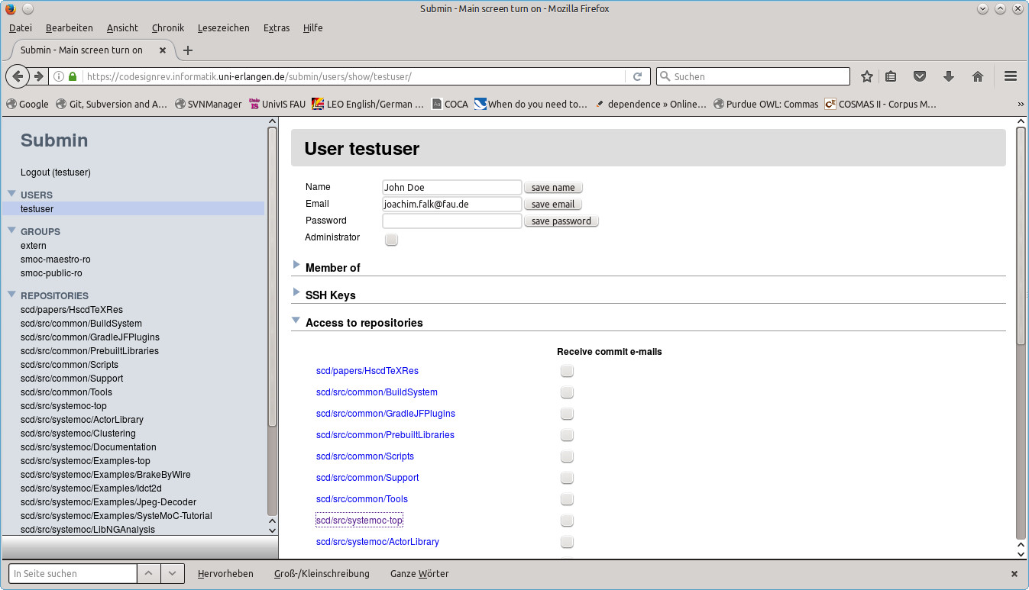
Checkout
First, login to Submin by using the following URL: https://codesignrev.informatik.uni-erlangen.de/submin
Then, select the repository scd/src/systemoc-top

Slide 20
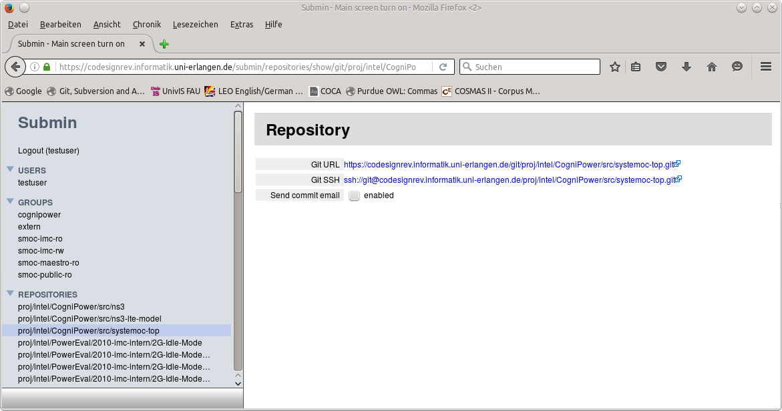
Checkout
Next, copy the appropriate URL for a clone via either https or ssh.

Slide 21
Checkout
Next, copy the appropriate URL for a clone via either https or ssh.
Subsequently, insert your username into the provided URL
Finally, clone the repository by executing the following command:
The resulting checkout in systemoc-top--devel--1.0 is still incomplete as the appropriate subprojects are missing.
[bash testuser@codesign30:tmp]$ git clone https://testuser@codesignrev.informatik.uni-erlangen.de/git/scd/src/systemoc-top.git systemoc-top--devel--1.0
Nach »systemoc-top--devel--1.0« wird geklont
Username for 'https://codesignrev.informatik.uni-erlangen.de': testuser
Password for 'https://testuser@codesignrev.informatik.uni-erlangen.de':
remote: Counting objects: 537, done.
remote: Compressing objects: 100% (304/304), done.
remote: Total 537 (delta 192), reused 511 (delta 179)
Objekte werden empfangen: 100% (537/537), 150.38 KiB | 0 bytes/s, done.
Unterschiede werden aufgelöst: 100% (192/192), done.
Verbundenheit wird überprüft … Fertig.
[bash testuser@codesign30:tmp]$ cd systemoc-top--devel--1.0
[bash testuser@codesign30:systemoc-top--devel--1.0]$

Slide 22
Checkout Subprojects
The missing subprojects are listed in the file .gitmodules, i.e., the following command will show them:
Note that in the url string the codesign: placeholder is used. For the following steps to succeed, the placeholder must be defined appropriately (see the slides GIT Setup and GIT Setup via SSH) for either https or ssh access in your GIT configuration file ~/.gitconfig.
[bash testuser@codesign30:systemoc-top--devel--1.0]$ cat .gitmodules
[submodule "HscdTeXRes"]
path = HscdTeXRes
url = codesign:scd/papers/HscdTeXRes.git
[submodule "Documentation"]
path = Documentation
url = codesign:scd/src/systemoc/Documentation.git
[submodule "Scripts"]
path = Scripts
url = codesign:scd/src/common/Scripts.git
[submodule "BuildSystem"]
path = BuildSystem
url = codesign:scd/src/common/BuildSystem.git
[submodule "Support"]
path = Support
url = codesign:scd/src/common/Support.git
…

Slide 23
Checkout Subprojects
To clone the missing subprojects, execute the following command:
[bash testuser@codesign30:systemoc-top--devel--1.0]$ git submodule update --init –recursive
Submodul 'ActorLibrary' (codesign:scd/src/systemoc/ActorLibrary.git) für Pfad 'ActorLibrary' in die Konfiguration eingetragen.
Submodul 'BuildSystem' (codesign:scd/src/common/BuildSystem.git) für Pfad 'BuildSystem' in die Konfiguration
…
Nach »ns3« wird geklont
Username for 'https://codesignrev.informatik.uni-erlangen.de': testuser
Password for 'https://testuser@codesignrev.informatik.uni-erlangen.de':
remote: Counting objects: 3791, done.
remote: Compressing objects: 100% (2679/2679), done.
remote: Total 3791 (delta 1072), reused 3754 (delta 1055)
Objekte werden empfangen: 100% (3791/3791), 26.60 MiB | 29.31 MiB/s, done.
Unterschiede werden aufgelöst: 100% (1072/1072), done.
Verbundenheit wird überprüft … Fertig.
Submodul-Pfad: 'ns3': 'aa3ad70607be0320f4a56ed9c6e6e68dcb5d129a' ausgecheckt
Nach »ns3-lte-model« wird geklont
Username for 'https://codesignrev.informatik.uni-erlangen.de': testuser
Password for 'https://testuser@codesignrev.informatik.uni-erlangen.de':
remote: Counting objects: 79, done.
remote: Compressing objects: 100% (75/75), done.
remote: Total 79 (delta 37), reused 0 (delta 0)
Unpacking objects: 100% (79/79), done.
Verbundenheit wird überprüft … Fertig.
Submodul-Pfad: 'ns3-lte-model': '8b0cd5bce84d0282d3a89e71785224ce532bf702' ausgecheckt
[bash testuser@codesign30:systemoc-top--devel--1.0]$

Slide 24
Outline
Access to our Submin repository manager
GIT Setup
Checkout
Compiling SysteMoC and Maestro

Slide 25
Compiling SysteMoC and Maestro
Before building, the build system has to be generated via the following tools:
autoconf (Tested versions: 2.64, 2.68, 2.69)
automake (Tested versions: 1.10.3, 1.11.2, 1.14.1)
libtool (Tested versions: 1.5.26, 2.4.2)
First check for presence of these tools, i.e.,
[bash falk@codesign30:systemoc-top--devel--1.0]$ autoconf --version
autoconf (GNU Autoconf) 2.69
Copyright (C) 2012 Free Software Foundation, Inc.
…
[bash falk@codesign30:systemoc-top--devel--1.0]$ automake --version
automake (GNU automake) 1.14.1
Copyright (C) 2013 Free Software Foundation, Inc.
…
[bash falk@codesign30:systemoc-top--devel--1.0]$ libtool --version
libtool (GNU libtool) 2.4.2
Written by Gordon Matzigkeit <gord@gnu.ai.mit.edu>, 1996
…

Slide 26
Compiling SysteMoC and Maestro
If one of these is missing, install them as follows on your debian based distribution:
To generate the build, system execute the following command in the checkout:
The above step should have generated for each configure.ac and each Makefile.am a corresponding configure and Makefile.in file.
[bash falk@codesign30:~]$ sudo apt-get install autoconf automake libtool
Reading package lists... Done
Building dependency tree
Reading state information... Done
The following additional packages will be installed:
…
Need to get 2,523 kB of archives.
After this operation, 6,900 kB of additional disk space will be used.
Do you want to continue? [Y/n] Y
…
[bash falk@codesign30:systemoc-top--devel--1.0]$ ./autoreconf.sh
autoreconf: Entering directory `.'
autoreconf: configure.ac: not using Gettext
autoreconf: running: aclocal -I BuildSystem/m4
autoreconf: configure.ac: tracing
autoreconf: configure.ac: adding subdirectory Support to autoreconf
autoreconf: Entering directory `Support'
…
autoreconf: Leaving directory `Examples'
autoreconf: Leaving directory `.'
[bash falk@codesign30:systemoc-top--devel--1.0]$

Slide 27
Compiling SysteMoC and Maestro
To compile, g++ is required. We tested versions 4.5, 4.7, and 4.9.
Moreover, the following libraries must be available:
libboost-* (Tested versions: 1.54, 1.55, 1.56) Might also work with 1.48
libxerces-c (Tested versions: 3.1.1) Might also work with 2.8.0
libsystemc (Tested versions: 2.2.0, 2.3.1)
First check for presence or absence of these libraries, i.e.,
…]$ ls -lad /usr/include/boost /usr/lib/x86_64-linux-gnu/libboost_*.so
drwxr-xr-x 96 root root 12288 Aug 10 2015 /usr/include/boostlrwxrwxrwx 1 root root 25 Jun 21 2014 /usr/lib/x86_64-linux-gnu/libboost_atomic.so -> libboost_atomic.so.1.54.0
…
lrwxrwxrwx 1 root root 24 Jun 21 2014 /usr/lib/x86_64-linux-gnu/libboost_timer.so -> libboost_timer.so.1.54.0
…
…]$ ls -lad /usr/include/xercesc /usr/lib/x86_64-linux-gnu/libxerces-c.so
drwxr-xr-x 11 root root 4096 Feb 18 2016 /usr/include/xercesc lrwxrwxrwx 1 root root 18 Jul 1 21:15 /usr/lib/x86_64-linux-gnu/libxerces-c.so -> libxerces-c-3.1.so
…]$ ls -lad /usr/include/sysc /usr/lib/x86_64-linux-gnu/libsystemc*.so
drwxr-xr-x 8 root root 4096 Jun 11 2015 /usr/include/sysc
lrwxrwxrwx 1 root root 29 Jun 6 2015 /usr/lib/x86_64-linux-gnu/libsystemc-pthread.so -> libsystemc-pthread-2.so.3.1.0
lrwxrwxrwx 1 root root 21 Jun 6 2015 /usr/lib/x86_64-linux-gnu/libsystemc.so -> libsystemc-2.so.3.1.0

Slide 28
Compiling SysteMoC and Maestro
If one of libboost-* or libxerces-c is missing, install them as follows on your debian based distribution:
However, libsystemc is not provided by Ubuntu or Debian. Please use the prebuild debs we have provided in the Sharepoint!
[bash falk@codesign30:~]$ sudo apt-get install libboost-all-dev libxerces-c-dev
Reading package lists... Done
Building dependency tree
Reading state information... Done
The following additional packages will be installed:
…
Need to get 2,523 kB of archives.
After this operation, 6,900 kB of additional disk space will be used.
Do you want to continue? [Y/n] Y
…
[bash falk@codesign30:~]$ unzip libsystemc-2.3.1-3-binaries-ubuntu-14.04-amd64-debs.zip
Archive: libsystemc-2.3.1-3-binaries-ubuntu-14.04-amd64-debs.zip
extracting: libsystemc-2.3_2.3.1-3_amd64.deb
extracting: libsystemc-dev_2.3.1-3_amd64.deb
[bash falk@codesign30:~]$ sudo dpkg --install libsystemc-2.3_2.3.1-3_amd64.deb \
libsystemc-dev_2.3.1-3_amd64.deb
Selecting previously unselected package libsystemc-2.3.
Preparing to unpack libsystemc-2.3_2.3.1-3_amd64.deb ...
Unpacking libsystemc-2.3 (2.3.1-3) ...
Selecting previously unselected package libsystemc-dev.
Preparing to unpack libsystemc-dev_2.3.1-3_amd64.deb ...
Unpacking libsystemc-dev (2.3.1-3) ...
Setting up libsystemc-2.3 (2.3.1-3) ...
Setting up libsystemc-dev (2.3.1-3) ...

Slide 29
Compiling SysteMoC and Maestro
In case some of the required libraries are not in the compiler standard include and linker path, you might specify their location via appropriate --with-<libname> options to configure
To get help, call the following command:
[bash falk@codesign30:systemoc-top--devel--1.0]$ ./configure --help=recursive
…
--with-boost prefix or extern to use an installed library (default), no to disable
--with-boost-include include path for boost
--with-boost-lib library path for boost
--with-systemc prefix or extern to use an installed library (default), no to disable
--with-systemc-include include path for SystemC
--with-systemc-lib library path for SystemC
--with-xerces prefix or extern to use an installed library (default), no to disable
--with-xerces-include include path for xerces
--with-xerces-lib library path for xerces
…

Slide 30
Compiling SysteMoC and Maestro
To generate the makefiles for subsequent build, execute the following command in the object directory systemoc-top--devel--1.0/obj:
The above step generates for each Makefile.in in the source directory systemoc-top--devel--1.0 a Makefile in the object directory.
[bash falk@codesign30:systemoc-top--devel--1.0]$ mkdir obj; cd obj
[bash falk@codesign30:obj]$ ../configure -C --without-systemc-vpc --with-maestro
configure: creating cache config.cache
checking build system type... x86_64-unknown-linux-gnu
checking host system type... x86_64-unknown-linux-gnu
…
=== configuring in Support (…/systemoc-top--devel--1.0/obj/Support)
…
=== configuring in Maestro/MetaMap (…/systemoc-top--devel--1.0/obj/Maestro/MetaMap)
…
=== configuring in SysteMoC (…/systemoc-top--devel--1.0/obj/SysteMoC)
…
=== configuring in Maestro/ModelLibrary (…/systemoc-top--devel--1.0/obj/Maestro/ModelLibrary)
…
=== configuring in ActorLibrary (…/systemoc-top--devel--1.0/obj/ActorLibrary)
…
=== configuring in Testcases (…/systemoc-top--develr--1.0/obj/Testcases)
…
=== configuring in maestro (…/systemoc-top--devel--1.0/obj/Testcases/maestro)
…
=== configuring in …some more testcases and examples
…
configure: creating ./config.status
config.status: creating Makefile
config.status: creating config.h
config.status: executing depfiles commands
config.status: executing libtool commands
[bash falk@codesign30:obj]$

Slide 31
Compiling SysteMoC and Maestro
Finally, to compile SysteMoC and Maestro, execute the following command in the object directory systemoc-top--devel--1.0/obj:
The above step will generate the SysteMoC and Maestro libraries in their respective directories as well as compile an example starter project in obj/Testcases/maestro.
[bash falk@codesign30:obj]$ make –j4
make all-recursive
make[1]: Verzeichnis »…/systemoc-top--devel--1.0/obj« wird betreten
Making all in Support
make[2]: Verzeichnis »…/systemoc-top--devel--1.0/obj/Support« wird betreten
…
Making all in Maestro/MetaMap
make[2]: Verzeichnis »…/systemoc-top--devel--1.0/obj/Maestro/MetaMap« wird betreten
…
Making all in SysteMoC
make[2]: Verzeichnis »…/systemoc-top--devel--1.0/obj/SysteMoC« wird betreten
…
Making all in Maestro/ModelLibrary
make[2]: Verzeichnis »…/systemoc-top--devel--1.0/obj/Maestro/ModelLibrary« wird betreten
…
Making all in Testcases
make[2]: Verzeichnis »…/systemoc-top--devel--1.0/obj/Testcases« wird betreten
make all-recursive
make[3]: Verzeichnis »…/systemoc-top--devel--1.0/obj/Testcases« wird betreten
Making all in maestro
make[4]: Verzeichnis »…/systemoc-top--devel--1.0/obj/Testcases/maestro« wird betreten
…
Some more Testcase and Examples
[bash falk@codesign30:obj]$

