Slide 1


Online installation
※”Operation Autonomy Support Engine” is referred to as “OASE” in this manual.
Version 1.0
Exastro developer

Slide 2
Table of contents
Introduction
1.1 About this manual
System configuration
2.1 Requirements(1/2)
2.2 Requirements(2/2)
OASE environment construction procedure
3.1 Online installation
3.2 Advance preparation（1/2）
3.3 Advance preparation （2/2）
3.4 OASE environment construction flow
3.5 Environment construction （1/7）
3.6 Environment construction （2/7）
3.7 Environment construction （3/7）
3.8 Environment construction （4/7）
3.9 Environment construction （5/7）
3.10 Environment construction （6/7）
3.11 Environment construction （7/7）
OASE operation check
4.1 Operation check （1/7）
4.2 Operation check （2/7）
4.3 Operation check （3/7）
4.4 Operation check （4/7）
4.5 Operation check （5/7）
4.6 Operation check （6/7）
4.7 Operation check （7/7）

Slide 3
1. Introduction

Slide 4
1.1 About this manual
About this manual
This manual describes the procedure to construct OASE in all-in-one configuration(described later) with installer using external repository.

Slide 5
2. System configuration

Slide 6
2.1 Requirements(1/2)
To operate OASE, the following environment is required.
Server requirements
(Please refer to Documents for the construction method of middleware.)
https://exastro-suite.github.io/oase-docs/documents.html
OS | CentOS | 7.5.1804
Web server | Nginx | 1.17.1
Framework | Django | 2.1.3
Database | MySQL | 8.0.16
Language | python | 3.6.5
 | OpenJDK | 1.8.0_212
Python Library | openpyxl | 2.5.14
Red Hat | Decision Manager | 7.3.1
 | JBoss EAP | 7.2.0

Slide 7
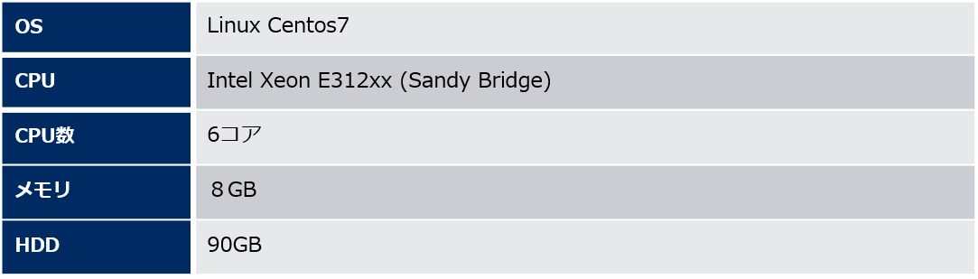
2.2 Requirements(2/2)
System requirements(For reference)
Client side PC requirements
CPU cores
6 core
OS | windows | Windows7 or higher
Software | Excel | MS Office 2016
Browser | InternetExplorer | 11
 | FireFox | 64.0
 | Chrome | 72.x or higher

Slide 8
3. OASE environment construction procedure

Slide 9
3.1 Online installation
About the installation procedure
If the OASE server is in online environment, the system configuration is performed by installing required library from internet and executing OASE installer.
OASE Server
OASE
OASE installation package
JAVA(openJDK)、Jboss EAP、
Python(uWSGI)、 Django
memcached,
Advance installation
and setting
RabbitMQ Server、MySQL Server、Nginx
Decision Manager、 Maven
Online

Slide 10
3.2 Advance preparation（1/2）
OASE environment construction tool list
The list of OASE environment construction tool is as follows.
Description | File | Storage path
OASE installer | oase_online_installer.sh | /(installation file storage)/oase-1.0.0/oase_install_package/install_scripts/
Application environment construction tool | oase_app_setup_core.sh | /(installation file storage)/oase-1.0.0/oase_install_package/install_scripts/bin/
Library collection script | oase_common_libs.sh | /(installation file storage)/oase-1.0.0/oase_install_package/install_scripts/bin/
Database environment construction tool | oase_db_setup_core.sh | /(installation file storage)/oase-1.0.0/oase_install_package/install_scripts/bin/
Environment construction tool | oase_deployment_core.sh | /(installation file storage)/oase-1.0.0/oase_install_package/install_scripts/bin/
Middleware environment construction tool | oase_middleware_setup_core.sh | /(installation file storage)/oase-1.0.0/oase_install_package/install_scripts/bin/

Slide 11
3.3 Advance preparation（2/2）
OASE environment construction tool list
The list of OASE environment construction tool is as follows.
Description | File | Storage path
OASE service setup tool | oase_service_setup_core.sh | /(installation file storage)/oase-1.0.0/oase_install_package/install_scripts/bin/
OASE environment setting tool | oase_settings_core.sh | /(installation file storage)/oase-1.0.0/oase_install_package/install_scripts/bin/
OASE uninstall tool | oase_uninstall_core.sh | /(installation file storage)/oase-1.0.0/oase_install_package/install_scripts/bin/
Answer file | oase_answers.txt | /(installation file storage)/oase-1.0.0/oase_install_package/install_scripts/

Slide 12
3.4 OASE environment construction flow
Environment construction flow (Online)
The flow of environment construction is as follows.
①Download file from Github
②Change privilege of
installation script
③Edit answer file
④Execute environment
construction tool (online version)
Process content
Connect RabbitMQ
Setup MySQL
Install JBoss
Setup other services
Execute OASE installer

Slide 13
3.5 Environment construction（1/7）
Download file from Github
Download file via the following command. $ wget https://github.com/exastro-suite/oase/archive/vx.x.x.tar.gz ※Please install wget command beforehand.
※Please change the version(x.x.x) properly.
Change the privilege of installation script
Extract zip file and change the privilege of installation script $ tar zxf vx.x.x.tar.gz $ find ./oase-x.x.x/oase_install_package/install_scripts/ -type f -name *.sh | xargs chmod 755
Edit answers file
/oase-x.x.x/oase_install_package/install_scripts/oase_answers.txt

Slide 14
3.6 Environment construction（2/7）
Edit answers file(1/2)
The way to edit the setting file(oase_answers.txt) of OASE environment construction is as follows.
Item | Required | Default value | Description
install_mode | ○ | Install
RabbitMQ_username | ○ | - | Username of RabbitMQ
RabbitMQ_password | ○ | - | Password of RabbitMQ
RabbitMQ_queuename | ○ | - | Queue name of RabbitMQ (Since it will be generated, any desired name is OK)
RabbitMQ_ipaddr | ○ | - | IP address of RabbitMQ
db_root_password | ○ | - | Root password of MySQL
db_name | ○ | - | Name of the MySQL database for OASE
db_username | ○ | - | Username of the MySQL database for OASE
db_password | ○ | - | Password of the MySQL database for OASE
db_erase | ○ | - | Erase or keep the database when uninstalling OASE
jboss_root_directory | ○ | - | Installation path of Jboss
rhdm_adminname | ○ | - | Administrator name of RHDM

Slide 15
3.7 Environment construction（3/7）
Edit answers file(2/2)
The way to edit the setting file(oase_answers.txt) of OASE environment construction is as follows.
Item | Required | Default value | Description
rhdm_password | ○ | - | Password of RHDM
dm_ipaddrport | ○ | - | IP address and port number of RHDM
rulefile_rootpath | ○ | - | Root path of RHDM rule setting file (Since it will be generated, any desired path is OK)
apply_ipaddrport | ○ | - | IP address and port to start Apply service
mavenrep_path | ○ | - | Storage path of RHDM Maven jar file
oasemail_smtp | ○ | - | Setting of OASE mail server
oase_directory | ○ | - | Installation target directory of OASE
oase_session_engine | ○ | - | The way to keep OASE session
ev_location | ○ | - | IP address to execute clone job when connected with ActiveDirectory
oase_language | ○ | ja | Language of OASE
oase_os | ○ | - | Environment OS
oase_base | ○ | yes | Select installation content

Slide 16
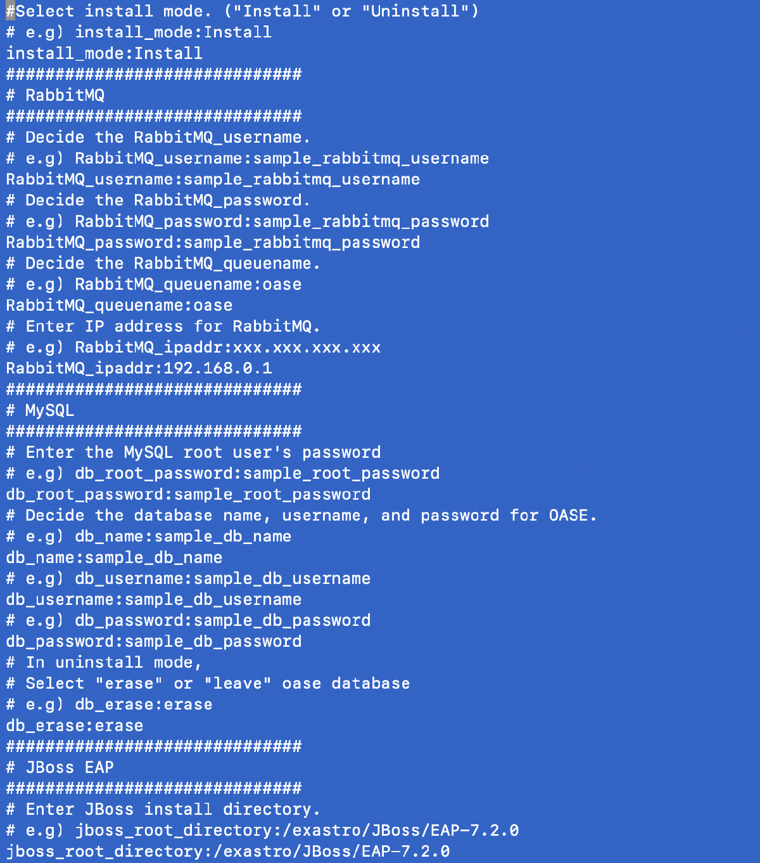
3.8 Environment construction（4/7）
Description sample of answer file(oase_answers.txt) 1/3
The description sample of answer file(oase_answers.txt) is as follows.

Slide 17
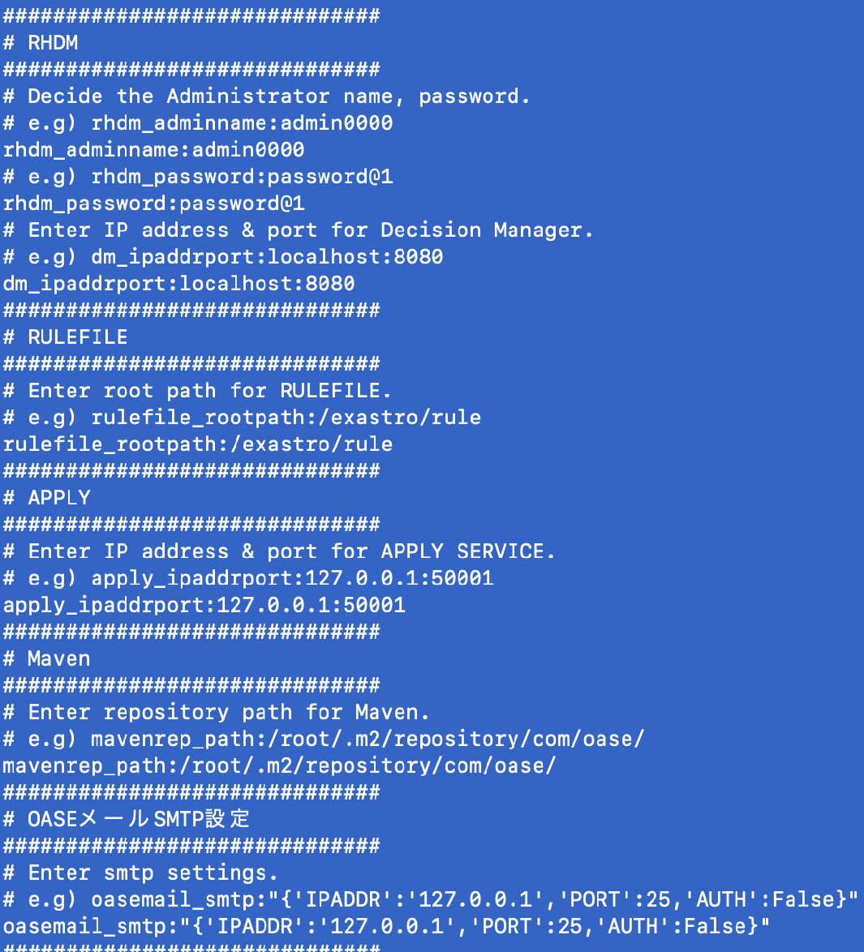
3.9 Environment construction（5/7）
Description sample of answer file(oase_answers.txt) 2/3

Slide 18
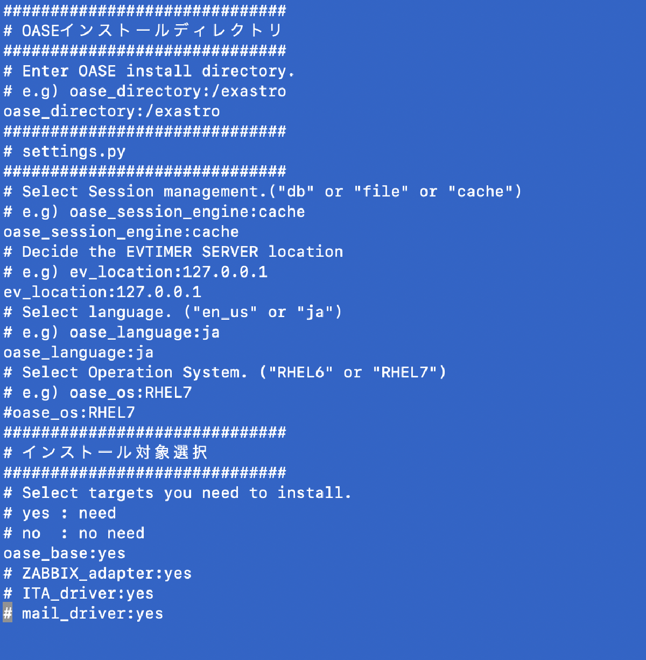
3.10 Environment construction（6/7）
Description sample of answer file(oase_answers.txt) 3/3

Slide 19
3.11 Environment construction（7/7）
Change directory
Move to the directory which contains the settings file and shell for environment construction $ cd oase-x.x.x/oase_install_package/install_scripts
Execute environment construction tool(online version)
Execute environment construction tool with the following command.
$ sh oase_online_installer.sh
The installation of OASE is completed.

Slide 20
4. OASE operation check

Slide 21
4.1 Operation check（1/7）
Check the display of main menu.
Please check if OASE and drivers are displayed correctly by accessing the main menu of OASE system from user’s windows PC by following the steps below.
Preparation for HTTPS access
Please add the IP address and host name of the OASE server to the hosts file in client device(Windows).
For Windows10, the hosts file is as follows.
Please add the following setting to hosts file
C:\Windows\System32\drivers\etc\hosts
“IP address of OASE server” exastro-oase Example） 192.168.0.3 exastro-oase

Slide 22
4.2 Operation check（2/7）
Import certificate to client device(Windows)
The certificate is stored in the following path of OASE installation package.
Download the file to client device via tools such as FFFTP or WinSCP.
Please import certificate to Web browser.
The procedure to import certificate to Google Chrome is as follows.
① Start Google Chrome and go to [Settings] from the [Settings] button at the top
right to proceed .
② After clicking[Advanced]at the bottom of the screen, click[Manage certificates]
from the item displayed.
③ Go to the Trusted Root Certification Authorities tab and click Import at the bottom left.
④ The import certificate wizard starts. Click Next.
⑤ Specify the file name to import and click [Next].
⑥ Make sure that certificates are placed in the next store (P) where it should be checked.
⑦ Select [Trusted Root Certification Authorities] and click [Next].
※ If it is not selected, please select [Trusted Root Certification Authorities] from [Reference]
on the right side .
⑧ Click [Finish].
OS of OASE server | File path | File name
RHEL 7, CentOS 7 series | /(installation file path)/oase-1.0.0/oase-root | exastro-oase.crt

Slide 23
4.1 Operation check（3/7）
Access URL
Please access the login screen from the following URL.
URL：https://exastro-oase/oase_web/top/login
※Accessing from both HTTP and HTTPS are available after installation.
Since HTTP is insecure, accessing from HTTPS is recommended.
Please check from Operation check(3/7) for the method to access from HTTP.
Login
Please enter the specific Login ID and default password then click the [Login] button when the login screen of OASE is displayed.
・Login ID ： administrator
・Default password： oaseoaseoase
The screen will move to [Change password screen] if it is the first login after installation.
Please change the default password from the change password screen.

Slide 24
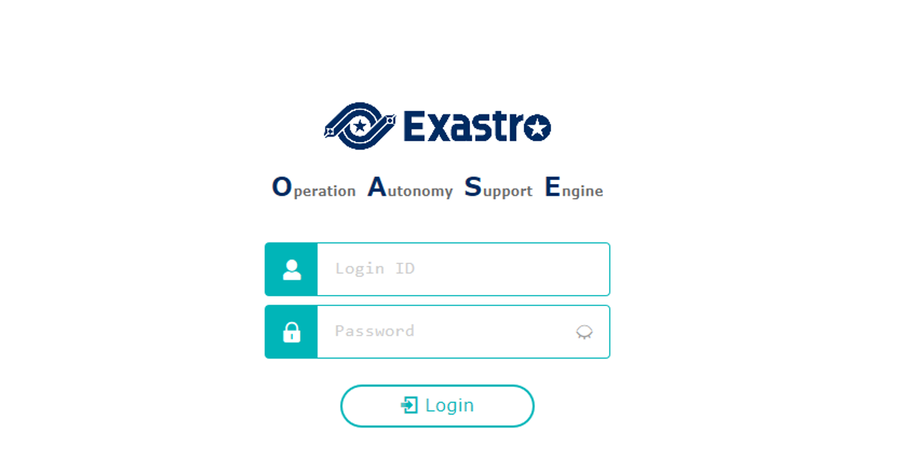
4.4 Operation check（4/7）
OASE login screen
If OASE is installed properly, the following login screen will be displayed.
Login ID： administrator
Default password：oaseoaseoase

Slide 25
4.5 Operation check（5/7）
Check contents according to the display of each menu
Please check if the following menu are displayed after login.
Function | Menu
OASE screen | DashBoard
 | Rule
 | System
 | Management

Slide 26
4.3 Operation check（6/7）
Enable HTTP access
To enable HTTP access, please perform the following procedure.
After installation, edit the generated “/etc/nginx/conf.d/oase.conf” file
server { listen 80; server_name exastro-oase; return 301 https://$host$request_uri; }
comment out(#) return 301 https://$host$request_uri;
then add following code
server { listen 80; server_name exastro-oase;
location / { include uwsgi_params; uwsgi_pass unix:///home/uWSGI/uwsgi.sock; }
location = / { include uwsgi_params; uwsgi_pass unix:///home/uWSGI/uwsgi.sock; return 301 /oase_web/top/login; }
location /static { alias /exastro/OASE/oase-root/web_app/static; }
error_page 500 502 503 504 /50x.html; location = /50x.html { root /usr/share/nginx/html; } }

Slide 27
4.3 Operation check（7/7）
Restart nginx with the following command.
# systemctl restart nginx
Access URL via HTTP
Please access the login screen via the following URL
URL：http://（IP address of server）
The steps after connection is the same as HTTPS.

