Slide 1


Quick Start
※”Operation Autonomy Support Engine” is referred to as “OASE” in this manual.
Version 1.0
Exastro developer

Slide 2
Table of contents
Introduction
1.1 Login screen
1.2 Screen description （Dashboard screen）
1.3 Screen description （Action setting screen）
1.4 Screen description （Decision table screen）
1.5 Screen description （rule screen）
1.6 Screen description （Request history screen）
1.7 Screen description （Action history screen）
Scenario description
2.1 The scenario in this manual and the steps of operation
Preparation before execution
3.1 Setup mail driver and create mail template (1/3)
3.1 Setup mail driver and create mail template (2/3)
3.1 Setup mail driver and create mail template (3/3)
3.2 Create decision table
3.3 Create decision table ※Excel operation (1/2)
3.3 Create decision table ※Excel operation (2/2)
3.4 Upload decision table file
3.5 Test request (1/2)
3.5 Test request (2/2)
3.6 Apply to production environment
Operation execution
4.1 Send request via curl command (1/2)
4.1 Send request via curl command (2/2)
4.2 Check the result of action execution
A Appendix
Sample1 (1/3)
Sample1 (2/3)
Sample1 (3/3)

Slide 3
1. Introduction

Slide 4
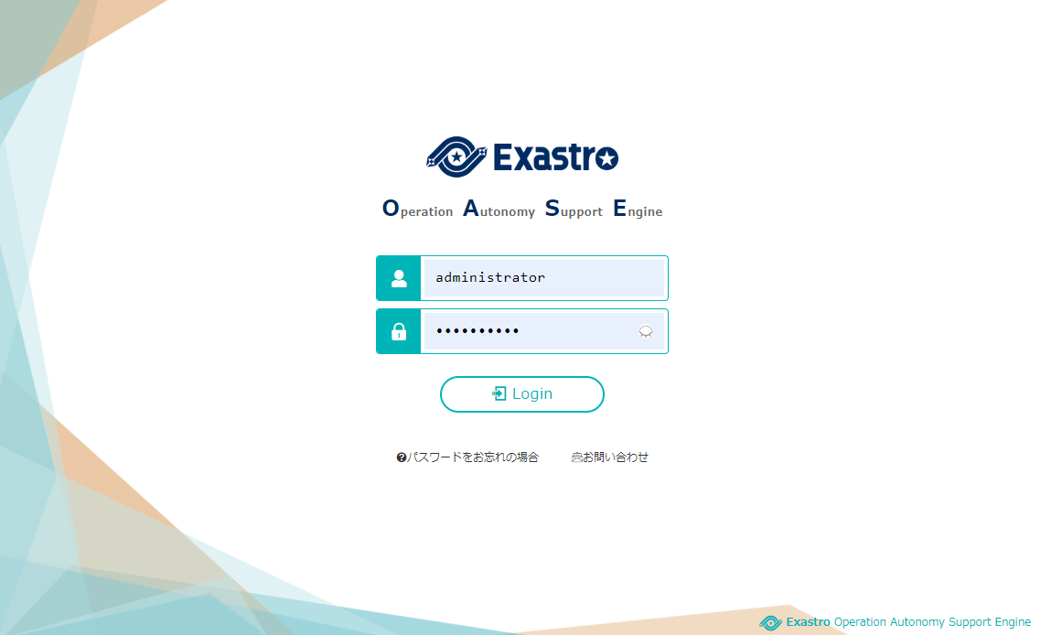
1.1 Screen description（Login screen）
OASE Login
The login screen will be displayed by accessing the following URL. https://exastro-oase/oase_web/top/login
Please refer to
<Environment construction
manual -Basics->
or
<OASE Learn -Introduction->
for the introduction of OASE.
The password will be requested to be changed immediately after login for the first time.

Slide 5
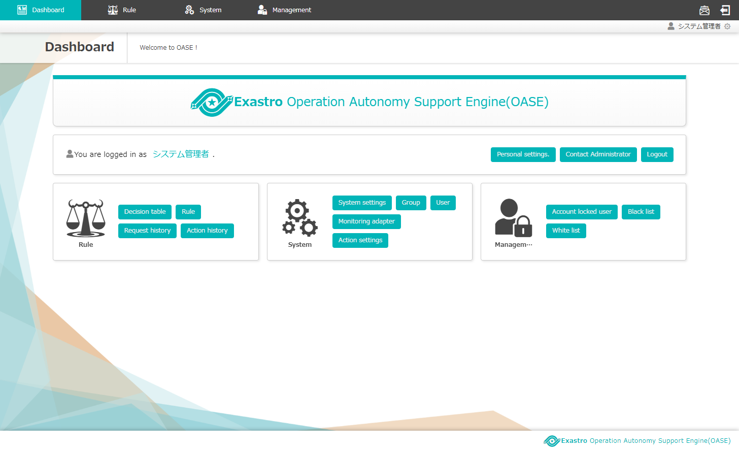
1.2 Screen Description（Dashboard Screen）
The overview of basic menu is as follows. （Login screen > DashBoard）
Menu
Please refer to the manuals for details of the functions in each menu.
■Menu overview
Rule ：Rule creation and action result management
System ：General settings and permission management
Management ：Security-related management

Slide 6
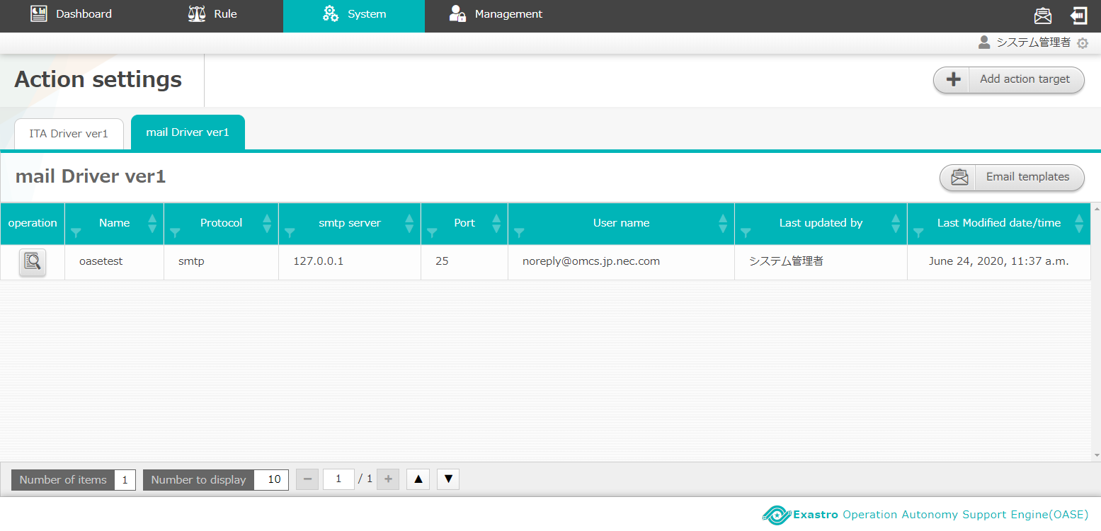
1.3 Screen description（Action setting screen）
The following functions are used in this quick start manual. （DashBoard > System > Action settings > mail Driver ver1）
③
①
④
②
■Function description
The name of the driver installed in OASE
The information of the registered action target
The button to add action target information to installed driver
The button to create mail template
Please refer to the manuals for details of the functions in each menu.

Slide 7
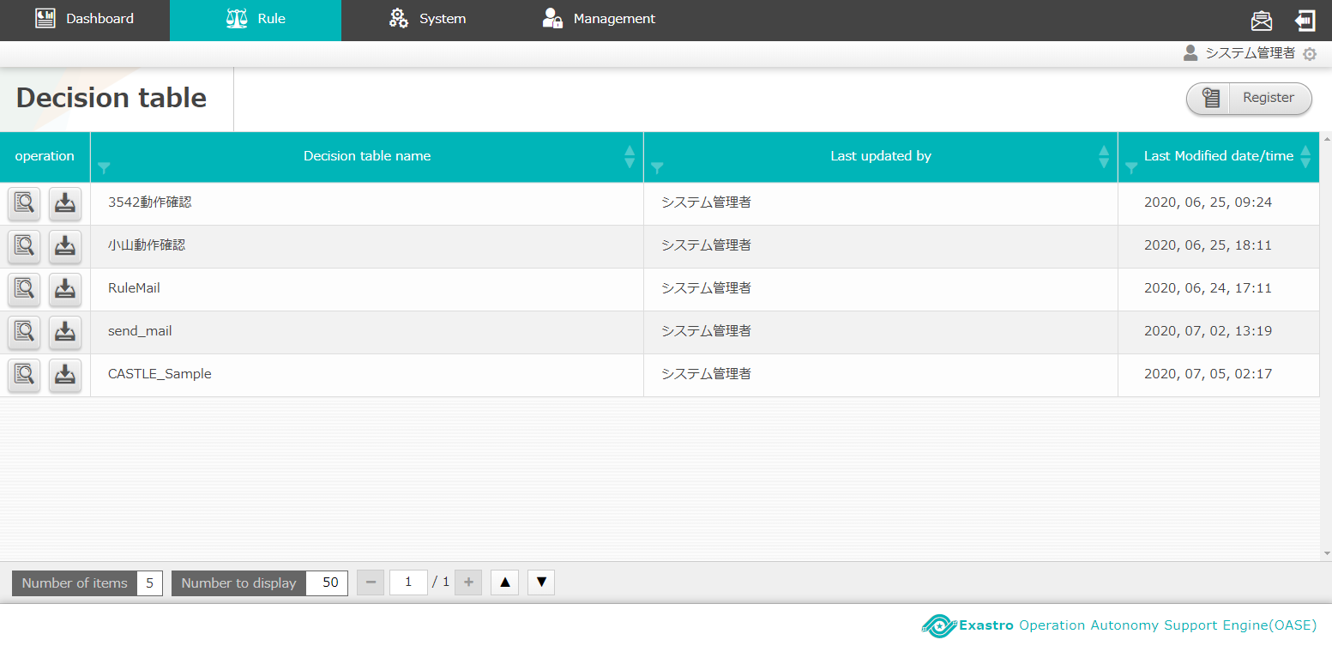
1.4 Screen description（Decision table screen）
The following functions are used in this quick start manual. （DashBoard > Rule > Decision table）
③
②
①
■Function description
The decision table registered in OASE
The button to download the decision table file
The button to move to register screen and create new decision table
Please refer to the manuals for details of the functions in each menu.

Slide 8
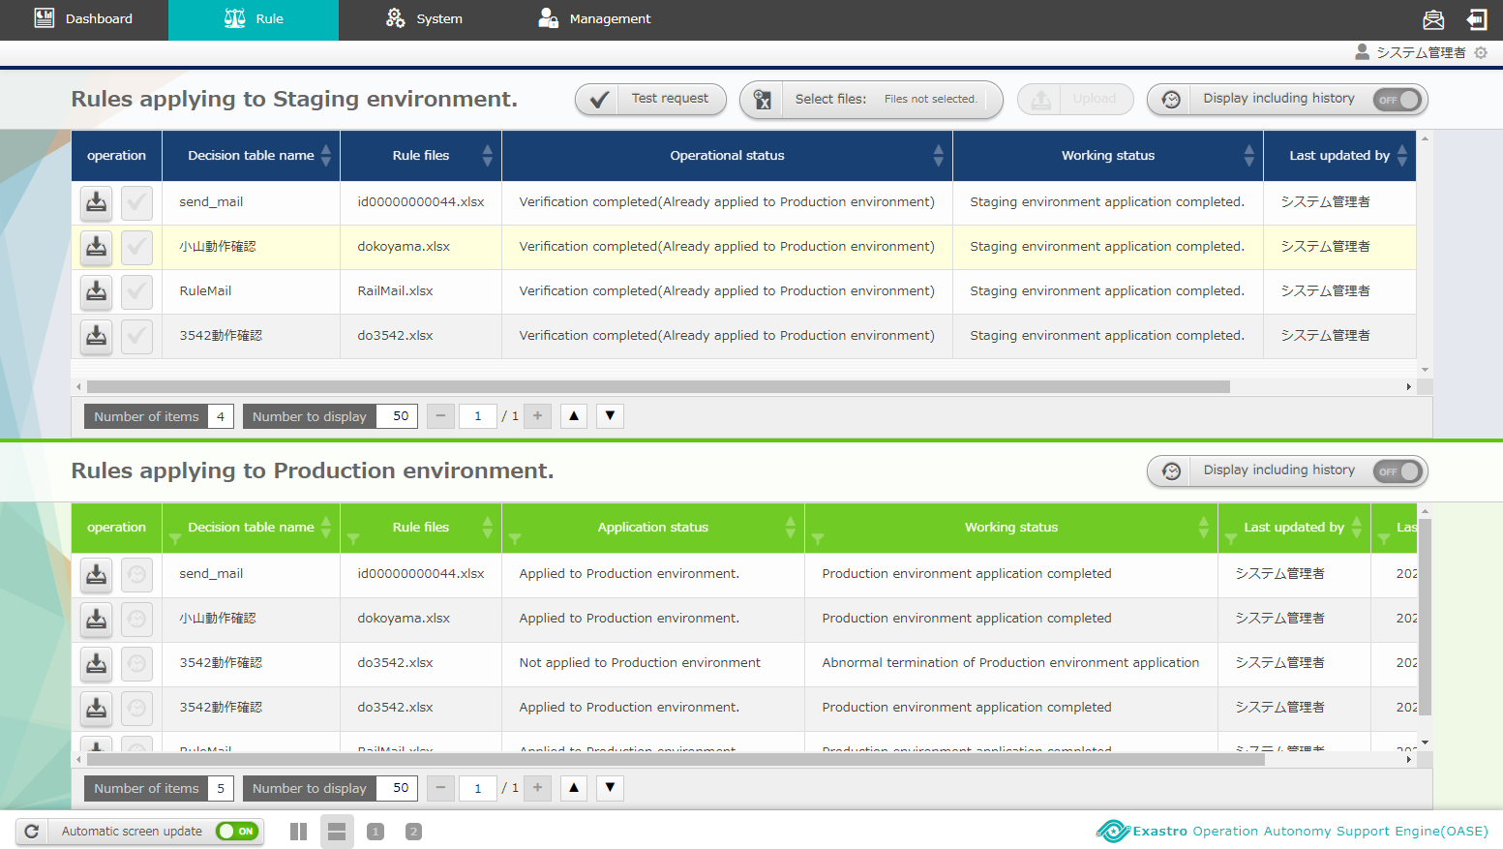
1.5 Screen description（Rule screen）
The following functions are used in this quick start manual. （DashBoard > Rule > Rule > Rules applying to Staging environment）
The “Apply” button will be enabled if the decision table has been uploaded to staging environment and applicable rules are found after performing test request.
①
②
③
■Function description
The button to operate the decision table file
The list of the uploaded decision table files and their status
The button to apply from staging to production environment
Please refer to the manuals for details of the functions in each menu.

Slide 9
1.5 Screen description（Rule screen）
The following functions are used in this quick start manual. （DashBoard > Rule > Rule > Rules applying to Production environment）
①
■Function description
The list of the rules that are practically operated when messages are sent to OASE
Please refer to the manuals for details of the functions in each menu.

Slide 10
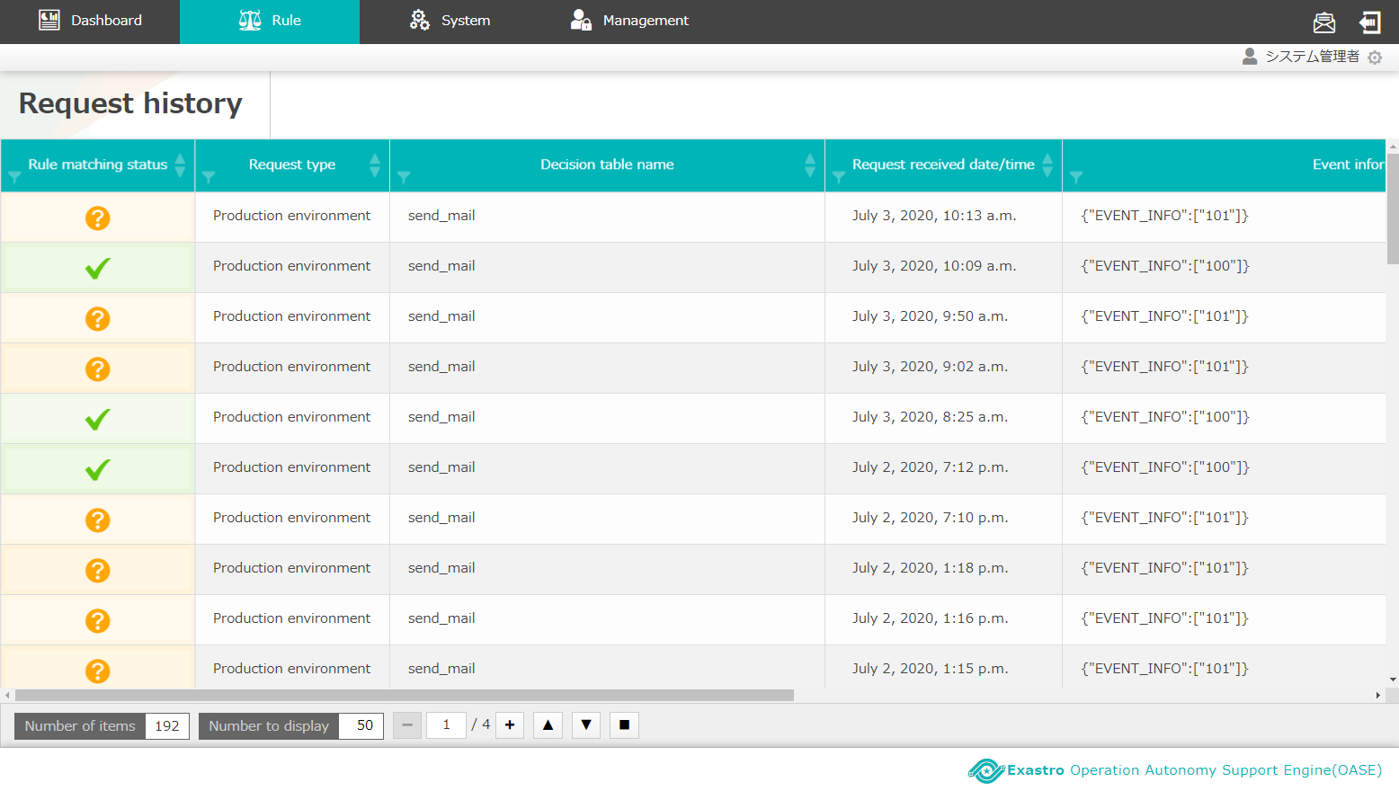
1.6 Screen description（Request history screen）
The following functions are used in this quick start manual. （DashBoard > Rule > Request history）
①
■Function description
The list of the matched rules and their status
Please refer to the manuals for details of the functions in each menu.

Slide 11
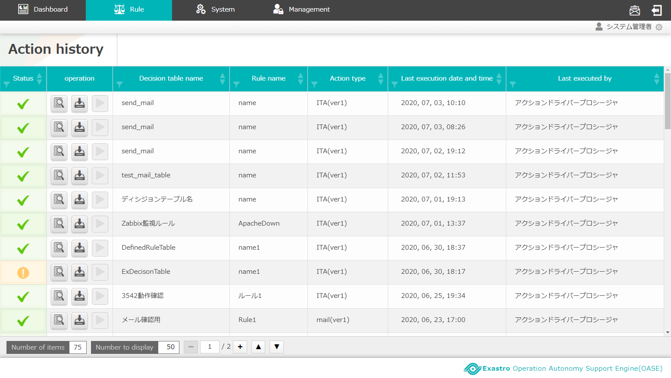
1.7 Screen description（Action history screen）
The following functions are used in this quick start manual. （DashBoard > Rule > Action history）
①
■Function description
The list of the matched rules and their status
Please refer to the manuals for details of the functions in each menu.

Slide 12
2. Scenario description

Slide 13
2.1 The scenario of this manual
Scenarios after OASE installation until action history being obtained.
Preparation
before
execution
１
Set mail driver and create mail template
２
Create decision table
３
Create decision table file ※In Excel
４
Upload decision table file
５
Test request
６
Apply to production environment
Operation
execution
７
Send request via curl command
８
Check the result of action execution
Preparation before execution includes driver setting and rule registration.
Operation execution includes sending messages to OASE to match rules and execute actions.

Slide 14
3. Preparation before execution

Slide 15
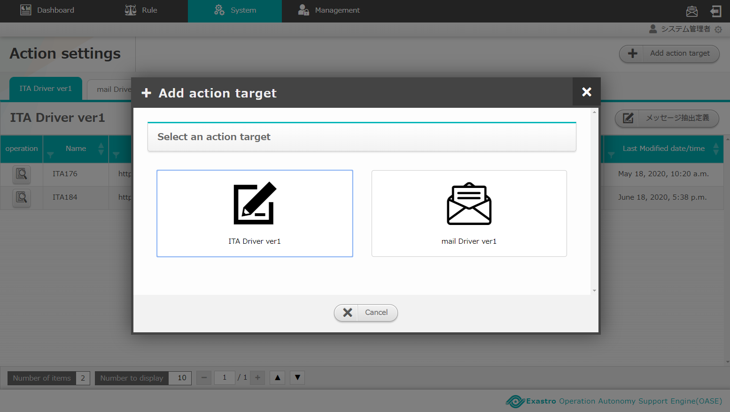
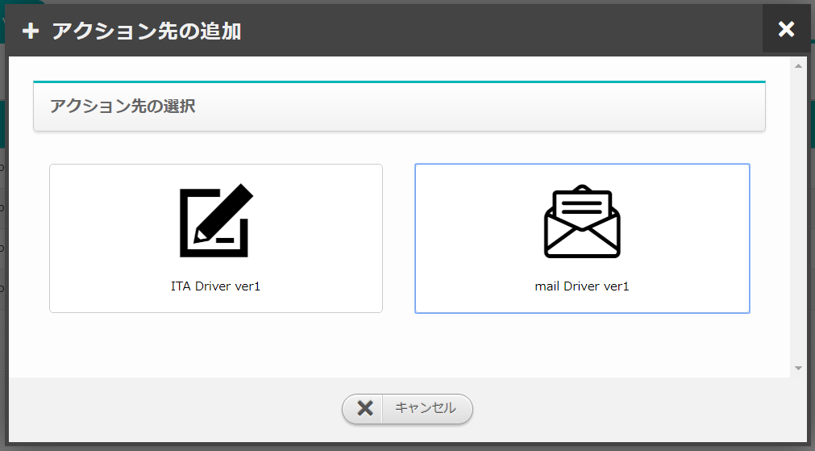
3.1 Set mail driver and create mail template (1/3)
Add action target
Click the “Add action target” button on the “Action settings screen”, them select “mail Driver ver1” in the “Select an action target” column.
Set mail driver and
create mail template
Create decision table
Create decision table file
※In Excel
Upload decision table file
Test request
Apply to production
environment
Send request via curl command
Check the result of
action execution
Please refer to <Environment construction manaul -Driver installation->
if the mail driver hasn’t been registered.

Slide 16
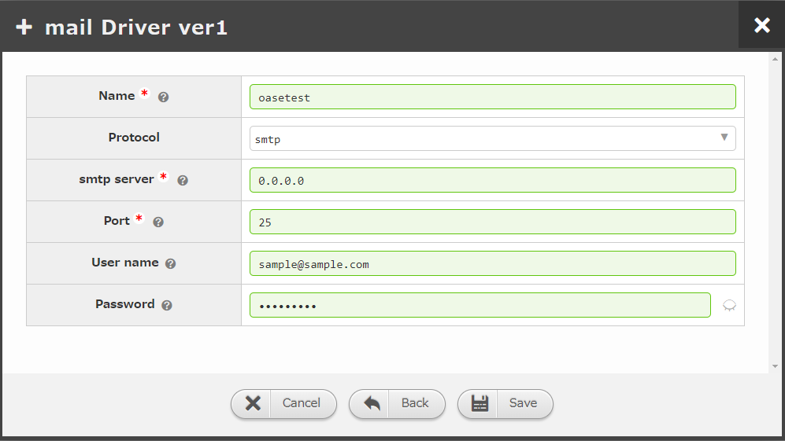
3.1 Set mail driver and create mail template (2/3)
Set action target
Enter required information then click the “Save” button.
Set mail driver and
create mail template
Create decision table
Create decision table file
※In Excel
“Item:name” is used to specify “Execute action to which action target” when creating the latter mentioned decision table file.
Upload decision table file
Test request
Item | Setting value
Name | Enter any desired action target name.
Protocol | Select either “smtp” or “smtp_auth”
Smtp Server | Enter private IP or global IP ※The SMTP server has to be prepared in advance
Port | Enter the port number used for communication
User name | Enter the user name as the mail sender.
Password | Enter the password required for authentication
Apply to production
environment
Send request via curl command
Check the result of
action execution
“Item:user name” is displayed as the sender of the mail.
Items with * are required items

Slide 17
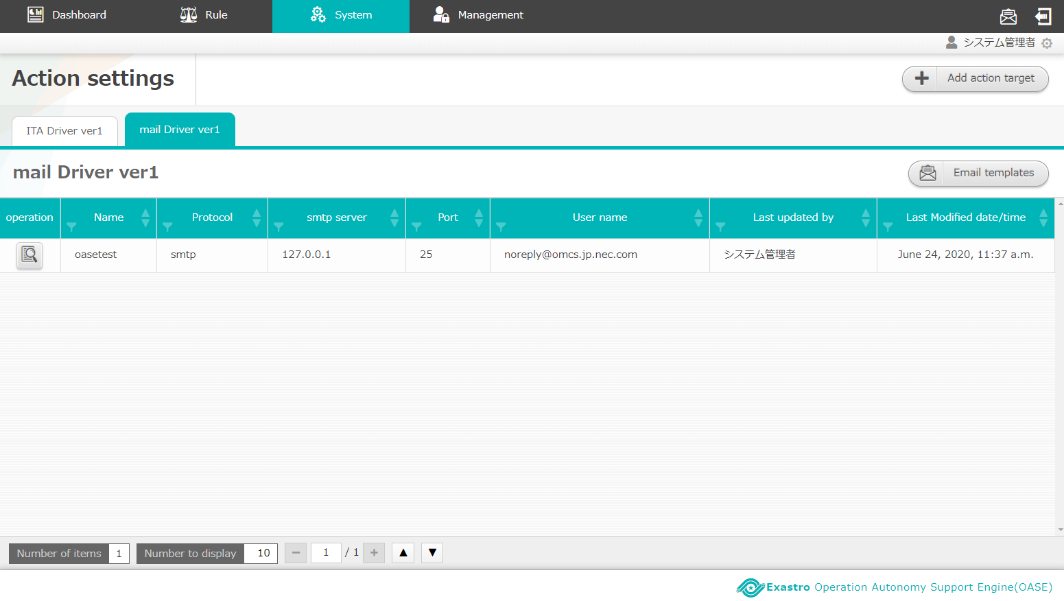
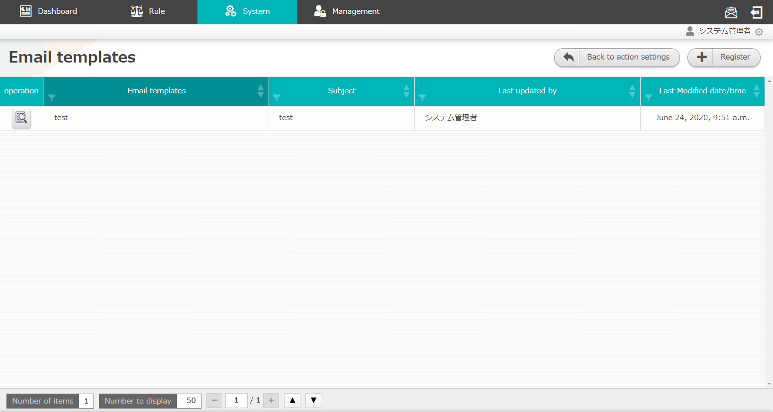
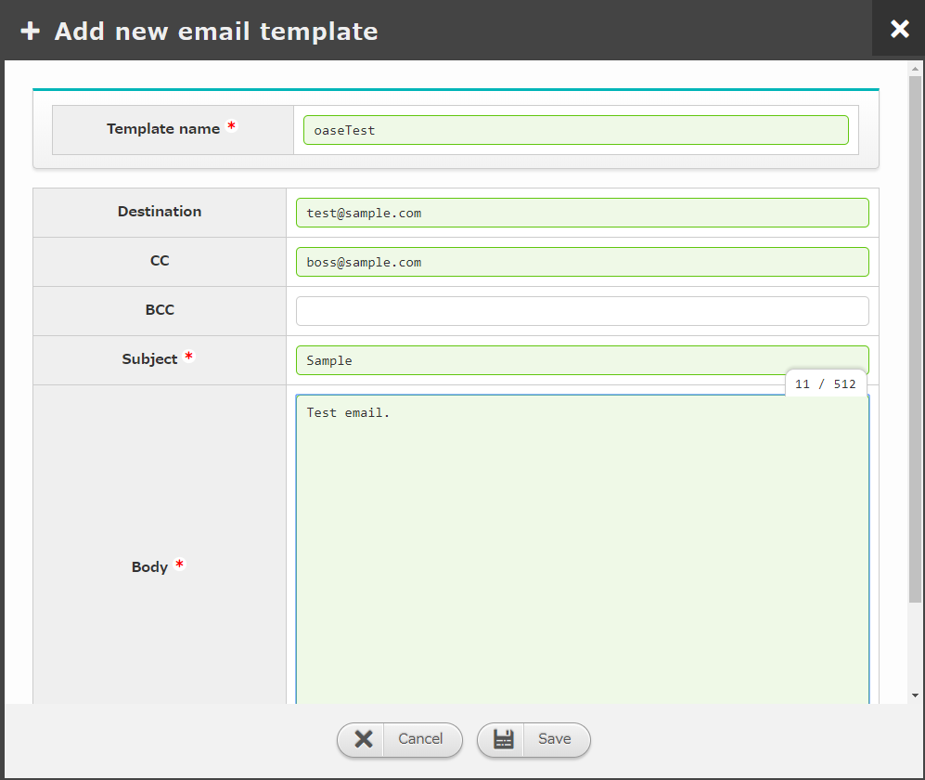
3.1 Set mail driver and create mail template (3/3)
Create mail template
Click the “Mail template” button then click the “Register” button.
Enter the required information in “Mail template register screen” then click the “save” button.
Set mail driver and
create mail template
Create decision table
Create decision table file
※In Excel
Upload decision table file
Test request
Apply to production
environment
Item | Setting value
Template name | Enter any desired template name
Destination | Enter destination mail address
CC | Optional
BCC | Optional
Subject | Enter any desired subject
Body | Enter any desired body context
Send request via curl command
Check the result of
action execution
“Item:template name” is used to specify “which mail template to use” when creating the latter mentioned decision table file.
Items with * are required items

Slide 18
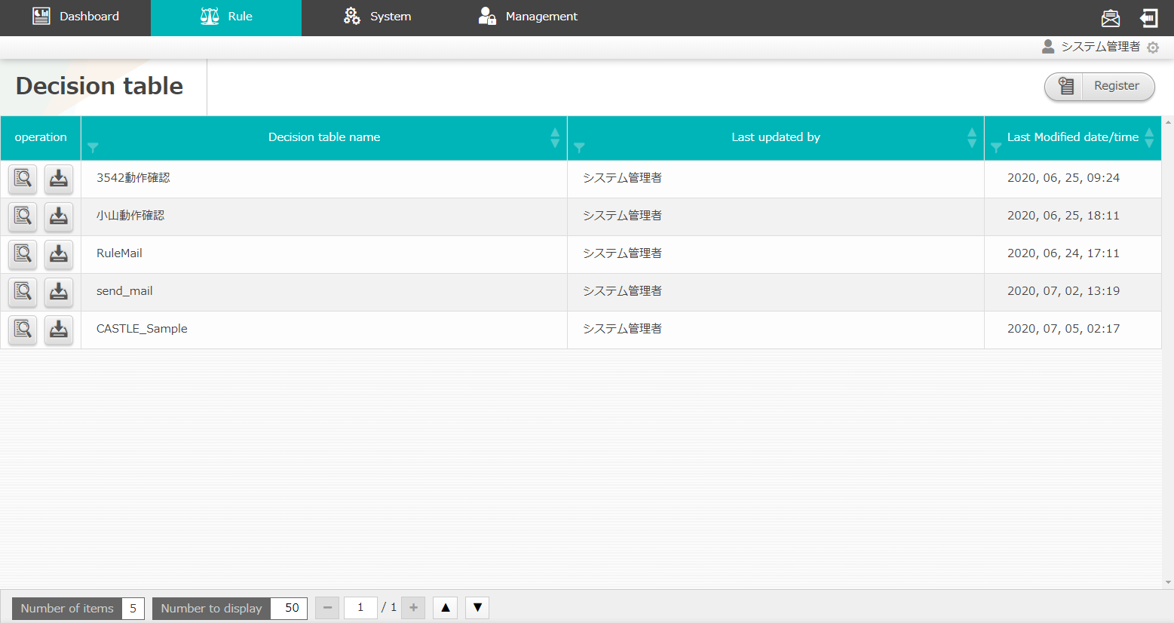
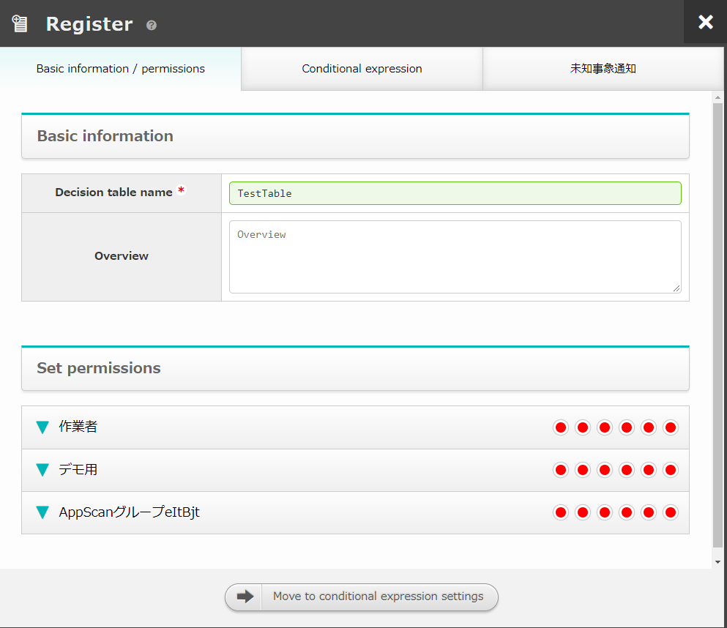
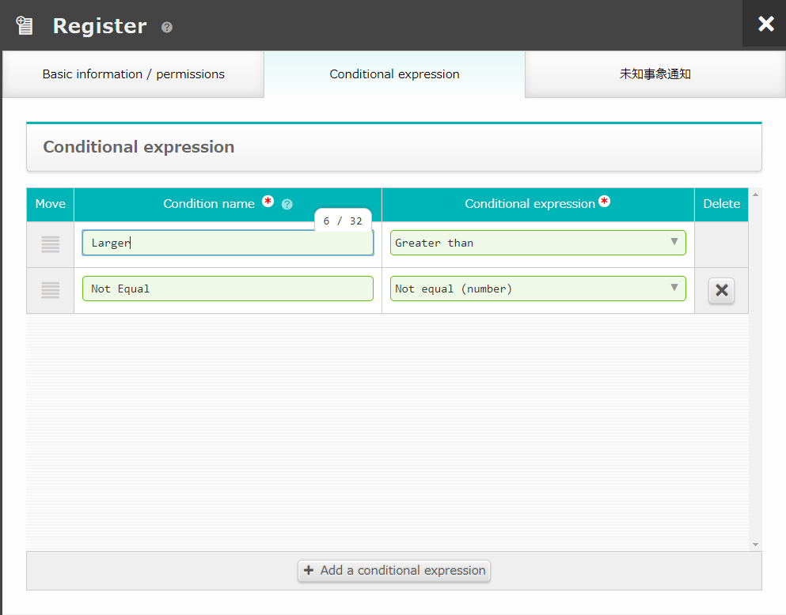
3.2 Create decision table
Create decision table
Click the “Register” button in “Decision table screen”, enter required information in “Basic information / permissions” tab and “Conditional expression” tab on the “Register” screen then click the “Save” button.
Enter any desired string for “Rule type” ,”RuleTable”, and “Condition name”.
Select “Coniditional expression” from the pulldown menu.
Set mail driver and
create mail template
Create decision table
Create decision table file
※In Excel
Upload decision table file
Test request
Apply to production
environment
Send request via curl command
Check the result of
action execution
“Item: Rule type” is handled as “created decision table name”
“Item: RuleTable” is handled as the “Decision table file name” as output excel file.
The specific value of the conditional expressions set here are set in the latter mentioned decision table file.
Items with * are required items

Slide 19
3.3 Create decision table file ※In Excel (1/2)
Download and create decision table file
Download the decision table created in “3.2 create decision table” by clicking the download button.
Set mail driver and
create mail template
Create decision table
Create decision table file
※In Excel
Upload decision table file
Test request
Apply to production
environment
Send request via curl command
Check the result of
action execution
The file name of the downloaded file
is the “Item: RuleTable” string entered in the previous page.
The details of each item will be described in the next page.

Slide 20
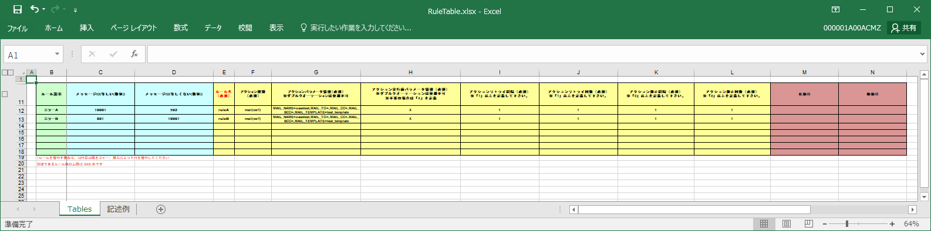
3.3 Create decision table file ※In Excel (2/2)
Enter the following content in the decision table file.
For practical usage example, please refer to “A Appendix Sample1”.
Set mail driver and
create mail template
Create decision table
①
②
③
④
Create decision table file
※In Excel
①Comment part | Can be empty. Enter description or other desired content.
②Condition part | Enter the condition which matches the rule.
③Action part | Set the action to be executed for each rule name. Users can set to execute action or send approval mail. Only the drivers set in “Action settings” screen can be entered in “action type”. （In this document, “mail Driver ver1” is set.) Please note that the format of “Action parameter information” is different for each action type.
④Action condition part | Can be empty. Users can set the time to enable and disable the rule.
Upload decision table file
Test request
Apply to production
environment
Send request via curl command
Check the result of
action execution
Please refer to the “Description example” sheet in the decision table file
For the way to describe the values.

Slide 21
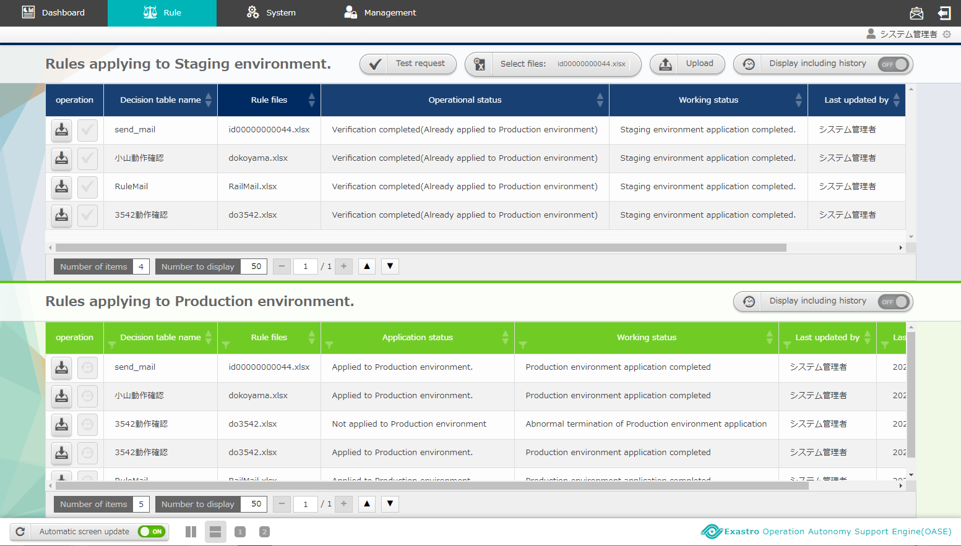
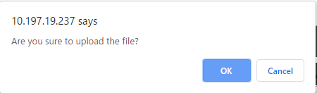
3.4 Upload decision table file
Select the decision table file to perform test request.
Click the “select file” button in the “Rule” screen then select the created decision table file.
Click the “Upload” button.
Set mail driver and
create mail template
①
②
Create decision table
Create decision table file
※In Excel
Upload decision table file
Test request
Apply to production
environment
Send request via curl command
Check the result of
action execution
File name is the string entered in the RuleTable column in <3.2 Create Decision table>.

Slide 22
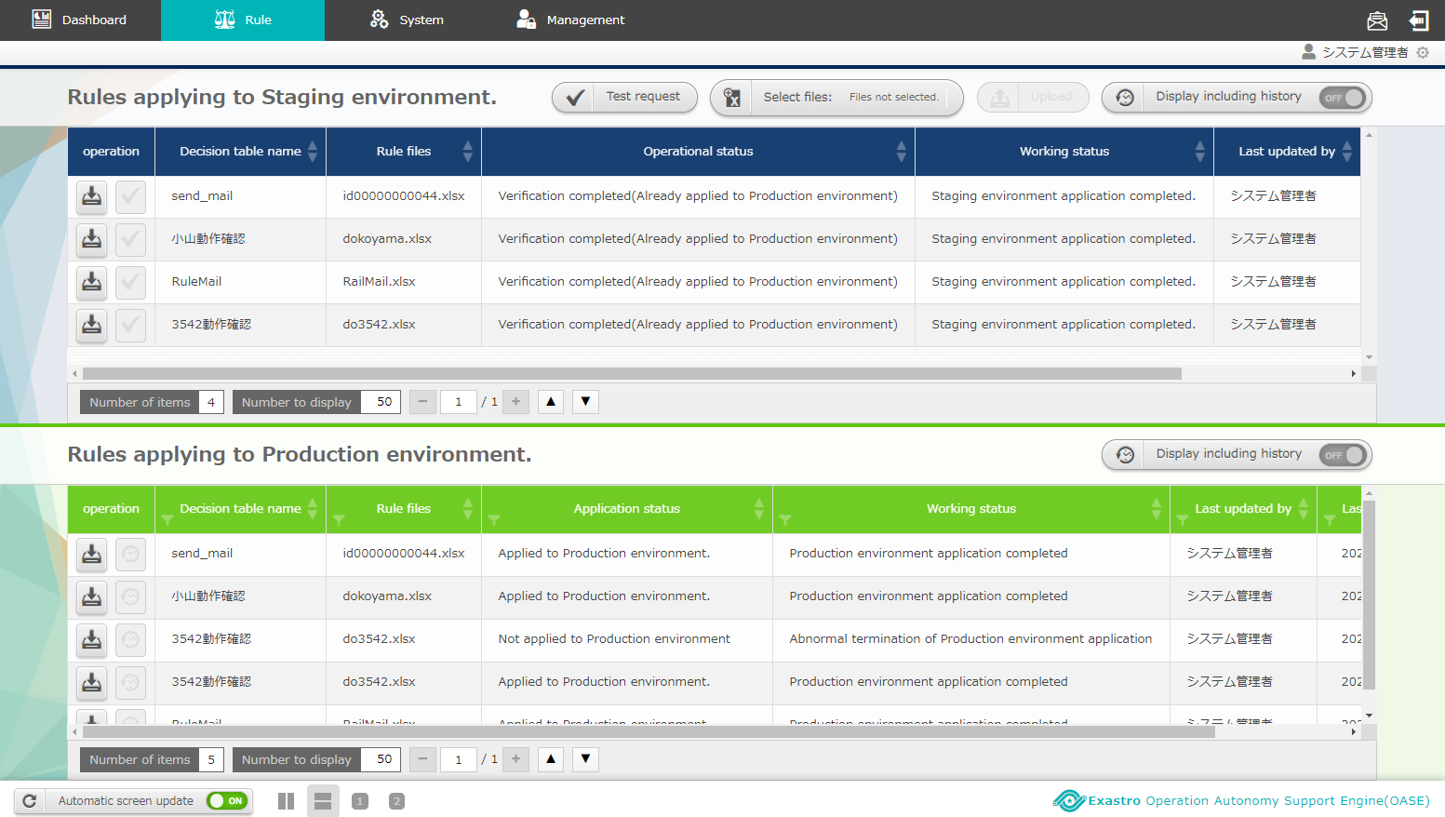
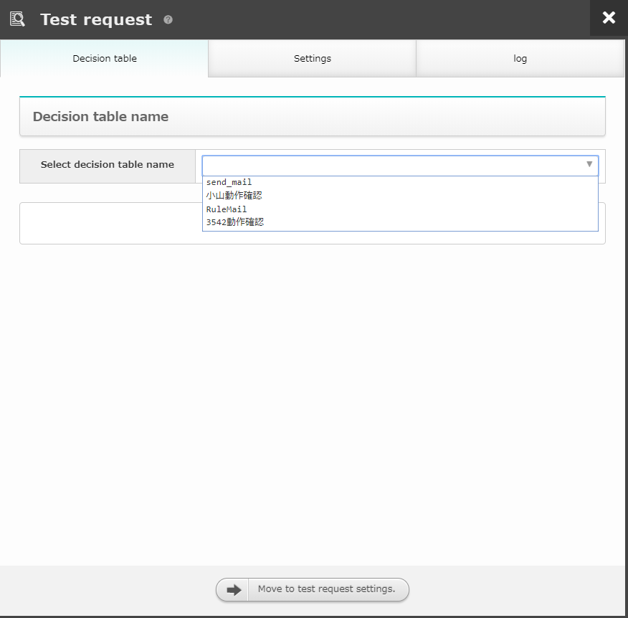
3.5 Test request (1/2)
Select test request target
Click the “Test request” button when the “Working status” columns becomes “Applied to Staging environment”.
Select the rule type to perform test in “Select rule type”,
then click the “Move to test request settings” button.
Set mail driver and
create mail template
Create decision table
Create decision table file
※In Excel
Upload decision table file
Test request
Apply to production
environment
Send request via curl command
Check the result of
action execution
The working status updates automatically every 5 seconds.
Please refer to <Instruction manual –Rule Screen- (1)Rule screen(Staging)> for the details of working status.

Slide 23
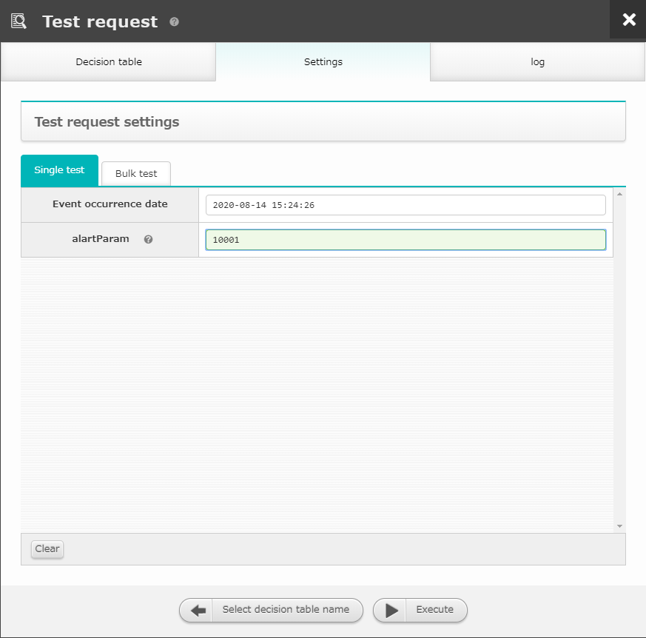


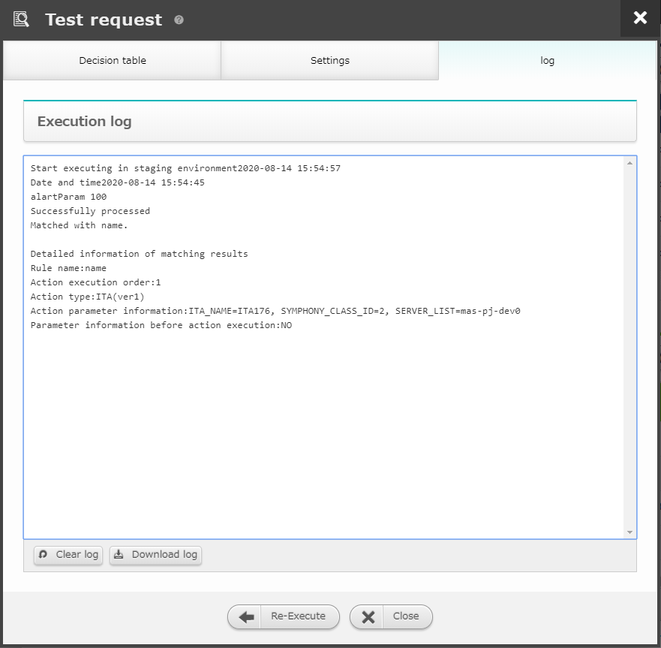

3.5 Test request (2/2)
Enter the value for the text, then execute to confirm that the rule is available.
Enter the value that matches the rule in the input field of “Single test” tab then enter the “Execute button.
Set mail driver and
create mail template
Create decision table
Create decision table file
※In Excel
Upload decision table file
Test request
Apply to production
environment
Send request via curl command
Check the result of
action execution
When matched the rules created in <3.3 Create decision table (Excel)>,
“Successfully processed” and “Matched” will be displayed in execution log.
When rule matched, “Operation status” will change to next state.

Slide 24
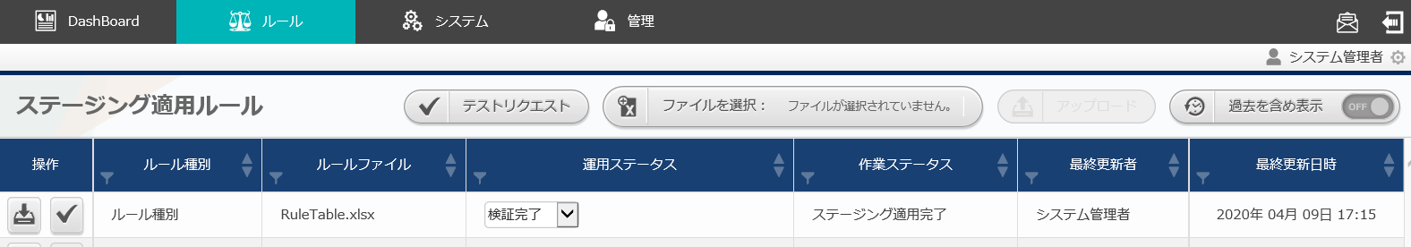
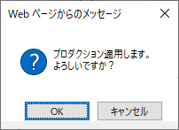
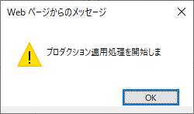
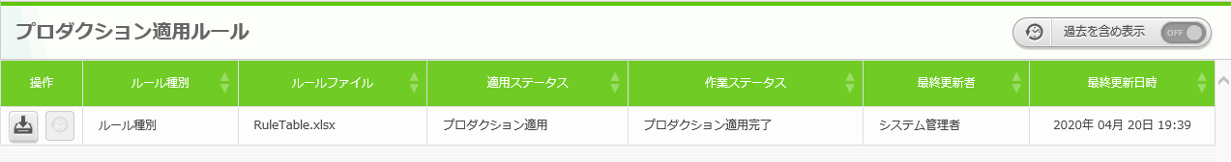
3.6 Apply to production environment
Make verified rules available in production environment.
To enable rule in production environment, apply the rule from “Rules applying to Staging environment” to “Rules applying to Production environment”.
When the test request matched the rule correctly, the operation
status in staging environment will change to “Verification completed”.
When the operation status in production environment becomes
“Applied to production environment after pressing the ”Apply” button,
the rule will be available in production environment.
Set mail driver and
create mail template
Create decision table
Create decision table file
※In Excel
Upload decision table file
②
①
Test request
Apply to production
environment
Send request via curl command
Check the result of
action execution
The operation status updates automatically every 5 seconds. Please refer to
<Instruction Manual -Rule Screen- (2)Rule Screen(Production)> for the details of operation status.

Slide 25
4. Operation execution

Slide 26
4.1 Send request via curl command (1/2)
Send the message and match the rule applied to production environment with the message
Open the terminal and execute after rewriting the following commands according to the rules.
See "A Appendix Sample 1" below for specific usage examples
of the curl command.
Set mail driver and
create mail template
curl -X POST -k “https://<①Host name>/oase_web/event/event/eventsrequest” -H “accept: application/json” -d “{\”ruletable\“:\“<②Ruletable name>\”,\”requesttype\“:\“<③Requesttype>\”,\”eventdatetime\“:\“<④event occurrence datetime>\”,\”eventinfo\“:[\“<⑤event info>\"]}"
Create decision table
Create decision table file
※In Excel
Upload decision table file
Item | Setting value
①Host name | Enter valid host name, IP address
②RuleTable name | Enter the rule file name applied to production environment(without .xlsx)
③Request type | Enter “1” since the target is “1:production environment” Example）,\"requesttype\":\"1\",
④Event occurrence datetime | Enter the time in”yyyy/mm/dd hh:mm:ss” format Example）,\"eventdatetime\":\"2020/01/01 01:01:01\",
⑤Event information | Specify in list format Example）[\“2\",\“foo\"]
Test request
Apply to production
environment
Send request via curl command
Check the result of
action execution
Please refer to <RestAPI Function Intstruction Manual> for the details of HTTP request.

Slide 27
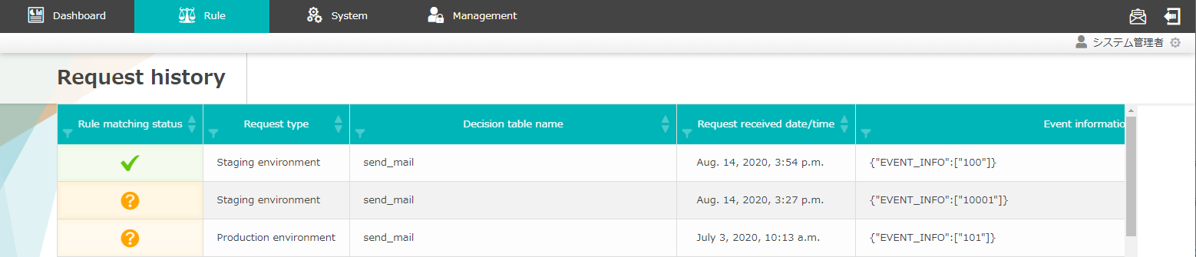
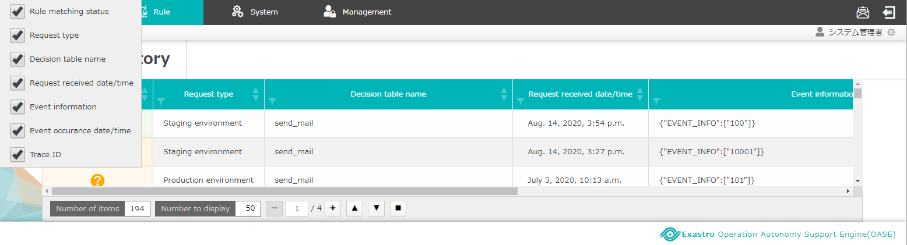
4.1 Send request via curl command (2/2)
Check the “request history” screen
A history of sending a request by specifying parameters with the curl command is added.
Items displayed in the “Request history” screen can be
changed.
Set mail driver and
create mail template
Create decision table
Create decision table file
※In Excel
Upload decision table file
Test request
Apply to production
environment
Send request via curl command
Check the result of
action execution

Slide 28
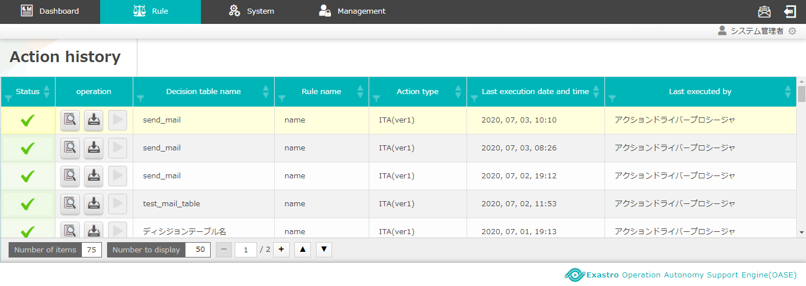
4.2 Check the result of action execution (action history)
Execute action
When rule is matched, action(mail notification) will be executed as users set in preparation before execution, and users can check the result in “Action history” screen.
Action will be executed as the specification in the action part of
<3.3 Create decision table file ※In Excel > （mail Driver will sent notification mail as user’s specification)
Mail notification
Mail with the receiver, title, body set in
<3.1 Set mail driver and create mail template> is sent.
Action history
Check if the rules are matched and executed are displayed in
“Action history” screen.
Set mail driver and
create mail template
Create decision table
Create decision table file
※In Excel
Upload decision table file
Test request
Apply to production
environment
Send request via curl command
Check the result of
action execution

Slide 29
A Appendix

Slide 30
Sample１(1/3)
Enter the sample value and execute OASE
Case: When OASE receive “MessageID: 10001”, execute a action to send a mail with information “Title:【OASE】Notification test”, “Body:[Request Info][Event Info]”
【Preparation before execution】
①「Action settings」 screen
Create the “Mail template” required when using mail template
 | ・Template name | ： test_template
 | ・Title | ： 【OASE】Notification test
 | ・Body | ： [ACTION_INFO] [EVENT_INFO]
 | （Register other required info）
Prepare action target driver 「mail Driver ver1」
 | ・Name | ： oasetest
 | （Register other required info）
②「Decision table」screen
The part introduced in<3.1 Set mail driver and create mail template>
and <3.2 Create decision table>
in this manual
Create the rule to match「message ID」
 | ・Rule type | ： Matching test
 | ・RuleTable | ： test
 | ・Condition name | ： message ID
 | ・Conditional expression | ： equal(value)

Slide 31
Sample１(2/3)
③「Decision table」file
Create a rule that “messageID:10001” will hit
 | ・MessageID（equal(value)） | ： | 10001
 | ・Action type | ： | mail(ver1)
 | ・Action parameter information | ： | MAIL_NAME=oasetest,MAIL_TO=,MAIL_CC=,MAIL_BCC=,MAIL_TEMPLATE=test_template
 | （Register other required information）
④「Rule（Rule applying to staging environment
⑤「Test request」screen
Test whether when request “MessageID:10001” matches the uploaded decision table or not
 | ・Select rule type | ： Matching test
 | ・MessageID | ： 10001
Upload the created decision table file
 | ・Select file | ： test.xlsx
The part introduced in<3.3 Create decision table file>,
<3.4 Upload decision table file>, <3.5 Test request>
in this manual

Slide 32
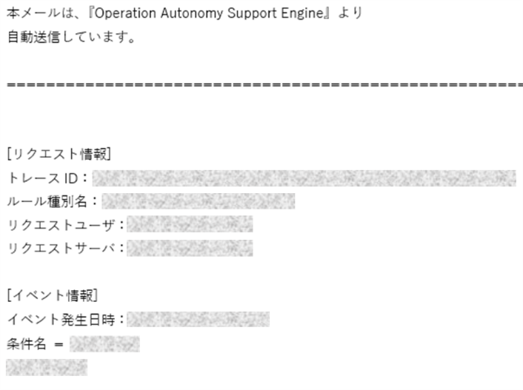
Sample１(3/3)
【Execute operation】
⑥Terminal operation （For Linux server）
Send request to the prepared rule via curl command ※Please change the part in red highlight
 | curl -X POST -k "https://<HostName>/oase_web/event/event/eventsrequest" -H "accept: application/json" -d "{\"ruletable\":\"test\",\"requesttype\":\"1\",\"eventdatetime\":\"2020/01/01 01:01:01\",\"eventinfo\":[\“10001\"]}"
⑦Mail
notification
Check if the
mail with
information
on the right
is sent.
Title：【OASE】Notification test Body： [Request information] Trace ID : Rule type name : Request user : Request server ： [Event information] Event occurance date time： Condition name ：
Image of
Notification
mail
The part introduced in<4.1 Send request via curl command>
and <4.2 Check the result of action execution (action history)>
in this manual

