Slide 1
Guided Project: Latent Denoising Diffusion Probabilistic Models
Introduction to Deep Learning Fall 2026
TAs:
Yixiong Fang
Kanping Liu

Slide 2
What an image generator learns
An image is a grid of pixels. Each pixel stores color information.
A neural network learns patterns from examples by adjusting its internal numbers, called weights.
Training uses many real images to learn patterns such as shapes, textures, and object parts.
Generation, also called sampling, uses the trained model to create a new image. The model keeps its learned weights while it generates.

Slide 3
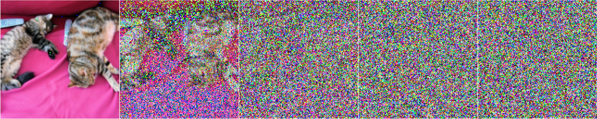
The idea behind diffusion
Add noise to an image. Learn to reverse the process.
Clean image
Increasing noise
Almost pure noise
To generate a new image, start from fresh noise and denoise.
Figure: Rogge & Rasul, The Annotated Diffusion Model, Hugging Face (2022)

Slide 4
Noise and denoising
Noise is random variation added to the pixel values. It makes an image look grainy and gradually hides its structure.
The noise level tells us how much of the original image remains visible. A timestep identifies a level in the noise schedule.
Denoising means estimating how to move a noisy image toward a cleaner, more plausible image.
At high noise levels, many clean images could fit. The model uses patterns learned during training to guide each update.

Slide 5
What you will build
You will train a model to generate new images resembling the ImageNet-100 training set.
First, build a working DDPM. This baseline gives you a starting result to compare later improvements against.
Then make generation faster and move the model into a smaller representation of each image.
Finally, let a user choose an image category. Measure the results and explain which changes helped.

Slide 6
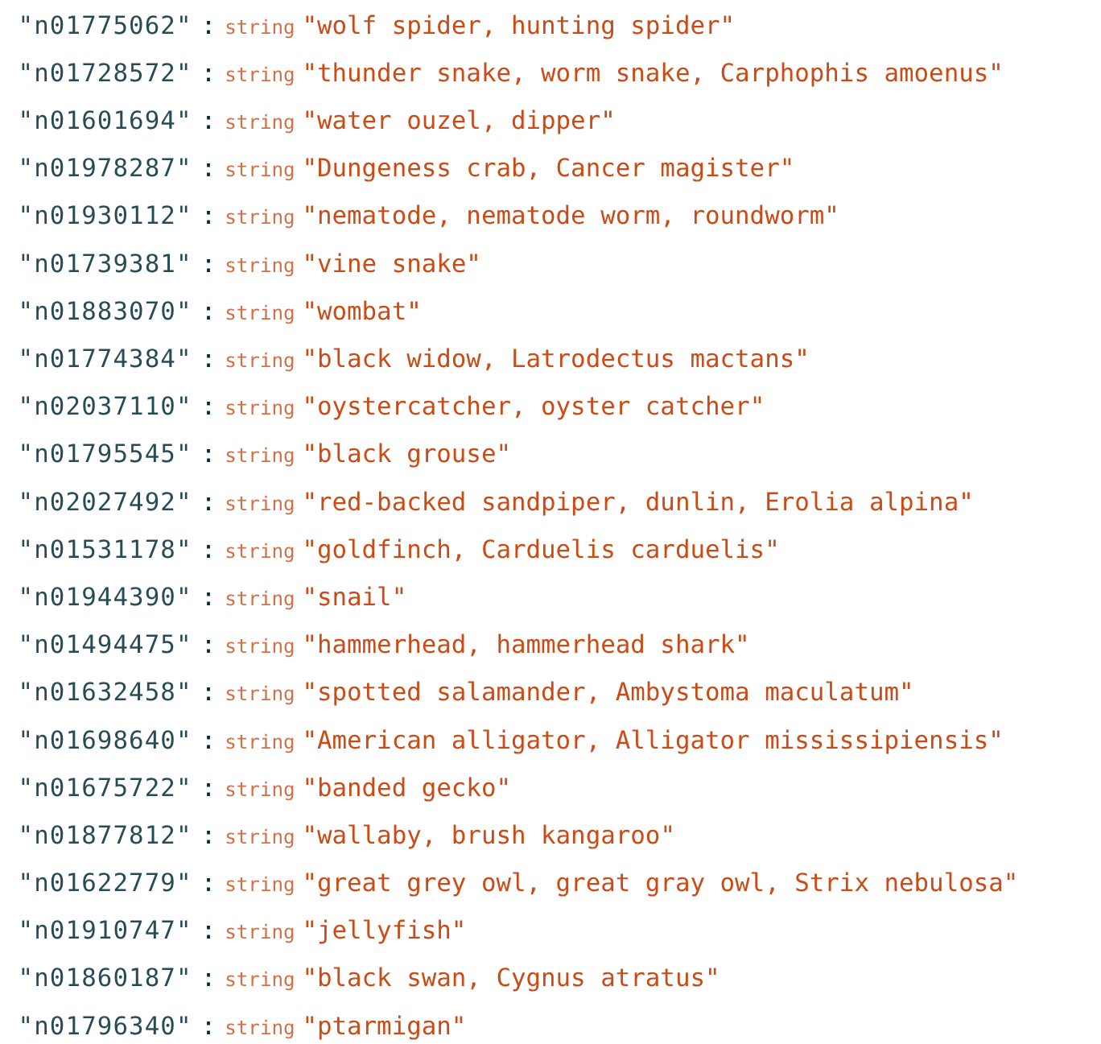
Your dataset: ImageNet-100
About 130,000 images at 128 by 128 pixels.
100 classes, meaning 100 categories of animals or objects.
Training images teach the model.
Validation images provide a separate reference for evaluation.

Slide 7
The project roadmap
DDPM: learn to generate images through repeated denoising.
DDIM: reuse the trained model with fewer generation steps.
Latent diffusion: use a VAE to denoise compressed image representations.
Classifier-free guidance: steer generation toward a chosen class.
Evaluation and exploration: measure every stage and test improvements.

Slide 8
DDPM: the baseline model
DDPM means Denoising Diffusion Probabilistic Model. It generates images through many small denoising steps.
For training, take a real image and add noise yourself. You now know exactly which noise the model should predict.
The prediction error is called the loss. Backpropagation helps update the network weights to reduce that error.
After training, reuse the same network at each generation step. It helps turn a fresh noise sample into an image.

Slide 9
The U-Net: the noise predictor
The U-Net is the neural network inside your diffusion model. It receives a noisy image and its current noise level.
One path reduces the image size to recognize broader patterns. Another path returns to the original size.
Connections between the paths carry fine details forward. The output is an estimate of the noise in the input.
Your task: assemble the supplied network modules and train them to make accurate noise predictions.

Slide 10
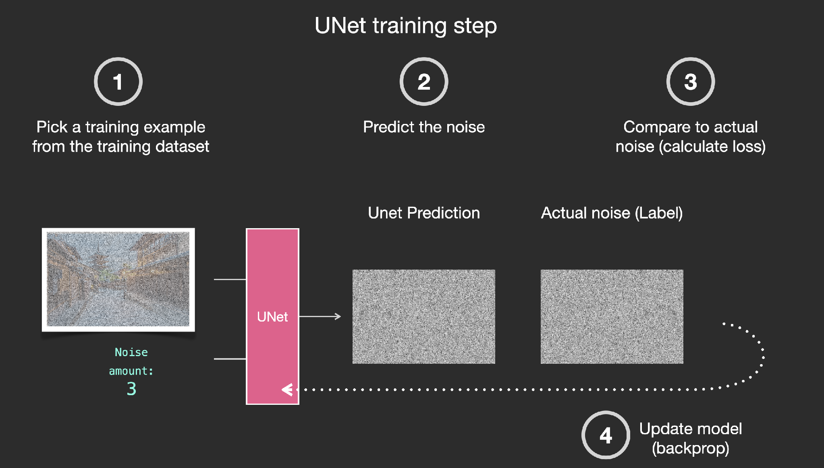
DDPM: learning to denoise
Figure: Jay Alammar (2022), CC BY-NC-SA 4.0

Slide 11
The noise scheduler
A noise schedule sets the noise levels used by the diffusion process. The scheduler applies the rules for those levels.
During training, it adds the chosen amount of noise to a clean image. The U-Net then learns to predict that noise.
During generation, it uses the prediction to compute the next, less noisy image. DDPM also adds randomness in most steps.
Your task: implement noise addition and the sampling updates, then connect the scheduler to the U-Net.

Slide 12
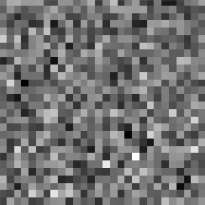
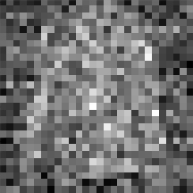
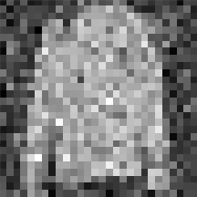
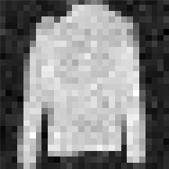

DDPM: generating an image
A new image emerges through repeated denoising.
Random noise
Repeated denoising
New image
Your task: connect the trained U-Net and scheduler for generation.
Example: Rogge & Rasul, Hugging Face (2022). Selected frames from their sampling animation.

Slide 13
DDIM: fewer denoising steps
DDIM means Denoising Diffusion Implicit Model. It offers another way to generate images with your trained noise predictor.
Its sampling rule supports larger jumps between noise levels, so generation can use fewer network evaluations.
The deterministic setting adds no fresh randomness during the steps. The same starting noise and settings give the same result.
Your task: implement the DDIM scheduler. Compare how changing the number of steps affects speed and image quality.

Slide 14
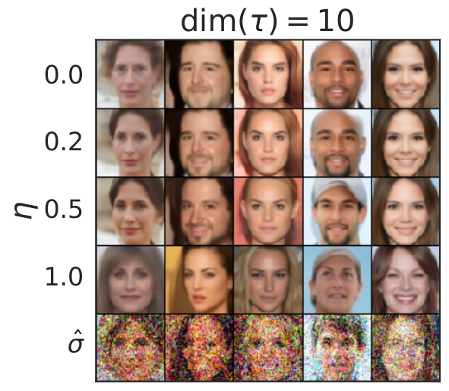
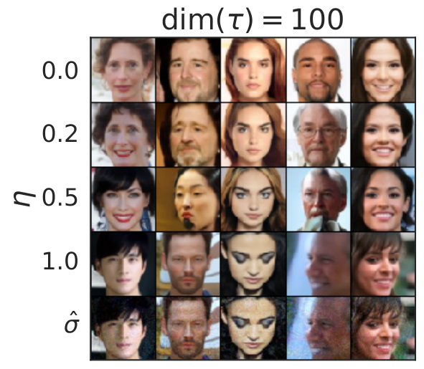
DDPM and DDIM samples
Reuse the trained model with fewer sampling steps.
10 steps
100 steps
DDPM
DDIM
Your task: implement DDIM and compare speed with image quality.
Paper examples: Song, Meng & Ermon, DDIM (2021), Fig. 3 (cropped)

Slide 15
VAE and latent space
VAE means Variational Autoencoder. It compresses an image into learned numbers, called a latent representation.
The encoder creates this representation. The decoder reconstructs an image from it, sometimes losing fine details.
Latent space is the space of these compact representations. Diffusion works on them to reduce computation.
The project supplies a VAE that is already trained. You implement encoding and decoding for the diffusion model.

Slide 16
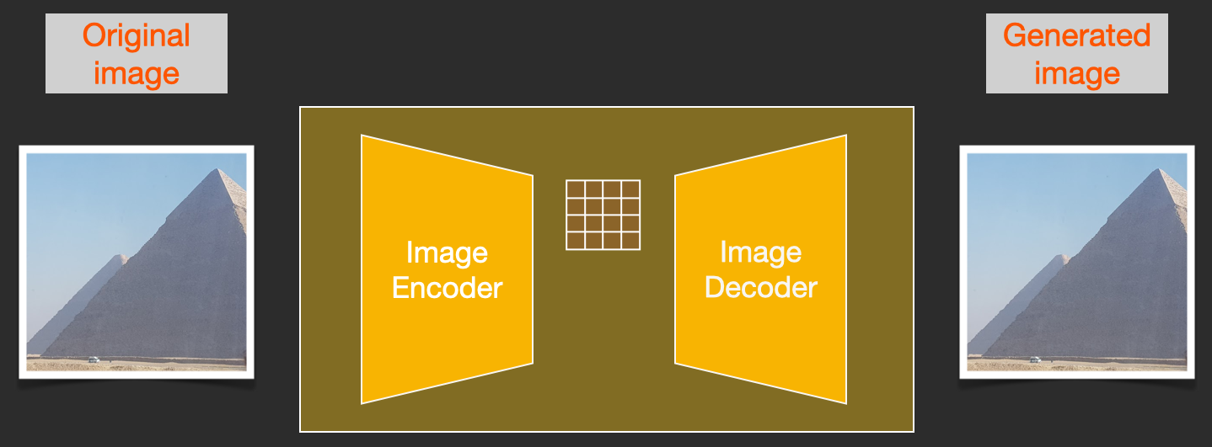
VAE: compressing images
Compress an image into a small representation, then reconstruct it.
Figure: Jay Alammar (2022), CC BY-NC-SA 4.0

Slide 17
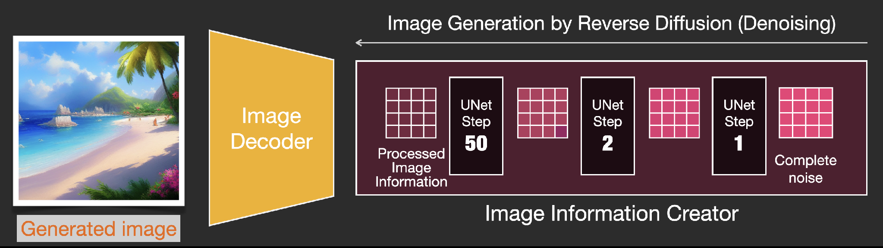
Latent diffusion: your VAE task
Training adds noise to encoded images. Generation denoises fresh latent noise, then decodes it.
Your task: encode, decode, and keep the supplied latent scaling.
Figure: Jay Alammar (2022), CC BY-NC-SA 4.0 (generation portion cropped)

Slide 18
Class conditioning
Unconditional generation asks for any image resembling the training set. You do not choose its category.
Conditional generation also supplies a class label, such as an animal category, to tell the model what to generate.
During training, the model sees images together with their labels and learns how each category affects denoising.
For classifier-free guidance, sometimes hide the label during training. This teaches the same network to predict noise with or without it.

Slide 19
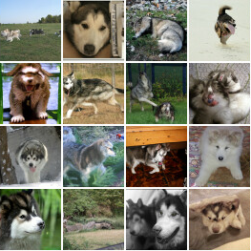
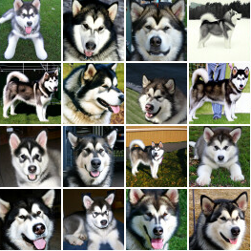
Classifier-free guidance
Class labels steer generation. Here, the requested class is “malamute.”
Class label only
With stronger guidance
Stronger guidance emphasizes the class, often reducing variety.
Paper examples: Ho & Salimans, Classifier-Free Diffusion Guidance (2022), Fig. 6 (cropped)

Slide 20
How classifier-free guidance works
At each generation step, run the same network twice: once with the chosen class and once without it.
The difference between the predictions shows how the class changes denoising. Emphasize this difference to steer the image.
Guidance strength controls this emphasis. Stronger guidance can make the class clearer, but reduce variety or add visual errors.
Your task: combine both predictions. You need no separate classifier, a network that predicts image categories.

Slide 21
Evaluating your results
Fréchet Inception Distance (FID)
An image-recognition network summarizes visual patterns in each image. FID compares these summaries across real and generated image sets. Lower is better.
Inception Score (IS)
An image classifier assigns categories to generated images. IS rewards confident predictions and a varied mix of predicted categories across the set. Higher is better.
Inspect sample images alongside both scores.

Slide 22
Comparing your experiments
Save a grid of generated images for each method. Look for recognizable objects, visual errors, and repeated-looking samples.
Use the same evaluation setup and number of images when comparing FID and IS. For speed, also keep the hardware consistent.
Record sampling time and the number of denoising steps. A faster method is useful only if its output quality meets your needs.
An ablation changes one component at a time. This helps explain which choice caused an improvement or a failure.

Slide 23
Exploring improvements
Change the noise schedule to test how the model learns from different amounts of corruption.
Try a larger U-Net or a Diffusion Transformer. The latter uses attention so image or latent patches can share information.
Learn the reverse-process variance to adjust the randomness in denoising updates. Compare the result with your baseline.
Use only the provided dataset. Train diffusion weights from scratch and use the supplied VAE.

Slide 24
Kaggle submission
Generate 5,000 images. With class guidance, generate 50 images for each of the 100 classes.
The supplied helper uses an image-recognition network to summarize the visual features of your generated images.
It saves the feature statistics in a CSV file. Submit that CSV to the course Kaggle competition.
Kaggle compares your statistics with a hidden set of real images using FID. A lower score indicates a closer match.

Slide 25
What you will submit
Midterm report: explain your DDPM and DDIM implementations and present their results.
Presentation video and Kaggle submission: describe your approach and submit the required image statistics.
Final report and code: cover every required stage and your advanced experiments. Include FID and IS for each stage.
Show sample images and record important settings. Explain what worked, what failed, and what you learned from comparisons.

Slide 26
Sharing your findings
The course is comparing diffusion training strategies across students and semesters.
Describe your methods and hyperparameters clearly so results can be compared.
Report FID and IS for each experiment or ablation.
Strong, well-documented work may contribute to a shared paper and potential co-authorship.

Slide 27
Getting started
Download the starter code and dataset. Confirm that you can load images and view their class labels.
Complete the DDPM training and sampling path first. Save generated samples as training progresses.
Add DDIM, then latent diffusion, then class guidance. Keep a working checkpoint, which is a saved copy of the model weights.
Evaluate every stage and record its settings. A lower noise-prediction loss alone does not guarantee better generated images.

Slide 28
Questions?

