Slide 1

Analysis Tool for Water Supply Management
Work developed by:
João Afonso Santos up202108805
João Pedro Silva up202208936

Slide 2
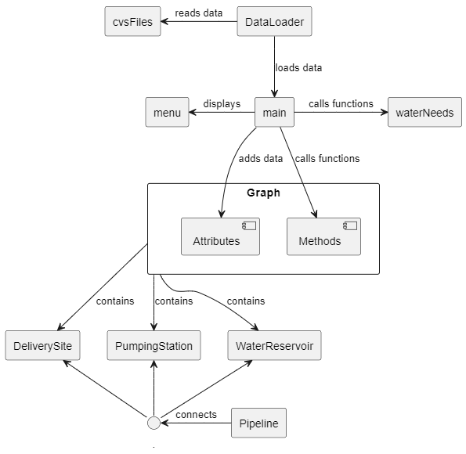
Class Diagram

Slide 3
Description of the reading of the datasets
The reading of the data provided in the .csv files was carried out through 4 functions belonging to the DataLoader class that provide reading of the data through the getline function, storing it in the appropriate data types. Each time the program is started, the functions are called, loading all the data, making it easy and simple to access and use for various purposes.

Slide 4
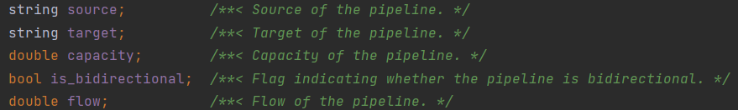
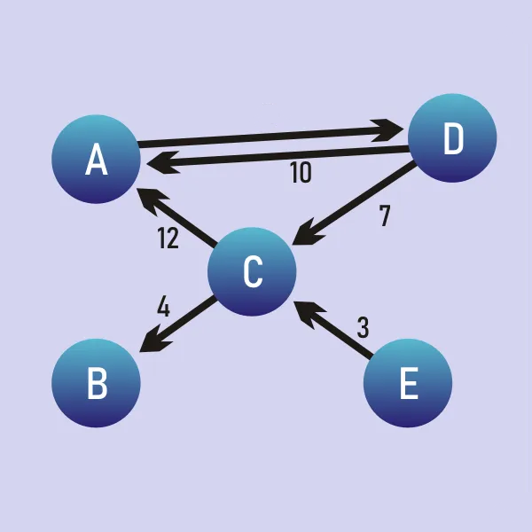
Description of the graph
Our graph is directed and was implemented using an edge list, the edges being the pipelines.
The Pipeline class has the following attributes:
For this example, the edge list would be as follows:
Source | Target | Capacity | Is_Bidirectional
A | D | 10 | True
B | A | 12 | False
C | B | 4 | False
D | C | 7 | False
E | C | 3 | False
With the flow attribute being determined by a function we developed and depending on the of type of each node.

Slide 5
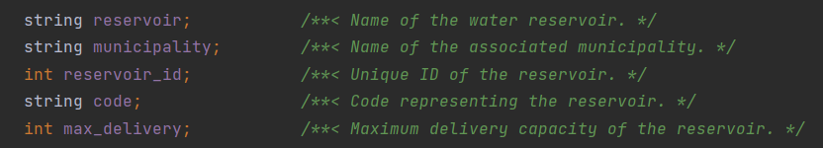
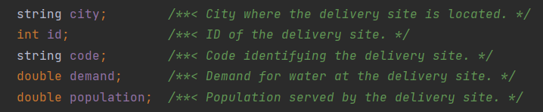
Description of the graph (continuation)
Each node represents a structure, there being 3 different types, each with its own class and attributes:
Water Reservoir:
Pumping Station:
Delivery Site:

Slide 6
Description of implemented functionalities and associated algorithms (and graphs)
This function performs a Breadth-First Search (BFS) from a source water reservoir to a target delivery site. It finds all the paths from the source to the target in the graph. It also keeps track of the minimum flow along each path..
Time complexity: O(V+E)
This function implements the Edmonds-Karp algorithm to find the maximum flow from a source water reservoir to a target, or sink, delivery site. It creates a copy of the graph and then runs the bfs() function on it for each water reservoir. The maximum flow from each reservoir to the delivery site is added to the total flow.
Time complexity: O(V*E^2)

Slide 7
Description of implemented functionalities and associated algorithms (and graphs) - continuation
This function calculates the maximum amount of water that can reach each city or a specific city using the Edmonds-Karp algorithm. It iterates over all source-sink pairs and calculates the maximum flow from the source to the sink (the sources being the water reservoirs and the sinks being the delivery sites, leaving the pumping stations as intermediate nodes). If the flow is greater than the current maximum flow for the sink, it updates the maximum flow.
Time complexity: O(R*C*V*E^2)
This function simulates the rupture of each pipeline in the network and determines which cities would be affected by each rupture. It uses the Edmonds-Karp algorithm to calculate the maximum flow to each city after each pipeline rupture.
Time complexity: O(V*E^3)

Slide 8
Description of implemented functionalities and associated algorithms (and graphs) - continuation
This function calculates the water deficit for each city in the network. It iterates over all pipelines and adds their capacity to the total water supply for each city. Then it iterates over all cities and checks if the total water supply is less than the city's demand. If it is, the city and its water deficit are added to the list of cities with a deficit.
Time complexity: O(P+C)
This function balances the load across all pipelines in the network. It calculates the difference between the capacity and the flow of each pipeline and tries to minimize this difference. It does this by increasing the flow in pipelines with a flow less than the average flow until the total flow equals the total capacity or the pipeline's flow equals the average flow.
Time complexity: O(R*C*V*E^2)

Slide 9
Description of implemented functionalities and associated algorithms (and graphs) - continuation
This function updates the water reservoirs in the graph. It iterates over the provided map of reservoirs and updates the corresponding reservoir in the graph.
Time complexity: O(R)
This function calculates the water deficit for each city in the network after a specific water reservoir is removed. It first removes the specified reservoir from the graph. Then, for each city in the graph, it calculates the maximum flow to the city using the maxFlow() function. If the maximum flow is less than the city's demand, it adds the city and its water deficit to an unordered map of affected cities.
Time complexity: O(C*V*E^2)

Slide 10
Description of implemented functionalities and associated algorithms (and graphs) - continuation
This function calculates the cities that would be affected if each pumping station were temporarily taken out of service. It creates a copy of the graph for each water reservoir and removes the reservoir from the copy, then calculates the maximum flow to each city in the copied graph. If the maximum flow is less than the original maximum flow, the city is added to the list of affected cities.
Time complexity: O(Ps*V*E^2)
Key:
V – Vertices
E – Edges
P – Pipelines
C – Cities
R – Water Reservoirs
Ps – Pumping Stations

Slide 11
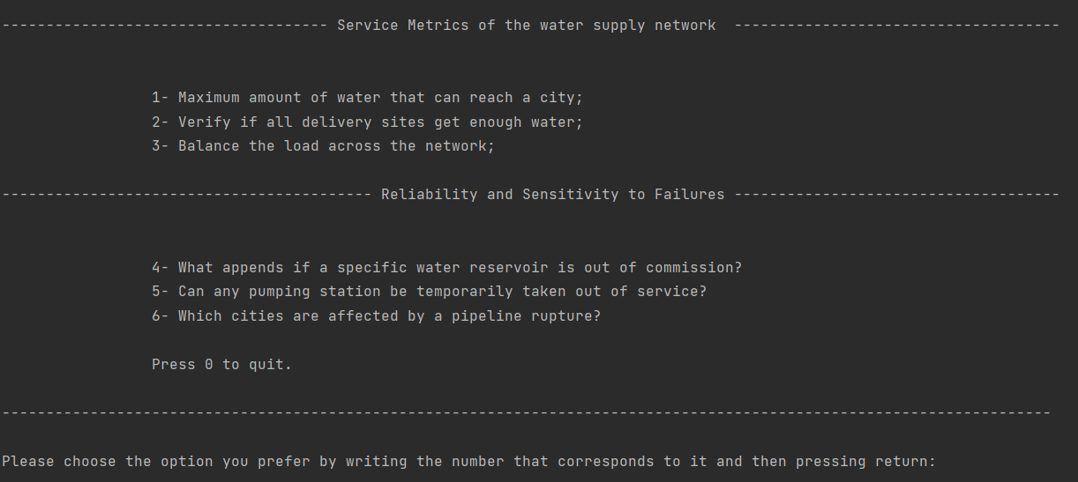
Interface
Main menu with various sub-menus where the user is able to choose the operation to perform.

Slide 12
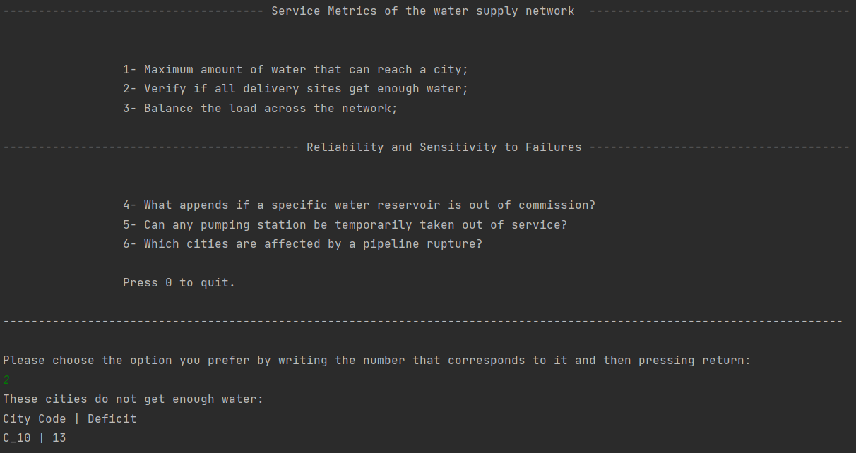
Interface – example of use

Slide 13
Main Difficulties
Our greatest difficulty relied mainly on developing the maxFlow() function. It was essential for the whole project, but we just didn’t seem to get it right.
Members Participation
João Afonso:
Creation of the Graph
T1.2
T3.1
T4.1
João Pedro:
T1.3
T2.3
T3.3
T4.1
Bernardo:
T1.1
T1.3
T2.1
T2.2
T3.2

