Slide 1


Azure Cost Management by Cloudyn
Sarah Lean
Cloud Solution Architect
Sarah.Lean@Microsoft.com
@TechieLass

Slide 2

Sarah Lean
Cloud Solution Architect
Microsoft
IT Admin since 2005
Blogger
Geek
Glasgow Azure User Group Founder
Photographer
www.techielass.com
@TechieLass

Slide 3
Objectives
What is Azure Cost Management
Get the best out of it

Slide 4
With Cost Management, you can:
Monitor cloud
spend
Drive organizational
accountability
Optimize cloud
efficiency
Across your multi-cloud environment
Notes:
With Azure Cost Management, you can:
With Azure Cost Management, you can now manage cloud spend in three main ways:
Monitor cloud spend
Drive organizational accountability
Optimize cloud efficiency
…across your entire multi-cloud environment.
Let’s unpack each one of these, starting with monitoring your cloud spend.

Slide 5

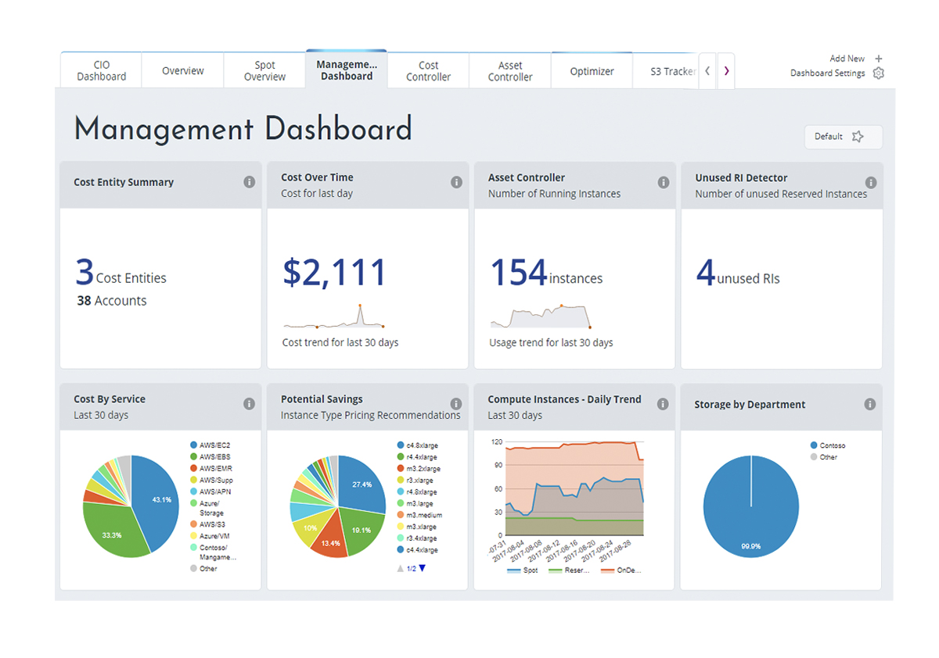
Monitor cloud spend
Track usage and cost trends
Detect spending anomalies and usage inefficiencies
Forecast future spend using your historical data
Visualize data in consolidated or custom dashboards
Notes:
Monitor cloud spend
With Azure Cost Management, you can gain access to rich operational and financial insights:
Monitor resource usage and costs on a daily or monthly basis and track the trends across all your clouds in any way you want (by resource types, by business units, by projects, etc.)
Detect usage and spending anomalies, which could be a good thing (for example, a spike in customer demand after a holiday) or an anomaly that requires immediate investigation. You can also detect usage inefficiencies and take actions to address them.
And forecast future spend more accurately based on historical data
All these insights are visualized in intuitive dashboards. One key advantage of Azure Cost Management is that you can see your cloud usage and spend from different clouds in one single, unified view. You can also customize the dashboards based on roles.
The screenshot you are looking at shows a management dashboard that has everything managers need to know about their cloud usage and spend.
Next, we can easily see how actual cloud expenses are lining up to your budget, in this case, a month by month view.
You can also dive deeper to look at daily costs and detect any spikes on a specific point in time—really helpful in locating anomalies. In this case, you have a huge cost spike on August 15. You better look into what caused it.

Slide 6
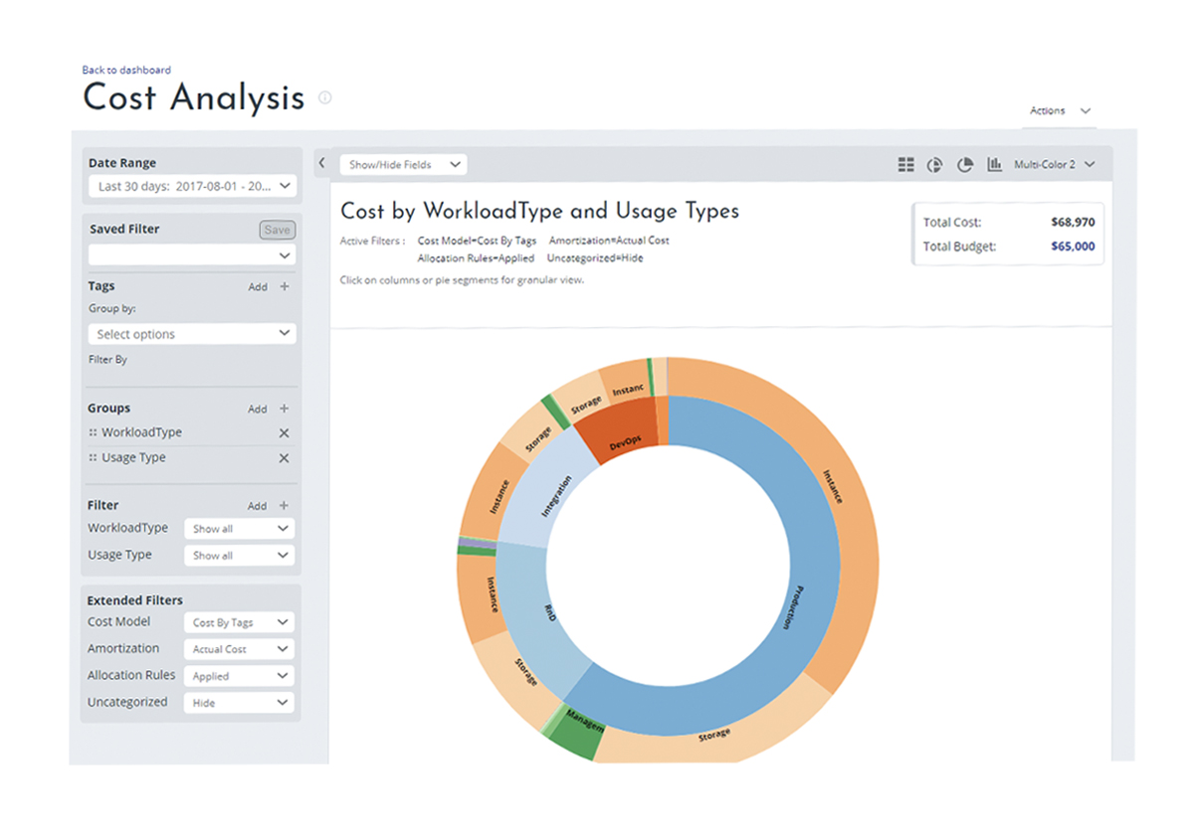
Drive organizational accountability
Allocate usage and costs to business units and projects
Produce chargeback and showback reports
Let teams access data and insights with Role-Based Access Control
Automatically alert stakeholders of spending anomalies and overspending risks
Notes:
Drive organizational accountability
The next ability is driving organizational accountability.
Accountability is a difficult thing to track or drive in any organization, but Azure Cost Management helps you drive accountability by enabling visibility at the most granular level and enforcing compliance with governance policies, alerts, and notifications.
Allocate usage and costs to business units and projects using resource tags.
Produce chargeback and showback reports.
Empower teams to better manage their cloud spend by giving individuals access to data and insights with Role-Based Access Control.
Set custom thresholds of spending vs. budget and alert stakeholders through automated notifications when they are at risk of overspending. You can also automatically alert stakeholders of usage and spending anomalies.
The screenshot shows cost allocation by workload and usage types so you can get visibility into who is using cloud resources for what purposes and the cost for each area. In this case, production is using the majority of cloud resources compared to R&D, Integration and DevOps, which is expected
Next is a chargeback report you can produce on a regular basis and email to stakeholders.
And finally, you can’t have your people keep checking on everything manually all the time, so there is an alert and notification system that allows you to set custom thresholds and policies and automatically send alerts & notifications to key stakeholders.

Slide 7
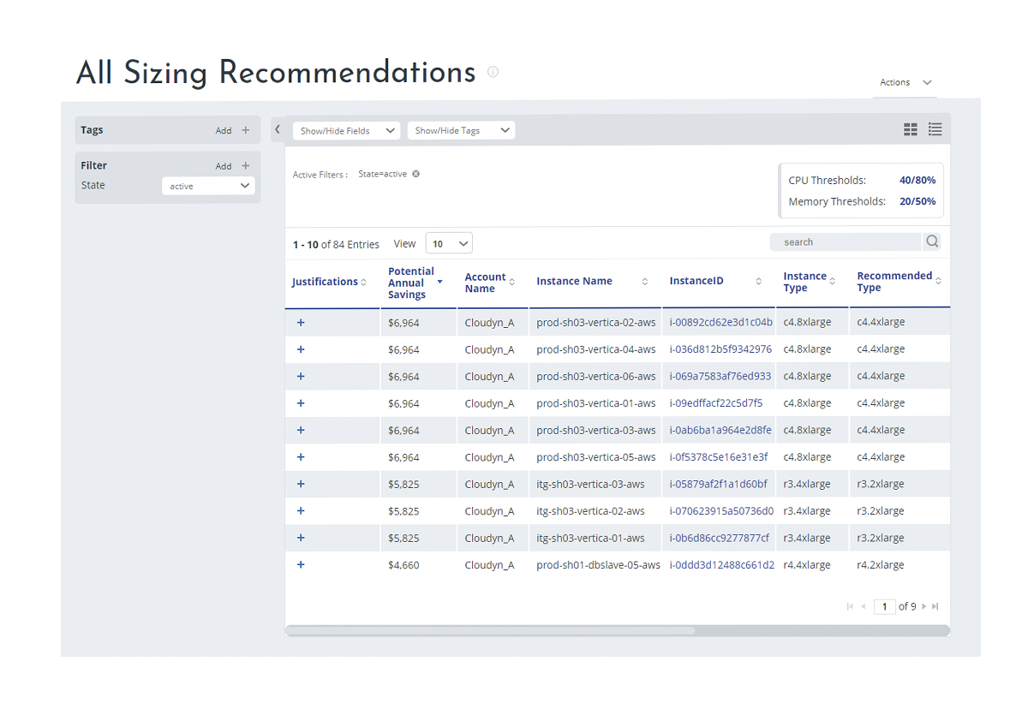
Optimize cloud efficiency
Increase resource utilization with virtual machine right-sizing
Eliminate idle resources
Improve virtual machine reserved instances management
Notes:
Optimize cloud efficiency
Finally, there’s optimizing cloud efficiency to improve ROI. There are three main ways Azure Cost Management lets you optimize cloud efficiency:
Increase resource utilization with virtual machine right-sizing. The tool tracks VM utilization, makes actionable recommendations on right-sizing and provides estimated cost savings. Right-sizing recommendations are made by types: general purpose, compute optimized, memory optimized or graphic optimized.
Azure Cost Management also detects idle resources such as unattached disks and unused memory, and makes recommendations to turn those off so you can eliminate waste.
Azure Cost Management offers another cool capability – helping you optimize virtual machine reserved instance purchases so you can maximize the cost savings. The service currently support AWS reserved instance management and will support optimizing Azure virtual machine reserved instances once it becomes available.
The screenshot here shows VM efficiency - you can see a view across all IaaS instances and their CPU utilization.
Next screenshot: sizing recommendations – you can see a list of sizing recommendations for your VM instances including what size is recommended based on the usage and the potential cost savings. You can double click on each line item to get more details.
Next screenshot: You see a list of unattached disks detected by the tool so you can turn them off and reduce waste.
Next screenshot: reserved instance purchase impact. Here you can see the cost of AWS workloads for a pay-as-you-go pricing shown in the blue bar and the cost if I pre-purchased a reservation with the green bar. I can save $5,734 of the cost by purchasing reserved instances up front.

Slide 8





Building Blocks
User Management
Cost Model
Budget
Cloud Accounts
Cost Entities
Notes:
Whenever you start with a new piece of software or tool there are always certain things that you need to do to get it operational, I refer to these tasks as the building blocks. To get the most out of Cost Management the things I recommend you spend some time on at the start is:
User Management
Cloud Accounts
Cost Entities
Cost Model
Budget

Slide 9
What are Cost Entities?
Cost Entities are logical groups for your organisation
You can create a hierarchy relating to project, teams, departments, etc
Users can be assigned to the hierarchy levels you’ve created, creating permission boundaries
You can associate subscriptions to hierarchy levels

Slide 10
Cost Models
Cost Modelling allows you to segment data using tags
It allows you to report on tags that are meaningful
Setting up a cost model can help an organisation charge back costs to other departments, etc
General advise is to ignore uncategorised section within Cost Models
Not all reports use the Cost Model
Notes:
Without a relevant cost model you won’t be able to create reports based on Tags assigned within Azure

Slide 11
Budget
Budgets can be assigned against the cost entity structure
Threshold alerts can be set up against budgets
Costs vs Budget reports can be drawn
Reporting can be done at an overall level or cost entity level

Slide 12
Reports
Actual Cost Analysis Report is the data that comes out of Azure Billing without any additional information on top of it (Raw Billing Data)
Actual Cost Over Time report is good to understand trends for cost entities
Azure Resource Explorer Report is great for identifying untagged resources
Azure Resource Explorer Report is also great at identifying which resource caused a spike in consumption
The Compute Instance over Time report can show used and unused Reserved Instances
Notes:
Actual Cost Analysis Report – Costs > Cost Analysis > Actual Cost Analysis
Actual Cost Over Time – Costs > Cost Analysis > Actual Cost over Time
Azure Resource Explorer – Resources > Resources > Azure Resource Explorer.
To use the Azure Resource Explorer report to identify untagged resources, do the following:
Load the report
Click on Add within the Tags section on the left
Select the tag you wish to check is missing
Click on the Exclude Tag Filters click button
The report generated should now show you the resources within Azure that are missing that tag
Compute Instance over Time – Resources > Compute > Instances over Time

Slide 13

Optimisation Features
Certain reports are designed for AWS only and certain reports are designed for Azure
Cost-Effective Sizing Recommendation Report will show you over provisioned Virtual Machines
Sizing recommendations will only give you one step down
Sizing thresholds can be customized to suit needs
The Instances – Highest CPU report can potentially identify virtual machines that need to be sized up
All recommendations are guidelines and should be further investigated before actioned
Notes:
Cost-Effective Sizing Recommendation – Optimizer > Sizing Optimization > Cost-Effective Sizing Recommendations
Instances – Highest CPU – Optimizer > Sizing Optimization > Instances-Highest CPU

Slide 14
Alert Management
Every cost report allows you to create an alert
Two types of alerts are available, threshold or recurring
Top level alerts can be created for Company wide notifications

Slide 15
Q & A

Slide 16
Feedback
https://aka.ms/sarahfeedback

