Slide 1
Untitled
Joan Claverol Romero

Slide 2
Slide 1

Slide 3
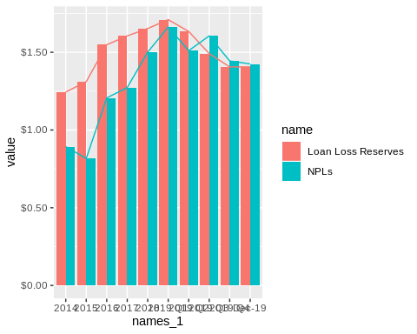
Slide 2

Slide 4
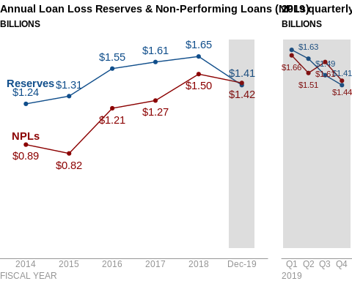
Slide 3

