Slide 1

Profit Predictor of Companies using LSTM
PATTERN RECOGNITION AND MACHINE LEARNING - Master’s in Automatic Control and Robotics
Joan Font Casadevall
Ivan Quirante González
Laura Cervera Sancho

Slide 2
Index of contents
Data Extraction and management pipeline
Data Analysis and Exploration
Baseline Models: SVR and RFR
LSTM Model and Training
Evaluation and Results
Global Comparison
Conclusions
Table of contents

Slide 3
Data Extraction and Management pipeline
-> Source: SABI platform.
-> Data scraping using humanlike interaction techniques.
-> Scripts to convert .xls to csv clean and imputation were implemented.
After scraping, filtering and cleaning, the resulting dataset comprises 2,159 unique companies with complete yearly financial data spanning from 2000 to 2023.

Slide 4
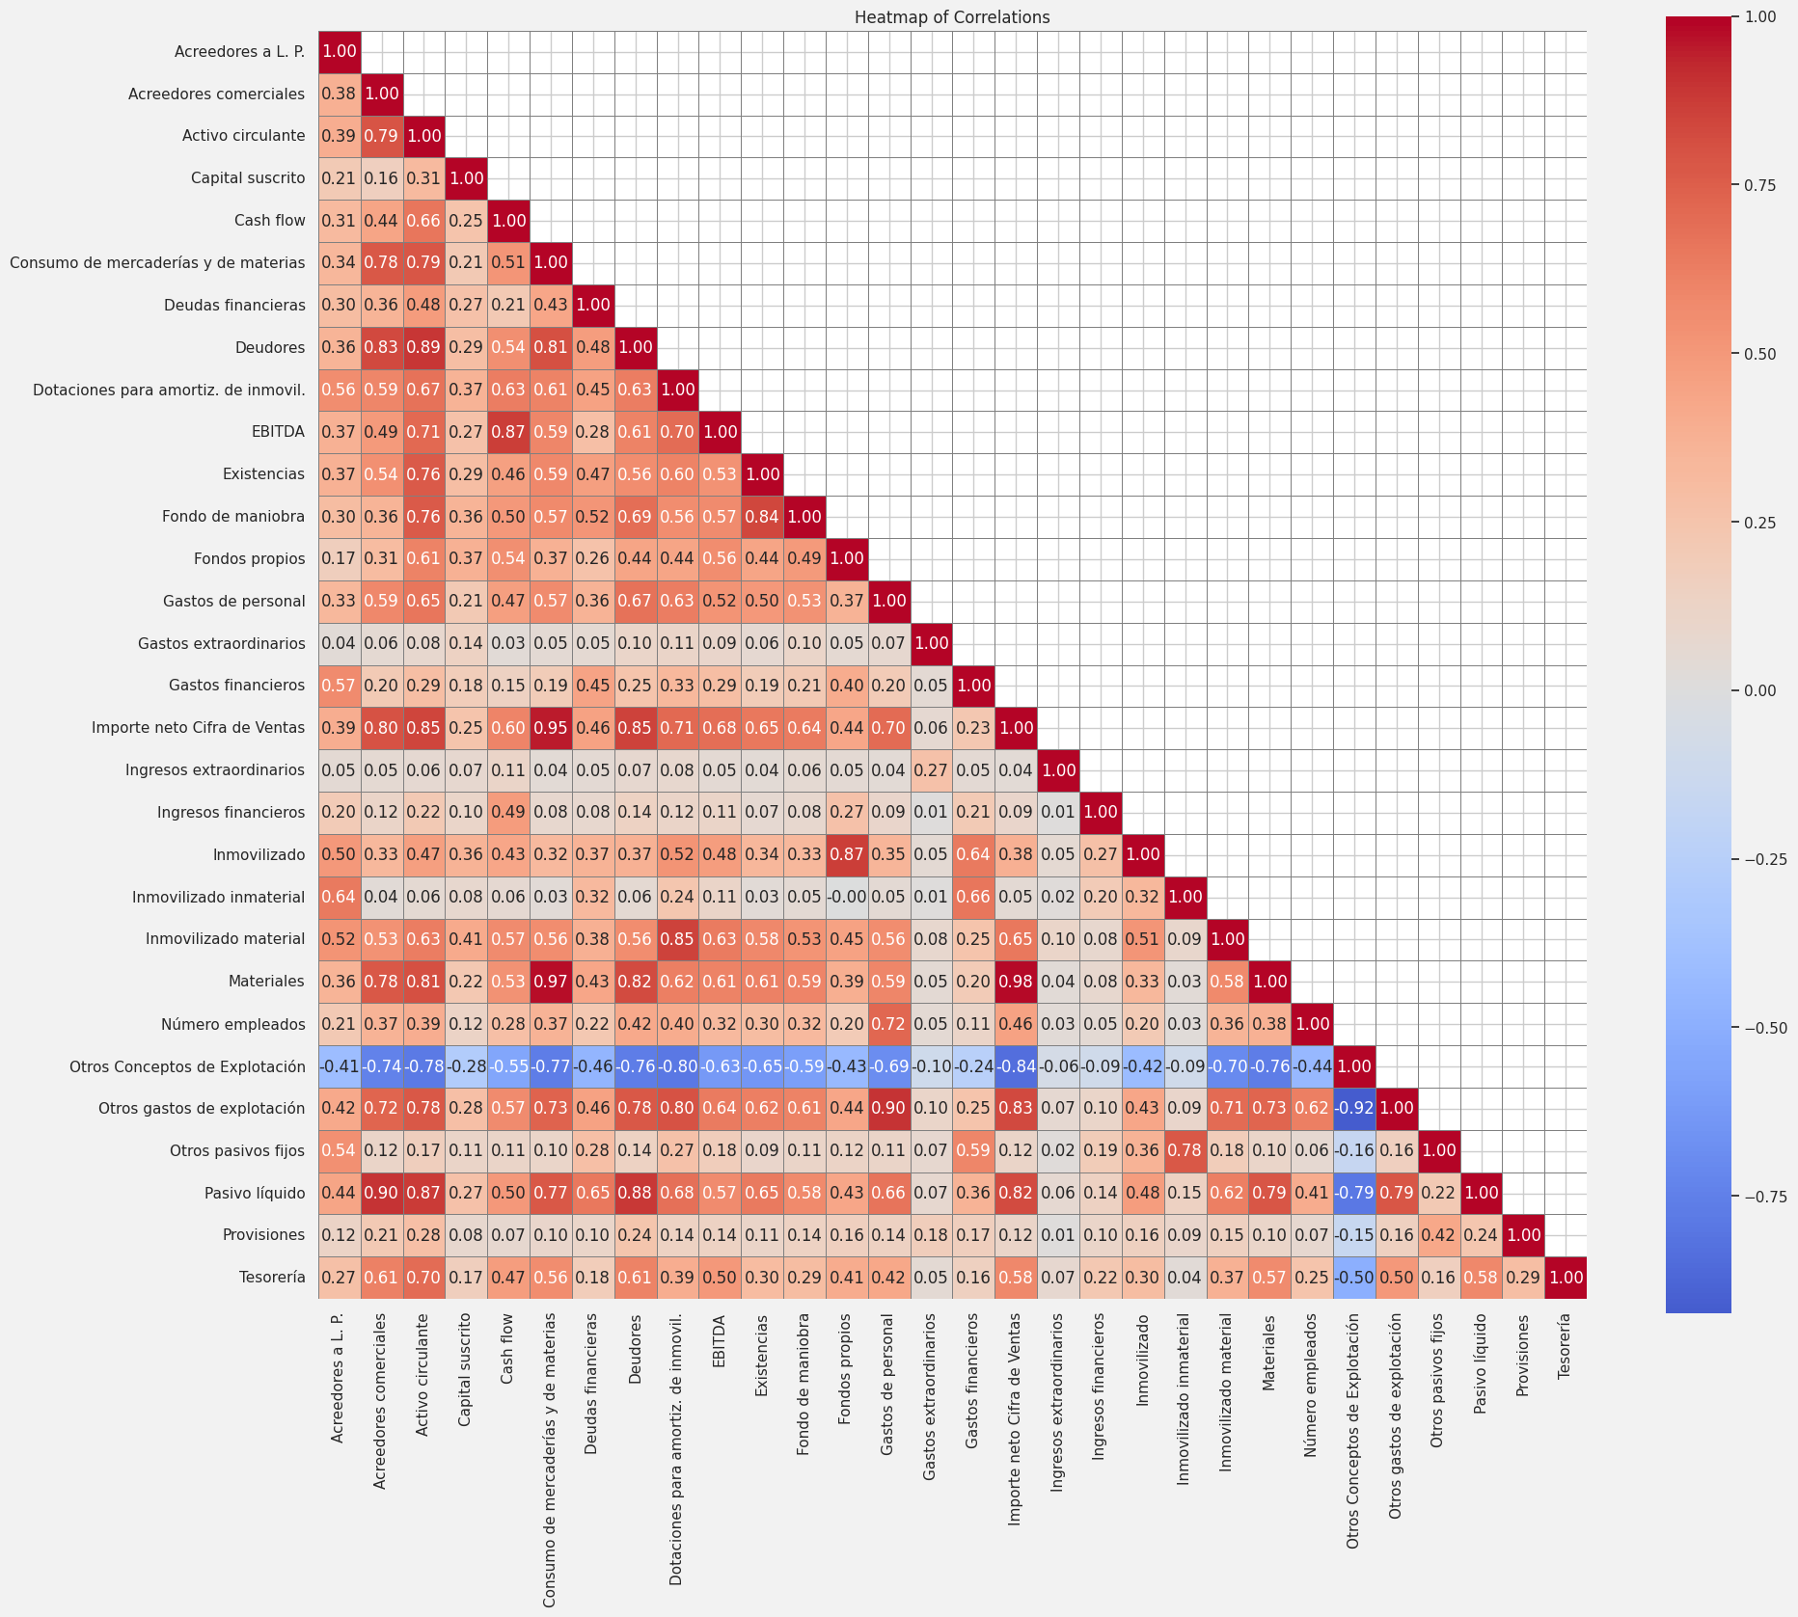
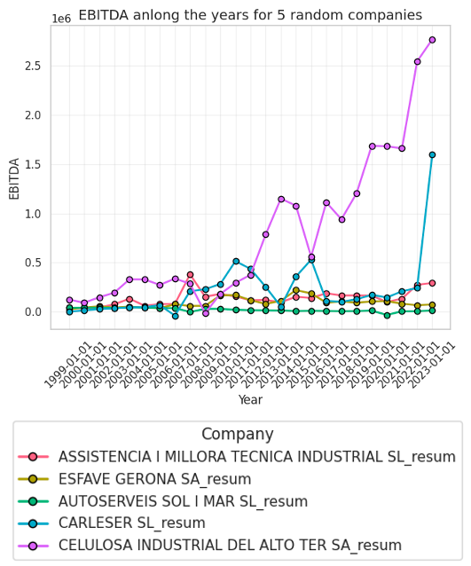
Data Analysis and Exploration

Slide 5
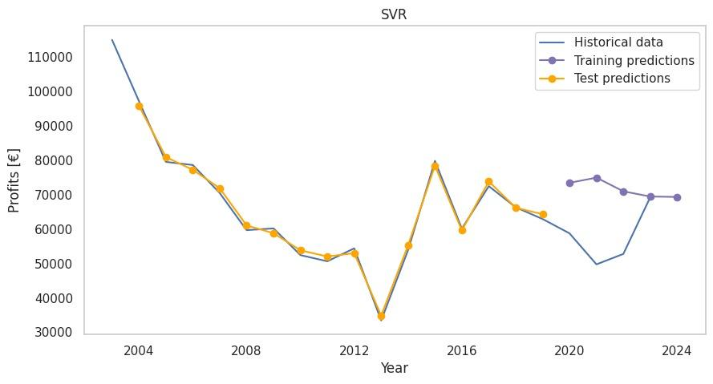
SVR Predictions
SVR model predictions for a single company.

Slide 6
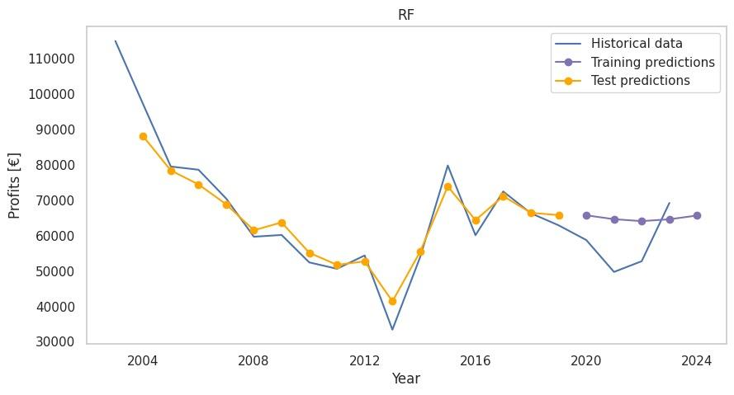
Random Forest Predictions
Random Forest predictions for a single company.

Slide 7
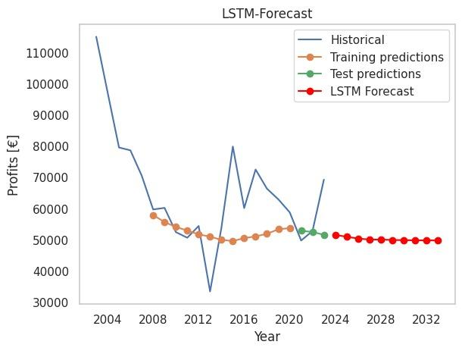
LSTM Prediction
LSTM model predictions for a single company.

Slide 8
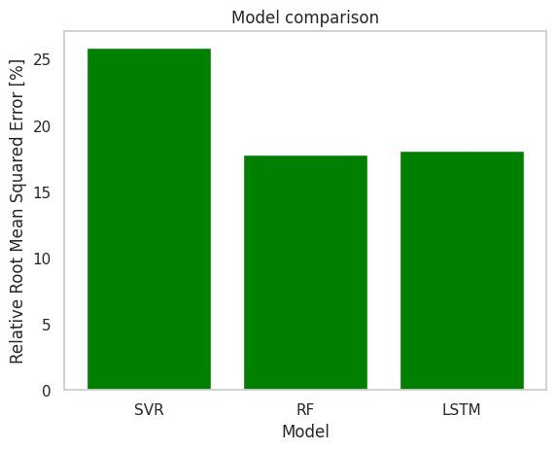
RRMSE Comparison
Relative Root Mean Squared Error (RRMSE) for SVR, RF, and LSTM.

Slide 9
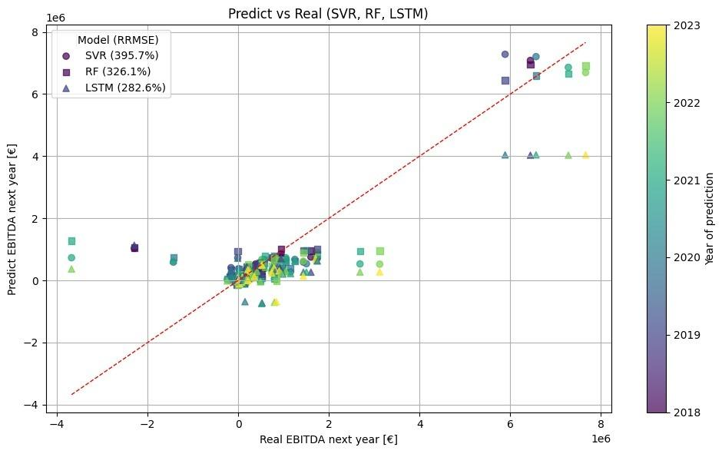
Global Comparison
Predicted vs Real EBITDA values across all companies.

Slide 10
Conclusions
• LSTM outperforms SVR and RF in RMSE and visual trend matching.
• None of the models is ready for real-world use.
• Prediction errors remain large.
• Future work: better data and advanced models (e.g. transformers).

