Slide 1
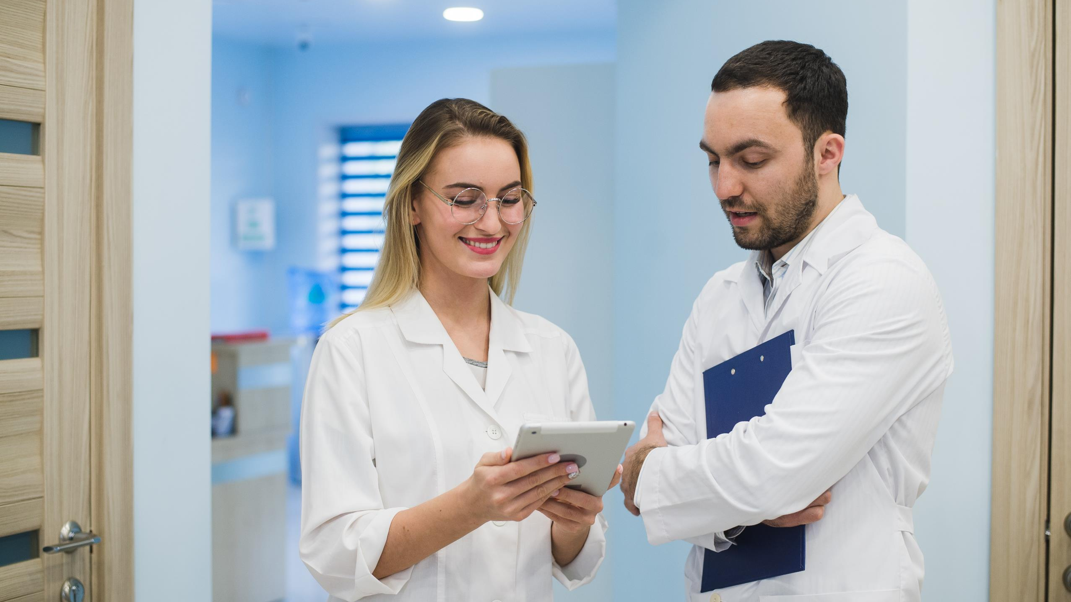
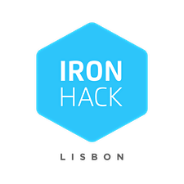
Predicting medical specialties
JOAN CONCHA
FINAL PROJECT
Data Analytics Full-Time Bootcamp, June 2020

Slide 2
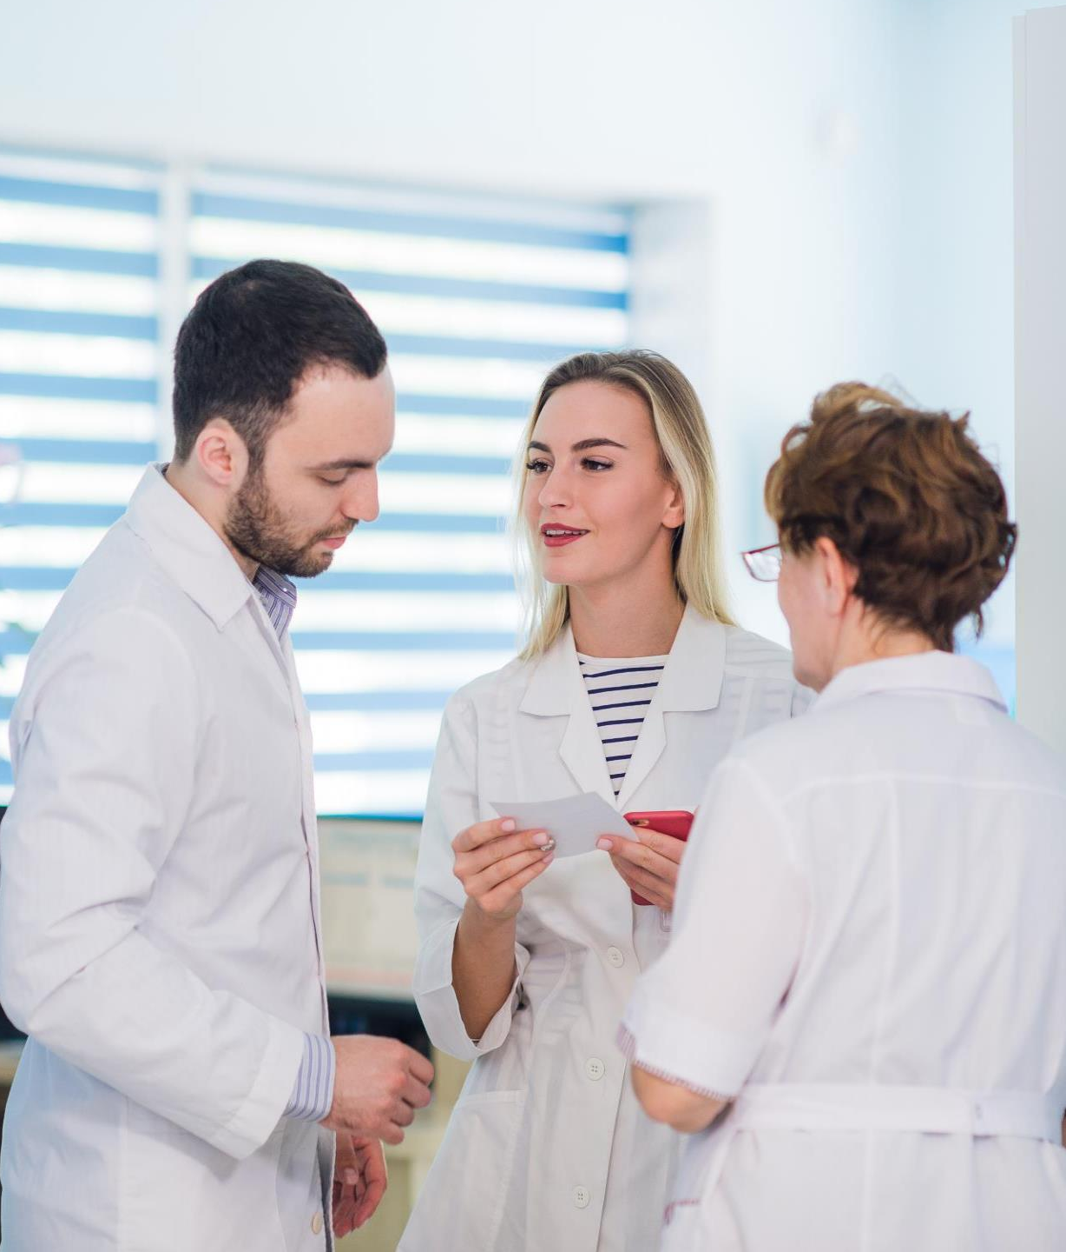
Machine Learning in Healthcare
Vision
Workflow
Model Implementation
Main Difficulties
Future Perspectives
SUMMARY
SUMMARY
Workflow
Model Implementation
Results and Discussion
Future work

Slide 3
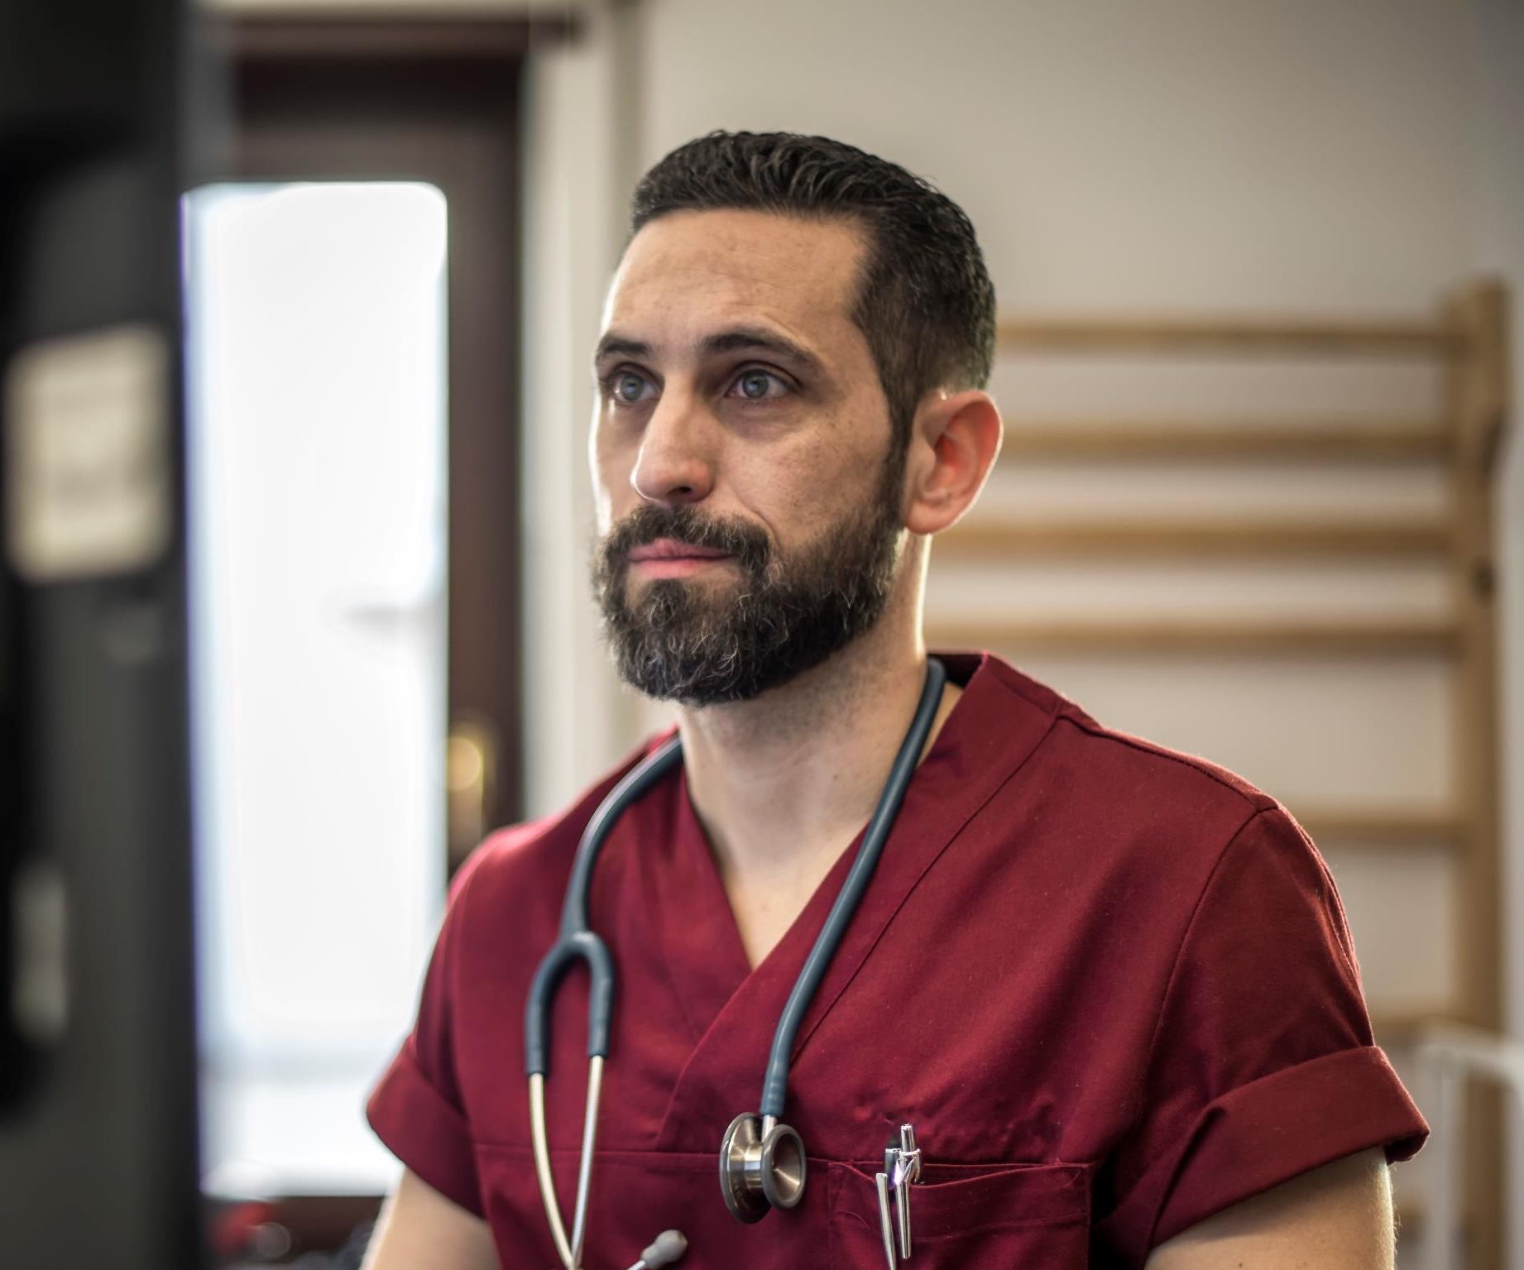
Machine Learning
for Healthcare
Machine learning in healthcare is one such area which is seeing gradual acceptance in the healthcare industry.

Slide 4


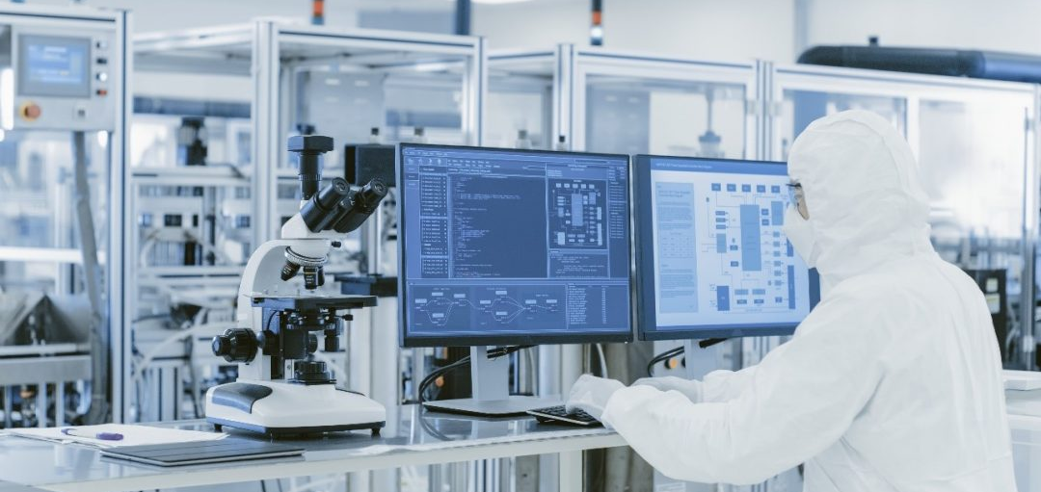
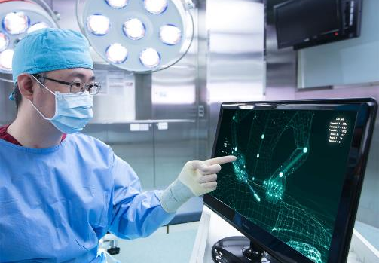
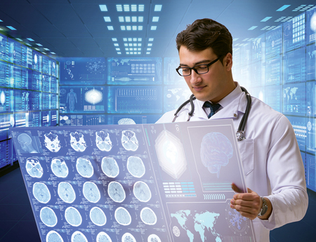
Machine Learning for Healthcare
Top three applications
Diagnosis and Diseases
Drug Discovery and
Manufacturing
Medical Imaging
Diagnosis
diseases and ailments considered hard-to-diagnose
early-stage drug discovery process
image diagnostic tools for image analysis
https://www.flatworldsolutions.com/healthcare/articles

Slide 5

VISION
Aid healthcare workers identify the right medical specialty based on the patient diagnosis transcriptions.

Slide 6
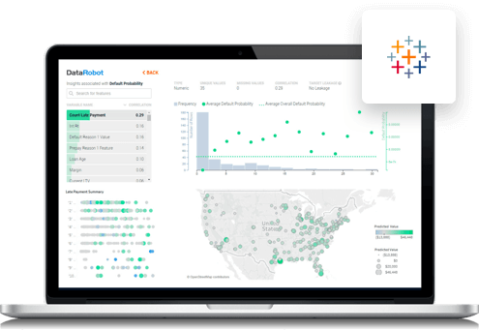
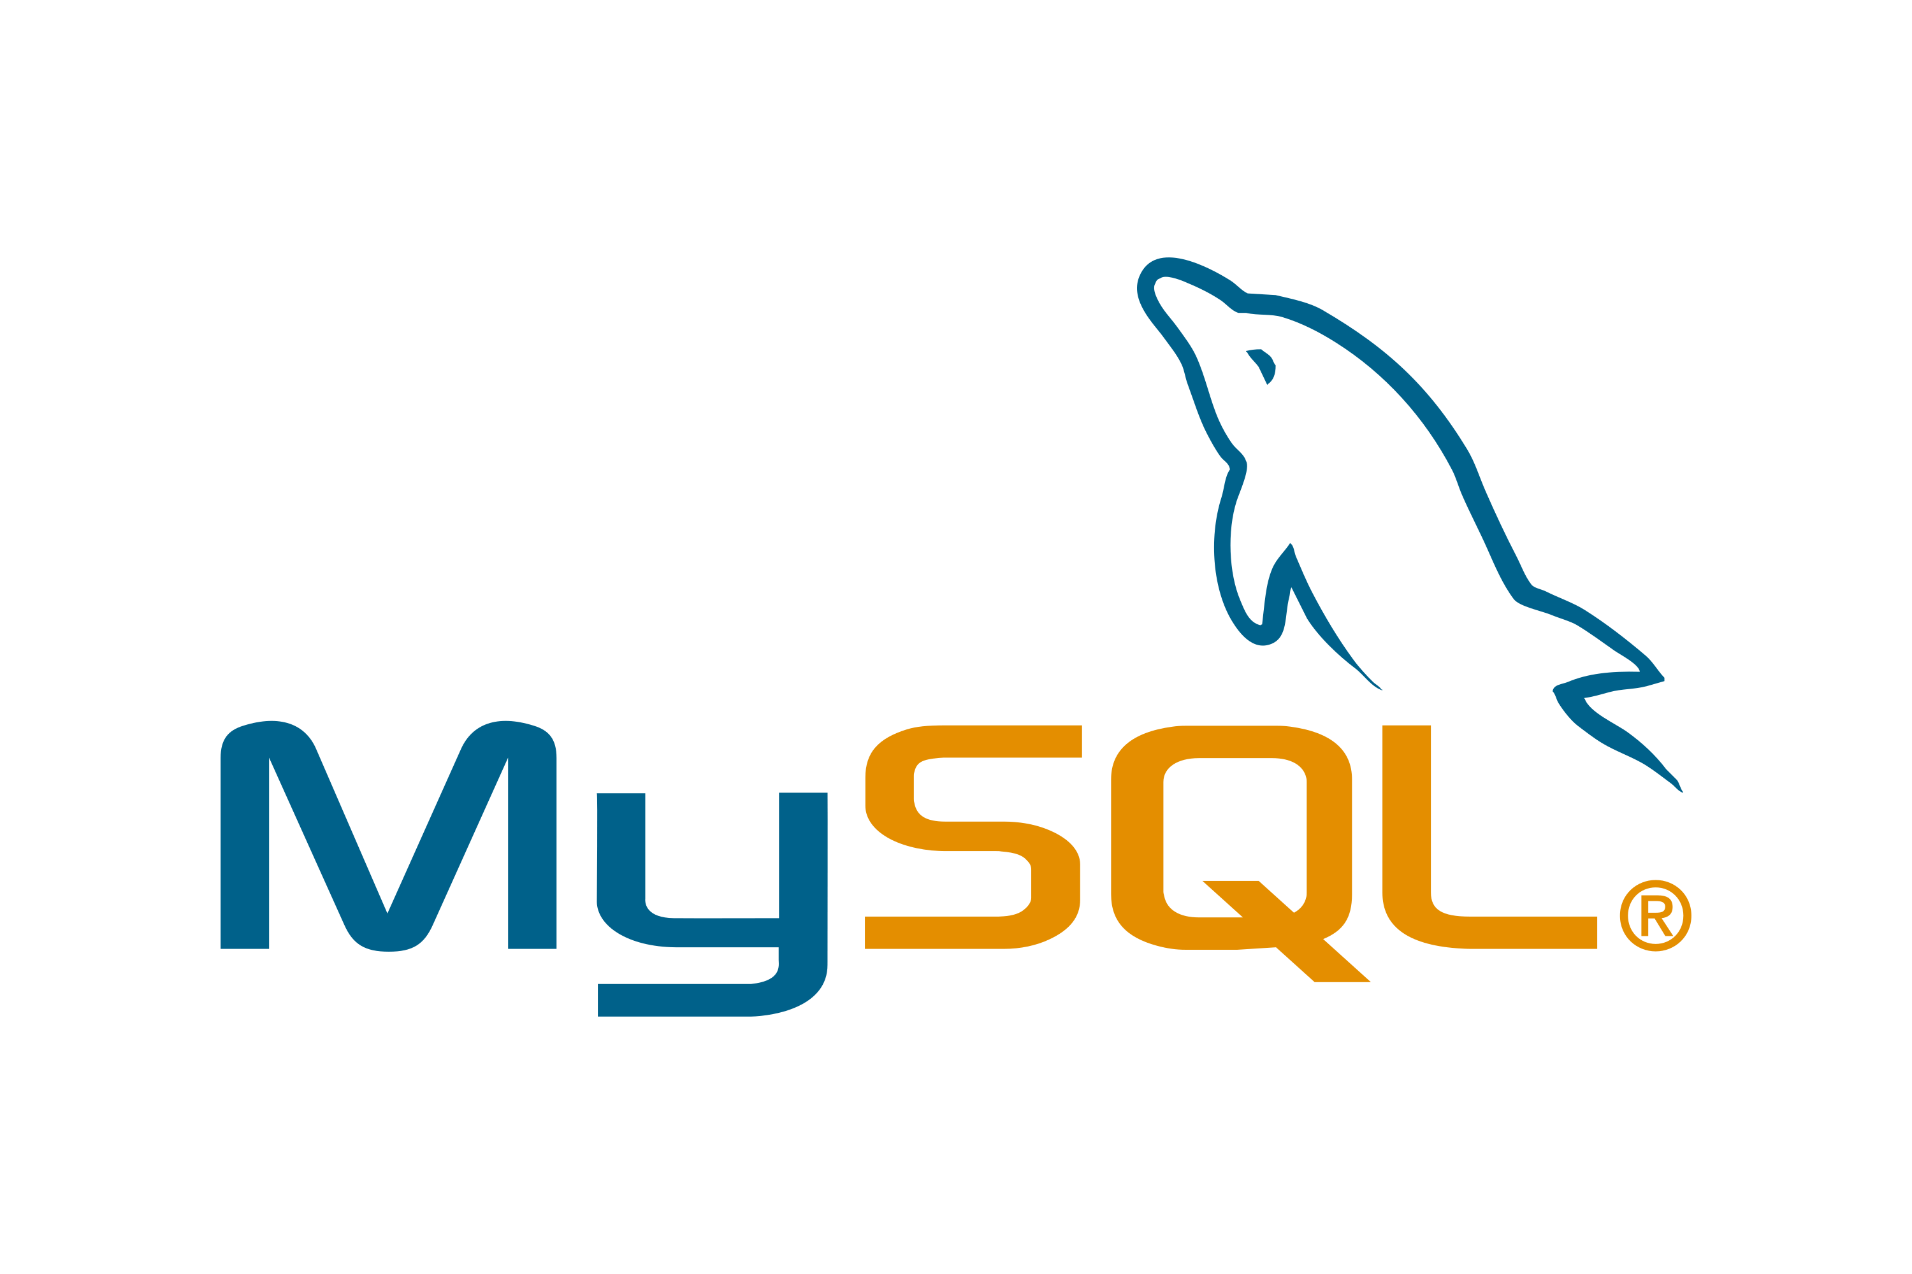

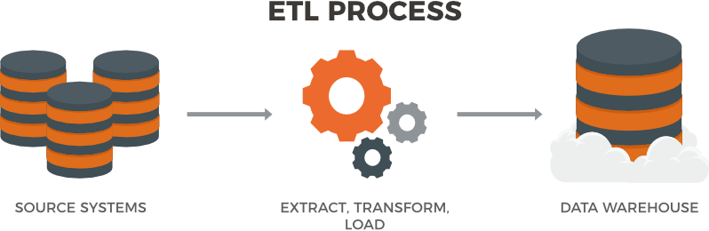



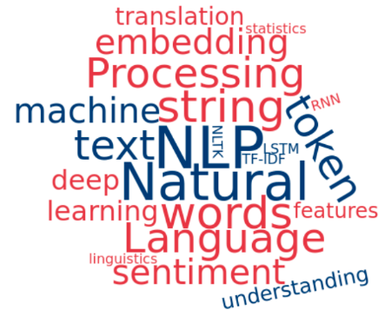
Workflow
ETL
Tableau
dashboard
Source
Extract
Transform
Load
Data Warehouse
Machine Learning Model

Slide 7
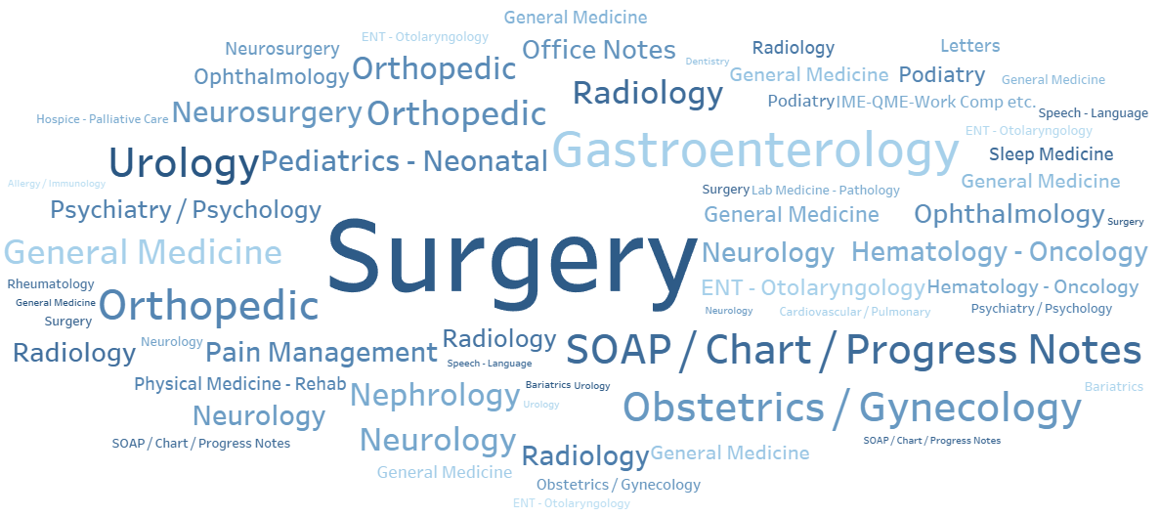
Data Overview
40 Medical Specialties
4966 Medical Transcriptions

Slide 8

Data cleaning
Class Imbalance
Null rows
Necessary transformations (blank spaces)
Cleaned dataset insights->
https://public.tableau.com/profile/joan.concha#!/vizhome/final_project_dashboard/Firstdashboard

Slide 9
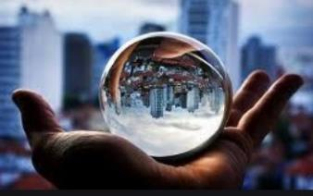
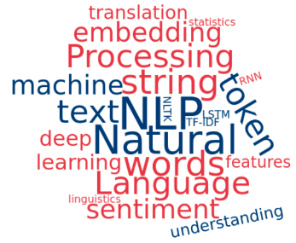
Model Implementation
TF-IDF
Predictions
N-grams (1, 3)
Max features: 2000
Stop words
Flask App
Bootstrap
Tableau Dashboard
Splitting data
Model Selection
80%
20%
Training set
Testing set
Supervised ML model
Multinomial Naive Bayes / Random Forest
Grid search parameter optimization
Best accuracy: 45%

Slide 10

Choosing dataset.
Too many medical specialties / poor information
in some medical specialties.
Low accuracy.
Productivity.
Main difficulties
MAIN
DIFFICULTIES

Slide 11
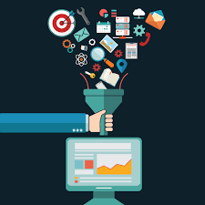


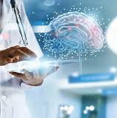
Future Perspectives
More Data
Predicting Keywords
Glintt software used in many hospitals (Portugal).
Identify diseases, diagnosis, pharmaceutical drugs, and more.
Improve the Flask app
NLP vs Neural Network
Improving the accuracy and the predictive power of the final model.
Import lots of transcriptions at a time into a database.

Slide 12

“The best way
to predict the future
is to create it”
Abraham Lincoln

Slide 13
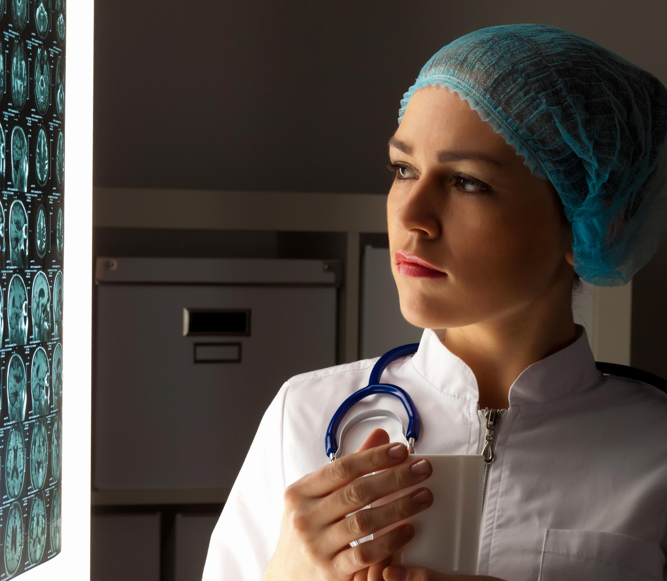
ANY
QUESTIONS?

