Slide 1
3D Printer Factory Simulator
Week 8 — Autonomy & Analysis
A discrete-event supply-chain simulation with three autonomous AI agents
Multi-Agent Coordination | Scenario-Driven Stress Testing | Emergent Behaviour
1 / 10

Slide 2
System Architecture
Three independent FastAPI apps orchestrated by a Turn Engine
Turn Engine (orchestrator)
Provider API :8001
Manufacturer API :8002
Retailer API :8003
supplier.db
Stock, Pricing Tiers
Purchase Orders
Provider Metrics
HTTP
simulator.db
Production, Inventory
Sales Orders, BOM
Manufacturer Metrics
HTTP
retailer.db
Catalog, Customer Orders
Retailer Stock
Retailer Metrics
No app touches another's database. All coordination happens through HTTP + shared world state.
3 SQLite DBs | 3 FastAPI apps | 1 Turn Engine | Scenario-driven events
2 / 10

Slide 3
Agent: Provider Manager
skills/provider-manager.md — Manages raw material stock & pricing
Decision Framework
Market Signal Response
1. Assess — query stock levels & pending orders
2. Restock — replenish products below 50% of starting level
3. Adjust Prices — raise if stock < 30%, lower if > 150%
4. Summarise — structured log for engine capture
supply_modifier < 0.7 → raise prices, conserve stock
demand_modifier > 1.5 → build stock ahead of surge
Max 15% price change per day (gradual adjustments)
Never let stock hit zero if orders are pending
Available CLI Commands
./provider-cli stock | ./provider-cli orders list | ./provider-cli catalog
./provider-cli restock <product> <qty> | ./provider-cli price set <product> <tier> <price>
Agent NEVER calls day advance — Turn Engine is the sole orchestrator
3 / 10

Slide 4
Agent: Manufacturer Manager
skills/manufacturer-manager.md — Production planning & material procurement
Decision Framework (6 steps)
Key Constraints
1. Assess — day, wallet, stock, capacity, sales orders
2. Identify Bottlenecks — compare BOM vs inventory
3. Release Production — prioritize older orders first
4. Plan Material Orders — bulk buy for tier discounts
5. Adjust Pricing — raise if wallet < 3000
6. Report — structured summary for logging
Daily production capacity: 10 units (configurable)
Must check wallet before ordering materials
Must check supplier stock before placing PO
Tier pricing: 10+ = -10%, 50+ = -18%, 100+ = -25%
Materials reserved on release, consumed on completion
Market Signal Response
demand_modifier > 1.0 → keep stock ready, consider price increases
demand_modifier < 1.0 → conserve cash, reduce orders, avoid overproduction
4 / 10

Slide 5
Agent: Retail Manager
skills/retail-manager.md — Customer fulfillment & pricing strategy
Decision Framework
Key Rules
1. Fulfill — ship from stock or backorder each pending order
2. Reorder — purchase from manufacturer if stock < 3 days demand
3. Price — raise 5% if stock low, lower 5% if piling up
4. Summarise — orders fulfilled, backordered, purchases placed
NEVER leave customer orders in 'pending' status
Retail price MUST be > manufacturer wholesale + 20%
Reorder enough to cover ~5 days of expected demand
Backordered orders trigger extra reorder quantity
Market Signal Response
demand_modifier > 1.5 → place larger purchase orders now, hold or raise prices
demand_modifier < 0.8 → slow reorders, consider cutting prices 5%
price_sensitivity = 'high' → be cautious raising prices, customers are shopping around
5 / 10

Slide 6
Scenario Design
Two scenarios: calm baseline vs. volatile holiday rush
Calm Market (Control)
Holiday Rush (Volatile)
25 days, stable demand (mean=4, var=1)
demand_modifier = 1.0 throughout
supply_modifier = 1.0 throughout
Purpose: establish baseline agent behaviour
No disruptions — tests steady-state decisions
Days 1-10: Normal (demand=1.0x, supply=1.0x)
Days 11-13: Black Friday (demand=3.0x, price-sensitive)
Days 14-20: Chip Shortage (supply=0.4x, lead time=2.0x)
Days 18-25: Christmas (demand=2.5x, supply=0.6x)
Days 18-20: COMPOUND (demand=3.75x, supply=0.24x)
Holiday Rush Timeline
Christmas
Normal
BF
Chip Shortage
1
2
3
4
5
6
7
8
9
10
11
12
13
14
15
16
17
18
19
20
21
22
23
24
25
6 / 10

Slide 7
Live Demo
Running 2-3 simulated days with all three agents
python turn_engine.py config/sim.json scenarios/holiday-rush.json 25
What to Watch
Emergent Behaviour
Dashboard
Agent decisions printed per turn
Market signals passed to each agent
Day summary: orders / fulfilled / backordered
Wallet changes and inventory shifts
Bullwhip effect: demand amplified upstream
Price wars during low demand
Stockout cascades across the chain
Coordination WITHOUT direct communication
localhost:8002 — full React SPA
Real-time SVG charts
Scenario timeline overlay
Event logs from all 3 apps
The demo is the most important part. Have a plan for what to do if agents stall.
7 / 10

Slide 8
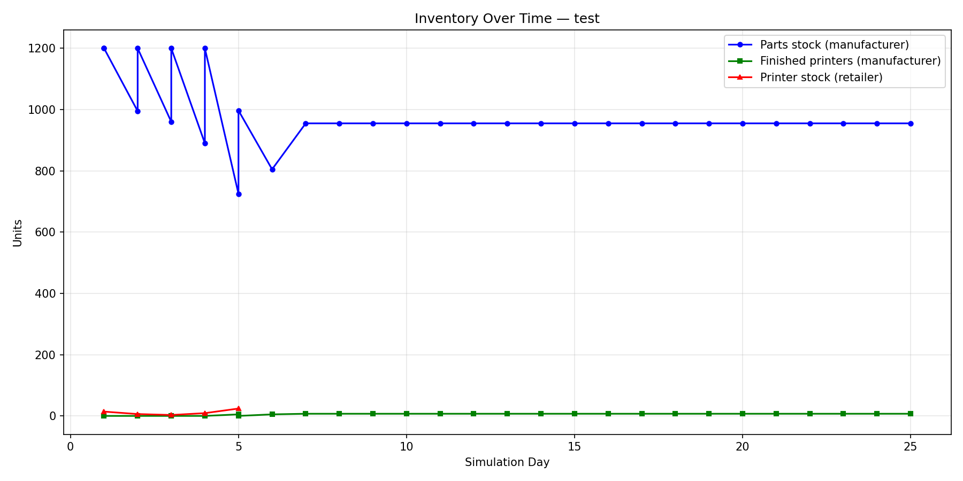
Results: Inventory Over Time
Interpretation
Three lines: parts stock (manufacturer), finished-printer stock (manufacturer), printer stock (retailer)
Look for: stock drawdowns during Black Friday (days 11-13), recovery patterns after the spike
Chip shortage (days 14-20) should cause parts stock to plateau or drop as supply is constrained
Christmas overlap (days 18-20) is the stress peak — compound demand 3.75x with supply at 0.24x
Did the manufacturer build stock ahead of Black Friday? If not, stockouts cascade downstream
8 / 10

Slide 9
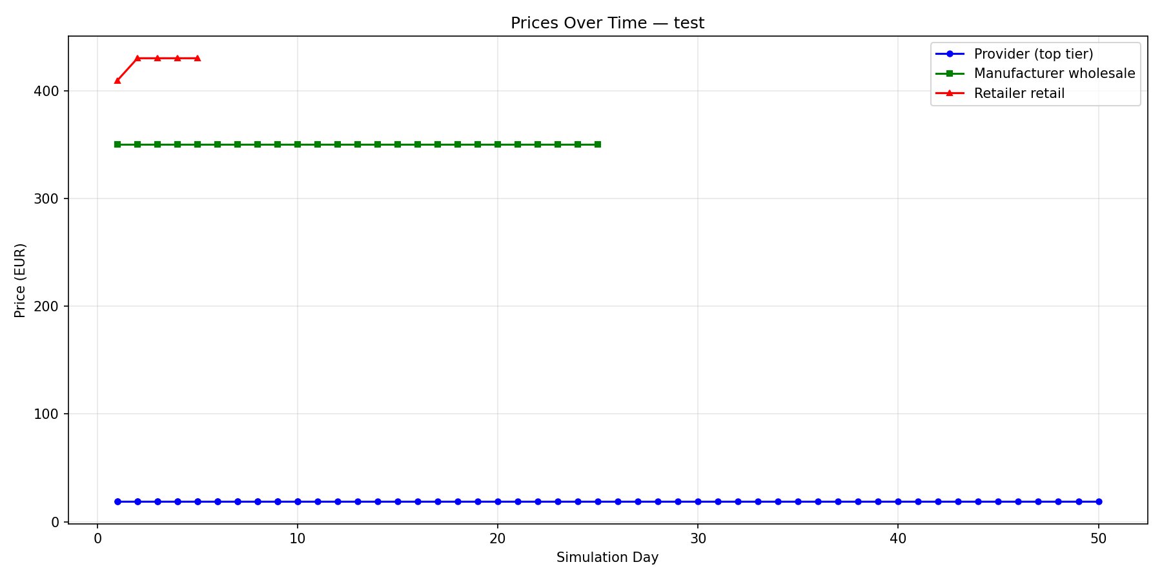
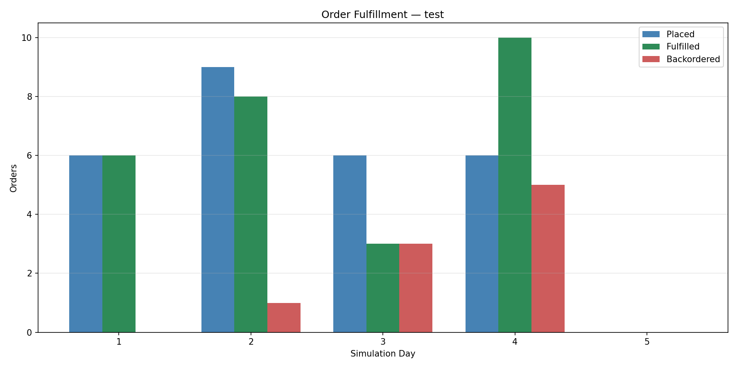
Results: Prices & Order Fulfillment
Prices Interpretation
Three lines: provider part price, manufacturer wholesale, retailer retail
Prices should rise during shortage (days 14-20) as agents react to supply_modifier < 0.7
Did prices stabilise or oscillate? Oscillation = agents overreacting to signals
Price sensitivity during Black Friday: did the retailer hold prices despite high demand?
Fulfillment Interpretation
Daily bars: orders placed vs fulfilled vs backordered
Backorder spikes indicate stockouts — whose decision was the root cause?
Compare calm scenario (near-100% fulfillment) vs holiday rush (gaps expected)
Bullwhip moment: demand variance amplified upstream through the chain
9 / 10

Slide 10
Reflection & Lessons Learned
What Worked
Challenges
Three-DB isolation: clean boundaries, no coupling
Skill-based agent design: version-controlled, testable
Scenario-driven testing: reproducible stress conditions
Event-sourced logging: full audit trail for analysis
Agents can make bad calls that cascade into crises
Skill ambiguities revealed mid-run (tuning needed)
Compound events (3.75x demand + 0.24x supply) are brutal
Observability is crucial — without metrics, analysis is impossible
Key Takeaway
Emergence is the feature: coordination happens through world state, not direct communication
Deterministic software handles execution; LLMs handle strategy; well-defined interfaces keep everything auditable
The hardest part was not any single component — it was keeping your head across all of them
This architecture mirrors real autonomous systems: Uber surge pricing, Amazon warehouse robots, MMO economies
This is not a toy. This is the shape of real autonomous business systems.
10 / 10

