Slide 1
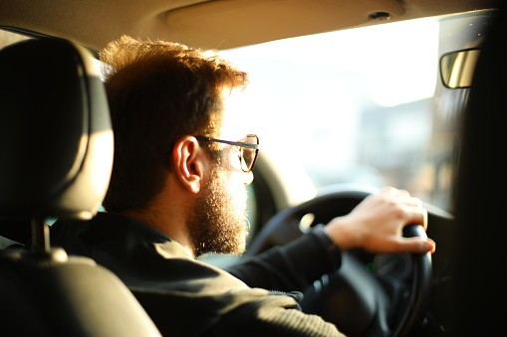

TECH CHALLENGE COBIFY
Created by Joan Vendrell (February 2023)

Slide 2
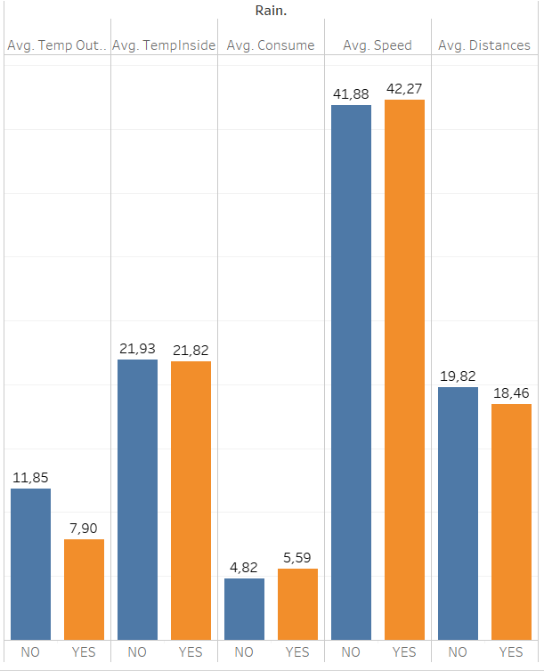
Averages when It’s raining
The speed increase a little bit when it’s raining but not too much because is more dangerous.
When it’s raining the temperature outside decrease but doesn’t change the temperature inside of the car.
The consume increase pretty much when it’s raining day.
The distance decrease when is raining because people don’t walk.

Slide 3
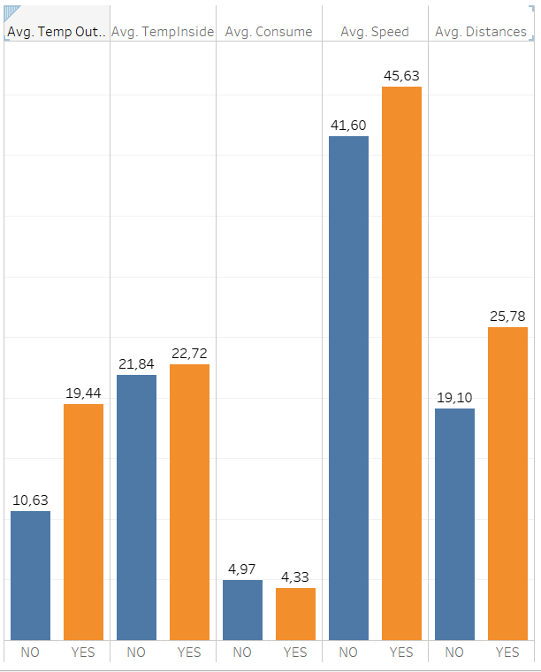
Averages when It’s sunny
The speed increase pretty much because there are a good conditions on road.
When it’s sunny the temperature outside increase a lot and increase a little bit inside of the cars.
The consume decrease a little bit when it’s sunny day.
The distance increase pretty much because people travel more.

Slide 4
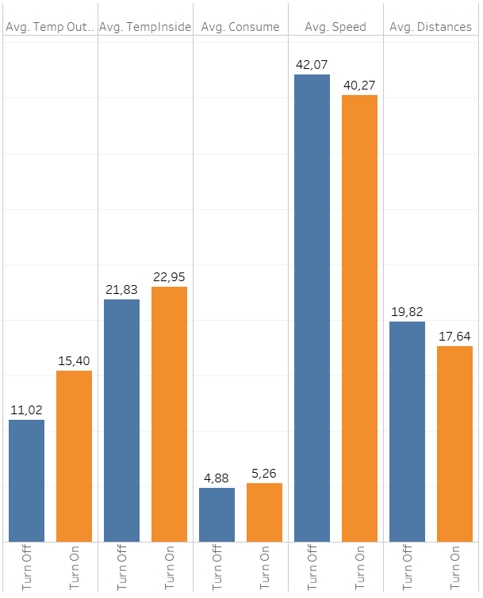
Averages when the AC is turn off / on
Decrease the speed when the AC is turn on because there is less power in the engine.
When the AC is turn on the temperature outside is hotter.
The same when the temperature inside is higher.
The AC is turned off when the distances are longer.
The consum increase pretty much when the AC is turn on.

Slide 5
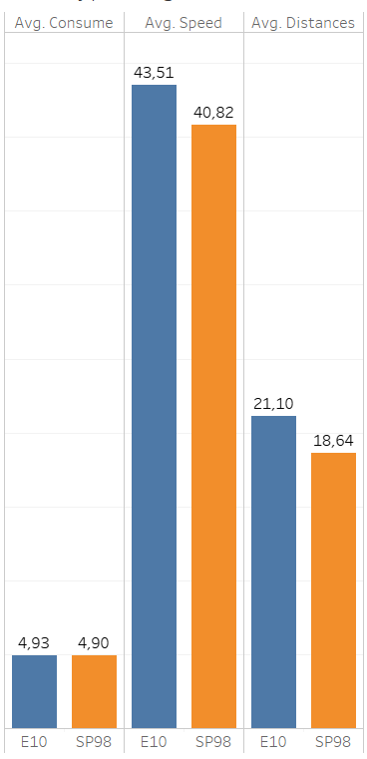
Averages by type of gas
The consum is almost the same by type of gas.
The speed is less for cars with SP98.

