Slide 1
<Joana Teye>
Web Tech Fall 2021 Final Exams

Slide 2
<Joana Teye> is developing a data powered website to help <patients> solve <view information about hospitals in Accra and allow administrators to perform operations concerning information about hospitals>.

Slide 3
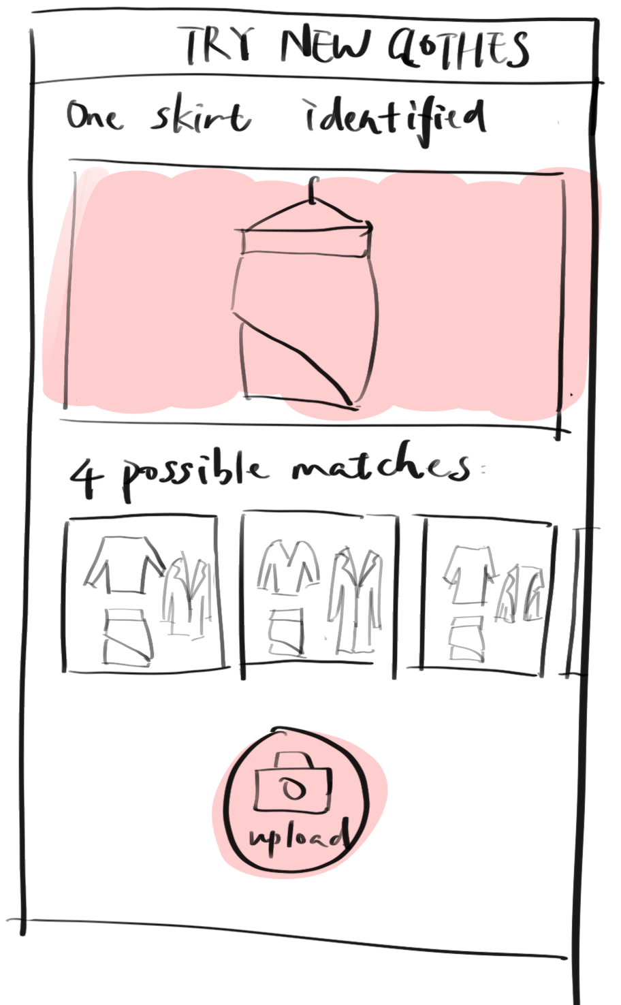
Project Title
ddd
Lack of information about hospitals causing people to waste time and money which can be dangerous in situations surrounding health emergencies.
The website gives information about most websites and this allows patients to view services offered, location and working hours so they do not spend time moving from hospital to hospital which can lead to loss of a life in serious cases.
Patients
Administrators
Users can now view information about a hospital, such as its location, their specialties and the insurances they accept without going there physically which can be a waste of time and resources.

Slide 4
User / Customer
People who would want to would want to view information about hospitals
People who want to select hospitals based on a certain criteria
The people are patients or potential patients.

Slide 5
Main Functions of the Website
3- 4 functions that will be built to solve the problem.
Allows administrators to log in
Users should be able to access information about a hospital’s location, services available, working hours, and the type of health insurances they accept.
Users should be able to select hospitals based on a criteria.
Administrators can add, delete and edit content.
Administrators can sign other people up as administrators.

Slide 6
Architecture
Image of 3 tier architecture and how they connect, programing languages for each tier and why, other technologies (frameworks, etc).
Presentation layer | HTML, CSS and JavaScript
Application layer | PHP
Database layer | MySQL

