Slide 1
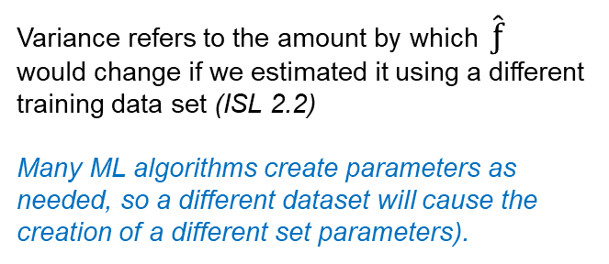
Comments on Modeling and Machine Learning
The Trade-Off between Bias and Variance
Variance refers to the amount by which $\hat{ƒ}$ would change if we estimated it using a different training data set (ISL 2.2)
Many ML algorithms create parameters as needed, so a different dataset will cause the creation of a different set parameters).
Bias refers to the error that is introduced by approximating a real-life problem, which may be extremely complicated, by a much simpler model. (ISL 2.2)
A better explanation is: bias refers to the process an algorithm uses to create parameters, find parameter values, and fit those parameters to data.
The Trade-Off between Prediction Accuracy and Interpretability
As ML algorithms create, transform and expand parameters – they quickly become too complex for human interpretation, which means that they do not explain (i.e., explanatory models) the relationships between dimensions and outcome (i.e., business drivers can’t be explicitly managed).
Ch 2 ISL

Slide 2
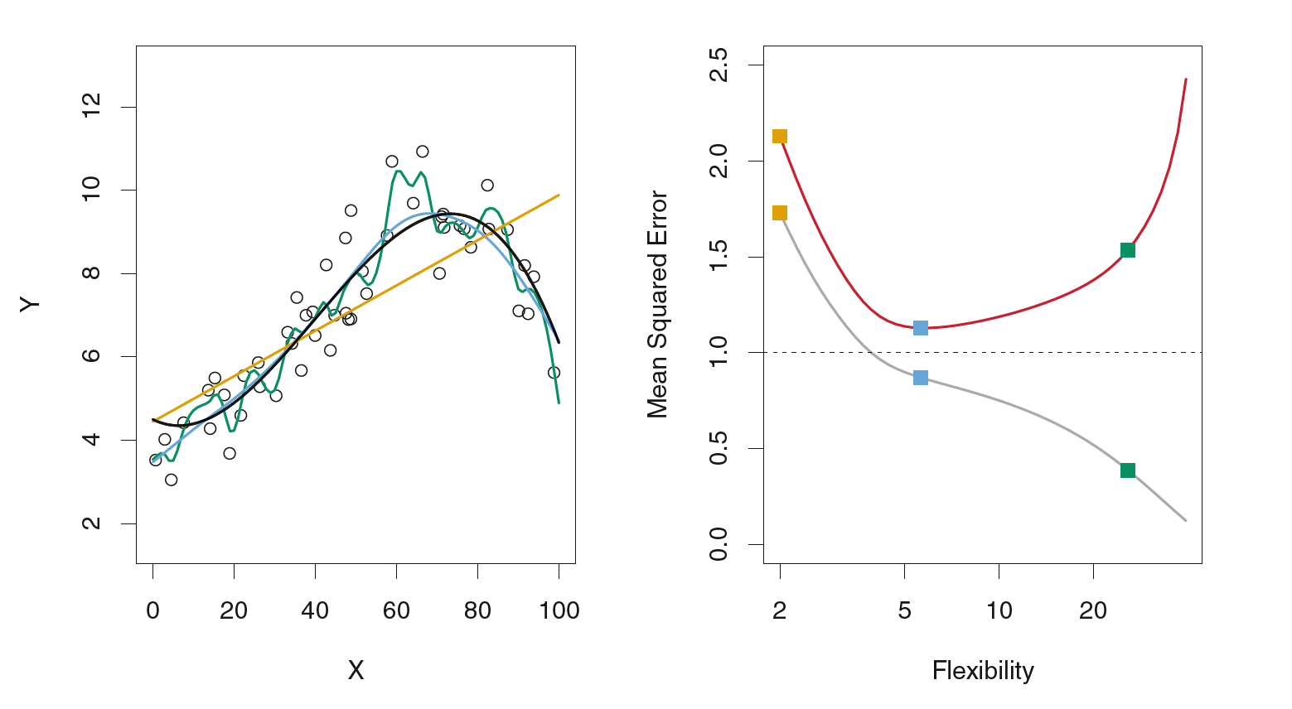
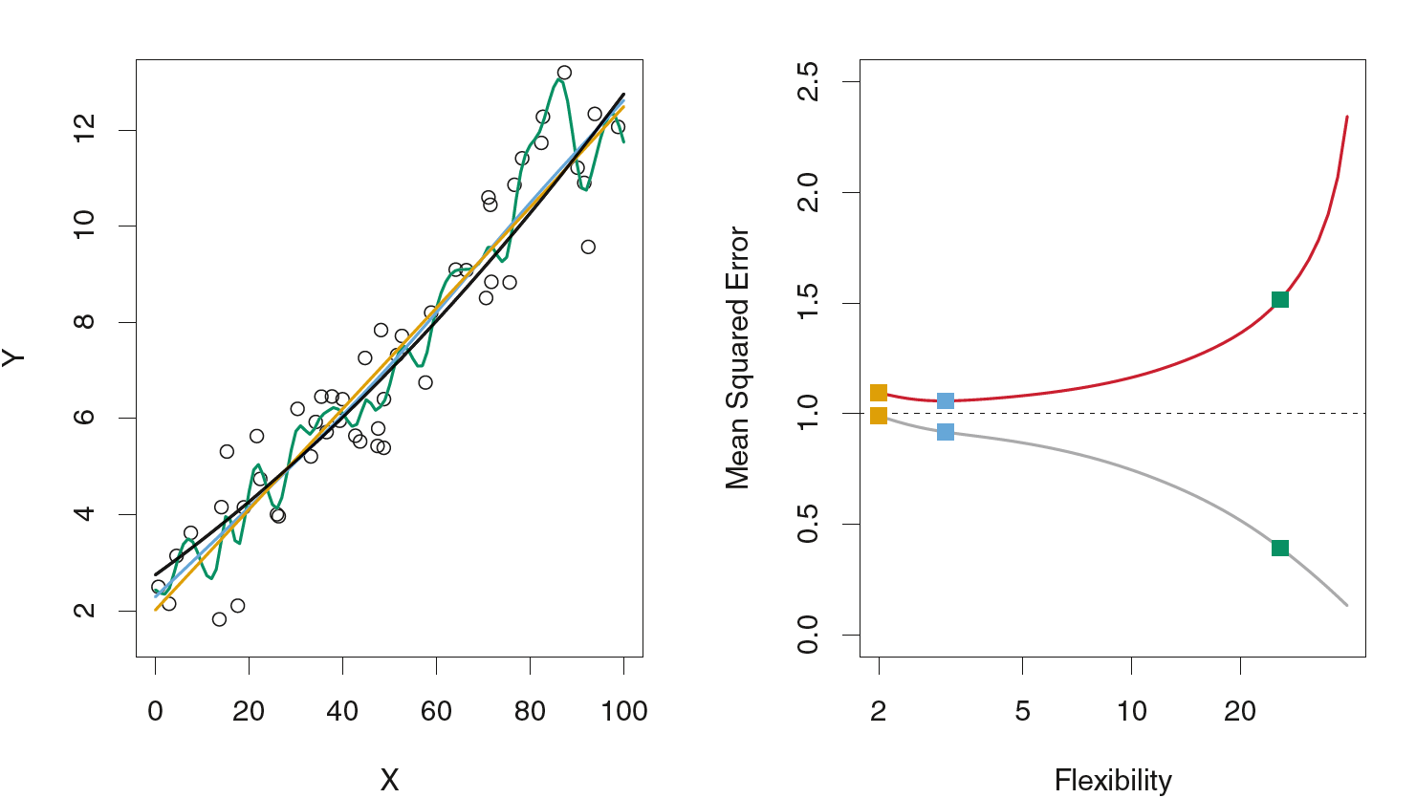
Data simulated from f, shown in black. Three estimates of f are shown: the linear regression line (orange curve), and two smoothing spline fits (blue and green curves).
Right: Training MSE (grey curve), test MSE (red curve), and minimum possible test MSE over all methods (dashed line). Squares represent the training and test MSEs for the three fits shown in the left-hand panel.
More linear data
So what we need is a mechanism to prevent overfitting.

Slide 3
Here’s our sweet spot – good metrics (depends on your specifications) with real (out-of-sample) data is what matters. Business data are dynamic and validation is dependent on those dynamics - sometimes once a year, sometimes once a minute.
If you want your model to explain relationships causes, drivers and be able to make recommendations, then you have to consider the direction of interpretability
This is s core competency for analysts. Your judgment determines model selection, tuning and interpretation. Technology won’t solve this problem for you - it’s your ambiguous intuition and effort that determines outcome. That’s why we have case methods in business school, case-based interviews and internships. Companies will test your understanding of business drivers, data relevancy and problem rationalization. Pushing buttons won’t get you points. Also keep in mind that technical skills will be competing with AI and low cost labor.
Note: Bayesian modeling retains interpretability with increasing flexibility, and also integrates ambiguous judgment. That’s why we’ll study it.

Slide 4
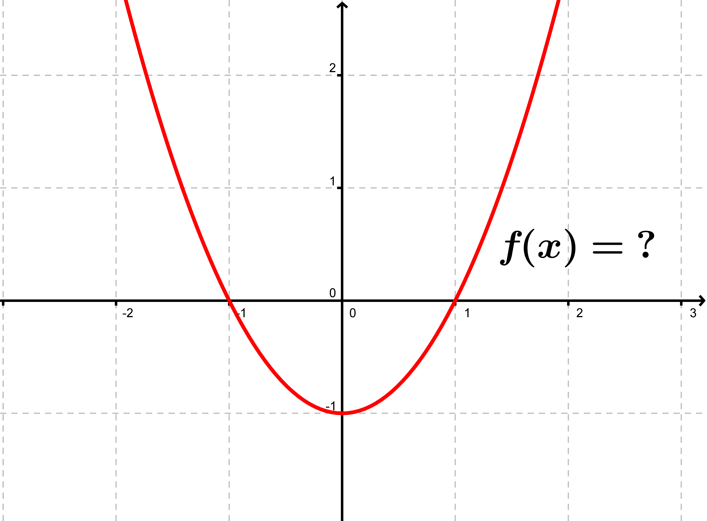
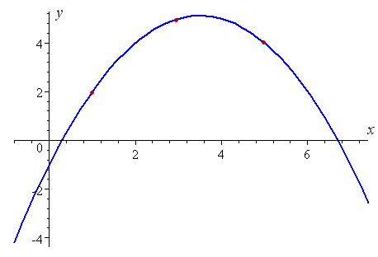
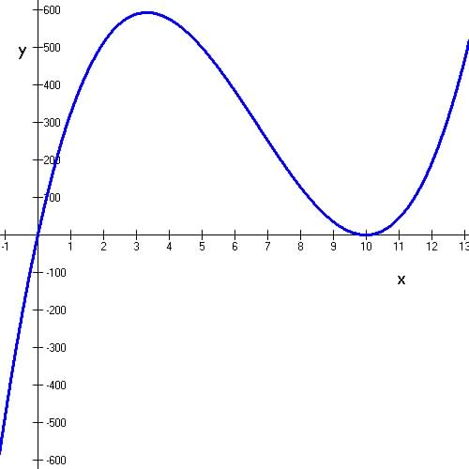
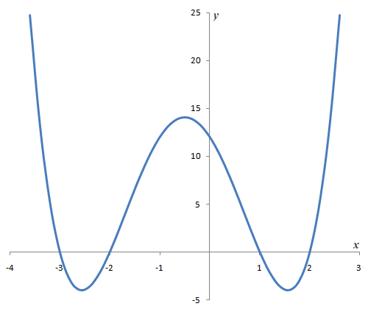
Review - Polynomial Regression
Polynomials (i.e., quadratic, cubed, quartic, quantic…) transform a linear model into a curved model. Because we’re transforming the data, not the coefficients (like the log transforms earlier), we can still use an linear model to fit.
Like function fitting earlier, you need to look at the data first. You can add as many terms as you want, but to diminishing returns. Envision the curve – good place to start:
A quadratic term creates a curve with one “hump” a U or inverted U shape. The curve does not need to contain both sides of the U. In can contain just part of it too!.
A cubic has two humps–one facing upward and the other down. The curve goes down, back up, then back down again (or vice-versa).
A quartic function has multiple humps…. On and on.

Slide 5
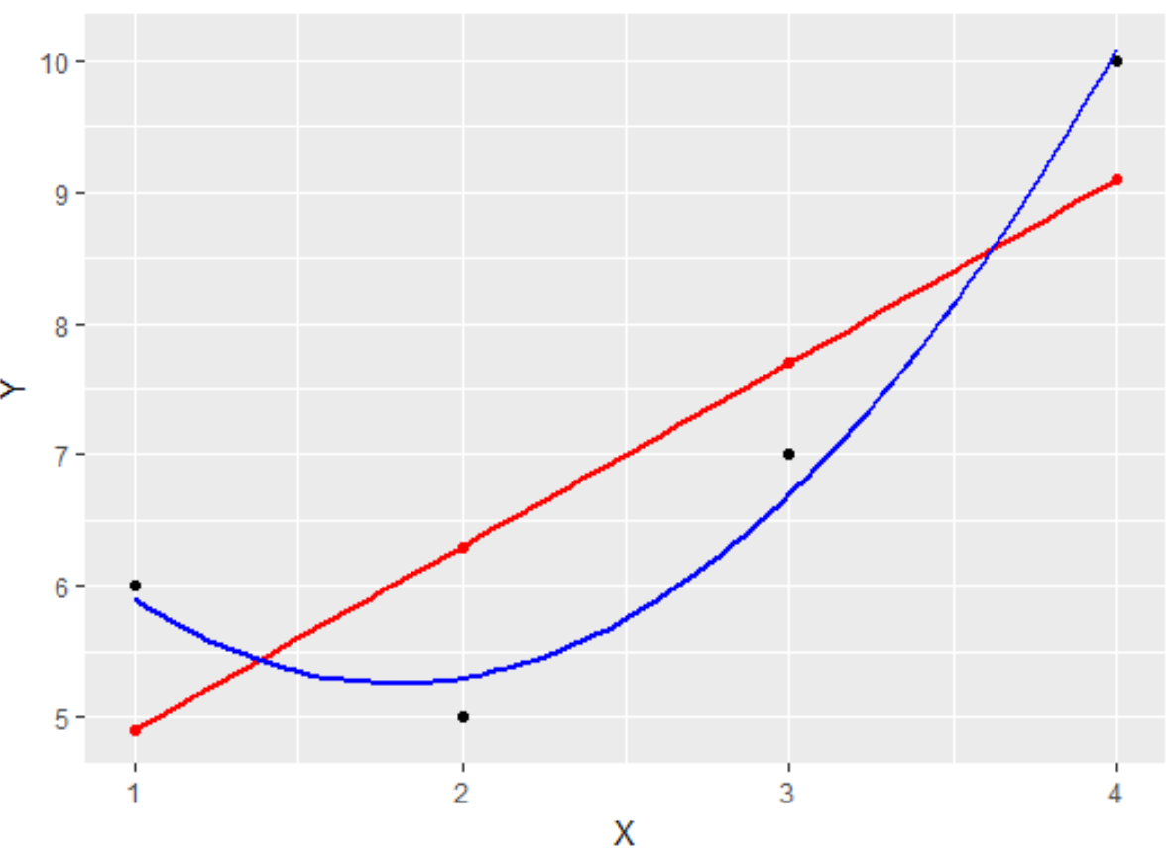
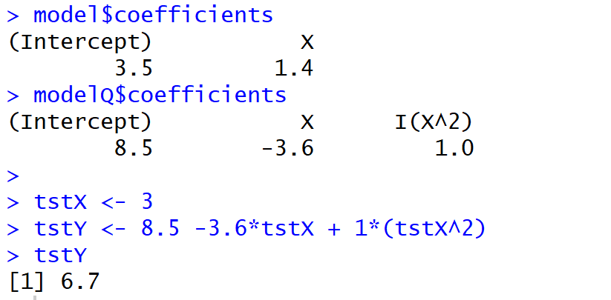
Polynomial Regression
library(ggplot2)
setwd("C:/Users/ellen/OneDrive/Documents/Spring 2017/Section III/History")
mydata <- read.csv(file="Ex1LS.csv", header=TRUE, sep=",")
model <- lm( formula = Y ~ X, mydata)
modelQ <- lm( formula = Y ~ X + I(X^2), mydata)
modData <- mydata
modData$newYQ <- predict(modelQ, mydata)
modData$newYQ <- predict(modelQ, mydata)
modData$newY <- predict(model, mydata)
p <- ggplot(modData, aes(x=X, y=Y))+geom_point()
p <- p + geom_point(data = modData, aes(x=X, y = newY), color = 'red')
p <- p + geom_smooth(data=modData, aes(X, newY), se=FALSE, color = "red", span = 1.5)
p <- p + geom_smooth(data=modData, aes(X, newYQ), se=FALSE, color = "blue", span = 1.5)
p
model$coefficients
modelQ$coefficients
x <- mydata$X
y <- mydata$Y
d <- data.frame(x=x,y=y)
#mydata <- d
p <- ggplot(d, aes(x,y)) + geom_point()
p

Slide 6
Regularization
Regularization really lies at the heart of machine learning. Think of it this way:
We use algorithms to find parameters (like we use gradient descent to find a regression coefficient). As we’ll soon see, many machine learning algorithms are free to create as many parameters as they need to fit the data. And recall from ISL that, as algorithms become more flexible, more complex, they also tend to be more variable, Sometimes this is needed – you might have many, many variables that affect, or even cause, the values of a dependent variable, that involve complex relationships that cannot represented by interpretable equations. So complex algorithms become our best solution (there are many caveats to this statement!).
But this variability is also a problem because, as soon as real scenarios and data are applied. The algorithms will freak out (my term for expansion of error and confidence intervals ☺). Simply stated, expected values will be way off. We call this “overfitting”, and it’s a common failure with inexperienced analysts (who trust technology and data science way, WAY too much)
Regularization is one approach for compensating with models that tend to overfit. In fact, the more complex the model, the more regularization impact (it penalizes complexity and large coefficients that are often large due to complexity – so, it’s a great idea in that the penalty fits the crime, and it’s really quite simple conceptually).
This whole subject has many aspects that we will discuss during the course – save this for later. I’ll leave you with this epiphany that I had when I studied complexity and self organizing systems: from one perspective, if anything changes – everything changes. From another perspective: systems (and relationships) tend to self-organize, and there are global tendencies that “collar” variability.

Slide 7
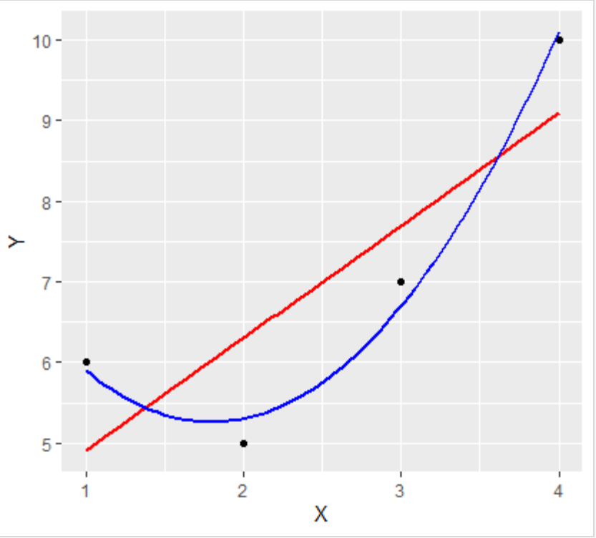
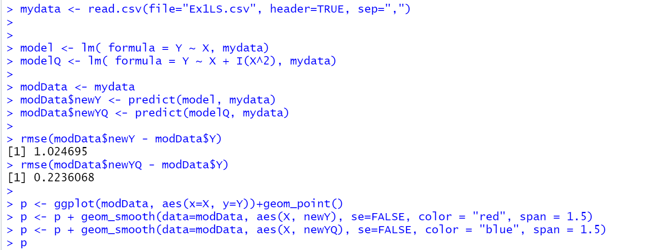
We studied polynomial regression in DA1, and found out that, for some datasets (esp. non-linear), it gives us a better fit – i.e., we’re increasing the complexity and flexibility of the model to fit the data.
Comparing the rmse above, modelQ, the polynomial model, has lower error on TEST data.
Regularization Intro.R

Slide 8
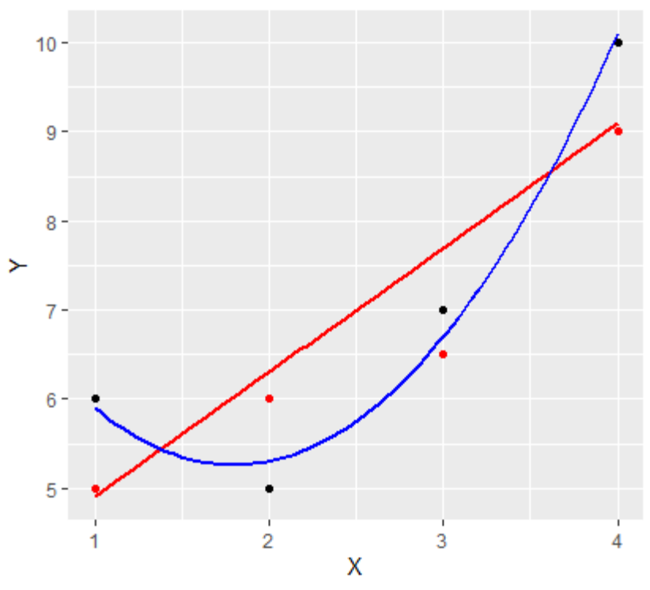
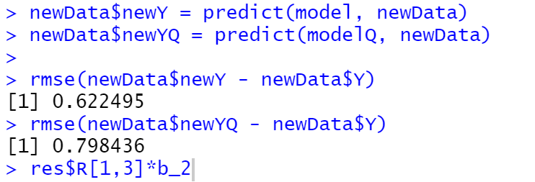
But what happens when “real” data is applied?
Real data in business is very different from test data (e.g., we might use last years data to build a pricing model, or a controls testing model), and this year, new products are introduced, old ones retired, new locations open up, new competitors enter the market… and all the relationships change:
So, the more flexible, variable models often miss the mark. Note that the new data yields a lower rmse with the linear model here.
Variance refers to the amount by which ˆ f would change if we estimated it using a different training data set. ISL pg 34

Slide 9
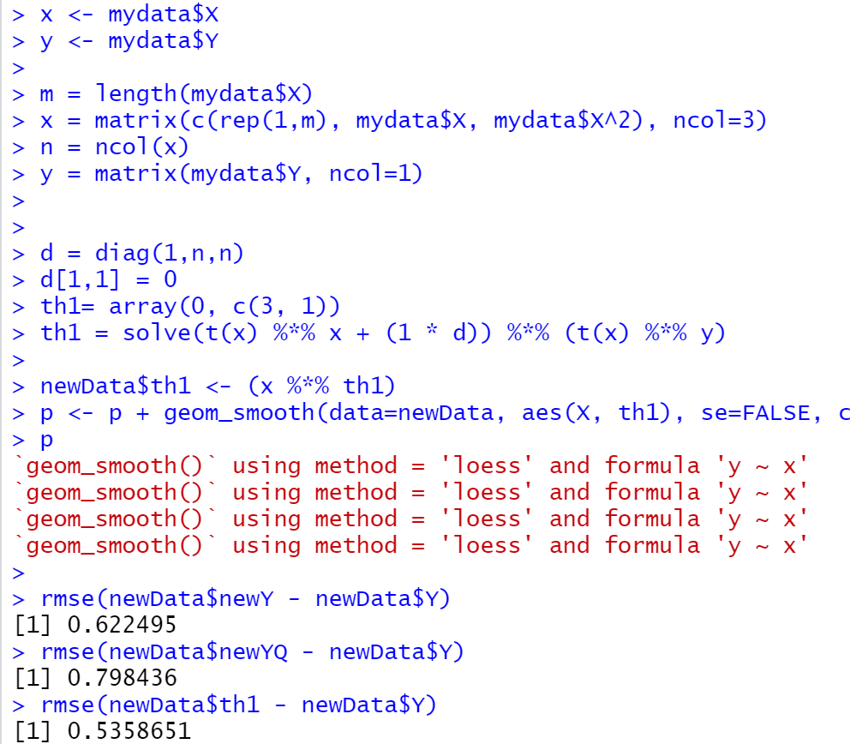
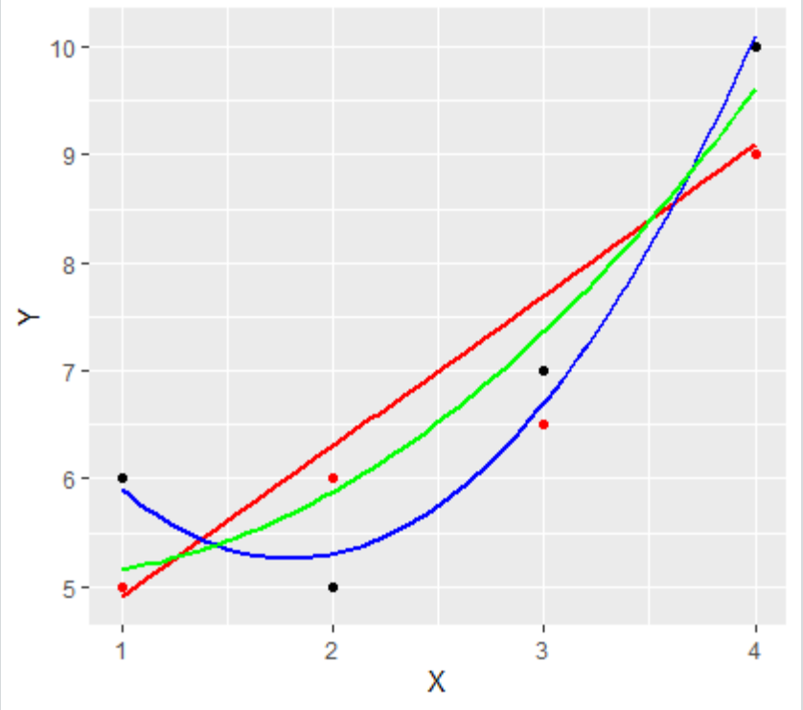
One way to compensate for “overfitting” with the more flexible, variant models – i.e., to “regularize” them, is to penalize the parameters – to “dumb down” the effects – is by creating a penalty term that proportionately reduces the effect of a parameter. We call this a regularization term.
This often gets us a better result with the real world data (remember, the idea is the perform in the real world, not the test lab)

Slide 10
Again, this is a central concept in machine learning. Remember, the bias variance tradeoff. (Chpt 6 in the book – good source of MC questions).
Regularization adds a term to a cost function to penalize complexity (which prevents overfitting – remember the bias / variance tradeoff)
The reg term works in opposition to the minimization function
We’ll use Lambda for the Constant
It favors smaller coefficients when there’s uncertainty.
Overfitting is controlled by parameter C.
C is set in practice using nested cross-validation (later in the course).

Slide 11
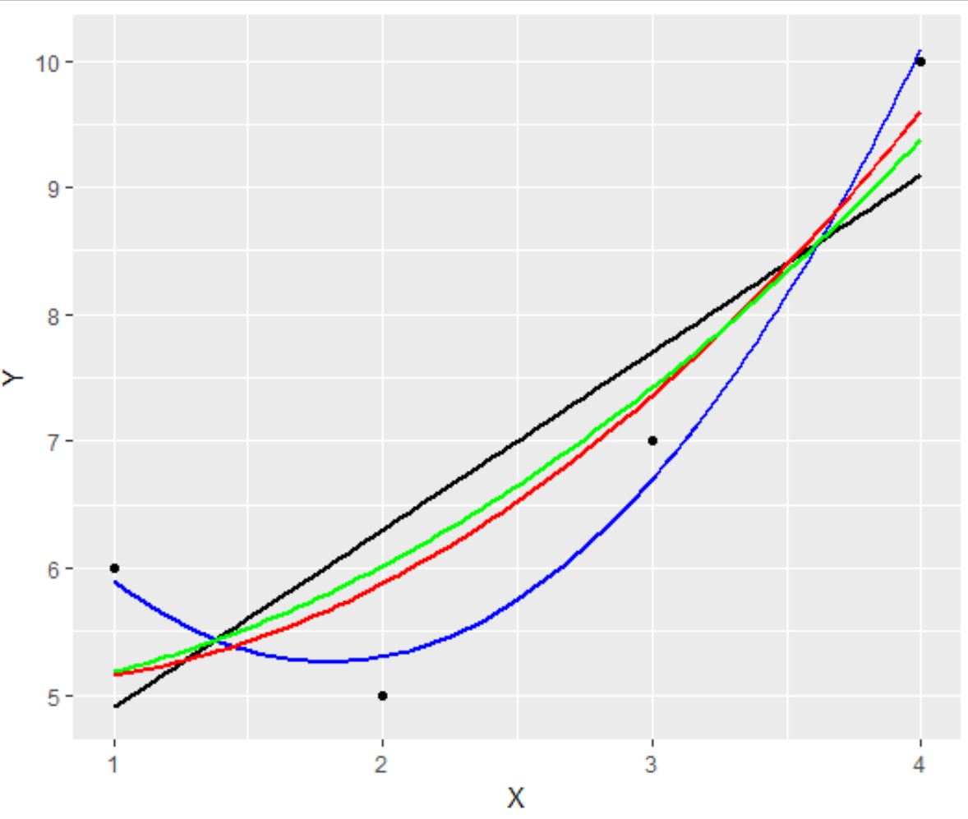

… polynomial and regularization
m = length(mydata$X)
x = matrix(c(rep(1,m), mydata$X, mydata$X^2), ncol=3)
n = ncol(x)
y = matrix(mydata$Y, ncol=1)
lambda = c(0,1,10)
d = diag(1,n,n)
d[1,1] = 0
th = array(0,c(n,length(lambda)))
for (i in 1:length(lambda)) {
th[,i] = solve(t(x) %*% x + (lambda[i] * d)) %*% (t(x) %*% y)
}
nwx = seq(1, 4, len=50)
x = matrix(c(rep(1,length(nwx)), nwx, nwx^2), ncol=3)
newData <- as.data.frame(nwx)
newData$th1 <- (x %*% th[,1])
newData$th2 <- (x %*% th[,2])
newData$th3 <- (x %*% th[,3])
X <- newData$nwx
newData$lm <- predict(model, newData = X)
p <- ggplot(mydata, aes(x=X, y=Y))+geom_point() + geom_smooth(method = 'lm', se=FALSE, color = 'black')
p <- p+ geom_smooth(data = newData, aes(x=nwx, y = th1), color = 'blue')
p <- p+ geom_smooth(data = newData, aes(x=nwx, y = th2), color = 'red')
p <- p+ geom_smooth(data = newData, aes(x=nwx, y = th3), color = 'green')
p
Plot out with different reg terms:
Black line is straight lr – no reg term
Blue line is polynomial with lambda = 0
Red line is polynomial with lambda = 1
Green line is polynomial with lambda = 10
Add a regularization term (here, we added 3 increasing values to see the effects)
Take the normal equation from Regression 1 (which is a least cost minimization function)
$β$ = (X^{T}X)⁻¹ (X^{T}Y)
betaHat <- solve(t(X)%*%X) %*% t(X) %*%y

Slide 12
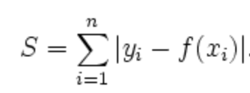
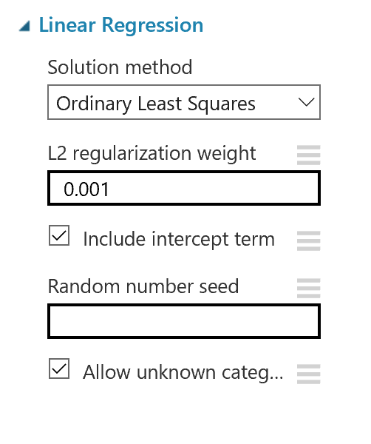
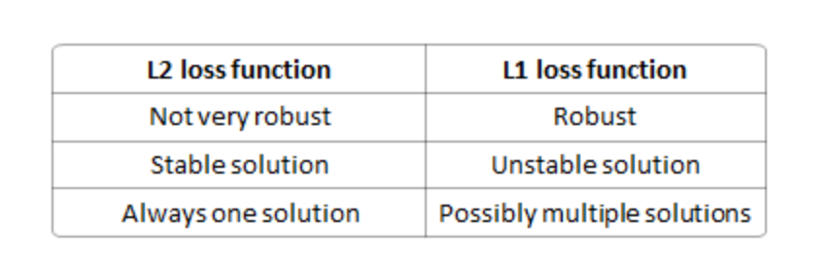
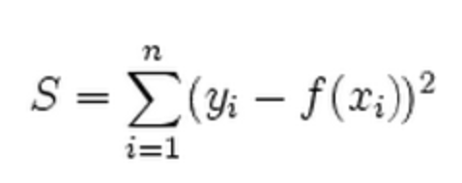
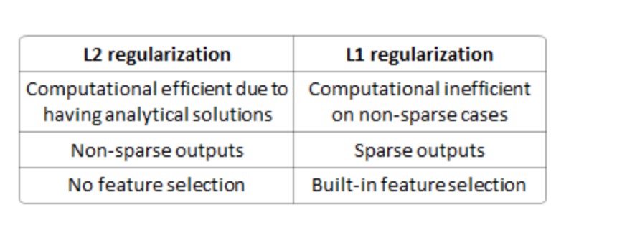
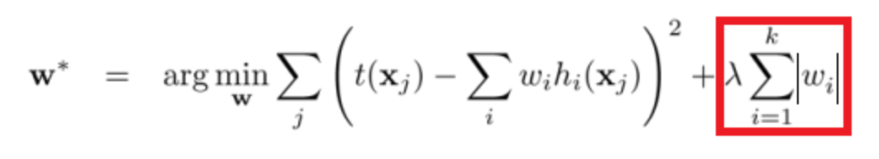
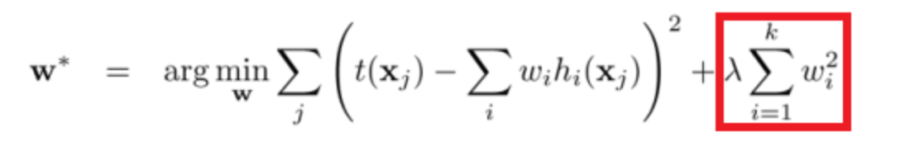
L1 and L2 Norms
L1 Loss Function
Note: the book refers to L1 as Lasso and L2 as Ridge Regression
L2 Loss Function
The compares with a scaled lambda term in your code sample
L1 Regularization
L2 Regularization (what we just did)
Read about comparison between L1 and L2 re: dimension reduction in book – Chptr 6!!

Slide 13
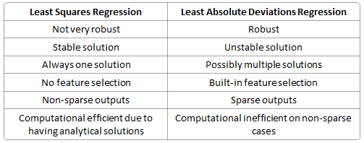






L1 and L2 norms
OLS assumes that the “best” predictions for y minimize the squared residuals. Known as the L2 norm:
$$\frac{1}{m}$$
$$\sum_{i=1}^{m}{ }$$
($\text{y}\text{i} \text{− (}β_{0}\text{+}β_{1}Xi \text{) = 0}$
An L1 norm considers the absolute error (instead of the squared error which can over-emphasize outliers).
$$\frac{1}{m}$$
$$\sum_{i=1}^{m}{ }$$
($\text{y}\text{i} \text{− }|β_{0}\text{+}β_{1}Xi\text{|}\text{ = 0}$
Comparing again:
True if you consider ‘Inf’ and ‘NA’ solutions

Slide 14
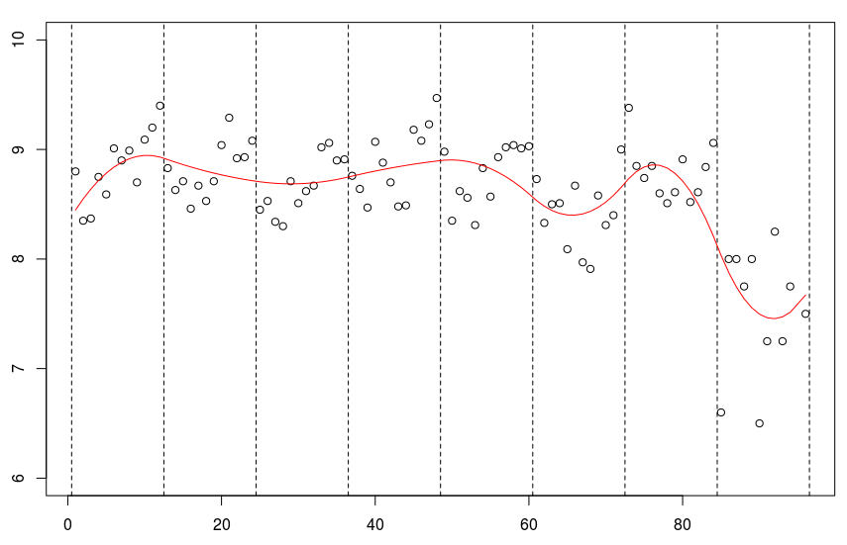
splines
A ‘spline’ is a function that is constructed piece-wise from polynomial functions. The term comes from the tool used by shipbuilders and drafters to construct smooth shapes having desired properties. Drafters have long made use of a bendable strip ﬁxed in position at a number of points that relaxes to form a smooth curve passing through those points
B-spline knots. B-spline curves are composed from many polynomial pieces.
Most people select knots by trail and error. Some R packages will select knots for you (Semi-Parametric).

Slide 15
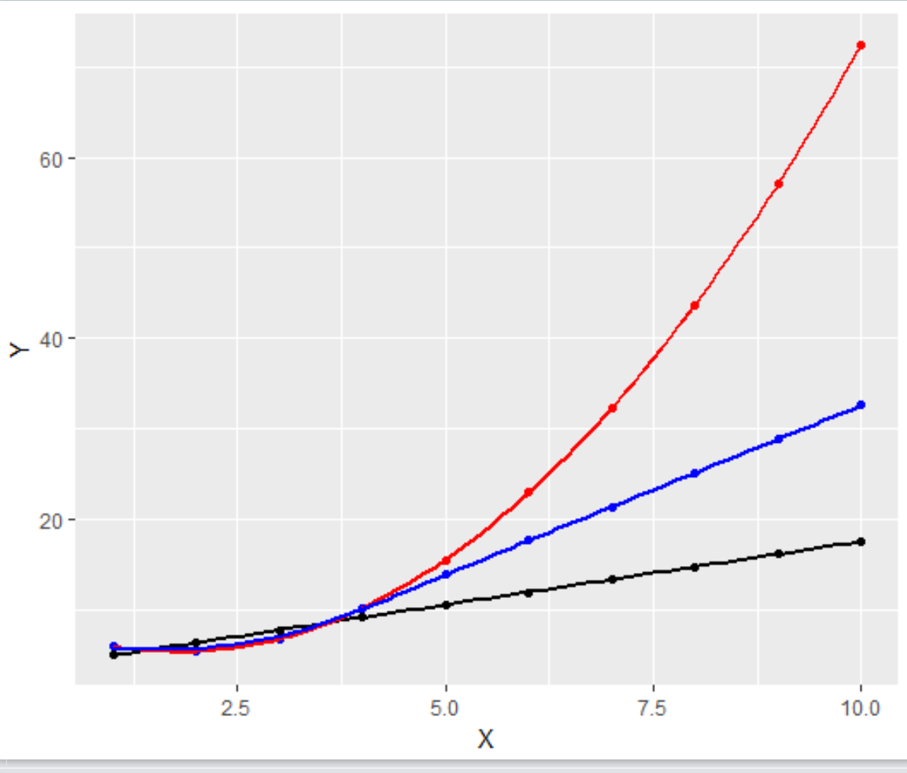
Local Regression - splines
library(ggplot2)
library(splines)
setwd("C:/Users/ellen/OneDrive/Documents/Spring 2017/Section III/History")
mydata <- read.csv(file="Ex1LS.csv", header=TRUE, sep=",")
mydata$X1 <- mydata$X
model <- lm( formula = Y ~ X, mydata)
modelQ <- lm( formula = Y ~ X + I(X^2), mydata)
modelNS <- lm(data = mydata, Y ~ ns(X, 3))
predData <- data.frame(X = seq(1, 10, 1))
predData$Y <- predict(model, predData)
predData$Q <- predict(modelQ, predData)
predData$NS <- predict(modelNS, predData)
p <- ggplot(predData, aes(x=X, y=Y))
p <- p + geom_point(data = predData, aes(x=X, y = Y), color = 'black')
p <- p + geom_point(data = predData, aes(x=X, y = Q), color = 'red')
p <- p + geom_point(data = predData, aes(x=X, y = NS), color = 'blue')
p <- p + geom_smooth(data=predData, aes(x=X, y = Y), se=FALSE, color = "black")
p <- p + geom_smooth(data=predData, aes(x=X, y = Q), se=FALSE, color = "red")
p <- p + geom_smooth(data=predData, aes(x=X, y = NS), se=FALSE, color = "blue")
p
summary(model)
summary(modelQ)
summary(modelNS)

Slide 16
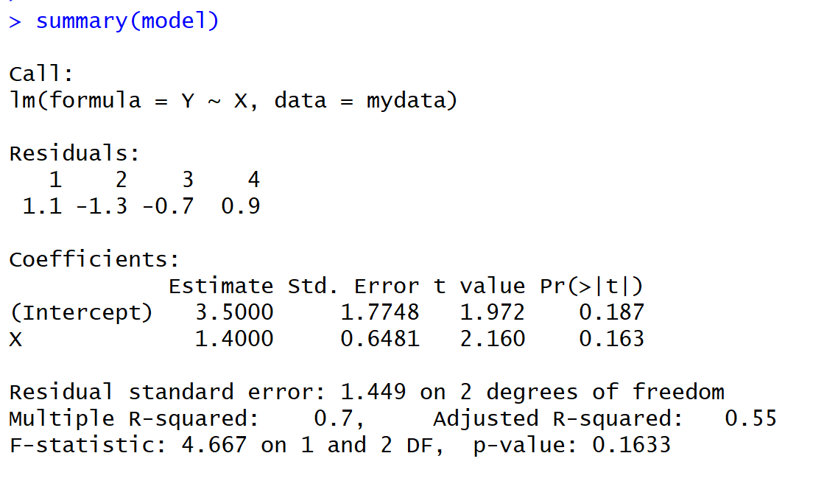
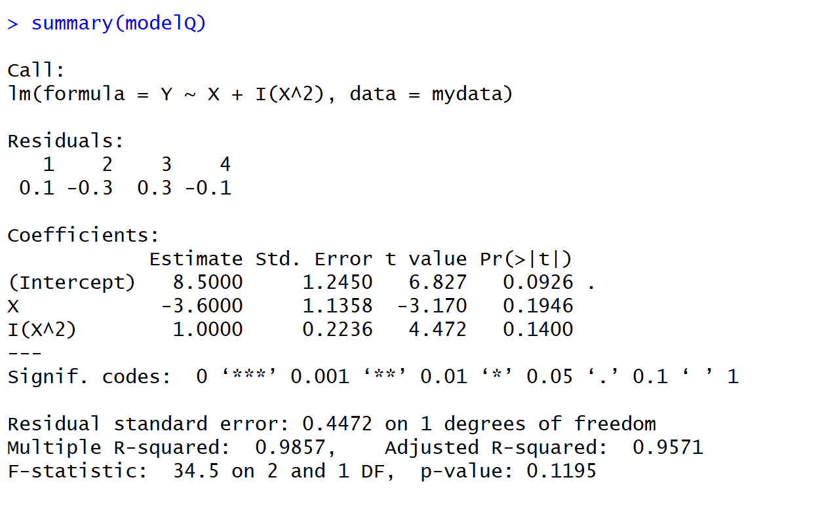
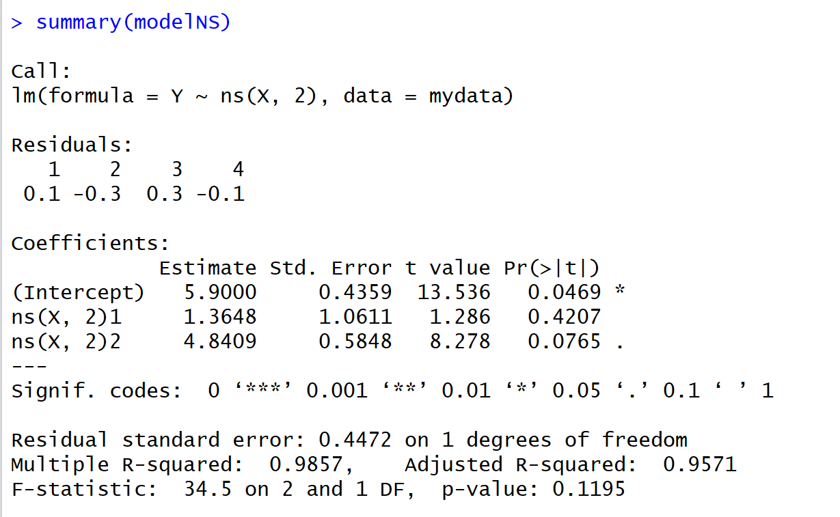
splines – comparing models

Slide 17
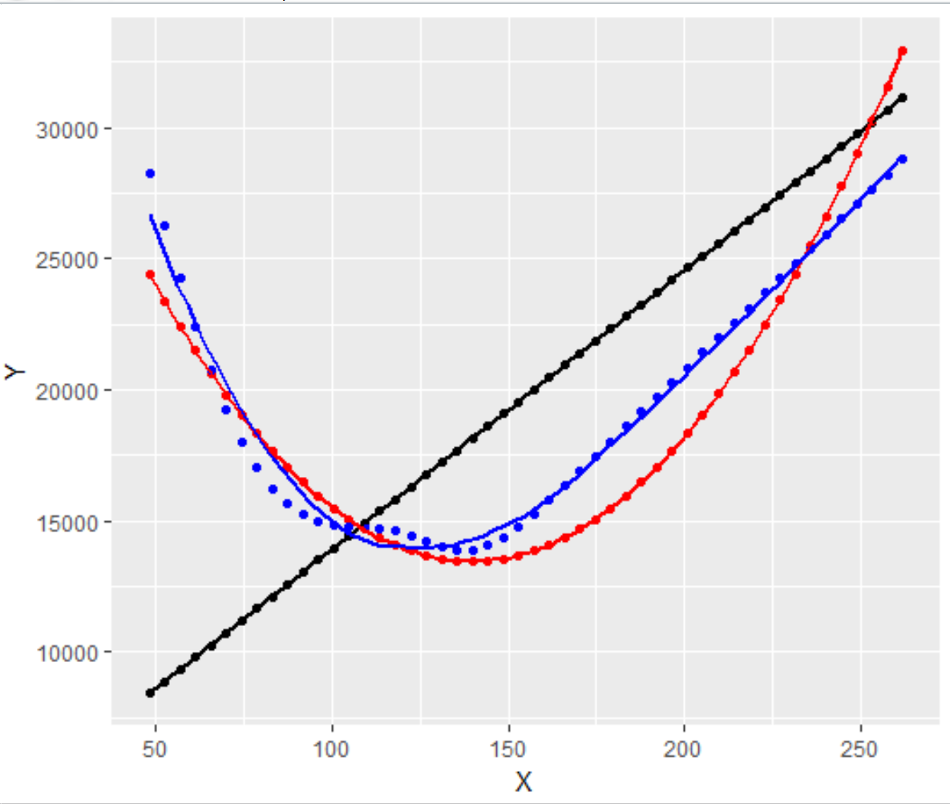
Comparing Splines to Polynomial
model <- lm(price ~ horsepower + highway.mpg, data = Auto)
modelQ <- lm( formula = price ~ horsepower + I(horsepower^2) + highway.mpg + I(highway.mpg^2), Auto)
modelNS <- lm(data = Auto, price ~ ns(horsepower, 5) + ns(highway.mpg, 5))
predData <- data.frame(horsepower = seq(min(Auto$horsepower), max(Auto$horsepower), length.out = 50), highway.mpg = seq(min(Auto$highway.mpg), max(Auto$highway.mpg), length.out = 50))
predData$Y <- predict(model, predData)
predData$Q <- predict(modelQ, predData)
predData$NS <- predict(modelNS, predData)
p <- ggplot(predData, aes(x=X, y=Y))
p <- p + geom_point(data = predData, aes(x=horsepower, y = Y), color = 'black')
p <- p + geom_point(data = predData, aes(x=horsepower, y = Q), color = 'red')
p <- p + geom_point(data = predData, aes(x=horsepower, y = NS), color = 'blue')
p <- p + geom_smooth(data=predData, aes(x=horsepower, y = Y), se=FALSE, color = "black")
p <- p + geom_smooth(data=predData, aes(x=horsepower, y = Q), se=FALSE, color = "red")
p <- p + geom_smooth(data=predData, aes(x=horsepower, y = NS), se=FALSE, color = "blue")
p
summary(model)
summary(modelQ)
summary(modelNS)

Slide 18
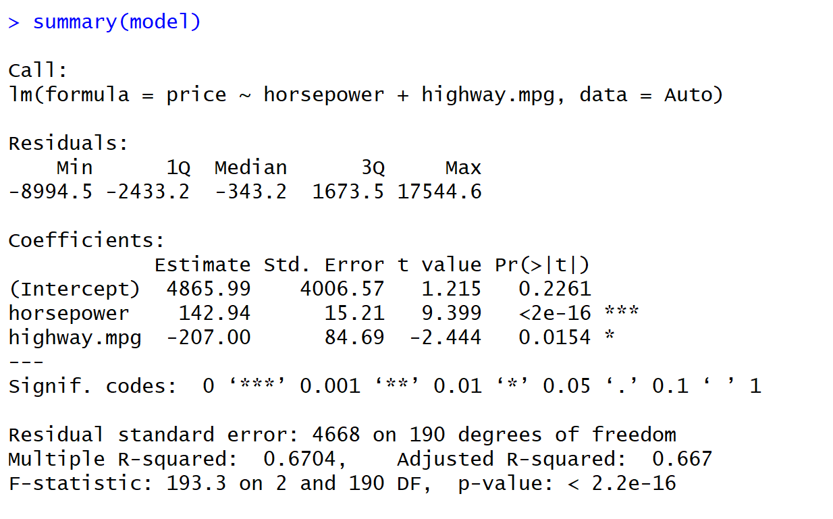
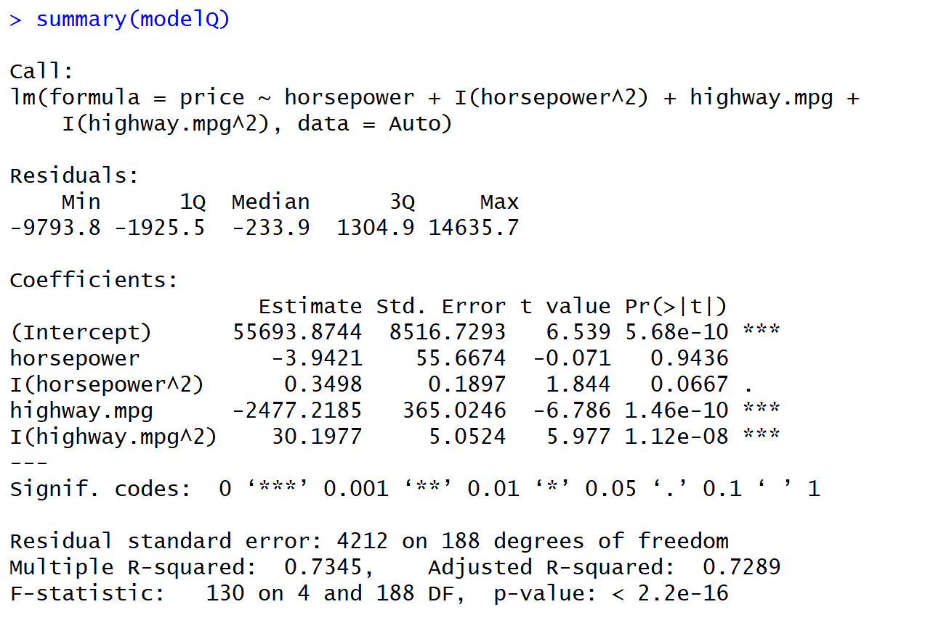
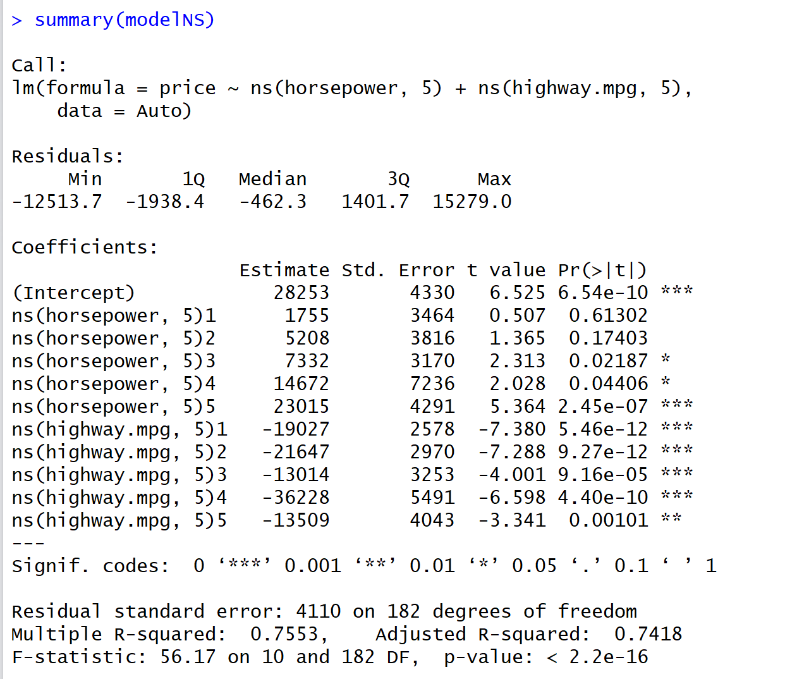
We asked lm to use a natural spline and create 5 knots. We get a different coefficient for each section, and to construct a formula, we would have to segment the data and run each through the coefficient values.

Slide 19

GAMs
Generalized additive models (GAMs), invented by Trevor Hastie and Robert Tibshirani in 1986, have a lot of appeal:
Relationships between the individual predictors and the dependent variable follow smooth patterns that can be linear or nonlinear.
We can estimate these smooth relationships simultaneously and then predict g(E(Y)) by simply adding them up.
Mathematically speaking, a GAM is an additive modeling technique where the impact of the predictive variables is captured through smooth functions which, depending on the underlying patterns in the data, can be nonlinear The structure of these models generally follows:
Where g() is the link function (links the expected value to the predictor variables). The terms denote smooth, nonparametric functions (the shape of predictor functions are fully determined by the data).
GAMs are a type of hybrid – containing parametric and non-parametric terms. Moreover, like generalized linear models (GLMs will be introduced in Classification), GAM supports multiple link functions.
$g\left(E\left(y\right)\right)= α$ + ƒ₁(x₁) + …+ ƒ_{p}(x_{p})
link function
similar to splines – different functions (not just different coefficients) for knots
For more details on how to create these smooth functions, see the section called “Splines 101” https://multithreaded.stitchfix.com/assets/files/gam.pdf

Slide 20
GAMs strike a balance between the interpretable, yet biased, linear model, and the extremely flexible, “black box” learning algorithms.
Interpretability
When a regression model is additive, the interpretation of the marginal impact of a single variable (the partial derivative) does not depend on the values of the other variables in the model. Hence, by simply looking at the output of the model, we can estimate the effects of the predictive variables.
Flexibility and Automation
GAMs can capture common nonlinear patterns that a classic linear model would miss. When fitting fully parametric regression models, these types of nonlinear effects are typically captured through binning or polynomials. This leads to clumsy model formulations with many correlated terms and counterintuitive results. Moreover, selecting the best model involves constructing a multitude of transformations. We don’t have this problem with GAM. Predictor functions are automatically derived during model estimation. We don’t have to know up front what type of functions we will need.
Regularization
As mentioned above, the GAM framework allows us to control smoothness of the predictor functions to prevent overfitting.
Application Note: GAMs can be very helpful in Parametric Exploratory and Diagnostic Modeling

Slide 21
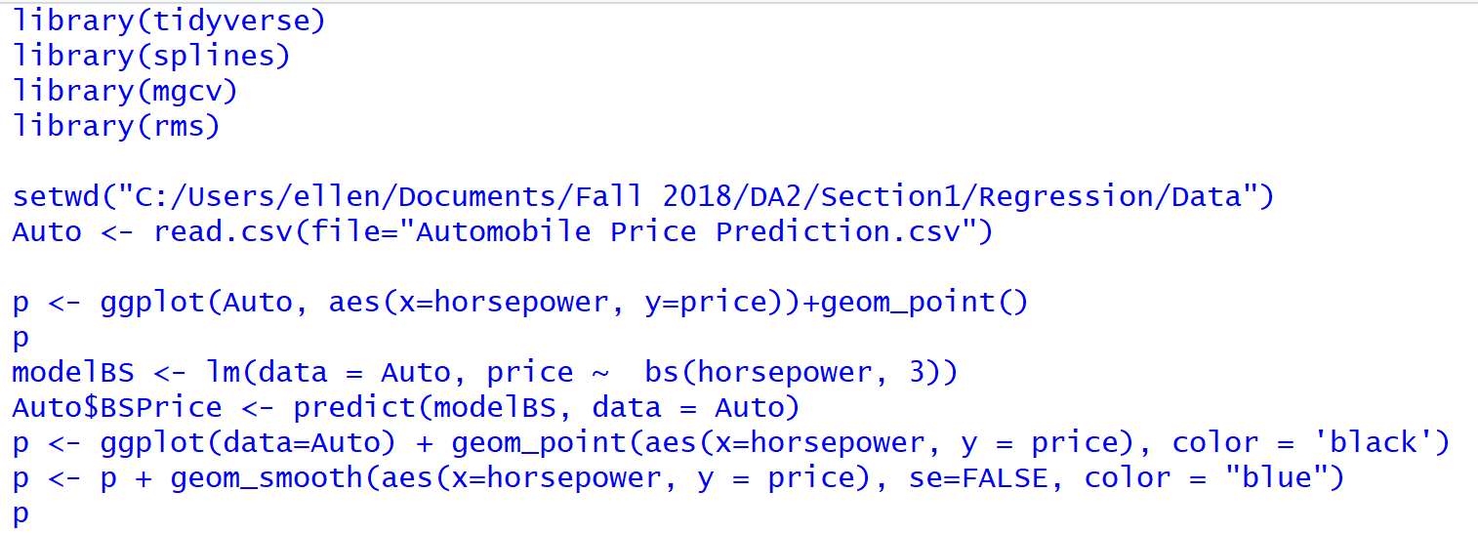
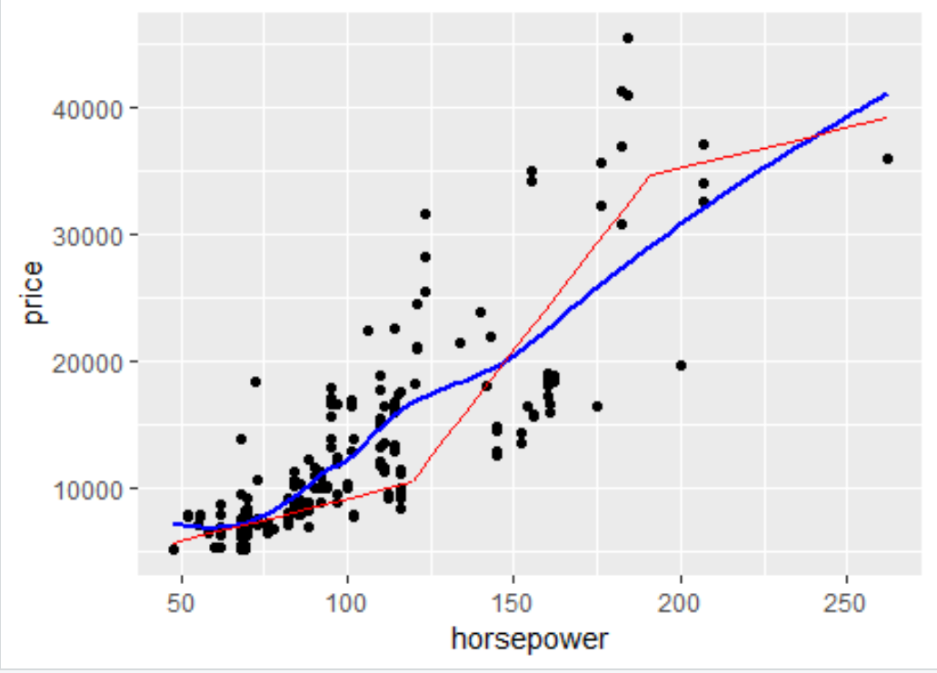
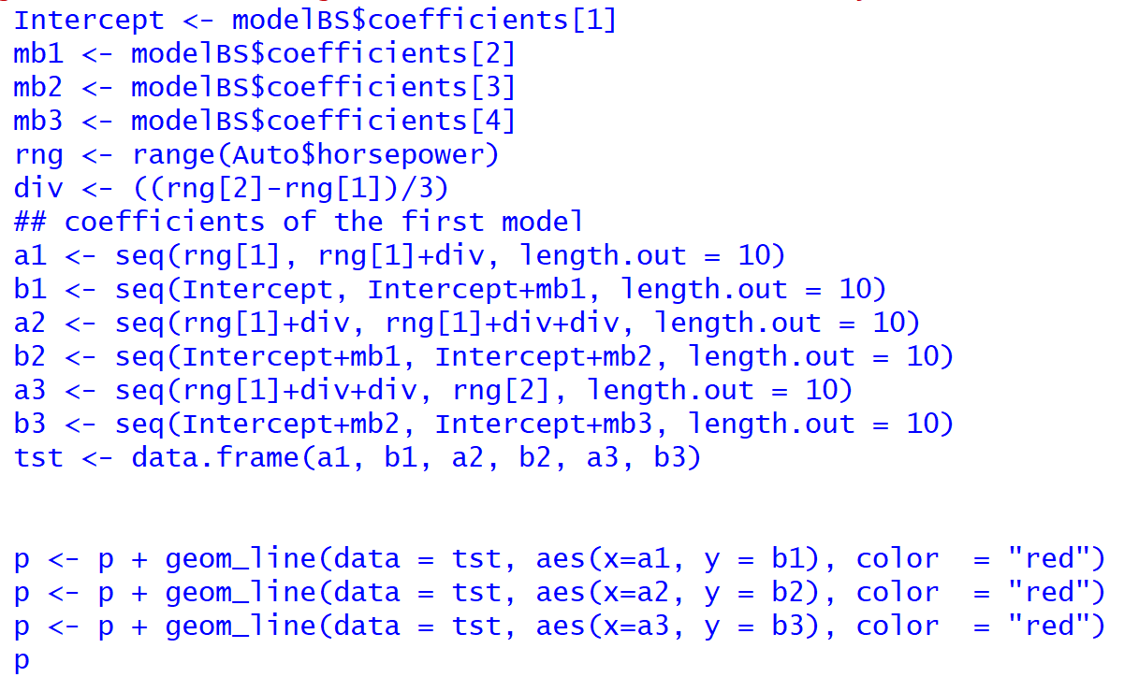
Comparing splines to GAMs (super simple example)
Splines will take these the functions for each knot, and smooth them with another function (going from red line => blue line)

Slide 22
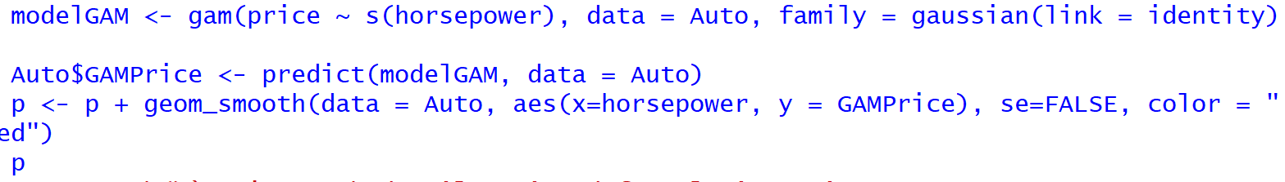
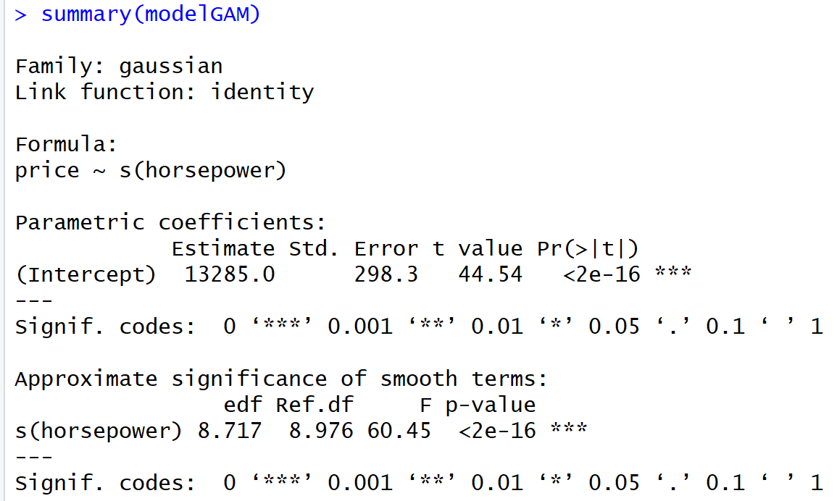
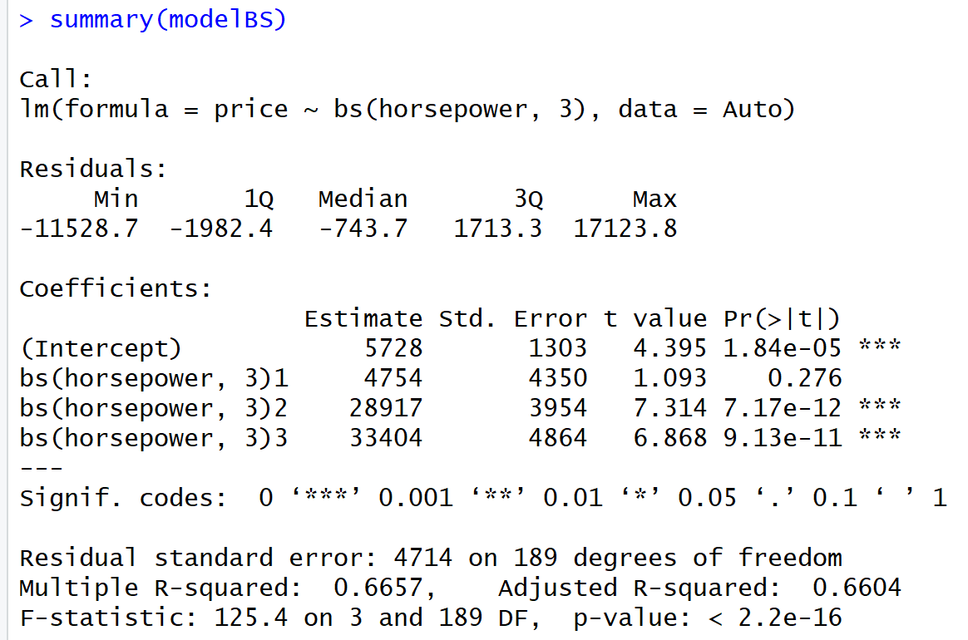
A few points here:
GAMs are far more powerful for modeling regression problems than polys or splines, but with more loss of interpretability (you’re dealing with a different function for each knot).
They are very useful for non-parametric apps, and should be considered vs. SVM or Tree-Based Models, and also for prototyping and testing parametric models (like the Bayesian models we’ll see in Section II of this course)
GAM’s use a link function like Generalized Linear Models (which we’ll introduce in the Classification Section), but they’re NOT GLM’s which has broad application in parametric application.
The LOESS you see out of ggplot is a type of GAM (it uses a bandwidth parameter for df control vs knots)

Slide 23
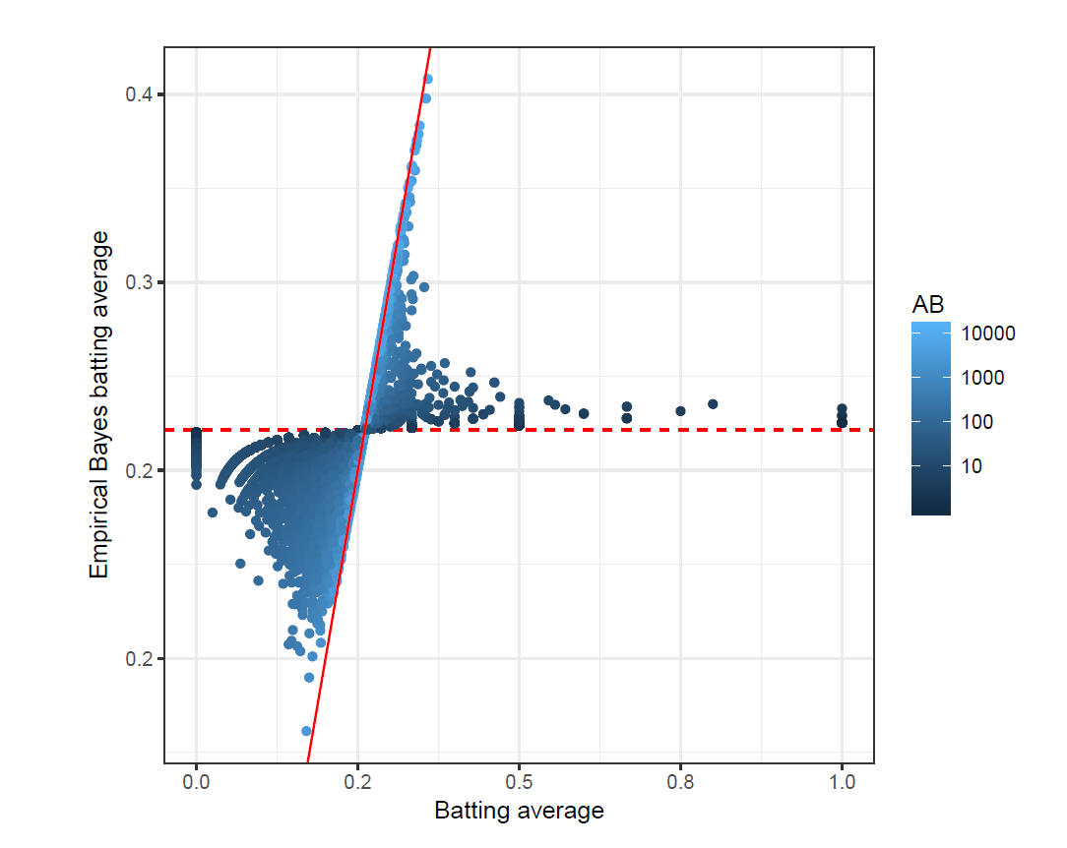
Looking Forward
Bayesian modeling is a very different approach - parameters are regularized by priors, pooling and levels which gives fine control over each parameter.
Additionally, priors gives us the ability to apply judgment to parameter values. How much does judgment influence parameter values? Depends on the evidence - in the visual to the right, we see how batting averages shrink towards a range from 200-400, but those at the extremes (> 300), require more evidence (ABs).
Extraordinary claims require extraordinary evidence. In the real world, we often don’t have data and we must apply judgment, letting evidence weigh effect.

