Slide 1
視窗程式設計 - 期 末 報 告 猜拳與擲骰子遊戲
何嘉蕾 N12170031
陳達志 N12170036

Slide 2
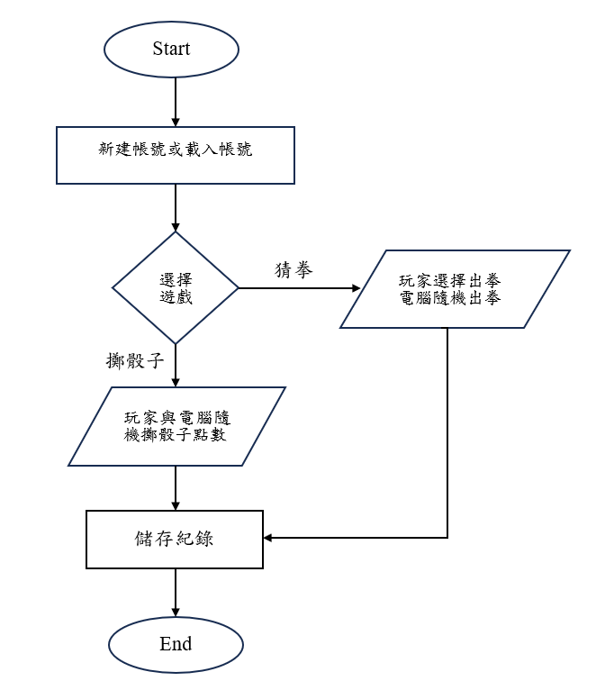
流程圖

Slide 3
UML
Main
-btnRPS_Click(): void -btnDice_Click(): void -新帳號ToolStrip_Click(): void -載入紀錄ToolStrip_Click(): void -查詢紀錄ToolStrip_Click(): void -UpdateStats(): void
RecordForm
-SelectedIndex: int -selectionMode: bool
-Record_Load(): void -btnDelete_Click(): void -btnLoad_Click(): void
Implementation
實作
GameStats
PlayerWins: int +ComputerWins : int +CurrentPlayerName : int +Records: List AllPlayers: List - recordFile: void
+ Reset(): void + AddPlayer(): void + GetAllPlayers() : List +SaveCurrentRecord(): void +LoadAllRecords(): void +LoadRecord(): void + DeleteRecord(): void +SaveRecord(): void
Association
關聯
Association
關聯
RPS
-rand: Random -LoadImages(): void -Play(): async Task -btnScissors_Click(): async void -btnRock_Click(): async void -btnPaper_Click(): async void -DisableButtons(): void -EnableButtons(): void -RPS_Load(): void -ResetButton(): void -SaveResult(): void
Dice
-rand: Random -LoadDiceImage(): void -RollDice(): async Task -SaveResult(): void
Aggregation聚合
Composition組成
GameRecord
+PlayerName: string +PlayerWin: int +PCWin: int
Implementation
實作
Implementation
實作

Slide 4
核心功能
*課本應用：CH 14 ”MenuStrip’功能表控制項以及多表單應用

