Slide 1



Marist Computing Conference
Causal Inference and Machine Learning
in Education
Part-Time Instruction and First-Semester Freshmen
Eitel J.M. Lauría
November 7, 2025
Notes:
Good afternoon. Today I'm going to talk about using causal inference and machine learning to answer an important question in higher education: Do part-time instructors help or harm first-semester freshmen? This is work conducted at Marist University in collaboration with the retention committee.

Slide 2
Motivation
Marist Computing Conference
Part-time (PT) faculty represent ∼44% of U.S. faculty (NCES 2024).
Ongoing debate: do PT instructors help or harm students?
Why focus on first-semester freshmen?
  Early academic experiences strongly shape persistence.
Past studies often associational, not causal.
Eitel J.M. Lauría
Causal Inference and Machine Learning in Education MCC – 11/7/2025
Notes:
So why does this matter? Part-time faculty now represent about 44% of all faculty in U.S. higher education. There's an ongoing debate about whether this is good or bad for students. We're focusing specifically on first-semester freshmen because early academic experiences are crucial for student persistence. And importantly, most past studies have been correlational—they haven't established causation.

Slide 3

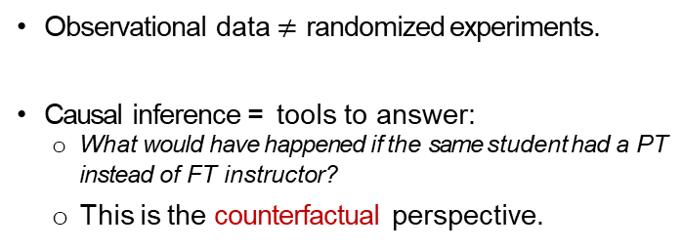
Why Causal Inference?
Marist Computing Conference
Observational data$≠$randomized experiments.
Causal inference = tools to answer:
  What would have happened if the same student had a PT instead of FT instructor?
      This is the counterfactual perspective.
Source: XKCD
Eitel J.M. Lauría
Causal Inference and Machine Learning in Education MCC – 11/7/2025
Notes:
This brings us to why we need causal inference. Observational data isn't the same as a randomized experiment. We can't just compare grades between students who had part-time versus full-time instructors—there are confounding factors. Causal inference gives us tools to answer the counterfactual question: What would have happened if the same student had a part-time instead of a full-time instructor?

Slide 4
Counterfactuals
Marist Computing Conference
Factual outcome: student’s grade with actual instructor.
Counterfactual: student’s grade with alternative instructor type.
Problem: we never observe both outcomes for the same student.
Solution: approximate counterfactuals by adjusting for confounders (what are confounders?)
Eitel J.M. Lauría
Causal Inference and Machine Learning in Education MCC – 11/7/2025
Notes:
Let me clarify what we mean by counterfactuals. The factual outcome is the student's actual grade with their actual instructor. The counterfactual is what that student's grade would have been with the alternative instructor type. The fundamental problem is we never observe both outcomes for the same student. The solution? We approximate counterfactuals by carefully adjusting for confounding variables.

Slide 5
Pearl’s Framework (and the risks of having ice cream)
Marist Computing Conference
Ice Cream
Drowning
Eitel J.M. Lauría
Causal Inference and Machine Learning in Education MCC – 11/7/2025
Notes:
To understand this better, let's use Judea Pearl's causal framework with a simple example. Imagine we observe that ice cream sales are associated with drowning incidents. Should we ban ice cream?

Slide 6
Pearl’s Framework (and the risks of having ice cream)
Marist Computing Conference
Summer
Ice Cream
Drowning
Directed Acyclic Graph (DAG) encodes assumptions.
Confounders open backdoor paths.
Summer affects both Ice Cream Sales and Drowning Risk
Creates a spurious association (a backdoor path).
Eitel J.M. Lauría
Causal Inference and Machine Learning in Education MCC – 11/7/2025
Notes:
Of course not! Summer is a confounder—it affects both ice cream sales AND drowning risk by increasing swimming. This creates a spurious association, what we call a 'backdoor path.' Summer opens this backdoor path between ice cream and drowning.

Slide 7
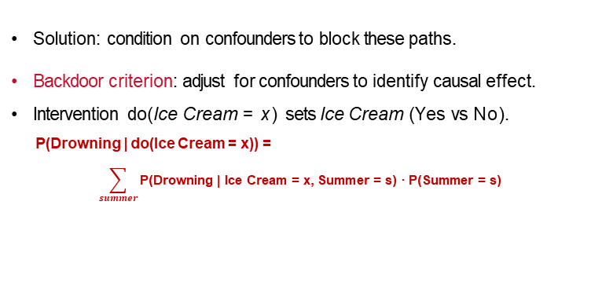
Pearl’s Framework
Marist Computing Conference
Summer
×
×
Ice Cream
Drowning
Solution: condition on confounders to block these paths.
Backdoor criterion: adjust for confounders to identify causal effect.
Intervention do(Ice Cream = x) sets Ice Cream (Yes vs No).
P(Drowning | do(Ice Cream = x)) =
$$\sum_{summer}{\text{P}\text{(}\text{Drowning}\text{ | }\text{Ice} \text{Cream}\text{ = }\text{x}\text{, }\text{Summer}\text{ = }\text{s}\text{) · }\text{P}\text{(}\text{Summer}\text{ = }\text{s}\text{)}}$$
Eitel J.M. Lauría
Causal Inference and Machine Learning in Education MCC – 11/7/2025
Notes:
Pearl's solution is elegant: condition on the confounders to block these backdoor paths. This is the backdoor criterion. When we intervene—represented by 'do' notation—we're setting ice cream consumption, not just observing it. The formula shows we need to adjust for summer by summing over its possible values, weighted by their probabilities.

Slide 8
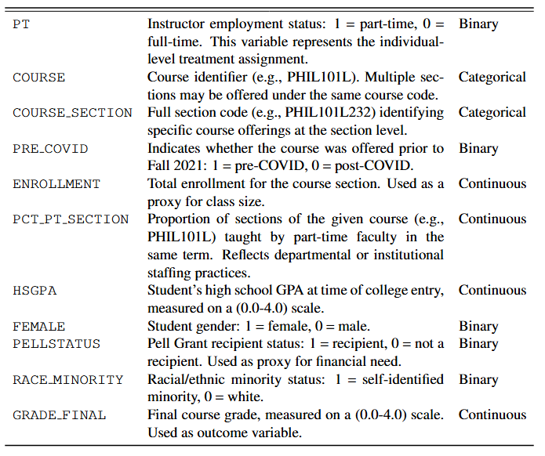
Data and Context
Marist Computing Conference
Thirteen academic years (Fall 2012 through Spring 2024) containing both student-level and course-level records.
Focus on first-semester freshmen and their academic outcomes (final grades)
Primary unit of analysis: a student enrolled in a course section. The dataset contains final course grades enriched by student demographics and instructional context covariates for each credit-bearing undergraduate course enrollment.
Treatment: part-time instructor; Outcome: final grade
Net 48,138 first-semester freshmen records, after eliminating courses that presented severe treatment imbalance
Eitel J.M. Lauría
Causal Inference and Machine Learning in Education MCC – 11/7/2025
Notes:
Now let's get to our actual study. We analyzed thirteen years of data from Fall 2012 through Spring 2024, focusing on first-semester freshmen. Our unit of analysis is a student enrolled in a course section. The treatment is having a part-time instructor, and the outcome is final grade. After removing courses with severe treatment imbalance, we had 48,138 student-course records. As you can see in the table on the right, we have variables for instructor type, course information, student demographics, and various contextual factors.

Slide 9
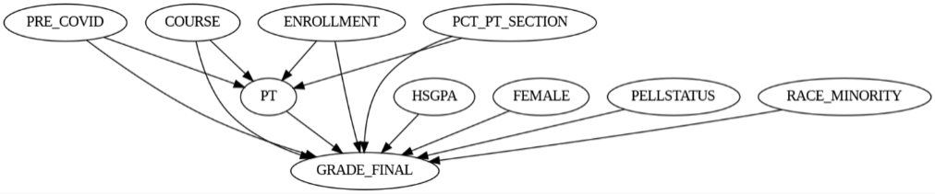
Identification & Adjustment Set
Marist Computing Conference
From DAG analysis:
Z = {Course, Enrollment, Pre-COVID, %PT Section}
V = {HS GPA, Gender, Pell, Minority}
Z : confounders → must adjust to block backdoors.
V : precision covariates → improve efficiency.
Ensures valid estimation of Average Treatment Effect (ATE).
Eitel J.M. Lauría
Causal Inference and Machine Learning in Education MCC – 11/7/2025
Notes:
Based on our causal DAG—shown at the bottom—we identified our adjustment set. Z contains our confounders: Course, Enrollment, Pre-COVID period, and percentage of PT sections. These we must adjust for to block backdoor paths. V contains precision covariates like high school GPA, gender, Pell status, and minority status. These improve efficiency but aren't strictly necessary for identification. Together, this ensures valid estimation of the Average Treatment Effect.

Slide 10
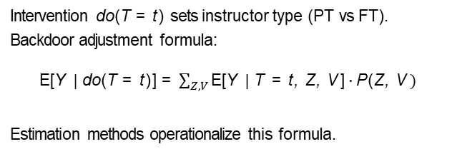
General Causal Estimand
Marist Computing Conference
Average Treatment Effect
ATE = E[Y | do(T = 1)] − E[Y | do(T = 0)]
Intervention do(T = t) sets instructor type (PT vs FT). Backdoor adjustment formula:
E[Y | do(T = t)] = $\sum_{Z,V}{\text{E}\text{[}\text{Y} \text{|} \text{T} \text{=} \text{t}\text{, }\text{Z}\text{, }\text{V} \text{]} \text{· }\text{P}\text{(}\text{Z}\text{, }\text{V}} )$
Estimation methods operationalize this formula.
Eitel J.M. Lauría
Causal Inference and Machine Learning in Education MCC – 11/7/2025
Notes:
Formally, the Average Treatment Effect is the difference in expected outcomes under intervention. The 'do' operator represents setting the instructor type to part-time versus full-time. Using the backdoor adjustment formula, we can express this as a sum over all combinations of our confounders and precision variables, weighted by their joint probability.

Slide 11
Estimation Methods Overview
Marist Computing Conference
Double Machine Learning (DML): ML-based, flexible
Bayesian hierarchical models: account for course - level variation.
      If we have time (probably not ☺)
.
Eitel J.M. Lauría
Causal Inference and Machine Learning in Education MCC – 11/7/2025
Notes:
We used two complementary approaches. First, Double Machine Learning, which is flexible and leverages modern ML methods. Second, Bayesian hierarchical models, which account for course-level variation. I'll focus primarily on DML today due to time constraints.

Slide 12
Marist Computing Conference
What is Double Machine Learning?
Key idea: Remove the influence of confounders before estimating the causal effect.
Frisch–Waugh–Lovell (FWL) theorem: In linear regression, the coefficient of a treatment variable T can be obtained by:
  Regressing T on (Z , V ) and taking the residuals R_{T}.
  Regressing the outcome Y on (Z , V ) and taking the residuals R_{Y}.
  Regressing R_{Y} on R_{T} .This isolates the variation in T that is orthogonal to the confounders.
  Double Machine Learning (DML):
    Extends this idea by replacing the linear regressions with flexible ML models.
    Ensures the treatment effect remains unbiased even when outcome and treatment models are nonlinear or high-dimensional.
  → Orthogonalization + Machine Learning = Double Machine Learning
Eitel J.M. Lauría
Causal Inference and Machine Learning in Education MCC – 11/7/2025
Notes:
Double Machine Learning extends a classical idea from econometrics. The Frisch-Waugh-Lovell theorem tells us we can isolate a treatment effect by removing the influence of confounders first—getting residuals—then regressing outcome residuals on treatment residuals. DML extends this by replacing linear regression with flexible machine learning models. The 'double' comes from modeling both the outcome AND the treatment. This orthogonalization plus machine learning gives us robust causal estimates even with complex, high-dimensional data.

Slide 13
Estimating ATE with DML
Marist Computing Conference
Key idea: partial out confounders with machine learning, then regress residuals.
Step 1: Fit Treatment and Outcome Models
Model T: Train binary classifier f_{T} (Z, V ) to predict treatment T
Model Y: Train regressor f_{Y} (Z, V ) to predict outcome Y.
Step 2: Compute Residuals
R_{T} = f_{T} (Z, V ) − T (treatment residuals)
R_{Y} = f_{Y} (Z, V ) − Y (outcome residuals)
Step 2: Causal Effect Estimation
Regress R_{Y} on R_{T} to estimate the average treatment effect
Configurations:
Logistic (treatment) + Lasso (outcome).
Logistic (treatment) + Random Forest (outcome).
Eitel J.M. Lauría
Causal Inference and Machine Learning in Education MCC – 11/7/2025
Notes:
Here's how it works in three steps. First, we fit two models: a binary classifier to predict treatment assignment, and a regressor to predict the outcome—both using our confounders and precision variables. Second, we compute residuals for both treatment and outcome. Finally, we regress the outcome residuals on treatment residuals to estimate the causal effect. We tried different ML algorithms—logistic with Lasso for the outcome, and logistic with Random Forest

Slide 14
Estimating ATE with DML
Marist Computing Conference
Average Treatment Effect (ATE): ≈ +0.20 grade points.
Robust across DML algorthims.
Use refutation methods available in DoWhy to ‘falsify’ the findings
  Random Common Cause: Estimated ATE = 0.2031, p-value = 0.90
  Data Subset Refuter: Estimated ATE = 0.2038, p-value = 0.92
  Bootstrap Refuter: Estimated ATE = 0.2043, p-value = 0.90
Eitel J.M. Lauría
Causal Inference and Machine Learning in Education MCC – 11/7/2025
Notes:
And here are our main results. The Average Treatment Effect is approximately +0.20 grade points—meaning students with part-time instructors did better on average. This effect is robust across different DML algorithms. We also used multiple refutation tests available in the DoWhy library to validate our findings—including random common cause tests, data subset refuters, and bootstrap refuters. All showed our estimate held up well with high p-values, giving us confidence these results aren't spurious.
Random Common Cause Test: An independent random variable is added to the dataset asa confounder, and the estimate is recalculated. Does the estimation method change the valueof its estimate after adding the confounder to the dataset? This added random common causeshould not affect the estimate.
Data Subset Refuter: The given dataset is replaced with a randomly selected subset, and the estimate is recalculated. This tests robustness to specific sample composition. Is theestimated effect sensitive to this change?
Bootstrap Refuter: The given dataset is replaced with bootstrapped samples from the samedataset, and the estimate is recalculated. Does the estimated effect change significantly?

Slide 15
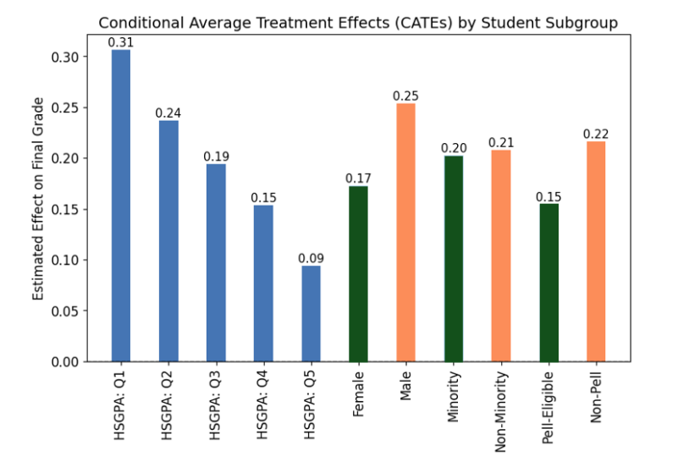
Marist Computing Conference
Estimating CATE with DML
CATEs) estimated by DML Logistic Regression + Lasso CV).
HSGPA is binned in quintiles: Q1 (2.88-3.44), Q2 (3.44-3.56), Q3 (3.56-
3.64), Q4 (3.64-3.76), Q5 (3.76-4.0)
Eitel Lauría Marist University
Causal Inference and Machine Learning in Education
Notes:
We can also look at Conditional Average Treatment Effects to see how the impact varies across student groups. This chart shows that lower-performing students—those in the bottom quintile of high school GPA—benefit most from part-time instructors, with an effect of 0.31 grade points. The effect decreases for higher-performing students. We also see variation by gender and Pell status, with males and non-Pell students showing slightly higher benefits.

Slide 16
Bayesian Hierarchical Models
Marist Computing Conference
Motivation: students are nested within courses. Model random intercepts and random slopes for PT.
Produces posterior distributions (not just point estimates). Reveals variation across courses.
Example: Biology ↑, English ↓.
Eitel J.M. Lauría
Causal Inference and Machine Learning in Education MCC – 11/7/2025
Notes:
Now, our Bayesian approach offers complementary insights.

Slide 17
Estimating ATE with Bayesian Hierarchical Regression
Marist Computing Conference
In the Bayesian setting, we allow for heterogeneity in baseline performance across courses by including random intercepts at the course level, while keeping a global slope for the treatment PT. This captures unobserved differences between courses while assuming the effect of part-time instruction is constant across them.
Eitel J.M. Lauría
Causal Inference and Machine Learning in Education MCC – 11/7/2025
Notes:
We model students as nested within courses, with random intercepts and random slopes for the PT effect. This produces full posterior distributions rather than just point estimates and reveals substantial variation across courses.

Slide 18
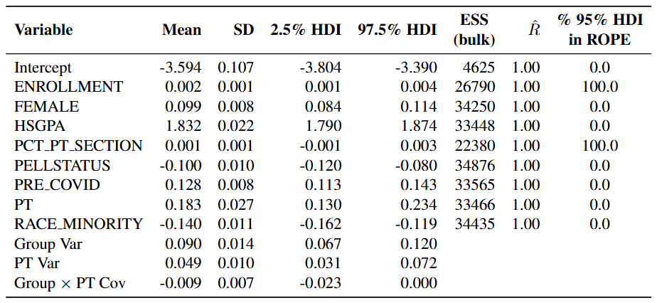
Estimating ATE with Bayesian Hierarchical Regression
Marist Computing Conference
Eitel J.M. Lauría
Causal Inference and Machine Learning in Education MCC – 11/7/2025
Notes:
The model shows a global ATE of about 0.183 with good convergence diagnostics.

Slide 19
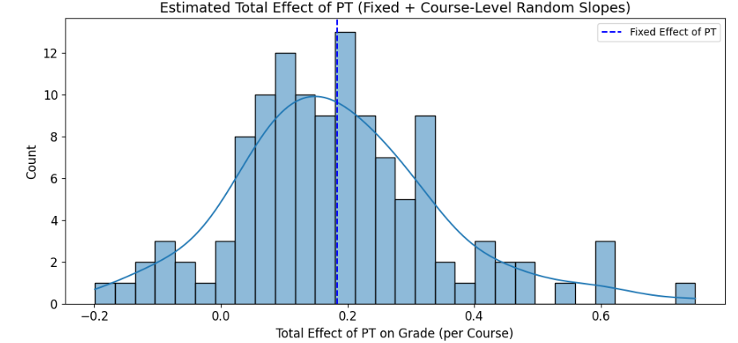
Estimating CATE with Bayesian Hierarchical Regression
Marist Computing Conference
Eitel J.M. Lauría
Causal Inference and Machine Learning in Education MCC – 11/7/2025
Notes:
We can see from the distribution of course-specific effects that some courses show much stronger positive effects while others show small negative effects.
For example, BIOL232 shows the strongest positive effect at 0.75, while ENG271L shows a small negative effect

Slide 20
Key Takeaways
Marist Computing Conference
The study challenges assumption that PT faculty harm students.
  PT instruction → modest positive causal effect.
Demonstrates value of causal inference + ML in education
  Pearl’s framework provides credible causal identification.
  DML: flexible, robust causal estimation with ML.
  Bayesian models: capture course-level variation and uncertainty.
Eitel J.M. Lauría
Causal Inference and Machine Learning in Education MCC – 11/7/2025
Notes:
So what are our key takeaways? First, this study challenges the common assumption that part-time faculty harm students—we find a modest positive effect. Second, it demonstrates the value of combining causal inference with machine learning in education research. Pearl's framework provides rigorous causal identification. Double Machine Learning offers flexible, robust estimation. And Bayesian models capture important heterogeneity and uncertainty across courses

Slide 21
Marist Computing Conference
Questions?
Eitel J.M. Lauría
Causal Inference and Machine Learning in Education MCC – 11/7/2025
Notes:
That brings me to the end of my talk. I'm happy to take your questions. Thank you!

Slide 22
Marist Computing Conference
Thank You!
Eitel J.M. Lauría
Causal Inference and Machine Learning in Education MCC – 11/7/2025

