Slide 1
Generative AI for enhancing societal polls
Dinesh C. Verma

Slide 2
Problem Statement
Population opinion polls are a key part of political, economy and market research conducted by pollsters and enterprises
Sentiments of people today are collected by means of polls on a small sample of population
Challenges
  Sample may or may not be fully representative
    Relevant only to polled mix of population
    Results are hard to generalize
  Polling is expensive and slow
    Many plans for polling are abandoned
    For new questions, new polls need to be conducted (more expense/time)
  Poll results are hard to explain

Slide 3
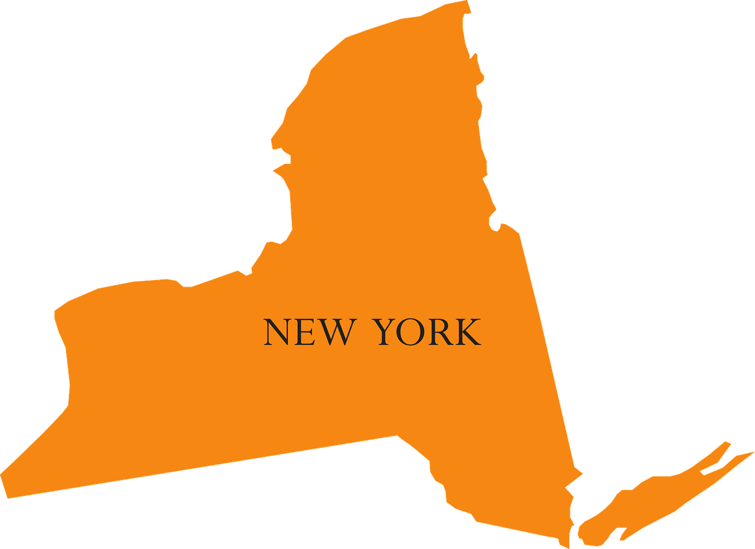

Problem Illustration
Consider a company operating in New York and New Jersey which wants to get answer to the poll question:
  What do you think about proposed changes to Medicare?
  For its audience in New Jersey
It has already conducted an earlier poll with the same question in New York
How can it extrapolate from NY results to NJ without conducting a new poll (or a smaller poll)
Variations:
  Questions may be different
    What do you think about proposed revisions to social security?
Median: 40 years
Under 18: 16%
18-40: 33%
40-65: 34%
Over 65: 17%
Available
Data
Real Poll Data
1000 people
Desired
Data
Median: 40 years
Under 18: 22%
18-40: 25%
40-65: 26%
Over 65: 27%
Apparatus
Desired Poll Data for
1000 people

Slide 4
Our Approach
Create an Artificial Society
with question-answering
agents
Learn Attributes of an
Artificial Society
that matches real poll
sample
Obtain Real Poll Sample
Run polls for
new environment
on Artificial Society

Slide 5
What are Synthetic Communities
A synthetic community is a simulated community which feels like a real community
  Consists of a collection of one or more agents
  Each agent is capable of generating a textual response to a question
Usage of Synthetic Communities
  Can be used to extrapolate poll results from real communities
    Generate responses for a related question that differs from one that was asked
    Generate polling results for a community that may have different properties than existing community
    Explore what-if scenario on polling results
  Can be used as simulated focus groups for business problems
  Can be used to study social policies and their impact
    Examine reactions of synthetic agents to various policies.

Slide 6



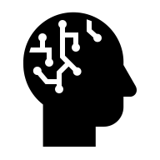
Model of Synthetic Society/Synthetic Agents
We model a synthetic society as a collection of Synthetic Agents
A Synthetic Agent is a responder/translator
  It translates X to Y
  Example: When the agent is asked question X, it replies with Y
Each instance of an agent is defined by its attributes and its type
A society is a collection of different types of Synthetic Agents
  Each type of Agent has a different way to map X to Y
  In effect, each type of agent is associated with a different AI model configuration.
X
Y
Synthetic Agent
400
instances
300
instances
200
instances
100
instances
Synthetic Society

Slide 7
Synthetic Community Creation
Creating a synthetic community requires generation of synthetic data
  A set of simulated people with their attributes
    Attributes need to be synthetic
  A mechanism for simulated people to respond
    Can use a LLM for this purpose
How can we generate the synthetic data to create a realistic society
There may be some constraints on the synthetic societies
Typical Constraints on Synthetic Societies
  Mean values of some attribute,
    e.g. average age of the community
  Relationship among agent attributes
    The number of years of education of an individual must be less than the age minus 5.
  Relative behavior of agents
    People who are in higher income bracket tend to favor less progressive tax policies

Slide 8
Creating a synthetic agent
Requires creation of an AI model that can translate from X to Y
Approaches
  When X and Y are numeric
    If there is sufficient samples of X and Y, then one can
    Train a standard AI model to generate Y from X
  When X and Y are free flowing text
    Fine-tune a LLM to generate Y from X
      Generally needs a larger sample
    Select proximity based samples to create a prompt (In Context Learning)
      Suitable with smaller samples

Slide 9
Current Status
Working on developing the software for synthetic agents and synthetic society
Cooperating with Marist Polls team as part of IBM Marist Collaboration

