Slide 1

Partially Homomorphic Encryption for the Internet of Things
Bowu Zhang
Associate Professor of Computer Science
Marist University

Slide 2
Motivation
IoT devices generate vast amounts of sensitive data
  Location and Movement data
  Health data
  Smart Home data
  Communication data
  Financial & Transactional Data
Can these data be utilized?
Notes:
IoT is growing rapidly, but security remains a major concern.
IoT devices collect a wide range of data depending on their application. Here are some common types of data they gather:
1. Environmental Data
Temperature, humidity, air quality
Light levels, sound levels, radiation levels
2. Location & Movement Data
GPS coordinates, geofencing data
Motion sensors, accelerometers, gyroscopes
3. Biometric & Health Data
Heart rate, blood pressure, oxygen levels
ECG, EEG, body temperature, activity tracking
4. Device Performance & Usage Data
Battery levels, operational status, error logs
Usage patterns, software updates, device connectivity
5. Smart Home & Security Data
Camera feeds, door lock status, alarm triggers
Energy consumption, appliance usage
6. Industrial & Manufacturing Data
Machine health, predictive maintenance
Production rates, supply chain monitoring
7. Financial & Transactional Data
Contactless payments, transaction logs
Smart contracts, blockchain-based data
8. Communication & Behavioral Data
Voice commands, text inputs, facial recognition
App usage, browsing behavior
Because IoT devices collect vast amounts of sensitive data, encryption (like homomorphic encryption) is critical to protect privacy and security.
Traditional encryption methods often fail due to computational limits on IoT devices.
The data collected by IoT devices can be highly valuable across various domains when properly utilized. Here are some key applications:
1. Medical Research & Healthcare
Remote Patient Monitoring: Wearables track heart rate, blood pressure, and glucose levels to help doctors monitor chronic diseases.
Disease Prediction & Prevention: AI analyzes IoT health data to detect patterns for early disease diagnosis (e.g., predicting heart attacks).
Drug Development: Large-scale health data from IoT devices can improve clinical trials and personalized medicine.
2. Customer Service & User Experience
Personalized Recommendations: Smart home assistants (Alexa, Google Home) learn user preferences to offer better suggestions.
Retail Analytics: Smart shelves and cameras track customer behavior to optimize store layouts and product placements.
Predictive Maintenance: IoT devices in cars or home appliances detect issues before they fail, improving customer support.
3. Personal Security & Smart Homes
Intrusion Detection: Smart security cameras and motion sensors alert users to potential threats.
Automated Emergency Response: Wearable IoT devices can detect falls or heart attacks and automatically call emergency services.
Location-Based Safety: GPS-enabled wearables help track children, elderly individuals, or pets.
4. Smart Cities & Infrastructure
Traffic Management: IoT sensors optimize traffic signals and reduce congestion.
Energy Efficiency: Smart meters help reduce electricity consumption by analyzing usage patterns.
Disaster Response: IoT-enabled weather stations provide early warnings for natural disasters.
5. Financial Services & Fraud Detection
Secure Transactions: IoT devices like smartwatches facilitate contactless payments securely.
Fraud Prevention: AI analyzes transaction patterns to detect fraudulent activity.
Ethical Considerations
While IoT data is powerful, it also raises concerns about privacy, security, and data ownership. Techniques like homomorphic encryption allow data to be analyzed while keeping it encrypted, ensuring both utility and security.

Slide 3
Data Gathering and Sharing in IoT
Collaboration, Better efficiency, Automation, Smarter decision-making.
  Pooling traffic data through traffic sensors can reduce traffic jams
  IoT-enabled shelves detect low stock levels and share with warehouse systems to trigger automatic restocking
Security and Privacy risks: Possible to learn a lot of information from the data
  Personal conversation
  Medical data
  ...
Notes:
IoT data sharing creates a connected ecosystem where devices work together for improved efficiency, safety, and decision-making.
is useful for full utilization
Improved Decision-Making – IoT devices collect real-time data and share it to optimize performance.
Automation & Efficiency – Devices work together to reduce manual intervention.
Resource Optimization – Shared data helps balance workloads and reduce waste.
Enhanced Security & Safety – IoT networks detect and respond to threats faster.
Personalization & User Experience – Shared insights improve user interactions
1. Smart Homes 🏠
Example: A smart thermostat shares temperature data with smart blinds to optimize room cooling.
Benefit: Reduces energy consumption and enhances comfort.
2. Connected Healthcare 🏥
Example: A wearable heart monitor shares patient vitals with a hospital system. If irregularities are detected, an ambulance is dispatched.
Benefit: Enables real-time health monitoring and faster emergency response.
3. Smart Traffic Management 🚦
Example: Traffic sensors share congestion data with navigation apps like Google Maps to suggest alternative routes.
Benefit: Reduces traffic jams and improves commuting efficiency.
4. Industrial IoT (IIoT) & Predictive Maintenance 🏭
Example: Factory machines share vibration and temperature data with AI systems to predict failures.
Benefit: Prevents unexpected breakdowns and reduces downtime.
5. Smart Agriculture 🌾
Example: Soil moisture sensors share data with an automated irrigation system to water crops only when necessary.
Benefit: Saves water and improves crop yields.
6. Smart Retail 🛒
Example: IoT-enabled shelves detect low stock levels and share the data with warehouse systems to trigger automatic restocking.
Benefit: Improves inventory management and prevents stockouts.
While IoT data sharing offers many benefits, it also introduces serious security and privacy risks.
IoT devices collect personal data (health, location, habits). If shared improperly, it could be misused.
Smart home assistants (Alexa, Google Home) record conversations. If compromised, private talks could be leaked.
A hacker breaches a smart security camera system, gaining access to live video feeds.
A smart fridge with a default password gets hacked, giving attackers access to the home Wi-Fi network.
A hacker manipulates traffic sensors, causing congestion or rerouting vehicles for criminal activities.

Slide 4
Challenges Remain to Protect IoT Data Sharing
Limited Computational Power on IoT Devices
Scalability & Dynamic IoT Networks
  IoT networks constantly changing: new devices joining and leaving
  Secure group key management becomes difficult
High Communication & Computation Costs
Latency
Notes:
IoT devices collect personal and sensitive data, making them attractive targets for cyber threats.
While encryption and security protocols exist, protecting IoT data sharing still faces several challenges due to the unique nature of IoT networks.
Limited Computational Power on IoT Devices 🔋
📌 Challenge: Many IoT devices (e.g., sensors, wearables) have low processing power, making it difficult to implement strong encryption methods.
📌 Impact: Traditional encryption (AES, RSA, Fully Homomorphic Encryption) can drain battery life and slow down operations.
Traditional encryption methods struggle with resource-constrained IoT devices
🔹 Example:
A smart thermostat may not have enough power to encrypt all data before sending it to the cloud.
3. Scalability & Dynamic IoT Networks 🌍
📌 Challenge: IoT networks are constantly changing, with new devices joining and leaving.
📌 Impact: Secure key management becomes difficult, leading to vulnerabilities in group data sharing.
🔹 Example:
In a smart office, devices like printers and laptops join and leave frequently, making traditional encryption-based group key management inefficient.
4. Weak Authentication & Default Credentials 🔑
📌 Challenge: Many IoT devices still use default usernames and passwords, making them easy targets.
📌 Impact: Hackers can gain control over an entire IoT network by breaking into one weak device.
7. High Communication & Computation Costs 💰
📌 Challenge: Encrypting and securely sharing IoT data requires extra bandwidth, storage, and processing power.
📌 Impact: This increases operational costs and may lead to latency issues in real-time applications.
🔹 Example:
Self-driving cars generate large amounts of sensor data. Encrypting and transmitting this data without delay is extremely challenging.

Slide 5
Our Solution
Use Lightweight Encryption – Partially Homomorphic Encryption (PHE)
  Extra encryption strength
  Faster operation
Automated Key Management – Re-encryption
  Dynamic IoT groups
  Secure group communication
Notes:
Use Lightweight Encryption Partially Homomorphic Encryption (PHE) balance security and performance
apply homomorphic encryption to both messages and selected historical data.
This joint encryption approach introduces significant complexity and randomness, thereby strengthening data security.
Automated Key Management – Use re-encryption methods to handle dynamic IoT groups securely.
Inspired by the observation of frequent membership changes in IoT groups,
we introduce re-encryption to accommodate dynamic memberships of users.
Specifically, we classify members into short-term and long-term based on the time that a member expects to stay in a group.
When a short-term member want to participate in data sharing, we create a re-encryption key
instead of generating a new group key,
significantly reduce the communication and computation cost in group data exchange.

Slide 6
What is Homomorphic Encryption?
where •, ° is either addition or multiplication
E_{k}[m₁]: a ciphertext of m1
E_{k}[m₂]: a ciphertext of m2
Addition: Example: E_{k}[m₁] + E_{k}[m₂] = E_{k}[m1 + m2]
Multiplication: Example: E_{k}[m₁] * E_{k}[m₂] = E_{k}[m1 * m2]
  E_{k}[m₁]• E_{k}[m₂] = E_{k}[m₁°m₂]
Notes:
Homomorphic encryption schemes allow for performing computations on ciphertexts such that the output
ciphertext will decrypt to the same plaintext output as if one had operated directly on the underlying plaintexts.
is useful in scenarios where sensitive data needs to be processed by a third party without exposing the underlying data.
Banks or financial institutions can perform risk assessments, fraud detection, or credit scoring on encrypted financial data without accessing clients' raw financial information, ensuring compliance with privacy regulations.
Homomorphic encryption allows voters to encrypt their votes before submitting them. The election authority can compute the final sum on encrypted votes without ever decrypting individual ballots, ensuring privacy and verifiability.

Slide 7
Why Homomorphic Encryption?
Allows processing of encrypted data without ever decrypting it
Ensures privacy while allowing data processing
Application: E-voting, Financial Services, Cloud data processing

Slide 8
Types of Homomorphic Encryption
Fully Homomorphic Encryption (FHE) – allows any computation but is resource-intensive
Partially Homomorphic Encryption (PHE) – supports limited operations but is more efficient
  Paillier
  E_{k}[m₁]* E_{k}[m₂] = E_{k}[m₁+m₂]
Notes:
Due to computation complexity and massive ciphertext size,
fully homomorphic encryption (FHE) schemes have been considered impractical for IoT devices.
Compared with FHE,
Partially Homomorphic Encryption(PHE) only allows specific operations on ciphertexts, either addition or multiplication,
but with much less computation overhead.
Commonly used PHE methods include RSA (multiplicative), ElGamal[21] (multiplicative), and Paillier[22] (additive).
We use Paillier for data encryption so that given two plaintexts x1 and x2,
the multiplication of their ciphertexts E(x1) · E(x2) will be decrypted to the addition
of the plaintexts x1 + x2.
We perform Paillier on data to be collected jointly with history messages.

Slide 9
Introduce PHE to IoT Data Sharing
Input
  Data is distributed at different IoT devices
  There might be third parties (e.g., Cloud servers, Financial bodies) or individuals
Aim
  Pooling the data between devices or between devices and the server
  Carry out a secure computation on encrypted device data
Notes:
Consider the following parties involved in IoT data collection and sharing:
1) network-connected mobile devices with built-in sensors that can measure data
2) a third party, Cloud servers, Financial bodies or individuals that collects data from mobile devices and processes their data requests;
To secure the interactions between the mobile devices and the cloud server,
we propose an encryption approach based on the partially homomorphic encryption (PHE).
To enhance the strength of security, we will do a joint encryption of message and history data

Slide 10
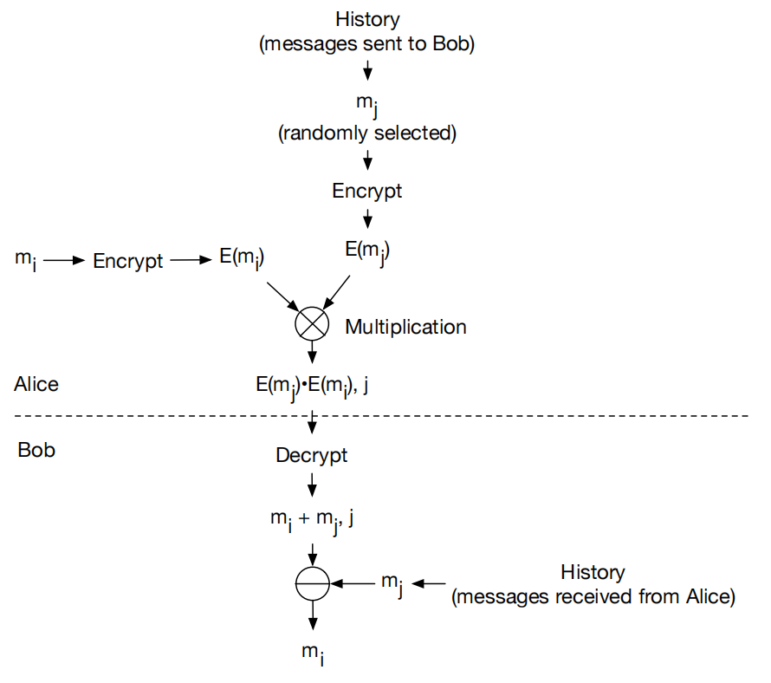
PHE-Based Joint Encryption
Encrypt new data alongside randomly selected historical data
Receiver receives encrypted sum, enhancing security
Ensures uniqueness in encrypted messages
Notes:
By combining new data with previously encrypted messages, this method enhances security while enabling data analysis.
Alice wants to send mi to Bob
She would first encrypt mi to obtain E (mi),
then randomly select a history message mj and encrypt it as well.
When transmitting the data to the receiver, instead of sending
just E (mi), Alice sends (j, E (mi) * E (mj )),
where Alice includes the message ID j so that
Bob knows which history message has been used for joint encryption.
Later Bob can decrypt the received data and obtain mi +mj ,
the addition of the messages mi and mj .
Finally, Bob can recover mi by subtracting mj, from the decryption result.

Slide 11
Benefits of using PHE-based Joint Encryption
Prevents data exposure to other users
Enhances encryption strength with history-based joint encryption
  challenging to recover the data even with the key
Protects against replay attacks
  randomly selected history data
Notes:
Even if an adversary intercepts the communication, assume somehow
he is able to decrypt the ciphertext, what he can obtain is mi + mj .
Unless the adversary has access to all the messages sent between the sender and the receiver,
and all the communication keys used, it is extremely challenging for him to recover mi
Protects against replay attacks.
the ciphertext transmitted is a joint encryption of mi and mj
Even if someone sends the same message mi and
even if he selects the same encryption key, the ciphertext should be different
unless he selects the same history message mj for encryption.

Slide 12
More Challenges in IoT Group Data Sharing
Sharing in a group, beyond two devices:
  Frequent membership changes (devices join/leave)
  Traditional group key management is inefficient: Diffie-Hellman
    All members participate in the generation of the shared key
    New-member joining or existing-member quitting will lead to a complete re-execution of the key generation algorithm.
  Need for scalable, low-cost solutions
Notes:
Now we consider data sharing between devices in a group, beyond just Alice and Bob, two people
Imagine that we have a bunch of IoT devices, for example, smart home, they want to share data with each other,
or smart transportation system, cars nearby want to talk to each other through multicast/broadcast.
To secure group communications, we can set up a group key for data encryption/decryption.
In IoT applications, devices move around physically and switch on and off frequently,
resulting in constant membership changes in groups.
Vehicles in smart transportation systems communicate with each other on the road,
but their membership in a specific communication group constantly changes as they move between locations.
Traditional group key management like Diffie-Hellman require all members to participate in the generation of a shared key,
new-member joining or existing-member quitting will lead to a complete re-execution of the key generation algorithm.
Due to limited battery and memory capability, it is challenging for IoT devices to deal with
frequent re-executions of the group key generation.
Managing encryption keys in dynamic IoT environments is difficult. We need efficient solutions for seamless data sharing.

Slide 13
Dynamic Group Membership
NOT every member stay long in a group
  duration an IoT device remains in a group varies from a few minutes to several hours or days
Long-term member joins or leaves: re-run the key generation algorithm to establish a new shared key
Short-term member joins or leaves: use re-encryption instead of creating a new group key
Notes:
We observe that the duration an IoT device remains in a group varies from a few minutes to several hours or days.
In many scenarios, devices do not stay in the group for long and often leave after only a few rounds of information exchange.
Based on this observation, we classify group devices into long-term members and short-term members based on their expected membership duration.
When a long-term member joins or leaves the group, we re-run the key generation algorithm to establish a new shared key.
When a short-term member joins the group, we use re-encryption to generate a unique key just for the new member,
instead of re-runing the group key generation algorithm to create a new group key for all members.
This process does not affect communications of existing group members.
By leveraging re-encryption, short-term members can participate in group communication
without repeatedly executing the group key generation algorithm,
significantly reducing computational and communication overhead.

Slide 14
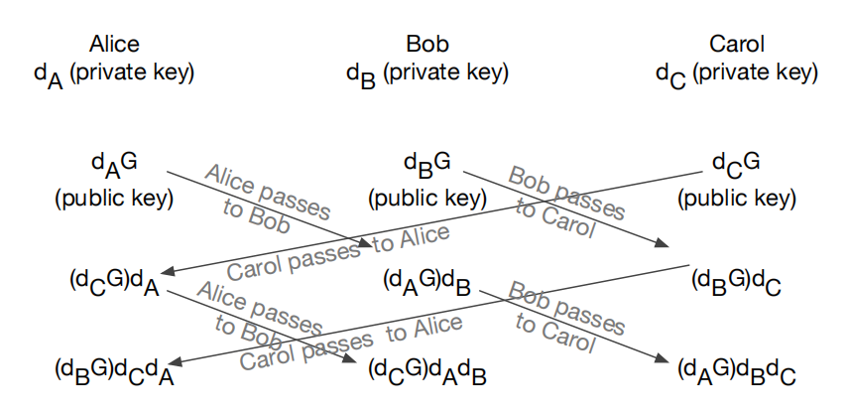
Traditional Way to Generate a Group Key
All members need to be involved to agree on a final shared key S.
Notes:
Fig presents an example of the ECDH key generation for a group of three members: Alice, Bob, and Carol.
We observe that to agree on a final shared key S, all members are involved in the key generation.
They need to talk to each other, exchange some parameters, finally decide a group key.
In addition, the shared key S should be updated every time a member
joins/leaves the group, resulting in a complete re-execution of
the key generation algorithm.

Slide 15
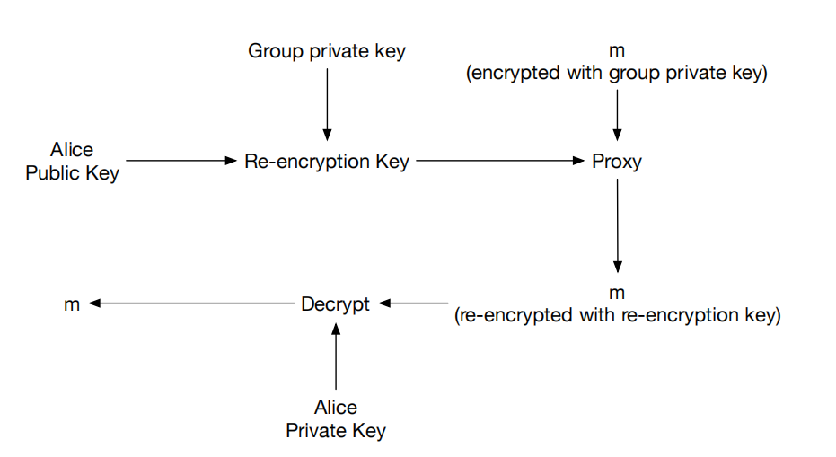
How Re-Encryption Works
Re-encryption key is generated for new short-term members
Sender in the group encrypts data with a long-term group key
Proxy server re-encrypts data for short-term members
Short-term members can decrypt data with their own private keys
Notes:
Here comes a new short-term member.
The re-encryption key is built upon the group’s private key and the short-member’s public key.
When a short-term member has data to be shared with the group,
he encrypts the data with the group’s public key, and sends the encrypted message to other members.
On the other hand, when someone in the group wants to send a message to the short-term member,
they would first forward the message to the proxy,
proxy could be the server or a randomly selected long-term member who acts as the point of connection to the short-term member,
the proxy performs re-encryption.
The proxy simply encrypts the message a 2nd-time, and they would not learn the contents of the message.
The proxy can forward the message to the short-term member.
The short-term member can decrypt using their public key.
This is a very smart way to reduce workload at the same time keep information confidential.
This method prevents frequent key regeneration, reducing communication and processing overhead.
Once a short-term member leaves the group,
all we need to do is to disable his re-encryption key in the proxy,
which significantly alleviate the workload of individual devices.

Slide 16
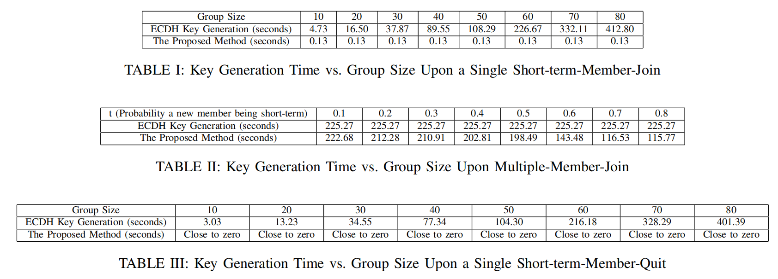

Slide 17
Security Analysis of the Proposed Scheme
Protects data from unauthorized access
Limits damage if a device is compromised
Prevents the cloud provider from learning plaintext data
Lower computational cost compared to traditional methods
Reduces key update overhead significantly
Efficient encryption and re-encryption for dynamic IoT environments
Notes:
The encryption algorithms used in the proposed data sharing scheme including PHE and re-encryption
are standard and lightweight.
When it is between 2 devices, we rely on PHE.
This provides strong cryptographic guarantees
by exploiting homomorphic operations over data and history records with efficient computations.
The joint encryption based on PHE and history messages can
significantly enhance the strength of data security by adding complexity and randomness.
As for group sharing, we introduce this concept of short-term member and long-term members,
by the dynamic nature of IoT groups.
For short-term member, we design a re-encryption scheme
instead of getting all members involved and generating a new shared key for every membership change,
the group can share data with short-term member with a simple re-encryption key.
This group sharing scheme can significantly reduce the communication
and computation cost.
The approach ensures confidentiality and minimizes risks, even if certain devices or servers are compromised.
Performance testing shows that this approach significantly outperforms traditional group key management techniques.

Slide 18
Limitations and Future Improvements
Increased memory usage due to storing historical data
Additional power consumption for key management
Future work: Optimize storage and power efficiency
Notes:
While this method improves security and efficiency, further optimizations are needed to address power and memory constraints.
The PHE based encryption may increase the memory usage and interactions between IoT devices and the cloud,
because history messages need to be retrieved and compared for encryption.
In addition, to allow re-encryption, we need to select a proxy,
and the proxy needs to establish and maintain key generation parameters with short-term members,
while operating communications with other group members,
demanding stronger security implementaion and higher power needs.
We will target these concerns in our future work

Slide 19
Q&A
Thank you!
Questions?
Notes:
Open the floor for questions and discussions.

