Slide 1

Walking patterns recognition under real world conditions
Russo, Nastastic, Cernigliaro, Broniarek, Alliende

Slide 2

Main research aim
Main goal: verify if there are different patterns of walking among the group members of this project.
Secondary goals:
Perform a multi-resolution analysis: analyze if the elicitation of the length of the window selected to divide the data affects the results of the classification
To make Francesco walk more than 10 minutes at once

Slide 3
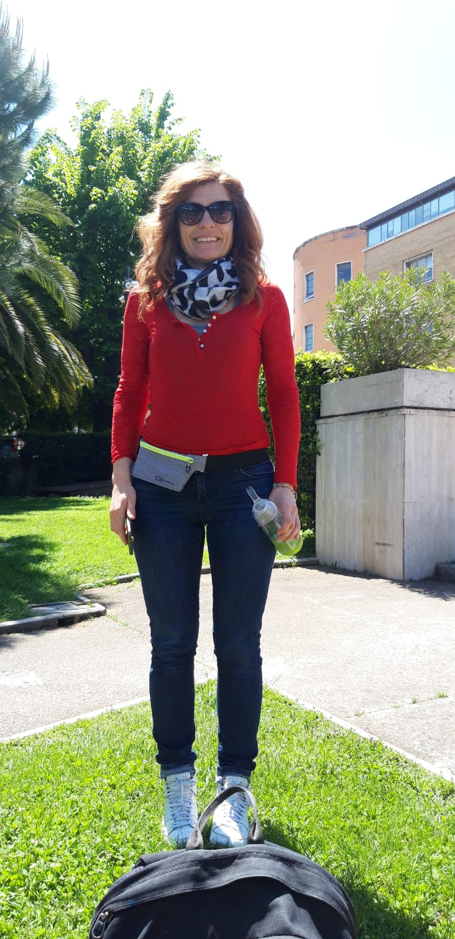
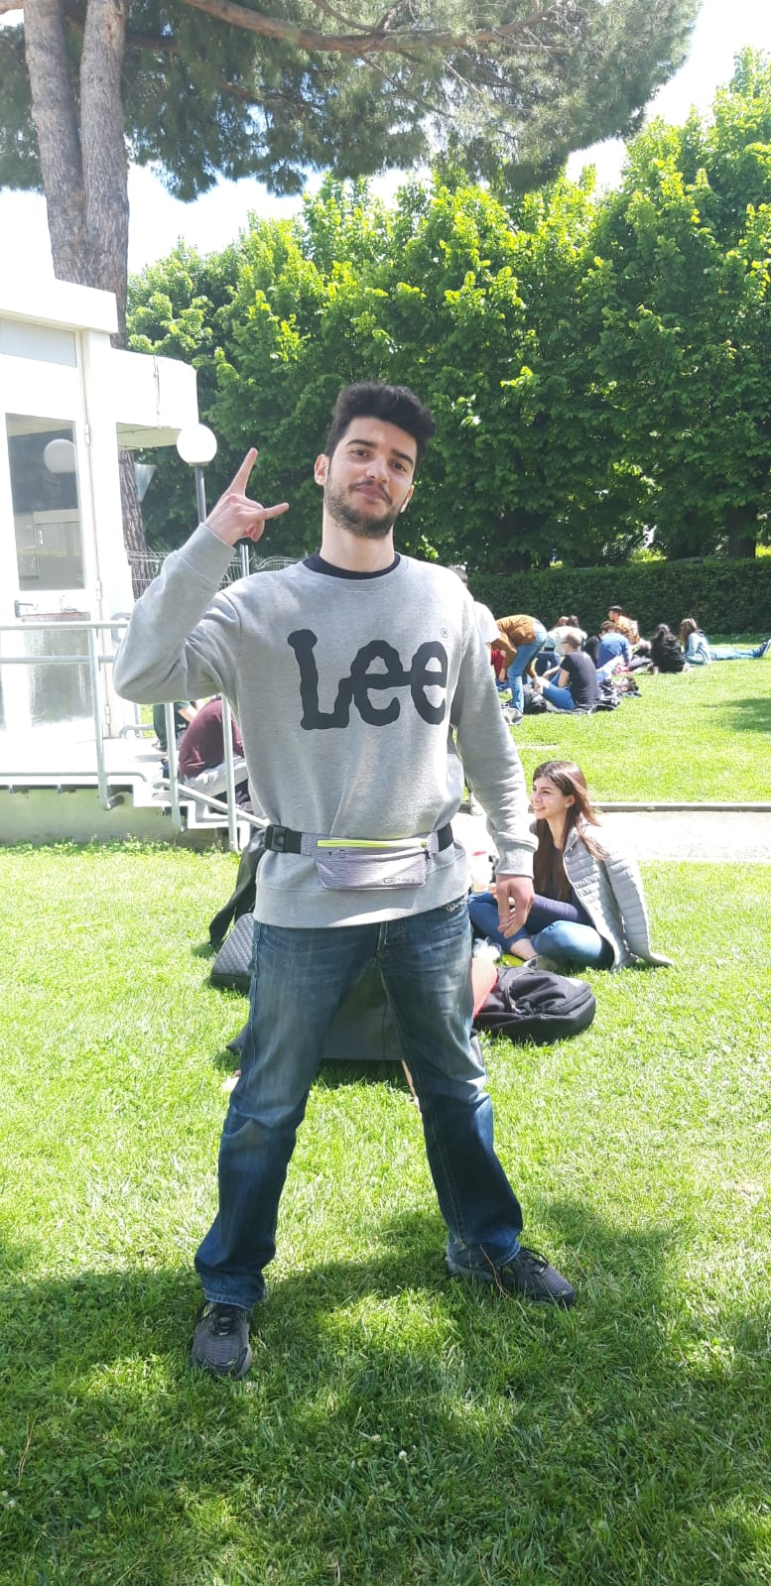
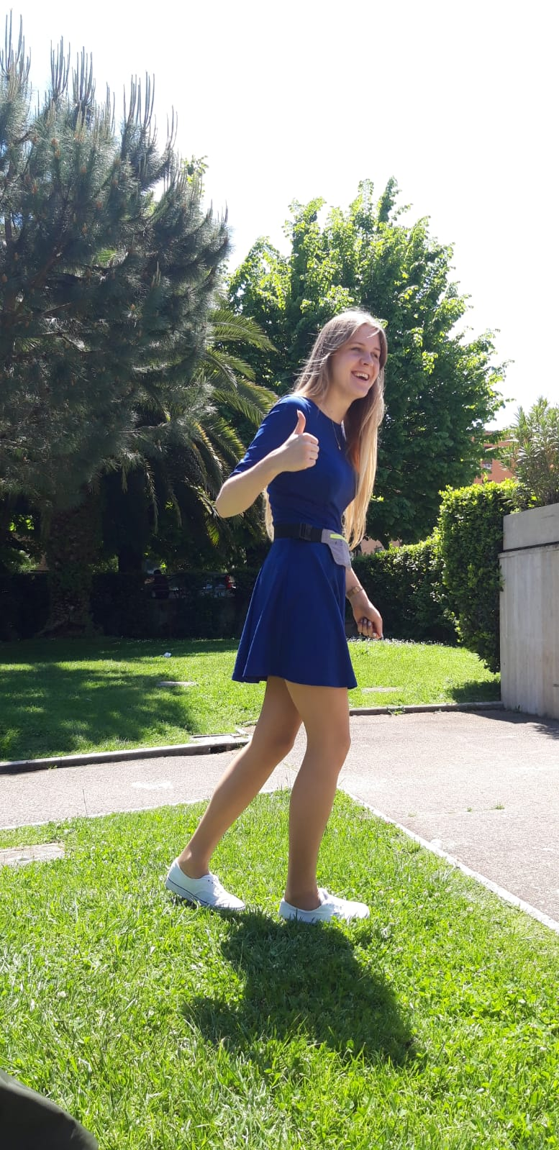

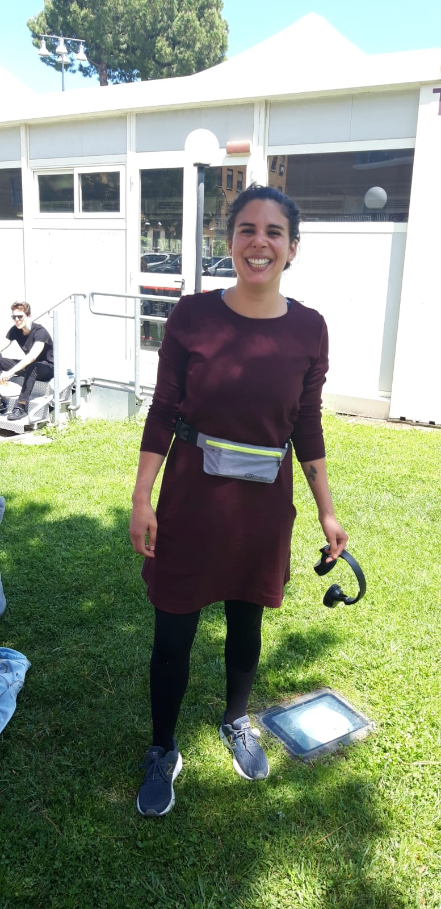

Data collection

Slide 4

The Data
5 files, one for each person of the group
Null-values, missing values
About 25 minutes of recording
Used sensors:
Linear Accelerometer Sensor
Acceleration on the x axis
Acceleration on the y axis
Acceleration on the z axis

Slide 5
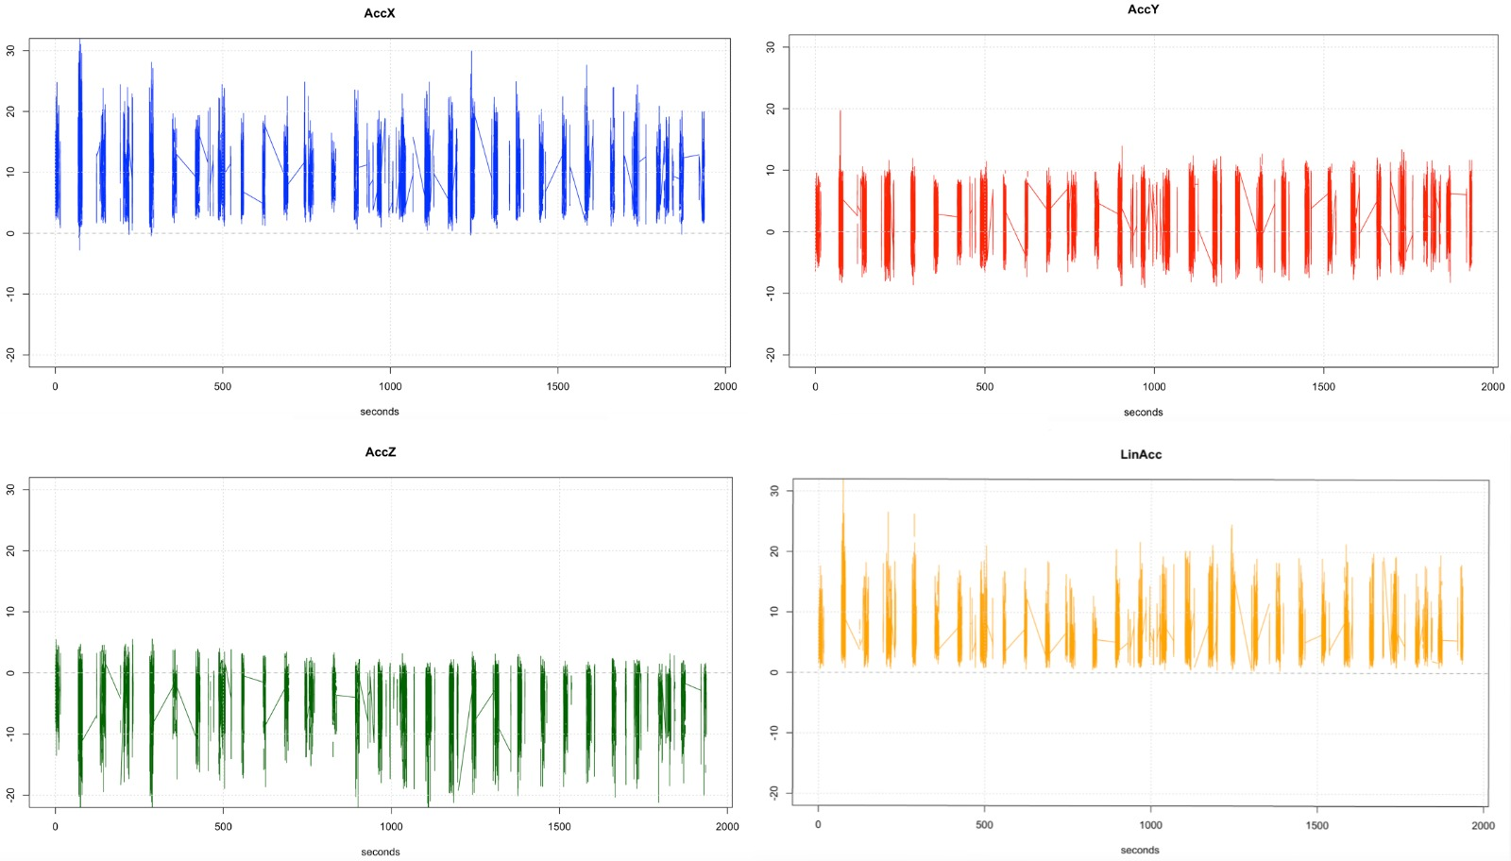
Ivana’s walk – raw data

Slide 6

The Labels
3
1
4
5
2

Slide 7

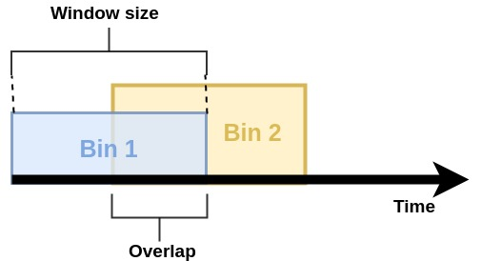
Data Pre-processing
Dealing with noisy data:
Removed 1 minute on the beginning and 1 minutes on the end of each recording
Time bins
Window and overlap → starting values: 500, 200
Coming soon: Multiresolution Analysis

Slide 8
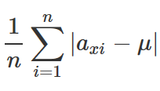
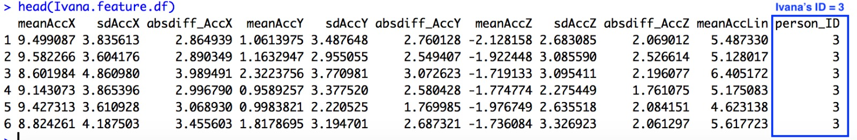
Data Pre-processing
Feature Generation:
Average acceleration for each axis and linear acceleration
Standard deviation for each axis
Average Absolute Difference for each axis:
10 features

Slide 9
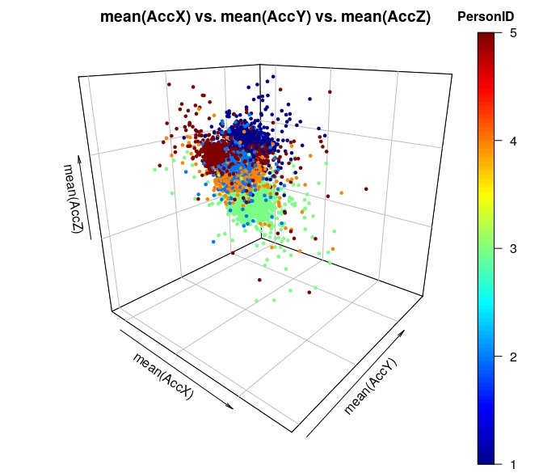

Slide 10

Modeling
Used algorithms:
Random Forest
Linear Discriminant Analysis
Naive Bayes (parametric)
LASSO Logistic Regression
k-Nearest Neighbours
SVM
Stacking Model from the best 4 models
* Training set: 80% of the data

Slide 11

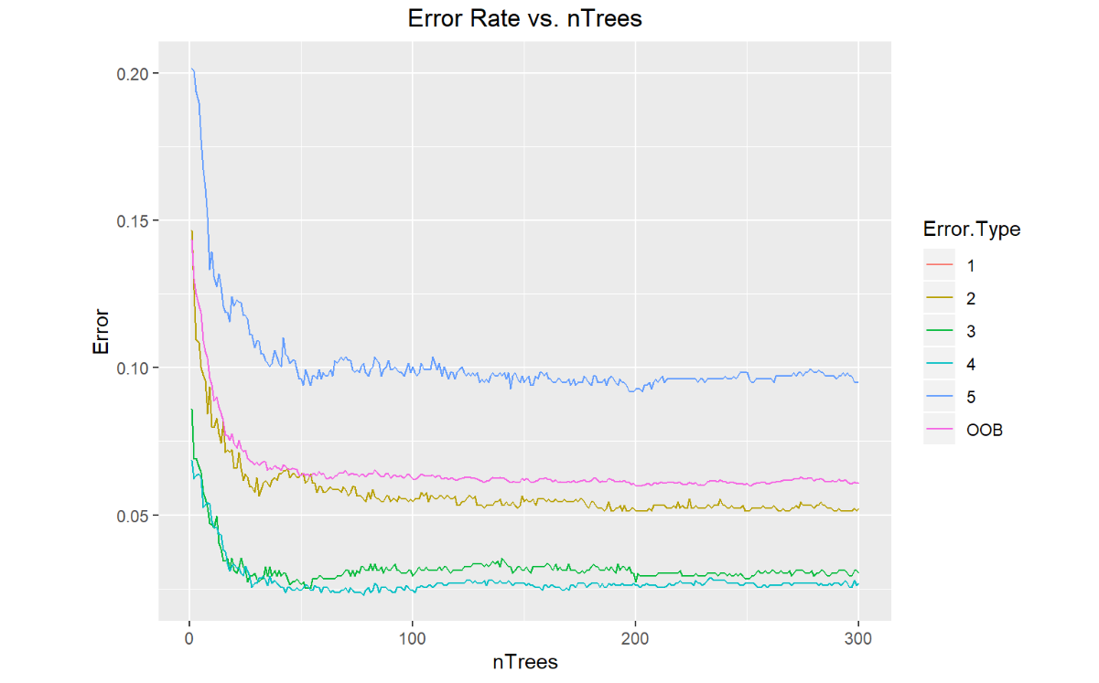

Random Forest Parameter elicitation
Number of trees: 80
Window size | Overlap
500 | 200

Slide 12

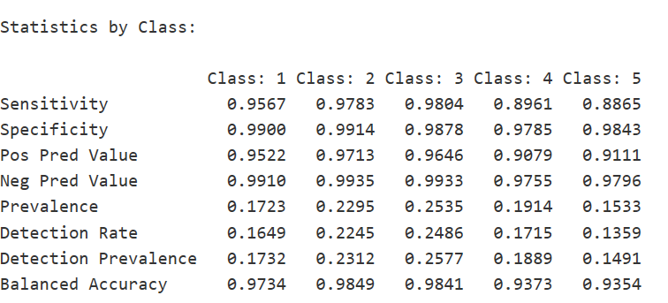
Random Forest Results
Overall Accuracy | 0.9453
Window size | Overlap
500 | 200

Slide 13
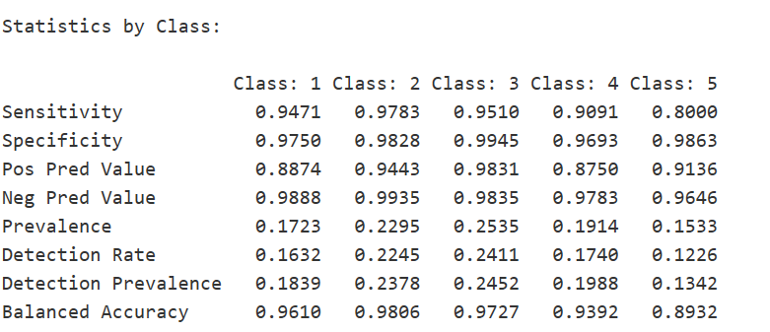
LDA Results
Overall Accuracy | 0.9254
Window size | Overlap
500 | 200

Slide 14
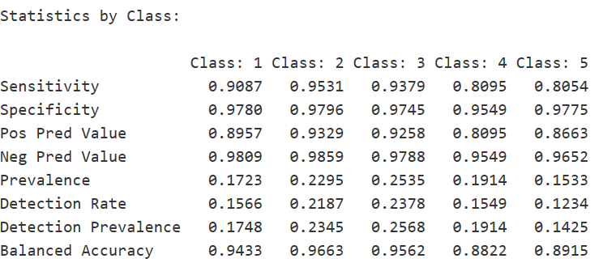
Naive Bayes (parametric) Results
Overall Accuracy | 0.8915
Window size | Overlap
500 | 200

Slide 15
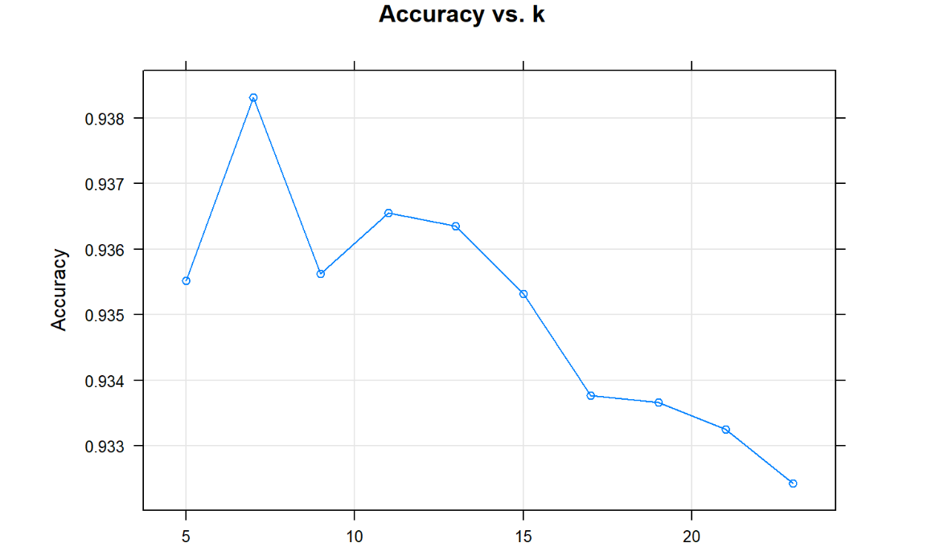
k-Nearest Neighbor Parameter elicitation
k= 7
Window size | Overlap
500 | 200

Slide 16
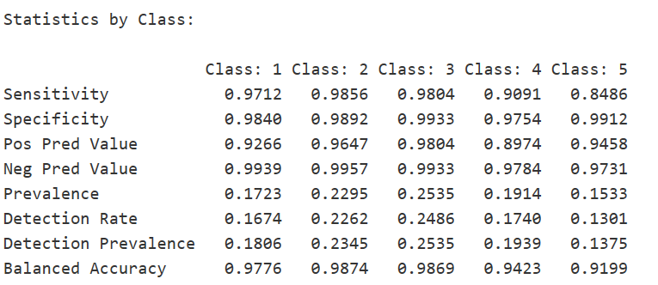
k-Nearest Neighbor Results
Overall Accuracy | 0.9461
Window size | Overlap
500 | 200

Slide 17
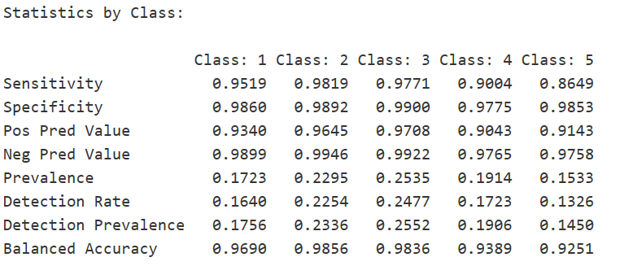
LASSO Logistic Regression Results
Overall Accuracy | 0.942
Window size | Overlap
500 | 200

Slide 18
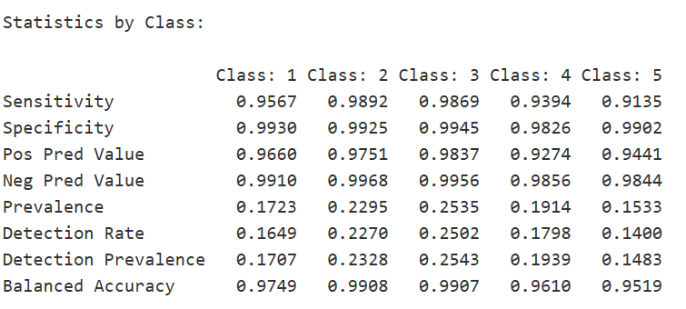
SVM Results
Overall Accuracy | 0.9619
Window size | Overlap
500 | 200

Slide 19

Stacking Model Metodology
Best four models: k-NN, Random Forest, LASSO and SVM.
Predictions of majority.
If each classifier returns different class → k-NN.

Slide 20
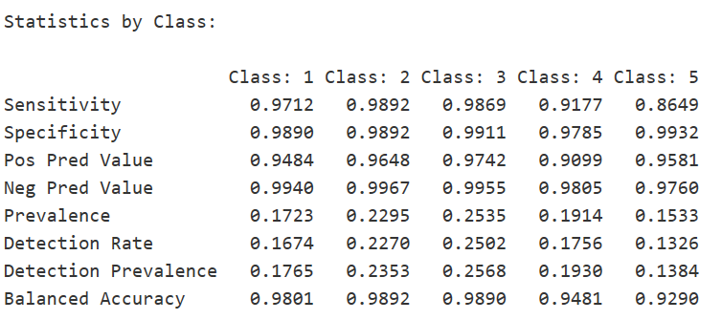
Stacking Model Results
Overall Accuracy | 0.9528
Window size | Overlap
500 | 200

Slide 21

Preliminary Ranking
1. SVM: 0.962
2. Stacking: 0.953
3. k-NN: 0.946
4. Random Forest: 0.943
5. LASSO: 0.942
6. LDA: 0.925
7. Naive Bayes: 0.892
Window size | Overlap
500 | 200

Slide 22
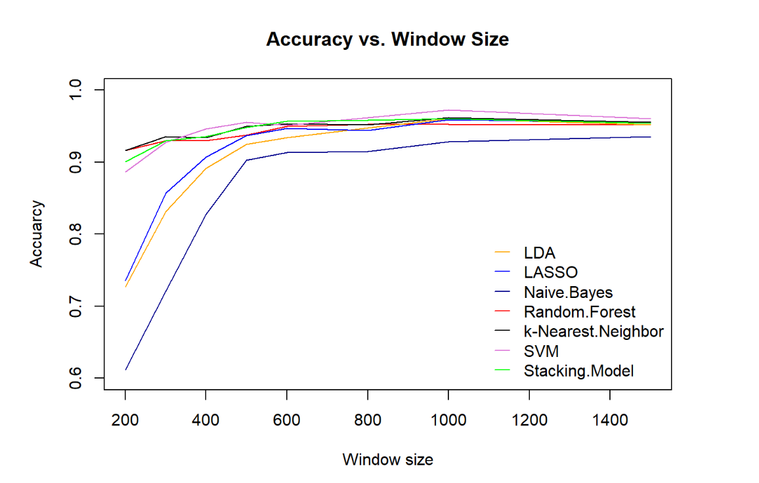
Multiresolution Analysis
Window size: 1000
Overlap: 400
Clean data
Create bins
Model
Feature Generation
Results

Slide 23
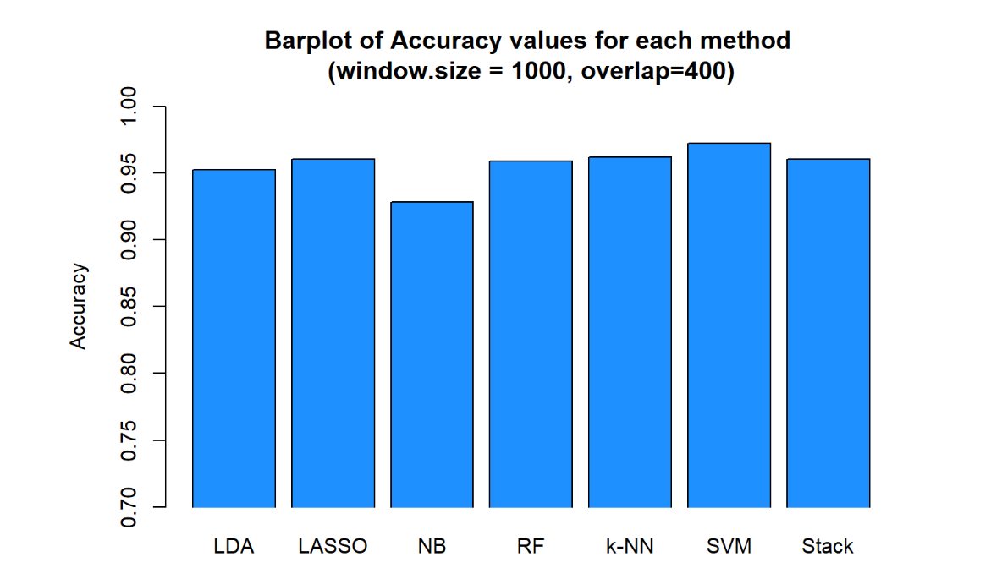

Comparing Models

Slide 24

Conclusions
Final Ranking
Top 1: SVM
The biggest looser: Naive Bayes
Window size → not relevant influence on the accuracy after reaching a size of around 1 second

Slide 25

Thank you!

