Slide 1
Second Genome Genomic Data Scientist Challenge
Joanna Dreux

Slide 2

Background
“ DrugPro has a small but profitable portfolio of bacterial-derived proteins to treat Chokeophobia, the clinical condition described by a debilitating fear that the Chicago Cubs won't return to the World Series this year.
Your R&D division has identified 10,000 proteins that are over-expressed in Cubs fans who are resistant to Chokeophobia.”
Find proteins that are most likely to confer resistance to Chokeophobia

Slide 3
Process
Step | Description
Collect Data | Sources: BLASTp, hmmscan, pydpi
Clean Data | Keep relevant columns, build a master data frame
Impute missing values | Queries that did not align / do not have a domain of interest
Feature Selection | Determine which columns to take into account
Algorithm Selection | Which model is the most accurate
Train the model | Train and validate the model on the training set data
Make predictions | Run the model on the putative data set
Score | Evaluate using the pickled dictionary
Notes:
Need to build a classifier (0 or 1) machine learning model to run on the putative set
These are the steps involved

Slide 4
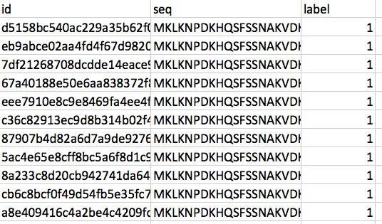
The Data
Sequence Homology: sequence similarities between valid proteins
Tool: BLASTp
Domain Homology: HMM to model homology
Tool: hmmscan
Physicochemical properties: properties of the AA bases
Tool: pydpi
264 sequences in the training set, 44 with label == 0
Notes:
Starting point is the protein sequence, from this we get the following information

Slide 5

BLASTp data
qseqid
pident
E-value
bitscore
Run a BLASTp job against valid proteins only (label = 0) to find homology to those proteins.
Fill in missing data – queries that share no homology to valid proteins with:
- % identical matches = 0
e-value = 1
Bitscore = 0

Slide 6
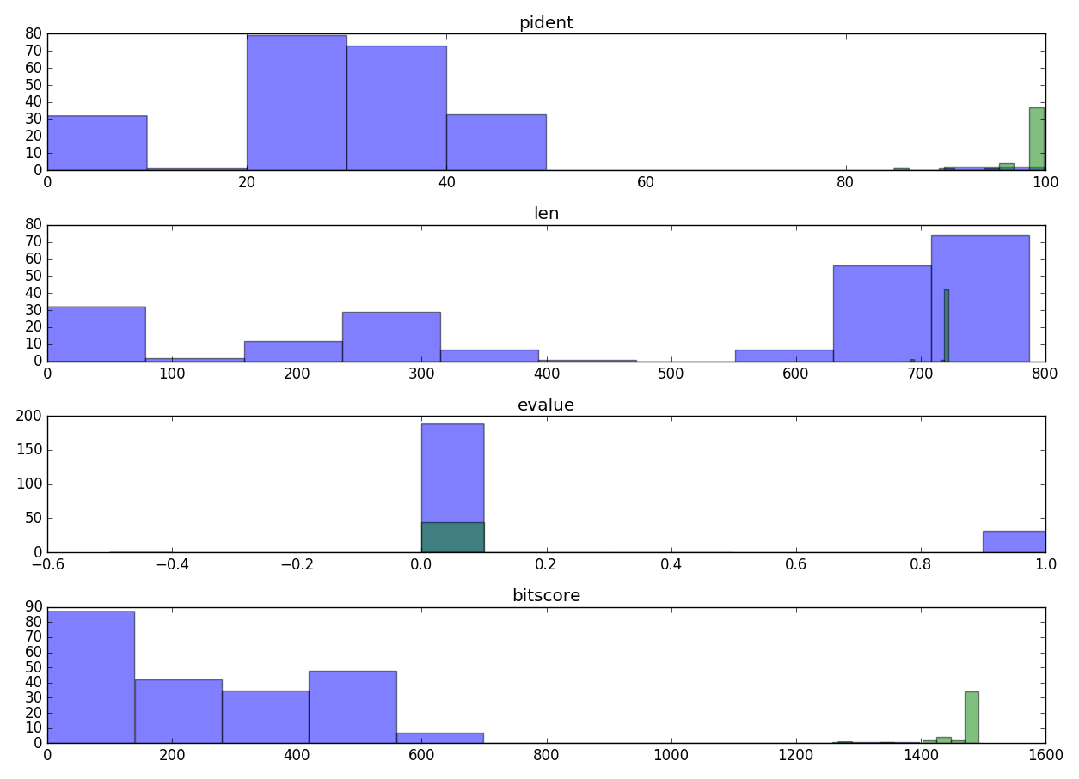
BLASTp data

Slide 7
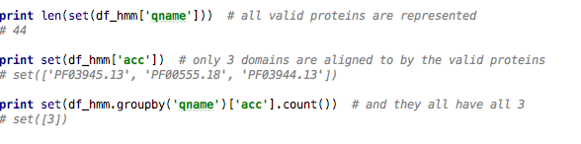
HMMer data
Run a hmmscan job against the Pfam-A protein with valid proteins
Use .hmm files obtained from http://pfam.xfam.org/ for each of the three domains of interest: endotoxin_M, endotoxin_C & endotoxin_N.
Run a hmmscan job for all seqs in the training set against these three

Slide 8
HMMer data
Filling in missing data: queries that do not have the domains of interest. For each domain:
e-value = 1
Score = 0
domain-score = 0
Reliability = 0
Count = 0
Add a count column: number of domains found.

Slide 9
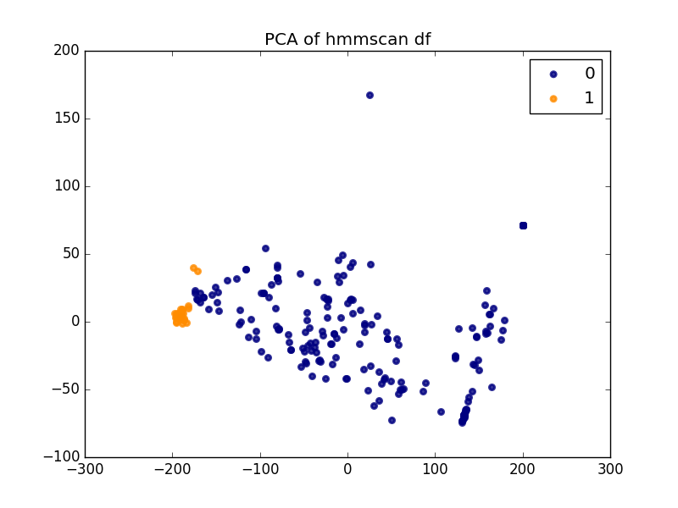
Hmmer data

Slide 10
Physicochemical features data
Loop over each protein sequence and collect various PyPro() computed features:
Amino acid composition (% each aa base)
Moreau Broto Autocorrelation
Geary Autocorrelation
Compositon / Transition / Distribution
PCA to see which features are good predictors

Slide 11
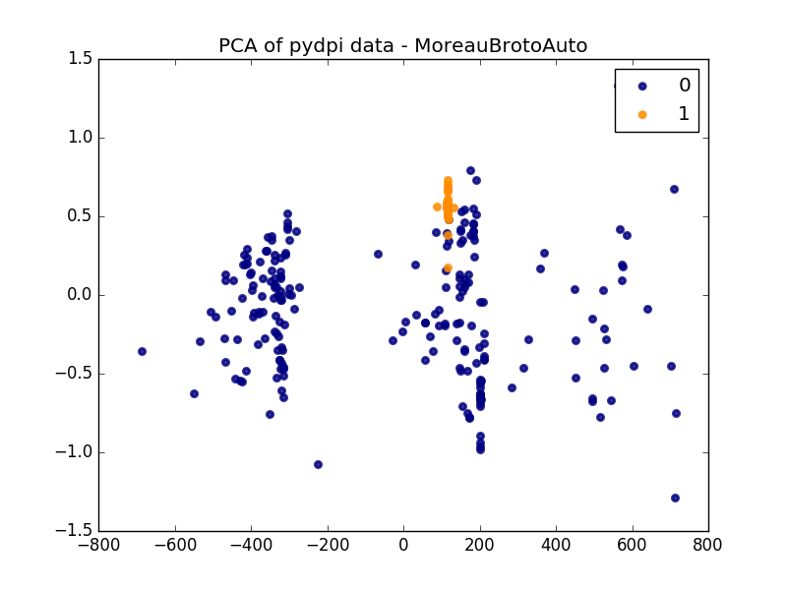
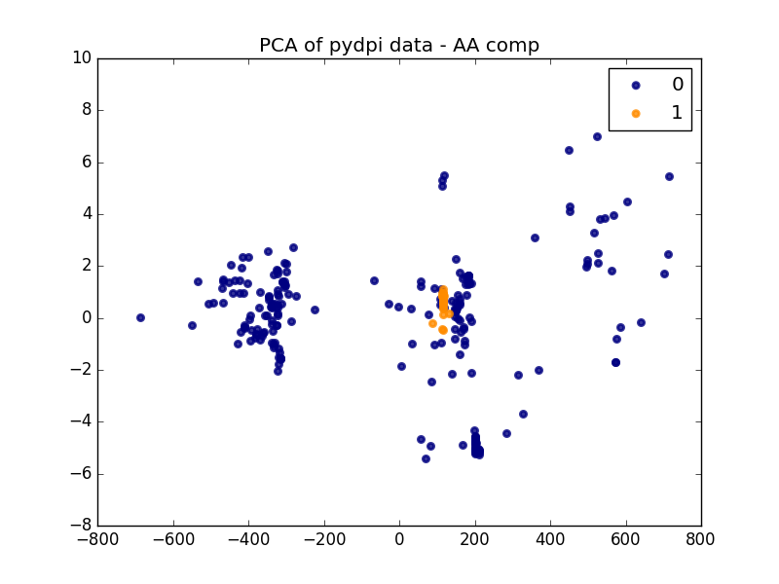
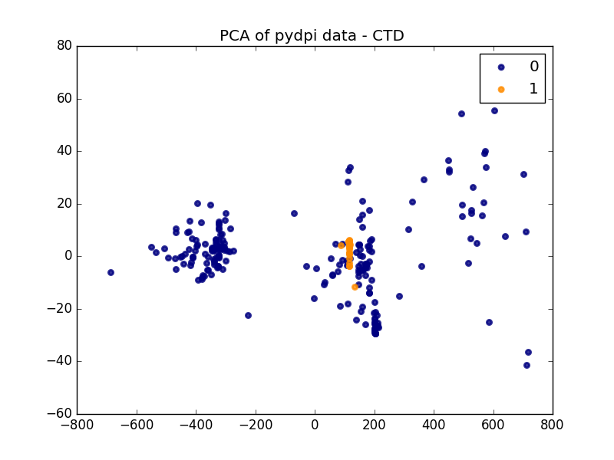
Bad predictors:

Slide 12
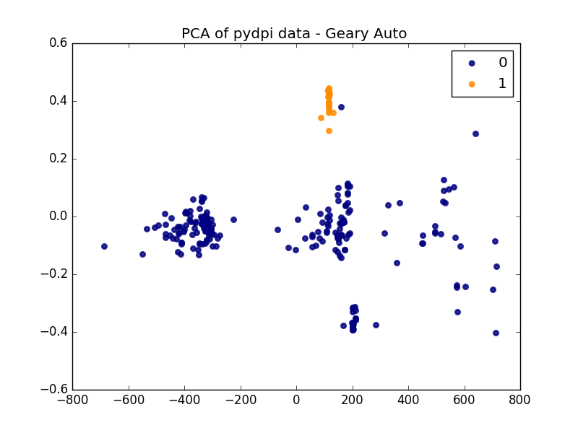
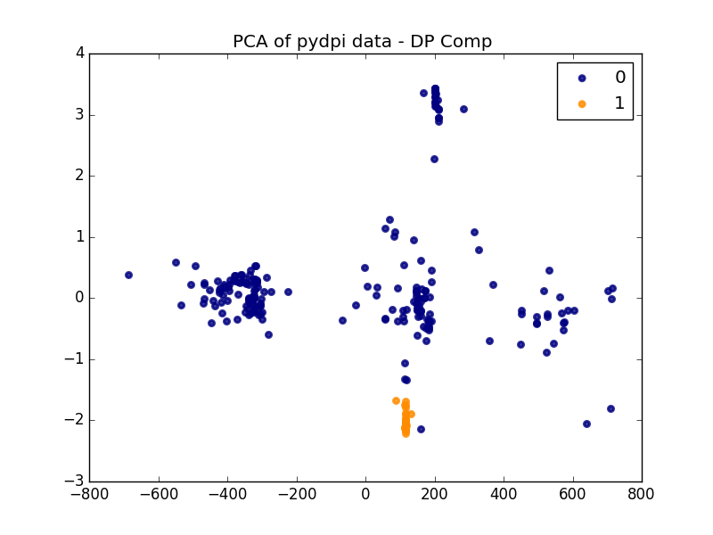
Better predictors:
Dipeptide composition
Geary Spatial Autocorrelation

Slide 13
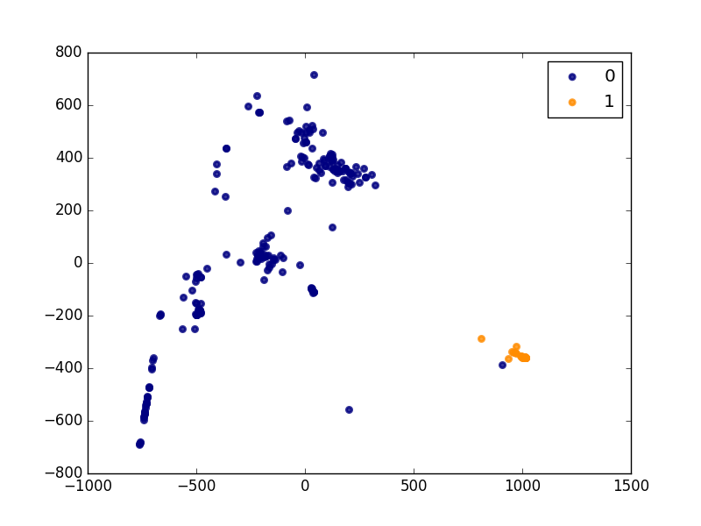
Feature Selection
The master df has 667 features

Slide 14
Feature Selection
Use a combination of:
Feature ranking with recursive feature elimination (RFE), using Linear SVC as an estimator.
Feature selection using the meta transformer SelectFromModel() based on LinearSVC() as an estimator
Keep ~200 features

Slide 15
Algorithm Selection
Create a validation set & a test set from the training data to estimate error
Choose 4 algorithms to compare: LogisticRegression(), LinearSVC(), K-nearest neighbor(), SVC()
LR: avg = 0.981339031339, (std = 0.0249548093603)
LinearSVC: avg = 0.771652421652, (std = 0.201350189994)
KNN: avg = 0.969515669516, (std = 0.033469418077)
SVC: avg = 0.973361823362, (std = 0.0295737611569)

Slide 16
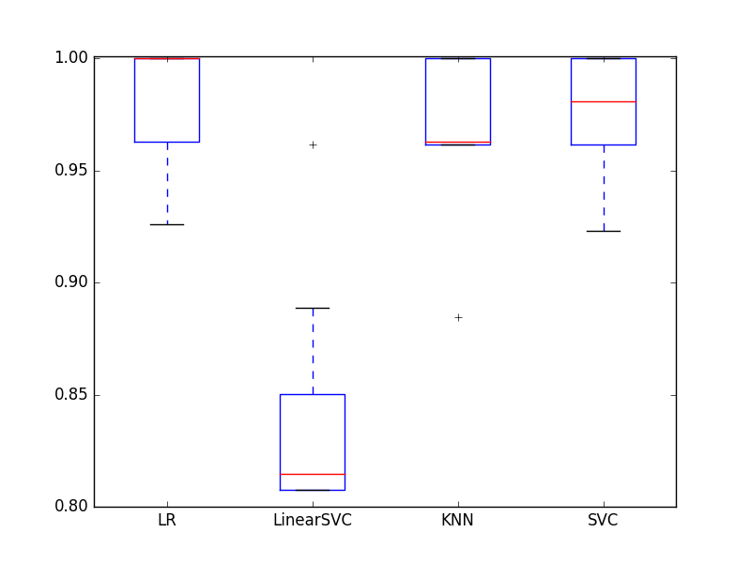
Algorithm Selection
Cross-validation, n=10 bins
Use the same seed for each algorithm to compare results directly
High accuracy for most – overfitting?
Move forward with LinearSVC (recommended for this type of data) & KNN (highest accuracy)

Slide 17
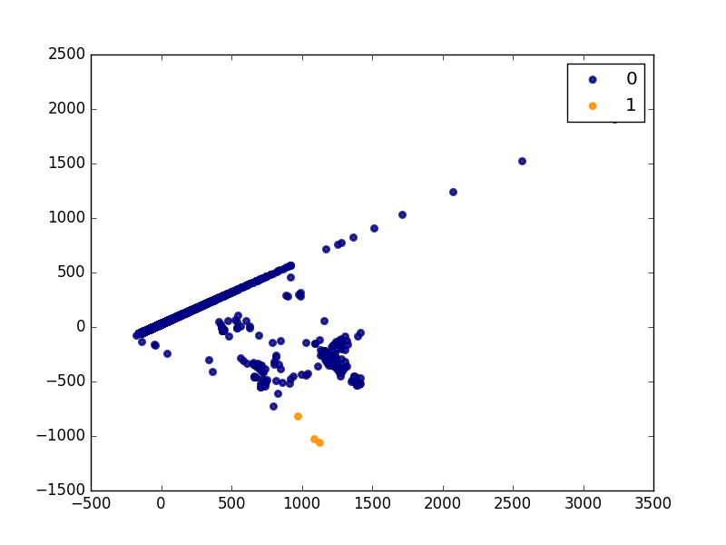
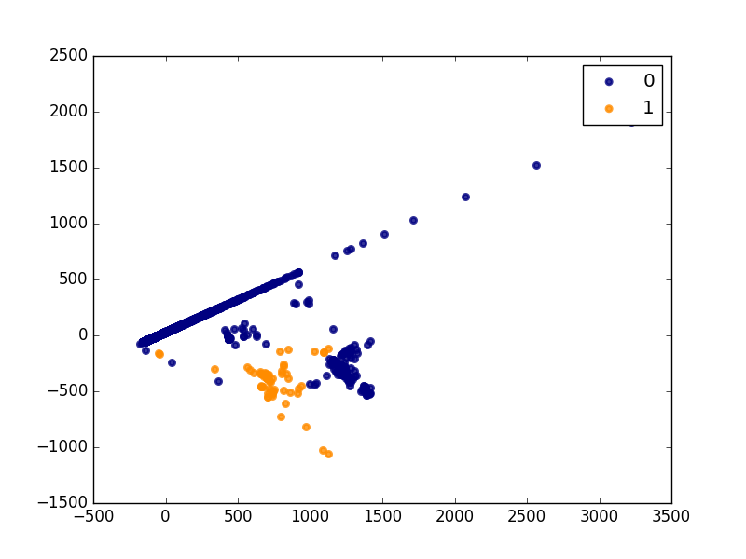
Scoring – model quality
Fit each algorithm to the training set then predict on the putative set
Add ‘label’ feature based on predictions and plot PCA:
KNN
Linear SVC

Slide 18
Scoring – model quality
Fit each algorithm to the training set then predict on the putative set
Add ‘label’ feature based on predictions and plot PCA
Score the model using the pickled dictionnary:
KNN: $2000000.0
Linear_SVC: $60000000.0

Slide 19
Improving on the model
Combining algorithms
Ensemble algorithms
Tweak algorithm hyper-parameters
Embedded feature selection
Encoding the blastp sseqid as a feature
Add categorical features– ‘all_three_domains’
Retain ‘location’ columns – alignment start/end and domain start/end

