Slide 1
Second Genome Genomic Data Scientist Challenge
Joanna Dreux

Slide 2

Background
“ DrugPro has a small but profitable portfolio of bacterial-derived proteins to treat Chokeophobia, the clinical condition described by a debilitating fear that the Chicago Cubs won't return to the World Series this year.
Your R&D division has identified 10,000 proteins that are over-expressed in Cubs fans who are resistant to Chokeophobia.”
Find proteins that are most likely to confer resistance to Chokeophobia

Slide 3
Process
Step | Description
Collect Data | Sources: BLASTp, hmmscan, pydpi
Clean Data | Keep relevant columns, build a master data frame
Impute missing values | Queries that did not align / do not have a domain of interest
Feature Selection | Determine which columns to take into account
Algorithm Selection | Which model is the most accurate
Train the model | Train and validate the model on the training set data
Make predictions | Run the model on the putative data set
Score | Evaluate using the pickled dictionary
Notes:
Need to build a classifier (0 or 1) machine learning model to run on the putative set
These are the steps involved

Slide 4
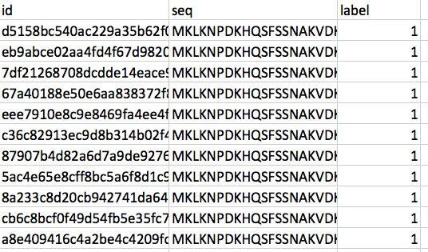
The Data
Sequence Homology: sequence similarities between valid proteins
Tool: BLASTp
Domain Homology: HMM to model homology
Tool: hmmscan
Physicochemical properties: properties of the AA bases
Tool: pydpi
264 sequences in the training set, 44 with label == 0
Notes:
Starting point is the protein sequence, from this we get the following information

Slide 5

BLASTp data
qseqid
pident
E-value
bitscore
Run a BLASTp job against valid proteins only (label = 0) to find homology to those proteins.
Fill in missing data – queries that share no homology to valid proteins with:
- % identical matches = 0
e-value = 1
Bitscore = 0

Slide 6
BLASTp data

Slide 7
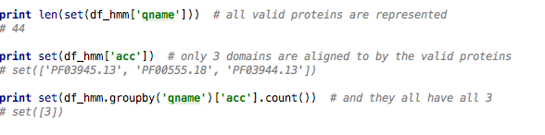
HMMer data
Run a hmmscan job against the Pfam-A protein with valid proteins
Use .hmm files obtained from http://pfam.xfam.org/ for each of the three domains of interest: endotoxin_M, endotoxin_C & endotoxin_N.
Run a hmmscan job for all seqs in the training set against these three

Slide 8
HMMer data
Filling in missing data: queries that do not have the domains of interest. For each domain:
e-value = 1
Score = 0
domain-score = 0
Reliability = 0
Count = 0
Add a count column: number of domains found.

Slide 9
Hmmer data
Plot?

Slide 10
Physicochemical features data
Loop over each protein sequence and collect:
Amino acid composition (% each aa base)
Sequence length
Moreau Broto Autocorrelation (autocorrelation of a topological structure (ATS) – describes how a property is distributed along the topological structure)
250 + features

Slide 11
Pca for hmm?

Slide 12
Feature Selection
Combine LogisticRegression() and LinearSVC() to find a set of 200 features
Filter DFs on these features
your feature selection methodolgy, if any
Test models

Slide 13
Algorithm Selection
Create a validation set & a training set
Model choice – sklearn cheat sheet
Compare different algorithms
Table
Plot
Combined algos?

Slide 14
How to pick a model
everal methods, including logistic regression and the Bayes point machine, assume linear class boundaries. That is, they assume that the boundaries between classes are approximately straight lines (or hyperplanes in the more general case). Often this is a characteristic of the data that you don’t know until after you’ve tried to separate it, but it’s something that typically can be learned by visualizing beforehand. If the class boundaries look very irregular, stick with decision trees, decision jungles, support vector machines, or neural networks.
Bayesian methods make the assumption of statistically independent data points. This means that the unmodeled variability in one data point is uncorrelated with others, that is, it can’t be predicted. For example, if the data being recorded is the number of minutes until the next subway train arrives, two measurements taken a day apart are statistically independent. However, two measurements taken a minute apart are not statistically independent - the value of one is highly predictive of the value of the other.
Boosted decision tree regression takes advantage of feature overlap or interaction among features. That means that, in any given data point, the value of one feature is somewhat predictive of the value of another. For example, in daily high/low temperature data, knowing the low temperature for the day allows you to make a reasonable guess at the high. The information contained in the two features is somewhat redundant.

Slide 15
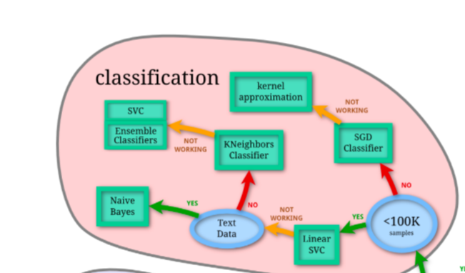
From sklearn’s cheat sheet

Slide 16
Cross validation
# We are using the metric of ‘accuracy‘ to evaluate models. This is a ratio of the number of correctly predicted # instances in divided by the total number of instances in the dataset multiplied by 100 to give a percentage # (e.g. 95% accurate). We will be using the scoring variable when we run build and evaluate each model next.

Slide 17
Scoring – model quality
How many nominations did I get?

Slide 18
Improving model / ideas
Boosting/bagging
Features – from pydpi other sets
Embedded feature selection
Encoding the blastp sseqid ?
Add categorical columns – ‘all_three_domains’
Retain location columns – alignment start/end and domain start/end

Slide 19
Background to refresh
Blastp algorithm
Evalue meaning in blast
HMM
Algorithms
https://www.analyticsvidhya.com/blog/2017/09/common-machine-learning-algorithms/
http://www.kdnuggets.com/2015/11/seven-steps-machine-learning-python.html
http://www.kdnuggets.com/2016/03/doing-data-science-kaggle-walkthrough-cleaning-data.html/2
https://pythonprogramming.net/machine-learning-tutorial-python-introduction/
https://bmcbioinformatics.biomedcentral.com/articles/10.1186/1471-2105-11-273
https://github.com/dformoso/machine-learning-mindmap
https://bmcresnotes.biomedcentral.com/articles/10.1186/1756-0500-7-810
https://github.com/PeptoneInc/dspp-keras

