Slide 1
How to work with git

Slide 2
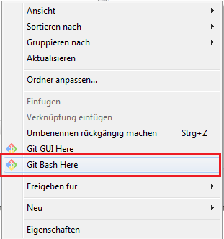
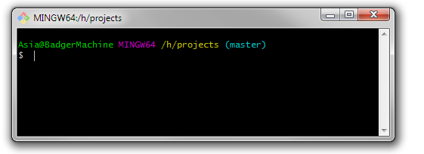
How to open Git Bash(terminal)
Open the context menu with the right click in the windows explorer and select:
‚Git Bash Here‘

Slide 3
Creating new repository and empty file (touch command)
New repository git init
New empty .html file touch file_name.html

Slide 4

Configuration

Slide 5

Commands
Status git status
Add files:
git add file_name.* (only this file)
git add . (all filles)
git add *.html (all .html files)
Remove add git rm –cached index.html

Slide 6
Commands
Commit git commit (the new window will opened to comment the commit)
Commit with comment git commit –m ‚comment‘

