Slide 1
Self-introduction
YIN XI (Joanna)
SEPTEMBER
27

Slide 2
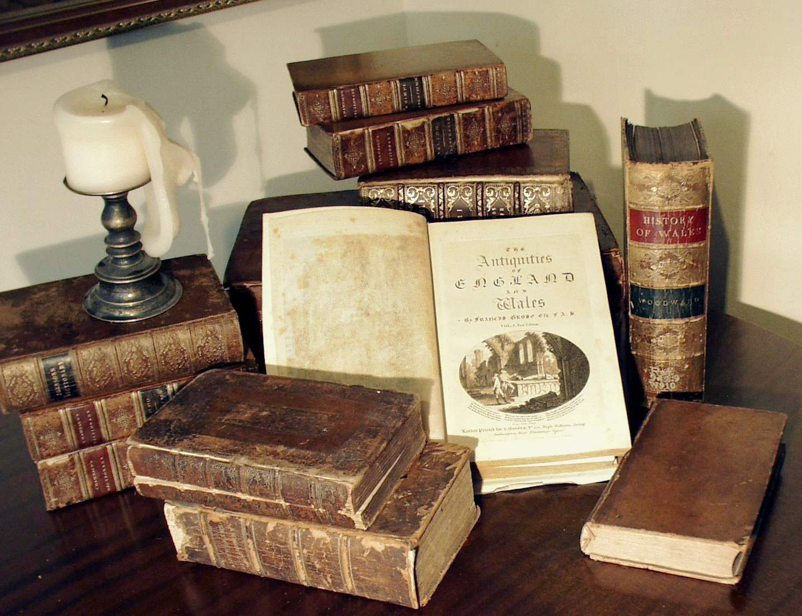
My experience
Cool and colorful life experience
I went to the kindergarten at Guangdong, the primary school at Jiangxi, and the high school at Liaoning. And now I am taking my bachelor degree in Malaysia.
This Photo by Unknown Author is licensed under CC BY-SA

Slide 3

My hobbies
This Photo by Unknown Author is licensed under CC BY-SA-NC
I learned how to play basketball when I started my senior high school.
I learned how to help people keep fit and how to make people stronger just in July this year. And now I have my CBBA certificate which means that I am a professional fitness coach. So if anyone who are interested in it can contact me with my We chat number JoannaPro.
A SPORT LOVER

Slide 4
Thank You!
CONTACT ME IF YOU LIKE FITNESS
Phone
60194827498
Email
CST1909162@xmu.edu.my

