Slide 1
Inversion based on simultaneous observations of voltage and calcium concentration
Joanneke E Jansen, JuNe 2017

Slide 2
Inversion
The computation of the most plausible values of not directly observable parameters using a set of measurements.
Classical inversion: patch clamping
- precise single cell measurements of transmembrane voltage, but time and labour intensive
Alternative: optical mapping
- voltage and calcium waves of a cluster of cells can be measured simultaneously

Slide 3
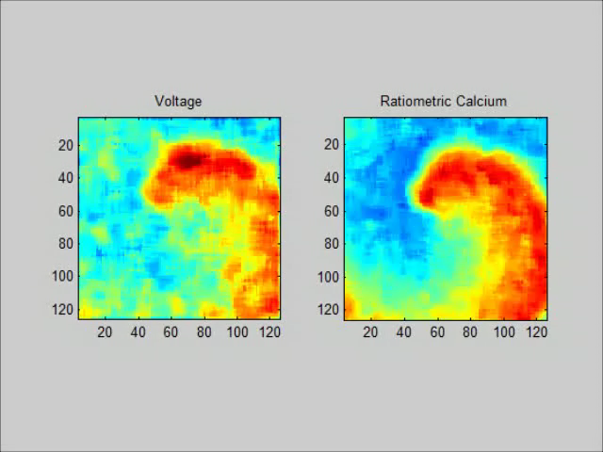
Optical mapping
Lee, P., Klos, M., Bollensdorff, C., Hou, L., Ewart, P., Kamp, T. J., … Jalife, J. (2012). Simultaneous Voltage and Calcium Mapping of Genetically Purified Human Induced Pluripotent Stem Cell–Derived Cardiac Myocyte Monolayers. Circulation research, 110(12), 1556-1563.

Slide 4
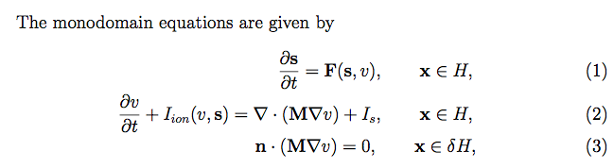
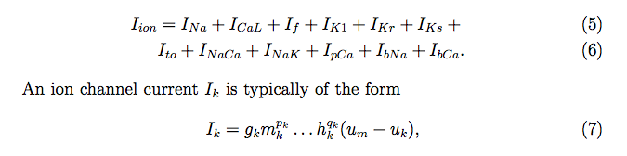
Monodomain and Paci cell model

Slide 5

The inverse problem
We want to find parameter values , such that
is minimized.

Slide 6
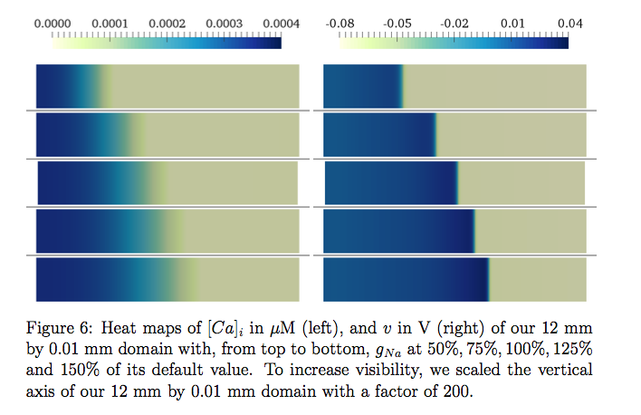
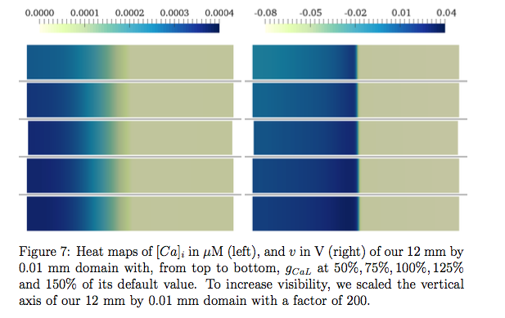
Sensitivity to different parameters

Slide 7
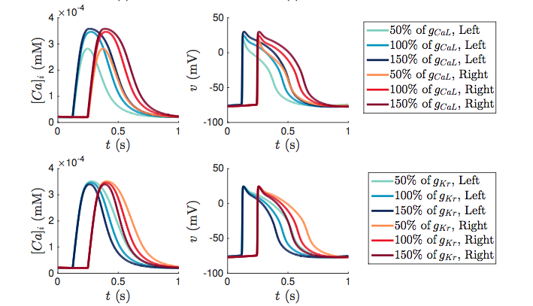
Sensitivity to different parameters

Slide 8
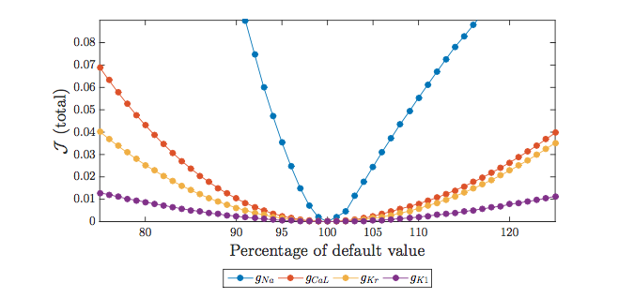
Varying one parameter

Slide 9
Varying four parameters
When the four parameters g_{Na}, g_{CaL}, g_{K1} and g_{Kr} are varied between 90% - 110% of their original values, we find a unique mimimum for our functional when g_{Na}, g_{CaL}, g_{K1} and g_{Kr} are all at 100% of their original value.

