Slide 1
WHALE TRACKING AND RESCUING SYSTEM

Slide 2
“To have a huge, friendly whale willingly approach your boat and look you straight in the eye is without doubt one of the most extraordinary experiences on the planet.” - Mark Carwardine

Slide 3
WTRS
New solution of whale endangerment
1

Slide 4


TECH TO SAVE NATURE

Slide 5
PARTICIPANTS
ETF Belgrade
School of Electrical Engineering, from University of Belgrade, Serbia
Goethe University
Germany
Hellenic Centre for Marine Research
Research centre, Greece
World Wildlife Fund
Charitable organization, Switzerland
TIMEZERO
Software company, Spain
Nokia Solution Networks
Telecommunications company, Finland

Slide 6
POINTS OF FOCUS
Whale tracking
Live location of every whale.
History of whale movement for last 2 weeks.
Recording additional data such as depth ,water , temperature and underwater sounds.
Identification and photos.
Accident reports
Reports lost signal on the map.
Reports endangered whales
and whales in critical position.
Reports dead whales.

Slide 7
USE CASES
Modern approach to whale tracking
2

Slide 8
SYSTEM FUNCTIONALITY
Report a not register or injured whale.
Insight into whale population sizes and migrations.
Insight into risky situations and accidents related to whale safety.
Recording whale behavior and activity for better understanding of these animal species.

Slide 9
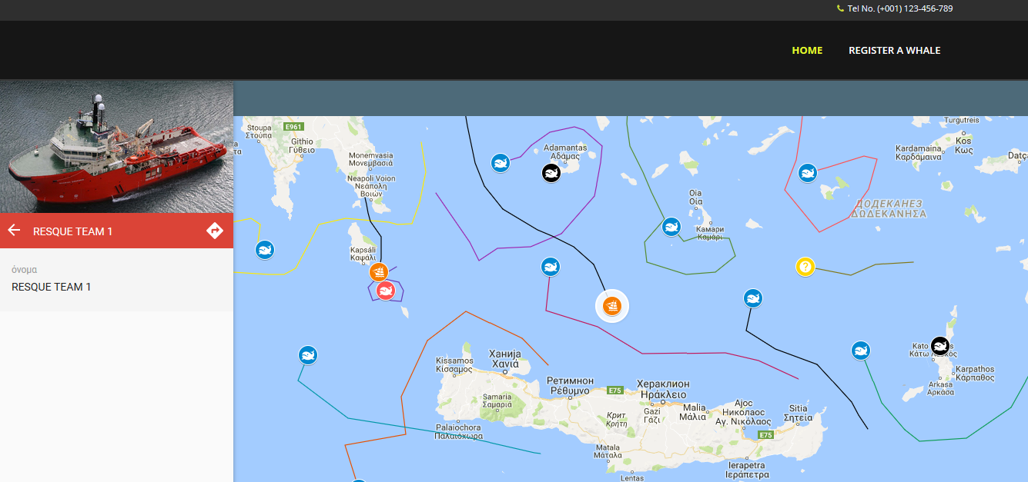
DESKTOP PROJECT
Show and explain your web, app or software projects using these gadget templates.
Place your screenshot here

Slide 10
PROJECT PLAN
Execution and budged propositions
3

Slide 11
DEVELOPMENT PROCESS
Hardware design and implementation
Design and implementation of information system and software solutions
Distribution and Implantation of tracking chips
Software and hardware components distributed to customers
Tracking chips successfully implanted in certain amount of whales
Hardware design specification
Hardware implementation
Tested hardware product
Web application
Mobile application
Public mobile application
Designed database and information system

Slide 12
999,671.00$
Total Grant requested from the EU

Slide 13
394,296.00$
293,500.00$
200,000+
Staff cost
Equipment cost
Users around the world!

Slide 14

THANKS! Q&A DISCUSSION

