Slide 1
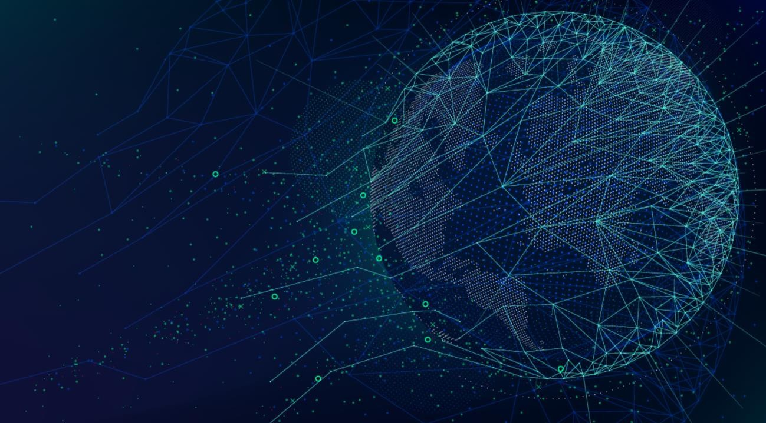
Online Social Network Analysis
Twitter Network Analysis
Joan Wambui

Slide 2
Introduction
Twitter is one of the most influential social media platforms, where millions of users share information daily. It serves as a hub for real-time updates, conversations, and the exchange of ideas across various domains. In this project, we focus on analyzing Twitter activity related to the #MamaMbogaMoment, a grassroots initiative. Our goal is to perform network analysis of the users engaging with this hashtag, leveraging key social media analysis concepts to better understand the relationships and interactions within this network.
By visualizing the interactions of Twitter users in the context of #MamaMbogaMoment, we will create a network graph that highlights significant nodes and their roles in spreading and sharing content. This analysis will allow us to identify key influencers, assess the network structure, and highlight any patterns of influence.
Why Twitter?
Twitter is a rich source of publicly available data, making it ideal for network analysis. Its real-time nature and wide reach allow us to gather insights from public profiles with fewer restrictions. By utilizing Twitter’s API, we can access large amounts of information and evaluate user interactions around trending topics. For this analysis, Twitter's accessibility and its users’ propensity to engage in conversations make it the ideal platform.

Slide 3
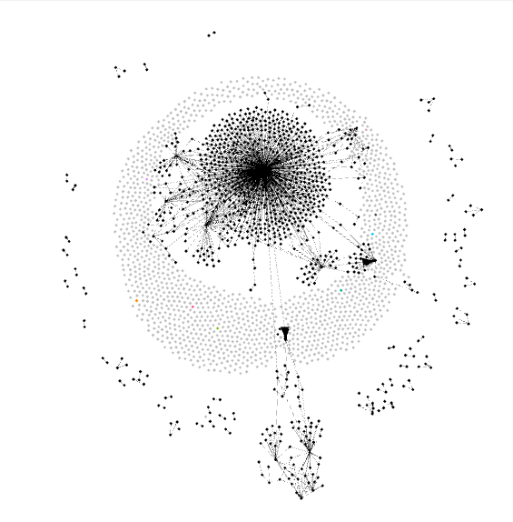
Approach
Following are the two steps that we take to perform analysis on twitter network
1. Data Visualization
Data collected from the above step is imported in Gephi for visualization. Gephi is the leading visualization and exploration software for all kinds of graphs and networks. Gephi is open-source and free.
Here is the outcome of our twitter network.

Slide 4
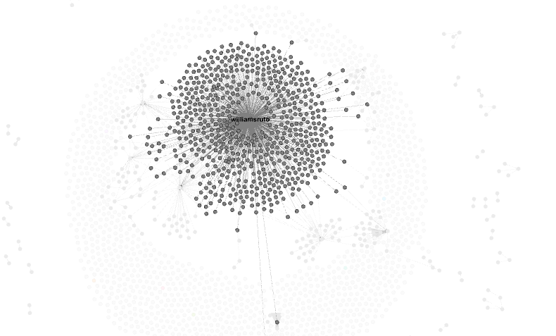
Insights from the Visualization
From our analysis, we identified William Ruto as the most influential figure in the #MamaMbogaMoment campaign. His central position in the network, with numerous connections and interactions, clearly shows his pivotal role in driving the conversation. As displayed in the visual below, Ruto’s influence surpasses other key figures, making him the primary node in terms of reach and engagement.

Slide 5
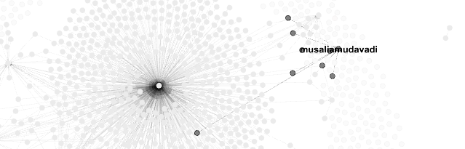
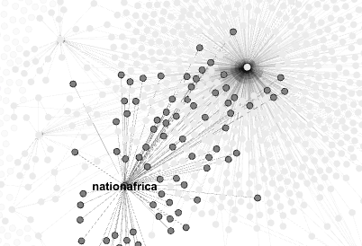
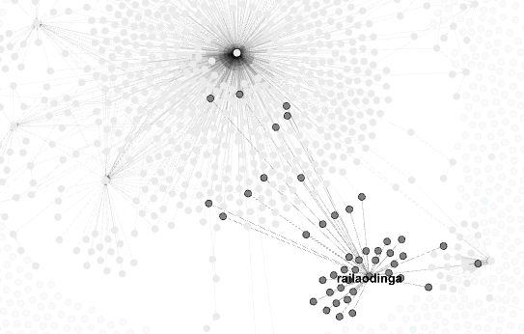
Insights from the Visualization
Additionally, several prominent figures played a significant role in shaping the conversation around the #MamaMbogaMoment campaign. Influential personalities such as Martha Karua, Raila Odinga, Dennis Itumbi, Mwalimu Amunga, and Musalia Mudavadi were evident as central nodes in the network. Their proximity to the center of the graph, along with the numerous connections (edges) they possess, highlights their key roles in spreading the message and engaging with other users. This level of influence underscores their relevance to the campaign and their ability to amplify the narrative.

Slide 6
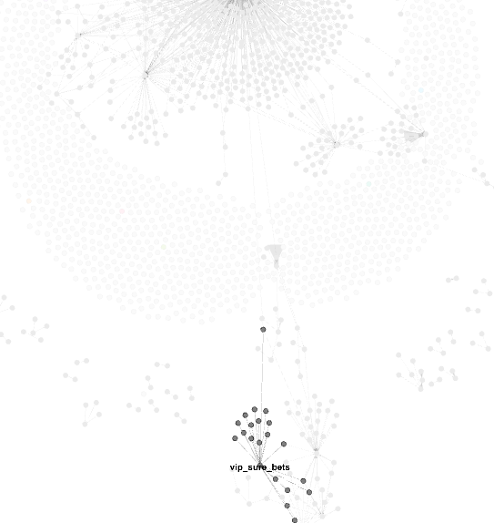
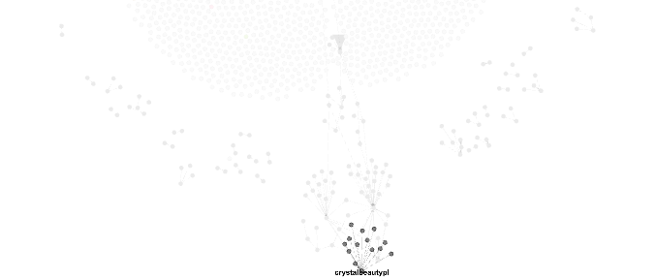
Insights from the Visualization
In our analysis, we also identified several ‘trendjackers’—accounts that used the #MamaMbogaMoment hashtag but did not contribute to the core issue's significance. Instead, these users leveraged the trending topic for self-promotion. Notable examples of these trendjackers include f_m networks, vip_sure_bets, and crystal beautyplace. As displayed in the visual, these accounts are positioned farther from the center of the network, reinforcing their lack of influence and relevance to the campaign.

Slide 7
Learnings and Findings
-Insights on Information Spread:
- Analysis focused on #MamaMbogaMoment and its impact within Twitter networks.
-Key Influencers Identified:
- William Ruto and Martha Karua emerged as central figures.
- Their central positions and dense connections indicate high engagement and influence.
- Trendjackers Noted:
- f_m networks, vip_sure_bets, and crystal beautyplace were identified as trendjackers.
- These accounts were positioned at the periphery, highlighting their minimal relevance to the campaign.
- Overall Findings:
- Central figures drive meaningful discussions and shape the narrative.
- Peripheral actors often use trending topics for self-promotion.
- Understanding both key influencers and trendjackers is crucial for effective social media analysis and campaign strategy.

