Slide 1
Exploratory Analysis Report

Slide 2
Univariate Analysis

Slide 3
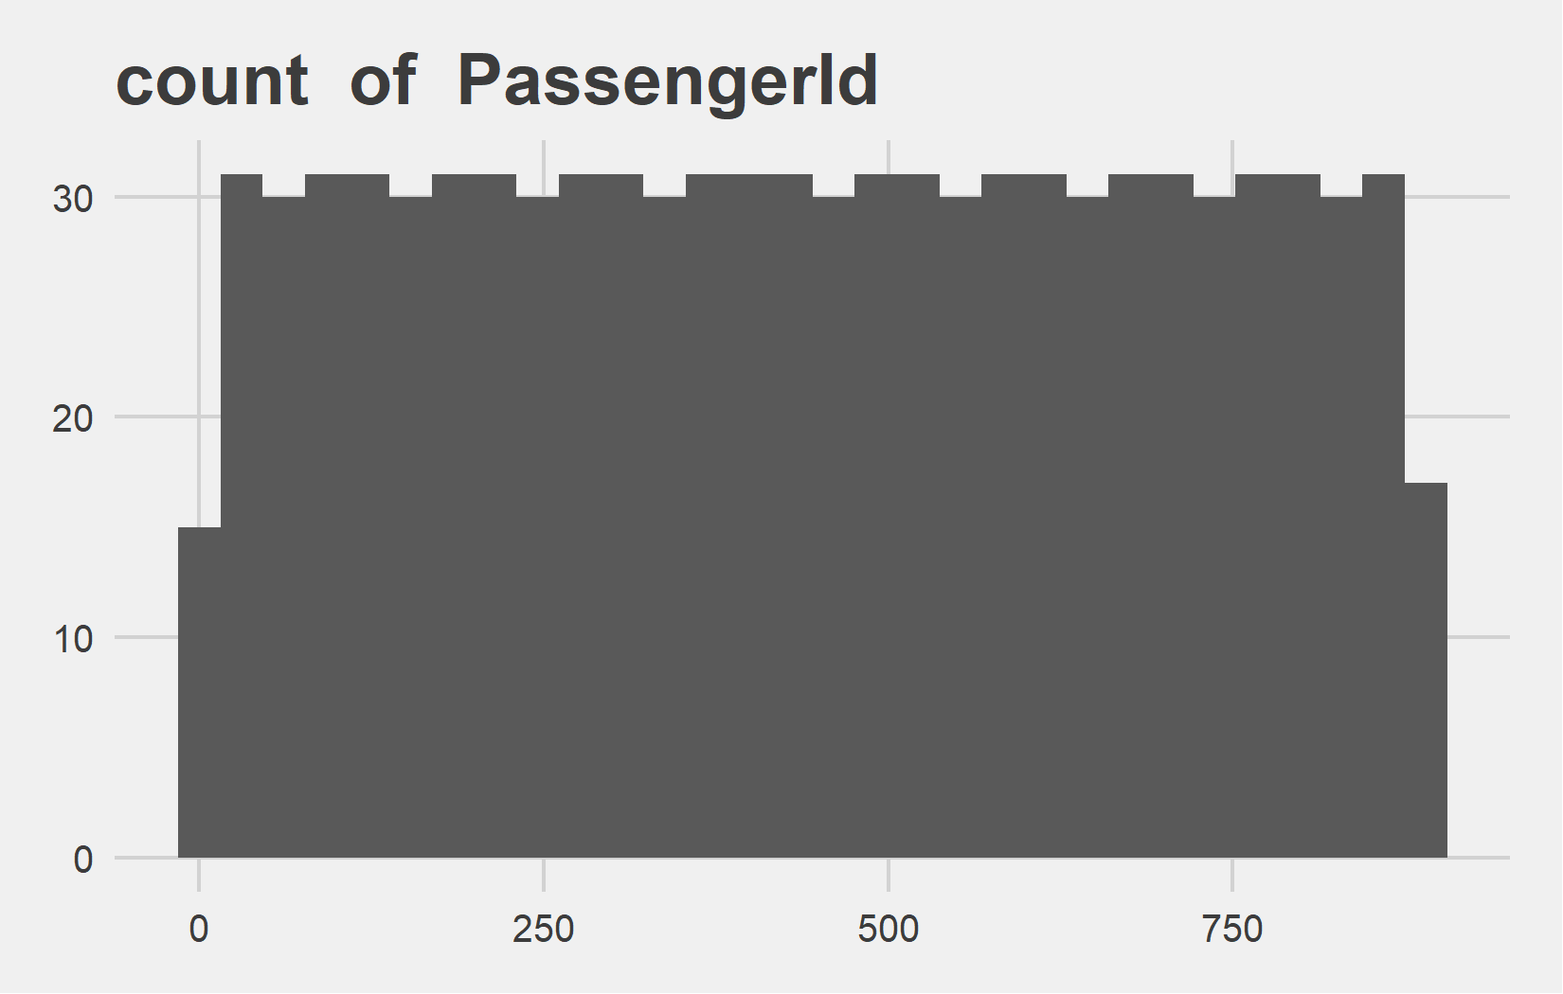
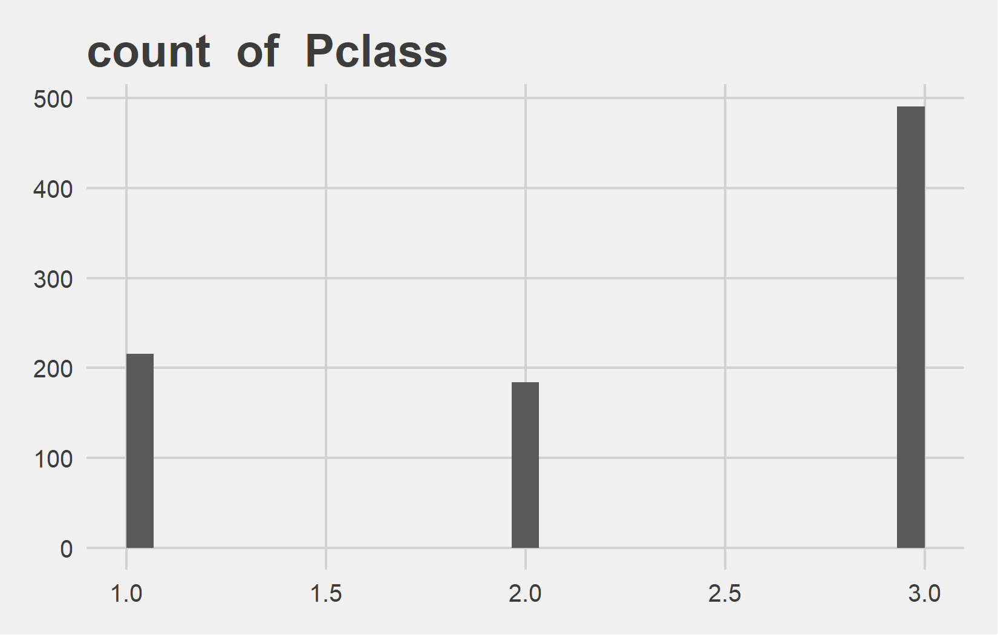
Univariate Analysis Slide 1 of 4
min | 25th | 50th | 75th | max
1 | 223.5 | 446 | 668.5 | 891
min | 25th | 50th | 75th | max
1 | 2 | 3 | 3 | 3

Slide 4
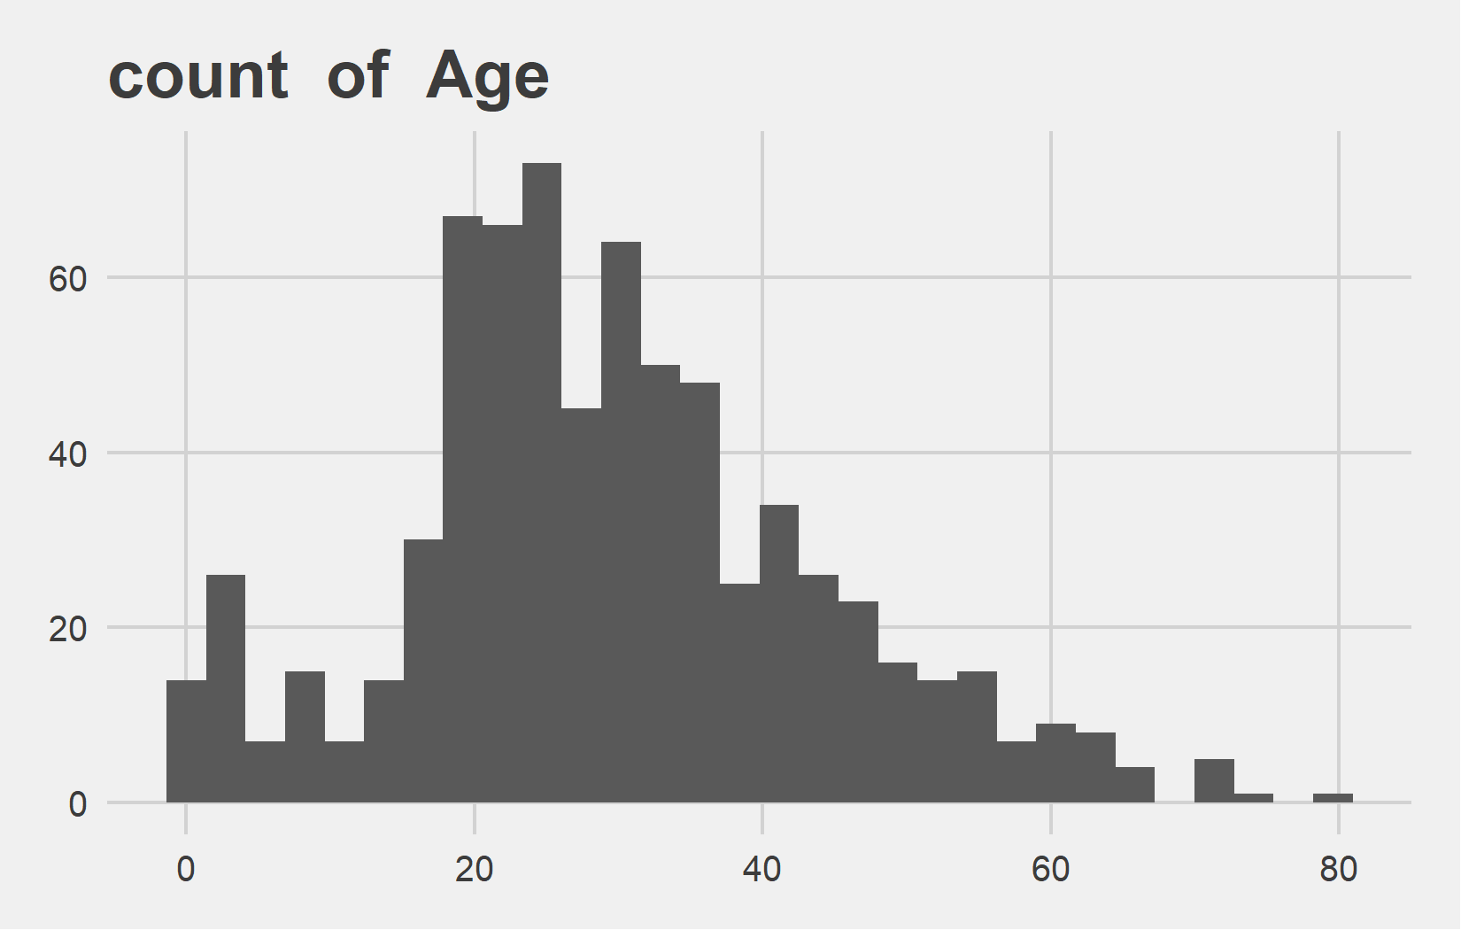
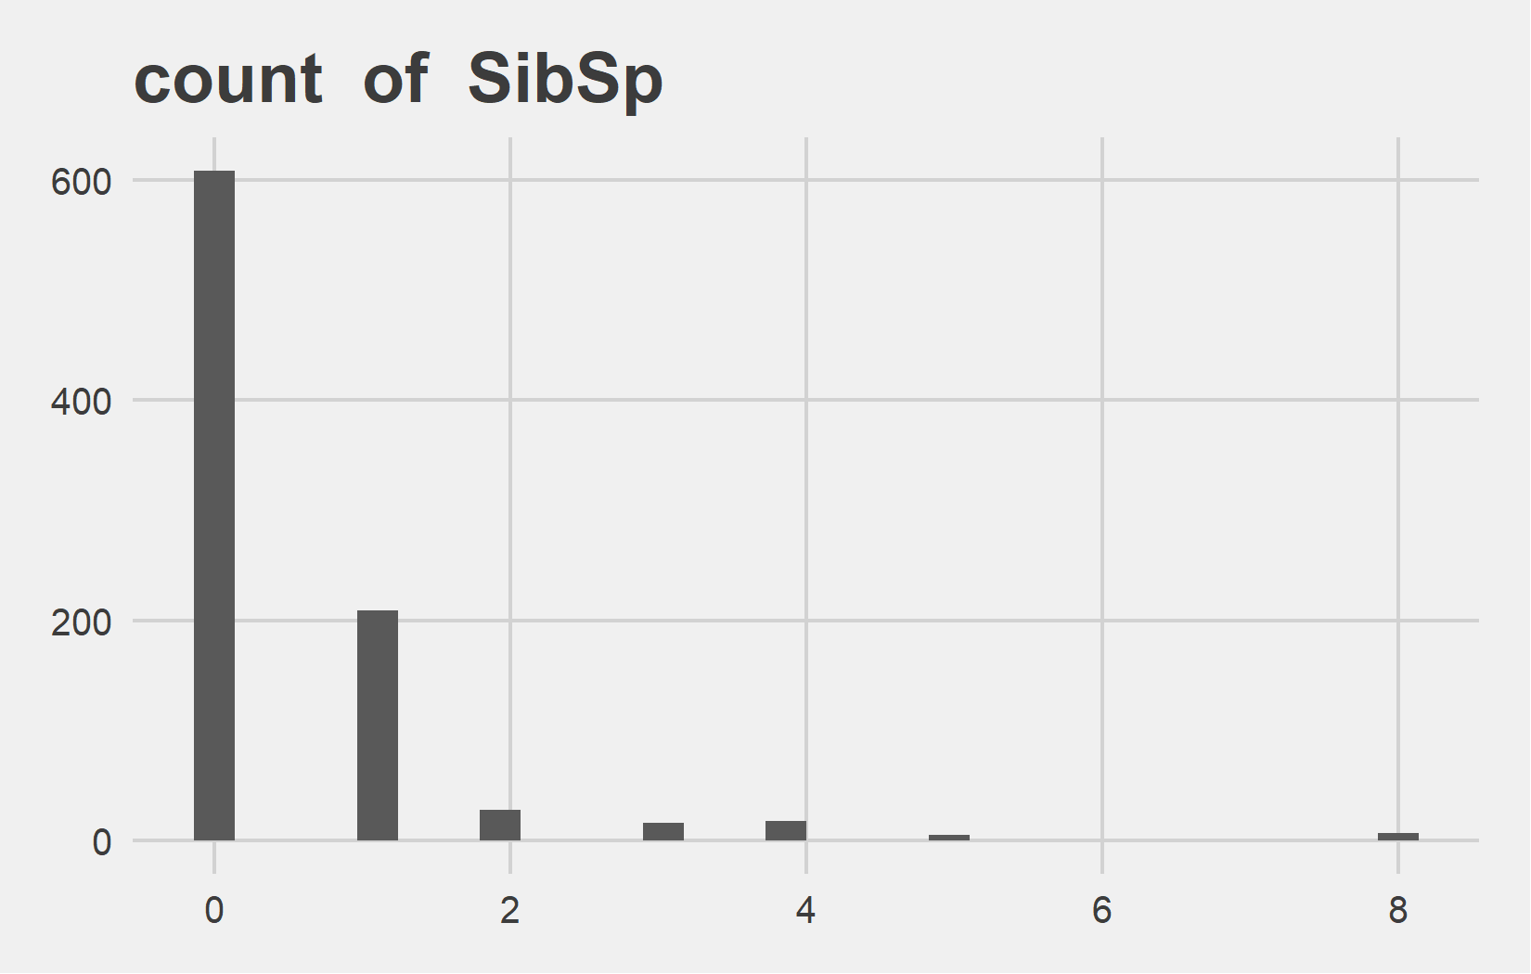
Univariate Analysis Slide 2 of 4
min | 25th | 50th | 75th | max
0.42 | 20 | 28 | 38 | 80
min | 25th | 50th | 75th | max
0 | 0 | 0 | 1 | 8

Slide 5
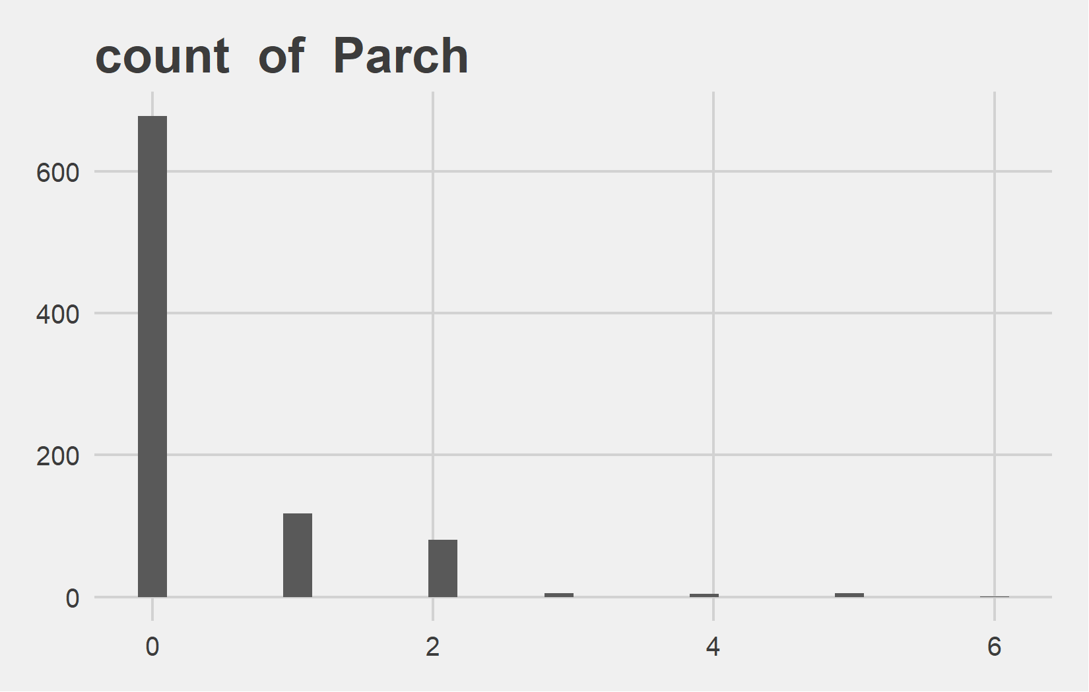
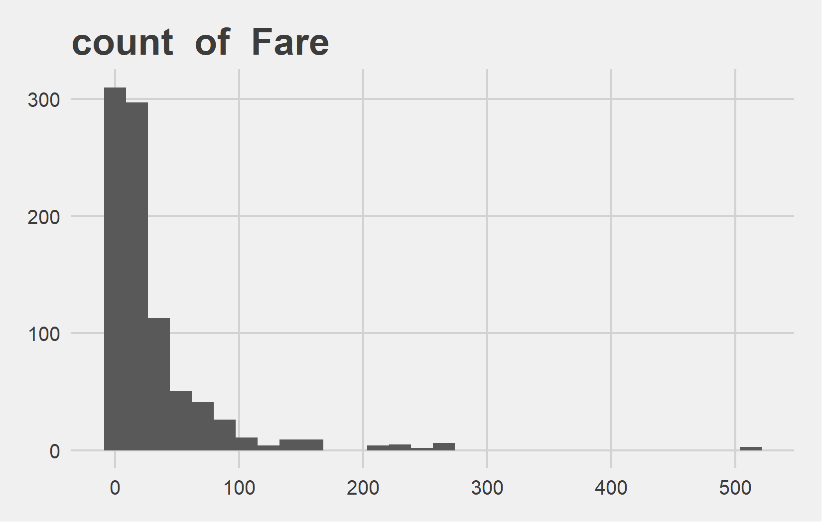
Univariate Analysis Slide 3 of 4
min | 25th | 50th | 75th | max
0 | 0 | 0 | 0 | 6
min | 25th | 50th | 75th | max
0 | 7.91 | 14.45 | 31 | 512.33

Slide 6
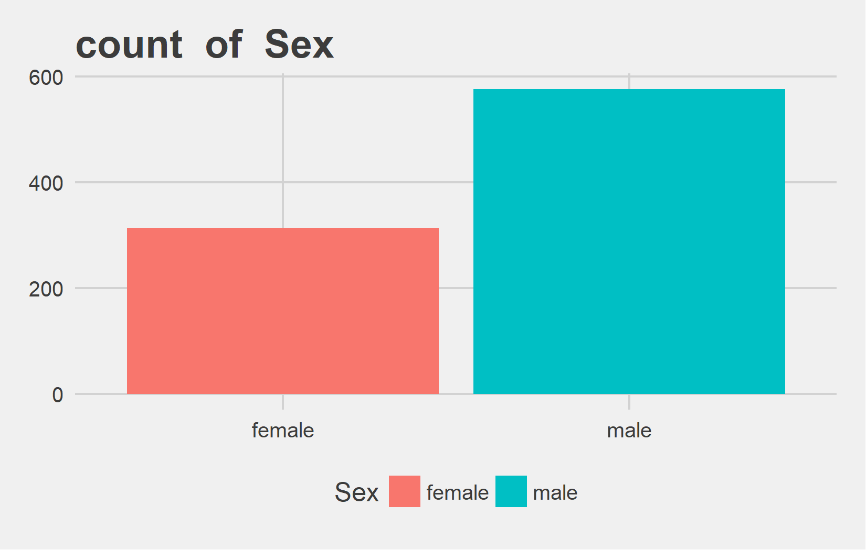
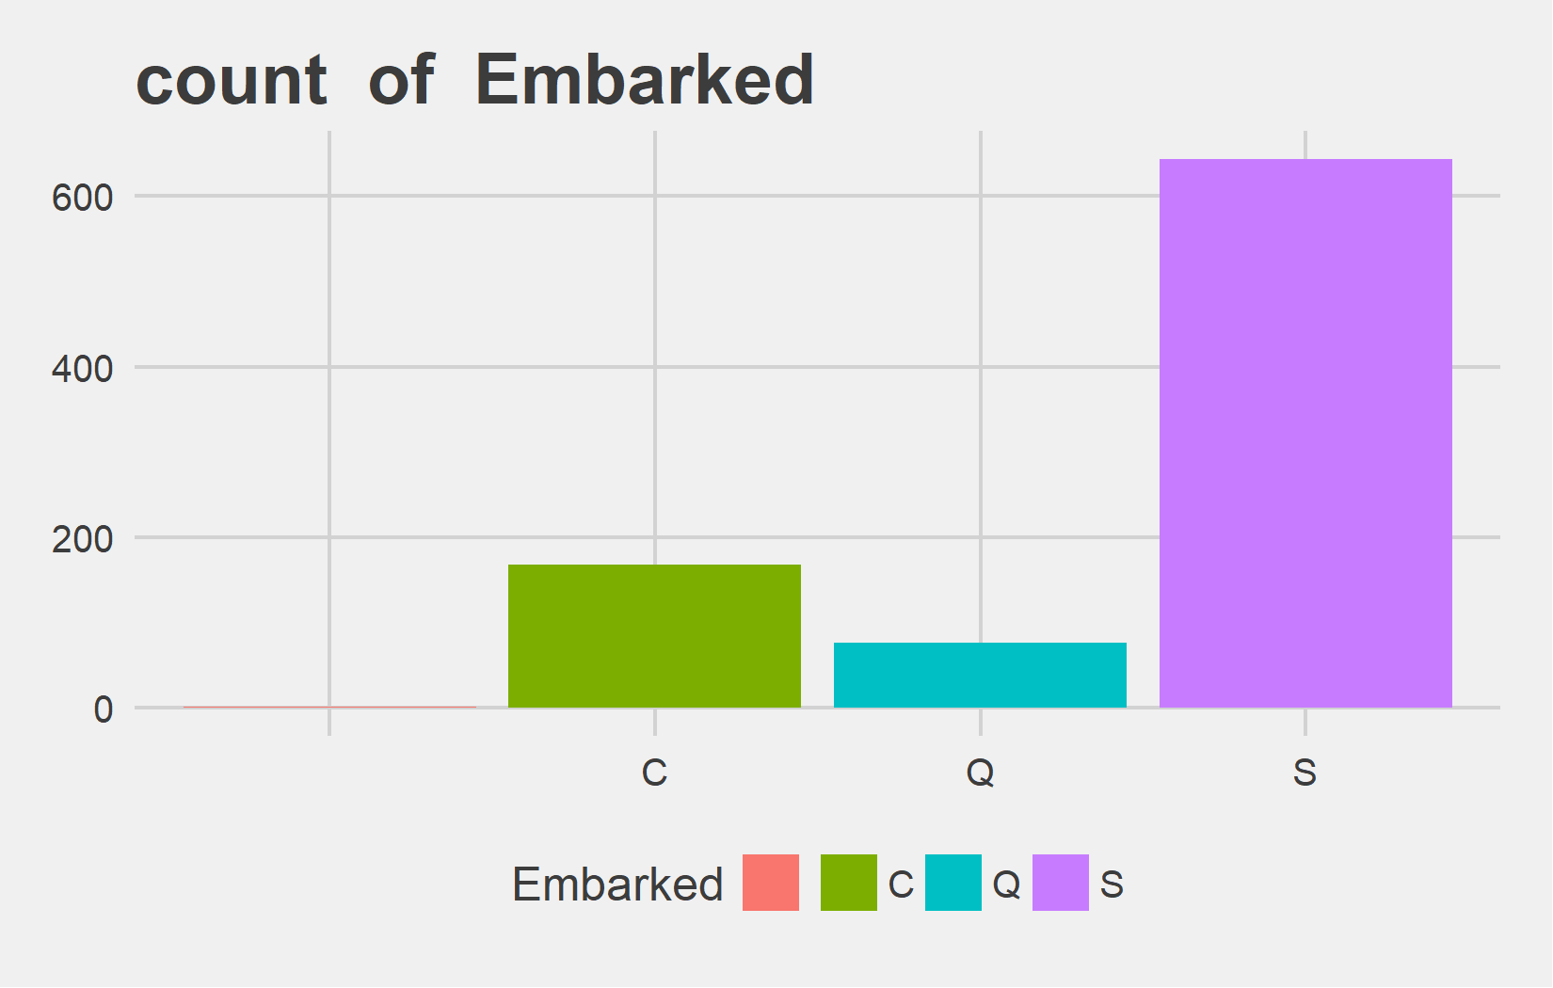
Univariate Analysis Slide 4 of 4
Metric | female | male
Count | 314 | 577
Perct. | 35.24% | 64.76%
Metric | V1 | C | Q | S
Count | 2 | 168 | 77 | 644
Perct. | 0.22% | 18.86% | 8.64% | 72.28%

Slide 7
Bi-variate analysis

Slide 8
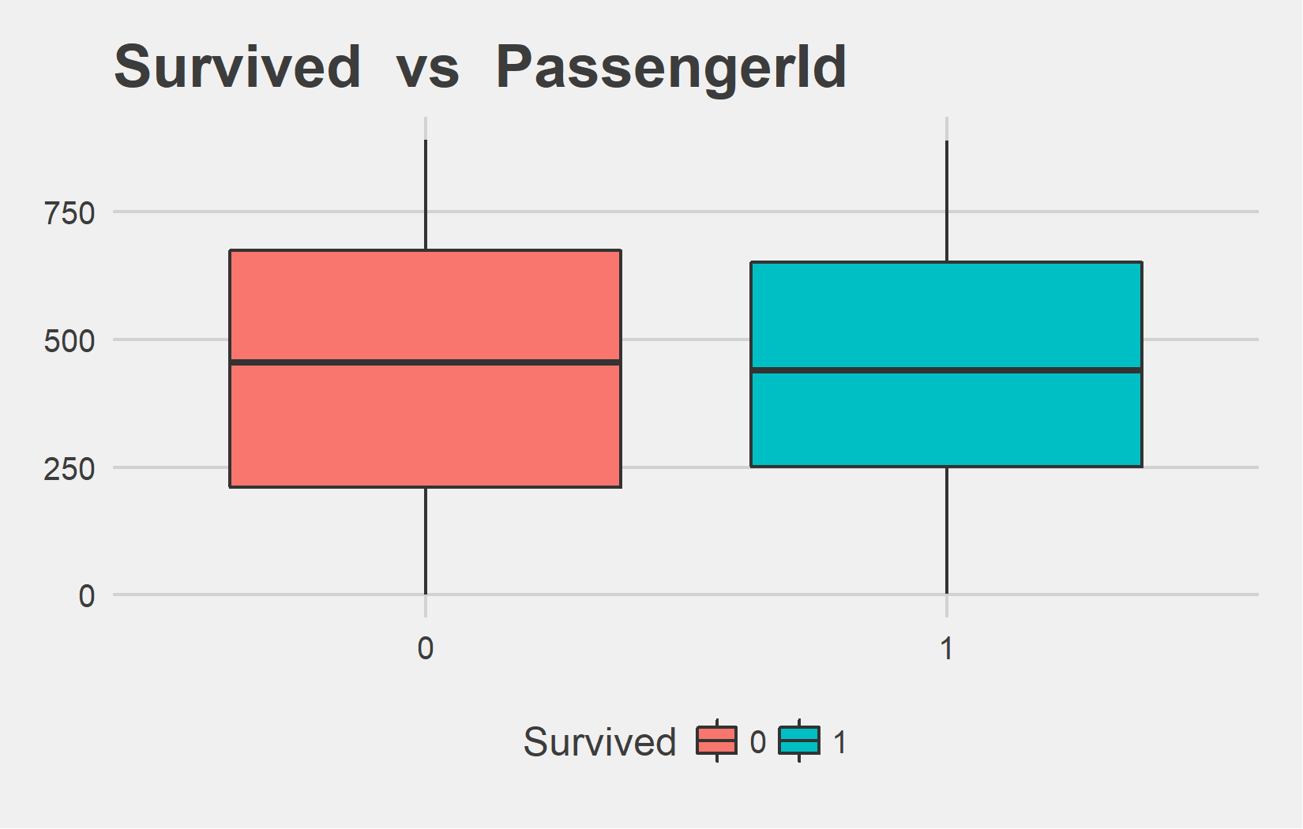
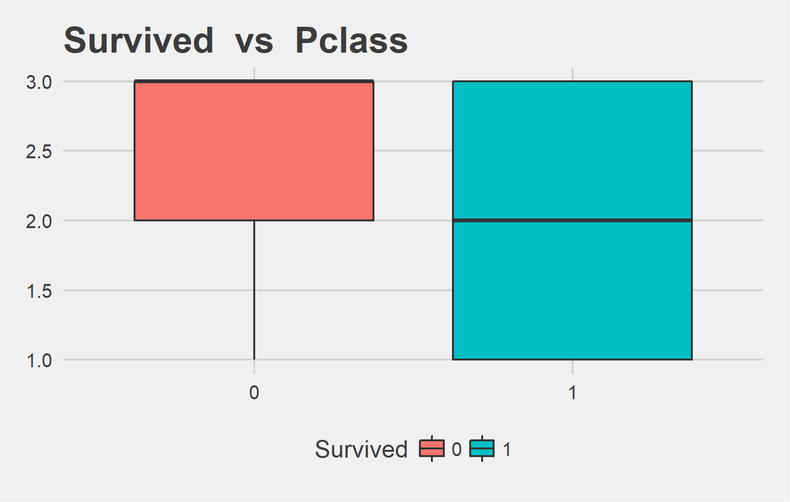
Bi-variate analysis Slide 1 of 4
Survived | mean - PassengerId | median - PassengerId
0 | 447.02 | 455.0
1 | 444.37 | 439.5
Survived | mean - Pclass | median - Pclass
0 | 2.53 | 3
1 | 1.95 | 2

Slide 9
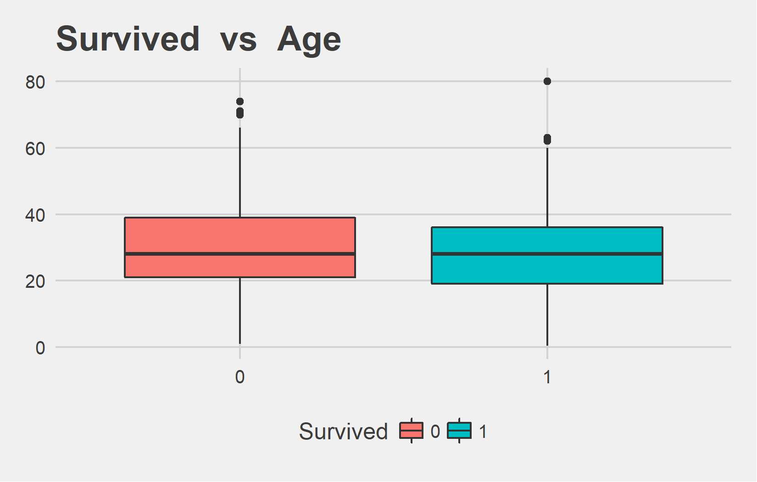
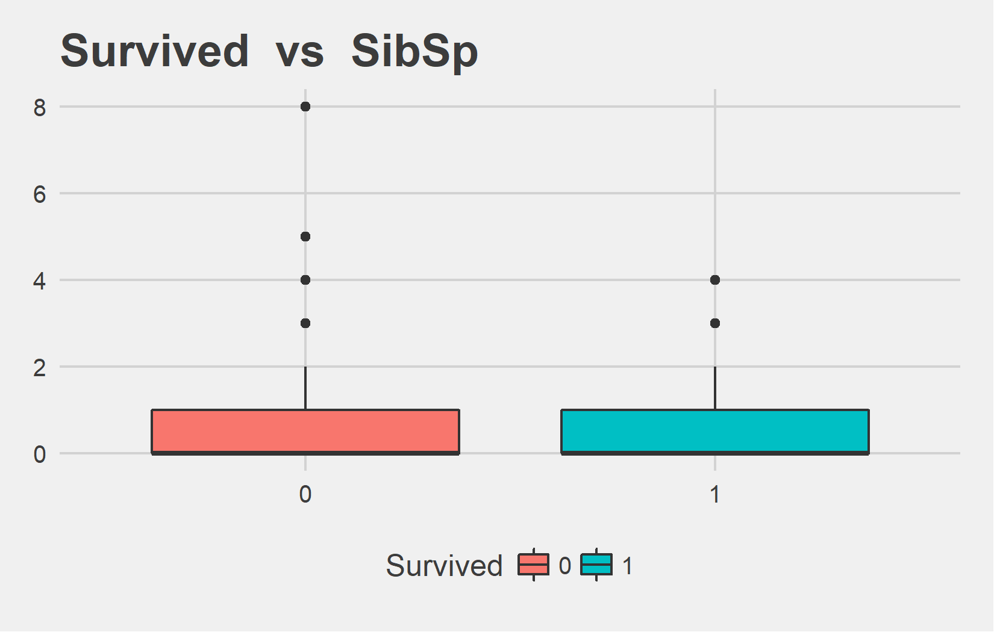
Bi-variate analysis Slide 2 of 4
Survived | mean - Age | median - Age
0 | 30.63 | 28
1 | 28.34 | 28
Survived | mean - SibSp | median - SibSp
0 | 0.55 | 0
1 | 0.47 | 0

Slide 10
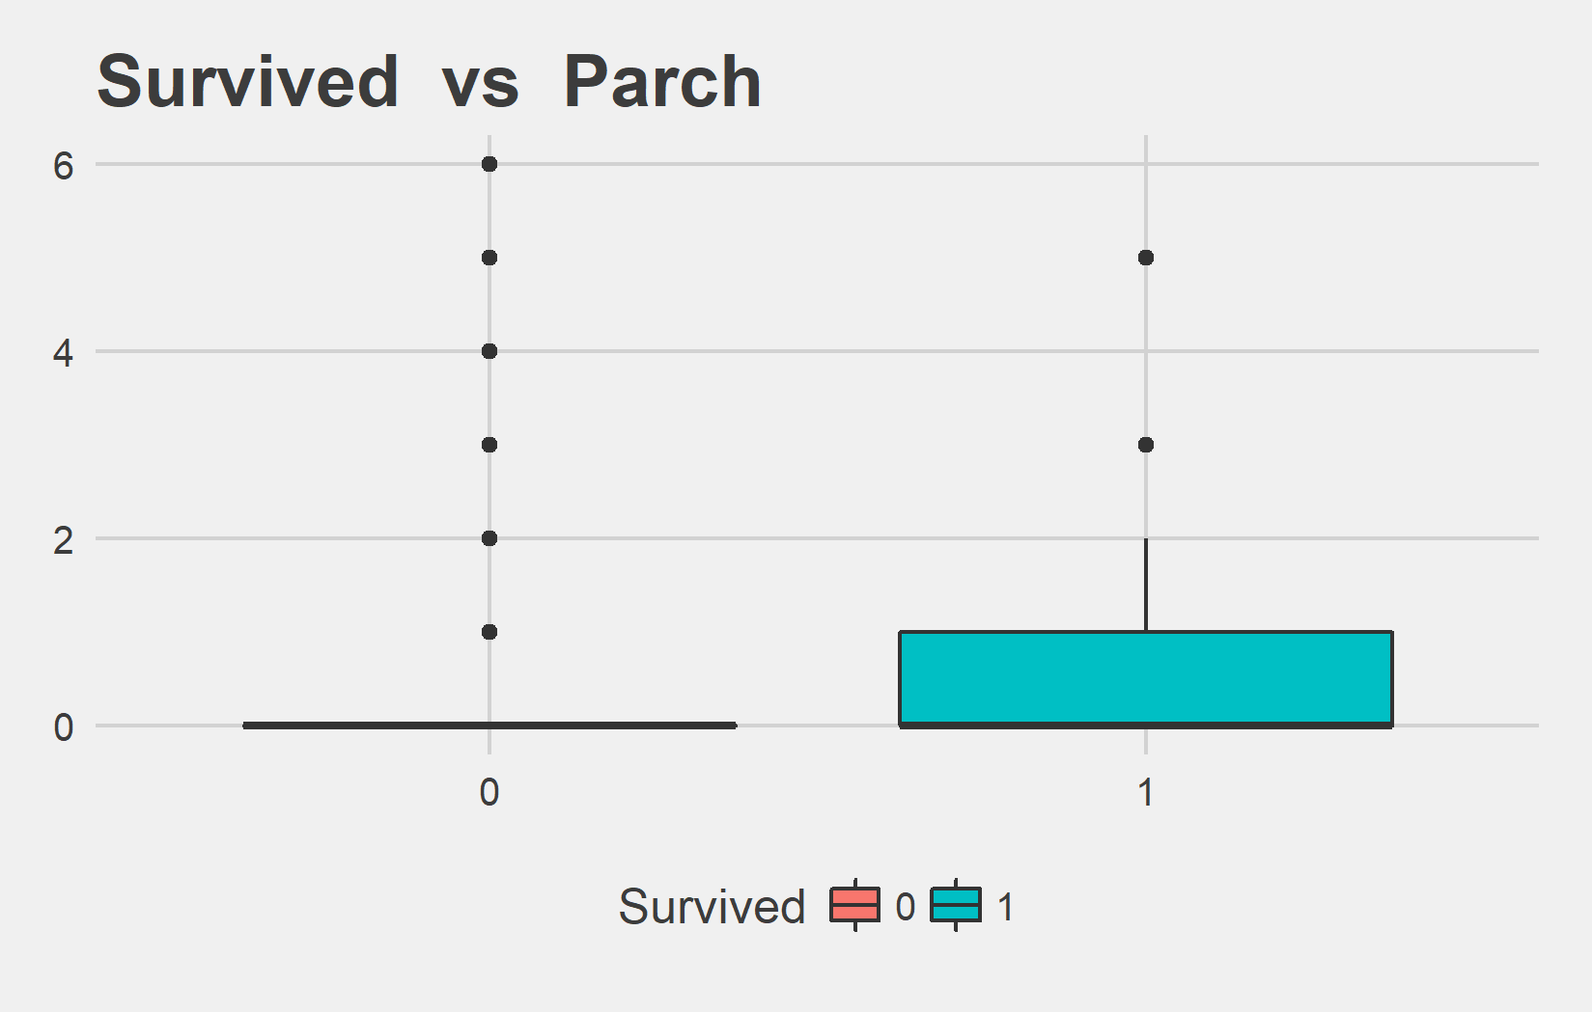
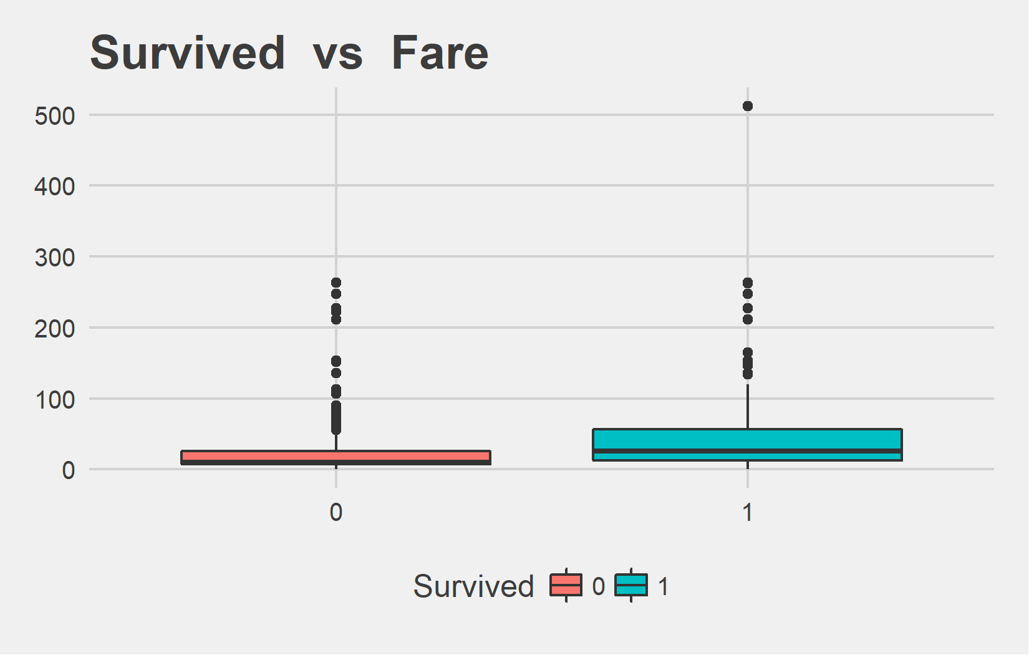
Bi-variate analysis Slide 3 of 4
Survived | mean - Parch | median - Parch
0 | 0.33 | 0
1 | 0.46 | 0
Survived | mean - Fare | median - Fare
0 | 22.12 | 10.5
1 | 48.40 | 26.0

Slide 11
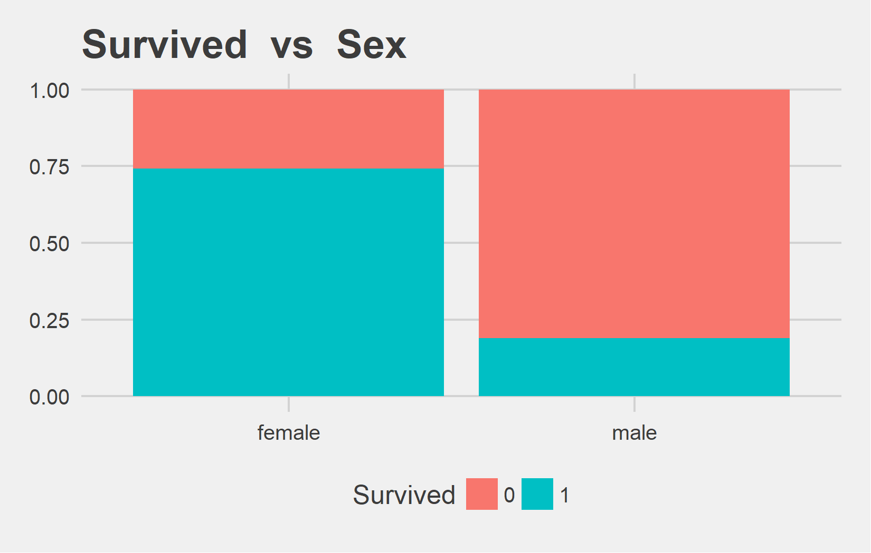
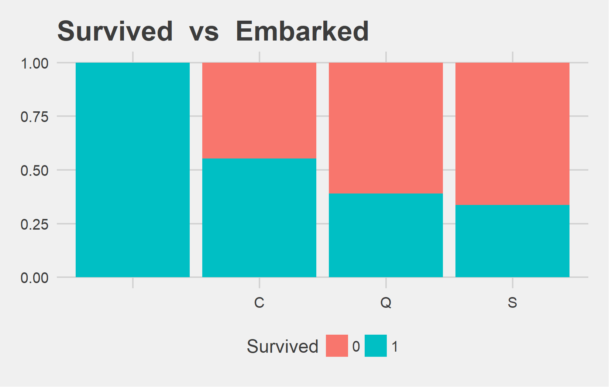
Bi-variate analysis Slide 4 of 4
Survived | female | male | female | male
0 | 81 | 468 | 25.8% | 81.11%
1 | 233 | 109 | 74.2% | 18.89%
Survived | Var.2 | C | Q | S | V1 | C | Q | S
0 | 0 | 75 | 47 | 427 | 0% | 44.64% | 61.04% | 66.3%
1 | 2 | 93 | 30 | 217 | 100% | 55.36% | 38.96% | 33.7%

