Slide 1

Redundancy
A business use case presentation for Replication program
João Azevedo
18/06/2024
Icon source: Copy, copy file, duplicate, move file icon - Download on Iconfinder

Slide 2
What is redundancy?
Why have redundancy?
The action or process that allows for a replication of hardware or software components.
More specifically, having data redundancy contributes to having a more fault tolerant system.

Slide 3

What risks does redundancy tackle?
And how does it tackle those?
(you might ask)
Data loss;
Data corruption;
Systems or services interruptions;
Poor load balancing;
By having previous working versions of the source files can be recovered;
And/or allow for a better traffic distribution.
Reference: Data Loss Risk Assessment – Research Data Service – U of I Library (illinois.edu)

Slide 4
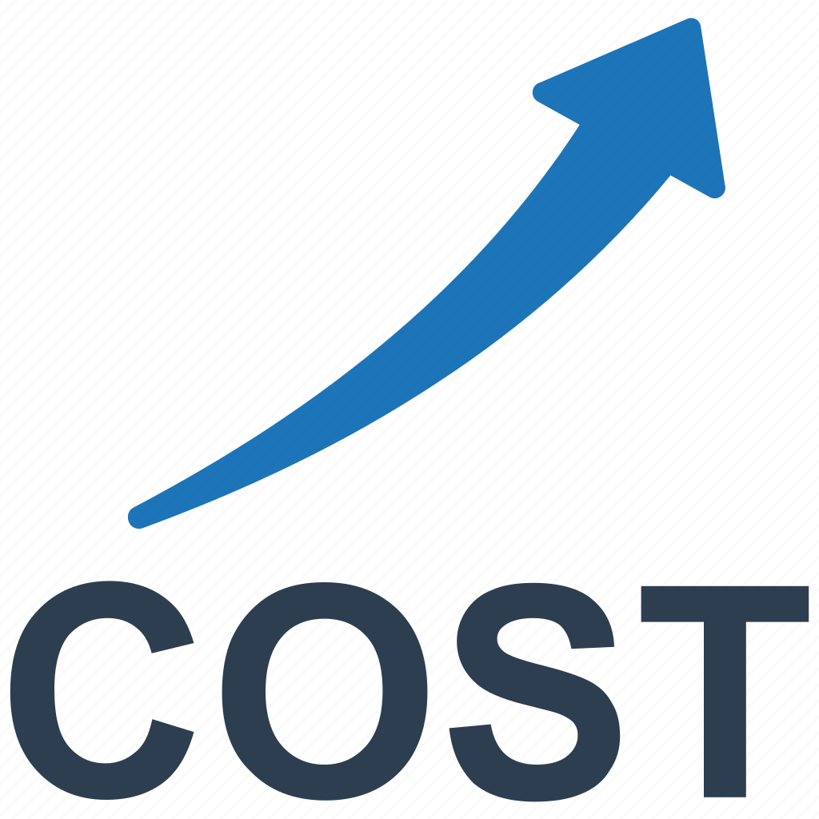
What is the financial risks of not implementing fault-tolerant systems?
Companies that don’t build fault-tolerant systems see an increase in opex:
Costs of hiring specialists to recover lost data.
Cost of downtime.
Reputational damage control.
On average, data loss can cost from $18k up to $15.6 million.
References:What is the Cost of Data Loss in 2024? Invenio IT; High cost, rising costs, cost increase icon - Download on Iconfinder

Slide 5
A Small-Scale Solution
Test_Task_Redundancy (under the MIT license) is a Python based directory replication scheduler that provides an interface for a small-scale user.
It can be found in this GitHub repo.

Slide 6

Questions?
Reference: 85 question red icons - Iconfinder

Slide 7
Thank you for your attention!
João Azevedo
18/06/2024

