Slide 1
Phase transition in optimization problems
Chapter 10

Slide 2
10.1 Satisfaction problems
Also called SAT problems

Slide 3
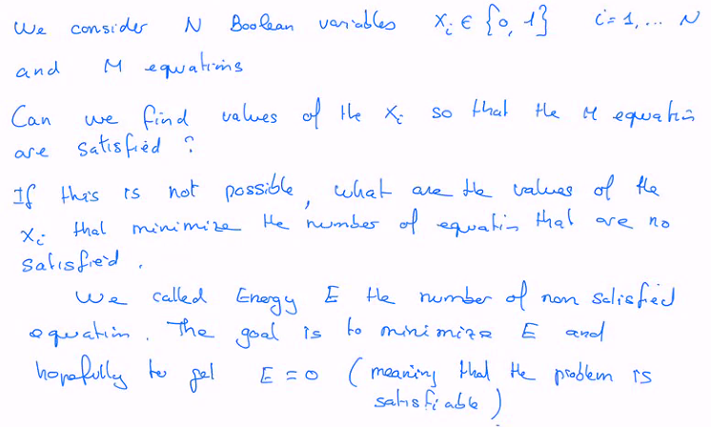
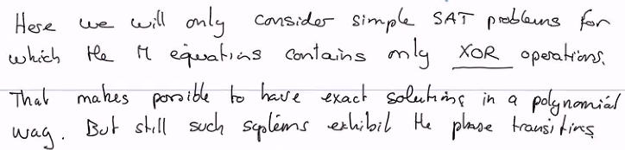

Slide 4
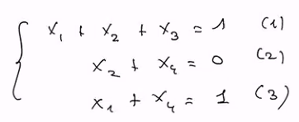
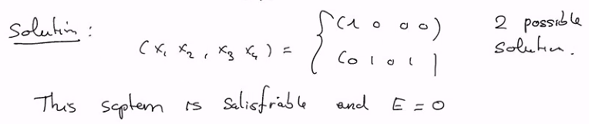
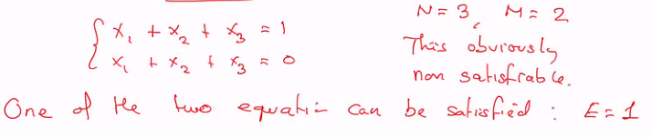
Examples
N = 4 variables (x₁, x₂, x₃, x₄)
M = 3 equations
+ means XOR: same as the addition mod 2
1+1 = 2 = 0
1+0 = 1 = 1
0+0 = 0 = 0

Slide 5
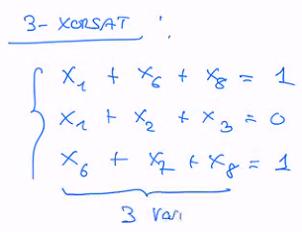
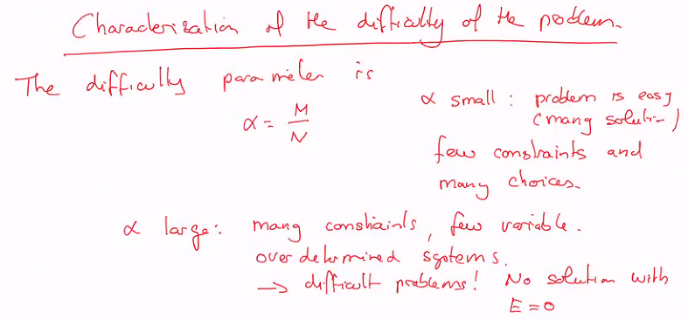
k-xorsat problems
Those are XORSAT problems (contain only XOR operations) but in addition, each of the M equations contains only k distinct variables out of the N variables.

Slide 6

Problem generation
We want to generate randomly k-xorsat problems and study the probability that such a problem is satisfiable.
This will be done for different values of N, M (thus α) for a given k.
In order to generate a random k-xorsat problem:
One needs to generate M equations.
Each of these will contain k variables chosen at random among N.
First one choses 1 variable among N
Second chooses 1 variable among N-1…
One generate a big number Ν = 10’000 such systems.

Slide 7
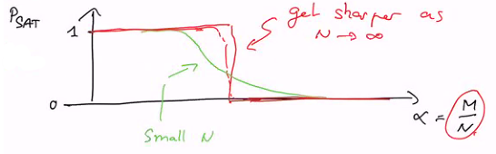
One defines P_{sat}(k, N, M) as the fraction of these systems that are satisfied.
P_{sat} is the probability that a random system with k, N, M given has a solution.
One observes the following phase transition in P_{sat} s a function of α:

Slide 8
10.2 Solving k-xorsat: Gaussian elimination
The goal is to eliminate a variable in all equations but one by linear combination of the others.

Slide 9
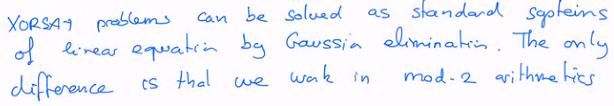
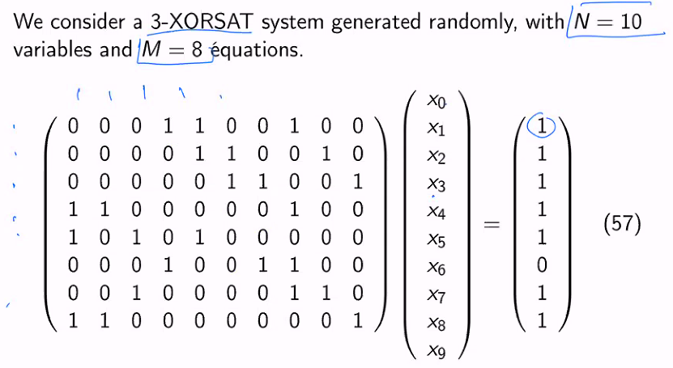
N variables
M equations

Slide 10
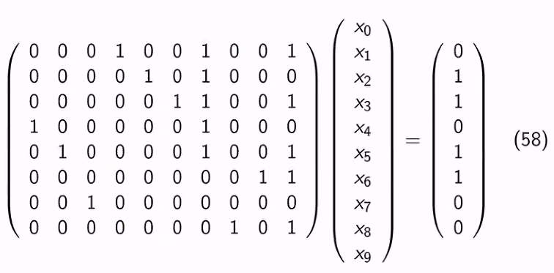
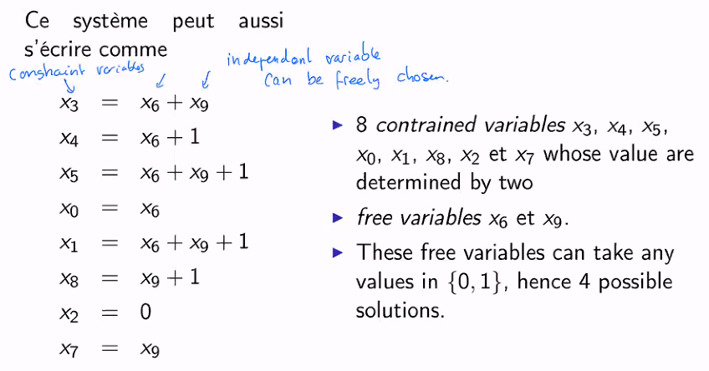
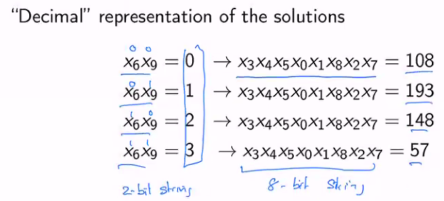
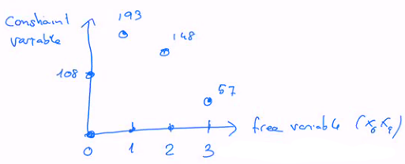
The Gaussian elimination is a polynomial algorithm that takes O(N³), which is much less than O(2^{N}) for exhaustive search

Slide 11
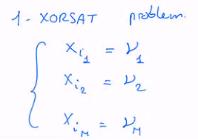
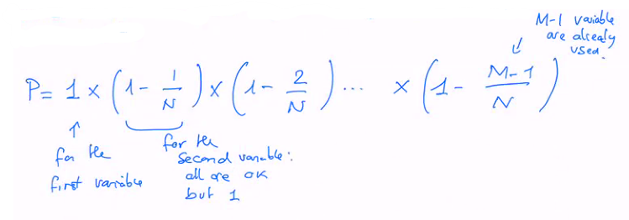
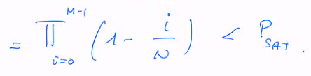
Space of solutions
For simple cases, one can compute analytically P_{sat}.
We will illustrate that for k = 1.
Such a system is satisfiable if the same variable does not appears in more than one equation.
If it appears more than once, the right hand side should be the same.
Thus P_{sat} > P
Where P is the probability of never getting twice the same variable.

Slide 12
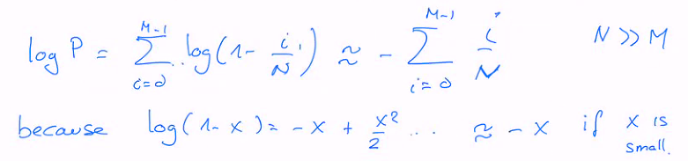
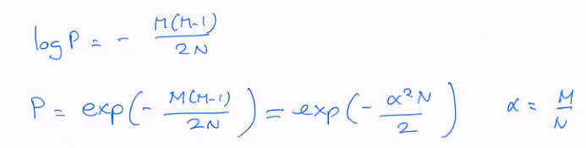
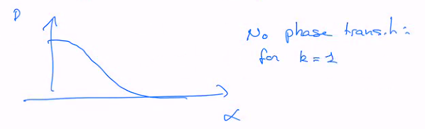
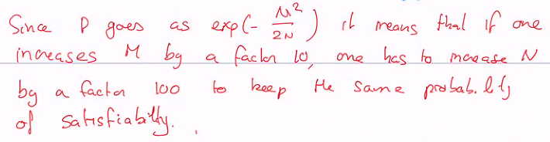

Slide 13
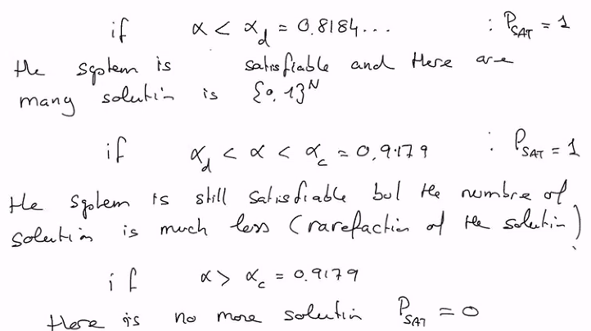
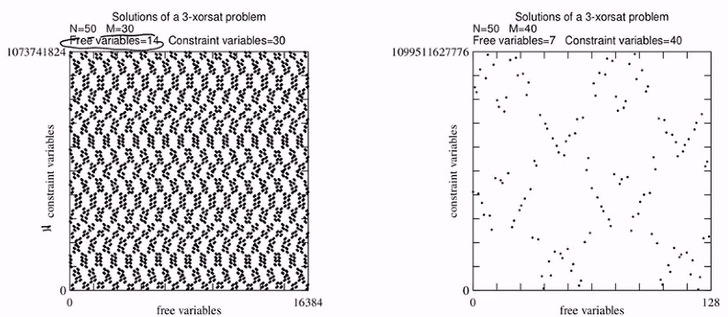
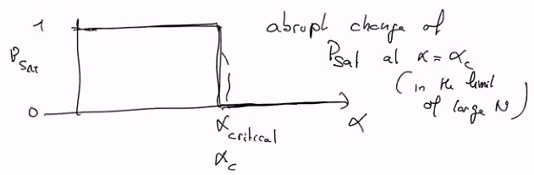
3-XORSAT problems
Analytical study shows the following properties:

Slide 14
10.3 Metaheuristics to solve SAT problems
We consider a simple metaheuristics, called RWSAT for Random Walk SAT, to solve k-XORSAT problems.
We’ll analize its behaviour as a function of the difficulty parameter α.
We’ll see that there are critical values of α (for abrupt change in behaviour).
But these critical values are not α_{c} and α_{d} from theory.
The metaheuristics fails much earlier !

Slide 15
RWSAT pseudo-code
Initialize all variables at random
Compute E (how many equations are not satisfied)
t = 0
While E > 0 and t < t_{max}:
Choose at random a non-satisfied equation
Choose at random one of the 3 variables of this equation
Change it’s value to it’s complement (0 → 1 and 1 → 0, so that this equation is now satisfied)
Compute E
t += 1
End while
Print E, t

Slide 16
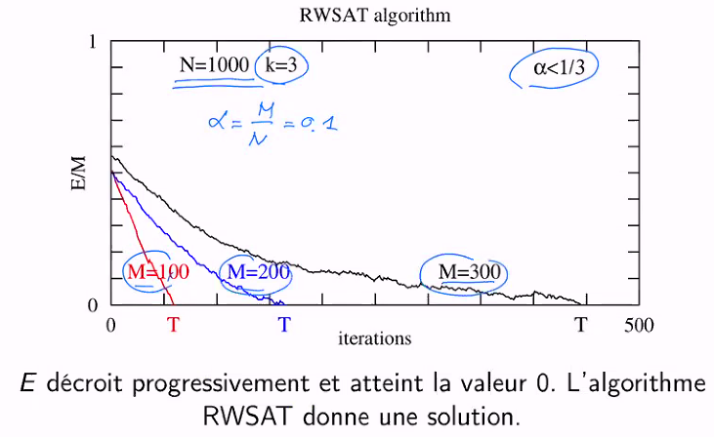
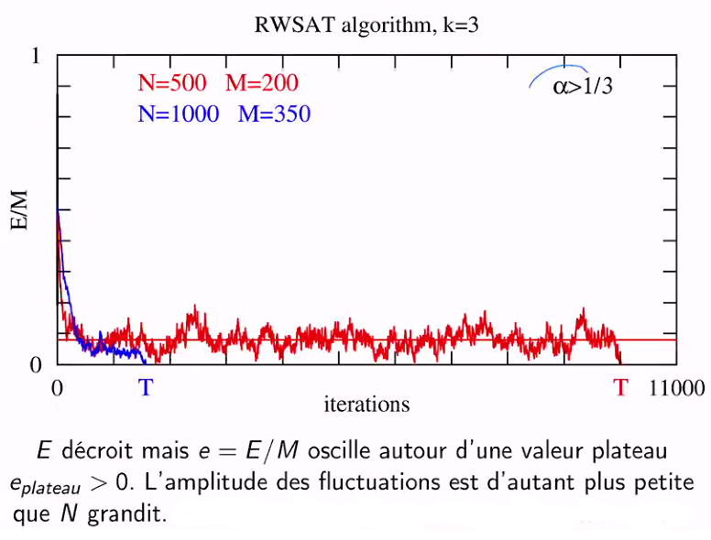
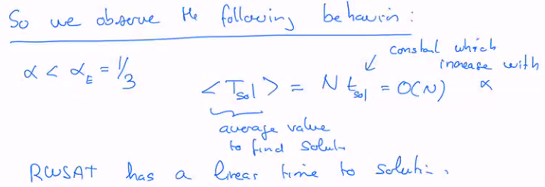
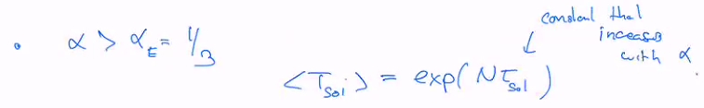


RWSAT results

