Slide 1
Métaheuristics for optimisation
Bastien Chopard

Slide 2
Exam & grading
1/3 for TPs
2/3 for Oral exam
No preparation, no material
List of questions, pick one
20min discussion on the topic
Course material
Notes
Books
Moodle & emails for notes and announcements

Slide 3
Introduction
Chapter 1

Slide 4
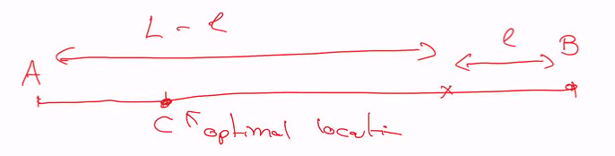
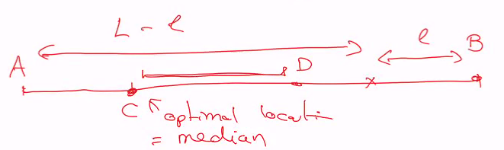
1.00 Introduction example
Example of optimisation
Some peoples are in a room
Where is the point for witch the global distance for them is minimal?
Let’s put it in 1D…
If odd number of points: C is the Median and Optimal location (left scheme)
If even number of points: will be somewhere between C and D (right scheme)
C
A
2D median
?
D
B

Slide 5
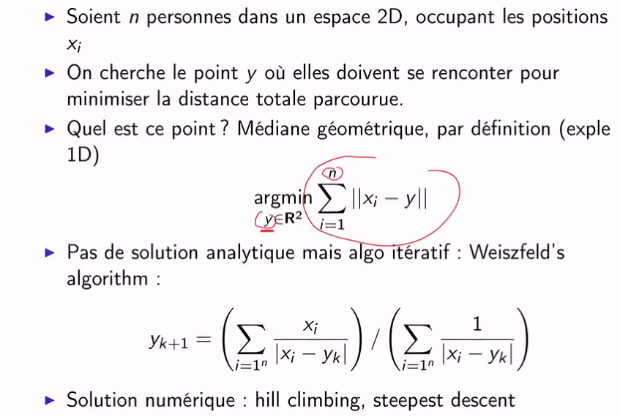
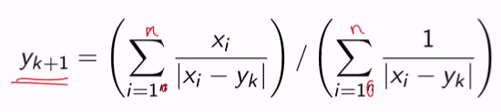
1.01 Exemple of median computation

Slide 6
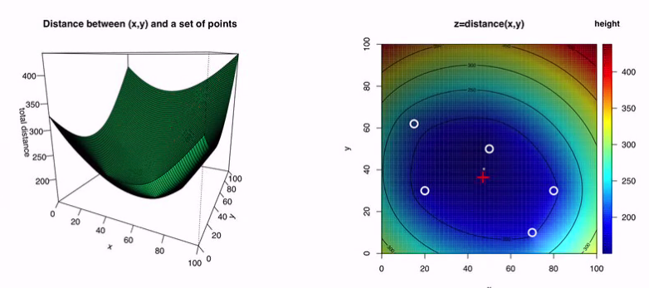
1.02 Graphical solution
Computing it: hill descent / sleepest descent
We go «down the hill» to the lowest point (orange arrow)

Slide 7
1.1 Search space
We want to solve an optimisation problem:
Find x such that a givenfunction f(x) is maximal (maximization problem) or minimal (minimization problem)
Definition: The search space S is the set of possible values for x
S = R² in the 2D median example
But in any case, we’ll consider situations where S is very big (no exhaustive search is tractable).
x ∈ S is often called a possible solution or also a configuration
What is f ?:
It’s always a function which quantify the quality of an x
f : S → R (or a subset of R on which there is an order relation)
Terminology: f is called the…
objective, cost or energy function
fitness (what we will use in this course)

Slide 8
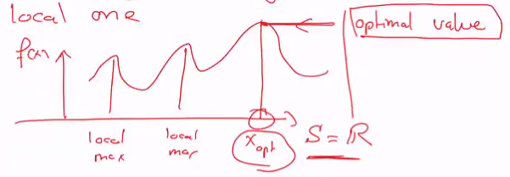
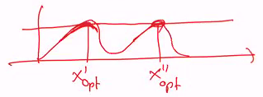
The optimal solution is:
x_{opt} ∈ S, such that
f(x_{opt}) ≥ f(y) or x_{opt} = argmax f(y) pour tout y ∈S (maximization problem)
f(x_{opt}) ≤ f(y) or x_{opt} = argmin f(y) pour tout y ∈ S (minimization problem)
Note: we are looking for a global optimum, not a local one
Questions:
Is the optimal value unique ?
Yes, otherwise these would be a smaller or bigger one, then choose the best!
Is the optimal solution unique ?
No, many points can have the same optimal value.

Slide 9
Usually S is multidimensional
n-component vector
n is called the problem size or the number of degrees of freedom («degrés de liberté»)
It means that the cardinality (number of elements) of S grows exponentially with n:
S = S₁ * S₂ * … * S_{n}
|S| = |S₁|*|S₂|…*|S_{n}| = |S_{i}|^{n}
We need algorithms and in particular metaheuristics to solve it.

Slide 10

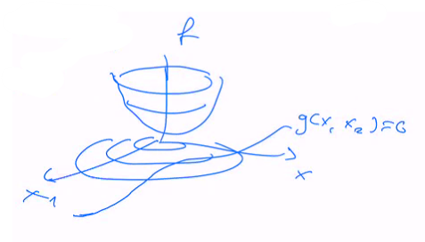
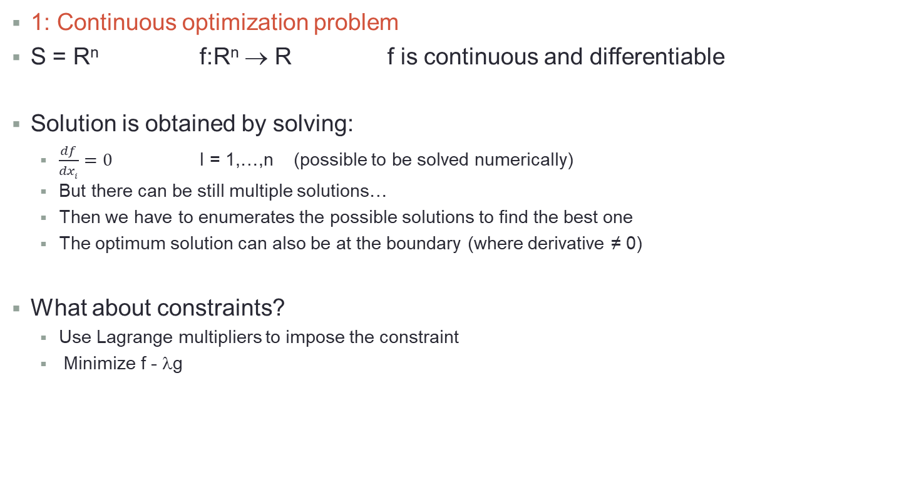
1.2 Examples of optimization problems
1: Continuous optimization problem
S = R^{n} f:R^{n} → R f is continuous and differentiable
Solution is obtained by solving:
$\frac{df}{dxi}=0$ I = 1,…,n (possible to be solved numerically)
But there can be still multiple solutions…
Then we have to enumerates the possible solutions to find the best one
The optimum solution can also be at the boundary (where derivative ≠ 0)
What about constraints?
Use Lagrange multipliers to impose the constraint
Minimize f - λg

Slide 11
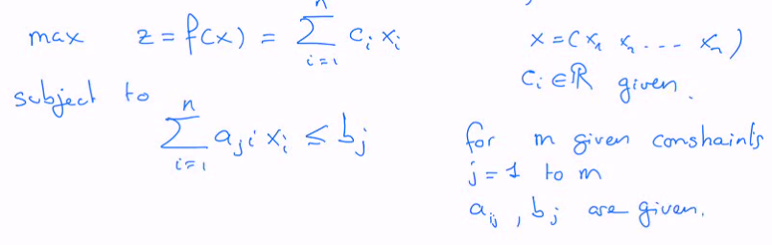
2: Linear programming (standard problem in economics)
The solutions are at the edge of a convex polygon.
Algorithm: SIMPLEX

Slide 12

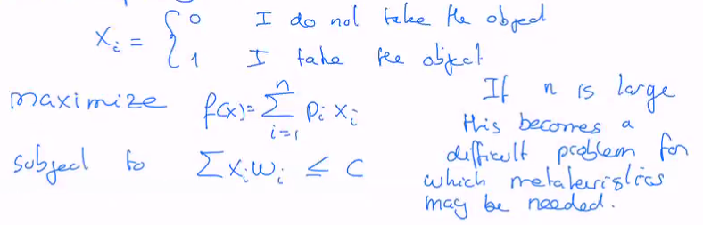
3: Knapsack
We have n objects of size w_{i} and value P_{i}.
We want to take as much value in the sack, whose capacity is C.

Slide 13
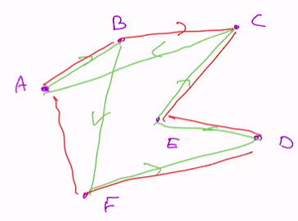
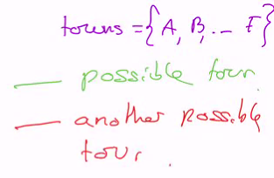
4: Traveler Salesman Problem (TSP)
We have n towns and salesman who has to go through these n towns, without going twice to the same town, and return to the initial town.
The tour should be the shortest possible.
A tour is specified by a permutation of the symbols A, B, C, D, E and F.
S = {set of permutations of n towns}
|S| = n! (grows very fast with n

Slide 14

5: NK-Landscape
Inspired by a biological problem: genetic regulatory networks.
S. Kaufmann formulate this problem in a mathematical way.
Consider N persons with two possible commercial strategies
x_{i} = 0, x_{i} = 1 I = 1,…,N
The success of these strategies depend of the choice of strategy of the people one is interacting with (that is weather people compete or collaborate).
The profit of agent i is some function f_{i} which depends on xi and that of its neighbors.
f_{i}(x_{i}, x_{i1}, x_{i2}…), where x_{in} are the neighbors.
Then there is K arguments to the function.
The problem is specified once the f_{i} are given, as well as K, N.
We want to maximize:
Our main interest with NK-problems is to be able to generate “syntetic” problems of increasing difficulty
As N and K increase, it becomes more and more difficult to solve

Slide 15


Examples of NK-problem: MaxOne problem
Find a chain of N bits that maximizes the number of 1.
Obvious solution: Put all the bits to 1 !!!
f_{i}(x_{i}, x”,…, x_{n}) = x_{i} K=1
Another example:
x = x₁, x₂,…, x_{n} f_{i}(x_{i-1}, x_{i}, x_{i+1}) K = 3
f_{i} is max for 1 1 1, then it is a trivial solution.
But if f_{i} is large for 1 0 1 and small for 0 1 0 then the chain 1 0 1 0 1 0 1 ?

Slide 16
1.3 Reminder on computational complexity
To solve an optimization problem, we need an efficient algorithm in terms of:
Execution time T_{cpu} (time complexity)
Memory usage (space complexity)
We are interested in what is called asymptotic complexity, that is:
T_{cpu} as a function of n, the problem size, for large enough n
More precisely we want to know how T(n) grows with n
We use the «gig O» notation:
If one says that T(n) = O(g(n))
It means that ∃ n_{o} and a constant k such that T(n) ≤ k g(n) if n≥n_{o}
T(n) = 0,5n² + 2n ➔ O(n²)
T(n) = n + log(n) < n + n ➔ O(n)
For many problems (sorting, matrix multiplication,…) there exist algorithms that are polynomial in the problem size
T(n) = O(n^{m}) where typically m = 2, 3, …
Such problems are said to belong to the P-class

Slide 17
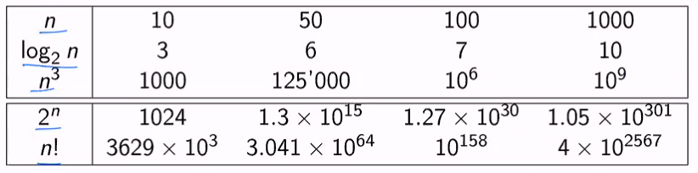
But there are other problems for which no polynomial algorithm is known.
There are only exponential algorithms
T(n) = O(2^{n})
Those problems are computationally difficult if n is large.

Slide 18
Complexity classes (P, NP, NP-complete, NP-hard)
Class P: there is an algorithm that solves the problem in a polynomial time
T(n) = O(n^{m})
Class NP: problems for which a solution can be checked in a polynomial time
Thus P ⊆ NP
Class NP-hard: those are problems whose solution can be used to solve any NP problem up to a polynomial additional time
Class NP-complete: are problems that are both in NP and NP-hard.
Typically NP-hard and NP-complete problems can be solved by exponential algorithms.
P
NP
NP-complete
NP-hard
TSP
Factorization of large integers
Graph coloring, Hamiltonian cycle,
SAT problems…

Slide 19
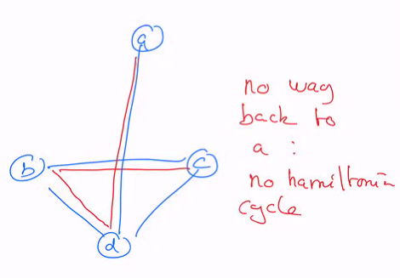
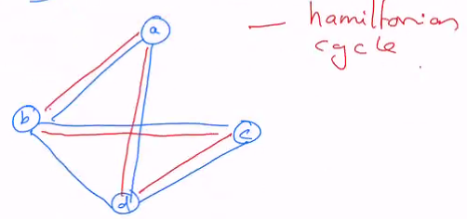
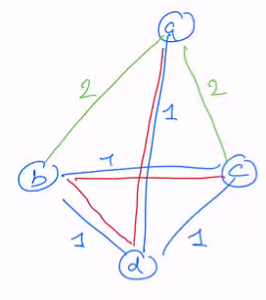
Example: Hamiltonian cycle
Find a close path on a graph that goes through all nodes once and only once, using the edges, and returning back to the starting node.
We can use a TSP algorithm to decide if a graph G has or not an Hamiltonian cycle.
Add a weight 1 to all existing edges of G
Add missing edges with weight 2 (make a fully connected graph)
Now solve the TSP problem of this fully connected graph.
If the shortest path is of length n, an Hamiltonian cycle exists
If it’s larger, it does not exists
Conclusion: a solution of TSP gives a solution of Hamiltonian cycle (which actually is NP-complete problem), but TSP is not NP because one cannot check in a polynomial time whether a tour is really the shortest.
So in this course we want to find ways to solve NP-hard optimization problems

