Slide 1
LECTURE 2
Chapter 1

Slide 2
First part to add from video

Slide 3

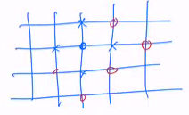
How to define the neighbourhood?
V(x) ? For any x ∈ S
A way would be to make an explicit list of all point in V8x), for each x
V(x) = {y₁^{x}, y₂^{x},…,y_{n}^{x}}
This is not practical in general.
Better to define V(x) through transformations Ti (of movement)
Here we have L movements that produce a neighbourhood with L candidates.
Example: S = Z²
Transformations:
North(i,j) ➔ (i,j+1)
South (i,j) ➔ (i,j-1)
Same for East and West…

Slide 4
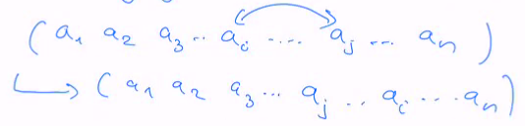
How to define the neighbourhood (follow)
Example: S is the space of permutations
S contains all the ways to place n objects on n positions
n = 3 S = {(a,b,c), (a,c,b), (b,a,c), (b,c,a), (c,a,b), (c,b,a)} O(n) = n!
How can we define a neighbourhood of a permutation?
A standard way is to generate neighbours by exchanging two objects
T(i,j) =
(I use the indices of the two swapped objects)
For instance, for n=3 the movements could be:
T(i,j) ∈ {(1,2), (1,3), (2,3)}
Note: T(1,1) is not interesting and T(1,2) is the same as T(2,1)
n = 4
T(i,j) {(1,2), (1,3), (1,4), (2,3), (2,4), (3,4)} ➔ 6 elements
We see that this produces neighbourhood of size O(n²) ➔ grows quadratically
n possibilities for the i value, and n-1 for j value.
And ones divides this number by 2

Slide 5

How to define the neighbourhood (follow)
There are other ways to generate neighbours of a permutation.
One can restrict to exchanges like (i,i+1)
|V(x)| = O(n)
Another way: displace one object between two others
|V(x)| = O(n²)
Terminology (used in this course):
One define a local search if V(x) is small in comparison S

Slide 6
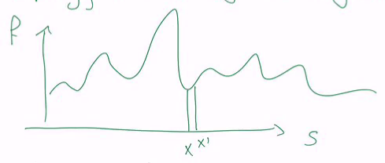
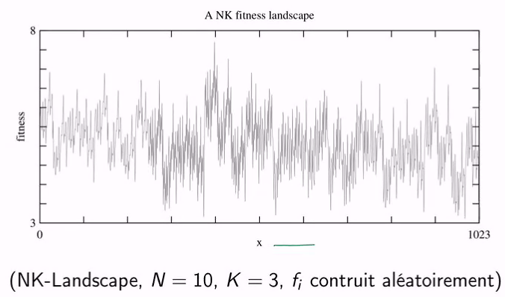
Energy landscape (or fitness landscape)
It’s the representation of f(x) according to the topology induced by the neighbourhood
Here x’ is by definition a neighbour of x
That’s why they are close on the x-axis
For the drawing, the fitness landscape is limited to simple neighbours:
x-1, x, x+1
For larger V(x) it is hard to draw…
But the fitness landscape tells how different the fitness of the neighbours are in V(x) and this relates to the difficulty to pick the next best candidate
Example: KL-Landscape

Slide 7
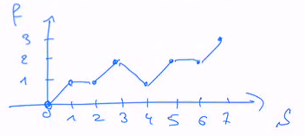
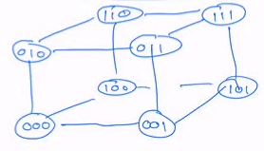
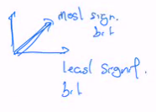
The neighbourhood affects the efficiency of the search
We consider here the maxOne problem.
Take the case of 3 bits (x₁, x₂, x₃) which we can see as a value between 0 and 7:
0 = 000 ➔ 7 = 111
The fitness is the number of 1s
V(x) = {x-1, x, x+1}
Consider a hill climbing metaheuristics:
go to the highest of the neighbours
If we start from X₀ = 0 ➔ you’ll stop at 3, as f(4) is lower than f(3).
Different neighbourhood (hypercube)
A point x’ is neighbour of x if x and x’ differ by only 1 bit
Now x₀ has 3 neighbours of fitness 1
Lets take one, he’s 2 neighbours of fitness 2
Let’s take one, there is one neighbours of fitness 1 and one of fitness 3
After 3 iterations we block in a local optimal.

Slide 8
Example of simple metaheuristics
Random walk: pick a neighbour at random disregarding its fitness
Random search: pick at random a successor within S (not in V)
Hill climbing: take the best of the neighbours
Stochastic hill climbing: pick randomly a neighbour with probability according to fitness values

