Slide 1
The Tabu Search
Chapter 2

Slide 2
2.1 Basic principles

Slide 3
Proposed in 1986 by Glover
Adapted to Quadratic Assignment Problems (QAP)
Explores the space from neighbour to neighbour
x_{i} → x_{i+1} ∈ V(x_{i})
The operator U chooses the best x’ ∈ V(x), best non-tabu candidate
In V(x) there might be forbidden solutions
U takes the non-tabu x’ ∈ V(x) – {x} which has the best fitness
If more than one x’ has this best fitness, one is chosen at random.
The specificity of the tabu search is the existence of a tabu list which indicates points in S that are not allowed, or movements that are forbidden.
The main goal of the tabu list is to prevent the exploration to return to an already visited point.
It’s important to note that the attribute “tabu” is not permanent
It’s always updated, iteration after iteration

Slide 4
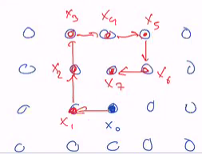
Example showing the tabu list cannot be permanent
Walker in Z², with the neighbourhood North, South, East, West.
Let’s assume the following iterations (in red)
If all the visited points are in the tabu list, once in x₇ there is no successor possible.
The algorithm would stop due to a lack of successor.
So one has to modify the tabu list dynamically.
For instance, the oldest point could be removed from the tabu list, so X₀ would be accessible again (in purple).
Flow chart of tabu search
Choose X₀
Empty tabu list
Generate the neighbours of x₀
Select from the neighbourhood x₁, the best non tabu point
Update current solution x₀ = x₁
Update the tabu list with the movement x₀ → x₁
End condition
Update the best solution so far
Output the best solution

Slide 5
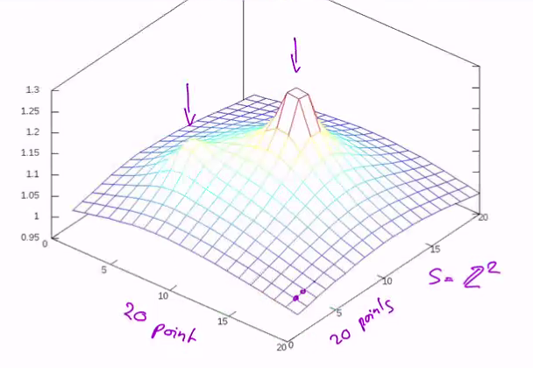
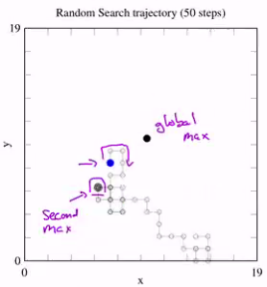
Example 1
Two extrema, one higher that the other.
The smaller one can attract a simple climber-hill algorithm.
Example 2
On the same problem, a random search can find by hazard one of the maximums
Random walk often move on the same point, then there is not a lot of visited points.

Slide 6
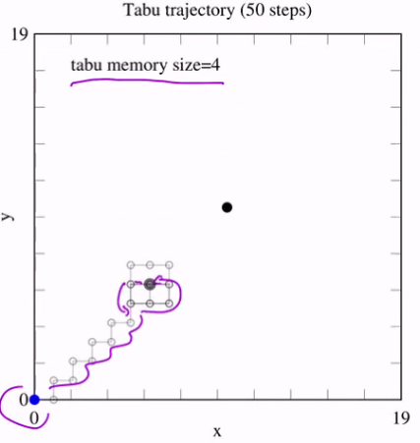
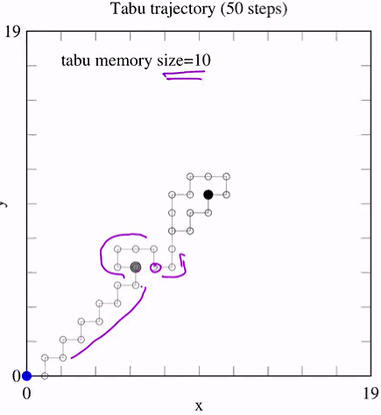
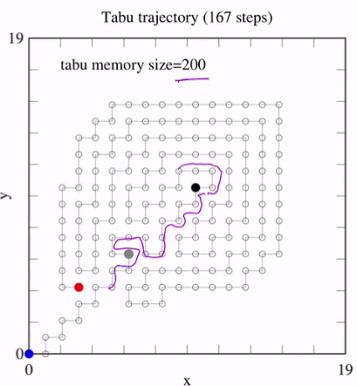
Example 3
Tabu list of size 4 will turn around the second maxima because it “forgot” he’s already gone on.
Example 4
Tabu list of size 10 forces to go far of the second maximum and we go in the attractive area of local optimal.
Example 5
If we increase the tabu list’s size, we efficiently visit the space but we can block (here after 167 steps).
There still be a lot of unexplored space.

Slide 7
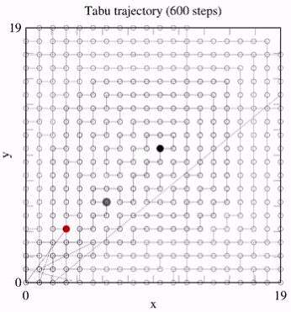
Example 6
When search is stuck, we restart from the oldest tabu point.
It can take more times than system size because lots of tabu points have neighbours also in the tabu list. Potentially we have to go back the list far away to find an issue.

Slide 8
Convergence
The convergence of a metaheuristics is its property to find the global optimum.
Tabu search will converge if:
S is finite
The neighbourhood is symmetric x ∈ V(y) ⬄ y ∈ V(x)
any y ∈ S can be reached by a finite number of steps
Then a tabu search that memorizes all the visited points in the tabu list, but allows the search to restart from the oldest point in the tabu list, will converge.
You cannot be trapped.
In other words, tabu search will explore all the space. But in a much efficient way.
An exponential time in |S| is expected.

Slide 9
2.2 Tabu list

Slide 10
Definitions
Tabu solutions are useful to prevent the search to visit places that have been already seen.
What do we put in the tabu-list?
How do we update it’s content?
What is in the tabu list?
Solutions from S that have been visited
Attribute of solution already seen (for instance the fitness, or another property)
More often, the list will contain forbidden movements: remember that the neighbour of the current solution are specified through a set of movements (also nammed transformations)!
V(x) = {x’ | x’ ∈ S, s’ = m_{i}(s), i=1,…,L} where m_{i} are the given movements
Then in the tabu list we will put the inverse movement of that we just used.
x --m_{i}--> y
then m_{i}⁻¹ will be banned to avoid to return to x from y

Slide 11
In case of permutation:
The movements are (i, j) (swapping elements at positions i and j).
The inverse is (i, j) again.
In case of the walker in Z² (move North, South, East, West):
The inverse of movement North is South...
But a tabu point cannot be permanent!
Management of the tabu list to remove banned solution or movement that is no more relevant.
i.e.: keep only the last movement, replacing the older one at every step.
The management of the tabu list uses what we call:
short term memory
long term memory

Slide 12
Short term memory
Can be implemented in different ways, according to what is in the tabu list.
In case one stores the solutions themselves:
One implement the memory as the number of banned solution one keeps (fix the size of the memory).
It is implemented as a FIFO structure (First In First Out)
For movement and attribute:
Typically add an interdiction time to all banned elements.
It means that for a given number of iteration, this movement or attribute will be forbidden.

Slide 13
Illustration: walker in Z²
Suppose that at iteration t=1, North was chosen.
Then South should be tabu.
South will get an Interdiction time given by t = t_{current} + k (k = duration of interdiction)
Suppose k = 1 in this iteration…
So the movement South is banned as long as the current iteration is not larger than 2.
Now suppose that at time t=2 one chosen East (South was tabu).
West become tabu until iteration t = 2 + k
k is chosen at random within a given interval (suppose we get k = 3)
… and so one...
T=1 | Interd. time | Relative Frequency
North | 0 | 0
East | 0 | 0
West | 0 | 0
South | 0 | 0
T=2 | Interd. time | Relative Frequency
North | 0 | 1
East | 0 | 0
West | 0 | 0
South | 2 (1+1) | 0
T=3 | Interd. time | Relative Frequency
North | 0 | 0,5
East | 0 | 0,5
West | 5 (2+3) | 0
South | 0 | 0

Slide 14
Long term memory
It analyses the statistics of movements during the entire search process.
If the relative frequency of some movements is too low (eg. South and West in our example) these movements are forced, despite they may be tabu.
It’s a way to prevent a bias in the exploration.
In the previous example, the “Relative frequency” is the “long term memory”.

Slide 15
Another example of the interdiction time
Suppose the tabu list contains an attribute h(x) of solution x.
Solutions with a value of h already seen will be tabu.
The tabu list is an array T of size M.
let x be the current solution at time t
One compute h(x) mod M (h is supposed to be integer)
At position T [h(x) mod M] will contain the iteration t until which this value of h is tabu.
T [h(x) mod M] = t + k
k is chosen randomly in a given interval
Then: solution x’ will be tabu at time t’ if:
t’ < T [h(x’) mod M]
Note that we are introducing new control or guarding parameters:
M, interval to chose k, number of movements…
Unfortunately, the optimal value of these parameters depends on the problem.
Another parameter has to be defined to specify when the long term memory takes over the short term one.
Again one does not know what is the best choice. One relies on empirical observation to propose acceptable values of these control parameters.

Slide 16
Exploration versus exploitation
Tabu search has these two mechanisms.
What is the tabu search method favours one on the other?
The more tabu items the more one forces the tabu search to accept less quality fitness solution and to explore new regions of S. -----> exploration / diversification
Conversely, a short tabu list will favour good fitness point -----> exploitation/intensification

Slide 17
Aspiration
Definition:
If a movement is tabu but will take us to a solution which is better than everything seen so far (“best so far”), then the tabu movement is ignored and this best solution is taken as the new current solution -----> aspiration.
Obviously it does not work if the tabu list is only storing solutions (not movements).

Slide 18
2.3 Quadratic Assignment Problems
QAP

Slide 19
Definition
It is an important class of combinatorial optimization problems.
One is given n objects and n locations to place these objects.
The distances between locations r and s are given in a matrix d_{rs} (size n x n).
Flows on weights f_{ij} are also given between objects i and j in a n x n matrix (tells how strongly objects are connected).
Intuitively we want to place strongly connected objects on close locations.

Slide 20

Possible locations: n = 9
We have n objects named 1, 2,…,9
f₂₅ = f₅₂ = 2
f₃₁ = f₁₃ = 3
could be seen as wires needed to connect i and j…
Goal:
Find the placement of the n objects on the n locations that minimize the length of wire.
Note: TSP is a particular example of QAP problem.
The locations are the cities to visit.
The objects are the order in which the visits are done.
2
1
5
3

Slide 21
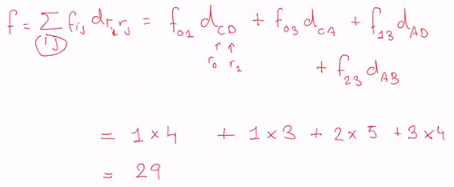
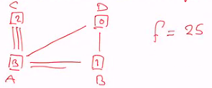
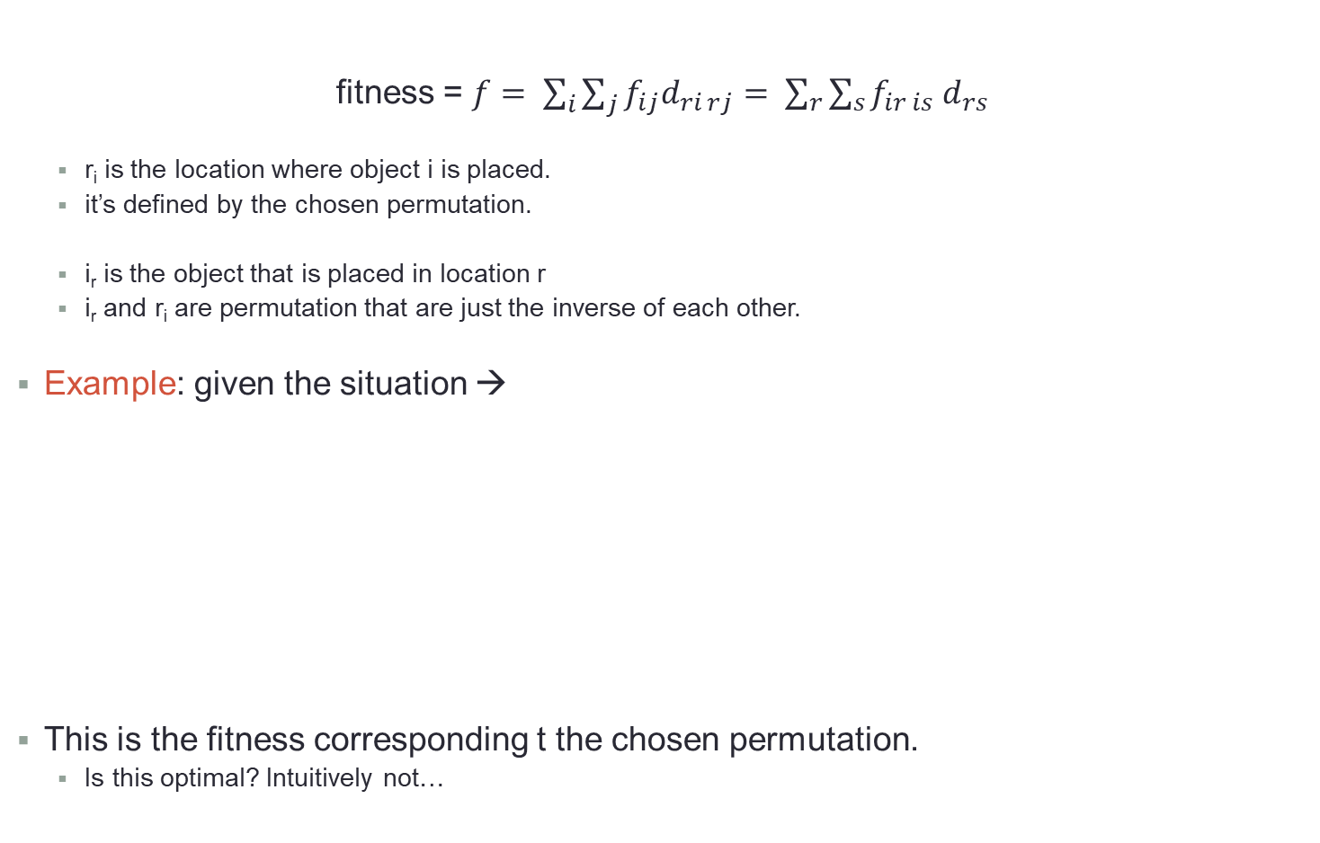
Fitness of a QAP problem
fitness = $f= \sum_{i}{\sum_{j}{f_{ij}d_{ri rj}}}= \sum_{r}{\sum_{s}{f_{ir is}{ d}_{rs}}}$
r_{i} is the location where object i is placed.
it’s defined by the chosen permutation.
i_{r} is the object that is placed in location r
i_{r} and r_{i} are permutation that are just the inverse of each other.
Example: given the situation →
This is the fitness corresponding t the chosen permutation.
Is this optimal? Intuitively not…
C
D
0
d_{CD}=4
1
d_{AC}=3
d_{AD}=5
3
2
A
B

Slide 22


Tabu search for QAP
The tabu search will explore the space of permutation of n objects.
p = (i₁, i₂,…,i_{n})
i_{j} is the object i in location j.
Movements are obtained by swapping two locations:
There are o(n²) such movements.
The fitness has to be recomputed for each neighbours of the current solution:
But when swapping two objects not all the components of f change!
So we can optimize the calculation of the new fitness by identifying the terms that have changed with the new permutation → O(n) terms instead of O(n²)!

Slide 23
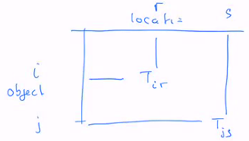
Tabu list in QAP
Let us consider a movement such that:
Object i left location r
Object j left location s
We need to reflect that in the tabu list.
We do not want to replace i in r and j in s…
…at least for a given number of iterations (duration of the interdiction).
The tabu list is a n x n matrix
A new movement (that will replace i in r and j in s) will be tabu at iteration t if:
t < T_{ir} and t < T_{js}
The interdiction applies only if both i and j are moving back to r and s, but not if only one of them goes back to its previous location.
Tir and Tjs contain the iteration at which i left r and j left s, augmented by k a duration:
k ∈ [0.9n, 1.1n + 4] chosen randomly

