Slide 1
Method of Ant Colony
Chapter 4
Swarm intelligence

Slide 2
4.1 Motivations and remarks
In 1992, by Cotorni, Dorigo & Maniezzo
Optimization algorithm inspired by ants behaviours. Multi-agent system adapted to combinatorial optimization problems (QAP)

Slide 3
Many metaheuristics are inspired by natural phenomena:
SA is a physics inspired process.
Here we will consider a metaheuristics inspired by the behaviour of insects, more specifically by ants.
Ants are very successful on Earth.
Their biomass is estimated to be comparable of human beings!
Ants are known to solve optimisation problems.
The most used example is the search for the shortest path between nest and food.
For this they “use” swarm intelligence (also called Collective intelligence).
It means that by collaboration, several individuals can perform tasks that would be impossible for only one
Individual ants have a limited capability, but together they develop new capabilities
A central ingredient of this algorithm is the presence of pheromones which make ants attracted to promising regions of the search space.

Slide 4
This process is often referred to as emergence in complex systems
Emergence: the whole is more than the sum of the parts.
This emergence builds up through interaction
Complex systems: systems composed of many simple individuals interacting with each others, from which a collective effect is often seen.
No centralized control: a local behaviour which produces a coherent global behaviour (auto-organization).
Very robust: as it does not depends on a specific individual.
Failure tolerant: even if some individuals do wrong it does not impact the global result
Progressive adaptation: to new constraints or problem change
Open the possibility to use parallel computing.
We will then consider a population metaheuristics in which several solutions are present at each iteration.

Slide 5
4.2 Pheromone trail
A natural optimization

Slide 6
We will investigate how real ants use pheromones to find the shortest path from nest to food.
Pheromones is a chemical that ants can drop on their trajectory to attract other ants.
They mark their path with this chemical.
The process to choose its way according to the presence of a chemical on the environment is called chemotaxi (chemo for chemical, taxi = movement in Greek).
Ants moves toward places where the concentration of pheromones is high.
Pheromones evaporates: their action is limited in time.
Only regions which are regularly visited by ants which add more pheromone will stag as a path over time.
It also means that pheromone trails which are not maintained will disappear, thus erasing low quality solution.
All this has been studied by scientists through experiments.

Slide 7
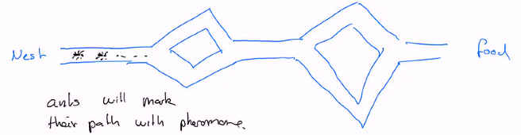
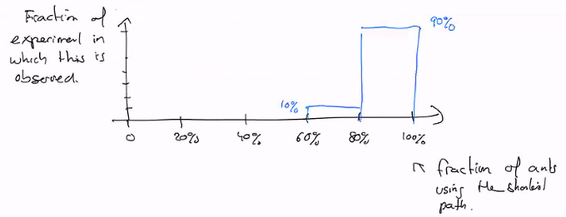
Experiment by Gross, 1989
He build a multiple path system from nest to food:
Observation:
In the beginning ants use all the possible path at random.
But as time goes on, only one is selected (quite all ants use the same trajectory) and this path turns out to be the shortest one.
In 90% of the experiments there are between 80-100% of ants on the shortest path.
In 10% of the experiments there are only between 60-80% of ants on the shortest path.
It’s certainly useful to have a few ants doing something different, in case of a change of environment.

Slide 8
Interpretation
At the beginning all path are equally marked.
But the ant that by chance took the shortest path will be the first to reach food.
On its way back it will reuse the same way (only one is marked).
Then the other ants reaching the food by a longer path will return by the path which is marked twice, thus reinforcing the shortest path.
See below for more details (experiments) and numerical simulation to assess this hypothesis.

Slide 9
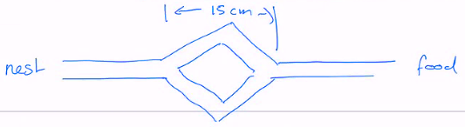
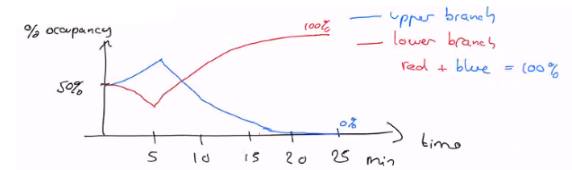
Experiment by Gross & Deneubourg, 1990
They created two path of exactly the same length.
At the beginning both paths were used equally.
But over time only one is selected.
If one redo the experiment, the selected path vary equally (half of the experiments goes through the upper path, half through the lower).
This is one possible scenario.
Different oscillations between the two branches are possible.
There is an amplification of one of the pheromone trail which is the result of fluctuation of ants decisions.
One a path is strongly marked, it becomes the preferred one and the other one is abandoned.

Slide 10
Mathematical model
Suppose we have m ant already through the system.
What is the probability for the next ant (m+1) to take the upper or lower branch?
Let Um be the number of ants that took the Uper branch.
And Lm be the number of ants that took the Lower branch
m = Um + Lm
P_{U}(m+1) : Probability that ant m+1 goes in the Upper branch
P_{L}(m+1): Probability that ant m+1 goes in the Lower branch
The proposition is that the following applies:
P_{U}(m+1) = (Um + k)^{h} / (Um + k)^{h} + (Lm + k)^{h}
P_{L}(m+1) = 1 - P_{U}(m+1)
Deneubourg and Gross showed that these formula represent how real ants behave, provide that the value are k = 20 and h = 2.

Slide 11
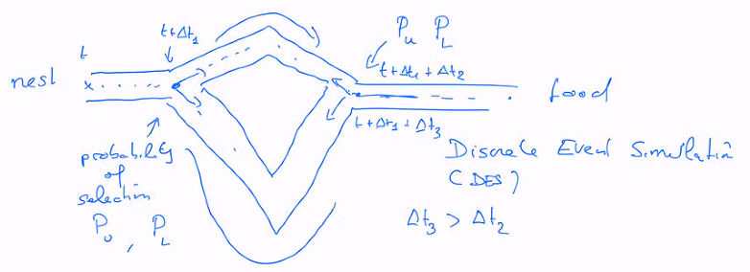
Interpretation of k and h
If k << Um and k << Lm, then P = 0,5
k is then the number of ants that need to go through a path to make it attractive enough.
h ≠ 1 means that there is a non-linearity in the perception of pheromone.
The attraction goes as the square of the amount of pheromones.
Is this mathematical model enough to explain that ants find the shortest path?
Make a Discrete event simulation (DES):

Slide 12
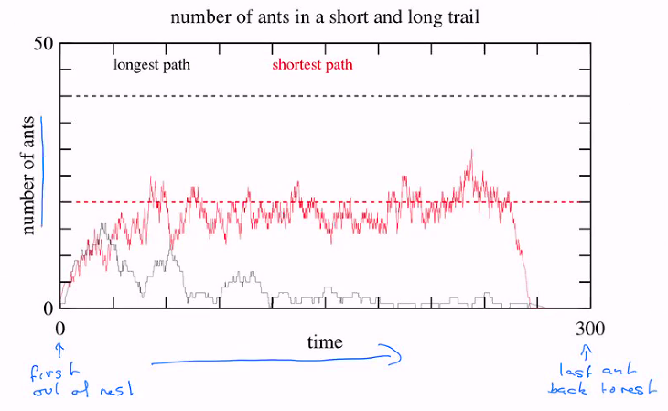
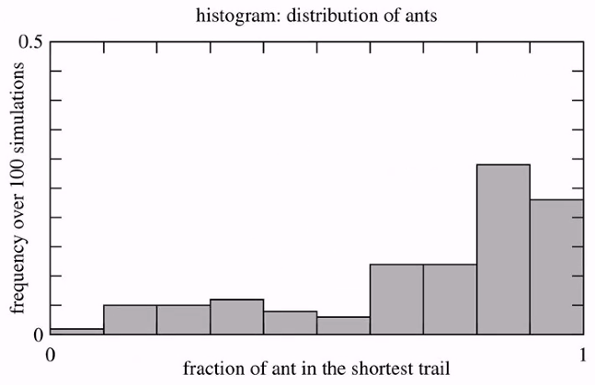
Example of DES

Slide 13
4.3 Algorithm
For computer based optimisation

Slide 14
We want to adapt the idea of the pheromone trail to a computer program doing combinatorial optimization, such as TSP.
In 1992, Dorigo et al. propose a new algorithm “AS” (for “Ant System”)
Later on, new versions were proposed, such as “ACS” (for “Ant Colony System”)
TPS:
Configuration: n Cities, separated by a distance d_{ij} between cities i and j.
Goal: find the shortest tour that goes through all cities once and only once, and return to the initial city.
Algorithm for AS
η_{ij} the visibility: η_{ij} = 1 / d_{ij}
Trail intensity τ_{ij} : is the amount of pheromone on the link between cities i and j
m: the number of ants that all create a tour
There are also guiding parameters that will be introduced later on
Main idea: an ant will decide on its trajectory based on the visibility and the intensity of the trail
It will prefer to move to a next city which is highly visible and with a trail with a lot of pheromones.
Once a ant takes a link it will add more pheromone, thus maintaining or increasing the attractivity of that link.
If a link is not taken, the pheromone will evaporate and its pheromone intensity will go to zero (this is a way to “erase” bad solutions).

Slide 15
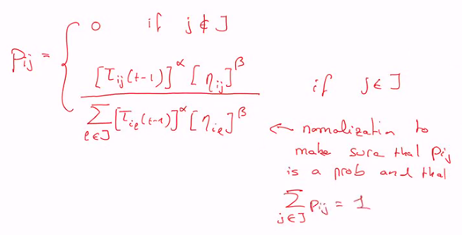
At each iteration, the m ants perform a tour one after the other.
Let us consider the movement of ant k once it reached the city i
This ant needs to choose its next city to move to.
Let J be the set of cities that ant k has not yet visited (possible destinations).
The ant will chose city j ∈ J with a probability Pij that depends on visibility and pheromone intensity.
Where α and β are guiding parameters that need to be specified:
α favors the intensity of pheromone trail: intensification
β favors a geographic information: diversification

Slide 16

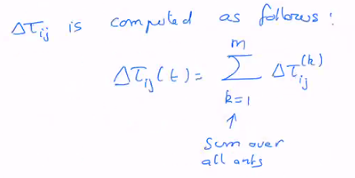
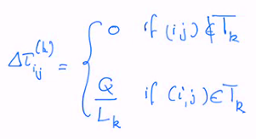
Pheromone trail update
Once all ants have finished their tour, the pheromone trail will be updated (increase or evaporation):
Let us call T_{k}(t) the tour of ant k at iteration t (the permutation of cities corresponding to the tour)
ρ is a new control parameter.
Q is a control parameter, and L_{k} the length of the tour T_{k} of ant k.
By this, short tours are reinforced.

Slide 17

Initialisation
First the algorithm is undefined if τ_{ij} = 0 for all (i, j).
Initially one sets:
Where L is an estimate of the length of the tour (recall: n is the number of cities)
Empirically it is found that the following choice gives good results:
m = n α = 1 β = 5 ρ = 0,5 Q = 1
AS is a population metaheuristics
at each iteration, one has m solutions to compute
With AS (as with many population metaheuristics) there is no explicit formulation of a neighbourhood.
Instead, a neighbour is selected by construction, namely here the new tours of the m ants based on the previous tours.
The tours of the m ants are independents
So one can parallelize the movements of ants (main gain of performances)

Slide 18
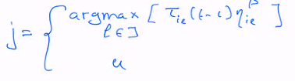
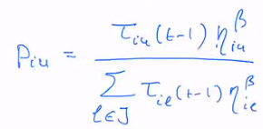
Ant Colony System (ACS)
AS got a best solution for the problem known as “Olivier30” in less CPU time than other methods.
But for a bigger problem it failed to find the known optimal solution.
ACS is a variation of AS which differs by the way the next city is chosen and how the pheromone trail is updated.
Ant k at city i will choose city j as follows:
with probabilit q₀ (exploitation)
with probabilit 1 - q₀ (exploration)
With probability 1 - q₀, the city u is chosen as before with a probability Piu:

Slide 19


Pheromone update
It’s a two steps process:
First each ant will add an amount φτ₀ on each link it has used.
and a fraction 1-φ of the existing amount of pheromone gets evaporated.
Second, an amount Δτ = 1 / Lmin of pheromone is added on the links (i, j) of the best tour only.
ρ is another evaporation factor.

Slide 20
4.4 Performance

Slide 21
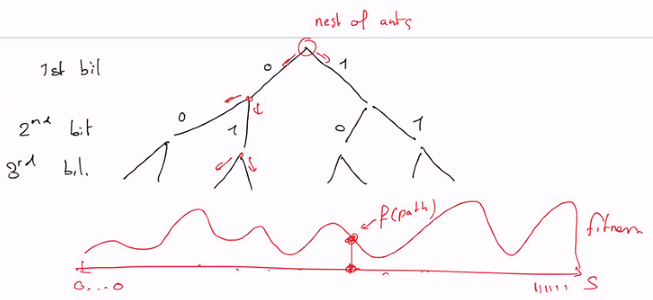
To analyse the performance of this metaheuristics, we will consider a simpler version of the algorithm.
The search space is S = {0, 1}^{N} : binary shifts
Such a search space can be visited as a tree.
The Fitness value found at the end of the path is interpreted as an amount of pheromone which is then distributed to all the sections of that path.

Slide 22
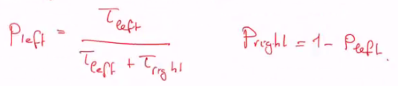
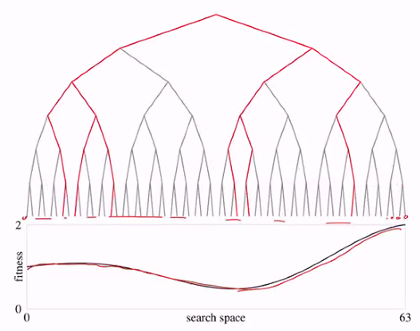
How to decide which branch to take?
With probability q₀ the ant takes the best branch (higher value of τ)
With probabilities 1- q₀ the two branches are selected at random following the mathematical model of Deneubourg & Gross:
Example:
6 ants
S = {0, 1}⁶ (0 to 63)
Fitness is a given function f(x_{i})

Slide 23
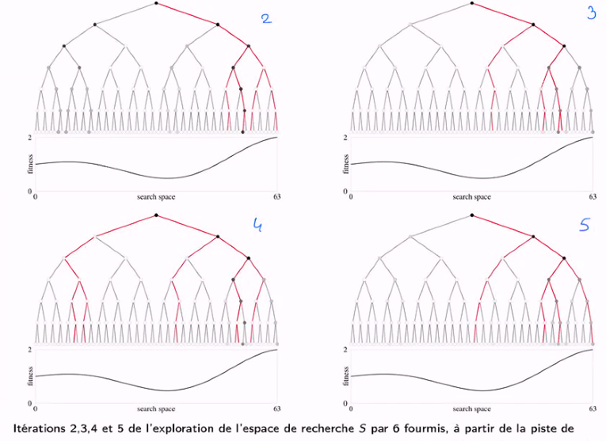

Slide 24
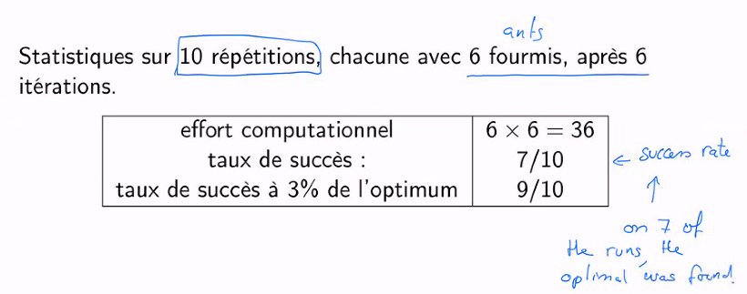
We need to repeat that a bit more to get statistical results.
So it means that with probability p = 0.7 the optimal solution is found and this with a computational effort of 6 x 6 = 36.
With probability of 90% the algorithm find a good solution (97% of accuracy).
The question is: is it good or not as a performance?

Slide 25
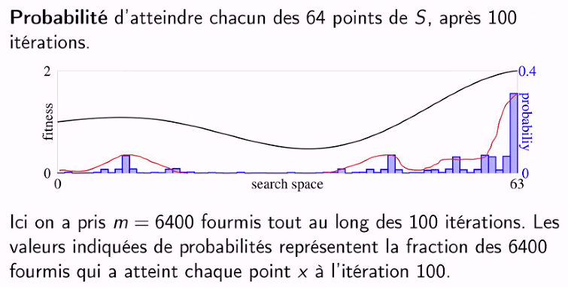
Compare with the performance of a random search with the same computational effort.
At random, what is the probability to reach the optimum?
Psuccess = 1 /64 for one attempt
But we have 6x6 attemps:
Psuccess = 1 – (1 – P)³⁶ = 0,43 (with P = 1/64)
To be compared with 0,70 with ants.
Therefore the idea of reinforcing promising path is doing something good!
With a more computational effort, we obtain 30% of ants finding the optimal Fitness.

