Slide 1
Evolutionary Algorithms
Chapter 6

Slide 2
6.1 Introduction

Slide 3
They are a family of metaheuristics based on Darwinian evolution: “survival of the fittest”.
This has been a powerful mechanism in Nature to have organisms adapted to more and more complex tasks.
Abstraction of these mechanisms in a computer model:
Best individuals evolve through reproduction and mutations.
This idea gave rise to population metaheuristics in the 1970’s.
Genetic algorithms (J. Holland)
Evolution strategy (I. Rechenberg)
Genetic Programming (L. Fogel & J. Koza, 1990’s), similarities with Machine Learning
All those are Evolutionary Algorithms.

Slide 4
6.2 Genetic algorithms (GA)

Slide 5
It’s a population of individuals (= solutions) ∈ S.
The coding or mathematical representation of an individual is referred to as its genome or chromosome.
The quality of an individual is its Fitness (as always).
There we will mostly consider maximization problems, so high Fitness individuals are the most adapted.
This population evolves generation by generation (= iterations):
One selects the best individuals
One applies crossover and mutations to have them evolve and form the next generation
These operations do not guarantee that the best individual of a generation is still present at the next generation. For this reason, one usually adds another mechanism, called elitism by which the best individual at generation t replaces the worst of iteration t+1.
This is however skipped if the best individual at t+1 is better than the best at t.
Note: for practical reason, the size of the population is maintained constant across all generations.

Slide 6
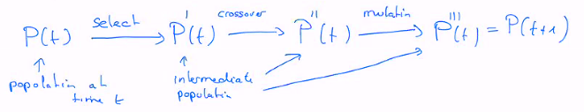

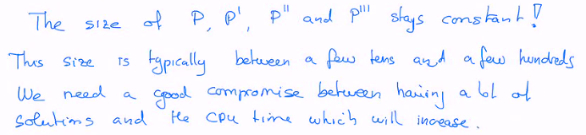
Pseudo-code
generation = 0
initialize population (at random)
while (not end-condition):
generation += 1
compute the fitness of all individuals
selection of best individuals
crossover
mutation
insert the best previous # to keep the best so far
Output the best solution
The end condition is similar to other metaheuristics seen so far :
A max number of iterations or a given computational effort
The fact we do not progress anymore (stagnation of the fitness)

Slide 7

Genetic operator: Selection
Fitness Proportionate
One draw n times an individual from P(t) (n is the size of the population)
This operation is done randomly but driven by the value of the fitness, so as to increase the selection of good individuals.
Selection by rank
Select only individuals with the best fitness
Tournament selection
Make such a game between some individuals to keep only the best of them
By repeating this process as many times as there are individuals in P, one gets population P’.
In P’ there are only individuals from P (no innovation) but the same individual can be present several times.
The good ones are overrepresented, and the worst are forgotten.

Slide 8

Genetic operator: Crossover
The n individuals selected in P’ are now the parents of the individuals in P’’.
Crossover (“croisement” in French), recombination, hybridation…
…is the process of mixing the genomes of two parents to produce offsprings.
The two parents may have a good solution for different parts of the problem.
By combining them, one hope to get an even better solution.
One select from P’ a pair of individuals in any way, for instance (S₁, S₂) (S₃, S₄)…
With probability P_{crossover} the genome of S_{i} and S_{j} are mixed (see below for example), depending on the coding, and they produce two children (population size preserved)
With probability 1-P_{crossover} , the two parents are inserted in P’’ without change.

Slide 9

Genetic operator: Mutation
On the n new individuals obtained by crossover, one can apply mutations, that is random modification.
Note: in nature, mutations are an important element of evolution. Due to errors in genome transcription, which allows the emergence of new solutions and innovations.
For a GA, the mutation will depend on the coding and the nature of the search space.
Mutation is also done with some (low) probability P_{mutation}.
Metaheuristics use exploration and exploitation to find the optimal solution.
GA are similar:
Selection favours exploitation (by selecting good individuals)
Mutation favours exploration (random modifications produces new solutions, whether good or bad)
Crossover is usually considered as favouring diversity (creation of new solutions) although it also act as intensification of two good parents.

Slide 10
6.3 A simple example
We’ll illustrate the behaviour of a GA on the maxOne problem

Slide 11
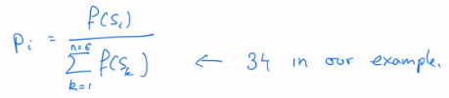
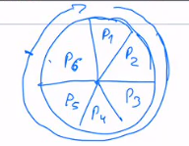


NK-problem with K = 1, find a string of bits which contains as many 1 as possible
Solution is obviously X = 111…111, but we’ll see how efficiently a GA can find it.
We’ll apply GA manually on n = 6 individuals, for 1 generation, and for a maxOne problem on L = 10 bits.
Let’s assume an initial population build at random:
S₁ = 1111010101 f(S₁) = 7 S₂ = 0111000101 f(S₂) = 5
S₃ = 1110110101 f(S₃) = 7 S₄ = 0100010011 f(S₄) = 4
S₅ = 1110111101 f(S₅) = 8 S₆ = 0100110000 f(S₆) = 3
Selection
Fitness proportionate selection: Individual Si will be selected with Prob:
Thus P1 = 7/34 = 0.2059
and P6 = 3/34 = 0,088
One gets P’ by repeating 6 time the selection of one individual in P:
Select individual i so that:

Slide 12

Let us then assume the following composite for P’:
S’₁ = 1111010101 (S₁) S’₂ = 1110110101 (S₃) S’₃ = 1110111101 (S₅)
S’₄ = 0111000101 (S₂) S’₅ = 0100010011 (S₄) S’₆ = 1110111101 (S₅)
We see that S₅ was selected twice, but S₆ was never selected.
Crossover
We can see a string of bit as genetic code with 0 and 1 (instead of the DNA symbols)
A crossover can be simulated by taking genes 1 to k of the first parent and genes k+1 to L from the second parent.
Here the value of k is chosen randomly between 1 and L-1. k is called the crossover point:
In our example, we take parents as (S’₁ S’₂) (S’₃ S’₄) (S’₅ S’₆) and we assume P_{crossover} = 0.6

Slide 13
Let’s consider the first pair, and assume k = 2:
S’₁ = 11,11010101 S’’₁ = 1110110101
S’₂ = 11,10110101 S’’₂ = 1111010101
No modification because the first k bits of both parents are identical
Consider the second pair will not create offsprings at all.
Let’s consider the pair (S’₅ S’₆) and k = 5
S’₅ = 01000,10011 S’’₅ = 0100011101
S’₆ = 11101,11101 S’’₆ = 1110110011
S’’₅ and S’’₆ are new solutions, we can create diversity.
Mutation
In our case, mutation is changing the value of one single bit.
It’s applied with probability P_{mutation} = 0.1 to all the bits of each individuals.
Let’s assume the bit underlined and orange will be mutated:
We see 4 over 6 are decreasing the fitness, that’s “normal” as our solutions trend to be quite good at this point.
S’’₁ = 1110110101
S’’₂ = 1111010101
S’’₃ = 1110111101
S’’₄ = 0111000101
S’’₅ = 0100011101
S’’₆ = 1110110011

Slide 14
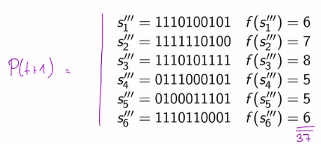
Final result for this iteration:
So there is an improvement of the quality of the population in one generation (9% fitness increase).

Slide 15
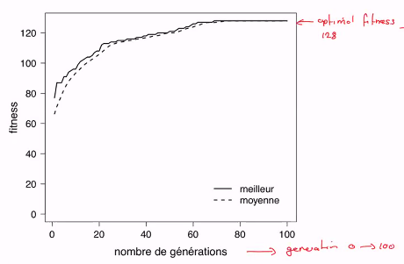
Let us now see the performance of a GA algorithm for a maxOne with L = 128 bits and a population of size n = 100.
We’ll observe that the GA find the optimal solution rather quickly.
The optimal solution is found after about 60 iterations.
First there is a rapid improvement of the fitness.
Followed by a slow improvement regime, often characterized by a stagnation of the fitness at sub-optimal value. (typical metaheuristics behaviour)

Slide 16
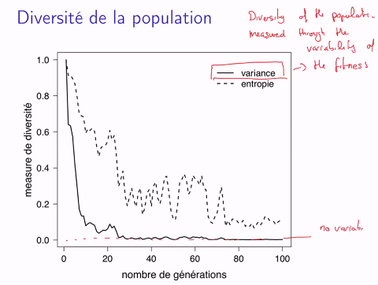

Diversity of the population
Diversity based on the fitness value (not on the genome of individuals)
Initial random state with high diversity.
All fitness are quite equals at the end, meaning the variance is quite null.
The loss of diversity in the population is due to the selection operator.
Loosing diversity prevents the exploration of more regions of S.
This can be seen as negative but on the other hand, the goal is to generate good solutions quickly, and that’s what happens.
Homogenization of the population is a typical feature of GA.
Note that one expects a similar behaviour for any NK problem. But there are other types of optimization that GA can solve.
Example: continuous optimization of a function in R^{d} → R

Slide 17
6.4 Case of real function

Slide 18
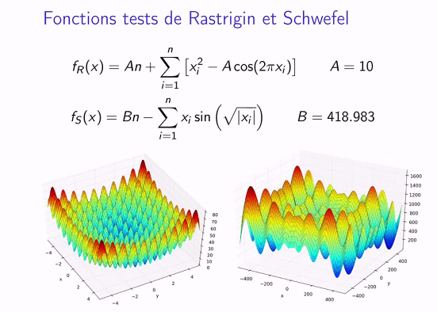
The main question is how to code the problem so as to be able to use a GA?
GA work well for multimodal functions in Rd, with a lot of local optima.
Thanks to crossover and mutation, a GA can escape local maximum or minimum.
Typical benchmark are the so called Rastrigin and Schwefel functions (see below):

Slide 19
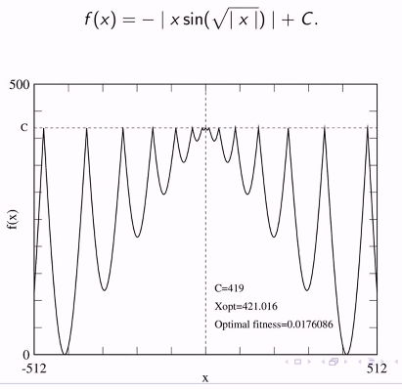


Let us consider a simpler example:
We want to find an optimal minima.
There is a lot of local minima.
The function is symmetrical with respect to zero, we the consider S = [0, 512]
Coding individuals
As a bit string with L bits:
We’ll map S to {0, 1}^{L}
We get a binary representation of [0, 512].
We first consider a fixed point arithmetic.
Let’s take L = 10, with allows us to have number between 0 and 1023.
Let’s call S such an integer number:
X ∈ [0, 512] is the possible solution to this optimization problem.
With such a coding, the accuracy we have on x is 0.5 (512 / 1023).
We can explore the space of S ∈ {0, 1}¹⁰ with a GA, as we defined it for the maxOne problem.
We can do mutation and crossover with this chain of 10 bits.
= $\frac{X_{max}}{S_{max}} ∗S$

Slide 20
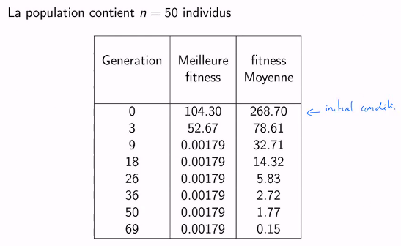
With n = 50 individuals, we have an optimal found after only 9 iterations!
F_{opt} = 0.00176, that is ok with the accuracy we have on x.
N * 9 = 450 evaluations of fitness.
It’s much less than exploring all 1024 possibilities in an exhaustive search.

Slide 21
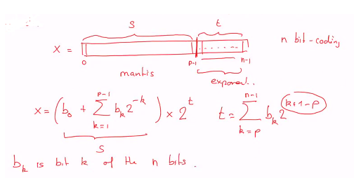
Floating point arithmetic
The approach proposed above is not very flexible and it may lack accuracy depending on the interval to explore.
We can also consider a floating point coding approach.
Note that p is called the precision of the coding.
For IEEE 754 standard:
Double precision (n = 64bits) requires
1 bit for the sign
p = 52 for S and q = 11 for t
=> 16 significant digits and an exponent between -1024 and 1023.
Single precision (n = 32bits)
p = 23 (7 significant digits)
q = 8 (-128 to 127 for exponent)

Slide 22
How to apply GA on such a coding?
x = (s, t), both are bit strings
Crossover and Mutation are applied separately on each of these components, possibly with different crossover and mutation probabilities.
For x in R^{d}, one has d such terms: xi = (si, ti), i = 1…d
The genetic operators are applied on each components.
Note: one can also formulate a genetic-like algorithm directly on real numbers (see chapter 7, “evolution strategy”)

Slide 23
6.5 Other selection operators

Slide 24

Selection: P(t) → P’(t)
There are several ways to perform the selection of individuals in view of the crossover and mutation.
We could think of a deterministic selection:
There is a criteria to keep or reject an individual
But usually one prefers a stochastic selection:
Based on a random criteria
Bias based toward the better ones
We always want to get n individuals in P’(t) (no population’s size change)
Fitness proportionate selection
Individual i is selected with probability:
This process is repeated n times, with replacement, so as to select n individuals
There are however some constraints to use such a selection mechanism:
The definition of P_{i} implies a maximization problem: high fitness values give high probabilities.
In case of a minimization problem, one can change f → -f
The definition of P_{i} does not guarantee that P_{i} is positive. If some f_{i} are negative and other not, we may well get P_{i} < 0. IN this case one can shift all values of f by a constant f_{i} = C + f_{i} > 0
Since evolution tends to reduce fitness diversity, the range of values of fitness in the population will decrease as time goes on.

Slide 25
TO COMPLETE WITH 16,11 LAST HOUR

Slide 26
6.7 TAKEOVER TIME

Slide 27
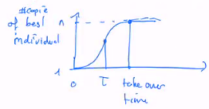
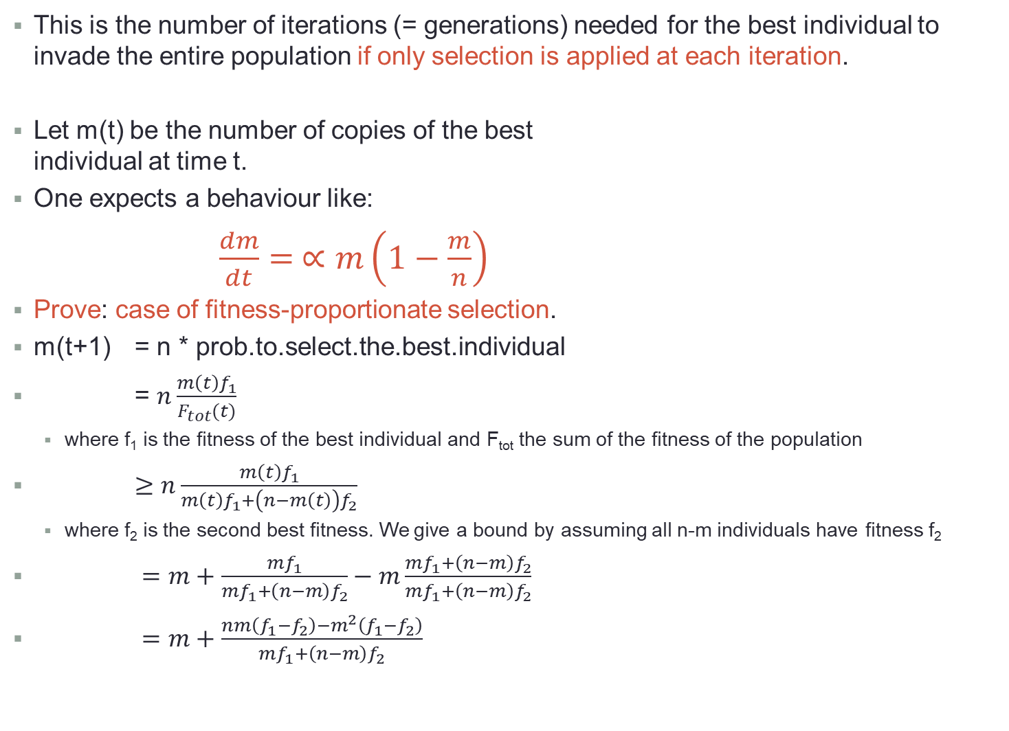
This is the number of iterations (= generations) needed for the best individual to invade the entire population if only selection is applied at each iteration.
Let m(t) be the number of copies of the best individual at time t.
One expects a behaviour like:
$\frac{dm}{dt}= ∝m\left(1−\frac{m}{n}\right)$
Prove: case of fitness-proportionate selection.
m(t+1) = n * prob.to.select.the.best.individual
= $n\frac{m\left(t\right)f_{1}}{F_{tot}(t)}$
where f₁ is the fitness of the best individual and F_{tot} the sum of the fitness of the population
$≥n\frac{m\left(t\right)f_{1}}{m\left(t\right)f_{1}+\left(n−m\left(t\right)\right)f_{2}}$
where f₂ is the second best fitness. We give a bound by assuming all n-m individuals have fitness f₂
$=m+\frac{mf_{1}}{mf_{1}+\left(n−m\right)f_{2}}−m\frac{mf_{1}+\left(n−m\right)f_{2}}{mf_{1}+\left(n−m\right)f_{2}}$
$=m+\frac{nm\left(f_{1}−f_{2}\right)−m^{2}\left(f_{1}−f_{2}\right)}{mf_{1}+\left(n−m\right)f_{2}}$

Slide 28
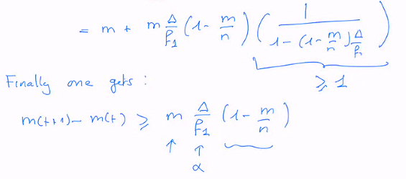



Let us introduce Δ = f₁-f₂ > 0 and Δ/f₁ < 1 because of 0 < f₂ < f₁ ➔ f₁-f₂ < f₁
m(t+1) $=m+\frac{nm∆(1−\frac{m}{n})}{nf_{1}+\left(n−m\right)∆}$
We can solve this equation by assuming that m(t+1)-m(t) = dm/dt:
Solution of this differential equation:
where m₀ = m(t=0) = 1, the initial number of copies of the best individual.

Slide 29

At what time τ do we have m(τ) = n/2 (half of the pop. is made of the best indiv.)?
τ = O(log n) which show a very fast selection mechanism.
So crossover and mutation are essential to bring diversity otherwise the diversity of the population is lost very fast.

Slide 30
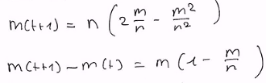
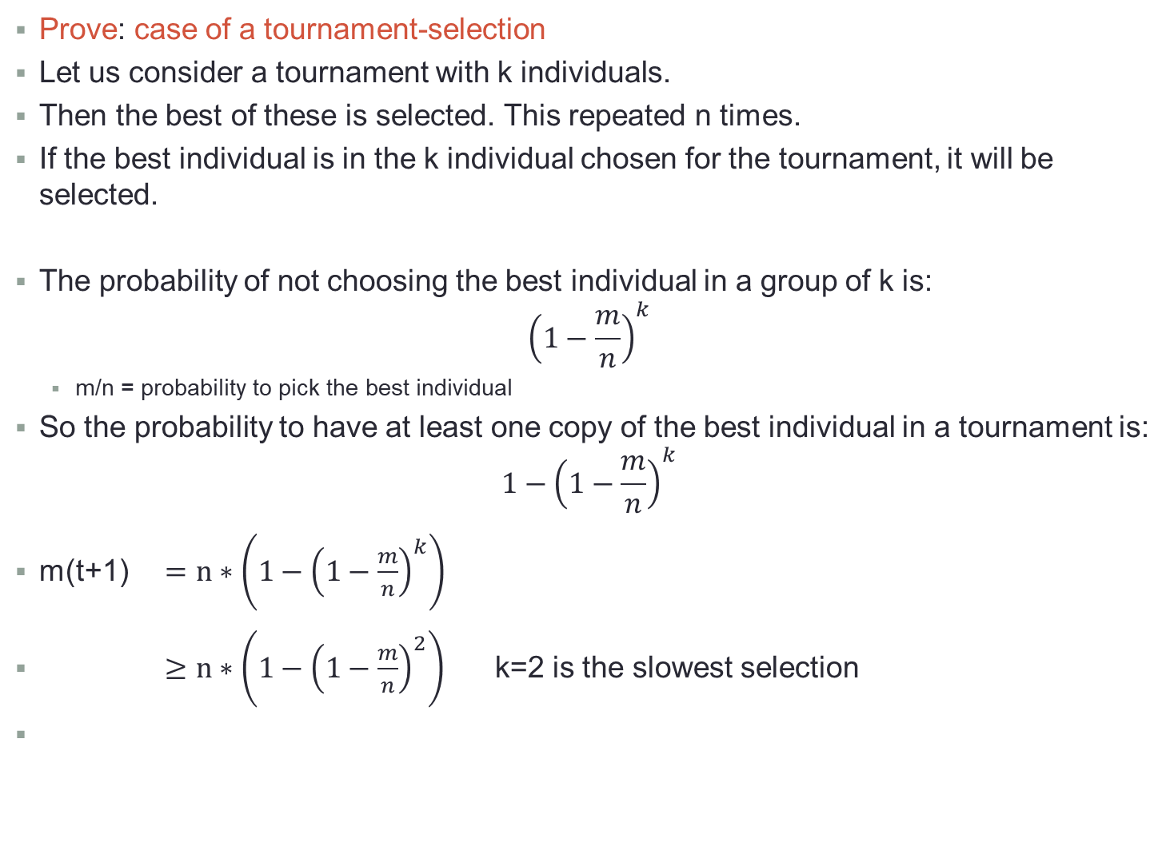
Prove: case of a tournament-selection
Let us consider a tournament with k individuals.
Then the best of these is selected. This repeated n times.
If the best individual is in the k individual chosen for the tournament, it will be selected.
The probability of not choosing the best individual in a group of k is:
$${\left(1−\frac{m}{n}\right)}^{k}$$
m/n = probability to pick the best individual
So the probability to have at least one copy of the best individual in a tournament is:
$${1−\left(1−\frac{m}{n}\right)}^{k}$$
m(t+1) $=n∗\left({1−\left(1−\frac{m}{n}\right)}^{k}\right)$
$≥n∗\left({1−\left(1−\frac{m}{n}\right)}^{2}\right)$ k=2 is the slowest selection

Slide 31
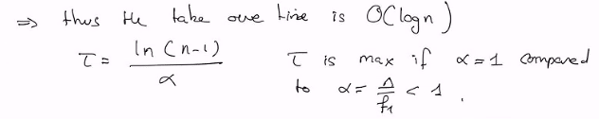
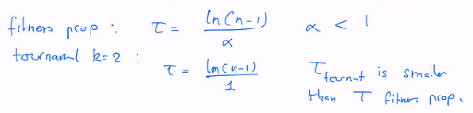

This is again a logistic equation:
$$\frac{dm}{dt}= ∝m\left(1−\frac{m}{n}\right) with ∝=1$$
The tournament selection is quicker than the fitness proportionate, even though are both in O(log n).

Slide 32
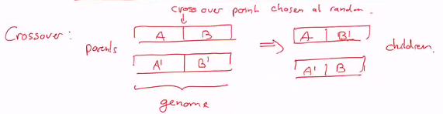
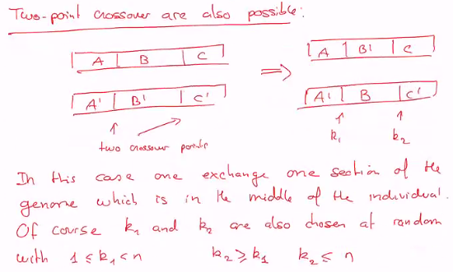
Other crossover and mutation operators
If k1 = k2 we come back to one-point crossover.
Similarily one can also have m-point crossover, alterning inverted sections in childrens.

Slide 33
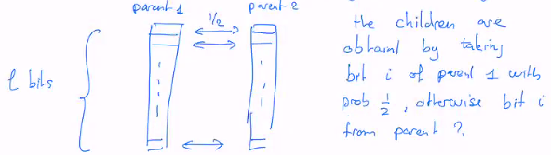
Uniform-crossover
This one is based on each gene of the genome
There are however problems for which these crossovers generate invalid children.
parent1 and parent2 ∈ S ➔ child1 and child2 ∈ S, if not one gets invalid children
This is the case if S is the space of permutation, as ion TSP:
Parent 1: 1 2 4 | 3 8 5 6 7 => Child1: 1 2 4 8 2 5 7 6 Town 2 selected twice
Parent 2: 1 3 4 | 8 2 5 7 6 => Child2: 1 3 4 3 8 5 6 7 Town 3 selected twice
One solution is to take the first part of parent1, then fill with elements of parent2 not already present, in the order they appears in parent2:
Parent 1: 1 2 4 | 3 8 5 6 7 => Child1: 1 2 4 3 8 5 7 6
Parent 2: 1 3 4 | 8 2 5 7 6 => Child2: 1 3 4 2 8 5 6 7

Slide 34
Other mutation operators
We have also a problem with the space of permutation.
One cannot randomly change a city with another of selected at random.
Better to use as mutation the movement seen before in Simulated Annealing or Tabu search:
Swap of two cities
Moving one city along the list
…

Slide 35
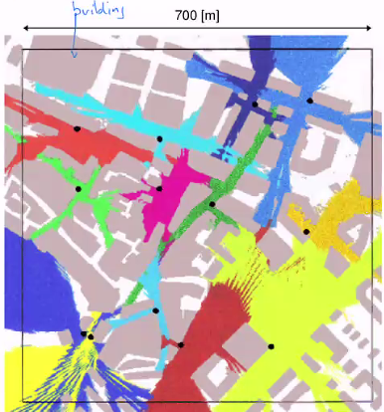
Example: Antenna coverage in a city
How to place antenna in a city to get the better coverage for cellular phones.
We use a wave propagation simulation to determine the coverage of a given placement
We need maximum coverage and some overlap between regions (cells)
Parents are parts of the zone (i.e.: left and right half of this plan)
Note: here the fitness calculation is the long part of the process.

Slide 36
6.8 Usefulness of genetic operators
Selection, Crossover, Mutation

Slide 37
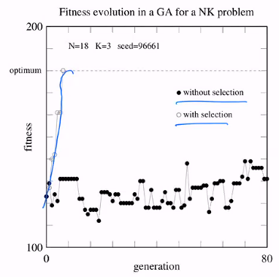
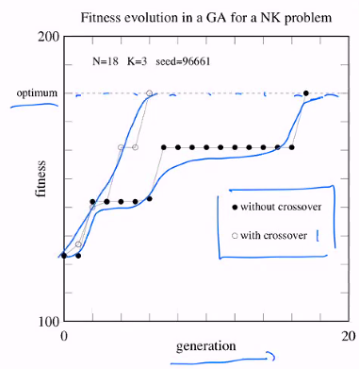
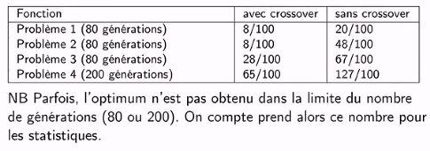
Examples in a NK problem

Slide 38
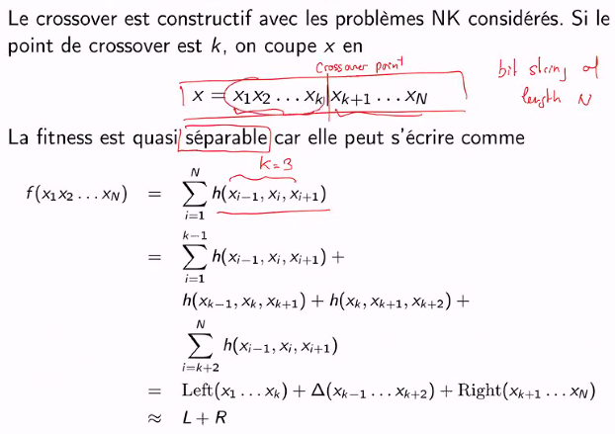

Slide 39
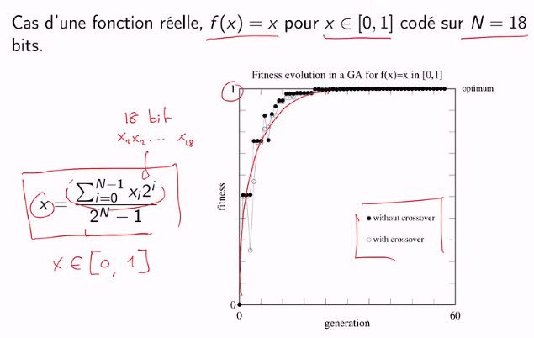
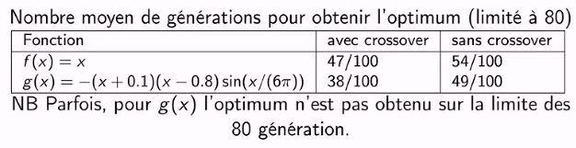

Slide 40
Final remarks
1) There is no good proof of convergence of GA.
Usually people propose the Theorem of schemas as a proof that GA works.
In short, this theorem says that if there is a pattern of bits in a solution whose fitness is higher than the average, it will be amplified (the number of time it appears in the population will increase) provided this pattern (schema) is not too long.
This is rather weak argument to explain convergence. The optimal solution would be a concatenation of small schema of good fitness.
2) GA are usually good to find a good region of the search space, but they may fail to find the exact optimal solution.
Thus it is suggested that the good candidates proposed by the GA is used as an initial point for another optimization technique (a local search with hill climbing for instance).

Slide 41
6.9 Neighbouring crossover

Slide 42
So far we assumed that individuals in the population can interact together without restriction. They are all visible from each other.
In biology such a totally mixed population is called a panmictic population.
But for real population, the mixing is not perfect.
It’s rather local, and crossover affect neighbouring individuals.
This correspond to sub-population that are weakly interacting.
We want to use this feature in a GA.
The goal is not just to copy nature. We’ll see that such a sub-population approach brings benefit in terms of quality of solutions and convergence speed.
This in particular will give us the opportunity to parallelize the evolution process.
This also speeding up the finding of the optimal solution, as more work is done faster on many processors.

Slide 43
Slide à ajouter depuis la vidéo (~30min avant la fin)

Slide 44
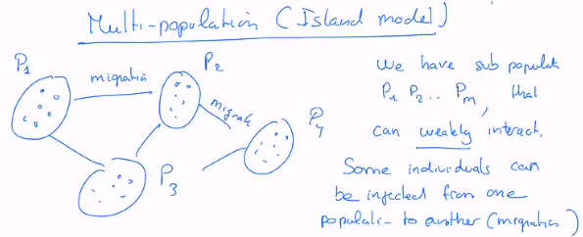
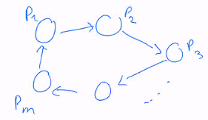
the topology of interaction can de freely chosen.
It turns out that the topology of interaction has little effect on the performance.
Often it is enough to organize the population as a ring:
Such a multi-population system is specified by choosing:
m = number of sub-populations ➔ order of tens (10, 100, 1000…)
size of sub-populations (assumed as constant) ➔ usually 50 individuals
evolution within each population (GA as seen before, but could be any population metaheuristics)
number and type of migrants ➔ 5-10% of the population, copies chosen among the best individuals that will replace the worst in the target population
frequency of migration ➔ every ~10 generations
We observe a faster convergence for a given computational effort.
Preserving diversity across populations.
Easy parallelization: each processor runs its own GA with the corresponding sub-population.
Asynchronous communication are enough to implement the migration.
There is no load imbalance problems as each processor can be in any state at any time.

Slide 45
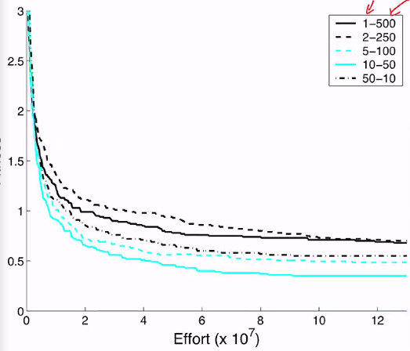
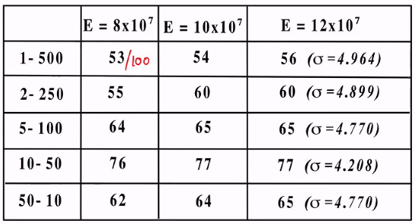
The main issue is to correctly balance the size of the sub-populations and they numbers.
For instance, a total of 500 individuals can be distributed in different ways:
1 population of 500 individuals (panmictic case)
2 populations of 250 individuals
5 populations of 100 individuals
10 populations of 50 individuals ➔ appears to be the best compromise
50 populations of 10 individuals…
To measure the benefit of the size and number of subpopulations, we plot the fitness as a function of the computational effort (defined for instance as the total number of fitness evaluations = n * nb of generations)
Rate of success to find the optimal solution

Slide 46
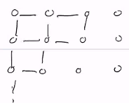

Cellular populations
Organize the individuals on a graph, and usually simply on a grid in 2D.
Then selection, crossover and mutation are done locally.
Selection: a tournament between an individual and its neighbours. The winner replaces the central individual.
Local crossover: performed between an individual and one of its neighbours.
Local mutation: as before, it was already local.
The update is done in parallel: all individuals are updated synchronously.
Benefit of cellular populations:
The selection is slower and diversity is preserved for a longer time.
The best individual has to propagate across the entire system before invading the population.

Slide 47
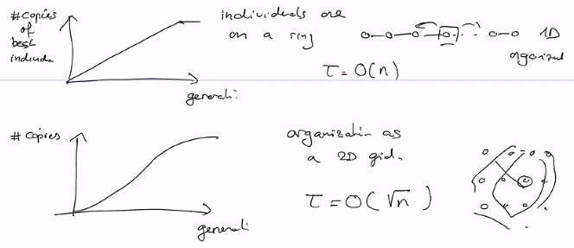
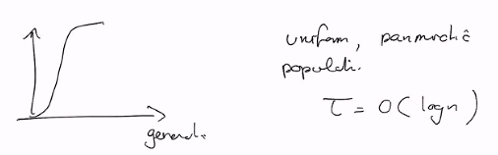
Takeover time:

