Slide 1
Genetic Programming (GP)
Chapter 7

Slide 2
7.1 Introduction
Developed a lot in 90’s by Koza.

Slide 3
Can we apply the concepts of evolutionary algorithms to a set of computers programs, instead to a set of numerical values?
We want to evolve a computer program so that it solves a given task.
We’ll consider a population of programs, that we’ll select, mutate and recombine until we find the desired optimal program.
What do we expect from this optimal program?
It produces an adequate output for any possible input.
Now we could call that Machine Learning.
But it can also be seen as optimization problem:
Minimize the difference between the output produced by the programs, and output that are known to correspond to the problem.
Therefore, one needs a training set, a set of input-output which can be used to drive the evolutionary process and evaluate the quality of the programs.
But we expect a generalization property:
The program should also provide a good output for input not in the learning set!
This contrast with the problem of overfitting (“sur-apprentissage”), where the training data are too well learned, at the expense of other inputs.
Search space: much less rich than what can be generated with usual programming languages.

Slide 4
7.2 Coding of a program
What language can we use so that the genetic operator can be applied?

Slide 5
We need to generate valid individuals, and the genetic operators should produce syntactically valid programs.
We’ll discuss two types:
Trees: programs can be represented as trees, functional style.
Stack-base linear: look more like traditional instructions driven code.
The Tree programs we’ll be more used and studied in this case.

Slide 6
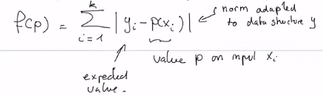
Fitness computation
Let P be a program that act as: y = P(x) where y is the output and x the input.
x and y can be data-structure (vectors, matrices…)
Let A = {<x₁, y₁>, <x₂, y₂>, …, <x_{n}, y_{n}>} the Training Set
Fitness of P is its capability to reproduce the output y_{i} with input x_{i}.
In this way, evolving a program is a minimization problem.
In a discrete space, we can also count how many outputs are correct.
It becomes a maximization problem.

Slide 7
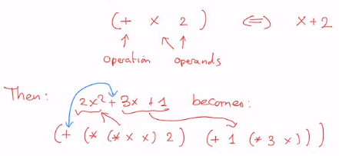
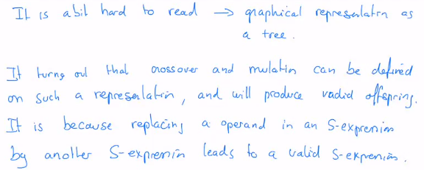
In many cases in GP, we would like to obtain an algebraic formulation of a process:
y = g(x)
Where for instance g(x) = 2x² – 3x +1
It can also be Boolean expression, if x and y are Boolean values.
Koza proposed to represent such program in a functional programming style, through s-expression, borrowed from the language Lisp.
For instance, we write:

Slide 8
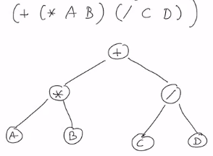
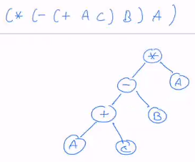
Coding as a tree
A tree representation is equivalent to the S-expression but more readable.
And Crossover and Mutation are easy to define.

Slide 9
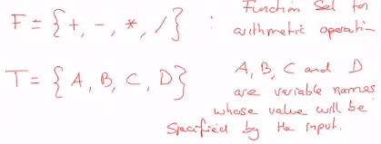

Function set and terminal set
A program will be defined on top of acceptable operations and using predefined variables.
The Function Set F will specify the operations that we can use to build a program.
The Terminal Set T will contain the variables and constants relevant to the problem.

Slide 10
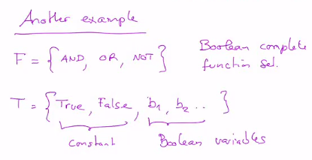
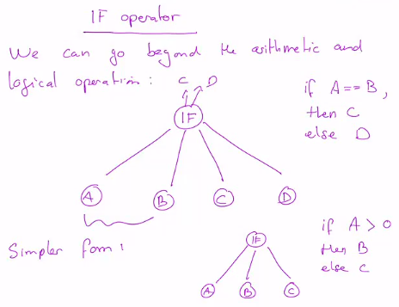
The Function Set and Terminal Set are defined according to the need of the problem.
Be sure that the following closure property is satisfied:
Function should accept any results of other function in F, as well as any value from T.
For instance, division should be extended to accept zeros as arguments:
0 / 0 or A / 0 ➔ must be defined
Has to be defined according to the need of the problem.

Slide 11
Search Space S is the set of all programs that can be built from any combination of elements in F and T
Potentially infinite, as programs can be as deeper as one wishes.
Long programs take memory and are longer to execute.
Therefore it is common to limit their depth artificially.

Slide 12
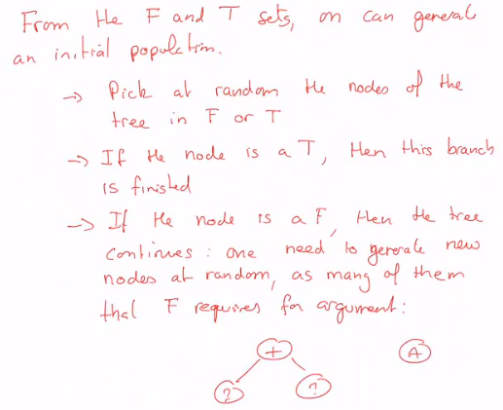
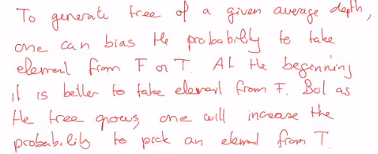
Initial population

Slide 13
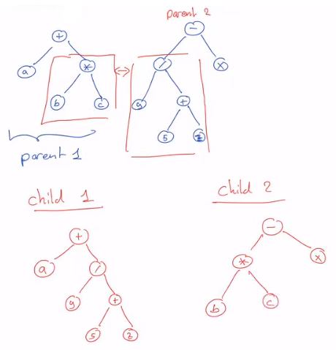
Crossover
Exchange branches between the Parents Trees.
As in GA, one can have a crossover probability.
We need to specify the “crossover point”
Probability is not uniform, so as to favour internal nodes than around the leaves.

Slide 14
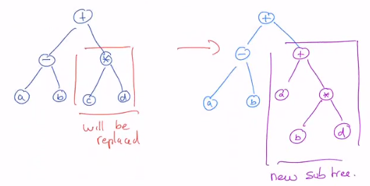
Mutation
Replace a sub-tree by a new one, built at random.
With Crossover and Mutation, the depth of programs tend to increase.

Slide 15
7.3 Example of application

Slide 16
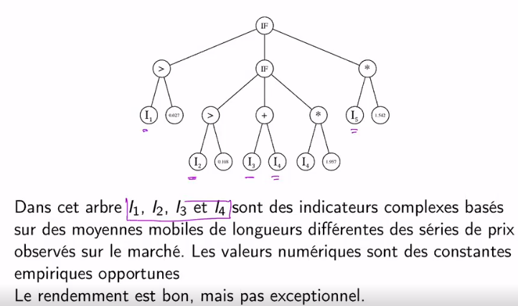
GP can be used to generate trading models in finance:
Recommendations for the traders to buy, sell or no action on something (output).
Based on the past evolution of prices (time series as input).
Fitness: profit we get if one has followed the model over a test period.
But risk should be taken into account:
Fitness is reduced by the standard deviation of the profit.
Ideally, high return with low risk.

Slide 17
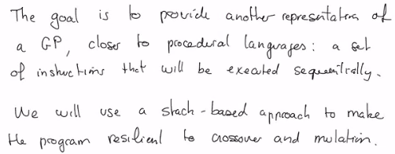
7.4 Stack-based sequential programs

Slide 18
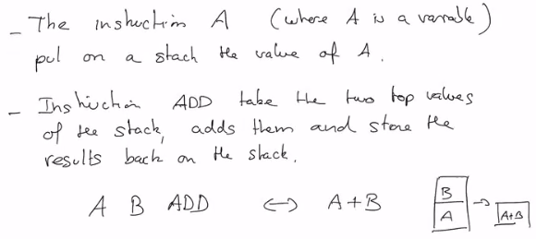
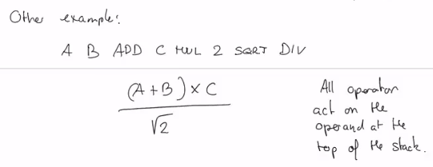
Elements of language

Slide 19
Closure property
the operation should work whatever the state of the stack:
3 ADD ➔ missing argument for ADD ➔ do nothing ➔ 3 ADD = 3
Functions and Terminals Sets can be defined as before to specify the search space.
The output of a GP is the state of the Stack as the end of the execution.
Or it can be the top value of the stack only (if a scalar is needed).
Note: length of these stack-based program do not change with crossover and mutation.

Slide 20
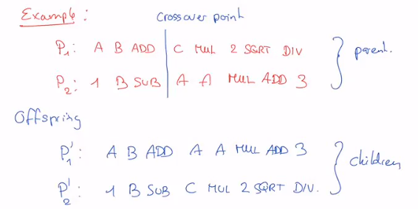
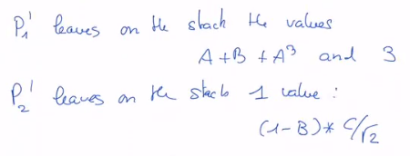
Crossover
As in GA: mix the two parts of the parents

Slide 21
Mutation
Change each instruction with a given probability.
New instruction is chosen at random in T or F.

Slide 22
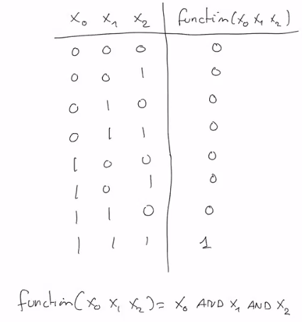
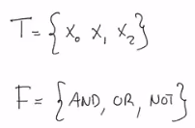


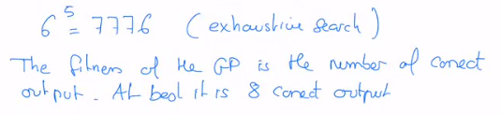
Example

Slide 23
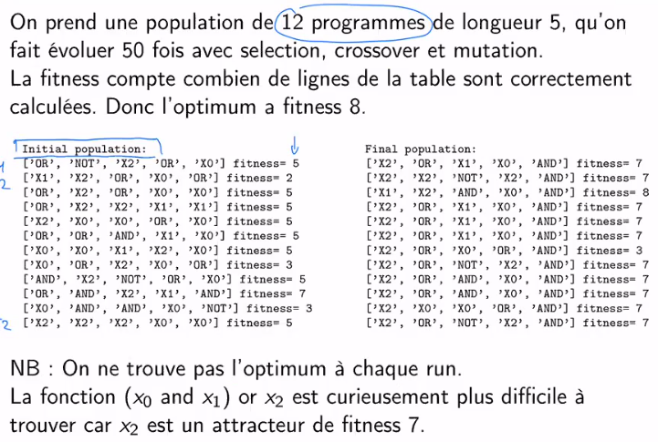


Slide 24

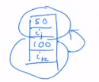
Control structures (If, Loops)
Branching can also be implemented in the representation:
IF: can take the top of the stack and compare it to zero (or something else).
If True, instructions following the IF are executed normally.
Else all following instructions are ignored until an END-IF instruction.
This can be implemented by a flag ∈ {0, 1} that defines if instructions are executed or ignored.
This flag can be switched by the IF and END-IF.
Loop: we can introduce LOOP and END-LOOP functions.
LOOP will take the value on top of the data stack and put it on a new stack (the Loop-stack).
When reaching the END-LOOP instruction, if there is a Loop-stack:
The top Loop-stack value is decremented by 1
Execution jumps back to the i_{k} position
If the decremented value reach zero, the Loop-stack is cleared.
then several loops can be nested.

Slide 25
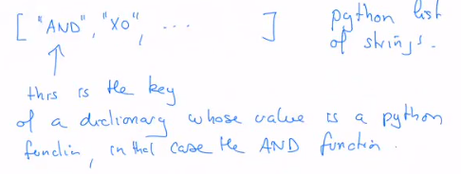
Note on python programming

