Slide 1
EVOLUTION STRATEGY (ES)
Chapter 8

Slide 2
8.2 Introduction
Part of Evolutionary Algorithms with GA and GP.
Proposed independently in 1960 by Rechenberg.
Initially it was a metaheuristics with a single individual x ∈ R^{d} adapted to continuous optimization. Called (1+1)-ES.
Later, it turned to a population metaheuristics with an evolution based on crossover and mutations.

Slide 3
8.2 (1+1)-ES algorithm
(1+1) means one parent giving one child, who potentially replaces the parent.

Slide 4
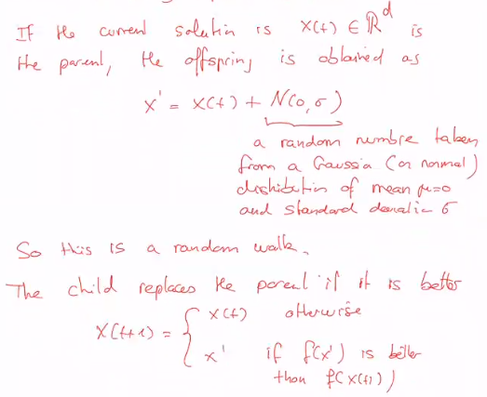


Slide 5
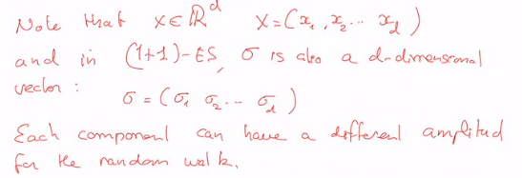
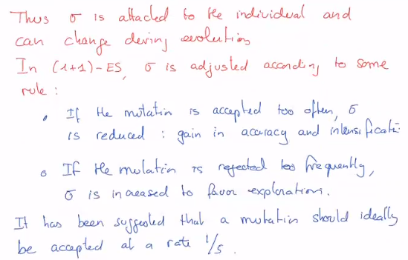

Slide 6
8.3 Population version of ES

Slide 7
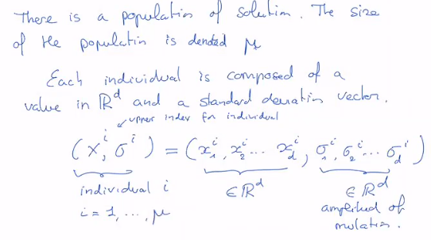

Slide 8
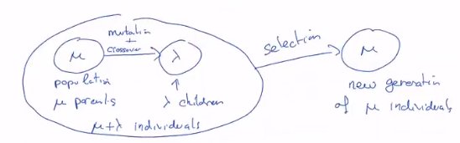

First version: (μ+λ)-ES

Slide 9
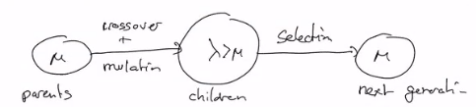

Second version: (μ, λ)-ES

Slide 10
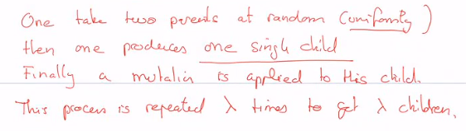
How to generate a child?

Slide 11
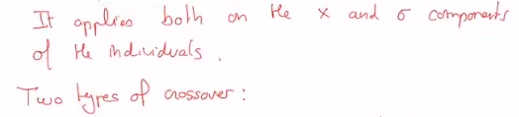
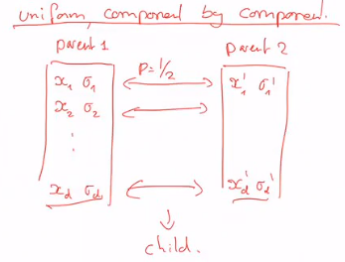
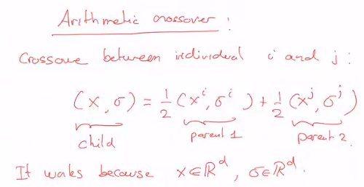
Crossover

Slide 12
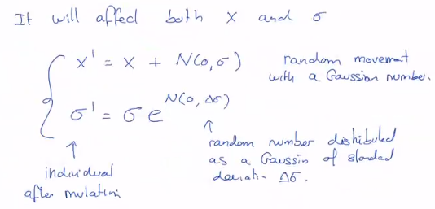
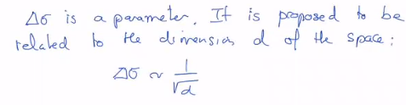

Mutation

Slide 13

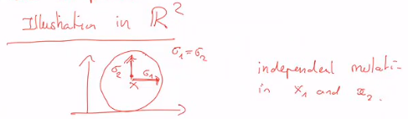
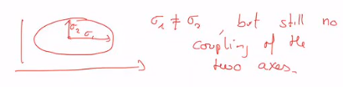
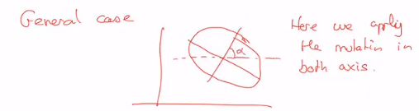
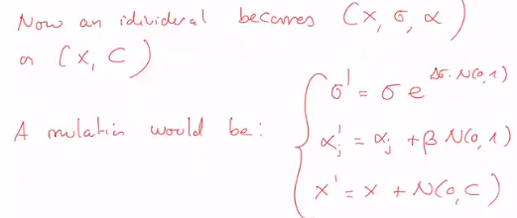
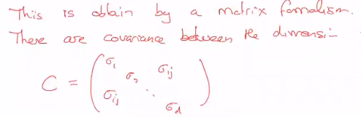
Generalized version

