Slide 1
Performance of metaheuristics
Chapter 9

Slide 2
9.1 Introduction

Slide 3
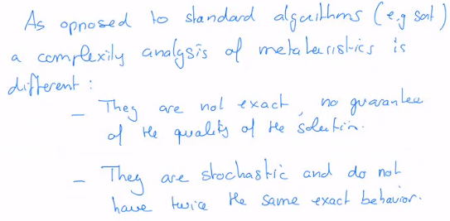

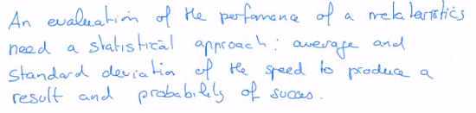

Slide 4
9.2 Example of behavior of SA for the TSP

Slide 5


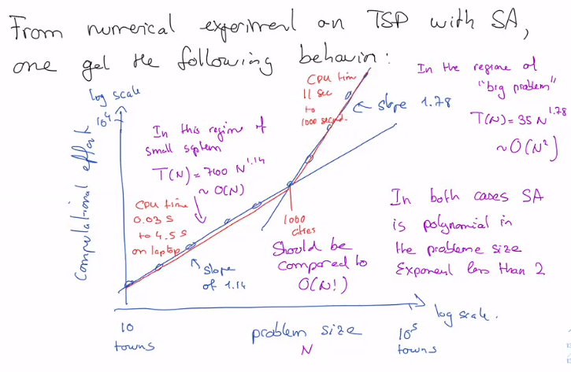

Slide 6
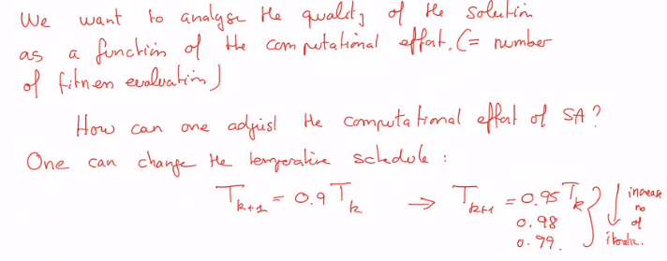

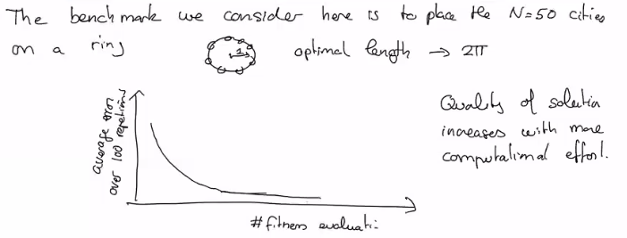
Accuracy of the solution

Slide 7
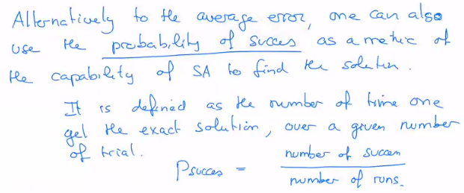
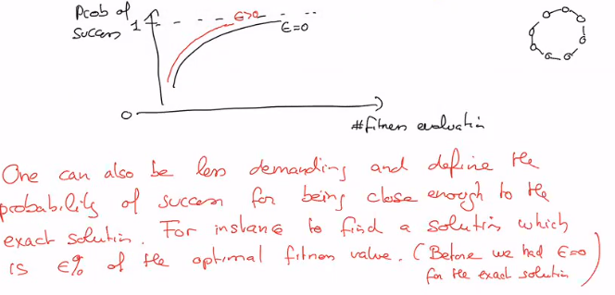

Slide 8
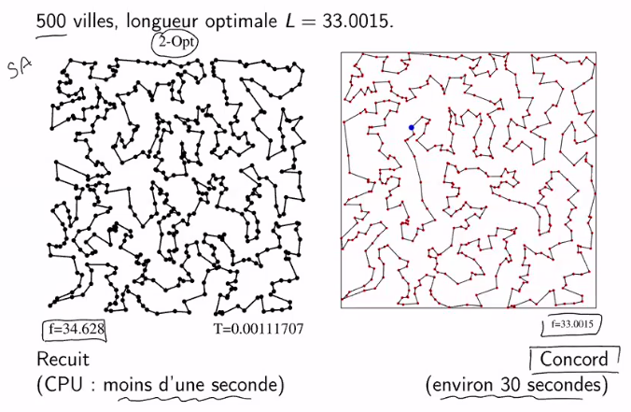

Slide 9
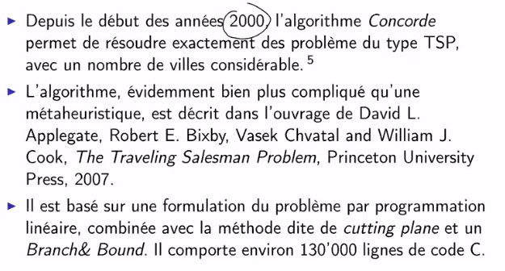
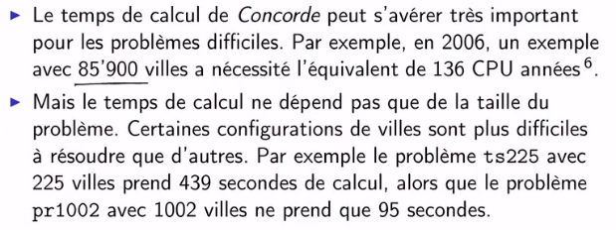
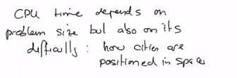
Concord algorithm

Slide 10
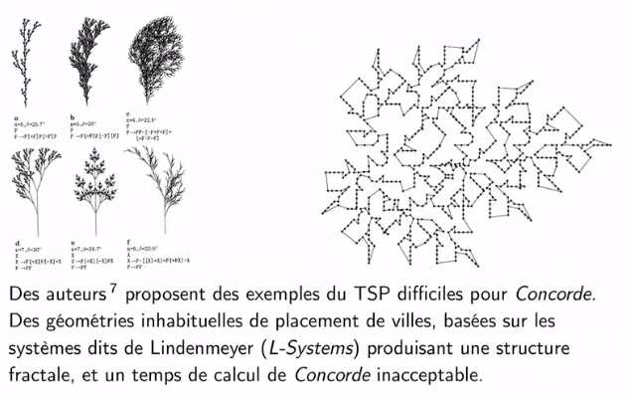

Slide 11
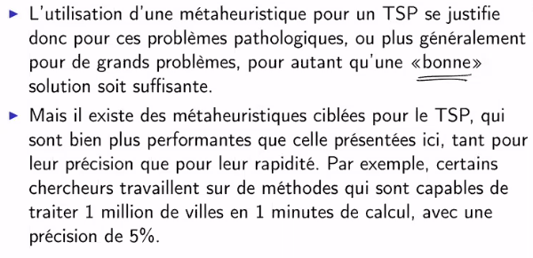
Remarks on TSP

Slide 12
9.3 Example of behavior of Ga for NK-Landscape

Slide 13
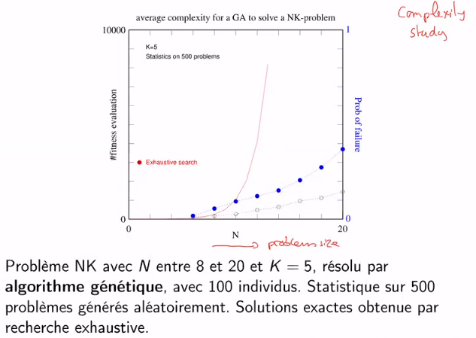
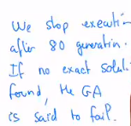
Complexity study
2^{N}
Prob of failure of GA
Time of GA

Slide 14
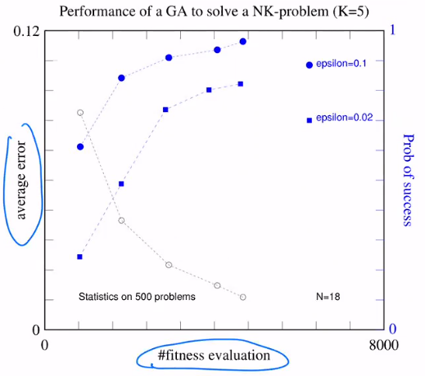
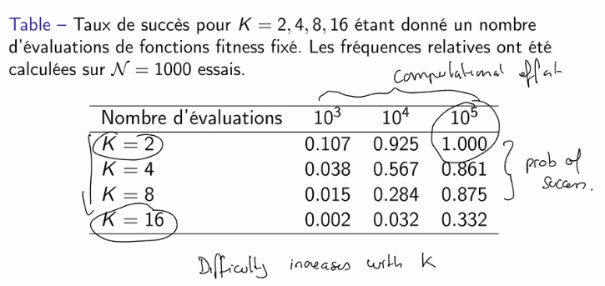

Accuracy neede dto say the GA succeeded

Slide 15
9.4 Principles for evaluate the perf. of a metaheuristics

Slide 16
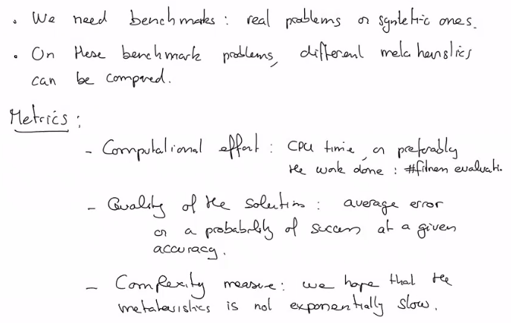
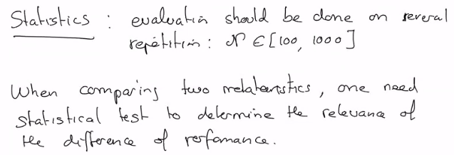

Slide 17
9.5 The «no free lunch» theorem

