Slide 1

Multimedia security and privacy
Section 2

Slide 2
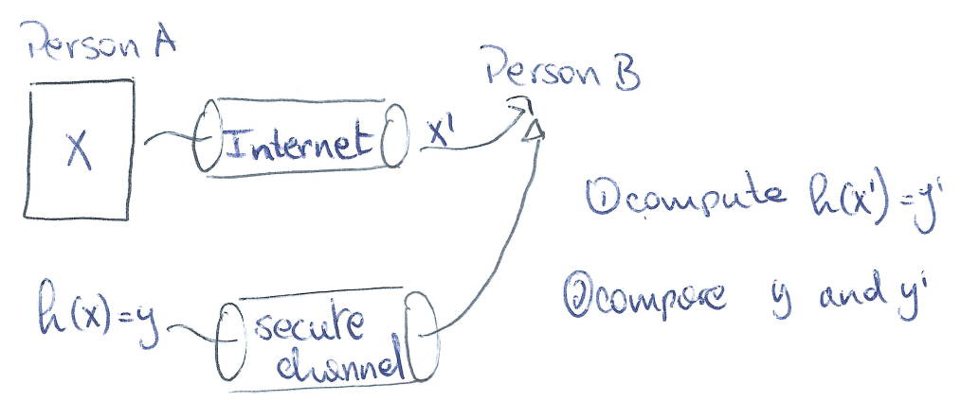
(2.1) Explain the main differences between content fingerprinting (robust perceptual hashing) and cryptographic hashing
A cryptographic function has the following properties:
  Noted: h(X) = y
  Input (X) is a binary string of any length (padding may be required)
  Output (y) is a binary string of a given length
  Changing a single bit in X, will change at least 50% of the bits of y
  From y, it is impossible to find the corresponding X
  It is computationally impossible to find collisions
  Some hashing functions may require the use of keys
Usage: Integrity
(Authentication if key is used)

Slide 3
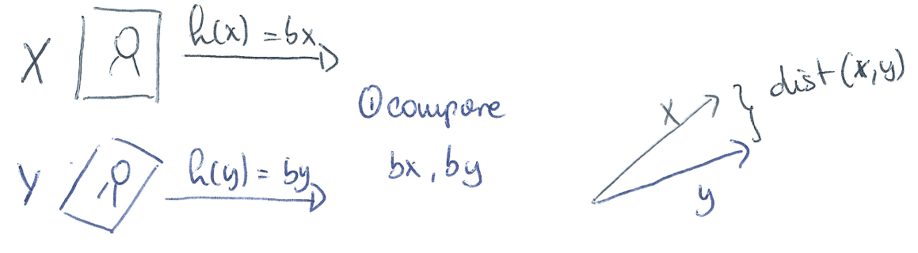
(2.1)
A content fingerprinting function has the following properties:
  Noted: h(X) = bx
  Input (X) is a binary string of any length (N)
  Output (bx) is a binary string of a given length (L) => Short
  Changing a single bit in X, will have small repercussions on y => Invariant
  From y, it is impossible to find the corresponding X => Secure
  Easy to find collisions
  Some hashing functions may require the use of keys
Usage: Authentication and Identification

Slide 4
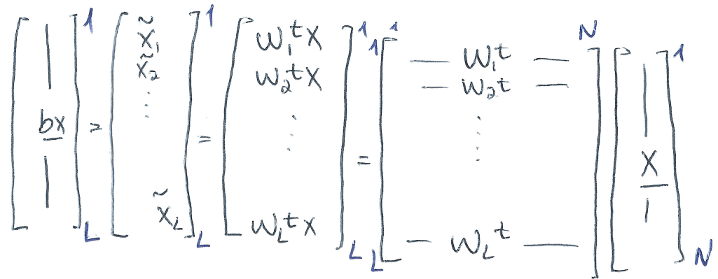
(2.1)
Levels of security
  N >> L, since the hash is much smaller than the input data, it is impossible to recover X from bx. This also results in easy comparison between hashes.
  Entropy of input: H(X) = N*H(Xi) = N*log2(256) = N*8
  Entropy of output: H(bx) = L*H(bxi) = L*log2(2) = L*1 = L

Slide 5
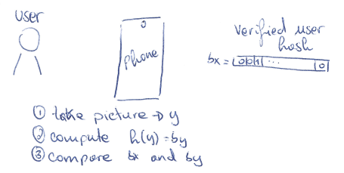
(2.2) Explain the main usage of content fingerprinting in various applications. What are the main advantages?
Main Usages: authentication and identification
Authentication:
  Example: a phone that is able to unlock via face recognition, must take a snap picture of a user (that wants to unlock the phone). The phone must decide “is it a verified user, or not?”
=> yes or no question

Slide 6
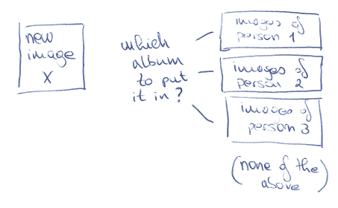
(2.2)
Identification:
  Example: a phone keeps albums of images of each different person in its images. When taking a new picture, it needs to identify into which album the image must go.
  => Must decide which album, or none at all

Slide 7
(2.2)
Problems with doing these operations with the image itself:
  Lets imagine we want to do both these operations with the image itself X
  Let our image be of size N
  In the authentication use case we need only to compare 2 images, each of size N => O(2*N) and O(N) (time/memory)
  In the identification use case we need to compare to J albums (let’s assume each album has 1 image), every image of size N => O(J*N) and O(N*J) (time/memory)
  Euclidean distance is a not a good measure of “likeness” in an image (not robust to geometrical operations)

Slide 8
(2.2)
If we instead compare the binary representation of each image bx, we get a certain number of advantages:
  Speed and memory, as we can replace N by L (N >> L)
  Vectors are binary, one can compute hamming distance instead of Euclidean distance
  Secure in the event of data breaches (can’t recreate X from bx)
  Robust to geometrical operations, compression
  Follows known distribution (question 2.4)

Slide 9
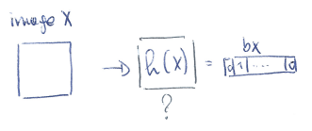
(2.3) Explain the construction of content fingerprinting function based on random projections and binarization
Recall:
  Noted: h(X) = bx
    Input (X) is a binary string of any length (N)
    Output (bx) is a binary string of a given length (L)

Slide 10
(2.3)
But what is h() doing exactly ?
  Vectorize input X
  Compute matrix W
  Compute:
  Turn into a 1 or a 0 (binarization)

Slide 11
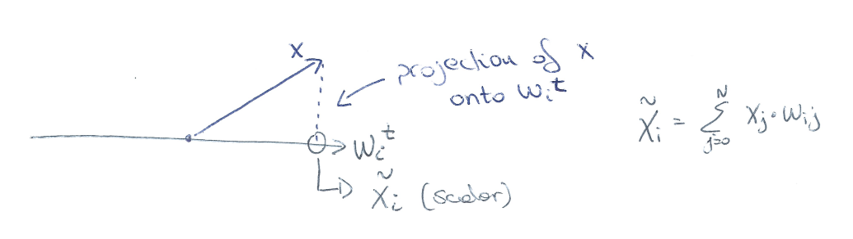
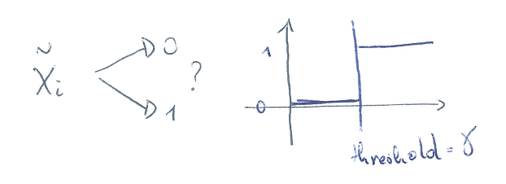
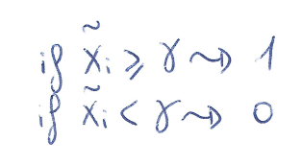
(2.3)
Projection:
Binarization:

Slide 12
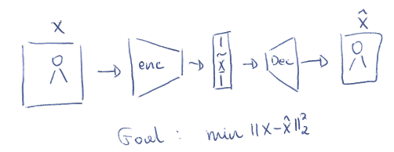
(2.3)
How do we compute matrix W ?
  There are 2 possibilities, it is either handcrafted (HC), or machine learning (ML)
HC uses a secret key k, that it uses as a seed to generate random values for W, whoever has access to the key k, can compute the same matrix W
ML uses machine learning algorithms to create the perfect matrix W, no key required

Slide 13
(2.3)
One question remains, which FP model is better ?
  ML offers more robustness to geometrical operations/compression on X
  ML needs training time to create a perfect encoder
  ML is fully data dependant, meaning an attacker that has access to the data, can train his own model, and have a decoder
Both can be used, depending on the application one might be more appropriate!

Slide 14
(2.4) Explain the statistics of coefficients under random projections used in content fingerprinting. Properties.
  Vectorize input X
  Compute matrix W
  Compute:
  Turn into a 1 or a 0 (binarization)

Slide 15
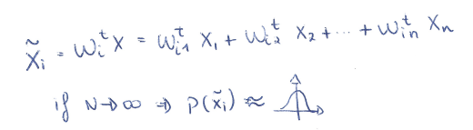
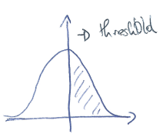
(2.4)
It is impossible to know the statistical distribution of X
However it is very possible to know the statistical distribution of bx!
Let’s do it:
  First of we have to understand that is statistically independent from , even though and are dependant, this is because the multiplication => , will make them independent
  When we add multiple independent variables, the result is a gaussian of mean 0!
  Because is gaussian of mean 0, it means that bx is of maximum entropy (if we choose the threshold correctly)!

Slide 16
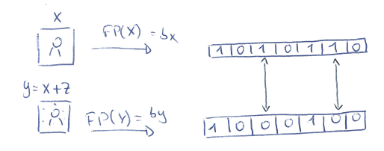
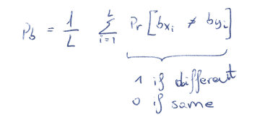
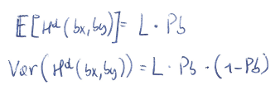
(2.4)
  Because and , we can compute the probability of error Pb, between two different binary strings
  There are L independent events, and at each attempt there is a probability Pb of flip. This is a Binomial distribution!
  From here we can compute expectancy and variance
  With L large enough, our binomial distribution will be gaussian shaped (symmetrical). Which also means we can easily compute Pm and Pfa

Slide 17
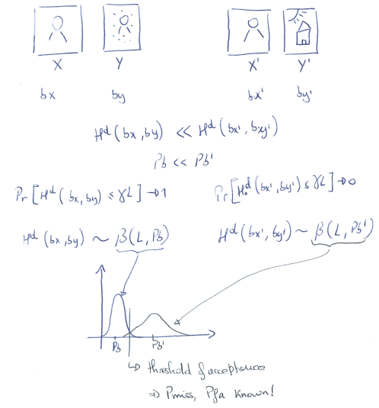
(2.4)

Slide 18
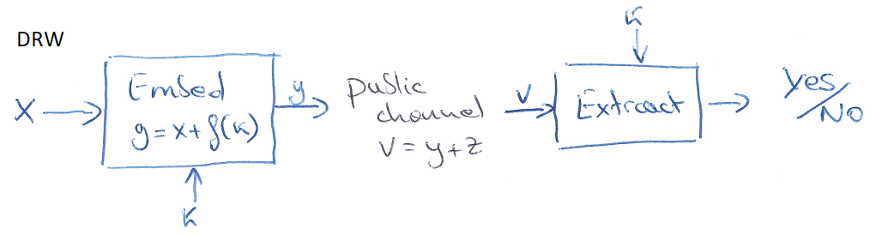
(2.5) Explain the difference between the sufficient statistics in digital watermarking (linear cross correlation) and Hamming distance? What are the implications of these differences?
Linear cross correlation:
  Used to detect the watermark in a media file
  Block diagram:
  Cross correlation used to answer yes/no
  Compute using
  Compute
  Compute
  Compute
  If accept, the threshold

Slide 19
(2.5)
Hamming distance:
  Used to decide if two FingerPrints are from close inputs
  Hamming distance used to answer yes/no
  Compute is any distortion
  Compute
  Compute
  Compute
  If accept, the threshold

Slide 20
(2.5)
Cross correlation result follows a gaussian distribution of mean
Hamming distance result follows a binomial distribution
if is large enough, is gaussian shaped!

Slide 21
(2.6) Explain the main requirements to privacy protection. Provide several examples of privacy protection schemes.

