Slide 1
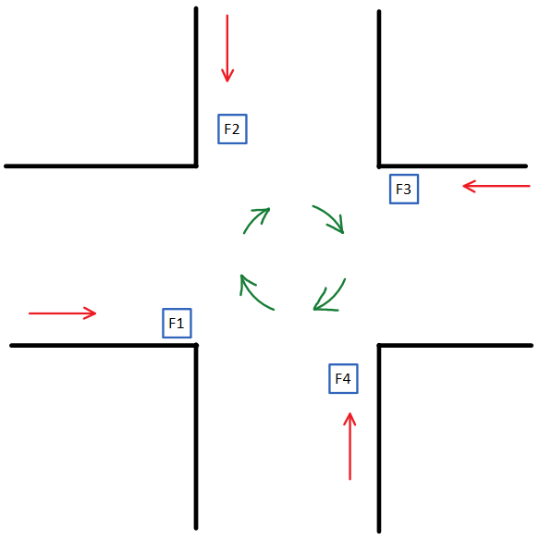
Scenario – Physical Dimension
Transition order: … -> F1 -> F2 -> F3 -> F4 -> F1 -> …
Only 1 light is green at a given time
This order is deterministic
10 second timer per light
Total rotation time of 40 seconds
This is the in the Physical Dimension

Slide 2
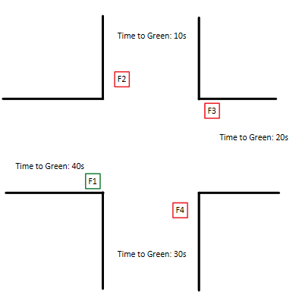
Scenario – Physical Dimension(2)
Let’s assume F1 is now Green.
Then we can compute how long until each Fi will be turning green

Slide 3
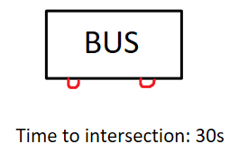
Scenario – Physical Dimension(3)
Event:
A bus is arriving at the intersection in 30s
he is coming from F1
The bus will wait in a red light for 10s, no matter what!
(because F1 time to green is 40s → 40s-30s = 10s)

Slide 4
Scenario – DT dimension
Let’s imagine it now in DT dimension!
There are 4 DT, one of each Physical light
A DT would be identified/described by:
(1) his unique ID
(2) his current state *1
(3) traffic urgency *2
*1 For simplicity, a state is either 0 or 1 => 1 is green and 0 is red
*2 Number of cars waiting for light to turn green => this is detected by sensors/cameras (none, low, medium, high)

Slide 5
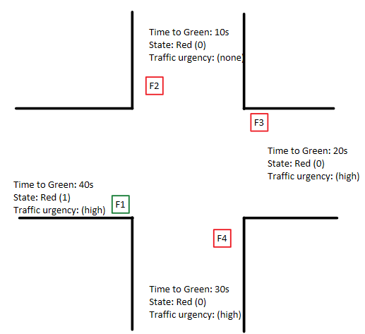
Scenario – DT dimension(2)
The 4 DTs want to communicate with each other
They would share their:
State
Traffic urgency
-> by sharing these information, they will try to make a non-deterministic optimal transition order

Slide 6
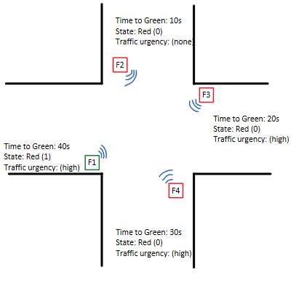
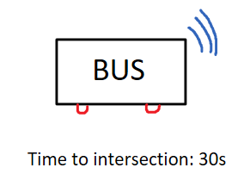
Scenario – DT dimension(3)
Event:
A New entity enters the group chat (BUS)
A new rotation of traffic is chosen
Define intersection state as:
S_inter = (SF1, SF2, SF3, SF4) → SF1 state of F1
State transition is:
t= 0: (1,0,0,0)
t=10: (0,0,1,0)
t=20: (0,0,0,1)
t=30: (1,0,0,0)
F2 has no traffic → never turns green
Bus doesn’t wait to pass through the intersection
Bus leaves group chat once he went through

Slide 7
What is happening
The physical objects, bus, and traffic light are from 2 different city actors
CA1 → TPG manages all public transportation:
Can issue certificates to each Physical bus/tram
Is the only entity that can issue an authentic certificate to a bus
CA2 → Traffic Geneva:
Can issue certificates to each Physical traffic light
Is the only entity that can issue an authentic certificate to a traffic light
Certificates would be stored in block chain → via use of contracts ? TBD

Slide 8
What is happening(2)
CA2 → Traffic Geneva:
Creates a communication “room” → authenticates it in the block chain
Tells the DT from the traffic lights (at the intersection) to connect to it
Users chatting can validate each other (verify certificate present on BC)
They communicate with the use of encryption

Slide 9
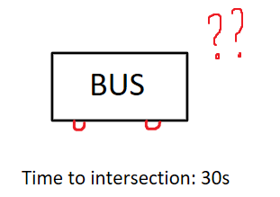
What is happening(3)

Slide 10
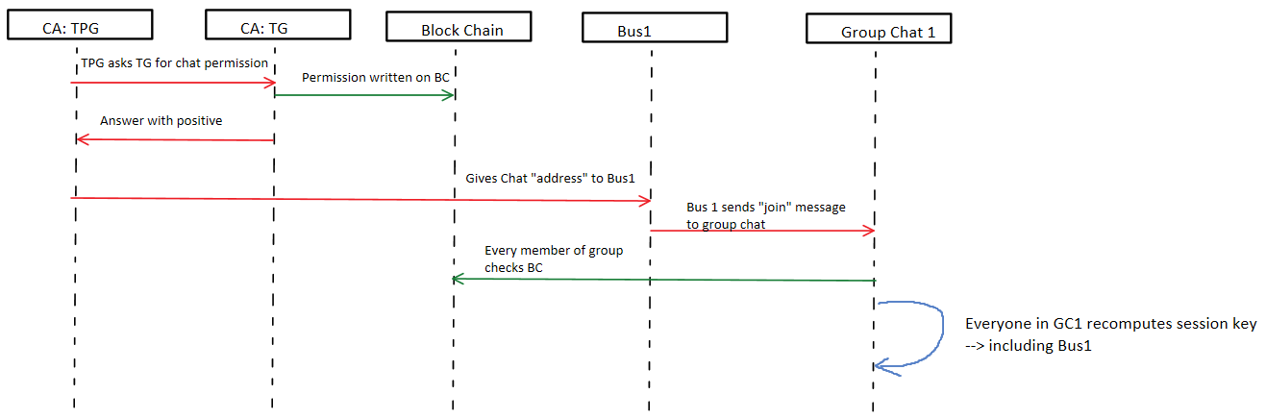
What is happening(4)

Slide 11
Messaging protocol
-> Paper 1 [30%] Provably Authenticated Group Diffie-Hellman Key Exchange – The Dynamic Case
+ Allows secure group communication
+ Manages dynamic membership
+ Only one entity checks Block Chain update
- Central entity generates every long-term key
- Central entity is a single point of failure
Central entity will check validity of join request
If valid, will add new user to the list of current users
Other users don’t need to bother checking

Slide 12
Messaging protocol(2)
-> Paper 2 [50%] Scalable Protocols for Authenticated Group Key Exchange
+ Allows secure group communication
- No dynamic solution for join/leave group
Once a new entity joins, they need to restart the whole protocol process

Slide 13
Messaging protocol(3)
-> Paper 3 [50%] Tree-based Group Key Agreement
+ Allows secure group communication
+ Dynamic solution for join/leave group
+ No central entity validating user
+ Each user capable of computing new secret key at any moment → after membership event
- All members need to check validity of new users
Once a new entity joins, each member has to checks Block Chain

Slide 14
[50%] Tree-based Group Key Agreement
Properties:
contributory group key agreement
key trees to efficiently compute and update group keys
Diffie-Hellman key exchange to achieve provably secure and fully distributed protocols
Communication semantic:
View Synchrony (VS) – if entity A is sending a message to the group, only entities that A knows are in the group view the message
(1) A sends message to group at t = 0
(2) New member B joins group at t = 1
(3) Every member receives message at t = 2
(4) B can’t read the message !

Slide 15
[50%] Tree-based Group Key Agreement (2)
Group membership events:
Join - new user joins group
Leave - user leaves group (voluntary or not)
Group merge - 2 Groups of any size merge into the same group
Group partition - multiple participants leave group
Group events may be due to Network failure, or explicit.
Obviously after any group membership event a new group key must be generated

Slide 16
[50%] Tree-based Group Key Agreement (3)
Cryptographic properties:
Group key secrecy - it is computationally infeasible to compute any secret key
Forward secrecy - knowing a set of keys, doesn’t help compute a following key
Backward secrecy - knowing a set of keys, doesn’t help compute a previous key
Key independence - knowing any set of keys, doesn’t help you compute any other group key
Every message MUST be digitately signed
Every recipient MUST verify a message signature

Slide 17
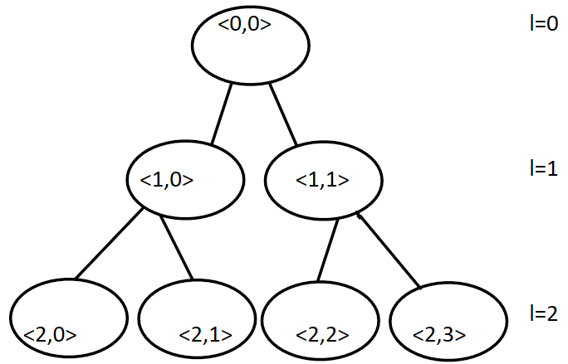
[50%] Tree-based Group Key Agreement (4)
Binary trees:
Every node is either a leaf, or a parent of 2 nodes
The root is located at level 0
Every node is denoted <l,v>
  l = level
  v = ith node at same level from left
Each node is associated with a key: K_<l,v>
Each node is associated with the blinded key: BK_<l,v> = f(K_<l,v>)
f(): f(k) =

Slide 18
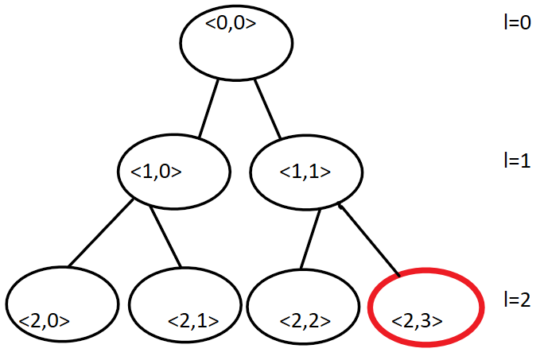
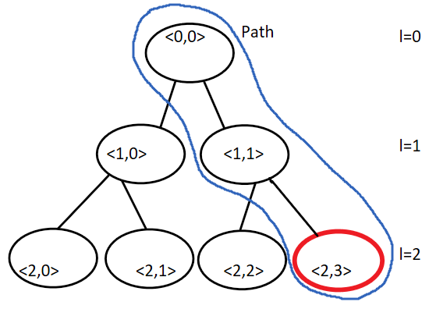
[50%] Tree-based Group Key Agreement (5)
Let’s assume you are node <2,3> (red)
Every node has: &&
Imagine a path from you to the root, you can compute the key for every node in the path (path in blue)
This is the Key path, denoted
You know every nodes blinded key
Denoted

Slide 19
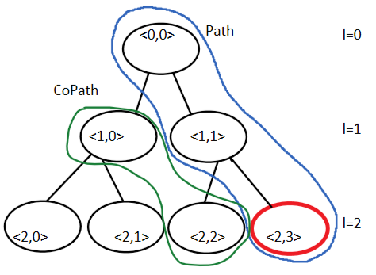
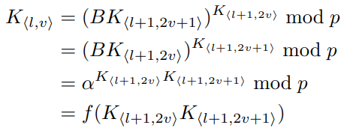
[50%] Tree-based Group Key Agreement (6)
Let’s assume node N1 has 2 sons, N2 and N3
To compute the key of N1, you need:
Key of N2, BK of N3 (or)
BK of N2, Key of N3
Let’s try it with the example, you are node <2,3> (red)
You have your own key, and BK<2,2> → can compute key of <1,1>
You now have key of <1,1>, and BK<1,0> → can compute key of <0,0>
This works from every leaf in the tree!
Everyone can compute Key <0,0> only knowing their own key!
→ Can compute cryptographic hash
→ We define CoPath = set of Bkeys you need to compute your key path

Slide 20
[50%] Tree-based Group Key Agreement (7)
Some more features:
Each member equally contributes to the group key
Each share is secret
When members join: more shares added (when someone joins, an old member modifies his own share! – Key freshness)
When members leave: their shares are removed
Sponsor:
The node that has to change his own private key when a new entity joins
Broadcasts his own view of the tree, and every BK !
Is identified by all group members

Slide 21
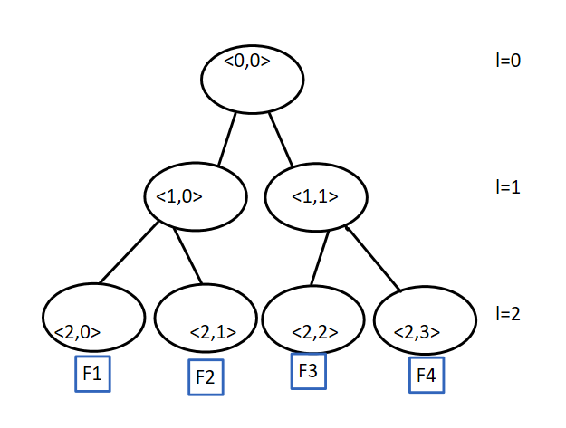
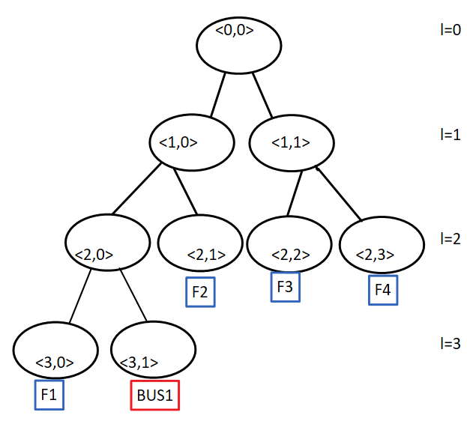
[50%] Tree-based Group Key Agreement (2)

