Slide 1
Blue City Project
Infrastructure and Data Security
03.05.2023
ENAC

Slide 2
City Actor
A City Actor is a system/organization that interacts with the physical environment within a city
Some examples would be:
  CFF / TP(G)
  Waste management
  Energy management
  Smart lighting system
  Traffic control system
  …
ELCA - The Independent Swiss IT Company

Slide 3
Situation
City Actors are able to collect different types of data across the city
(e.g. TP(G) can collect air pollution levels in real time)
This data might be useful for other City Actors
The collective use of this data amongst different City Actors may optimize the overall decision-making process withing the city
ELCA - The Independent Swiss IT Company

Slide 4
Problem
(1) Different City Actors collect data with different standards
(2) Different City Actors are at different stages in the overall digitalization process
(3) Different City Actors have different needs
(4) …
→ Data Security and Data integrity are crucial
ELCA - The Independent Swiss IT Company

Slide 5
Use Case
(1) Two organizations want a secure way of communicating between all their Digital Twins
(2) Both organizations want to add a third organization to the “channel”
(3) Some business transactions require traceability
ELCA - The Independent Swiss IT Company
4

Slide 6
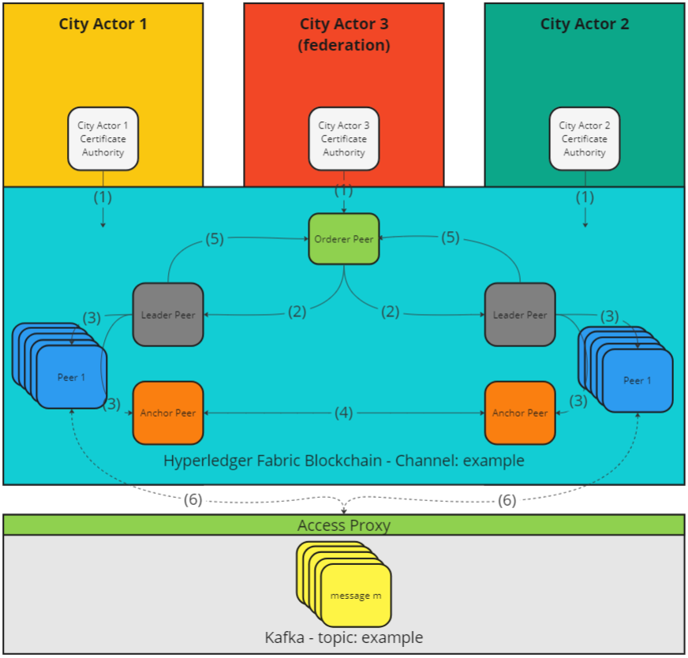

Slide 7
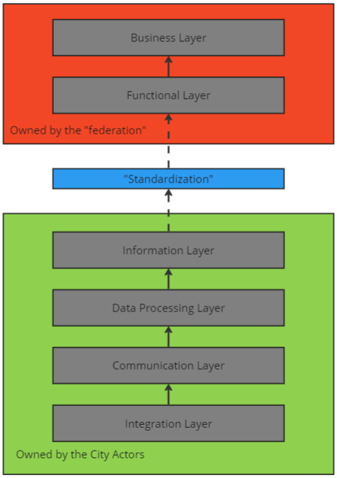
Proposed Solution
The proposed framework must:
consider all problems
enforce on-boarding “standards”
ensure trust in a trustless system
ELCA - The Independent Swiss IT Company

Slide 8
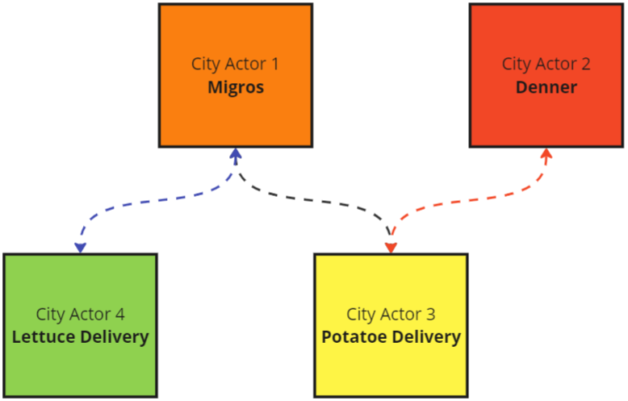
Proposed Solution (2)
Migros wants to order both Patatoes and Lettuce
Migros doesn’t want to display their order publicly
Potatoes Delivery wants the cost of Potatoes to be
secret between the various clients
→ All data can be used by the agronomic department
(e.g. predict future population need for more potatoes)
ELCA - The Independent Swiss IT Company

Slide 9
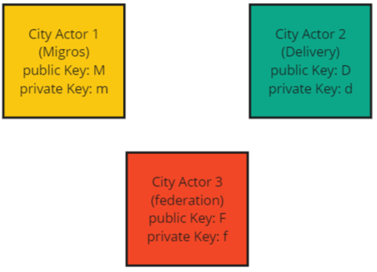
Proposed Solution (3)
City Actors meet in real life with the federation
Request the creation of a transaction ledger which both can use
Define contract with business logic
ELCA - The Independent Swiss IT Company

Slide 10
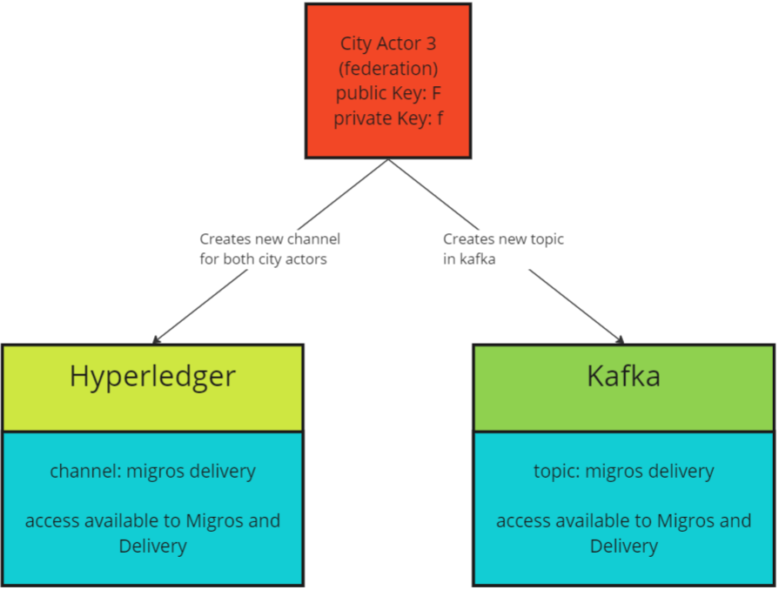
Proposed Solution (4)
Federation creates a channel in Hyperledger Blockchain
Federation creates a communication topic in Kafka
This channel will be private for both actors
If desired actors may be added in run time
ELCA - The Independent Swiss IT Company

Slide 11
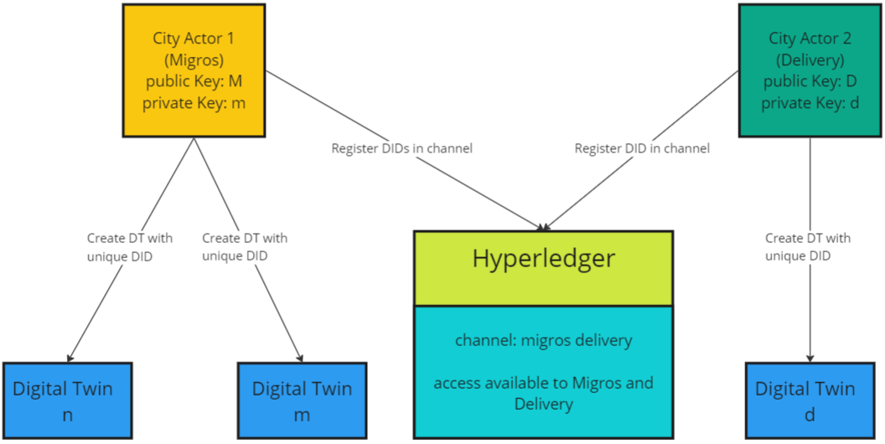
Proposed Solution (5)
Both City Actors can register nodes to the channel
These nodes represent Digital Twins
Each node will have the standard x509 certificate and a unique DID
ELCA - The Independent Swiss IT Company

Slide 12
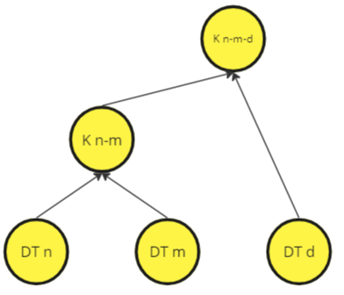
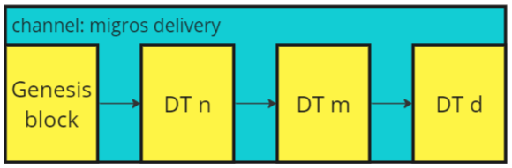
Proposed Solution (6a)
All nodes have the same view of the blockchain
All nodes can deterministically compute the same binary tree
ELCA - The Independent Swiss IT Company

Slide 13
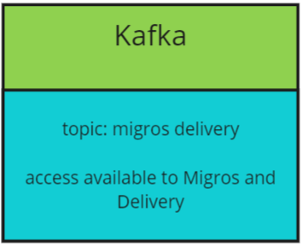
Proposed Solution (7a)
All nodes can connect to the Kafka topic and securely exchange messages
Messages Encrypted End-to-End
ELCA - The Independent Swiss IT Company

Slide 14
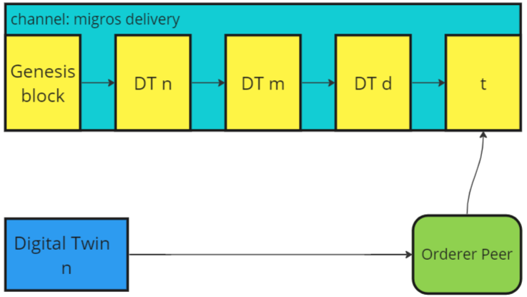
Proposed Solution (6b)
The various Digital Twins can propose new transactions to the Blockchain
These transactions were defined in the business logic section
These transactions are private to the Actors allowed in the channel
The Blockchain replaces the need for a Trusted Third Party
ELCA - The Independent Swiss IT Company

