Slide 1
Blue City

Slide 2
Use case
Droople created a smart tap that cold save millions of liters of water!
Droople sets up devices in each water terminal (sink, bath, shower, toilet …)
Each device is capable of collecting and sharing water consumption data
The aggregate of all data represents the value of water consumed by the household
→ Real Value
The City of Lausanne knows how much water a specific household consumed
Theoretical Value
If (Real Value) is different from (Theoretical Value) → Water leaks!
→ Efficient way to share important data with desired Actors!
ELCA - The Independent Swiss IT Company
‹#›

Slide 3
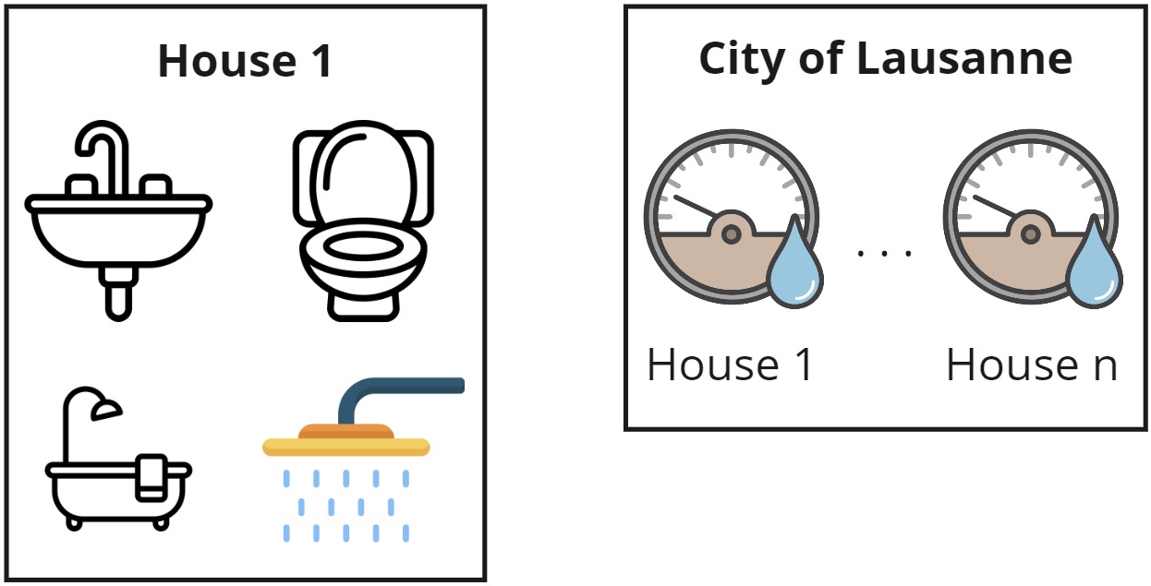
Use case
ELCA - The Independent Swiss IT Company
‹#›

Slide 4
Vocabulary
Assets (smart taps) are controlled by an Organization (Droople)
Assets create/collect data (water consumption) that represent a physical object/process/service
Different organizations (Droople and City of Lausanne) want to securely share data from their assets
ELCA - The Independent Swiss IT Company
‹#›

Slide 5
Requirements
Assets that share data must be authorized (real assets)
Assets should only be “created” by their own organization
Organizations should be able to create as many chat rooms as necessary, and have them be private → via encryption
System should always be available → some applications might require real time data feeds
ELCA - The Independent Swiss IT Company
‹#›

Slide 6
Decentralized approach
Using Smart Contracts to register and verify the identities(SSI) of each asset
Deploying Smart Contracts on Hyperledger Fabric Blockchain and use it as a Verifiable data and status registry(VDSR)
Assets compute shared secrete keys for symmetric encryption via Group Diffie-Hellman protocols
Assets write(read) to(from) a Kafka broker
ELCA - The Independent Swiss IT Company
‹#›

