Slide 1
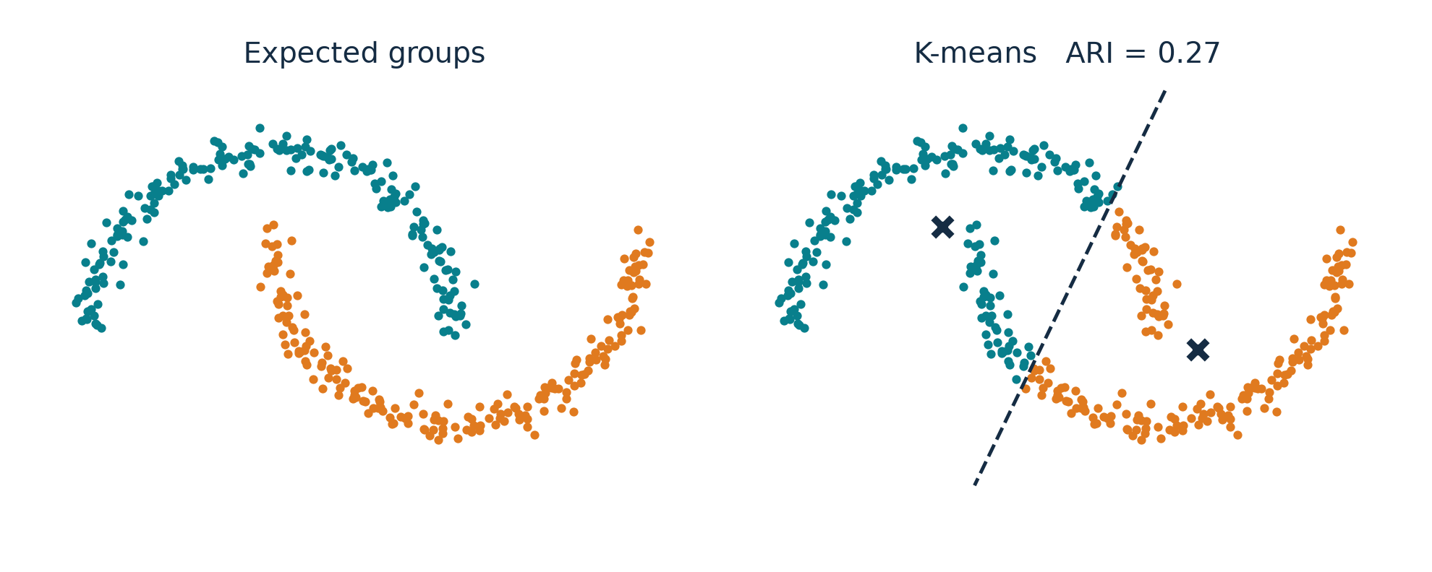
On Spectral Clustering
Analysis and an Algorithm
Andrew Y. Ng, Michael I. Jordan, Yair Weiss
NIPS 2001
Our data: two moons. Left: the groups we want. Right: K-means.
COMP3314 Group Project
Group members: ________________
Notes:
[~10 s] Title. Ng, Jordan and Weiss, NIPS 2001. We start straight from the example on the right.

Slide 2
Why does K-means get this wrong?
1 MOTIVATION
Two moons, 400 points, k = 2. Same data in both panels.
What K-means does
Each point joins the nearest centroid (✕).
Two centroids give one straight boundary (dashed).
Why that fails
The moons interlock. Any straight line cuts through both of them.
K-means ARI = 0.27 (1 = perfect, 0 = chance). These groups follow connectivity, not distance to a centre.
02
Notes:
[45 s] Here are two moons, 400 points we generated. On the left are the groups we would expect. On the right is
K-means with k = 2. K-means puts every point with its nearest centroid - the two crosses - so the boundary between the
two clusters is a straight line, the dashed one. The moons interlock, so any straight line cuts through both.
ARI is 0.27; ARI 1 would mean identical to the expected groups. The problem: these groups are defined by which points
are connected to which, not by distance to a centre.

Slide 3
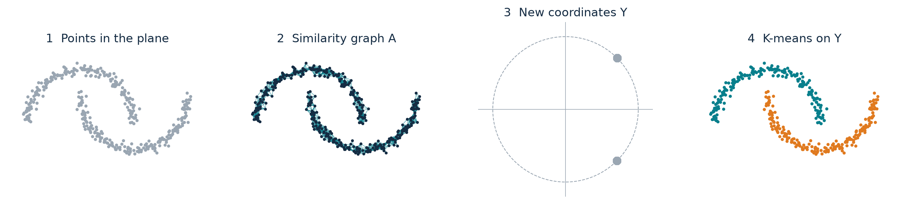
What does the new method change?
2 THE ALGORITHM
It changes the coordinates, not the clustering step.
Points
S: n × 2
›
Affinity
A: n × n
›
Normalize
L: n × n
›
Eigenvectors
X: n × k
›
Unit rows
Y: n × k
›
K-means
labels
Raw points
S: n × 2
Who is close to whom
A: n × n
One row per point
Y: n × k
Same K-means as before
labels
03
Notes:
[25 s] The method keeps K-means as its last step. What it changes is the representation. From the points we build a
similarity graph: who is close to whom. From the graph we compute new coordinates, one row per point. In those
coordinates each moon collapses to almost a single point, and K-means is trivial. The next three slides open up these
steps on a tiny example with six points, so that every number is visible.

Slide 4
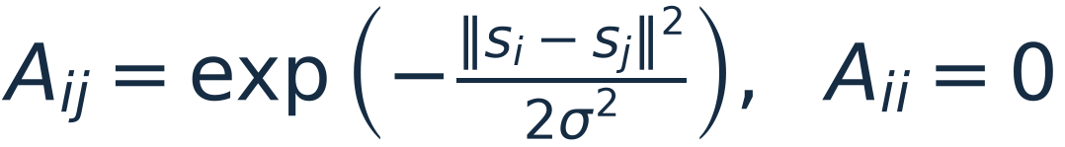
How do points become a matrix?
2 THE ALGORITHM
Every pair of points gets a similarity weight between 0 and 1.
Points
S: n × 2
›
Affinity
A: n × n
›
Normalize
L: n × n
›
Eigenvectors
X: n × k
›
Unit rows
Y: n × k
›
K-means
labels
1
2
3
4
5
6
0.00
Six points, σ = 0.7.
Entry Aᵢⱼ compares point i with point j.
The diagonal is 0: a point is not its own neighbour.
3
6
1
2
0.00
4
2
5
3
0.00
1
0.00
4
5
0.00
6
0.00
A (6 × 6)
04
Notes:
[65 s, two clicks] To see every number, take six points, sigma 0.7. A is a 6 by 6 table: entry i, j says how similar
point i and point j are. The diagonal is zero.

Slide 5
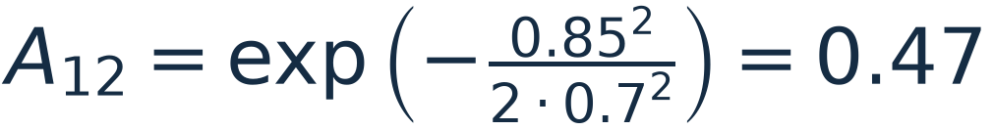
How do points become a matrix?
2 THE ALGORITHM
Every pair of points gets a similarity weight between 0 and 1.
Points
S: n × 2
›
Affinity
A: n × n
›
Normalize
L: n × n
›
Eigenvectors
X: n × k
›
Unit rows
Y: n × k
›
K-means
labels
1
2
3
4
5
6
0.00
0.47
Points 1 and 2 are 0.85 apart, so A₁₂ = 0.47.
A is symmetric: A₂₁ = A₁₂.
3
6
1
2
0.47
0.00
4
2
5
3
0.00
1
0.00
4
5
0.00
6
0.00
A (6 × 6)
04
Notes:
(click) Points 1 and 2 are 0.85 apart. Plug into the Gaussian: exp of minus 0.85 squared over 2 sigma squared gives
0.47. A is symmetric, so the same number goes in row 2, column 1.

Slide 6
How do points become a matrix?
2 THE ALGORITHM
Every pair of points gets a similarity weight between 0 and 1.
Points
S: n × 2
›
Affinity
A: n × n
›
Normalize
L: n × n
›
Eigenvectors
X: n × k
›
Unit rows
Y: n × k
›
K-means
labels
1
2
3
4
5
6
0.00
0.47
0.40
0.00
0.00
0.00
Two blocks: {1, 2, 3} and {4, 5, 6}.
One weak link across: A₂₄ = 0.07.
Line width in the graph = weight.
3
6
1
2
0.47
0.00
0.54
0.07
0.00
0.01
4
2
5
3
0.40
0.54
0.00
0.01
0.00
0.00
1
0.00
0.07
0.01
0.00
0.47
0.60
4
5
0.00
0.00
0.00
0.47
0.00
0.47
6
0.00
0.01
0.00
0.60
0.47
0.00
A (6 × 6)
Rows are numbered by group only so the blocks are easy to see. NJW never uses that order.
04
Notes:
(click) Fill in every pair. Within each group the weights are around 0.4 to 0.6; between the groups they are almost zero,
except one weak link, 0.07 between points 2 and 4. So A has two blocks. That block structure is what the rest of the
algorithm turns into coordinates.

Slide 7
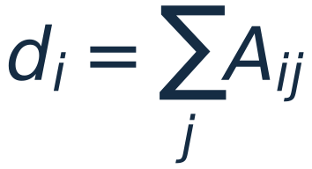
How do we get new coordinates?
2 THE ALGORITHM
A → D → L → X, on the same six points.
Points
S: n × 2
›
Affinity
A: n × n
›
Normalize
L: n × n
›
Eigenvectors
X: n × k
›
Unit rows
Y: n × k
›
K-means
labels
1
2
3
4
5
6
d
1
0.00
0.47
0.40
0.00
0.00
0.00
0.88
2
0.47
0.00
0.54
0.07
0.00
0.01
1.09
dᵢ is the row sum of A: how strongly point i is connected overall.
Point 2 has the largest degree, d₂ = 1.09: it also touches the other group.
D is the diagonal matrix with d on the diagonal.
3
0.40
0.54
0.00
0.01
0.00
0.00
0.95
4
0.00
0.07
0.01
0.00
0.47
0.60
1.16
5
0.00
0.00
0.00
0.47
0.00
0.47
0.95
6
0.00
0.01
0.00
0.60
0.47
0.00
1.08
A (6 × 6)
degrees
05
Notes:
[70 s, two clicks] Step two. The degree d_i is the row sum of A: how connected point i is overall. Point 2 has the
largest degree because it also touches the other group.

Slide 8
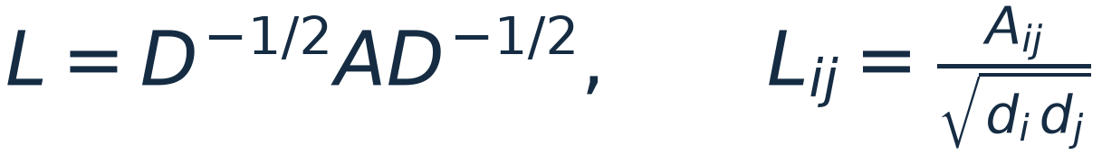
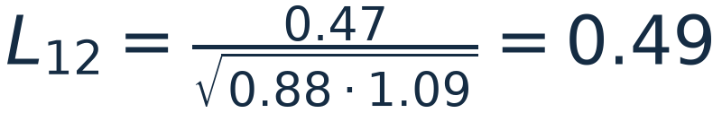
How do we get new coordinates?
2 THE ALGORITHM
A → D → L → X, on the same six points.
Points
S: n × 2
›
Affinity
A: n × n
›
Normalize
L: n × n
›
Eigenvectors
X: n × k
›
Unit rows
Y: n × k
›
K-means
labels
1
2
3
4
5
6
d
1
0.00
0.49
0.44
0.00
0.00
0.00
0.88
2
0.49
0.00
0.53
0.06
0.00
0.01
1.09
3
0.44
0.53
0.00
0.01
0.00
0.00
0.95
4
0.00
0.06
0.01
0.00
0.45
0.54
1.16
Each weight is divided by how connected its two endpoints are.
L is still 6 × 6, symmetric, with the same two blocks.
5
0.00
0.00
0.00
0.45
0.00
0.47
0.95
6
0.00
0.01
0.00
0.54
0.47
0.00
1.08
L (6 × 6)
degrees
05
Notes:
(click) L divides each weight by the square root of the two degrees. For example L12 = 0.47 over the square root of
0.88 times 1.09, which is 0.49. L is still 6 by 6 and keeps the two blocks.

Slide 9
How do we get new coordinates?
2 THE ALGORITHM
A → D → L → X, on the same six points.
Points
S: n × 2
›
Affinity
A: n × n
›
Normalize
L: n × n
›
Eigenvectors
X: n × k
›
Unit rows
Y: n × k
›
K-means
labels
1
2
3
4
5
6
Eigenvalues of L
v₁
v₂
1
0.00
0.49
0.44
0.00
0.00
0.00
1.00
0.94
-0.42
-0.44
-0.51
-0.57
1
0.38
0.41
2
0.49
0.00
0.53
0.06
0.00
0.01
keep the k = 2 largest → their eigenvectors v₁, v₂
2
0.42
0.42
3
0.44
0.53
0.00
0.01
0.00
0.00
Row i of X = new coordinates of point i.
Point 2 → (0.42, 0.42).
v₂ is positive on {1, 2, 3} and negative on {4, 5, 6}: it already separates the groups.
3
0.39
0.42
4
0.00
0.06
0.01
0.00
0.45
0.54
4
0.44
-0.39
5
0.00
0.00
0.00
0.45
0.00
0.47
5
0.39
-0.39
6
0.00
0.01
0.00
0.54
0.47
0.00
6
0.42
-0.41
L (6 × 6)
X (6 × 2)
05
Notes:
(click) Now the eigenvalues of L: 1.00 and 0.94, then a big drop to negative values. We keep the k = 2 largest and put
their eigenvectors side by side: that is X, 6 by 2. Read it by rows: row i is the new coordinate of point i. Point 2 is
now (0.42, 0.42). Look at the second column: positive on the first group, negative on the second. The groups are already
separated, but the rows still have different lengths.

Slide 10
Why normalize the rows?
2 THE ALGORITHM
X → Y. The numbers on the left and the points on the right change together.
Points
S: n × 2
›
Affinity
A: n × n
›
Normalize
L: n × n
›
Eigenvectors
X: n × k
›
Unit rows
Y: n × k
›
K-means
labels
x₁
x₂
‖xᵢ‖
y₁
y₂
0.38
0.41
True coordinates, no rescaling.
Unit circle for reference.
1
2
0.42
0.42
3
2
1
3
0.39
0.42
4
0.44
-0.39
5
0.39
-0.39
4
5
6
6
0.42
-0.41
X
÷
= Y
Rows of X as points: group {1, 2, 3} and group {4, 5, 6} point in two directions, at different lengths.
06
Notes:
[85 s, three clicks] Why the extra normalization? On the left is X; on the right each row of X is drawn as a point,
with the true coordinates. The two groups already point in two different directions, but at different lengths.

Slide 11
Why normalize the rows?
2 THE ALGORITHM
X → Y. The numbers on the left and the points on the right change together.
Points
S: n × 2
›
Affinity
A: n × n
›
Normalize
L: n × n
›
Eigenvectors
X: n × k
›
Unit rows
Y: n × k
›
K-means
labels
x₁
x₂
‖xᵢ‖
y₁
y₂
0.38
0.41
0.56
Dashed: the two directions.
1
2
0.42
0.42
0.60
3
2
1
3
0.39
0.42
0.58
4
0.44
-0.39
0.58
5
0.39
-0.39
0.56
4
5
6
6
0.42
-0.41
0.59
X
÷
= Y
‖xᵢ‖ is the length of row i. It differs inside a group, so it carries no group information.
06
Notes:
(click) Compute the length of each row. The lengths differ inside a group - 0.56 to 0.60 here, and much more on real
data - so the length says nothing about the group. It only adds noise for K-means.

Slide 12
Why normalize the rows?
2 THE ALGORITHM
X → Y. The numbers on the left and the points on the right change together.
Points
S: n × 2
›
Affinity
A: n × n
›
Normalize
L: n × n
›
Eigenvectors
X: n × k
›
Unit rows
Y: n × k
›
K-means
labels
x₁
x₂
‖xᵢ‖
y₁
y₂
0.38
0.41
0.56
0.68
0.74
Points slide along their direction onto the circle.
1
1
3
2
2
0.42
0.42
0.60
0.71
0.70
3
0.39
0.42
0.58
0.68
0.73
0.44
-0.39
0.58
0.74
-0.67
90°
4
5
0.39
-0.39
0.56
0.71
-0.70
6
0.42
-0.41
0.59
0.71
-0.70
4
6
5
X
÷
= Y
yᵢ = xᵢ / ‖xᵢ‖: keep the direction, set the length to 1. Each group collapses to one point, 90° apart.
06
Notes:
(click) Divide each row by its length. The numbers become Y, and every point slides along its direction onto the unit
circle. Each group collapses to one point, and the two points are 90 degrees apart. The next slide explains why 90.

Slide 13
Why normalize the rows?
2 THE ALGORITHM
X → Y. The numbers on the left and the points on the right change together.
Points
S: n × 2
›
Affinity
A: n × n
›
Normalize
L: n × n
›
Eigenvectors
X: n × k
›
Unit rows
Y: n × k
›
K-means
labels
x₁
x₂
‖xᵢ‖
y₁
y₂
0.38
0.41
0.56
0.68
0.74
K-means labels:
teal = {1, 2, 3}
orange = {4, 5, 6}
1
1
3
2
2
0.42
0.42
0.60
0.71
0.70
3
0.39
0.42
0.58
0.68
0.73
0.44
-0.39
0.58
0.74
-0.67
90°
4
5
0.39
-0.39
0.56
0.71
-0.70
6
0.42
-0.41
0.59
0.71
-0.70
4
6
5
X
÷
= Y
K-means on the rows of Y now has an easy job: {1, 2, 3} and {4, 5, 6}.
06
Notes:
(click) K-means on these rows is trivial: two far-apart dots. The labels go back to the six original points.

Slide 14
Why does this recover the clusters?
2 THE ALGORITHM
Start from a disconnected graph, then add links across the groups.
1
2
3
4
5
6
0.00
0.47
0.40
0.00
0.00
0.00
λ₁ = 1.00
λ₂ = 1.00
λ₃ = -0.44
gap λ₂ − λ₃ = 1.44
Dashed: the ideal directions.
Colour = group.
1
1
2
3
2
0.47
0.00
0.54
0.00
0.00
0.00
3
0.40
0.54
0.00
0.00
0.00
0.00
4
0.00
0.00
0.00
0.00
0.47
0.60
5
0.00
0.00
0.00
0.47
0.00
0.47
6
0.00
0.00
0.00
0.60
0.47
0.00
4
5
6
A
Ideal: no links across groups. L is block diagonal, λ₁ = λ₂ = 1, and Y is exactly two orthogonal points.
Theorem 2 (paper): if the gap is large compared with the links across groups, Y stays close to k orthogonal points.
07
Notes:
[50 s, two clicks] Why does this work? Start from the ideal case: delete every link between the groups. Then L is block
diagonal, the top two eigenvalues are both exactly 1, and each group lands on exactly one point - two orthogonal points.

Slide 15
Why does this recover the clusters?
2 THE ALGORITHM
Start from a disconnected graph, then add links across the groups.
1
2
3
4
5
6
0.00
0.47
0.40
0.00
0.00
0.00
λ₁ = 1.00
λ₂ = 0.94
λ₃ = -0.42
gap λ₂ − λ₃ = 1.37
Dashed: the ideal directions.
Colour = group.
1
1
3
2
2
0.47
0.00
0.54
0.07
0.00
0.01
3
0.40
0.54
0.00
0.01
0.00
0.00
4
0.00
0.07
0.01
0.00
0.47
0.60
5
0.00
0.00
0.00
0.47
0.00
0.47
6
0.00
0.01
0.00
0.60
0.47
0.00
4
6
5
A
Our actual weak link (A₂₄ = 0.07): λ₂ drops to 0.94. Y barely moves.
Theorem 2 (paper): if the gap is large compared with the links across groups, Y stays close to k orthogonal points.
07
Notes:
(click) Now our actual data, with the weak link of 0.07. Lambda 2 drops slightly to 0.94, and Y barely moves.

Slide 16
Why does this recover the clusters?
2 THE ALGORITHM
Start from a disconnected graph, then add links across the groups.
1
2
3
4
5
6
0.00
0.47
0.40
0.02
0.00
0.00
λ₁ = 1.00
λ₂ = 0.65
λ₃ = -0.18
gap λ₂ − λ₃ = 0.83
Dashed: the ideal directions.
Colour = group.
1
1
3
2
0.47
0.00
0.54
0.70
0.03
0.07
2
3
0.40
0.54
0.00
0.09
0.00
0.01
4
0.02
0.70
0.09
0.00
0.47
0.60
5
0.00
0.03
0.00
0.47
0.00
0.47
0.00
0.07
0.01
0.60
0.47
0.00
4
6
6
A
5
Links ×10 (A₂₄ = 0.70, as strong as inside a group): λ₂ = 0.65. Points 2 and 4 are pulled toward each other.
Theorem 2 (paper): if the gap is large compared with the links across groups, Y stays close to k orthogonal points.
07
Notes:
(click) Make the cross links ten times stronger - as strong as the links inside a group. Lambda 2 falls, the gap
shrinks, and points 2 and 4, which carry the link, are pulled toward each other. This is the paper's Theorem 2 in a
picture: small links and a large gap keep Y near the ideal; large links push it away. This is also why sigma matters.

Slide 17
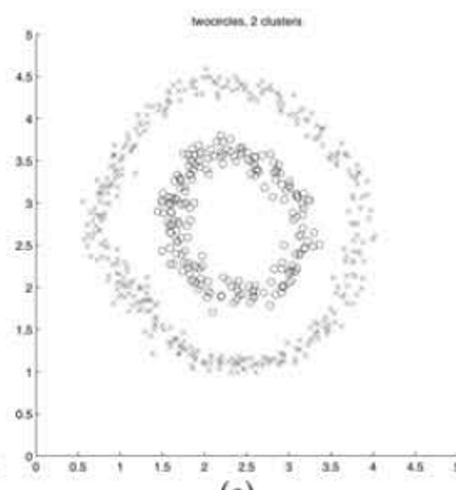
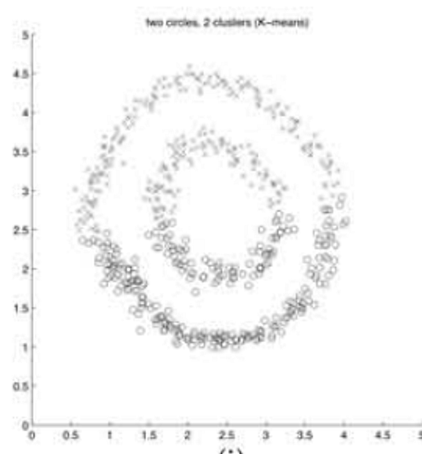
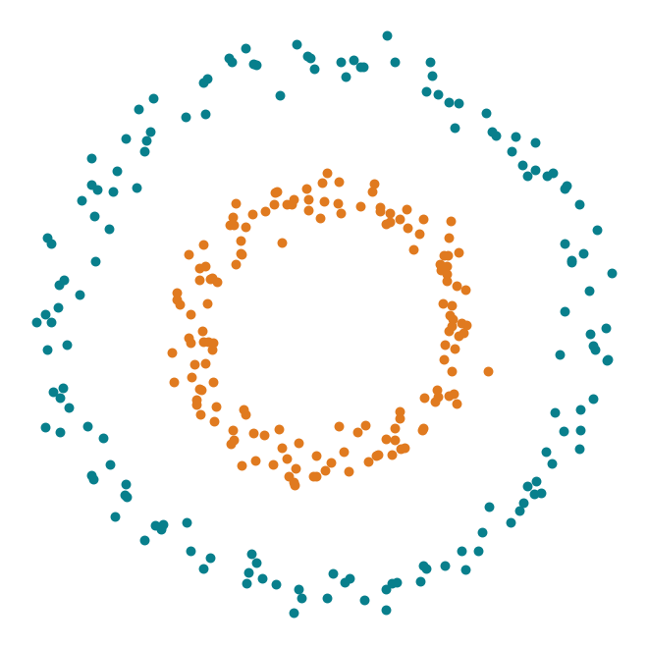
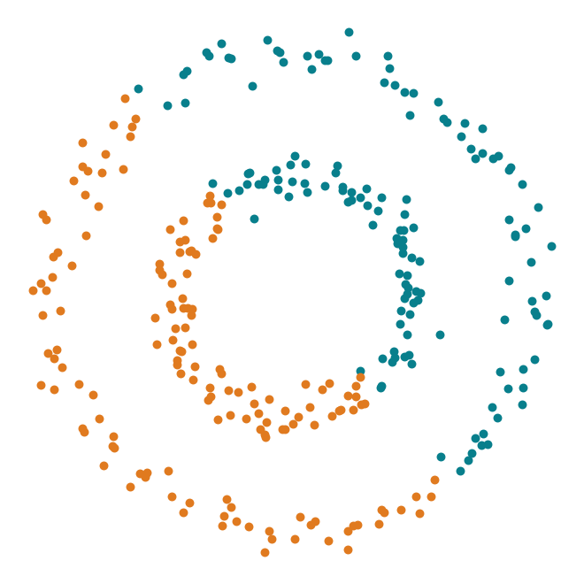
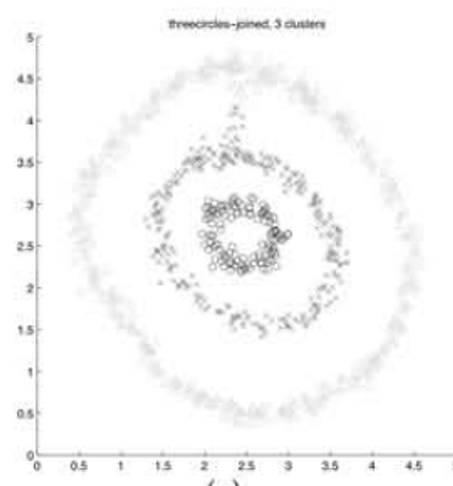
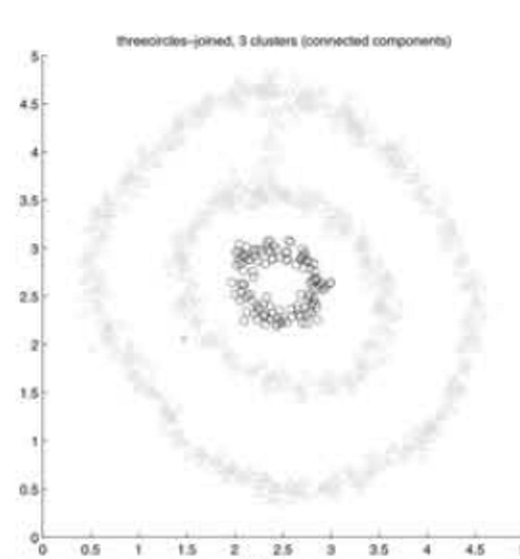
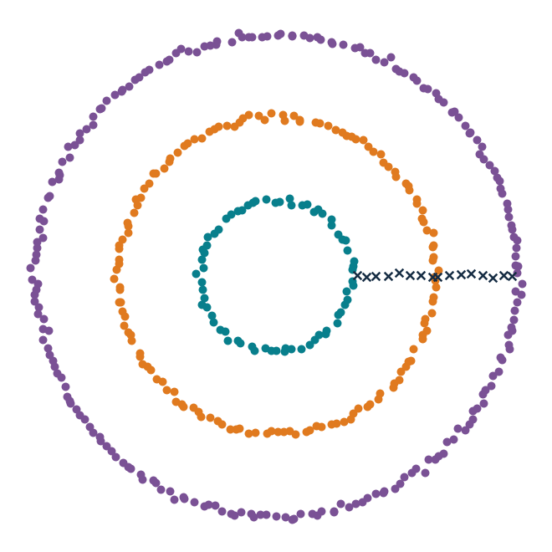
Did we see the same effect?
3 OUR REPRODUCTION
Original paper (pictures only) next to our implementation on data we rebuilt.
Original paper, Figure 1
Our reproduction (ARI)
All our numbers
K-means → NJW
Circles 0.00 → 1.00
Moons 0.27 → 1.00
Blobs 1.00 → 1.00
Figure 1 settings: NJW 1.00 on 6 of 6.
The paper reports no metric and released no data.
Two circles
k = 2
NJW
K-means
NJW 1.00
K-means 0.00
Joined rings
k = 3
Three rings recovered. K-means still fails on this shape.
NJW
Components
NJW 1.00
08
Notes:
[65 s] Did we see the same thing? Left, the paper's Figure 1; right, our own implementation on data we rebuilt - the
paper released neither the points nor sigma, so this is a qualitative comparison, and the ARI numbers are ours.
Top row, two circles: the paper shows NJW succeeding and K-means failing; we get exactly that, 1.00 against 0.00.
Bottom row, three rings joined by short bridges: NJW recovers the three rings here too. One sentence, then move on.
Across everything we ran: NJW beats K-means on circles and moons, ties on blobs, and gets 1.00 on the rebuilt
Figure 1 settings.

Slide 18
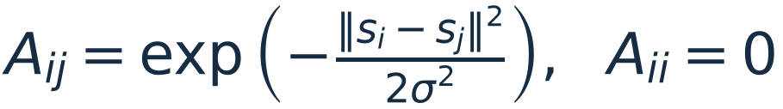
One σ, and how the paper chooses it
4 CRITICAL ANALYSIS
Same moons. The dashed curve is the two circles.
σ = 1 σ₀ ARI = 1.00
σ = 2.8 σ₀ ARI = 0.81
How the paper chooses σ
Try several values of σ.
For each, run K-means on the rows of Y.
Keep the σ with the smallest distortion.
Distortion is the sum of squared distances from each row of Y to its centre. True labels are not used.
On our grid that minimum sits where ARI = 1: distortion is about 0. Where ARI collapses, distortion rises to about 30.
The rule returns one winner. It does not say that 2σ₀ already fails on the circles.
ARI moons (solid), circles (dashed)
1
0.25
1
2
4
8
σ / σ₀
09
Notes:
[75 s] Sigma sets the scale of every link. The formula is on the right: Aij is exp of minus the squared distance over
2 sigma squared. The diagonal is 0. A small sigma only connects nearby points. A large sigma also connects points that
are far apart. The whole graph gets one sigma.
On the left, the moons at our default sigma: ARI 1.00. At 2.8 times that sigma, ARI is 0.81. The dashed curve is the
two circles. At 2 sigma-zero it drops to 0, and the cut looks like ordinary K-means.
The paper chooses sigma by trying several values. For each one it runs K-means on the rows of Y and keeps the sigma
with the smallest distortion. Distortion is the sum of squared distances from those rows to their centres. True labels
are not used.
On this grid, distortion is about 0 while ARI is 1, and it rises to about 30 when ARI collapses. So the rule lands in
the successful range. It returns one winner. It does not tell you that doubling sigma already fails on the circles.

Slide 19
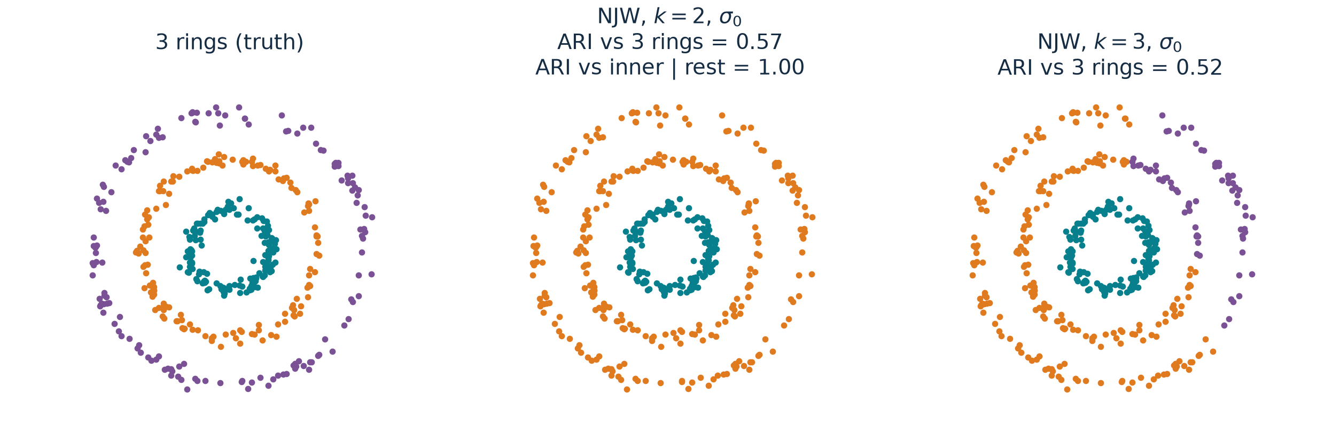
k is given by hand
4 CRITICAL ANALYSIS
Three rings we generated. Every panel uses the same default σ₀.
k = 2 is a different question: ARI 1.00 against inner vs rest, 0.57 against three rings.
The true k = 3 still scores 0.52 at σ₀. Same k, at 0.7σ₀, ARI rises to 0.90.
10
Notes:
[60 s] The algorithm does not decide how many groups there are. We tell it k.
Left: three rings, the groups we want.
Middle: we ask for k = 2. It does not scatter the points at random. The inner ring is one group, and the middle and
outer rings are merged. Against that merge, ARI is 1.00. Against the three rings, ARI is
0.57. So k = 2 is the right answer to a different question.
Right: we ask for k = 3, the true number. At our default sigma, ARI is still only 0.52. The inner
ring comes out, and the outer two are mixed.
One more number, and then stop. Same k = 3: shrink sigma to 0.7 times the default, and ARI rises to
0.90. The right count is not enough. The scale has to fit as well.

Slide 20
Where this method fits
5 SUMMARY
One scale, and k chosen by hand: that is what the last two slides marked out.
Where it fits
Clusters are connected by local neighbours, but not cut by a straight line.
One length scale, and k is known.
Separated round clouds: K-means is already enough.
Very different scales, or the wrong question for k: the last two slides.
What the 2001 paper fixed
Spectral clustering already existed. People used the eigenvectors differently.
This paper fixed one recipe: affinity graph, top-k eigenvectors, normalize each row, then K-means.
A whole connected piece becomes one point. That is the step K-means could not do.
On our moons: K-means 0.27 → NJW 1.00. The recipe is what made the paper last.
11
Notes:
[50 s] Where does this method fit? When groups are connected through local neighbours, but a straight line cannot
separate them: the rings and the moons. The graph needs one length scale, and k has to be known. When the clusters are
already separated round clouds, K-means is enough. When the scales differ, or k is asking a different question, that
is the previous two slides.
The paper matters because of the recipe. In 2001, spectral clustering was already around, but authors turned
eigenvectors into clusters in different ways. Ng, Jordan and Weiss fixed one sequence that people then actually used:
an affinity graph, the top k eigenvectors, each row normalized, then K-means. Normalization is the step that makes a
whole connected piece into one point, which is what K-means can cut. On our moons that takes ARI from
0.27 to 1.00.

Slide 21
Backup · Theorem 2 on our runs
BACKUP
True clusters used only as the blocks in the proof.
Dataset | gap δ | needs > (2+√2)ε | Condition | NJW ARI | Bound vs observed
circles | 0.0053 | 0.1818 | fails | 1.00 | -
moons | 0.0036 | 0.0144 | fails | 1.00 | -
blobs | 0.0879 | 2.5e-05 | holds | 1.00 | 1.5e-04 vs 3.6e-14
Thin shapes (rings, moons) mix slowly inside a cluster, so their own λ₂ is close to 1 and the gap is tiny.
Where the condition holds (blobs), the bound is about ten orders of magnitude loose.
B

Slide 22
Backup · Connections to the course
BACKUP
Concept | Connection | Distinction
K-means | Same final step, run on rows of Y | The embedding changes the geometry
PCA | Both keep top eigenvectors | PCA: covariance of features. NJW: graph over samples
Kernels / similarity | Gaussian pairwise weight | Aᵢᵢ = 0, so A need not be a PSD Gram matrix
Normalization | Degree normalization of A | Row normalization of X is a different step
B

Slide 23
Backup · Questions we prepared
BACKUP
Question | Short answer
Why run K-means again? | On Y the clusters are tight and orthogonal, so its job is easy.
Why keep the first eigenvector? | NJW uses the whole top-k subspace; dropping one loses a direction.
What if the eigenvectors rotate? | Rotations keep lengths and angles; Y is rotated, clusters stay.
Does a large eigengap prove correctness? | It supports subspace stability under A1–A4, not any particular labelling.
How do you choose σ and k? | σ: label-free rule or the paper's distortion search. k: given; see our three-ring test.
What exactly did you reproduce? | Our code, our data, Figure-1-like settings. Not the paper's points.
B

Slide 24
Backup · Baselines on the Figure 1 settings
BACKUP
ARI. Kernel methods share the distortion-chosen σ. Components search their own threshold.
Setting | NJW | Meila–Shi | Kannan-style* | Components | K-means
twocircles, k=2 | 1.00 | 1.00 | 1.00 | 1.00 | 0.00
lineandballs, k=3 | 1.00 | 1.00 | 1.00 | 1.00 | 0.68
fourclouds, k=2 | 1.00 | 1.00 | 1.00 | 1.00 | 1.00
squiggles, k=4 | 1.00 | 1.00 | 0.71 | 1.00 | 0.33
nips, k=8 | 1.00 | 1.00 | 0.76 | 1.00 | 0.64
threecircles_joined, k=3 | 1.00 | 1.00 | 0.33 | 0.00 | 0.00
threecircles_joined, k=2 | 0.79 | 0.79 | 0.04 | 0.00 | 0.00
* Our reading of one sentence in the paper (largest absolute eigenvector coordinate), not Kannan et al.'s code. Joined rings: NJW ARI here scores the ring points only.
B

Slide 25
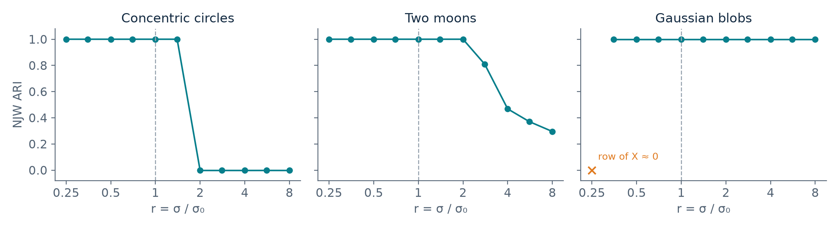
Backup · σ sensitivity on all three datasets
BACKUP
Same data and k as Part 3. Dashed line: our default σ₀. Labels did not choose σ₀.
Blobs: at r = 0.25 a point's row of X is numerically zero, so row normalization is undefined.
Moons: 1.00 up to r = 2, then 0.81, 0.47, 0.37, 0.30.
Row normalization off (350 vs 50-point blobs, same σ and k): ARI 1.00 → 0.96.
B

Slide 26
Backup · References and attribution
BACKUP
Primary paper
A. Y. Ng, M. I. Jordan, Y. Weiss. On Spectral Clustering: Analysis and an Algorithm. NIPS 14, 2001, pp. 849–856.
Figures
Slide 1 crops Figure 1 of the paper. Every other figure is our points, our code and our measurements.
Code
NJW implemented by us (src/njw_spectral). Libraries: SciPy eigh, scikit-learn KMeans and ARI, Matplotlib. sklearn SpectralClustering is not used.
B

