Slide 1
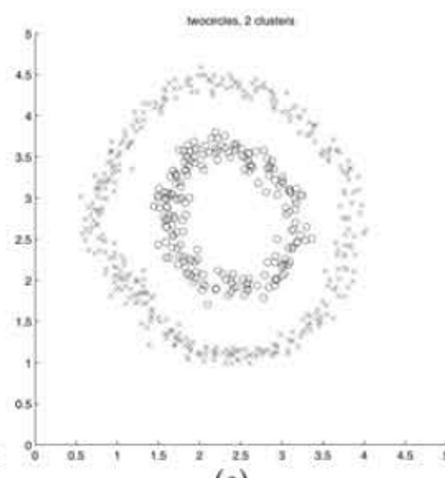
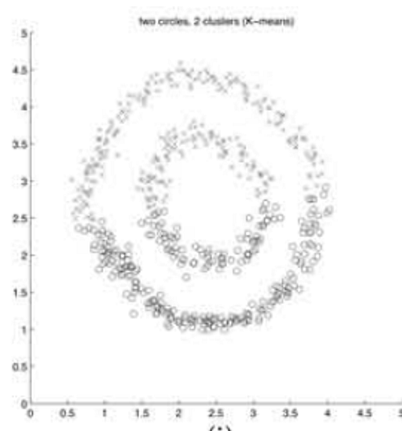
On Spectral Clustering
Analysis and an Algorithm
Andrew Y. Ng, Michael I. Jordan, Yair Weiss
NIPS 2001 COMP3314 Group Project
Clustering concentric circles
K-means partitions space around centroids.
The intended clusters can follow a different geometry.
NJW
Direct K-means
Original paper results: Figure 1(e) and 1(i)
01
Notes:
建议用时 45 秒
中文讲解
开场用原文同心圆图解释动机。左图是作者方法，右图是直接 K-means。强调这些是原文结果，不是我们的实验。介绍研究问题：利用相似关系构造表示，是否能让原本难聚类的数据变得容易？组号和姓名确定后可替换课程行。
English speaking draft
We study the spectral clustering algorithm proposed by Ng, Jordan and Weiss. These two figures come from the original paper. Direct K-means divides the circles in a way that does not match the intended inner and outer groups. The spectral method first changes the representation, then applies K-means. We focus on why that representation works and what conditions it needs.
Sources
Ng, Jordan & Weiss (NIPS 2001). Section 2 and Figure 1(e,i).
https://proceedings.neurips.cc/paper_files/paper/2001/file/801272ee79cfde7fa5960571fee36b9b-Paper.pdf

Slide 2
Problem and contributions
Given n points and a specified k, assign each point to one of k clusters
A particular algorithm
Empirical evidence
Use k eigenvectors together, normalize each embedded point, then cluster.
Show qualitative results on challenging clustering examples.
An explanation of its behavior
Connections to the course
Analyze ideal separation and perturbations of that ideal structure.
K-means and distance-based similarity
Eigenvectors and representation learning
PCA as a useful comparison
Earlier spectral methods already existed. The contribution is this construction and its analysis.
02
Notes:
建议用时 60 秒
中文讲解
准确说贡献，不能说作者发明了整个 spectral clustering。论文在已有工作基础上指定一种同时使用 k 个特征向量的算法，并用矩阵扰动理论给出条件。课程联系讲 K-means、相似度和特征分解；PCA只是比较，不要说两者优化同一目标。
English speaking draft
The task is unsupervised clustering with a known number of groups. Spectral clustering already existed before this paper. The authors contribute a specific algorithm using several eigenvectors together, an analysis of its behavior, and experimental examples. This connects to K-means because the final clustering step remains familiar. It also connects to eigenvector methods such as PCA, although the matrix and objective differ.
Sources
Ng, Jordan & Weiss (NIPS 2001). Abstract, Sections 1, 2 and 5.
https://proceedings.neurips.cc/paper_files/paper/2001/file/801272ee79cfde7fa5960571fee36b9b-Paper.pdf

Slide 3
The NJW algorithm
Each sample receives a new k-dimensional coordinate
1 Similarity
3 Spectral coordinates
Aᵢⱼ = exp(−‖sᵢ − sⱼ‖² / (2σ²))
Aᵢᵢ = 0
X = [v₁ … vₖ] ∈ ℝⁿˣᵏ
Largest k eigenvalues of L
2 Degree normalization
4 Normalize and cluster
dᵢ = Σⱼ Aᵢⱼ
L = D⁻½ A D⁻½
yᵢ = xᵢ / ‖xᵢ‖₂
Run K-means on the rows of Y
The paper uses L. The normalized Laplacian I − L has the same eigenvectors, with reversed eigenvalue order.
03
Notes:
建议用时 90 秒
中文讲解
用输入到输出顺序解释。s是原始样本，x_i是X的一行。A和L是n×n，X和Y是n×k。degree归一化改变相似度算子，行归一化改变嵌入坐标长度，是两件事。取最大的代数特征值，不按绝对值排序；保留第一特征向量。公式中的D对角为正。
English speaking draft
First, a Gaussian affinity converts distances into pairwise similarities. The diagonal is zero. Next, the degree matrix normalizes the affinity. We take the eigenvectors corresponding to the largest k eigenvalues of this symmetric matrix. Stacking them as columns gives one row per sample. Finally, we normalize each row to unit length and run K-means. The two normalizations act at different stages. The paper uses L, while many textbooks use the normalized Laplacian I minus L.
Sources
Ng, Jordan & Weiss (NIPS 2001). Section 2 and footnote 1.
https://proceedings.neurips.cc/paper_files/paper/2001/file/801272ee79cfde7fa5960571fee36b9b-Paper.pdf

Slide 4
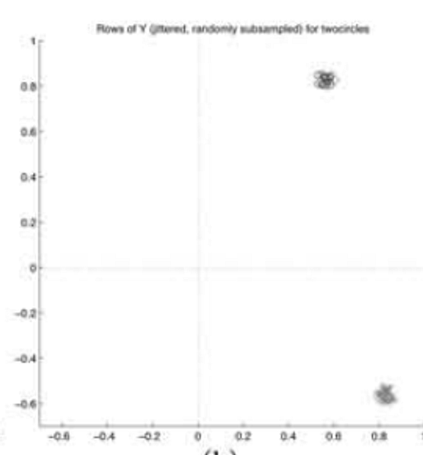
Why row normalization works
Ideal case: no links across clusters, connected clusters and positive degrees
For a point i in cluster c
xᵢ = αᵢ r(c) with αᵢ > 0
yᵢ = xᵢ / ‖xᵢ‖₂ = r(c)
Lengths can vary within a cluster.
Normalization keeps its shared direction.
Original Y embedding
Figure 1(h), with jitter
The k cluster directions are orthogonal. A rotation of the eigenvector basis preserves this geometry.
04
Notes:
建议用时 90 秒
中文讲解
本页是重点。先假设类间连接为零，类内连通且degree正。每一簇在特征子空间对应一个方向，点的长度与degree有关。r_c是正交旋转矩阵的一行，单位长度。同簇的alpha可不同，归一化后全部变为r_c。实际求解器可能旋转特征向量基，不能把某一列固定解释成某个簇。右图来自原文实际同心圆的Y，并非这个理想命题的精确数值例子，原图加了jitter。
English speaking draft
In the ideal case, the affinity has separate connected blocks. A point in cluster c has an embedded row equal to a positive scale times a cluster direction. Degrees can change the scale across points. Row normalization removes that scale, so every point in the same cluster becomes the same unit vector. Different clusters have orthogonal directions. The basis can rotate, but pairwise geometry stays the same. The original embedding on the right illustrates tight groups in practice.
Sources
Ng, Jordan & Weiss (NIPS 2001). Section 3.1, Proposition 1, Figure 1(h).
https://proceedings.neurips.cc/paper_files/paper/2001/file/801272ee79cfde7fa5960571fee36b9b-Paper.pdf

Slide 5
Beyond perfect separation
The analysis treats cross-cluster connections as a perturbation
Ideal structure
Conditions behind the guarantee
λ₁ = … = λₖ = 1
δ = λₖ − λₖ₊₁
Internally coherent clusters
Weak connections across clusters
No extremely weak-degree points
The top-k subspace is separated
from the remaining directions.
Perturbation must be small relative
to the spectral separation.
An eigengap alone does not guarantee agreement with any chosen semantic labels.
05
Notes:
建议用时 60 秒
中文讲解
这是原文一般情况的简化直觉，不是完整定理。A1约束类内第二特征值，A2/A3约束类间连接，A4控制极弱degree点。gap相对于扰动大小有意义，不能说gap大就永远聚对。定理控制归一化嵌入围绕正交方向的偏离，后续聚类还依赖其分离与聚类过程。
English speaking draft
Real data has cross-cluster links. The paper asks whether adding these links substantially changes the spectral representation. A gap separates the desired top-k subspace from the remaining directions. Stability depends on the perturbation relative to that separation, together with connectivity and degree conditions. This is a conditional explanation. A visually large eigengap alone does not prove that the clusters match a particular set of semantic labels.
Sources
Ng, Jordan & Weiss (NIPS 2001). Section 3.2, Assumptions A1–A4 and Theorem 2.
https://proceedings.neurips.cc/paper_files/paper/2001/file/801272ee79cfde7fa5960571fee36b9b-Paper.pdf

Slide 6
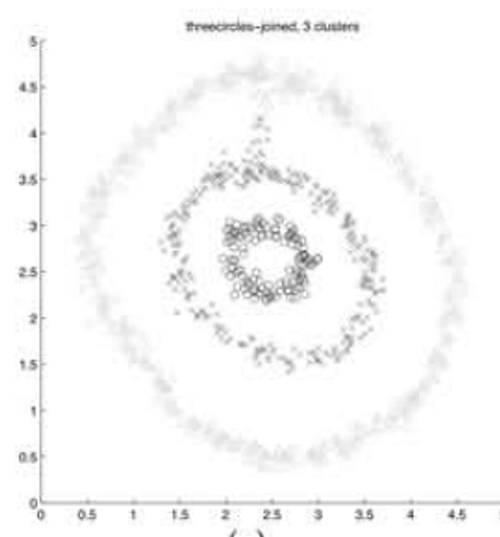
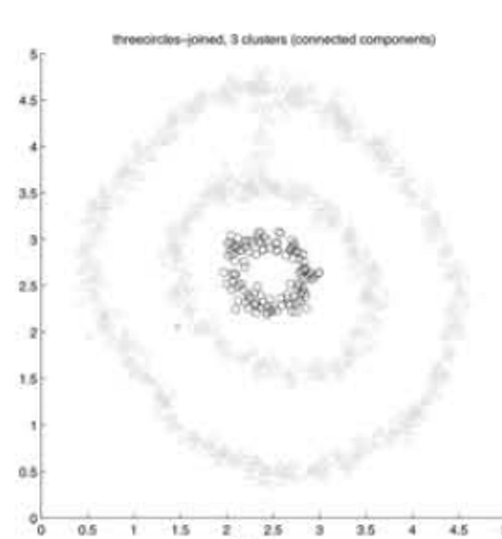
Evidence in the original paper
Seven clustering problems, with selected comparisons in Figure 1
What this example supports
Weighted affinities can avoid a poor
threshold-based partition on this example.
What remains uncertain
The paper does not sweep noise, scale, or seeds.
Those checks, on data we generated, follow.
NJW, k = 3
Connected components
Scale selection: search σ² for low distortion in Y. Original results: Figure 1(g,j), Section 4.
06
Notes:
建议用时 45 秒。这一页仍然只讲原文 Figure 1(g,j)：连通分量切出一个单点簇，加权亲和在这个例子上更合理。不要把这一对图说成全面评测。最后一句把话交给我们自己的实验：原文没有扫噪声、尺度和种子，后面几页是我们在自建数据上做的。
English speaking draft
On the joined rings, the paper's weighted method avoids the singleton produced by a threshold graph. That is one example, and the paper does not vary scale, noise, or seeds. The following slides are our measurements on data we generated.
Sources
Ng, Jordan & Weiss (NIPS 2001), Section 4, Figure 1(g,j).

Slide 7
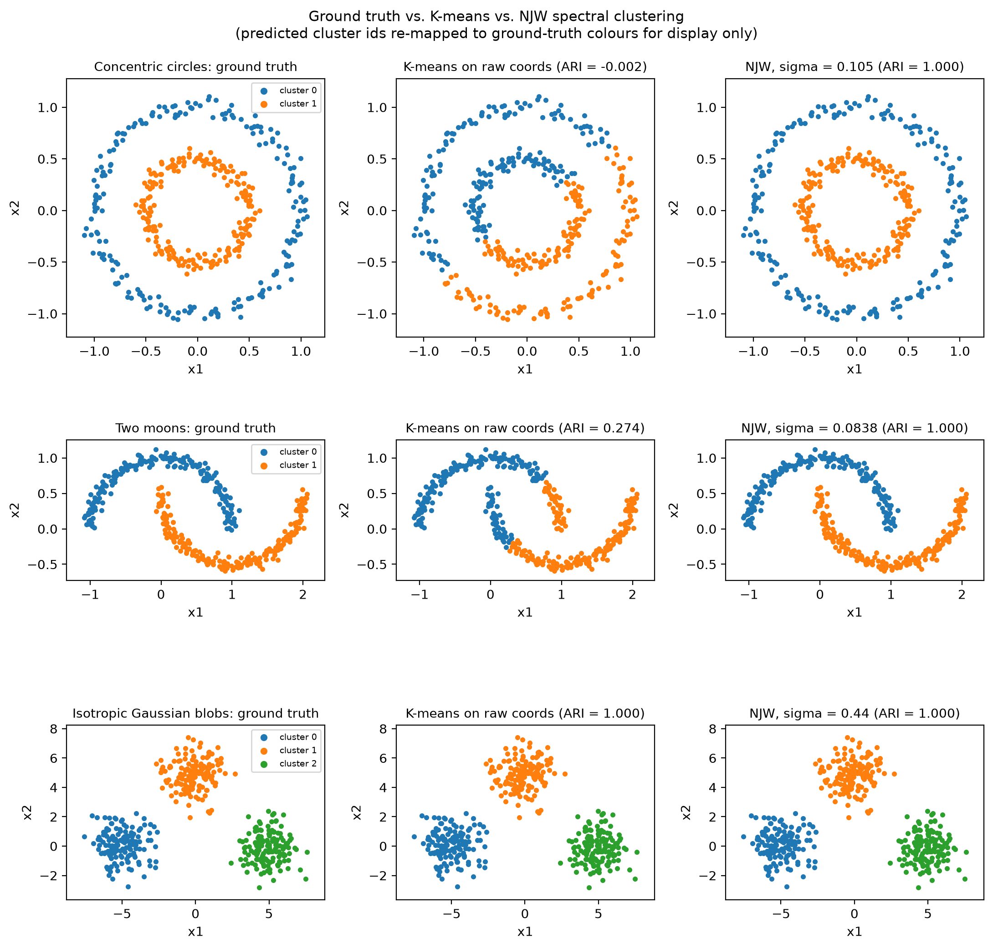
Curved clusters, on our data
Our points, one seed. Labels set k and ARI. They do not choose σ.
Concentric circles
NJW 1.000
K-means −0.002
σ = 0.105 gap 0.005
Two moons
NJW 1.000
K-means 0.274
σ = 0.084 gap 0.004
Gaussian blobs
NJW 1.000
K-means 1.000
σ = 0.440 gap 0.088
07
Notes:
建议用时 50 秒。这是我们的图，不是原文 Figure 1。三个数据都是 sklearn 生成器、data seed 0。σ 用第 7 近邻距离的中位数，没有用标签去调。K-means 和 NJW 看同一组原始坐标、同一个 k。圆环和双月上，直接 K-means 按直线切开，ARI 分别约 0 和 0.27；NJW 都是 1。三个分开的高斯团两种方法都是 1，这时谱方法没有额外优势，eigengap 也大得多（0.088 对圆环的 0.005）。图里预测颜色用匈牙利算法对齐到真值，只为了好看，ARI 不受影响。
九分钟剪辑：第 1–9 页加上 Critical analysis（第 15 页）。σ 的机制图、错误 k、噪声桥、定理 2、Figure 1 重建放在第 10–14 页和第 16 页，被问到再翻。
English speaking draft
These are our points. Direct K-means misses the two rings and only partly recovers the moons. Our NJW implementation recovers both, with ARI 1. On well-separated blobs both methods are perfect, and the eigengap is much larger. Sigma is a label-free neighbour heuristic. We did not use the paper's points.
Sources
results/figures/stage1_comparison.png, results/tables/stage1_results.csv.

Slide 8
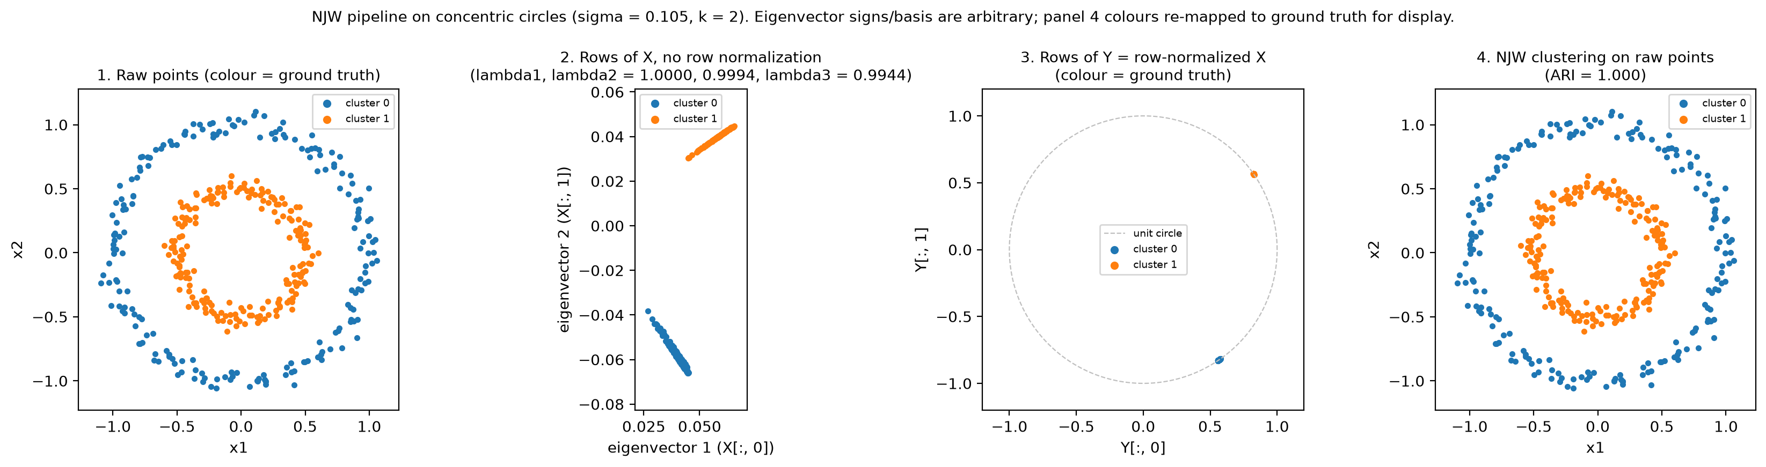
The rows of Y, on our circles
Same run as the circles panel. Eigenvector signs are arbitrary.
Raw points
Two rings. K-means on these coordinates cuts across them.
Before row scaling
Each cluster is a ray. Lengths differ inside the cluster.
After yᵢ = xᵢ / ‖xᵢ‖
Both clusters sit on the unit circle, apart. ARI = 1.
08
Notes:
建议用时 40 秒。这张图对上第 4 页的理想情形，但是我们自己的同心圆。第二格：X 的每一行还带着长度，同一簇可以长短不一。第三格：除以行范数以后，两簇收到单位圆上两个分开的位置。求解器可以翻转特征向量的符号，所以射线指向哪一边不重要。颜色再次只是显示用的对齐。
English speaking draft
This is our pipeline on the circles. Before row normalization, points in a cluster share a direction but not a length. Dividing by the row norm places each cluster at one point on the unit circle. K-means on those rows recovers the rings. The sign of an eigenvector is arbitrary.
Sources
results/figures/stage1_circles_pipeline.png. Proposition 1, Section 3.1.

Slide 9
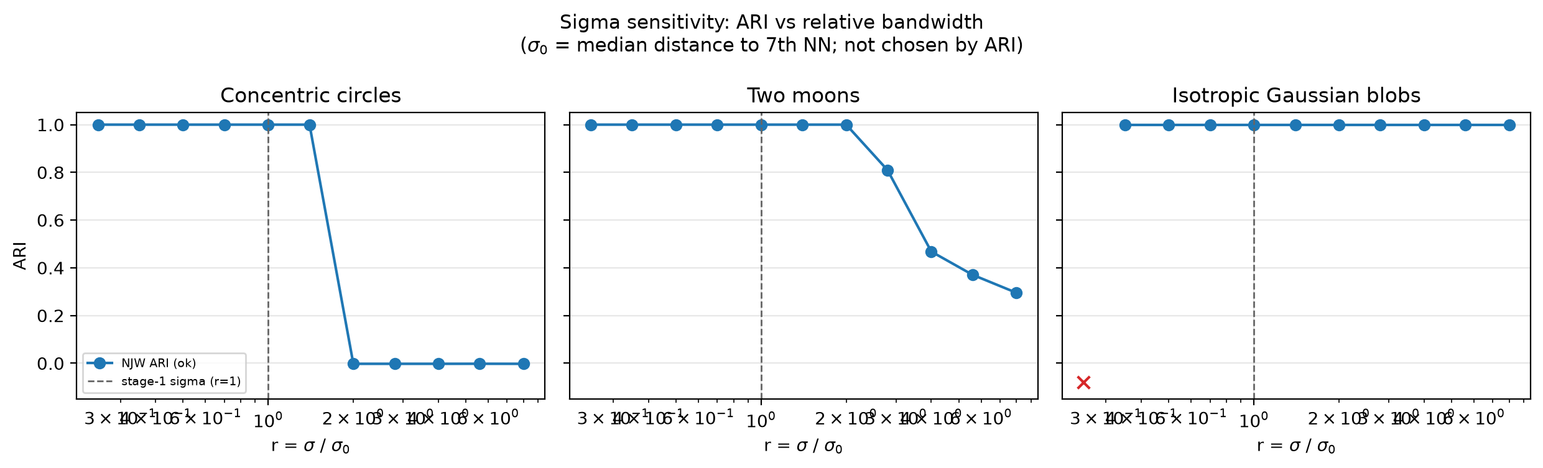
Moving σ, with the data fixed
r = σ / σ₀. The dashed line is the stage-1 choice, r = 1. ARI did not choose it.
Circles
ARI = 1 through r = 1.4. From r = 2 the score falls to about 0.
Moons
Still perfect at r = 2, then 0.81, 0.47, 0.37, 0.30.
Blobs
ARI = 1 from r = 0.35. At r = 0.25 a row norm vanishes.
09
Notes:
建议用时 45 秒。网格是事先定的：r 从 0.25 到 8。竖线是第一阶段的 σ，不是事后挑出来的。圆环对过大的 σ 是断崖：r≤1.4 完美，r≥2 就和直接 K-means 一样被直线切开。我们的默认值落在成功区，但下一个网格点已经失败。双月是慢慢变差。高斯团几乎一直成功；σ 太小会让图碎掉，某行范数变成 0，算法直接报错，所以不能只看 ARI 曲线。在这个网格上，Y 的 K-means distortion 最小的地方也是 ARI 高的地方，和原文用 distortion 选 σ 的方向一致。但很小的 σ 上 eigengap 也接近 0，distortion 小不等于理论条件舒服。
English speaking draft
With the points held fixed, circles have a cliff: perfect through 1.4 times our default sigma, and about zero from twice that. Moons degrade smoothly. Blobs fail numerically when sigma is too small, before ARI can be scored. On this grid, the sigma with the smallest distortion of Y also has high ARI.
Sources
results/figures/sigma_sensitivity_ari.png, docs/sigma_sensitivity_zh.md.

Slide 10
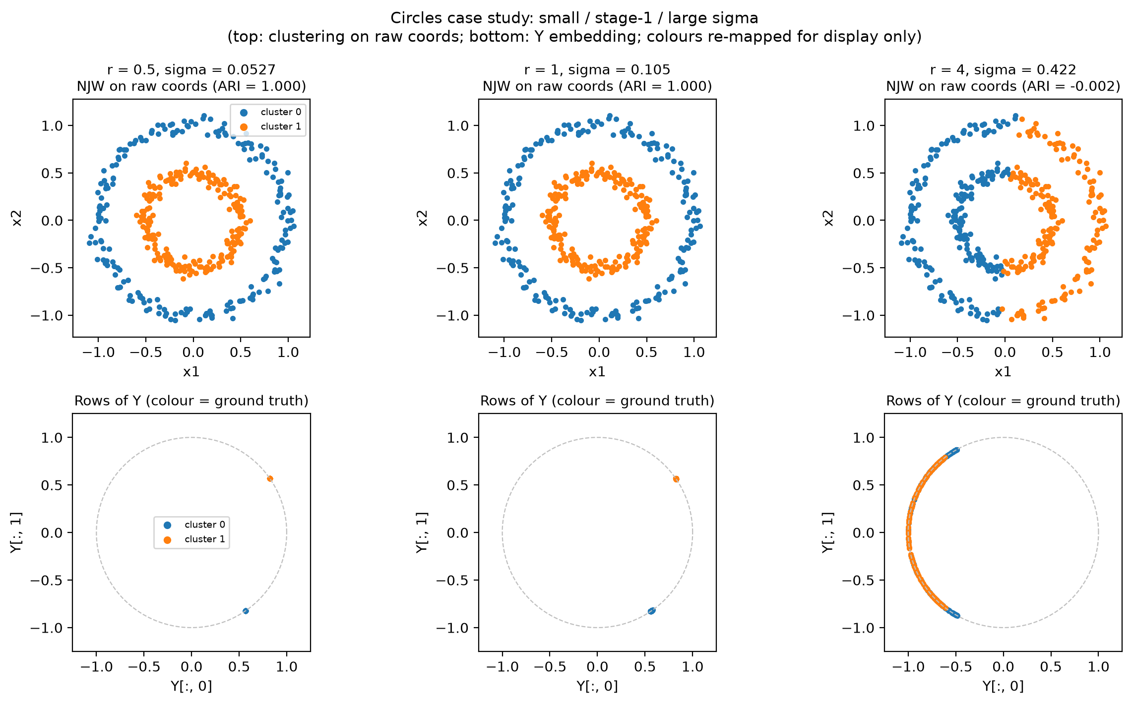
Why a large σ fails
Circles. Top: clusters in the plane. Bottom: rows of Y, coloured by the true ring.
r = 0.5 and r = 1
Y collapses to two points on the unit circle. ARI = 1.
r = 4
The two rings mix along an arc. K-means can only cut left from right. ARI ≈ 0.
Reading
Too large a scale rebuilds the geometry K-means already gets wrong.
10
Notes:
建议用时 40 秒。左图是圆环的三个尺度。成功时，Y 上两簇几乎是单位圆上的两个点。r=4 时，两个真值颜色在 Y 里缠成一段弧，K-means 只能左右切开，ARI 回到大约 0，和直接在原坐标上做 K-means 同一个错误。所以 σ 不是一个不影响结论的平滑参数。
English speaking draft
At the default scale, and at half of it, row normalization piles each ring on a single point of the unit circle. At four times the default, the rows form mixed arcs, and K-means slices them the same way it slices the original plane.
Sources
results/figures/sigma_sensitivity_cases.png.

Slide 11
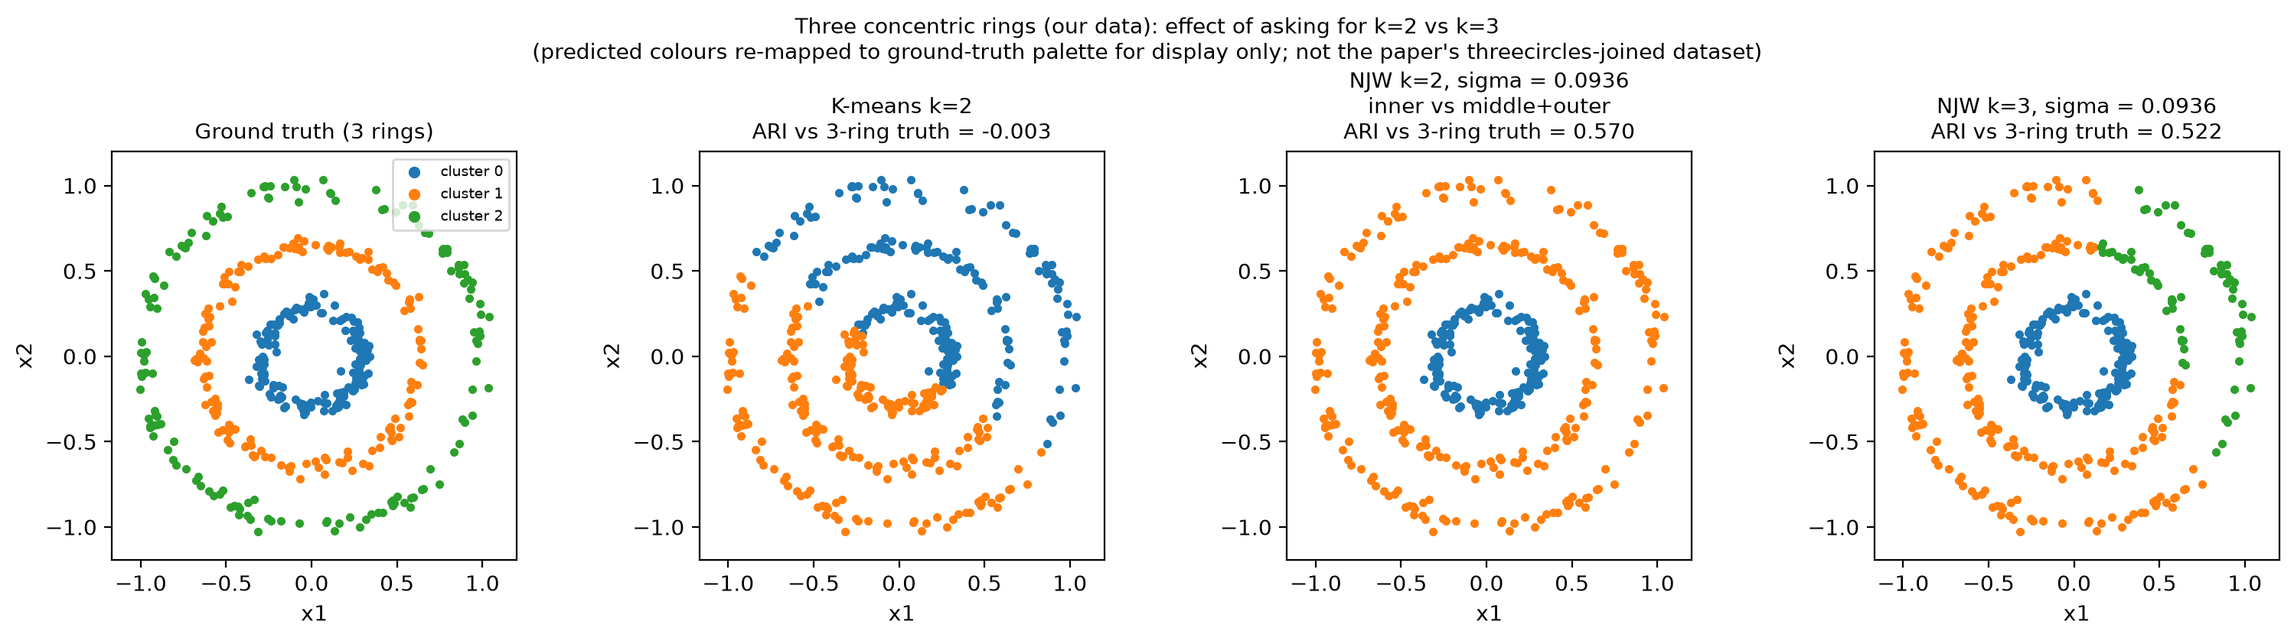
k chooses which question is asked
Three rings we generated. σ₀ = 0.094 from the same neighbour rule.
k = 2 is a stable merge
NJW keeps the inner ring and joins the other two. ARI is 1.00 against that merge, and 0.57 against three rings.
The true k is not enough
At this σ, k = 3 scores 0.52. At 0.7σ₀ it rises to 0.90. K-means stays near 0 for both k.
11
Notes:
建议用时 40 秒。数据是我们的三个同心环，半径 0.3、0.65、1.0，不是原文的 threecircles-joined。k=2 时 NJW 不是乱分：内环单独一类，中环和外环合并。相对这种合并 ARI=1，相对三环真值只有 0.57。Y 空间里内环单独待在单位圆的一处，中环和外环靠得更近，所以会这样并。图在 wrong_k_three_circles_embedding.png，这一页没放。就算 k 给对，默认 σ 下 k=3 的 ARI 只有 0.52；把 σ 降到 0.7 倍才到 0.90。k 和 σ 是绑在一起的。不要用这个探测去改第一阶段的默认 σ。
English speaking draft
With k=2 the algorithm merges the middle and outer rings and isolates the inner one. That partition is perfect against the merge and only 0.57 against three rings. Giving the true k at the same sigma reaches only 0.52. A slightly smaller sigma reaches 0.90. K-means fails at both values of k.
Sources
results/figures/wrong_k_three_circles.png, docs/wrong_k_three_circles_zh.md.

Slide 12
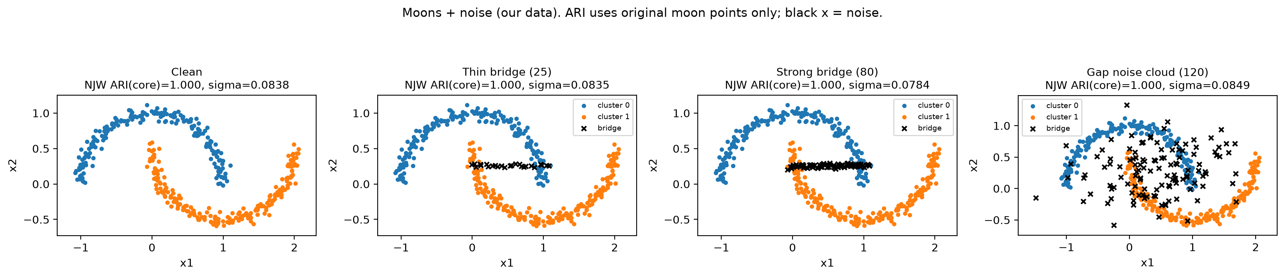
A sparse bridge hurts a hard threshold
Moons we generated. Black marks are bridge or gap points and are left out of ARI.
Setting
NJW ARI
Components
Clean moons
1.00
1.00
Same pattern as Figure 1(j)
The threshold graph still returns k pieces. The pieces no longer match the moons.
Thin bridge, 25 pts
1.00
0.00
Strong bridge, 80 pts
1.00
0.00
Gap noise, 120 pts
1.00
0.00
Blobs + corridor
1.00
0.00
12
Notes:
建议用时 40 秒。干净数据上，NJW 和“调阈值使连通分量数等于 k”都是 ARI 1。加上细桥、粗桥或缝隙里的噪声云之后，NJW 在原始月牙点上仍是 1，连通分量掉到 0。分量数仍然是 2，所以它不是“没切开”，而是切开的方式和真值无关。这和原文 Figure 1(j) 里单点簇的批评是同一类现象，数据是我们的。不要说任意噪声桥都会让 NJW 失败。这里的桥是稀疏的。σ 过大时的失败已经在前一页讲过，机制不同。双团加走廊的数字在同一张表里，图是 noise_bridge_blobs.png。
English speaking draft
On clean moons both methods score 1. After a thin bridge, a stronger bridge, or a cloud in the gap, NJW stays at 1 on the original points and the threshold graph falls to 0, even though it still returns two components. A sparse path is enough to fool a hard threshold. It is not enough, at this scale, to fool the weighted cut.
Sources
results/figures/noise_bridge_moons.png, results/tables/noise_bridge_and_density.csv.

Slide 13
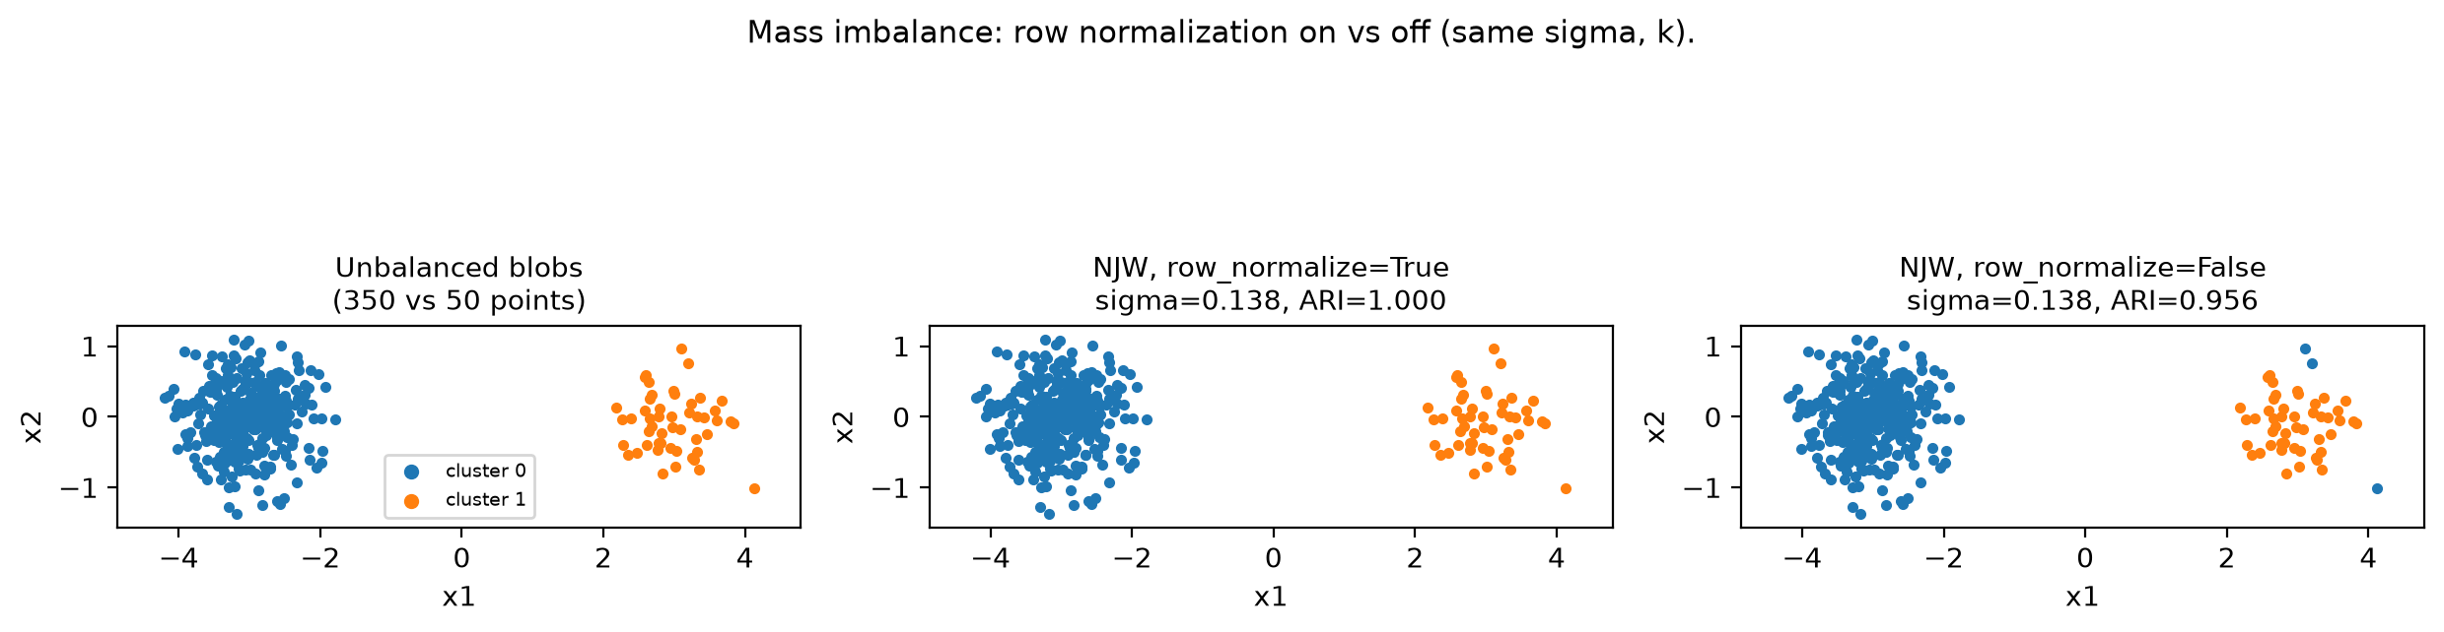
Row length, and Theorem 2
Two checks on the runs we already have. Neither one is a new default.
Turn row normalization off
350 points against 50, same σ and k.
Theorem 2 on the stage-1 runs
True clusters are used only as the blocks in the proof.
Circles and moons: δ > (2+√2)ε is false. NJW ARI is still 1.
Blobs: the condition holds. The bound is 1.5×10⁻⁴. The observed mean squared deviation is 3.6×10⁻¹⁴.
The guarantee is sufficient, and on the one run where it applies it is loose by about ten orders of magnitude.
On: ARI 1.000. Off: ARI 0.956.
The switch matters, by a small amount on this pair of blobs. The clusters do not fall apart.
13
Notes:
建议用时 40 秒。左边是质量不平衡：350 对 50。行归一化打开 ARI=1，关掉 0.956。有差别，不大，不能说关掉就会崩。右边用真值簇去检查定理 2 的条件，只用于分析。圆环和双月上条件不成立，可是 NJW 完全分对，所以条件不是必要的。高斯团上条件成立，理论上界大约 1.5e-4，实际偏差 3.6e-14，松了大约十个数量级。三种数据上都看到 λ_{k+1} 几乎等于簇内最大的 λ₂，这一点和理想情形的分析一致。
English speaking draft
On a 350-versus-50 pair, row normalization changes ARI from 0.956 to 1. A real difference, and a small one. Theorem 2's hypothesis fails on our circles and moons, where the clustering is perfect, so the condition is not necessary. On blobs it holds, and the bound exceeds the observed deviation by about ten orders of magnitude.
Sources
results/figures/density_imbalance_row_norm.png, results/tables/stage1_paper_assumptions.csv.

Slide 14
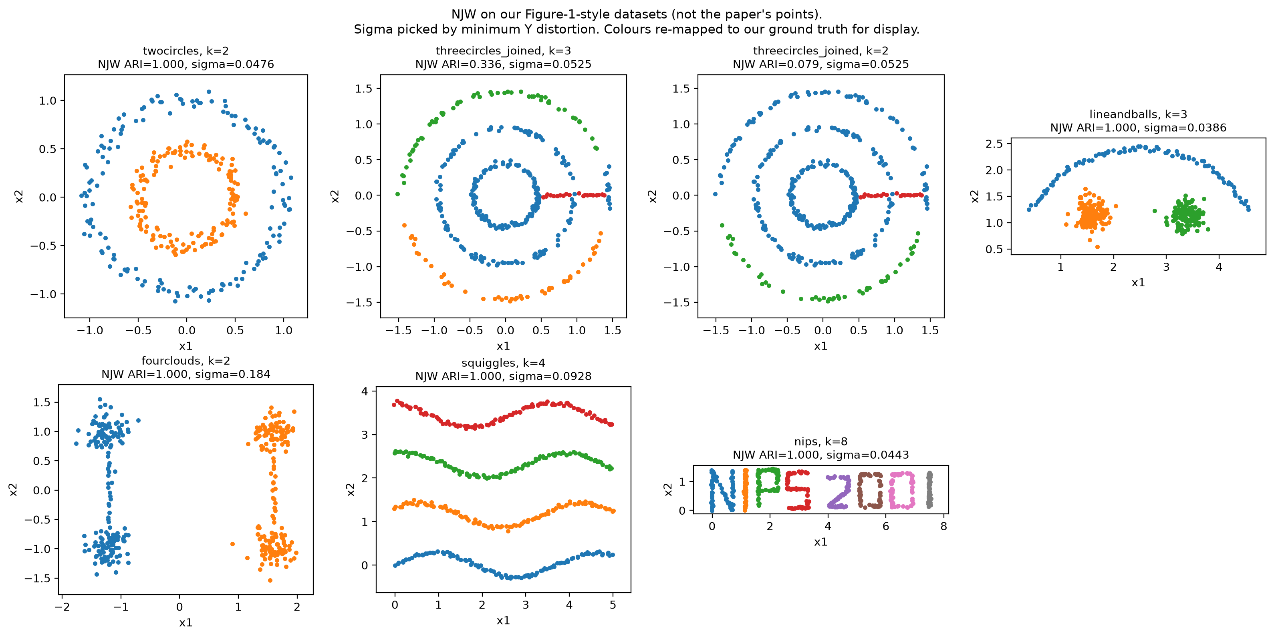
Figure 1 settings, rebuilt by us
The paper released neither the points nor n, the noise, or the σ grid.
How σ was chosen
Minimum K-means distortion of Y, on a fixed grid. Labels stayed out.
NJW ARI = 1
Two circles, line and balls, four clouds, squiggles, NIPS strokes.
K-means on the same points
Circles −0.003. Line and balls 0.68. Squiggles 0.33.
Joined rings, k = 3
NJW, Meila–Shi, components, and our Kannan-style rule all score 0.336. Figure 1(g) does not reappear.
14
Notes:
建议用时 45 秒。必须说清楚：这不是复现 Figure 1。原文没给点坐标、样本量、噪声和 σ 网格。我们按子图的题目和形状自己生成，σ 用原文的规则：在一组 σ² 里选 Y 上 K-means distortion 最小的。标签不参与选择。两圆、线加两个团、四团、四条波浪、NIPS 笔画上 NJW 的 ARI 都是 1。直接 K-means 在两圆上约 0，在波浪上 0.33。三环加短桥没有出现原文那种干净的三环。distortion 最小的 σ 很小，内环和中环被桥粘住；把 σ 加大，ARI 最高也只有大约 0.37。四种方法得分一样，所以这是我们这套桥的接法的限制，不能拿来否定原文 Figure 1(g)。Meila–Shi 在这批数据上和 NJW 的 ARI 相同，没有出现原文 Figure 1(k) 那种差距。我们的 line-and-balls 可能还不够不均衡。
English speaking draft
We rebuilt the problem types and chose sigma by the paper's distortion rule. NJW scores 1 on five of the settings. K-means does not, on the circles and the squiggles. On our joined rings every method we tried scores 0.336, including NJW. That is a limit of our point set. It is not evidence against Figure 1(g).
Sources
results/figures/paper_like_njw.png, docs/paper_like_experiments_zh.md.

Slide 15
Critical analysis
Issue | What we measured | How we read it
One global σ | Circles stay at ARI 1 until 1.4σ₀, then fall to about 0. | The scale can erase the structure NJW is meant to recover.
Specified k | k=2 merges two of three rings. True k=3 scores 0.52 at that σ. | k selects the question, and the answer still moves with σ.
Bridges | Sparse bridges: NJW stays at 1.00. A threshold graph falls to 0. | The cut uses weights. A connecting path is not yet a cluster.
Theorem 2 | The hypothesis fails on circles and moons, where NJW is perfect. | A sufficient condition, and a loose one on the blobs.
Still open
Repeated seeds, so we can report a variance.
Local scaling, the paper's 90° K-means start, and n beyond a few thousand.
15
Notes:
建议用时 50 秒。这一页是读法，不是新实验。四个限制都已经有我们自己的数字，不要再说成“打算做的测试”。
σ：圆环在两倍默认尺度就退回 K-means 的错误。
k：给 2 会得到稳定的合并，给对了 3 但 σ 不合适仍然只有 0.52。
桥：稀疏连接打垮阈值图，没有打垮这次的 NJW。
定理 2：在完全成功的圆环和双月上条件并不成立。
收尾讲还没做的：多种子方差、局部尺度、原文 90 度初始化、以及稠密亲和在 n 变大以后的 O(n²) 内存和 O(n³) 分解。
最后一句：算法把图变成更容易聚类的几何，结果仍然取决于这张图是怎么造的。
English speaking draft
Four limits now have measurements. A single scale can remove the ring structure. The requested k selects which partition we even mean, and it is coupled to sigma. A sparse bridge fools a threshold graph and not, in our runs, the weighted method. Theorem 2 does not cover the cases where our clustering is perfect. We still have no variance over seeds, no local scaling, and no result past a few thousand points.
Sources
Group measurements cited on the previous slides. Theorem 2: Section 3.2.

Slide 16
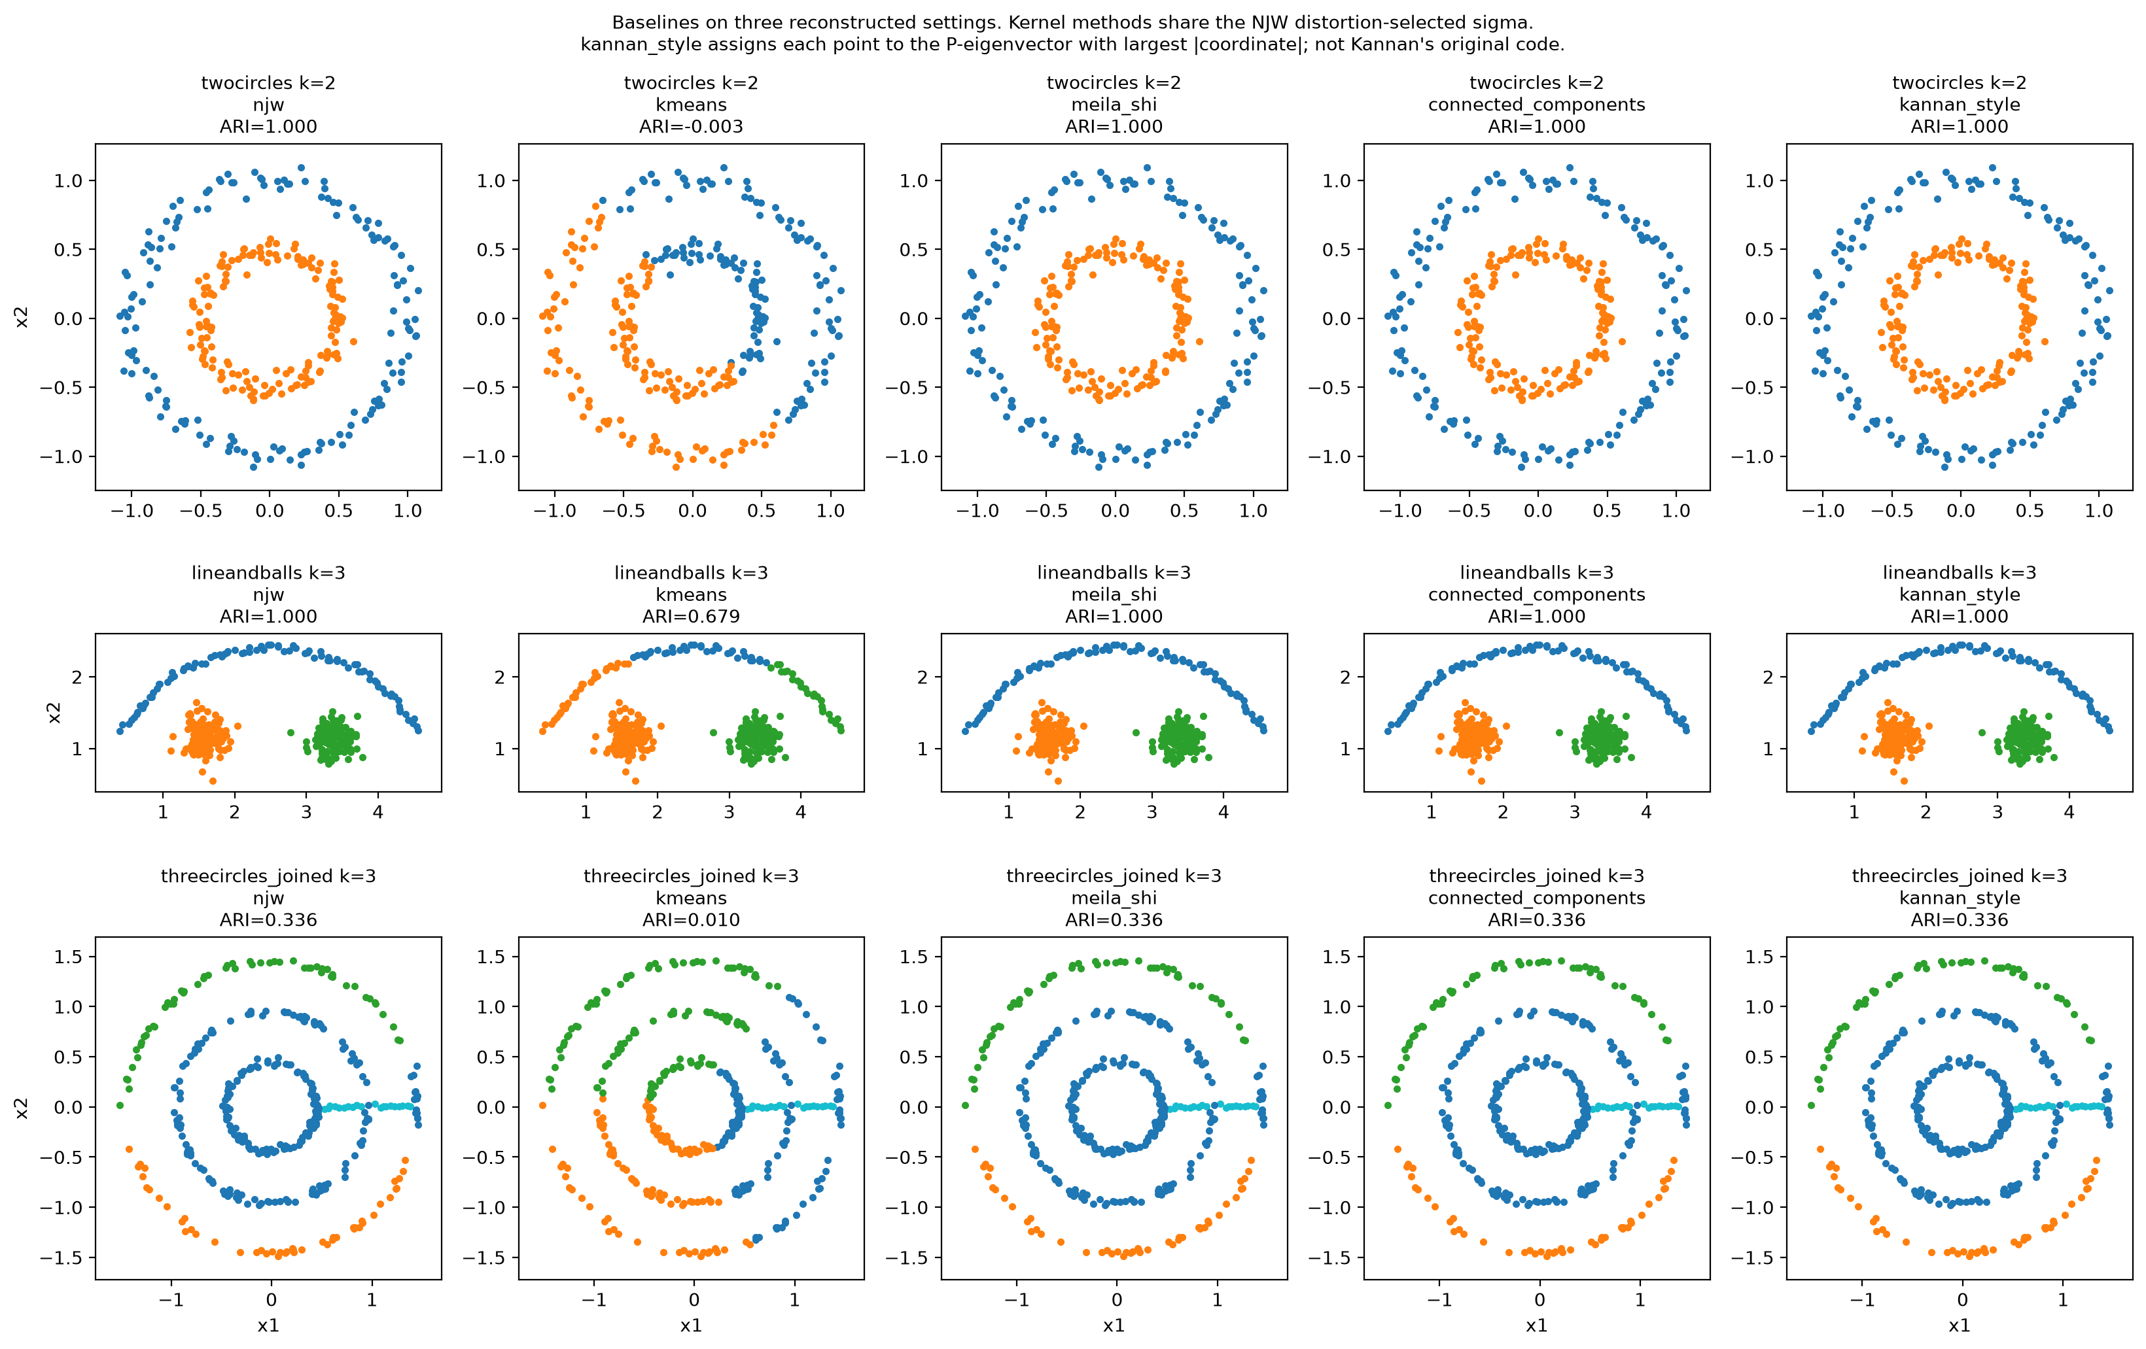
Backup The other methods, on our reconstructions
Kernel methods share the distortion-chosen σ. Components search their own threshold.
What each column is
Meila–Shi uses eigenvectors of D⁻¹A, with no row normalization.
Kannan-style assigns each point to its largest absolute coordinate. This is not their code.
Where they separate
Meila–Shi matches NJW on this batch, including the joined-ring failure.
Kannan-style falls to 0.71 on squiggles and 0.76 on the NIPS strokes.
16
Notes:
备用页。被问到对照方法时再讲。Meila–Shi 按原文：用 P=D⁻¹A 的特征向量，不做行归一化。
Kannan 式不是原文作者的代码。原文只说他们把簇对应到单个奇异向量；我们的做法是把每个点分给绝对值最大的那一列。
在我们这批重建数据上，Meila–Shi 的 ARI 和 NJW 相同，没有复现 Figure 1(k)。
Kannan 式在 squiggles（0.713）和 nips（0.762）上低于 NJW，方向和原文的批评一致，但算法和点集都不是原文的。
English speaking draft
Meila–Shi matches our NJW scores on these reconstructions, so we do not see the gap in Figure 1(k). The single-vector rule is weaker on the squiggles and on the NIPS strokes. That rule is our reading of one sentence in the paper, not Kannan's implementation.
Sources
results/figures/paper_like_baselines.png, src/njw_spectral/baselines.py.

Slide 17
Backup Connections to course concepts
Concept | Connection | Important distinction
K-means | Same final clustering objective on Y | Embedding changes the geometry
PCA | Both use eigenvector representations | PCA uses covariance and variance, NJW uses a graph
Similarity / kernels | Gaussian pairwise affinity | Setting Aᵢᵢ = 0 means A need not be a PSD kernel Gram matrix
Degree normalization changes the operator. Row normalization changes each embedded point.
17
Notes:
建议用时 0 秒
中文讲解
备用。PCA联系讲表示形式，不把谱聚类当作普通PCA。虽然Gaussian kernel矩阵通常半正定，本篇把对角设零后的affinity不保证半正定，因此不要直接称其为标准kernel Gram矩阵。这个细节可在老师问kernel联系时补充。
English speaking draft
Both methods use eigenvectors, but they decompose different matrices and pursue different objectives. A Gaussian affinity resembles a kernel similarity, but the zero-diagonal convention means we should not automatically treat the affinity as a positive semidefinite kernel Gram matrix.
Sources
Ng, Jordan & Weiss (NIPS 2001). Sections 2 and 5, plus group mathematical interpretation.
https://proceedings.neurips.cc/paper_files/paper/2001/file/801272ee79cfde7fa5960571fee36b9b-Paper.pdf

Slide 18
Backup Questions to prepare
Why use K-means again?
The embedding makes the relevant groups easier to separate.
Why keep the first eigenvector?
NJW uses the full top-k subspace, including that direction.
What if the eigenvectors rotate?
Orthogonal rotations preserve distances and row norms.
Does a large eigengap prove correctness?
It supports subspace separation, conditional on the graph and perturbation.
What exactly did our group reproduce?
Our NJW, our circles and moons, ARI 1. Joined rings stay at 0.336.
18
Notes:
备用问答。最后一题用事实回答：我们自己实现了 NJW，在自己生成的圆环和双月上 ARI 为 1。点集不是原文的。三环加桥的重建没有出现 Figure 1(g)，四种方法都是 0.336。σ 的默认值是第 7 近邻中位数；Figure 1 风格的那一组改用了 distortion 最小规则。没有用 sklearn 的 SpectralClustering。K-means 步用的是 sklearn，k-means++，n_init=10。
English speaking draft
We implemented NJW ourselves. On our circles and moons it scores ARI 1 against K-means scores of about 0 and 0.27. We did not recover the paper's joined-ring figure: every method we tried scores 0.336 on our version. State the seed, the sigma rule, and that distinction if the question comes.

Slide 19
Backup References
Primary paper
Andrew Y. Ng, Michael I. Jordan and Yair Weiss
On Spectral Clustering: Analysis and an Algorithm
Advances in Neural Information Processing Systems 14
NIPS 2001, pp. 849–856
Figure attribution
Slides 1, 4 and 6 crop Figure 1 of the paper.
Slides 7–16 are our points, our code, and our measurements.
Official paper: proceedings.neurips.cc, NIPS 2001
19
Notes:
备用。第 1、4、6 页的图是原文 Figure 1 的裁剪，没有改数据。第 7 到 14 页是我们的生成数据、我们的 NJW 实现和实测。第 16 页是重建数据上的对照方法，备用。九分钟剪辑可以不翻第 10–14 页和第 16 页，但那些数字要能在问答里说出来。
Primary source
https://proceedings.neurips.cc/paper_files/paper/2001/file/801272ee79cfde7fa5960571fee36b9b-Paper.pdf

