Slide 1
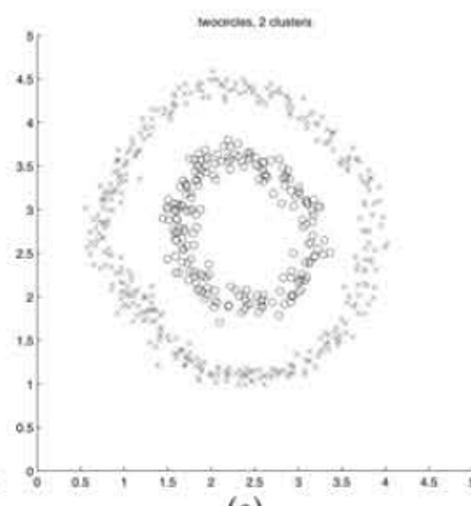
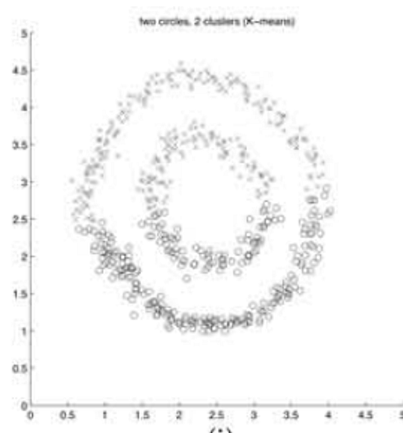
On Spectral Clustering
Analysis and an Algorithm
Andrew Y. Ng, Michael I. Jordan, Yair Weiss
NIPS 2001 COMP3314 Group Project
Clustering concentric circles
K-means partitions space around centroids.
The intended clusters can follow a different geometry.
NJW
Direct K-means
Original paper results: Figure 1(e) and 1(i)
01
Notes:
建议用时 45 秒
中文讲解
开场用原文同心圆图解释动机。左图是作者方法，右图是直接 K-means。强调这些是原文结果，不是我们的实验。介绍研究问题：利用相似关系构造表示，是否能让原本难聚类的数据变得容易？组号和姓名确定后可替换课程行。
English speaking draft
We study the spectral clustering algorithm proposed by Ng, Jordan and Weiss. These two figures come from the original paper. Direct K-means divides the circles in a way that does not match the intended inner and outer groups. The spectral method first changes the representation, then applies K-means. We focus on why that representation works and what conditions it needs.
Sources
Ng, Jordan & Weiss (NIPS 2001). Section 2 and Figure 1(e,i).
https://proceedings.neurips.cc/paper_files/paper/2001/file/801272ee79cfde7fa5960571fee36b9b-Paper.pdf

Slide 2
Problem and contributions
Given n points and a specified k, assign each point to one of k clusters
A particular algorithm
Empirical evidence
Use k eigenvectors together, normalize each embedded point, then cluster.
Show qualitative results on challenging clustering examples.
An explanation of its behavior
Connections to the course
Analyze ideal separation and perturbations of that ideal structure.
K-means and distance-based similarity
Eigenvectors and representation learning
PCA as a useful comparison
Earlier spectral methods already existed. The contribution is this construction and its analysis.
02
Notes:
建议用时 60 秒
中文讲解
准确说贡献，不能说作者发明了整个 spectral clustering。论文在已有工作基础上指定一种同时使用 k 个特征向量的算法，并用矩阵扰动理论给出条件。课程联系讲 K-means、相似度和特征分解；PCA只是比较，不要说两者优化同一目标。
English speaking draft
The task is unsupervised clustering with a known number of groups. Spectral clustering already existed before this paper. The authors contribute a specific algorithm using several eigenvectors together, an analysis of its behavior, and experimental examples. This connects to K-means because the final clustering step remains familiar. It also connects to eigenvector methods such as PCA, although the matrix and objective differ.
Sources
Ng, Jordan & Weiss (NIPS 2001). Abstract, Sections 1, 2 and 5.
https://proceedings.neurips.cc/paper_files/paper/2001/file/801272ee79cfde7fa5960571fee36b9b-Paper.pdf

Slide 3
The NJW algorithm
Each sample receives a new k-dimensional coordinate
1 Similarity
3 Spectral coordinates
Aᵢⱼ = exp(−‖sᵢ − sⱼ‖² / (2σ²))
Aᵢᵢ = 0
X = [v₁ … vₖ] ∈ ℝⁿˣᵏ
Largest k eigenvalues of L
2 Degree normalization
4 Normalize and cluster
dᵢ = Σⱼ Aᵢⱼ
L = D⁻½ A D⁻½
yᵢ = xᵢ / ‖xᵢ‖₂
Run K-means on the rows of Y
The paper uses L. The normalized Laplacian I − L has the same eigenvectors, with reversed eigenvalue order.
03
Notes:
建议用时 90 秒
中文讲解
用输入到输出顺序解释。s是原始样本，x_i是X的一行。A和L是n×n，X和Y是n×k。degree归一化改变相似度算子，行归一化改变嵌入坐标长度，是两件事。取最大的代数特征值，不按绝对值排序；保留第一特征向量。公式中的D对角为正。
English speaking draft
First, a Gaussian affinity converts distances into pairwise similarities. The diagonal is zero. Next, the degree matrix normalizes the affinity. We take the eigenvectors corresponding to the largest k eigenvalues of this symmetric matrix. Stacking them as columns gives one row per sample. Finally, we normalize each row to unit length and run K-means. The two normalizations act at different stages. The paper uses L, while many textbooks use the normalized Laplacian I minus L.
Sources
Ng, Jordan & Weiss (NIPS 2001). Section 2 and footnote 1.
https://proceedings.neurips.cc/paper_files/paper/2001/file/801272ee79cfde7fa5960571fee36b9b-Paper.pdf

Slide 4
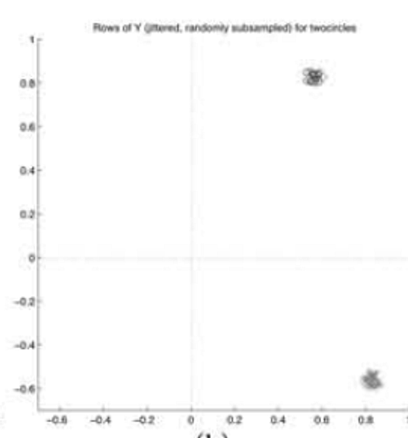
Why row normalization works
Ideal case: no links across clusters, connected clusters and positive degrees
For a point i in cluster c
xᵢ = αᵢ r(c) with αᵢ > 0
yᵢ = xᵢ / ‖xᵢ‖₂ = r(c)
Lengths can vary within a cluster.
Normalization keeps its shared direction.
Original Y embedding
Figure 1(h), with jitter
The k cluster directions are orthogonal. A rotation of the eigenvector basis preserves this geometry.
04
Notes:
建议用时 90 秒
中文讲解
本页是重点。先假设类间连接为零，类内连通且degree正。每一簇在特征子空间对应一个方向，点的长度与degree有关。r_c是正交旋转矩阵的一行，单位长度。同簇的alpha可不同，归一化后全部变为r_c。实际求解器可能旋转特征向量基，不能把某一列固定解释成某个簇。右图来自原文实际同心圆的Y，并非这个理想命题的精确数值例子，原图加了jitter。
English speaking draft
In the ideal case, the affinity has separate connected blocks. A point in cluster c has an embedded row equal to a positive scale times a cluster direction. Degrees can change the scale across points. Row normalization removes that scale, so every point in the same cluster becomes the same unit vector. Different clusters have orthogonal directions. The basis can rotate, but pairwise geometry stays the same. The original embedding on the right illustrates tight groups in practice.
Sources
Ng, Jordan & Weiss (NIPS 2001). Section 3.1, Proposition 1, Figure 1(h).
https://proceedings.neurips.cc/paper_files/paper/2001/file/801272ee79cfde7fa5960571fee36b9b-Paper.pdf

Slide 5
Beyond perfect separation
The analysis treats cross-cluster connections as a perturbation
Ideal structure
Conditions behind the guarantee
λ₁ = … = λₖ = 1
δ = λₖ − λₖ₊₁
Internally coherent clusters
Weak connections across clusters
No extremely weak-degree points
The top-k subspace is separated
from the remaining directions.
Perturbation must be small relative
to the spectral separation.
An eigengap alone does not guarantee agreement with any chosen semantic labels.
05
Notes:
建议用时 60 秒
中文讲解
这是原文一般情况的简化直觉，不是完整定理。A1约束类内第二特征值，A2/A3约束类间连接，A4控制极弱degree点。gap相对于扰动大小有意义，不能说gap大就永远聚对。定理控制归一化嵌入围绕正交方向的偏离，后续聚类还依赖其分离与聚类过程。
English speaking draft
Real data has cross-cluster links. The paper asks whether adding these links substantially changes the spectral representation. A gap separates the desired top-k subspace from the remaining directions. Stability depends on the perturbation relative to that separation, together with connectivity and degree conditions. This is a conditional explanation. A visually large eigengap alone does not prove that the clusters match a particular set of semantic labels.
Sources
Ng, Jordan & Weiss (NIPS 2001). Section 3.2, Assumptions A1–A4 and Theorem 2.
https://proceedings.neurips.cc/paper_files/paper/2001/file/801272ee79cfde7fa5960571fee36b9b-Paper.pdf

Slide 6
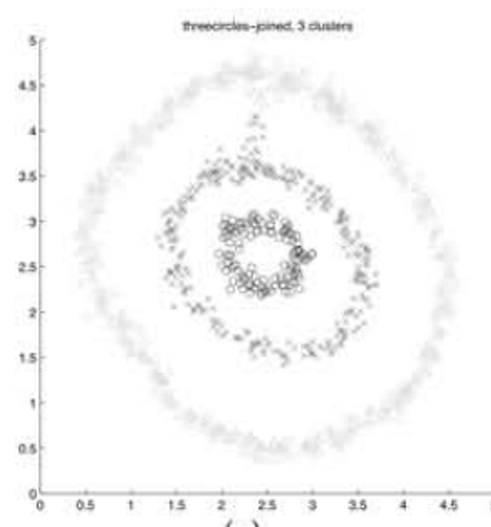
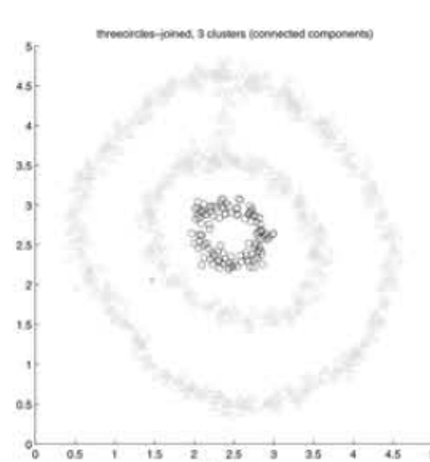
Evidence in the original paper
Seven clustering problems, with selected comparisons in Figure 1
What this example supports
Weighted affinities can avoid a poor
threshold-based partition on this example.
What remains uncertain
Broad robustness across noise levels,
scales and datasets needs more evidence.
NJW, k = 3
Connected components
Scale selection: search σ² for low distortion in Y. Original results: Figure 1(g,j), Section 4.
06
Notes:
建议用时 60 秒
中文讲解
原文图g与j比较三个相连的圈。connected components结果含一个单点簇，提醒图阈值划分可能不稳定。作者还对比K-means等，不能把这对图概括为全部方法的全面评测。原文通过搜索sigma平方、选择Y中较小聚类失真来确定尺度，使用利用近90度几何的初始化。图示支持特定案例，缺少我们希望补充的系统噪声和参数变化证据。
English speaking draft
The authors test seven clustering problems. Here, their weighted spectral method gives a more useful partition than a threshold-based connected-components method, which produces a singleton cluster. This supports the value of the representation on this example. It does not establish universal robustness. The paper selects the affinity scale by searching for low clustering distortion in Y. We would also want systematic checks across scales, noise and random seeds.
Sources
Ng, Jordan & Weiss (NIPS 2001). Section 4, footnote 3, Figure 1(g,j).
https://proceedings.neurips.cc/paper_files/paper/2001/file/801272ee79cfde7fa5960571fee36b9b-Paper.pdf

Slide 7
Our reproduction plan
Results pending review. No group measurements appear in this draft.
Question | Experiment | Evidence to insert
Does the method recover curved groups? | Circles, moons and blobs K-means vs our NJW | Clustering plots and ARI
How sensitive is the affinity scale? | Fixed data, predeclared σ grid | ARI curve and failure cases
Does row normalization help? | Optional controlled ablation | With / without comparison
Protocol
Use labels only for evaluation. Record seeds and settings.
Call regenerated examples a qualitative reproduction.
07
Notes:
建议用时 60 秒
中文讲解
本页是草稿占位，尚未获得并审查小组实验，因此没有任何实测值。正式展示前用实际结果图与2句观察替换实验计划，保留必要配置。E1基础比较，E2参数敏感性优先，E3可选。不要用真实标签调尺度，不把自生成数据叫精确复现原图。可以调用eigensolver和KMeans，核心NJW步骤自行实现。
English speaking draft
Our experiments will test the explanation rather than only show attractive plots. We compare a direct K-means baseline with our implementation, then vary the affinity scale on fixed data. We may also remove row normalization while keeping other choices fixed. Ground-truth labels serve only for evaluation. We will report regenerated examples as a qualitative reproduction. This draft contains no measurements yet, and this page will show the verified results in the final presentation.
Sources
Ng, Jordan & Weiss (NIPS 2001). Group experiment proposal, not a result reported by the paper.
https://proceedings.neurips.cc/paper_files/paper/2001/file/801272ee79cfde7fa5960571fee36b9b-Paper.pdf

Slide 8
Critical analysis and team insights
Issue | Why it matters | Possible next test
One global σ | Different densities can need different scales | Density variation and local scaling
Specified k | The method needs a chosen cluster count | Sensitivity to k and gap diagnostics
Ideal structure assumptions | Bridges and weak-degree points can violate them | Add controlled bridges or outliers
Concepts we worked through
A sample corresponds to a row of X. The subspace matters more than individual eigenvectors.
The two normalizations act on different objects.
08
Notes:
建议用时 75 秒
中文讲解
最后用限制引出可检验的扩展，避免把尚未做的改进说成已证明有效。全局尺度的限制需要实验支持，可说是待检验的风险。k在论文中已知，eigengap只能作诊断。团队理解对应我们已经讨论的真实概念，正式交接时确认全员认同。收尾一句：算法把图结构转成易聚类的几何，但结果仍取决于图的构造和假设。
English speaking draft
Our main concern is how the graph represents the intended groups. A single global scale may struggle with varying densities, which motivates a controlled test of local scaling. The method also requires k, and its assumptions can fail around bridges or weakly connected points. These are proposed tests, not established improvements. Conceptually, we learned to distinguish rows from columns and to focus on the eigenspace rather than individual eigenvectors. The method succeeds when the constructed graph supports a useful clustering geometry.
Sources
Ng, Jordan & Weiss (NIPS 2001). Sections 2–4. Limitations and proposed tests are group analysis.
https://proceedings.neurips.cc/paper_files/paper/2001/file/801272ee79cfde7fa5960571fee36b9b-Paper.pdf

Slide 9
Backup Connections to course concepts
Concept | Connection | Important distinction
K-means | Same final clustering objective on Y | Embedding changes the geometry
PCA | Both use eigenvector representations | PCA uses covariance and variance, NJW uses a graph
Similarity / kernels | Gaussian pairwise affinity | Setting Aᵢᵢ = 0 means A need not be a PSD kernel Gram matrix
Degree normalization changes the operator. Row normalization changes each embedded point.
09
Notes:
建议用时 0 秒
中文讲解
备用。PCA联系讲表示形式，不把谱聚类当作普通PCA。虽然Gaussian kernel矩阵通常半正定，本篇把对角设零后的affinity不保证半正定，因此不要直接称其为标准kernel Gram矩阵。这个细节可在老师问kernel联系时补充。
English speaking draft
Both methods use eigenvectors, but they decompose different matrices and pursue different objectives. A Gaussian affinity resembles a kernel similarity, but the zero-diagonal convention means we should not automatically treat the affinity as a positive semidefinite kernel Gram matrix.
Sources
Ng, Jordan & Weiss (NIPS 2001). Sections 2 and 5, plus group mathematical interpretation.
https://proceedings.neurips.cc/paper_files/paper/2001/file/801272ee79cfde7fa5960571fee36b9b-Paper.pdf

Slide 10
Backup Questions to prepare
Why use K-means again?
The embedding makes the relevant groups easier to separate.
Why keep the first eigenvector?
NJW uses the full top-k subspace, including that direction.
What if the eigenvectors rotate?
Orthogonal rotations preserve distances and row norms.
Does a large eigengap prove correctness?
It supports subspace separation, conditional on the graph and perturbation.
What exactly did our group reproduce?
State the data, settings, phenomena and discrepancies actually verified.
10
Notes:
建议用时 0 秒
中文讲解
备用问答。每个组员至少能回答负责部分的两项问题。最后一项必须等真实实验后用具体事实回答，不能只背抽象句子。
English speaking draft
Use these questions to check whether each presenter can explain the reasoning and the scope of the actual reproduction.
Sources
Ng, Jordan & Weiss (NIPS 2001). Sections 2–4. Final reproduction scope depends on verified group work.
https://proceedings.neurips.cc/paper_files/paper/2001/file/801272ee79cfde7fa5960571fee36b9b-Paper.pdf

Slide 11
Backup References
Primary paper
Andrew Y. Ng, Michael I. Jordan and Yair Weiss
On Spectral Clustering: Analysis and an Algorithm
Advances in Neural Information Processing Systems 14
NIPS 2001, pp. 849–856
Figure attribution
Slides 1, 4 and 6 reproduce selected panels of Figure 1.
All such figures show the paper’s results.
Official paper: proceedings.neurips.cc, NIPS 2001
11
Notes:
Primary source
https://proceedings.neurips.cc/paper_files/paper/2001/file/801272ee79cfde7fa5960571fee36b9b-Paper.pdf
Figure crops: Figure 1(e,i) on slide 1, Figure 1(h) on slide 4, Figure 1(g,j) on slide 6. Cropping only, no changes to data.
课前核对项
正式展示前补组员信息、经核查的小组实测结果、代码仓库链接及具体复现范围。正文8页总预算540秒。第9–11页为备用，不计入正文讲解。

