Slide 1
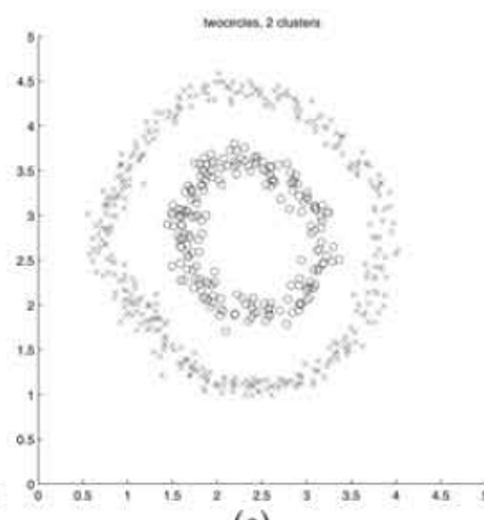
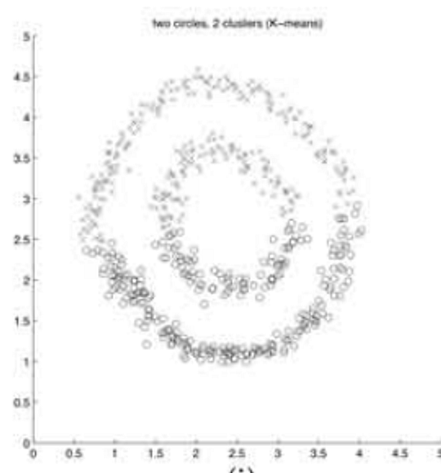
On Spectral Clustering
Analysis and an Algorithm
Andrew Y. Ng, Michael I. Jordan, Yair Weiss
NIPS 2001
NJW
K-means
Original paper, Figure 1(e) and 1(i)
COMP3314 Group Project
Group members: ________________
Notes:
[~15 s] Our paper is "On Spectral Clustering: Analysis and an Algorithm" by Ng, Jordan and Weiss, NIPS 2001.
The picture already shows the problem: two rings. The left panel is their algorithm, the right panel is plain K-means.
The talk has four parts: why K-means fails, the NJW algorithm step by step, our reproduction, and a critical analysis.

Slide 2
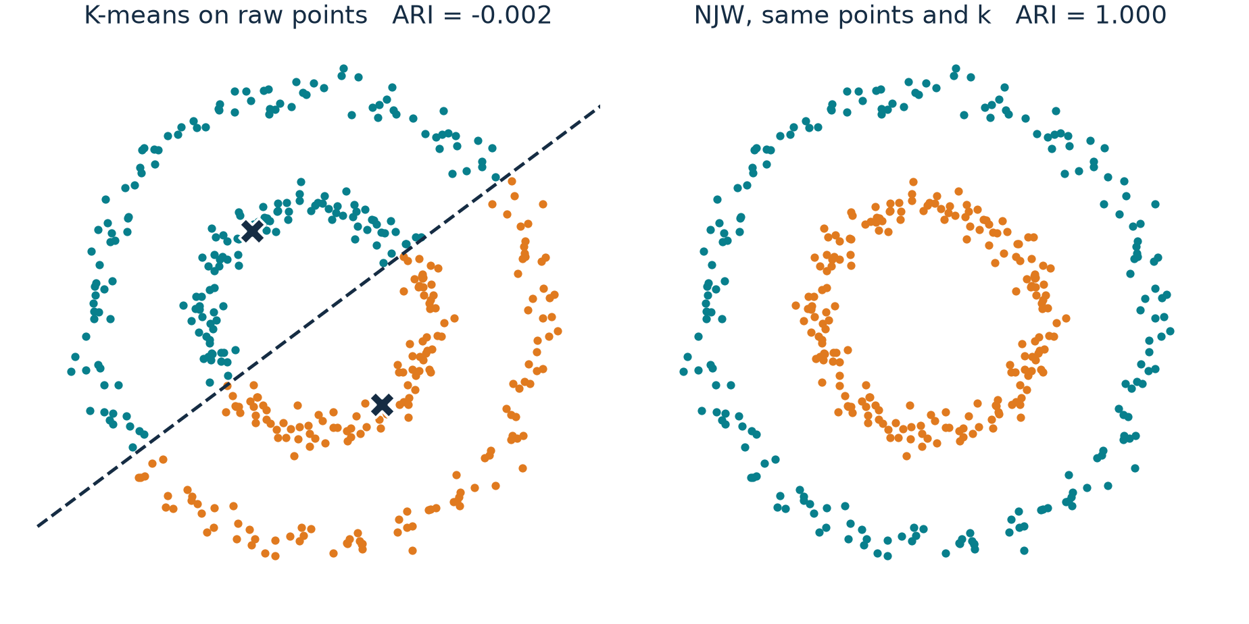
Why K-means fails on rings
1 MOTIVATION
Same 400 points, same k = 2. Only the method changes.
K-means
Each point goes to the nearest centroid.
Two centroids → one straight boundary (dashed).
A straight line cannot separate two rings.
Idea of NJW
Keep K-means.
Change the coordinates each point gets, so that the rings become easy to separate.
K-means ARI = -0.002 (chance level). NJW ARI = 1.000. ARI = 1 means identical to the true rings.
02
Notes:
[~40 s] These are our 400 points, two rings. K-means assigns each point to its nearest centroid, so with two centroids
the boundary is the perpendicular bisector: a straight line. No straight line separates two concentric rings, so the
result is at chance level, ARI about zero.
NJW keeps K-means as its last step. What it changes is the coordinates: it gives each point new coordinates in which the
two rings are trivially separable. The next slides show how those coordinates are built.

Slide 3
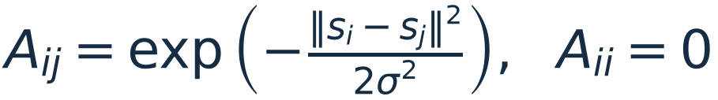
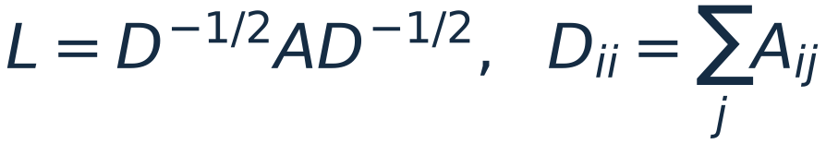


NJW in one picture
2 THE ALGORITHM
Input: n points, the number of clusters k, a scale σ. Output: one label per point.
Points
S: n × 2
›
Affinity
A: n × n
›
Normalize
L: n × n
›
Eigenvectors
X: n × k
›
Unit rows
Y: n × k
›
K-means
labels
The raw 2-D coordinates.
How similar is every pair of points?
Rescale by each point's total similarity.
Keep the k largest eigenvectors as columns.
Scale every row to length 1.
Cluster the rows of Y. Row i → point i.
1 Affinity
2 Normalize
3 Eigenvectors
4 Unit rows, then K-means
Key point: point i is now represented by row i of X (then Y). K-means only sees these rows.
03
Notes:
[~25 s] Here is the whole algorithm. Five matrices, left to right. A is n by n pairwise similarity. L rescales A by the
degrees. X stacks the top k eigenvectors of L as columns, so it is n by k. Y scales each row of X to unit length.
Finally K-means runs on the n rows of Y, and the label of row i is the label of point i.
The bar at the top will follow us through the next slides, highlighting the current step.
We use a small example: 52 points on two rings, 16 inner and 36 outer, sigma = 0.16.

Slide 4
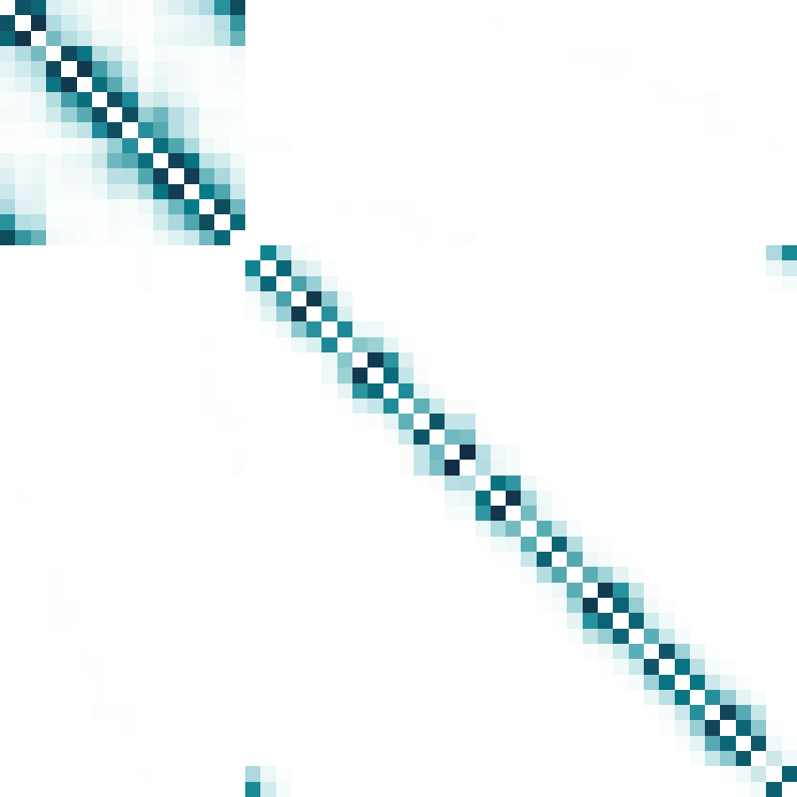
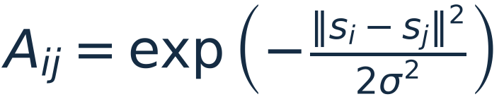

Step 1 · Affinity matrix A
2 THE ALGORITHM
Every pair of points gets a weight between 0 and 1.
Points
S: n × 2
›
Affinity
A: n × n
›
Normalize
L: n × n
›
Eigenvectors
X: n × k
›
Unit rows
Y: n × k
›
K-means
labels
inner
outer ring (columns j)
2σ
i
Near points: weight close to 1. Far points: close to 0.
σ decides what counts as near.
Row i (outer ring): its weight goes only to nearby points on the same ring.
i
Rows are ordered inner ring first only for display. Then A shows two blocks: within-ring weights, almost nothing across.
04
Notes:
[~40 s, two clicks] Step one. For every pair of points we compute a Gaussian weight: close to one for near points, close
to zero beyond a few sigma. The orange circle is two sigma around point i. The diagonal is set to zero.
The heat map on the right is A. The highlighted row is point i: all of its weight goes to its neighbours on the same
ring. (click) Pick a point on the inner ring: the same, its row is only non-zero inside the inner block.
Important: we sorted the rows inner ring first only so that you can see the blocks. NJW never uses this order.

Slide 5
Step 1 · Affinity matrix A
2 THE ALGORITHM
Every pair of points gets a weight between 0 and 1.
Points
S: n × 2
›
Affinity
A: n × n
›
Normalize
L: n × n
›
Eigenvectors
X: n × k
›
Unit rows
Y: n × k
›
K-means
labels
inner
outer ring (columns j)
2σ
i
Near points: weight close to 1. Far points: close to 0.
σ decides what counts as near.
Row i (inner ring): again, all weight stays inside its own ring.
i
Rows are ordered inner ring first only for display. Then A shows two blocks: within-ring weights, almost nothing across.
04
Notes:
Second frame of step 1 (Morph): the highlighted point moves to the inner ring.

Slide 6
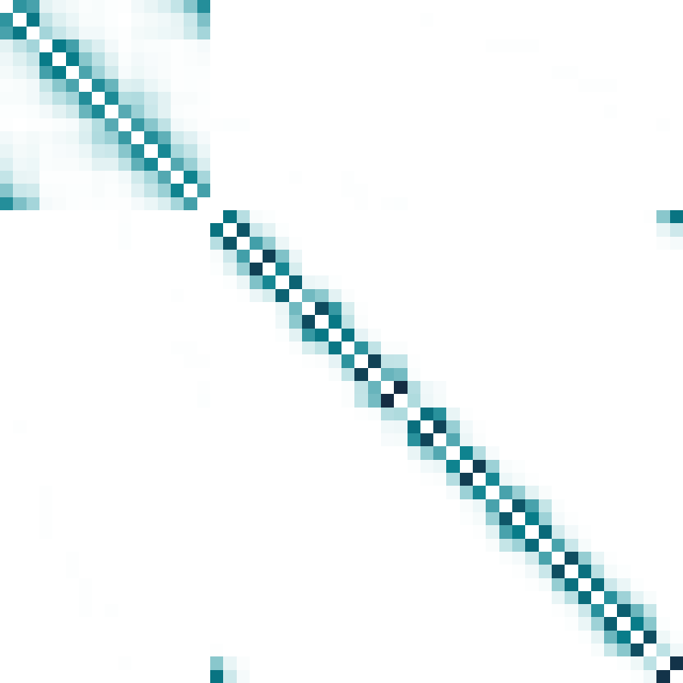
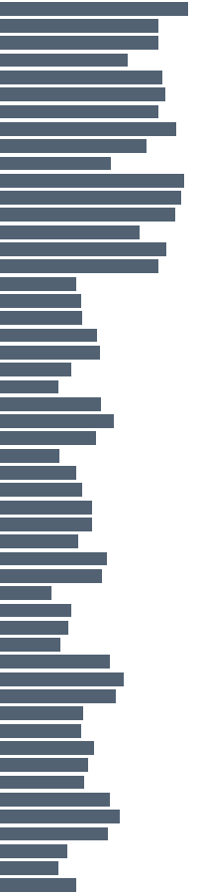
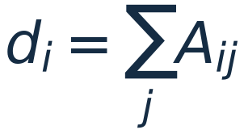

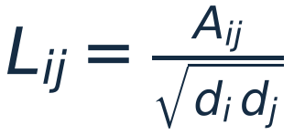
Step 2 · Normalize by degree: L
2 THE ALGORITHM
Divide each weight by how connected its two endpoints are.
Points
S: n × 2
›
Affinity
A: n × n
›
Normalize
L: n × n
›
Eigenvectors
X: n × k
›
Unit rows
Y: n × k
›
K-means
labels
inner
outer ring (columns j)
d
d (grey bars): total weight of each point.
Dense regions no longer dominate; L stays symmetric.
L keeps the two blocks of A.
Degree normalization changes the matrix. (Row normalization in step 4 changes each point; they are different steps.)
05
Notes:
[~25 s] Step two. The degree d_i is the row sum of A, how strongly point i is connected overall - the grey bars.
L divides each weight by the square root of d_i times d_j. This stops dense regions from dominating, keeps L symmetric,
and keeps the block structure we just saw. L is still n by n.

Slide 7
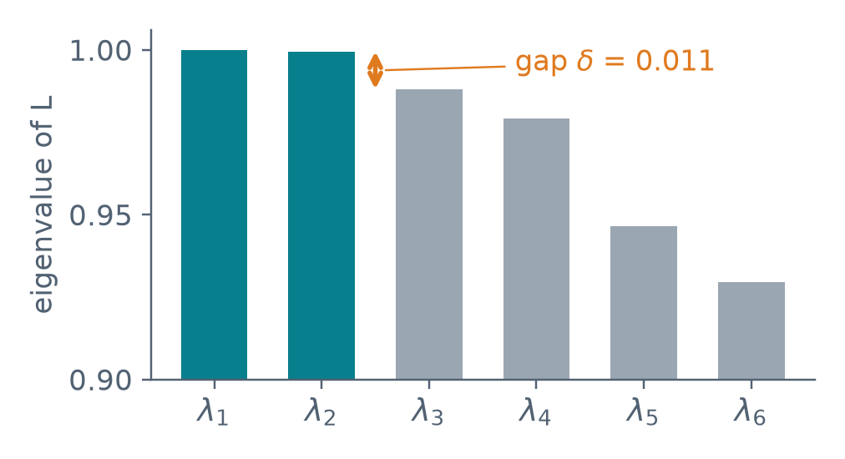

Step 3 · Top-k eigenvectors: X
2 THE ALGORITHM
Each point gets k = 2 new coordinates: its row of X.
Points
S: n × 2
›
Affinity
A: n × n
›
Normalize
L: n × n
›
Eigenvectors
X: n × k
›
Unit rows
Y: n × k
›
K-means
labels
v₁ v₂
Row i of X = new coordinates of point i.
Next: move every point to its row of X.
Eigenvalues of L are ≤ 1. Keep the k largest (by value, not absolute value) and put their eigenvectors side by side.
Teal = positive, orange = negative.
X
With k = 2 we only need the two largest eigenvalues: λ₁ = 1.000, λ₂ = 0.9996, then a gap.
06
Notes:
[~35 s, one click] Step three. We compute the eigenvalues of L. They are at most one. We keep the k largest, here two,
and put their eigenvectors side by side as the columns of X - an n by 2 matrix, shown on the right.
Notice the gap after lambda 2: this gap will matter for the theory.
Now the key move: row i of X is the new coordinate of point i. (click) Each point jumps to its row of X.
The two rings become two rays from the origin. Points on the same ray share a direction but have different lengths.

Slide 8
Step 3 · Top-k eigenvectors: X
2 THE ALGORITHM
Each point gets k = 2 new coordinates: its row of X.
Points
S: n × 2
›
Affinity
A: n × n
›
Normalize
L: n × n
›
Eigenvectors
X: n × k
›
Unit rows
Y: n × k
›
K-means
labels
v₁ v₂
xᵢ₂ ↑
Row i of X = new coordinates of point i.
The two rings became two rays from the origin. Points on one ray differ only in length.
xᵢ₁ →
Eigenvalues of L are ≤ 1. Keep the k largest (by value, not absolute value) and put their eigenvectors side by side.
Teal = positive, orange = negative.
X
Shown scaled up for display. Eigenvector signs are arbitrary; we fixed them so the frames line up.
06
Notes:
Morph: raw points move to their rows of X.

Slide 9
Step 4 · Unit rows Y, then K-means
2 THE ALGORITHM
Row normalization removes the length and keeps only the direction.
Points
S: n × 2
›
Affinity
A: n × n
›
Normalize
L: n × n
›
Eigenvectors
X: n × k
›
Unit rows
Y: n × k
›
K-means
labels
1 Rows of X
One ray per ring. Lengths αᵢ differ inside a ring.
Why is this enough?
Within a ring, rows of X share a direction but not a length.
K-means on X would still be pulled by length.
2 Normalize
yᵢ = xᵢ / ‖xᵢ‖ slides each point along its ray onto the unit circle.
3 K-means on Y
Two tight groups, 90° apart. K-means cannot miss.
4 Back to the points
Row i's label is point i's label.
07
Notes:
[~50 s, three clicks] Step four. Here are the rows of X again, drawn with the unit circle. Inside one ring, the rows share a
direction but have different lengths. (click) We divide every row by its length. Each point slides along its ray onto the
unit circle, and each ring collapses to almost a single point. The two points are 90 degrees apart - the next slide
explains why. (click) Now K-means runs on these rows. It is the same K-means that failed before, but here the task is
trivial: two far-apart dots. (click) Finally the label of row i goes back to point i. The rings are recovered, ARI = 1.

Slide 10
Step 4 · Unit rows Y, then K-means
2 THE ALGORITHM
Row normalization removes the length and keeps only the direction.
Points
S: n × 2
›
Affinity
A: n × n
›
Normalize
L: n × n
›
Eigenvectors
X: n × k
›
Unit rows
Y: n × k
›
K-means
labels
1 Rows of X
One ray per ring. Lengths αᵢ differ inside a ring.
Why 90°?
Different clusters end up in orthogonal directions (next slide).
Every ring collapses to (almost) one point.
2 Normalize
yᵢ = xᵢ / ‖xᵢ‖ slides each point along its ray onto the unit circle.
90°
3 K-means on Y
Two tight groups, 90° apart. K-means cannot miss.
4 Back to the points
Row i's label is point i's label.
07
Notes:
Morph: rows of X slide onto the unit circle (row normalization).

Slide 11
Step 4 · Unit rows Y, then K-means
2 THE ALGORITHM
Row normalization removes the length and keeps only the direction.
Points
S: n × 2
›
Affinity
A: n × n
›
Normalize
L: n × n
›
Eigenvectors
X: n × k
›
Unit rows
Y: n × k
›
K-means
labels
1 Rows of X
One ray per ring. Lengths αᵢ differ inside a ring.
K-means on Y
The same K-means that failed on the raw points.
In Y its job is trivial: two far-apart dots.
2 Normalize
yᵢ = xᵢ / ‖xᵢ‖ slides each point along its ray onto the unit circle.
90°
3 K-means on Y
Two tight groups, 90° apart. K-means cannot miss.
4 Back to the points
Row i's label is point i's label.
07
Notes:
K-means on Y: colours appear, crosses mark the centroids.

Slide 12
Step 4 · Unit rows Y, then K-means
2 THE ALGORITHM
Row normalization removes the length and keeps only the direction.
Points
S: n × 2
›
Affinity
A: n × n
›
Normalize
L: n × n
›
Eigenvectors
X: n × k
›
Unit rows
Y: n × k
›
K-means
labels
1 Rows of X
One ray per ring. Lengths αᵢ differ inside a ring.
Result
ARI = 1.00 on the toy rings.
Same pipeline, 400 points: ARI = 1.00 (Part 3).
2 Normalize
yᵢ = xᵢ / ‖xᵢ‖ slides each point along its ray onto the unit circle.
3 K-means on Y
Two tight groups, 90° apart. K-means cannot miss.
4 Back to the points
Row i's label is point i's label.
07
Notes:
Morph: points fly back to the original plane with their labels.

Slide 13
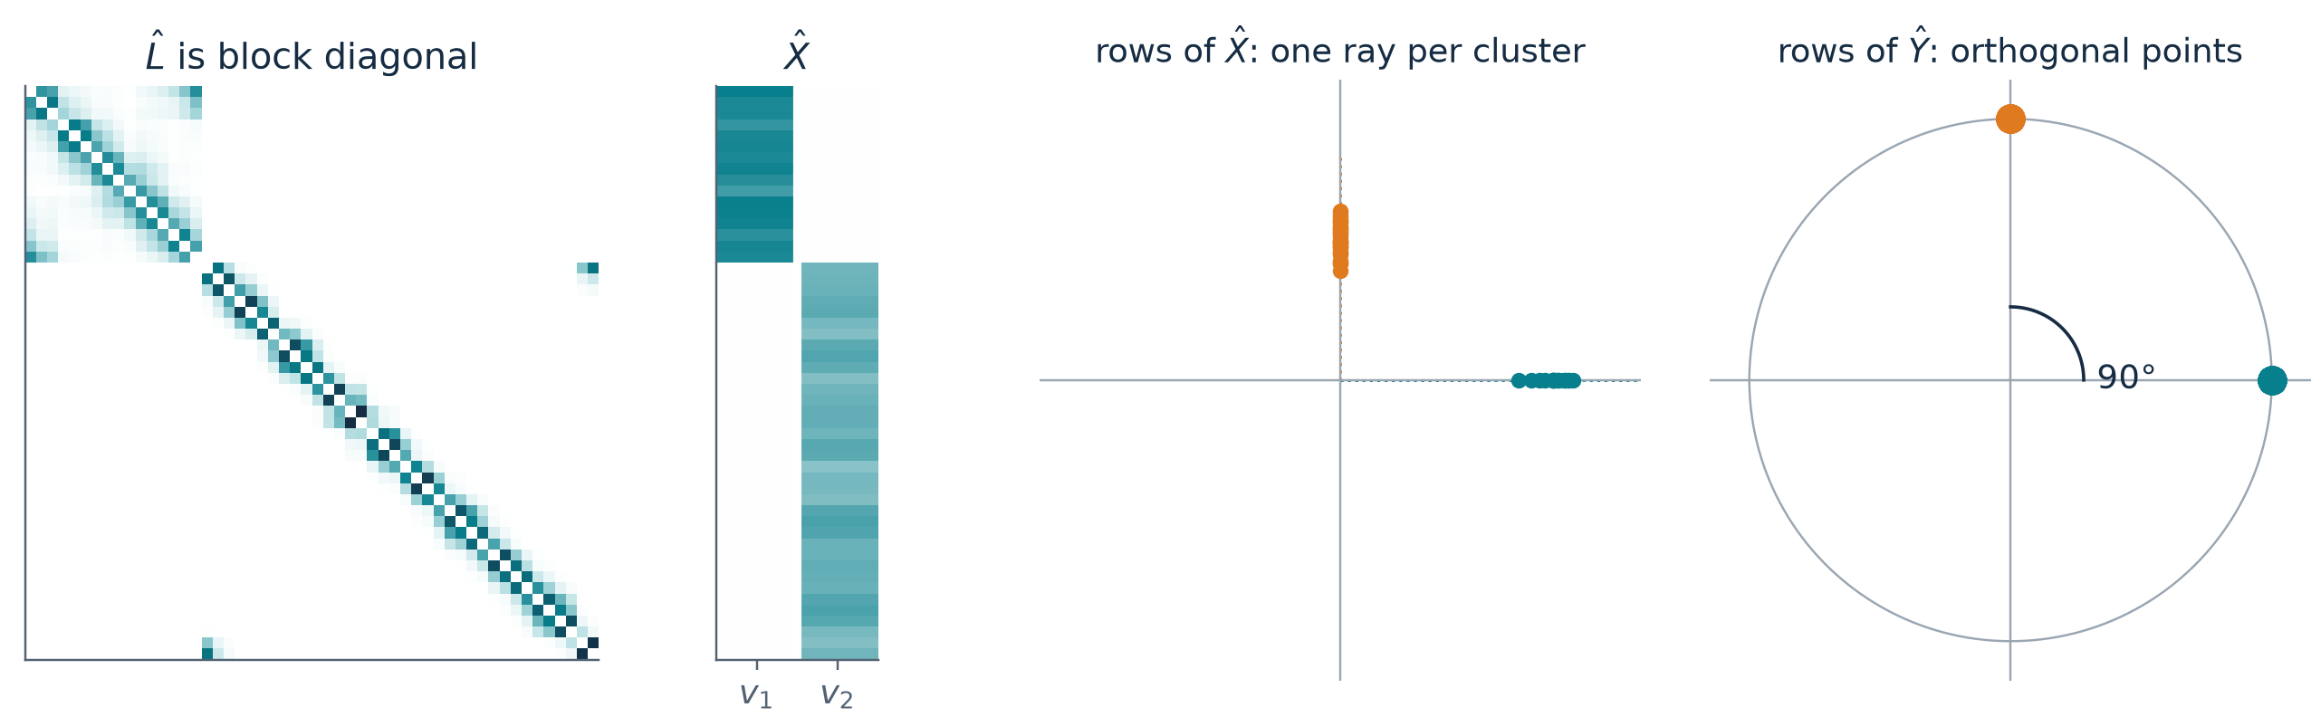


Why it works: the ideal case
2 THE ALGORITHM
Suppose there is no weight at all between clusters.
Ideal L is block diagonal
Each block has eigenvalue 1, so λ₁ = … = λₖ = 1.
Each eigenvector lives on one cluster.
Rows of the ideal X
After normalizing
direction from the cluster, length αᵢ varies
true for any rotation of the eigenvector basis
08
Notes:
[~40 s] Why does this work? Take the ideal case: remove every weight between the two rings. Then L-hat is block
diagonal. Each block has eigenvalue exactly one, so the top k eigenvalues are all one, and the eigenvectors can be chosen
to live on one cluster each - that is X-hat in the middle.
So row i of X-hat is alpha_i times r_c: the direction depends only on the cluster, the length alpha_i varies.
Dividing by the length removes alpha_i, so y_i = r_c. Different clusters give orthogonal directions - the 90 degrees.
The solver may return any rotation of these eigenvectors; a rotation keeps lengths and angles, so the picture is the same.

Slide 14
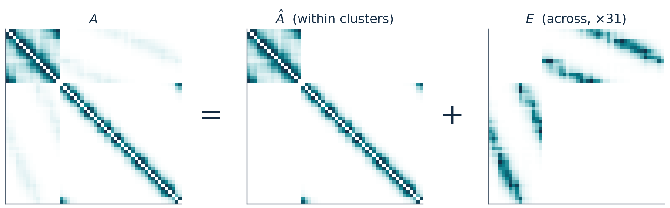
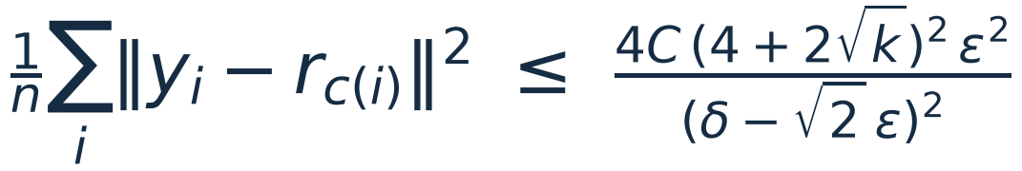
Beyond the ideal case: a perturbation
2 THE ALGORITHM
Real data has some weight across clusters. The paper treats it as noise added to the ideal matrix.
Toy rings at σ = 0.24, so that E is visible. E is scaled up for display.
Conditions (paper's A1–A4, in words)
Each cluster is well connected inside: gap δ = λₖ − λₖ₊₁.
Little weight across clusters: small ε.
No point is only weakly tied to its own cluster.
Theorem 2
If δ > (2 + √2) ε, there are k orthogonal unit vectors r₁…rₖ with
09
Notes:
[~25 s] Real data is not ideal. The paper writes A as the ideal within-cluster part plus a perturbation E, the weights
across clusters. Matrix perturbation theory then says: if every cluster is well connected inside - a large eigengap
delta - and the cross-cluster weight epsilon is small, then the rows of Y stay close to k orthogonal points, so K-means
still works. That is Theorem 2. We will test whether its condition actually holds on our data in Part 4.

Slide 15
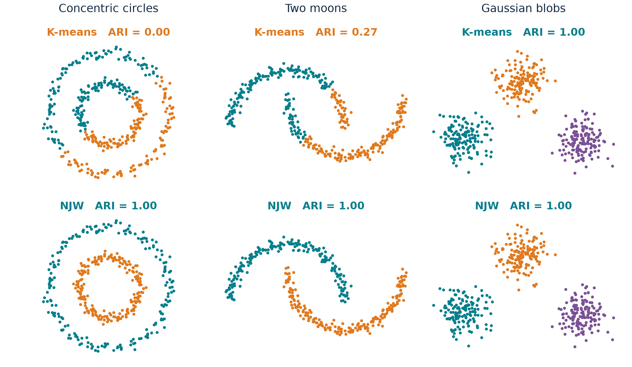
Our reproduction: three datasets
3 OUR REPRODUCTION
Our own NJW code (no sklearn SpectralClustering), our generated points.
Setup
n = 400, 400, 450. Data seed 0.
Same points and same k for both methods.
σ = median distance to the 7th neighbour. No labels used.
Labels only for ARI and colours.
Reading
Rings: 0.00 → 1.00
Moons: 0.27 → 1.00
Blobs: both 1.00, K-means already works.
NJW wins where clusters are not convex. On compact blobs it gives the same answer as K-means.
10
Notes:
[~40 s] Part three, our reproduction. We implemented NJW ourselves; only the eigensolver and the final K-means come from
libraries. Three datasets we generated, same points and same k for both methods. Sigma comes from a fixed,
label-free rule; labels are only used to score with ARI.
On rings and moons K-means fails - 0.00 and 0.27 - and NJW is perfect. On blobs both are perfect: NJW's advantage
is specifically on non-convex shapes, not everywhere.

Slide 16
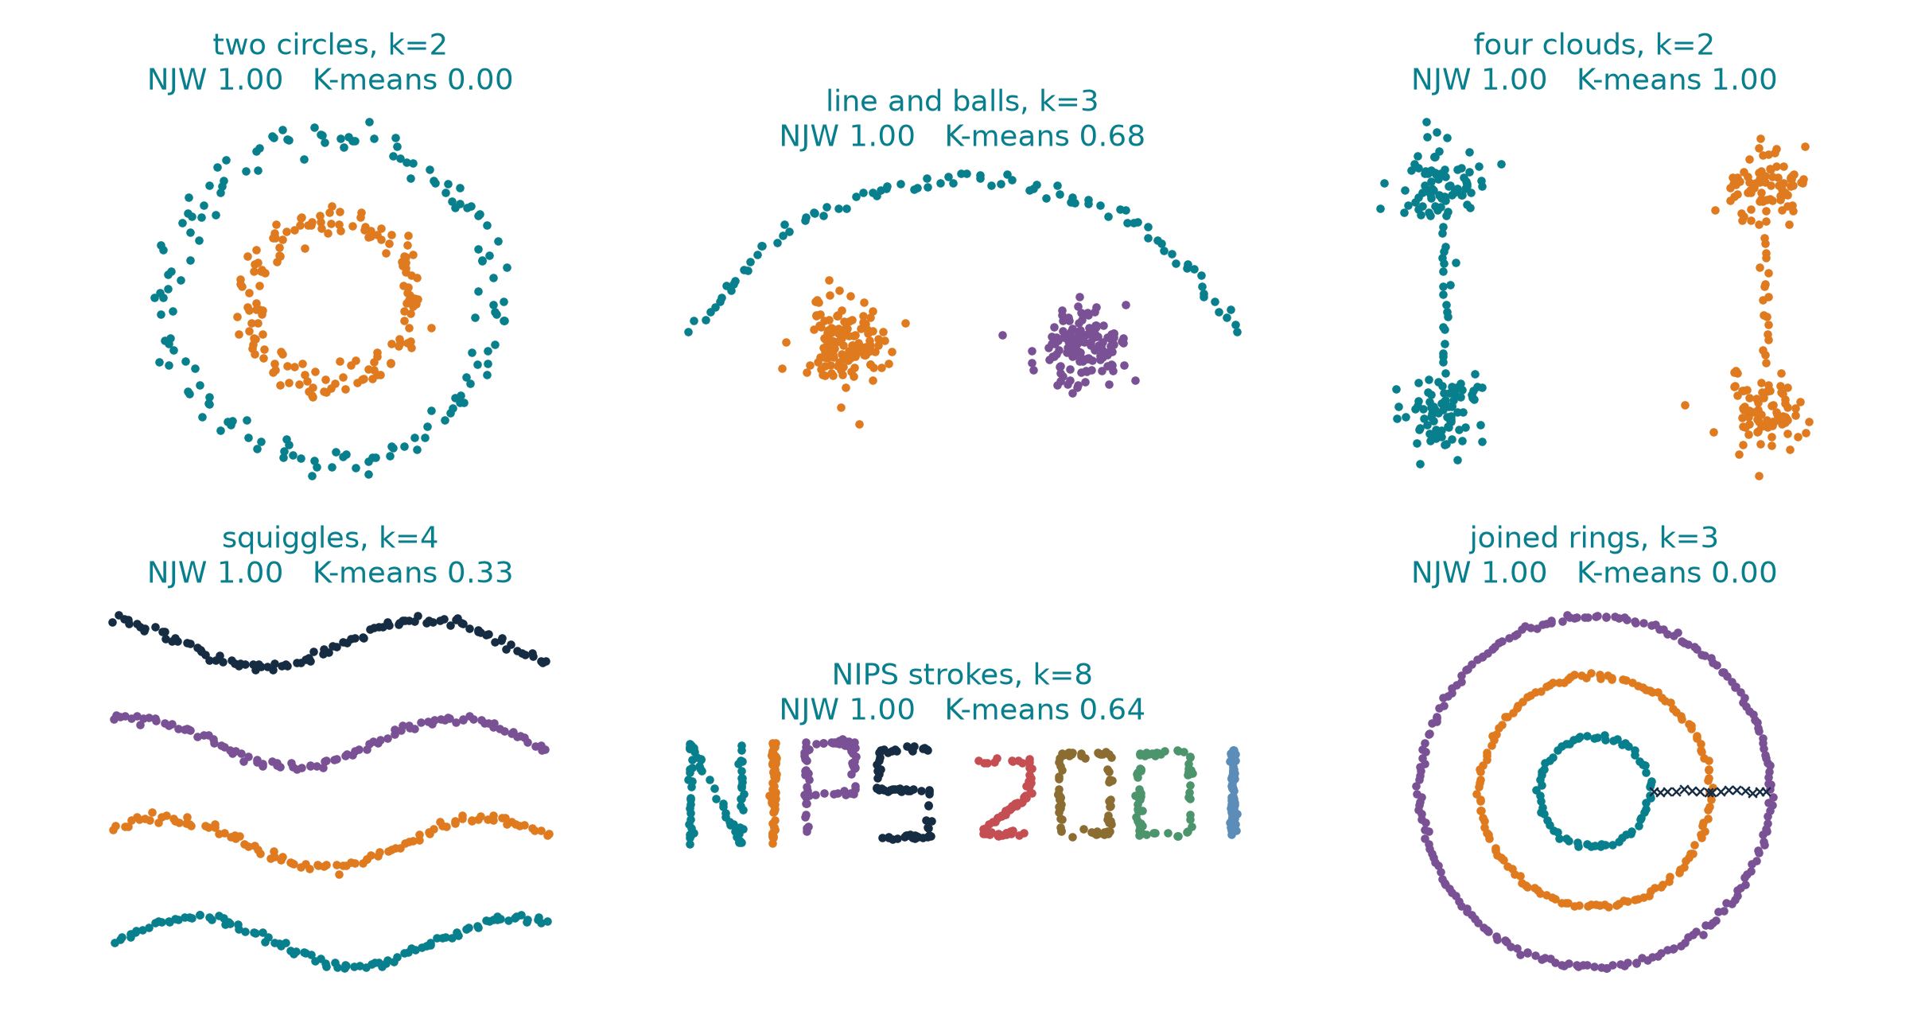
Rebuilding the paper's Figure 1 settings
3 OUR REPRODUCTION
The paper released no points, n, noise or σ grid, so this is a qualitative reproduction.
σ chosen as in the paper
Try a grid of σ.
Keep the σ whose rows of Y give the smallest K-means distortion.
No labels involved.
Result
NJW = 1.00 on 6 of 6 settings.
Joined rings included: three rings, recovered.
K-means still fails on the non-convex shapes.
The main claim reproduces: one algorithm, no per-shape tuning, many non-convex shapes.
11
Notes:
[~40 s] We also rebuilt the settings of the paper's Figure 1 - two circles, line and balls, four clouds, squiggles, the
NIPS letters, and joined rings. The paper did not release data, so this is qualitative.
We used the paper's own rule for sigma: pick the sigma whose rows of Y cluster most tightly. No labels.
NJW gets 1.00 on these rebuilt settings, including the three joined rings. K-means still fails where the shape is
not convex. The limits of sigma and k are the next slides.

Slide 17
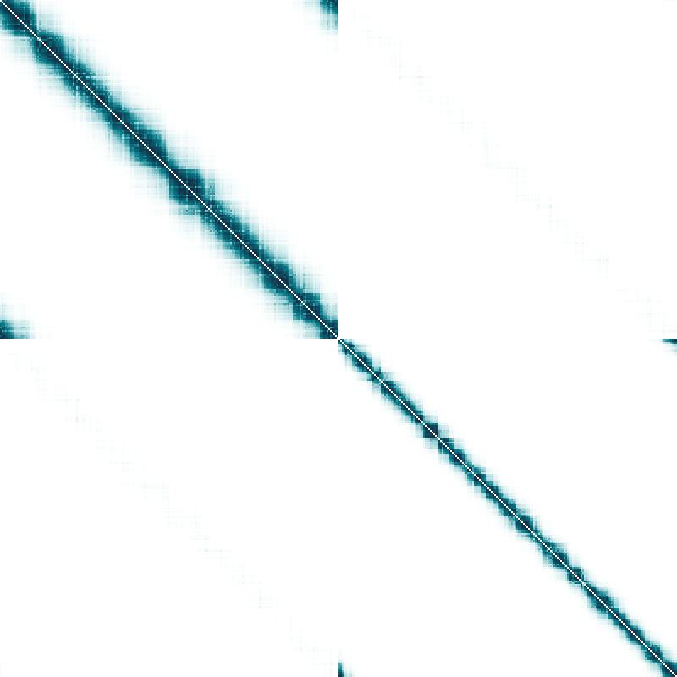
Sensitivity to the scale σ
4 CRITICAL ANALYSIS
Circles from Part 3 (400 points). σ = r · σ₀, σ₀ = our label-free default.
A (inner ring first)
rows of Y (colour = true ring)
NJW ARI
circles
1
moons
0
0.25
1
4
r = σ / σ₀ (log scale)
r = 1 ARI = 1.00
Blocks are clean. Each ring collapses to one point of Y.
One global σ. Circles: fine up to 1.4σ₀, ARI 0 from 2σ₀. The method does not reveal the safe window.
12
Notes:
[~50 s, three clicks] Part four, critical analysis. First, sensitivity to sigma, on the circles from Part 3. Left: A.
Middle: the rows of Y, coloured by the true ring. Right: ARI as we scale sigma.
At our default the blocks are clean and Y is two points. (click) At 1.4 sigma-zero, still fine. (click) At 2 sigma-zero
weight appears between the rings, Y smears into an arc, and ARI drops to zero. (click) At 4, A has lost its blocks, and NJW
cuts the plane just like K-means.
So the method depends on one global scale. On circles the safe window is narrow; on moons the decline is gradual. The
paper's distortion rule chooses sigma without labels, but nothing guarantees it lands in the window.

Slide 18
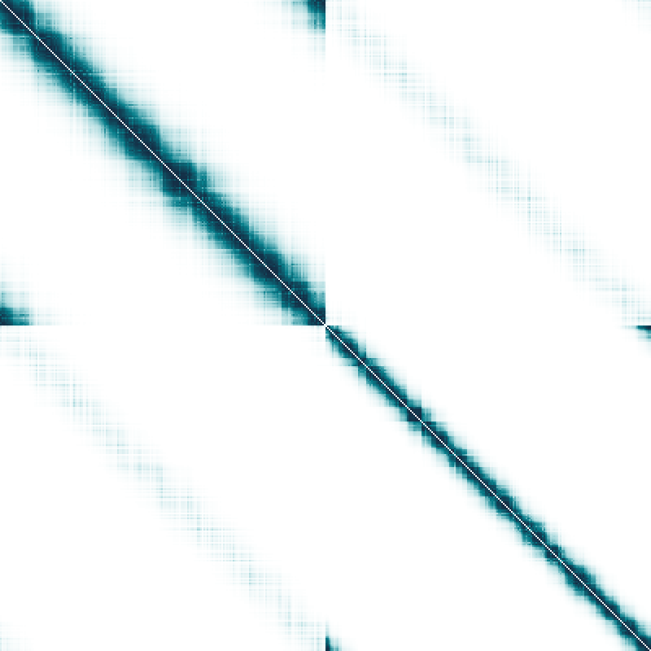
Sensitivity to the scale σ
4 CRITICAL ANALYSIS
Circles from Part 3 (400 points). σ = r · σ₀, σ₀ = our label-free default.
A (inner ring first)
rows of Y (colour = true ring)
NJW ARI
circles
1
moons
0
0.25
1
4
r = σ / σ₀ (log scale)
r = 1.4 ARI = 1.00
Still almost no weight across rings. Y is still two tight points.
One global σ. Circles: fine up to 1.4σ₀, ARI 0 from 2σ₀. The method does not reveal the safe window.
12
Notes:
Morph: sigma ratio r = 1.4.

Slide 19

Sensitivity to the scale σ
4 CRITICAL ANALYSIS
Circles from Part 3 (400 points). σ = r · σ₀, σ₀ = our label-free default.
A (inner ring first)
rows of Y (colour = true ring)
NJW ARI
circles
1
moons
0
0.25
1
4
r = σ / σ₀ (log scale)
r = 2 ARI = 0.00
Weight appears across the rings. Y smears into an arc. ARI falls to 0.
One global σ. Circles: fine up to 1.4σ₀, ARI 0 from 2σ₀. The method does not reveal the safe window.
12
Notes:
Morph: sigma ratio r = 2.

Slide 20

Sensitivity to the scale σ
4 CRITICAL ANALYSIS
Circles from Part 3 (400 points). σ = r · σ₀, σ₀ = our label-free default.
A (inner ring first)
rows of Y (colour = true ring)
NJW ARI
circles
1
moons
0
0.25
1
4
r = σ / σ₀ (log scale)
r = 4 ARI = 0.00
A has no block structure left. NJW now cuts the plane like K-means.
One global σ. Circles: fine up to 1.4σ₀, ARI 0 from 2σ₀. The method does not reveal the safe window.
12
Notes:
Morph: sigma ratio r = 4.

Slide 21
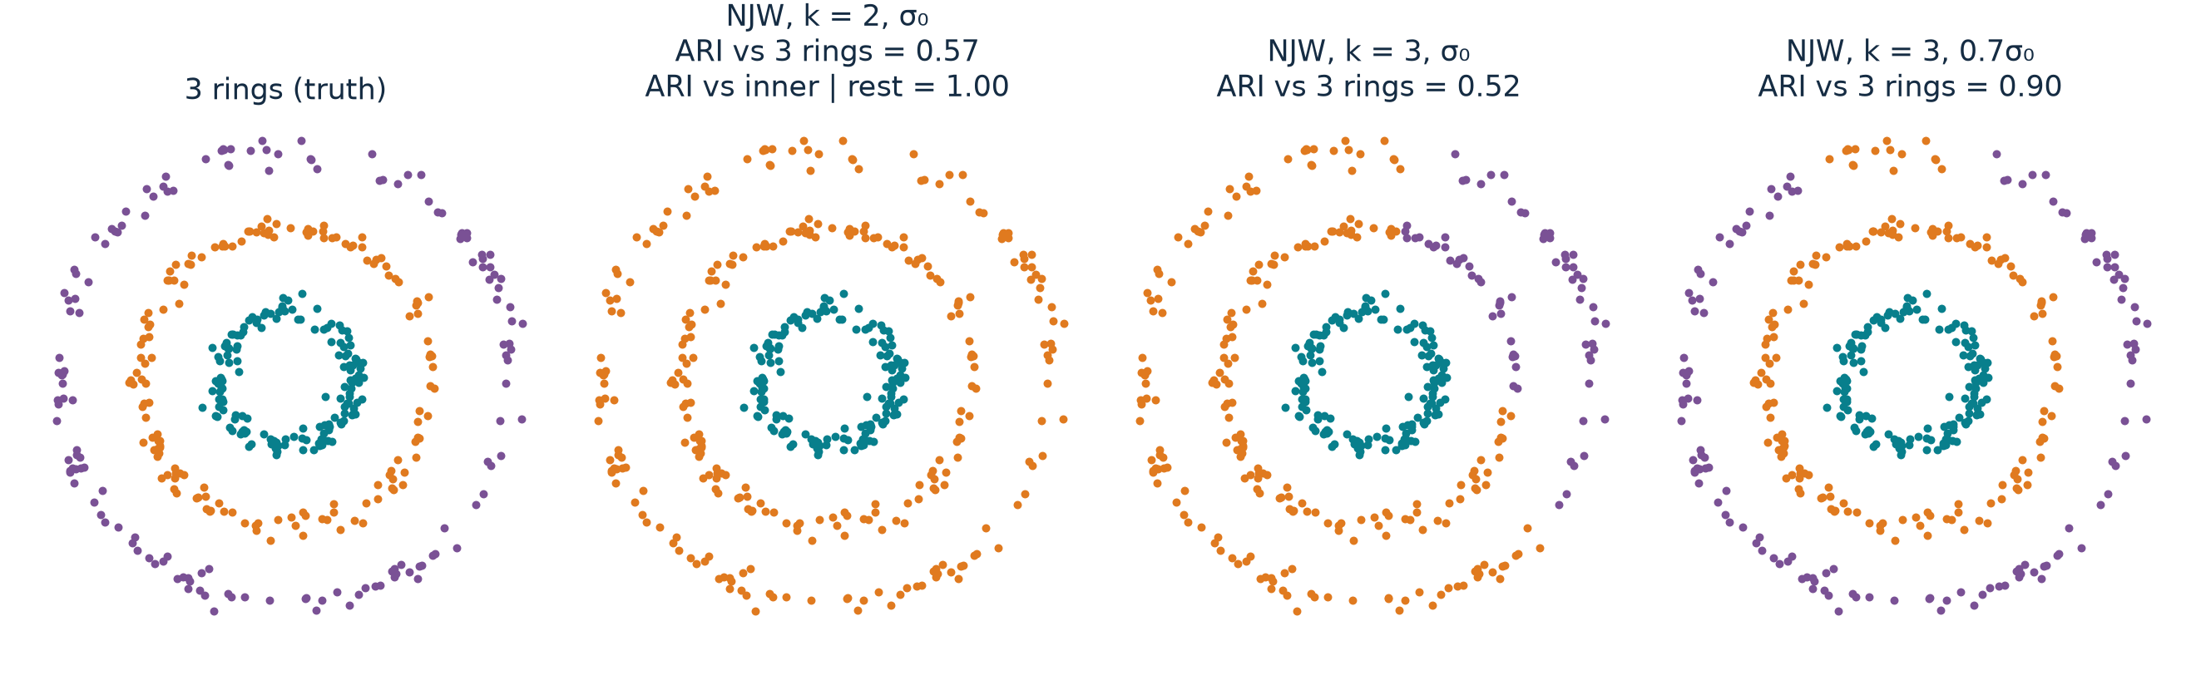
k must be given, and is not enough
4 CRITICAL ANALYSIS
Three rings we generated. σ₀ = 0.094 from the same neighbour rule.
k = 2
Inner ring vs. the other two, every time (ARI 1.00 against that split).
k = 3 (the true k)
0.52 at σ₀, 0.90 at 0.7σ₀. The two outer rings mix at σ₀.
Reading
k chooses which question is asked. σ still decides the answer.
13
Notes:
[~35 s] Second, the number of clusters k is an input. The paper sets it by hand in every Figure 1 run.
With k = 2 on three rings, NJW consistently separates the inner ring from the other two - a stable, sensible merge.
With the true k = 3, it is still not right at our default sigma: 0.52, the two outer rings mix. At 0.7 sigma-zero it rises
to 0.90. So knowing k is not enough: k picks the question, sigma still decides the answer.

Slide 22
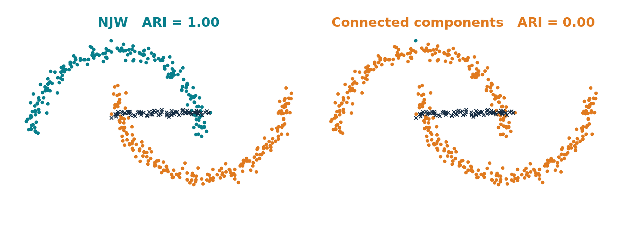
Robustness, and what the theory explains
4 CRITICAL ANALYSIS
Left: noise between clusters. Right: Theorem 2 checked on the Part 3 runs.
Theorem 2 needs δ > (2 + √2) ε
Circles: δ = 0.0053 < 0.182. Fails, yet ARI = 1.
Moons: δ = 0.0036 < 0.0144. Fails, yet ARI = 1.
Blobs: holds. Bound 1.5e-04, observed 3.6e-14.
Reading: sufficient, not necessary. Rings have a tiny gap δ, so the theory misses the examples that motivate the method. Checking it needs the true clusters.
Moons + 80 bridge points (×, left out of ARI)
Setting | NJW | Components
Clean moons | 1.00 | 1.00
Thin bridge, 25 pts | 1.00 | 0.00
Strong bridge, 80 pts | 1.00 | 0.00
Noise cloud, 120 pts | 1.00 | 0.00
Row normalization switched off
350 vs 50-point blobs, same σ and k: ARI 1.00 → 0.96. It helps, by a small margin here.
Weights, not a hard threshold: bridges barely move NJW but break connected components.
14
Notes:
[~40 s] Third, robustness and the theory. We added bridge points between the moons. NJW stays at 1.00, because a thin
bridge carries little total weight. A hard-threshold method, connected components, falls to 0: one chain of points
merges the clusters. This matches the paper's own comparison.
On the right we checked Theorem 2's condition on our Part 3 runs, using the true clusters. On circles and moons it fails
- the gap is far too small - yet NJW is perfect. On blobs it holds, but the bound is about ten orders of magnitude
above what we observe. So the theorem is sufficient, not necessary, and it does not explain the ring examples.
Last, the row normalization step: switching it off drops ARI from 1.00 to 0.96 on unbalanced blobs - it helps, modestly.

Slide 23
Summary
5 SUMMARY
What NJW does
Why it works
Where it is fragile
• Builds a similarity graph A.
• Normalizes it to L.
• Uses the top-k eigenvectors as new coordinates.
• Normalizes rows, then runs K-means.
• Ideal case: block-diagonal L.
• Each cluster → one direction, all directions orthogonal.
• Small cross-cluster weight + large eigengap keep Y close to that picture.
• One global σ with a narrow safe window.
• k is given by hand; the true k is not enough.
• Theorem 2 does not cover thin shapes; it needs the true clusters to check.
• Dense n × n matrix and eigensolver: O(n²) memory.
Our part: NJW from scratch, 3 + 6 datasets, tests of σ, k, noise, row normalization and Theorem 2.
15
Notes:
[~30 s] To summarize. NJW turns each point into a row of the top-k eigenvectors, normalizes the rows, and clusters them.
It works because in the ideal case every cluster becomes one direction and the directions are orthogonal, and small
perturbations keep that picture. It is fragile in sigma and k, and its main theorem does not cover the thin shapes that
motivate it. Thank you - we are happy to take questions.

Slide 24
Backup · Connections to the course
BACKUP
Concept | Connection | Distinction
K-means | Same final step, run on rows of Y | The embedding changes the geometry
PCA | Both keep top eigenvectors | PCA: covariance of features. NJW: graph over samples
Kernels / similarity | Gaussian pairwise weight | Aᵢᵢ = 0, so A need not be a PSD Gram matrix
Normalization | Degree normalization of A | Row normalization of X is a different step
B

Slide 25
Backup · Questions we prepared
BACKUP
Question | Short answer
Why run K-means again? | On Y the clusters are tight and orthogonal, so its job is easy.
Why keep the first eigenvector? | NJW uses the whole top-k subspace; dropping one loses a direction.
What if the eigenvectors rotate? | Rotations keep lengths and angles; Y is rotated, clusters stay.
Does a large eigengap prove correctness? | It supports subspace stability under A1–A4, not any particular labelling.
How do you choose σ and k? | σ: label-free rule or the paper's distortion search. k: given; see our three-ring test.
What exactly did you reproduce? | Our code, our data, Figure-1-like settings. Not the paper's points.
B

Slide 26
Backup · Baselines on the Figure 1 settings
BACKUP
ARI. Kernel methods share the distortion-chosen σ. Components search their own threshold.
Setting | NJW | Meila–Shi | Kannan-style* | Components | K-means
twocircles, k=2 | 1.00 | 1.00 | 1.00 | 1.00 | 0.00
lineandballs, k=3 | 1.00 | 1.00 | 1.00 | 1.00 | 0.68
fourclouds, k=2 | 1.00 | 1.00 | 1.00 | 1.00 | 1.00
squiggles, k=4 | 1.00 | 1.00 | 0.71 | 1.00 | 0.33
nips, k=8 | 1.00 | 1.00 | 0.76 | 1.00 | 0.64
threecircles_joined, k=3 | 1.00 | 1.00 | 0.33 | 0.00 | 0.00
threecircles_joined, k=2 | 0.79 | 0.79 | 0.04 | 0.00 | 0.00
* Our reading of one sentence in the paper (largest absolute eigenvector coordinate), not Kannan et al.'s code. Joined rings: NJW ARI here scores the ring points only.
B

Slide 27
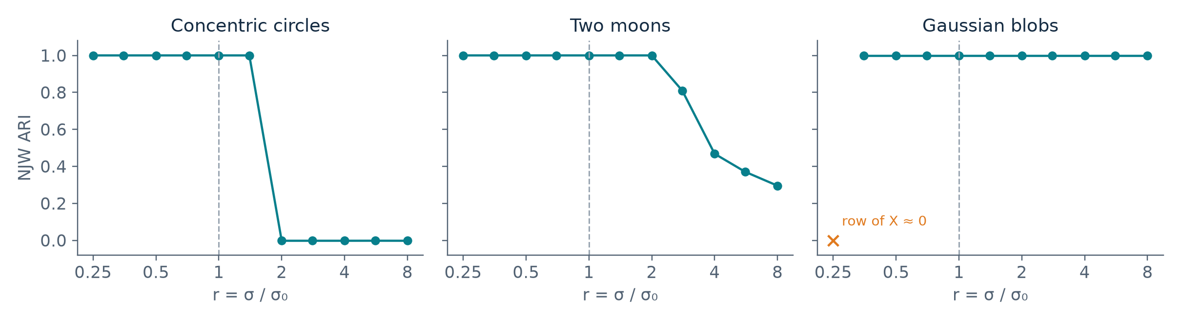
Backup · σ sensitivity on all three datasets
BACKUP
Same data and k as Part 3. Dashed line: our default σ₀. Labels did not choose σ₀.
Blobs: at r = 0.25 a point's row of X is numerically zero, so row normalization is undefined.
Moons: 1.00 up to r = 2, then 0.81, 0.47, 0.37, 0.30.
Row normalization off (350 vs 50-point blobs, same σ and k): ARI 1.00 → 0.96.
B

Slide 28
Backup · References and attribution
BACKUP
Primary paper
A. Y. Ng, M. I. Jordan, Y. Weiss. On Spectral Clustering: Analysis and an Algorithm. NIPS 14, 2001, pp. 849–856.
Figures
Slide 1 crops Figure 1 of the paper. Every other figure is our points, our code and our measurements.
Code
NJW implemented by us (src/njw_spectral). Libraries: SciPy eigh, scikit-learn KMeans and ARI, Matplotlib. sklearn SpectralClustering is not used.
B

